Slide 1

Failover Clustering:
Pro Troubleshooting in Windows Server 2008 R2
WSV309
John Marlin
Senior Support Escalation Engineer
Microsoft Corporation

Slide 2

Agenda
Cluster Validate
What, why, and where to look
Scenario 1: CNO / VCO Recovery
Scenario 2: CSV Troubleshooting
Other Troubleshooting Items
Summary

Slide 3
Agenda
Cluster Validate
What, why, and where to look
Scenario 1: CNO / VCO Recovery
Scenario 2: CSV Troubleshooting
Other Troubleshooting Items
Summary

Slide 4
Cluster Validate
Support Policy:
KB943984
The Microsoft Support Policy for Windows Server 2008 or Windows
Server 2008 R2 Failover Clusters
http://support.microsoft.com/default.aspx?scid=kb;EN-US;943984
All hardware and software components must meet the qualifications to receive a “Certified for Windows Server 2008 R2” logo.
The fully configured solution must pass the Validate test in the Failover Clusters Management snap-in.
Technet: (more information)
http://technet.microsoft.com/en-us/library/cc732035(WS.10).aspx

Slide 5
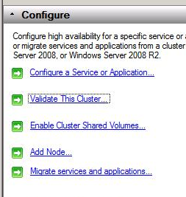
Cluster Validate
Built into the product
Can warn if best practices are not being met
Tests collection of servers and storage that is
  intended to be a Cluster
Run validate each and every time you …
  Create a new cluster
  Add a node, disk, or network
  Update system software (drivers, firmware, service packs,
    MPIO)
  Configure hardware (HBA, MPIO, Network Adapter, etc)
  Change any component in your solution
    It’s the very first thing you do!
http://technet.microsoft.com/en-us/library/cc732035(WS.10).aspx#BKMK_understanding_tests

Slide 6
New Validation Tests in R2
Cluster Configuration
  List Information (Core Group, Networks, Resources, Storage, Services and Applications)
  Validate Quorum Configuration
  Validate Resource Status
  Validate Service Principal Name
  Validate Volume Consistency
Network
  List Network Binding Order
  Validate Multiple Subnet Properties
System Configuration
  Validate Cluster Service and Driver Settings
  Validate Memory Dump Settings
  Validate OS Installation Options
  Validate System Driver Variable

Slide 7
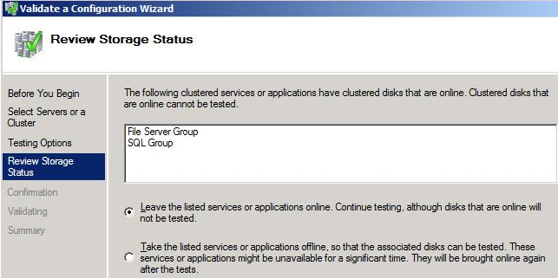
Validate: Storage
Validate will include:
  Disks currently not in use
  Disks in the “Available storage” group
  Disks in groups that are offline
    Validate wizard gives the option to take groups offline automatically

Slide 8

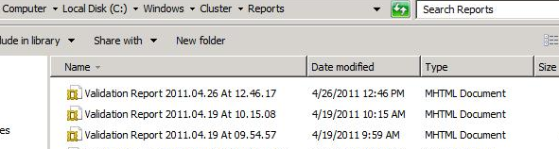
Validate Tips
Cluster Shared Volumes (CSV) must be brought offline manually to be tested
Can be run anytime with no downtime, unless take groups offline.
Reports are located in the %WinDir%\Cluster\Reports folder
Can run as many times as wish – filenames are date/time stamped

Slide 9
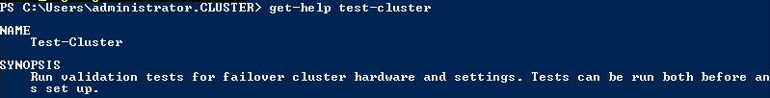
Validate Tips
Running on Single node will not give you much
Can see how groups/resources are configured in case needs to be recreated
PowerShell Commandlet “Test-Cluster”
Use it as a troubleshooting tool !!!

Slide 10
Agenda
Cluster Validate
What, why, and where to look
Scenario 1: CNO / VCO Recovery
Scenario 2: CSV Troubleshooting
Other Troubleshooting Items
Summary

Slide 11
Powershell
Get to know the Powershell commandlets.
  Cluster.exe is no longer being updated.
All Cluster commandlets have help online
  http://technet.microsoft.com/en-us/library/ee461009.aspx
Can get examples of the commandlets
Configure Read-Only access now.
  Enables users to view, but not modify, the state of the Cluster and Resources

Slide 12
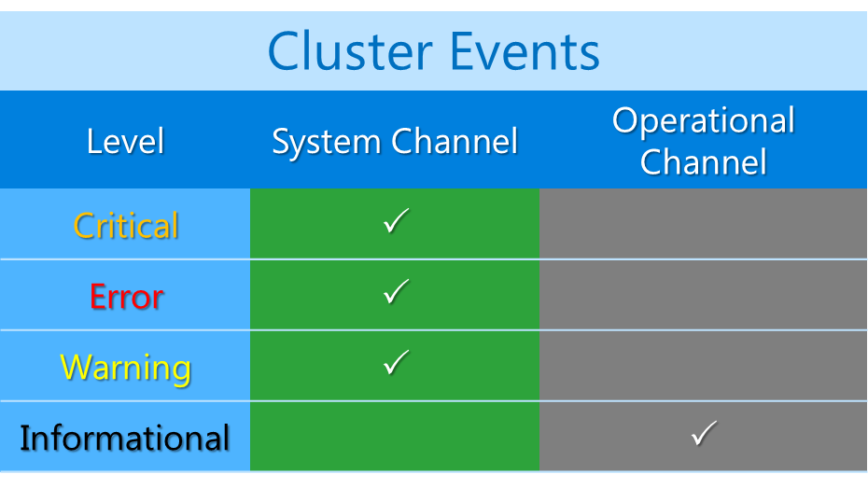
Where to find Cluster events

Slide 13
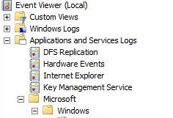
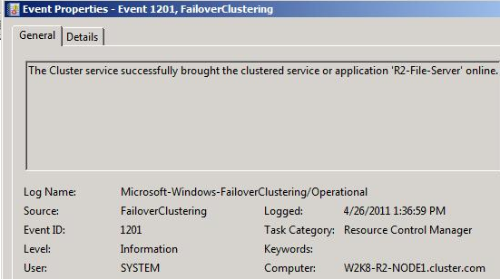
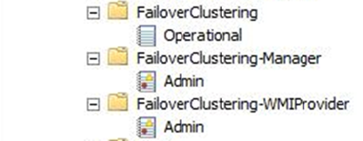
Operational Channel

Slide 14
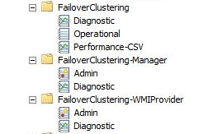
New Diagnostic Logging
Capture snap-in pop-up’s
  Even before cluster creation
New debug logging channels
  Disabled by default
  Enabled for advanced troubleshooting
Cluster.log converted to an ETW channel, now appears in Event Viewer as well
Tip: Be sure to click on View / Show Analytic and Debug Logs

Slide 15
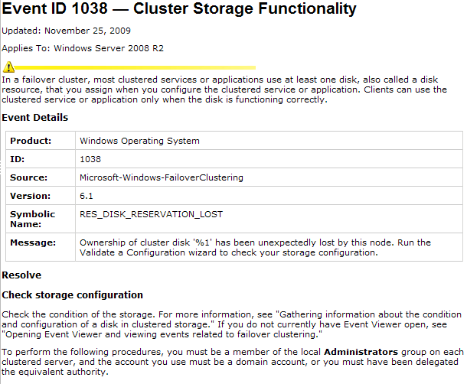
Understanding Cluster Events
Online troubleshooting steps for all cluster events:
  http://technet.microsoft.com/en-us/library/dd353290(WS.10).aspx
Every Cluster event edited with improved descriptive text and error codes

Slide 16
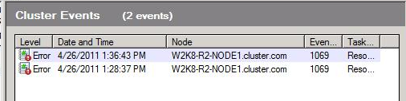
Viewing Events Cluster Wide
Failover Cluster Manager provides an aggregated view of cluster events from all nodes. Click “Recent Cluster Events” to see all Error and Warnings Cluster wide in the last 24 hours.

Slide 17
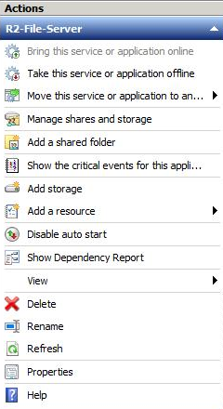
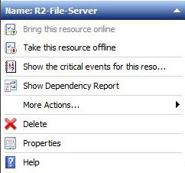
Built-in Event queries
On the right hand ‘Actions’ pane in Failover Cluster Management there are links to open filtered events
Application Level
  Events associated with all resources in the group
Resource Level
  Events related to that specific resource

Slide 18
Troubleshooting Tips
When you encounter a problem, always, always, always start with Cluster Events
  Look at a Cluster wide view of the Cluster events
  Dig into all events in the System Event log
  Check the Application Event log
Don’t be distracted by symptoms - focus on root cause
  For example, if you see Cluster IP Address failures, don’t waste lots of time looking at Cluster events
    Instead look for other networking related errors
  There may be multiple retries after a failure, producing more events. Look for what caused the first failure

Slide 19
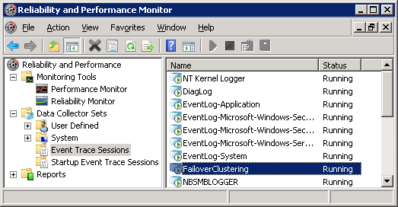
Cluster Debug Logging
  All Cluster debug logging done to an event trace session:
    Microsoft-Windows-FailoverClustering
  No longer is there a Cluster.Log file being written to. Must manually generate to get a “snapshot in time”.

Slide 20
Configuring Debug Logging
Logging enabled by default
Log files stored as .ETL in:
  %WinDir%\System32\winevt\logs\Microsoft-Windows-FailoverClustering
Default log size is 100 MB
  Set-Clusterlog –Size 100
Default log level is 3
  Set-Clusterlog –Level 3
Cluster Output Levels
Level | Error | Warning | Info | Verbose | Debug
0 (disabled)
1 | P
2 | P | P
3 | P | P | P
4 | P | P | P | P
5 | P | P | P | P | P
Default
Can have performance impact

Slide 21

How it works
An ETL file lasts for the uptime of a node
A new ETL file is used each time you restart the node
  When you restart, you move on to the next file. After you have restarted 3 times you return back to the first file.
Each ETL has a log size of 100 MB and will wrap on themselves, but only within their own log
Cmdlet will merge all the .ETL logging data into a single contiguous text file
  Get-ClusterLog
  The output can be confusing and a common question on where the data went
ETL.001
Reboot
Reboot
ETL.003
ETL.002
Reboot
http://blogs.technet.com/b/askcore/archive/2010/04/13/understanding-the-cluster-debug-log-in-2008.aspx

Slide 22

Troubleshooting Tips
The cluster log is verbose and complex!
  It should be the last place you go, not the first
Make sure your cluster.log captures at least 72 hours of data
  Mileage will vary depending on how noisy apps are
Cluster log timestamps are in GMT, while event log timestamps are in local time
Start at the bottom and work your way upwards searching for:
  [ERR]
  -->failed
Use NET HELPMSG to decipher error codes

Slide 23
Agenda
Cluster Validate
What, why, and where to look
Scenario 1: CNO / VCO Recovery
Scenario 2: CSV Redirected Troubleshooting
Other Troubleshooting Items
Summary

Slide 24
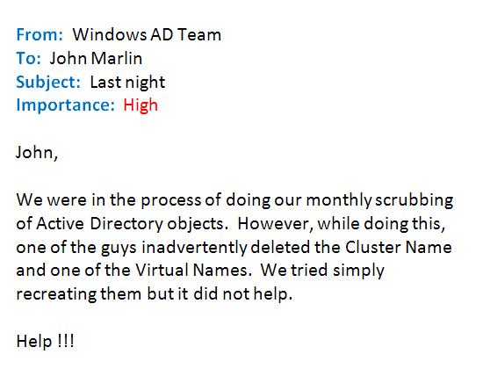

Slide 25
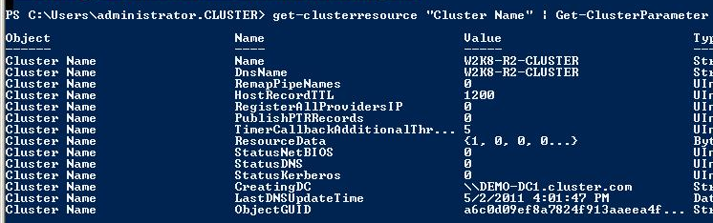
What you need to know
Two things you want to know before beginning
  What DC is the name created on?
  What is the objectGUID?

Slide 26
CNO / VCO Recovery
demo

Slide 27
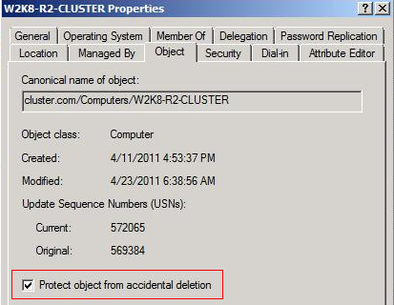
Troubleshooting Tips
To prevent this from occurring, check “Protect object from accidental deletion” under the properties of the object

Slide 28
Troubleshooting Tips
If you have to repair the object:
  CreatingDC is where you should be
  Decipher the GUID in case of multiple deleted objects with the same name
  Ensure Domain Replication takes place after restoring

Slide 29
Troubleshooting Tips
If you do not have the AD Recycle Bin enabled:
Logged on user doing the repair needs “Reset Passwords” right
http://blogs.technet.com/b/askcore/archive/2009/04/27/recovering-a-deleted-cluster-name-object-cno-in-a-windows-server-2008-failover-cluster.aspx
If you do have the AD Recycle Bin enabled:
http://blogs.technet.com/b/askcore/archive/2011/05/18/recovering-a-deleted-cluster-name-object-cno-in-a-windows-server-2008-failover-cluster-part-2.aspx

Slide 30
Troubleshooting Tips
  As discussed previously in the troubleshooting, take advantage of the AD Recycle bin. It can save you.
  The AD Recycle Bin: Understanding, Implementing, Best Practices, and Troubleshooting
  http://blogs.technet.com/b/askds/archive/2009/08/27/the-ad-recycle-bin-understanding-implementing-best-practices-and-troubleshooting.aspx

Slide 31
Agenda
Cluster Validate
What, why, and where to look
Scenario 1: CNO / VCO Recovery
Scenario 2: CSV Troubleshooting
Other Troubleshooting Items
Summary

Slide 32
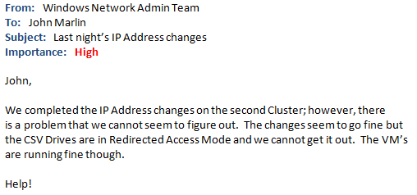

Slide 33








CSV in action
I/O Redirected via network
VM running on Node 2
Coordination Node
SAN
SAN Connectivity Failure
VHD

Slide 34
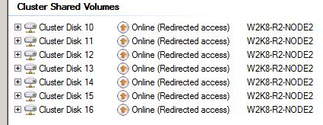
What you need to know
Possible Causes:
One or more nodes have lost direct connection to the SAN/LUN
CSV aware backup is in progress
Manually put into “Redirected access”

Slide 35
Troubleshooting Redirected Access
demo

Slide 36
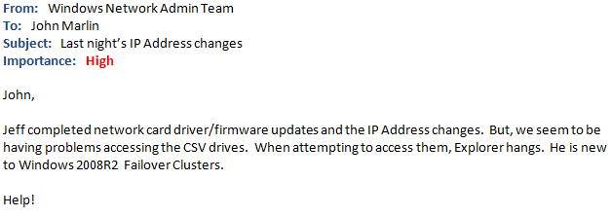

Slide 37
Troubleshooting hanging CSV accessibility
demo

Slide 38
Troubleshooting Tips
Check System Event log for network connectivity or AD access problems.
Verify Server and Workstation Services are started.
Verify all Cluster networks are configured to support SMB. KB258750 breaks CSV.
Perform file copies from the coordinator.
When troubleshooting a CSV “storage” problem, it could really be a network problem.
  Check network connectivity between nodes. Test using “Net Use” from non-owning node using owning node’s IP address
  Verify NTLM has not been disabled
  Ability to authenticate with a domain controller
  Don’t make assumptions, things are different!

Slide 39
Agenda
Cluster Validate
What, why, and where to look
Scenario 1: CNO / VCO Recovery
Scenario 2: CSV Troubleshooting
Other Troubleshooting Items
Summary

Slide 40
Troubleshooting RHS Terminations
How clustering deals with unresponsive resources
  RHS makes calls to resources (IsAlive, LooksAlive, Online, Offline, Terminate, etc…)
  If that resource does not respond, Cluster health detection attempts to recover
  The RHS process is restarted, so the resource can be restarted
Events Generated
  Event 1230
  Cluster resource 'Resource Name' (resource type '', DLL ‘xxx.dll') either crashed or deadlocked. The Resource Hosting Subsystem (RHS) process will now attempt to terminate, and the resource will be marked to run in a separate monitor.
  Event 1146
  The cluster resource host subsystem (RHS) stopped unexpectedly. An attempt will be made to restart it. This is usually due to a problem in a resource DLL. Please determine which resource DLL is causing the issue and report the problem to the resource vendor.

Slide 41
Troubleshooting RHS Terminations (cont)
The problem is that the resource did not respond to a Cluster call within the timeout period.
What was the resource trying to do?
    http://support.microsoft.com/kb/914458
Look for underlying core failures / events
    Physical Disk… look for storage issues
    Network Name… look for networking issues
See these blogs for more details:
    http://blogs.technet.com/askcore/archive/2009/11/23/resource-hosting-subsystem-rhs-in-windows-server-2008-failover-clusters.aspx
    http://blogs.msdn.com/clustering/archive/2009/06/27/9806160.aspx

Slide 42
User Mode Problems Caught by Cluster
Bugcheck: USER_MODE_HEALTH_MONITOR (9e)
  Clustering conducts health monitoring from kernel mode to a user mode process to detect when user mode becomes unresponsive or hung. To recover from this condition, clustering will bugcheck the box. This is configurable via the following property.
PS C:\> Get-Cluster | fl ClusSvcHangTimeout, HangRecoveryAction
ClusSvcHangTimeout : 60
HangRecoveryAction : 3
ClusSvcHangTimeout = This property controls how long we wait between heartbeats before determining that the Cluster Service has stopped responding.
HangRecoveryAction = This property controls the action to take if the user-mode processes have stopped responding.
  0 = Disables the heartbeat and monitoring mechanism.
  1 = Logs an Event ID: 4870 in the System Event Log.
  2 = Terminates the Cluster Service.
  3 = Causes a Stop error (Bugcheck) on the cluster node.

Slide 43
User Mode Problems Caught by Cluster (cont)
This is not a Cluster problem, Cluster is reporting a problem.
  Check memory.dmp for evidence of what caused the hang, like locks, memory, handles, etc
See this blog for more details:
  Why is my 2008 Failover Clustering node blue screening with a Stop 0x0000009E?
  http://blogs.technet.com/b/askcore/archive/2009/06/12/why-is-my-2008-failover-clustering-node-blue-screening-with-a-stop-0x0000009e.aspx

Slide 44
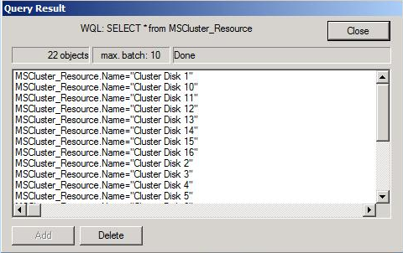
Check WMI
Very common error is due to WMI being offline
  Create Cluster, Add Node, Migration
To test if WMI is online
From a remote server
  PS > get-wmiobject mscluster_resourcegroup -computer W2K8-R2-NODE1 -namespace "ROOT\MSCluster“
  If an error is returned, must re-enable WMI by rebooting
  If that doesn’t work try:
    Stop WMI service to ensure that dependent services are stopped
    Start WMI service again
    PS > winmgmt /salvagerepository
2. Directly on the node/machine
  CMD > Wbemtest
  Select: root\mscluster
  Use authentication level: Packet Privacy
  Select ‘query’ and type: SELECT * from MSCluster_Resource

Slide 45
Performance Counters
Some components in the Cluster deal with lots of calls or traffic going through them and some buffer information in memory before it can get processed. We have added performance counters to several such components.
Cluster API Calls
Cluster API Handles
Cluster Checkpoint Manager
Cluster Database
Cluster Global Update Manager Messages
Cluster Multicast Request-Response Messages
Cluster Network Messages
Cluster Network Reconnections
Cluster Resource Control Manager
Cluster Resources
Cluster Shared Volumes

Slide 46
Agenda
Cluster Validate
What, why, and where to look
Scenario 1: CNO / VCO Recovery
Scenario 2: CSV Troubleshooting
Other Troubleshooting Items
Summary

Slide 47
Summary
Validate, Validate, Validate. Use it for troubleshooting. Use it for best practices. Use it when changes are made to your system.
Since we are reliant on active directory objects, protect yourself. Enable the Recycle Bin in AD, protect the objects from accidental deletion.
Everything is headed in the Powershell direction. Invite her in and can be a good friend.
When troubleshooting, take a step back and look at everything that can be affected. Then start narrowing your focus.
Failover Cluster is designed to detect, recover from, and report problems. The fact that the cluster is telling you there is/was a problem does not mean the cluster caused it. Don’t shoot the messenger………

Slide 48

Related Failover Cluster Content
Required Slide
Speakers, please list the Breakout Sessions, Interactive Discussions, Labs, Demo Stations and Certification Exam that relate to your session. Also indicate when they can find you staffing in the TLC.
Visit the Cluster Team in the TLC!
We will be there every hour it is open!
Breakout Sessions
  VIR303 – Failover Clustering and Hyper-V: Multi-Site Disaster Recovery
  VIR304 – Failover Clustering and Hyper-V: Planning Your Highly-Available Virtualization Environment
  WSV203 – Failover Clustering 101: Get Highly Available Now!
  WSV308 – Failover Clustering in 2008 R2: What's New in the Top High-Availability Solution
  WSV309 – Failover Clustering: Pro Troubleshooting in Windows Server 2008 R2
  SIM357 – Microsoft System Center Virtual Machine Manager 2012: Server Fabric Lifecycle, Part 3 - Cluster Creation, Update Management
  DBI302 – Microsoft SQL Server Code-Name "Denali" AlwaysOn Series, Part 1: Introducing the Next Generation High Availability Solution
  DBI404 – Microsoft SQL Server Code-Name "Denali" AlwaysOn Series, Part 2: Building a Mission-Critical High Availability Solution Using AlwaysOn
  EXL312 – Designing Microsoft Exchange 2010 Mailbox High Availability for Failure Domains
Interactive Sessions
  WSV373-INT – Failover Clustering Pro Workshop: Everything You Wanted to Know, But Were Afraid to Ask!
  VIR471-INT – Virtualization FAQ, Tips and Tricks
Hands-on Labs
  WSV273-HOL – Failover Clustering Introduction with Windows Server 2008 R2
  DBI393-HOL – Microsoft SQL Server 2008 R2 - Implementing Clustering

Slide 49
Failover Cluster Resources
Required Slide
Track PMs will supply the content for this slide, which will be inserted during the final scrub.
Cluster Team Blog:
http://blogs.msdn.com/clustering/
Clustering Forum:
http://forums.technet.microsoft.com/en-US/winserverClustering/threads/
Cluster Resources:
http://blogs.msdn.com/clustering/archive/2009/08/21/9878286.aspx
Cluster Information Portal:
http://www.microsoft.com/windowsserver2008/en/us/clustering-home.aspx
Clustering Technical Resources:
http://www.microsoft.com/windowsserver2008/en/us/clustering-resources.aspx
Windows Server 2008 R2 Cluster Features:
http://technet.microsoft.com/en-us/library/dd443539.aspx

Slide 50
Track Resources
Don’t forget to visit the Cloud Power area within the TLC (Blue Section) to see product demos and speak with experts about the Server & Cloud Platform solutions that help drive your business forward.
You can also find the latest information about our products at the following links:
Cloud Power - http://www.microsoft.com/cloud/
Private Cloud - http://www.microsoft.com/privatecloud/
Windows Server - http://www.microsoft.com/windowsserver/
Windows Azure - http://www.microsoft.com/windowsazure/
Microsoft System Center - http://www.microsoft.com/systemcenter/
Microsoft Forefront - http://www.microsoft.com/forefront/

Slide 51





Resources
  Connect. Share. Discuss.
http://northamerica.msteched.com
Learning
  Sessions On-Demand & Community
  Microsoft Certification & Training Resources
www.microsoft.com/teched
www.microsoft.com/learning
  Resources for IT Professionals
  Resources for Developers
http://microsoft.com/technet
http://microsoft.com/msdn

Slide 52












Complete an evaluation on CommNet and
enter to win!

Slide 53


Slide 54

© 2011 Microsoft Corporation. All rights reserved. Microsoft, Windows, Windows Vista and other product names are or may be registered trademarks and/or trademarks in the U.S. and/or other countries.
The information herein is for informational purposes only and represents the current view of Microsoft Corporation as of the date of this presentation. Because Microsoft must respond to changing market conditions, it should not be interpreted to be a commitment
on the part of Microsoft, and Microsoft cannot guarantee the accuracy of any information provided after the date of this presentation. MICROSOFT MAKES NO WARRANTIES, EXPRESS, IMPLIED OR STATUTORY, AS TO THE INFORMATION IN THIS PRESENTATION.

