Slide 1

NuGet for The Enterprise
.NET Package Management
DEV338
Scott Hanselman
Principal Program Manager
Microsoft

Slide 2


Slide 3
nservicebus
PublishSettingsGenerator
UrlShortener.Helper
postal
Simple.Data.Core
Autofac
FakeItEasy
Altairis.Web.Security
Bootstrapper
Spark
QuickGraph
FluentHtml-ci
Common.Logging
Antlr
Machine.Specifications
Should
AutoMapper
MvvmLight
NUnit
reactiveui-core
51Degrees.mobi
StructureMap
Elmah
Hammock
MvcMailer
Adam.JSGenerator
RhinoMocks
Newtonsoft.Json
DotNetZip
BBCode
fasterflect
Castle
AzureToolkit
FluentNHibernate
Lucene
NHibernate
FluentAssertions
NSubstitute
FluentValidation
DotNetOpenAuth
NLog
Ninject
log4net
WatiN
AutoPoco
jQuery
Rx
TweetSharp
Facebook SDK
Iesi Collections
HtmlAgilityPack
SharpZipLib
xunit
iTextSharp
combres
linq.js
MvcContrib
CLEditor
Moq
jQuery.Validation
RestSharp
MvcSiteMapProvider
Simple.Data.Core
RavenDB
ErikEJ.SqlCeMembership

Slide 4
What’s my goal here?

Slide 5


Slide 6
Make using OSS as easy
as “Add Reference”

Slide 7
Make using software as easy as “Add Reference”

Slide 8
How do we do that?

Slide 9


BUILD UP THE DEVELOPER
ECOSYSTEM

Slide 10
Adding a library to a project
What is the experience to add an existing 3rd Party or open source library to a project today?
Let’s take a look

Slide 11
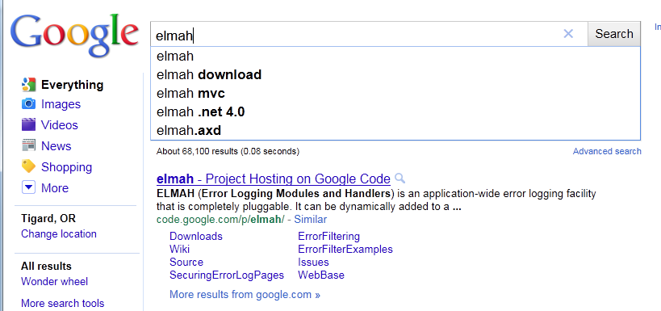
Like all good stories, it starts with a Google search

Slide 12

Like all good stories, it starts with a Bing
search

Slide 13
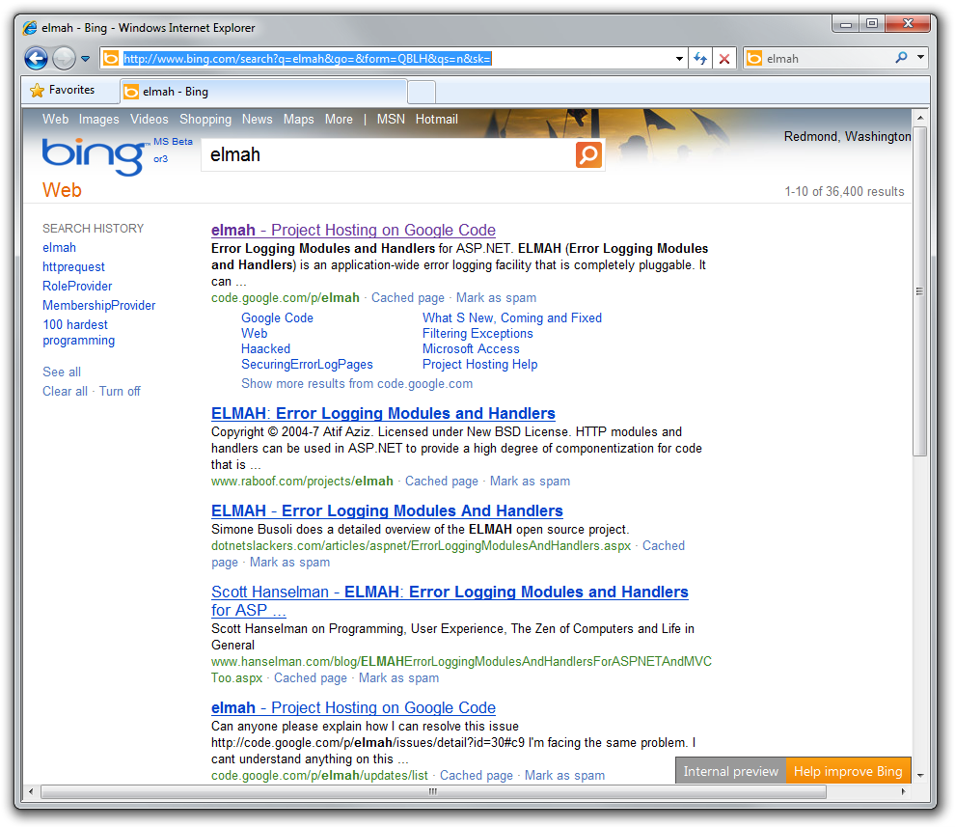
So far so good in this case.

Slide 14
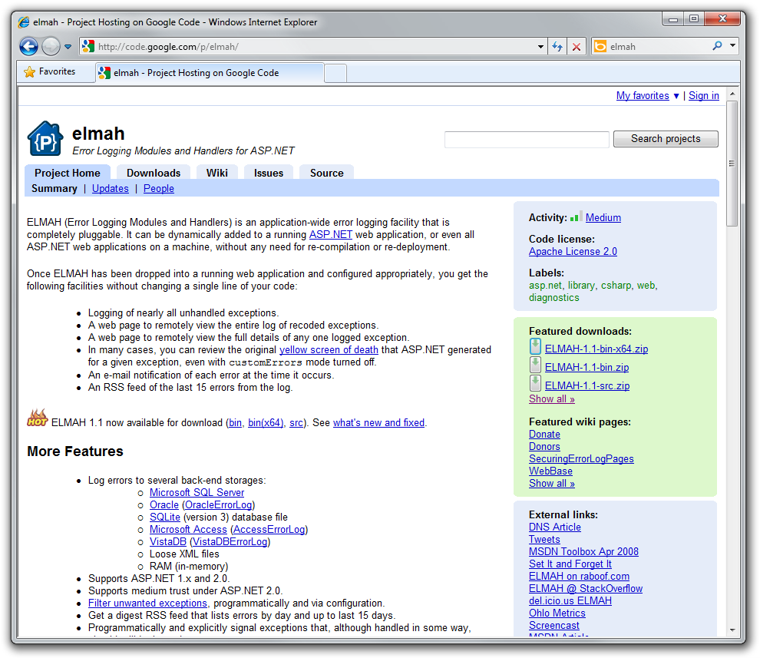
This looks right

Slide 15
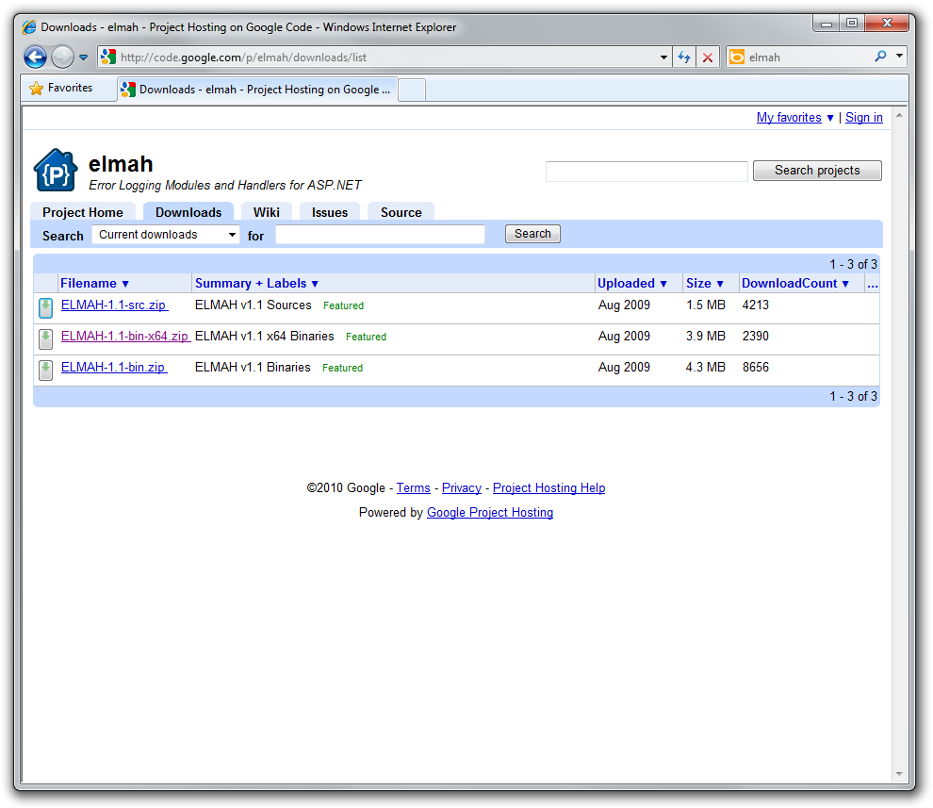

Slide 16
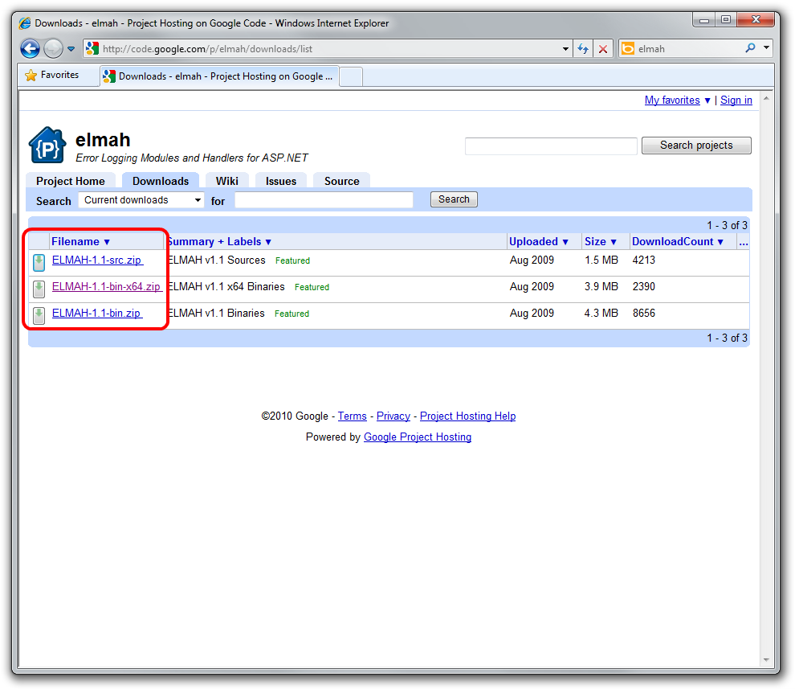
?
Turns out, this is the right one.

Slide 17
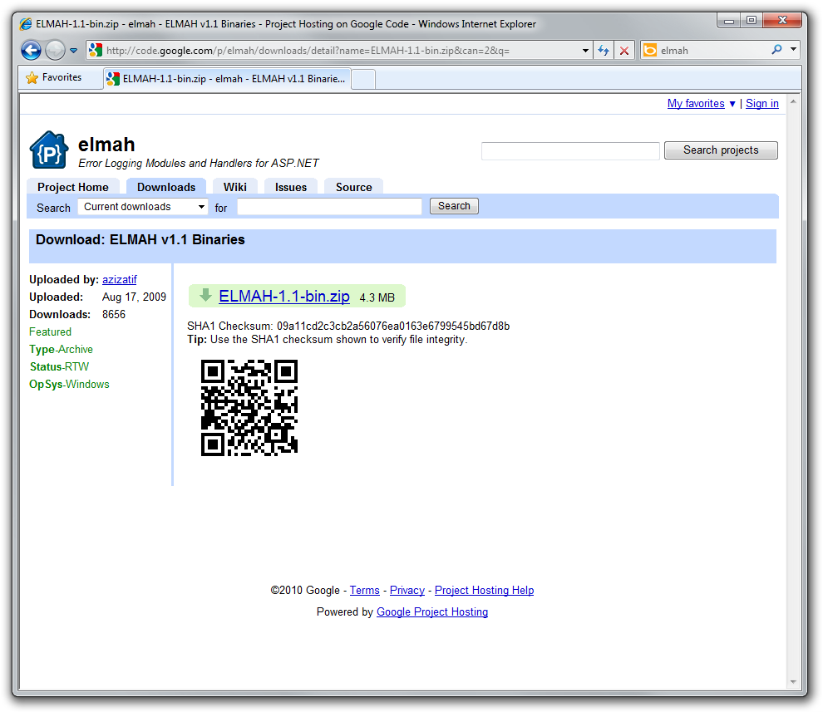
Looks right to me,
I guess.

Slide 18
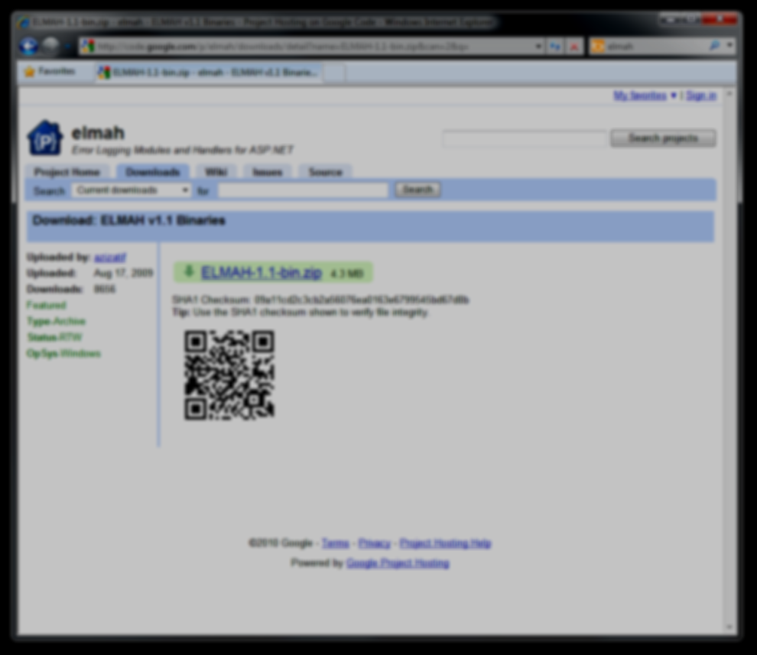
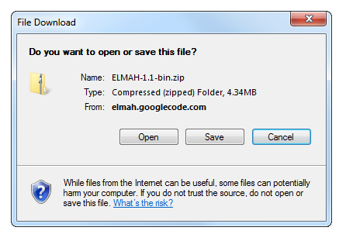

Slide 19
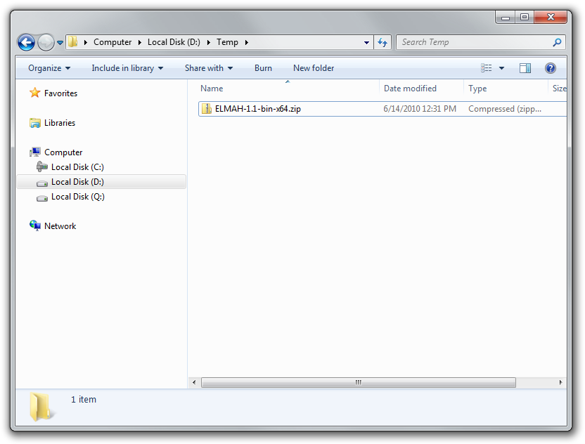

Slide 20
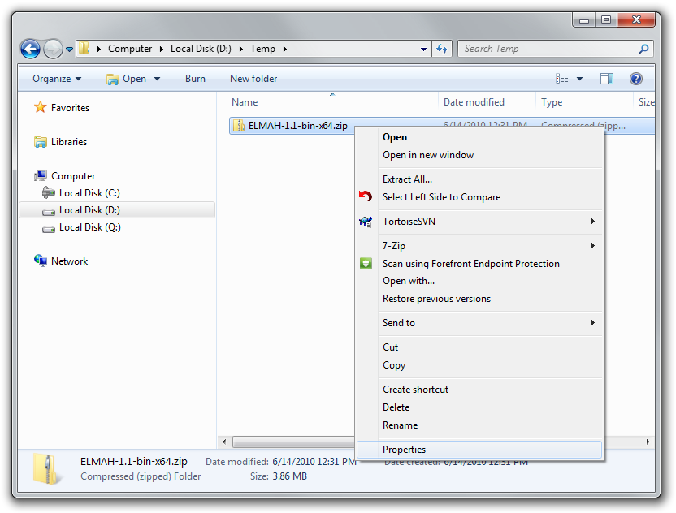
Before we extract it, we need to visit the Properties

Slide 21
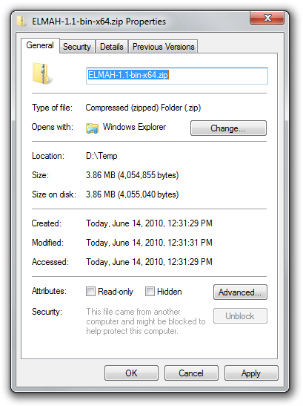
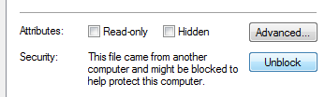
Don’t forget this!

Slide 23


Slide 24
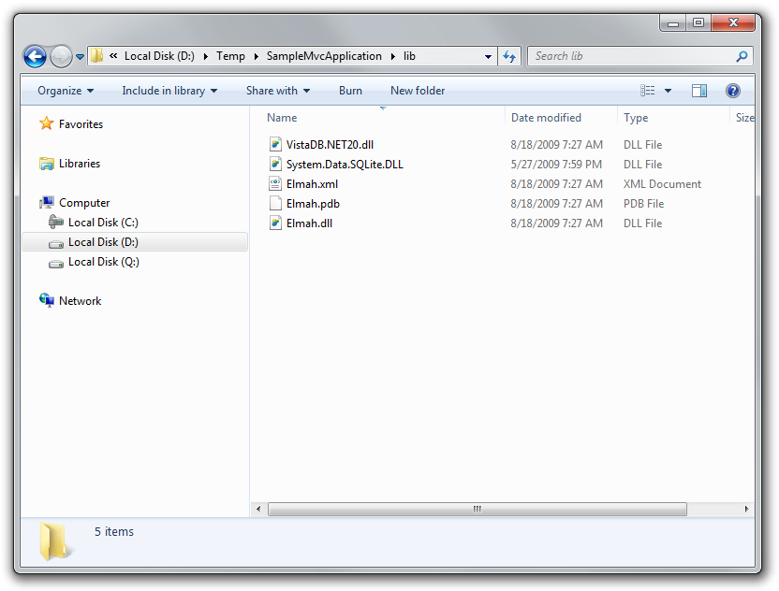
Extract assemblies to a folder within the solution directory

Slide 25
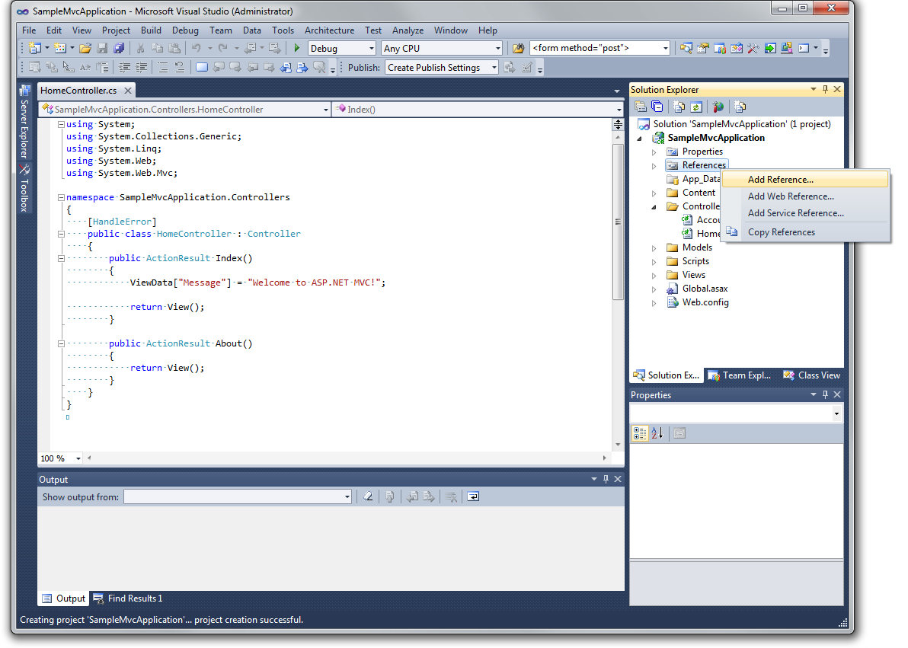

Slide 26
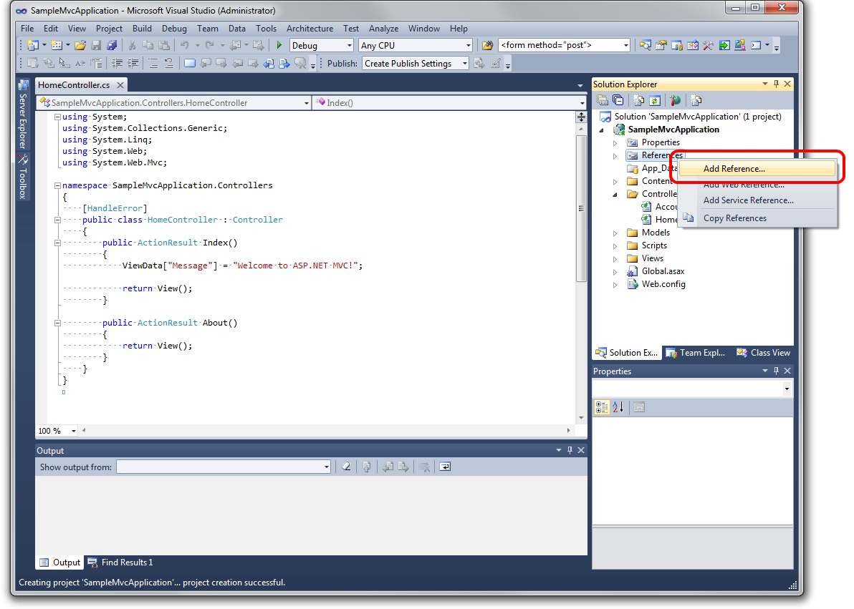

Slide 27
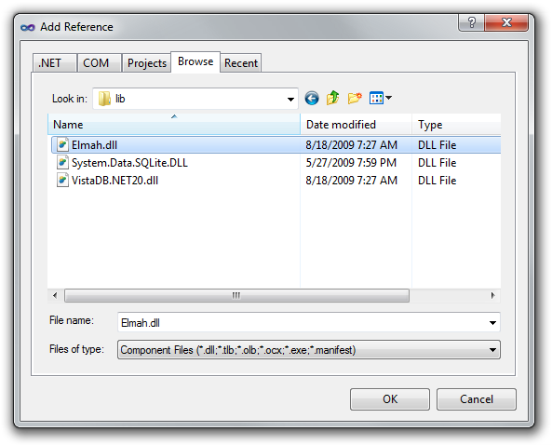

Slide 28
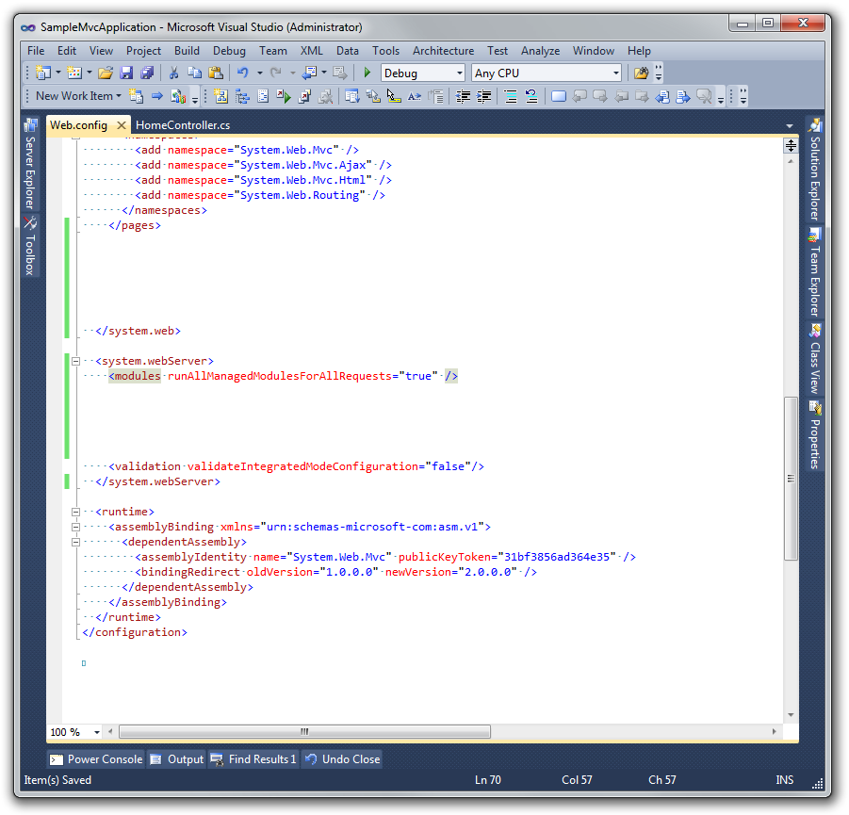
Need to add the correct configuration to web.config

Slide 29
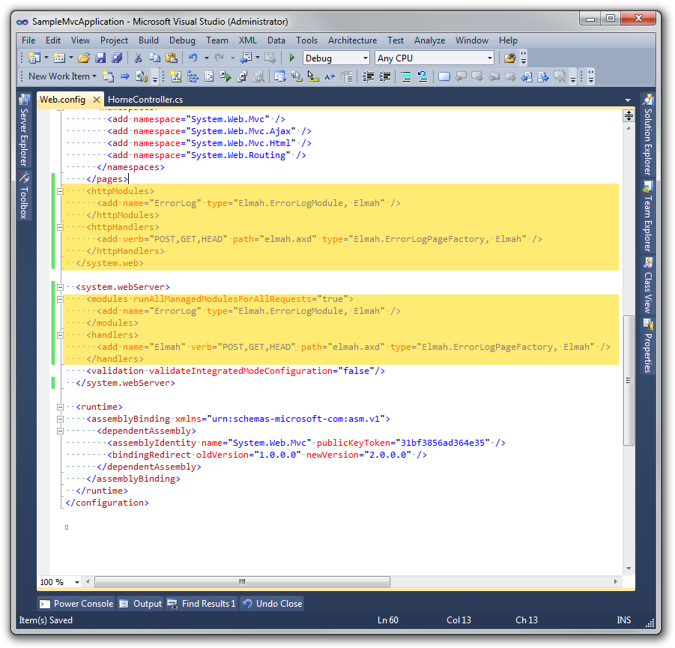
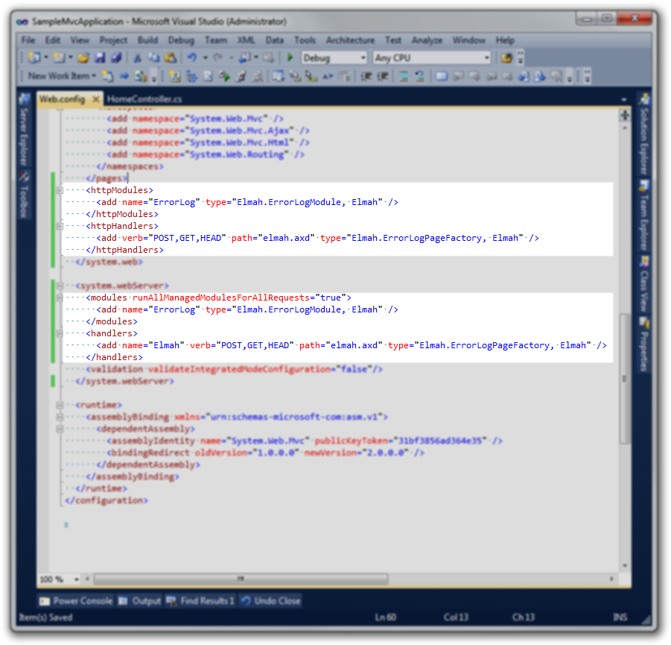

Slide 30
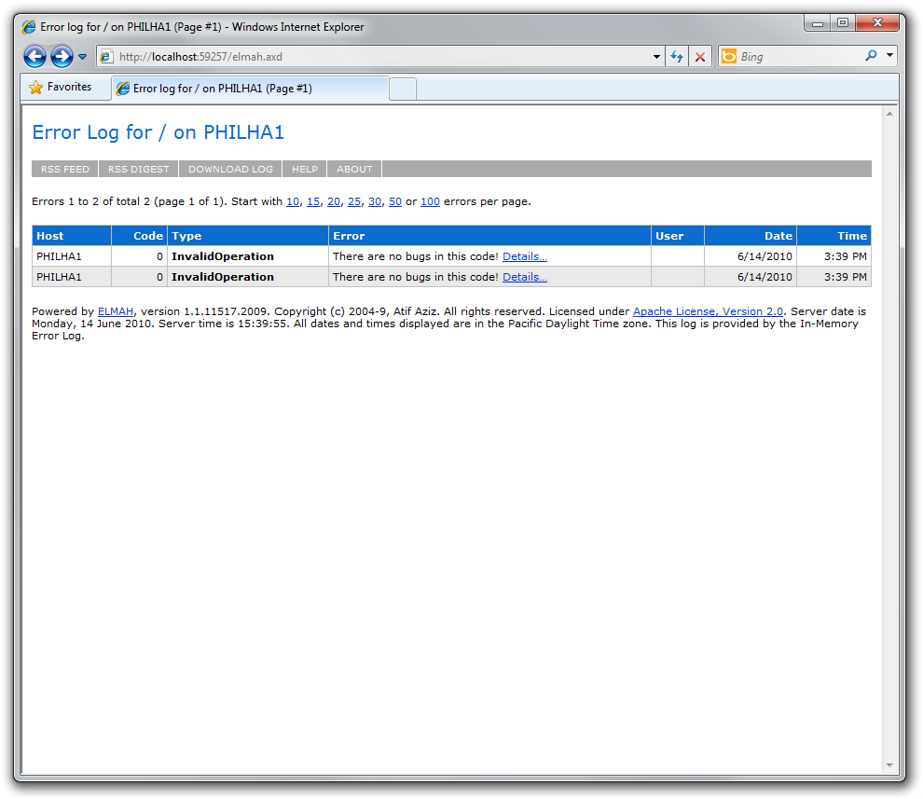
Finally! It works!

Slide 31
that‘s for a single assembly!

Slide 32
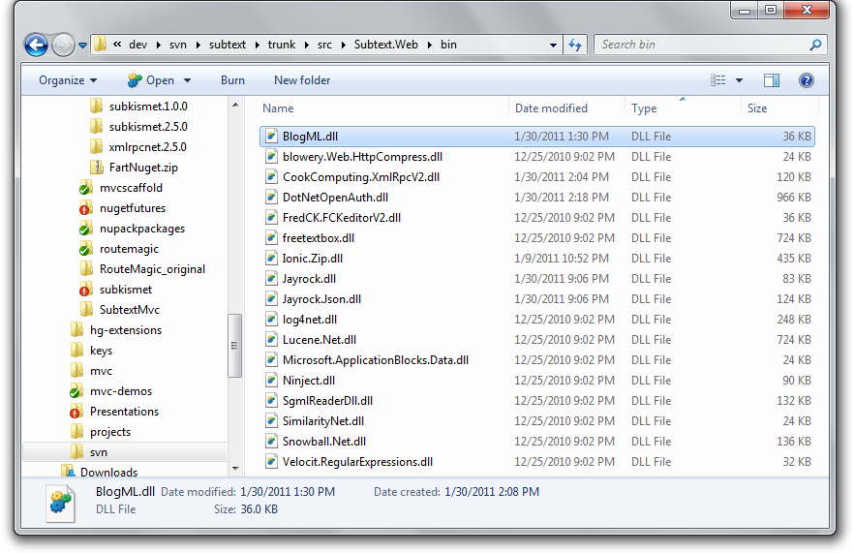
What Happens When I’m Ready For Build V2?

Slide 33
we can do much better!

Slide 34
Our NuGet Agenda
Basics: What it can do
Making Packages & Publishing
Command-line vs. UI
Examples from Simple to Advanced
  Conventions, Transforms and Preprocessing, PowerShell
NuGet Servers of all Sizes
NuGet and Source Control
NuGet and Continuous Integration
Extreme Examples

Slide 35
What about the Enterprise?

Slide 36


http://flic.kr/photos/kwl/3875936992/

Slide 37
What about big boring companies?

Slide 38
What problem are we trying to solve?
Sharing business level components among teams.
Sharing best practices among teams.
Build productivity helpers on top of existing Out of
the Box, Open Source or 3rd party tools and libraries.
Setup configuration that is specific to the
enterprise environment.

Slide 39
How is this solved today
File shares with folders full of assemblies or downloaded 3rd party installers.
Tribal knowledge
Sparse documentation in wikis or email threads.
Pulled from existing source code trees within the company.

Slide 40
How does NuGet help?
Provides a central location to store this knowledge, in the form of code, assemblies, configuration, and automation scripts.
Provides concrete solutions rather than guidance, policies, or abstract standards.

Slide 41
Using NuGet in the enterprise.
Setup a Company Repository.
  For a single location use a UNC share
  Distributed companies should use a http server.
Start by manually packaging up existing company shared libraries and components and their configuration.
Create meta packages to share better practices.

Slide 42
Create a Meta package
Meta package is a package that does not contain assemblies or code. It only combines a set of dependent packages.
Examples
  Testing package could have your unit test, assertion, and mocking framework
  Application – IoC, ORM, ect… The reference app that can install into a MVC 3 Empty template.

Slide 43
Continuous Integration
Create a second Repository for CI builds.
Automate the NuGet Package creation from your CI builds to publish to the CI Repository
Automatically increment your version numbers in your assemblies and NuGets

Slide 44
Define a Publishing process
Define a process for when your Nuggets are published to the official company repository.
After a development iteration all your release/acceptance tests pass.
Publish your package to the Released feed.

Slide 45
Automation scripts
Automate solution to common errors.
  Configurations
  Install assemblies in the GAC
  Create Event Log Sources
  Ect.
Use the Package Manager Console to interactivly create a solution to a reproducible support problems.

Slide 46
Hacking NuGet
“things the product team will tell you not to do”
Distribute additional Visual Studio Add-ins (VSIX).
Distribute code templates.
Add additional commands to the package console to carry out common developer tasks.
Change base classes for files in your VS project. Add method overrides….. Ect.
This can all be done in powershell.

Slide 47
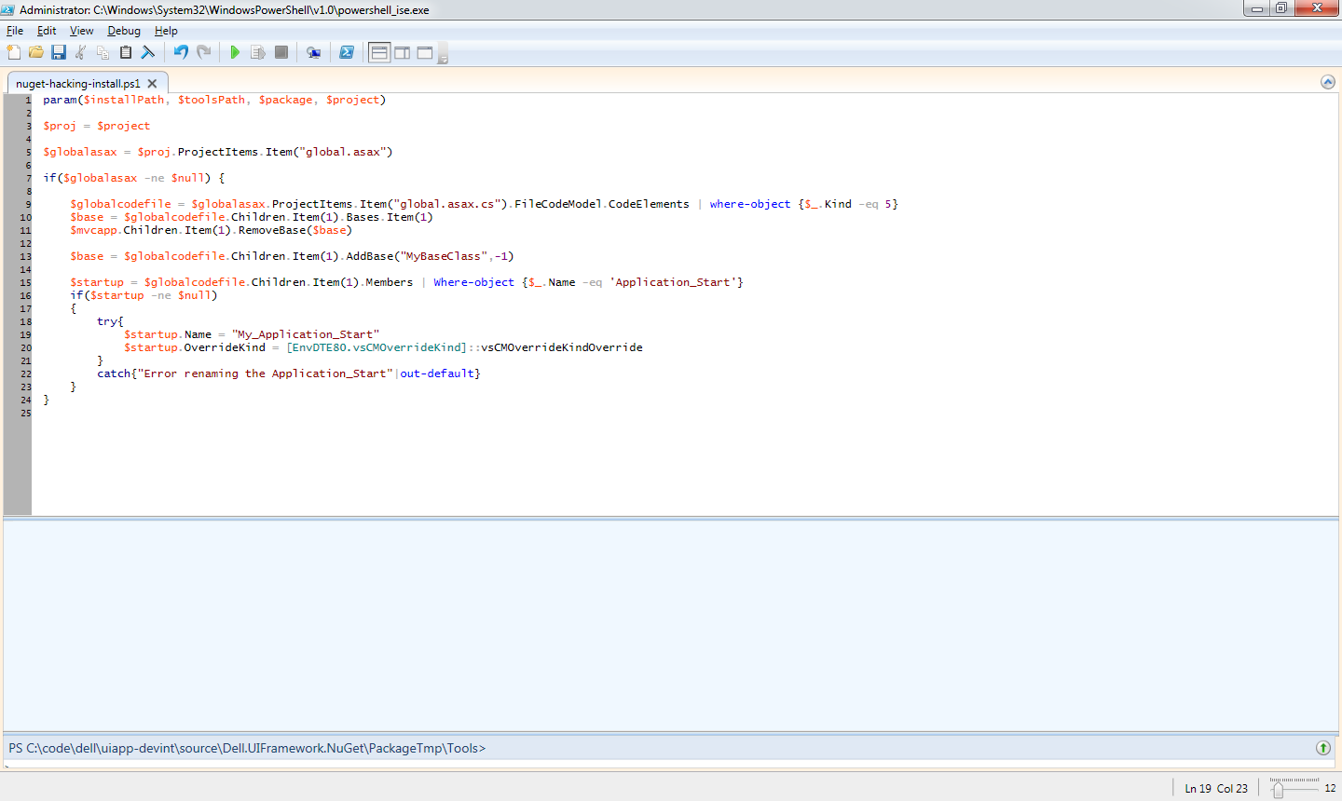
Changing a global.asax base class demo

Slide 48
PILE OF DEMOS!
NuGet

Slide 49
Development
NuGet is an OuterCurve Foundation Project
Hosted on http://nuget.codeplex.com
External contributions allowed
  Several external core contributors
Monthly point release cadence
Large uptake so far: http://stats.nuget.org

Slide 50
help us spread the word!

Slide 51

Be well, write good code, and stay in touch scottha@microsoft.com
@shanselman http://hanselman.com

Slide 52
Web Track Resources
http://www.asp.net/
http://www.silverlight.net/
http://www.microsoft.com/web/gallery/
http://www.iis.net/
http://weblogs.asp.net/Scottgu/
http://www.hanselman.com

Slide 53





Resources
  Connect. Share. Discuss.
http://northamerica.msteched.com
Learning
  Sessions On-Demand & Community
  Microsoft Certification & Training Resources
www.microsoft.com/teched
www.microsoft.com/learning
  Resources for IT Professionals
  Resources for Developers
http://microsoft.com/technet
http://microsoft.com/msdn

Slide 54












Complete an evaluation on CommNet and
enter to win!

Slide 55


Slide 56

© 2011 Microsoft Corporation. All rights reserved. Microsoft, Windows, Windows Vista and other product names are or may be registered trademarks and/or trademarks in the U.S. and/or other countries.
The information herein is for informational purposes only and represents the current view of Microsoft Corporation as of the date of this presentation. Because Microsoft must respond to changing market conditions, it should not be interpreted to be a commitment
on the part of Microsoft, and Microsoft cannot guarantee the accuracy of any information provided after the date of this presentation. MICROSOFT MAKES NO WARRANTIES, EXPRESS, IMPLIED OR STATUTORY, AS TO THE INFORMATION IN THIS PRESENTATION.

