Slide 1

Microsoft Visual Studio IDE Futures
DEV326
Weston Hutchins
Program Manager, Visual Studio IDE Platform
Microsoft Corporation

Slide 2
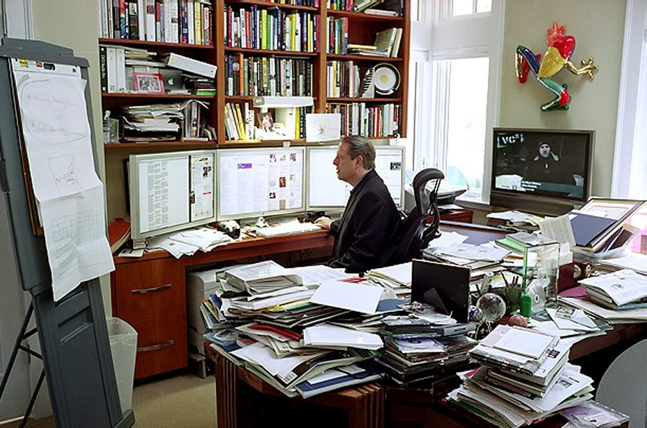
Image source: http://www.flickr.com/photos/handforged/510227143/

Slide 3
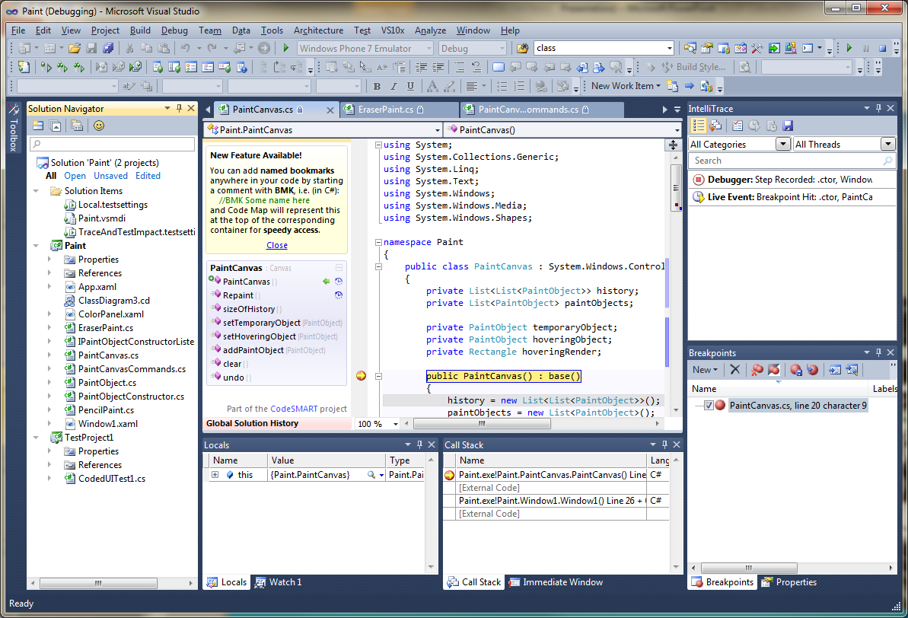

Slide 4
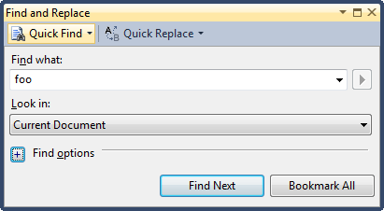
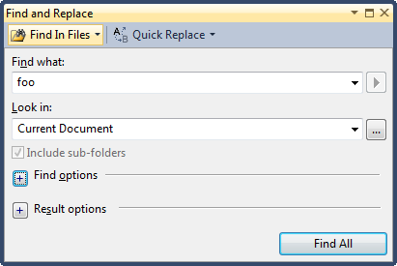


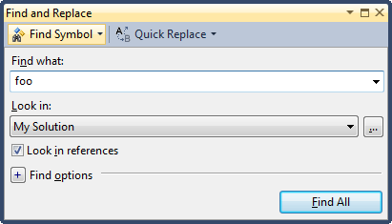
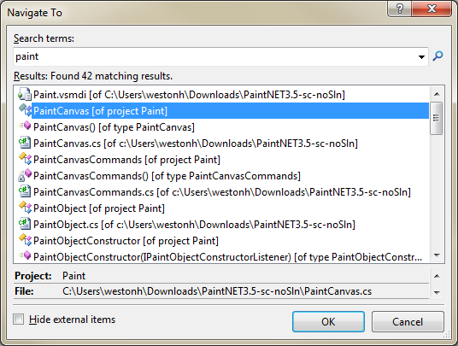

Slide 5
Simpler + Faster = More Productive

Slide 6


Images sources: http://www.flickr.com/photos/peterhess/2976755407/ http://www.flickr.com/photos/sepblog/3941048713/

Slide 7
Visual Studio vNext - Simpler
demo

Slide 8
Simple
Code Experience/Understanding
Improved Solution Explorer
  Search
  Smart Rename
  Collapse All
  Multiple Instances
  Integration of Class View/Object Browser/Find References
    View types and members in a file (C#/VB/C++)
    Explore code relationships (calls, called by, used by, base/derived types, …)
VB Call Hierarchy

Slide 9
Simple
Window Management
Streamlined toolbars
Floating Tab Wells
  Aero-peak taskbar preview support
  Minimize to taskbar
Preview Tab
  Single-click preview in Solution Explorer, Find in Files, Find Symbol Results, and more…
Pinned Tabs
Simplified Navigate Back/Forward

Slide 10
Simple
Search/Find
Streamlined Quick Find/Replace
Search in Solution Explorer, Toolbox, Error List, Team Explorer and more…
Reusable search control
Scope Error List to “Open Documents”, “Current Project”, or “Current Document”
IDE Search (searches menus, open documents, options, …)
New Add Reference Dialog

Slide 11
Performance – Four Key Areas of Investment
Overall Responsiveness
Long Running Operations
Memory Utilization
Better Feedback/Telemetry

Slide 12
Visual Studio vNext - Performance
demo

Slide 13
Performance
Responsiveness/Long Running Operations
  Background build (VB, C#, C++)
  Parallel Multi-proc build
Memory Utilization
  Out-of-proc (C#, C++)
  Reduction in virtual memory usage throughout the product
Better Feedback/Telemetry
  Visual Studio PerfWatson

Slide 14

Related Content
Required Slide
Speakers, please list the Breakout Sessions, Interactive Discussions, Labs, Demo Stations and Certification Exam that relate to your session. Also indicate when they can find you staffing in the TLC.
Visual Studio Team Blog
Visual Studio Gallery
  Productivity Power Tools
  Color Theme Editor
  Visual Studio PerfWatson
Find Me Later at the “Visual Studio 2010” booth in the TLC-DEV area

Slide 15
DEV Track Resources
http://www.microsoft.com/visualstudio
http://www.microsoft.com/visualstudio/en-us/lightswitch
http://www.microsoft.com/expression/
http://blogs.msdn.com/b/somasegar/
http://blogs.msdn.com/b/bharry/
http://www.microsoft.com/sqlserver/en/us/default.aspx
http://www.facebook.com/visualstudio

Slide 16





Resources
  Connect. Share. Discuss.
http://northamerica.msteched.com
Learning
  Sessions On-Demand & Community
  Microsoft Certification & Training Resources
www.microsoft.com/teched
www.microsoft.com/learning
  Resources for IT Professionals
  Resources for Developers
http://microsoft.com/technet
http://microsoft.com/msdn

Slide 17












Complete an evaluation on CommNet and
enter to win!

Slide 18


Slide 19

© 2011 Microsoft Corporation. All rights reserved. Microsoft, Windows, Windows Vista and other product names are or may be registered trademarks and/or trademarks in the U.S. and/or other countries.
The information herein is for informational purposes only and represents the current view of Microsoft Corporation as of the date of this presentation. Because Microsoft must respond to changing market conditions, it should not be interpreted to be a commitment
on the part of Microsoft, and Microsoft cannot guarantee the accuracy of any information provided after the date of this presentation. MICROSOFT MAKES NO WARRANTIES, EXPRESS, IMPLIED OR STATUTORY, AS TO THE INFORMATION IN THIS PRESENTATION.

