Slide 2

C# and Visual Basic Future:
Async Made Simple
DEV324
Alex Turner
Program Manager
VB/C# Compilers
Microsoft

Slide 3
C# and VB Evolution
C# 4.0 + VB 10.0
Dynamic + Language Parity
C# 3.0 + VB 9.0
Language Integrated Query
C# 2.0 + VB 8.0
Generics
C# 1.0 + VB 7.0
Managed Code

Slide 4
Trends
Declarative
Dynamic
Concurrent

Slide 5
Trends
Increasingly connected applications
  More latency
  More UI responsiveness problems
  More scalability issues
Asynchronous programming
  Becoming the norm in responsive, scalable apps
  Async-only APIs, e.g., JavaScript and Silverlight

Slide 6
C# and VB Evolution
C# + VB v.Next
Asynchronous Programming
C# 4.0 + VB 10.0
Dynamic + Language Parity
C# 3.0 + VB 9.0
Language Integrated Query
C# 2.0 + VB 8.0
Generics
C# 1.0 + VB 7.0
Managed Code

Slide 7
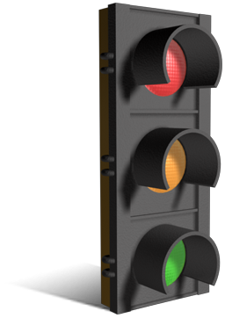
Asynchrony in a Nutshell
Synchronous → Wait for result before returning
  string DownloadString(...);
Asynchronous → Return now, call back with result
  void DownloadStringAsync(..., Action<string> callback);
Asynchrony benefits
  UI responsiveness: Frees UI thread for interaction
  Server scalability: Thread can be reused for other requests

Slide 8
Synchronous versus Asynchronous
var data = DownloadData(...);
ProcessData(data);
Thread
STOP
DownloadData
ProcessData
DownloadDataAsync(... , data => {
ProcessData(data);
});
Thread
DownloadDataAsync
ProcessData

Slide 9
Synchronous versus Asynchronous
var data = DownloadData(...);
ProcessData(data);
Thread
STOP
STOP
DownloadData
ProcessData
DownloadDataAsync(... , data => {
ProcessData(data);
});
Thread
DownloadDataAsync
ProcessData

Slide 10
Asynchronous Responsive UI
demo

Slide 11
Asynchronous Control Flow
async void DoWorkAsync() {
var t1 = ProcessFeedAsync("www.acme.com/rss");
var t2 = ProcessFeedAsync("www.xyznews.com/rss");
await Task.WhenAll(t1, t2);
DisplayMessage("Done");
}
async Task ProcessFeedAsync(string url) {
var text = await DownloadFeedAsync(url);
var doc = ParseFeedIntoDoc(text);
await SaveDocAsync(doc);
ProcessLog.WriteEntry(url);
}
Message Pump
UI Thread

Slide 12
Asynchronous Control Flow
async void DoWorkAsync() {
var t1 = ProcessFeedAsync("www.acme.com/rss");
var t2 = ProcessFeedAsync("www.xyznews.com/rss");
await Task.WhenAll(t1, t2);
DisplayMessage("Done");
}
async Task ProcessFeedAsync(string url) {
var text = await DownloadFeedAsync(url);
var doc = ParseFeedIntoDoc(text);
await SaveDocAsync(doc);
ProcessLog.WriteEntry(url);
}

Slide 13
Asynchronous Control Flow
async void DoWorkAsync() {
var t1 = ProcessFeedAsync("www.acme.com/rss");
var t2 = ProcessFeedAsync("www.xyznews.com/rss");
await Task.WhenAll(t1, t2);
DisplayMessage("Done");
}
async Task ProcessFeedAsync(string url) {
var text = await DownloadFeedAsync(url);
var doc = ParseFeedIntoDoc(text);
await SaveDocAsync(doc);
ProcessLog.WriteEntry(url);
}

Slide 14
Asynchronous Control Flow
async void DoWorkAsync() {
var t1 = ProcessFeedAsync("www.acme.com/rss");
var t2 = ProcessFeedAsync("www.xyznews.com/rss");
await Task.WhenAll(t1, t2);
DisplayMessage("Done");
}
async Task ProcessFeedAsync(string url) {
var text = await DownloadFeedAsync(url);
var doc = ParseFeedIntoDoc(text);
await SaveDocAsync(doc);
ProcessLog.WriteEntry(url);
}

Slide 15
Asynchronous Control Flow
async void DoWorkAsync() {
var t1 = ProcessFeedAsync("www.acme.com/rss");
var t2 = ProcessFeedAsync("www.xyznews.com/rss");
await Task.WhenAll(t1, t2);
DisplayMessage("Done");
}
async Task ProcessFeedAsync(string url) {
var text = await DownloadFeedAsync(url);
var doc = ParseFeedIntoDoc(text);
await SaveDocAsync(doc);
ProcessLog.WriteEntry(url);
}
t1

Slide 16
Asynchronous Control Flow
async void DoWorkAsync() {
var t1 = ProcessFeedAsync("www.acme.com/rss");
var t2 = ProcessFeedAsync("www.xyznews.com/rss");
await Task.WhenAll(t1, t2);
DisplayMessage("Done");
}
async Task ProcessFeedAsync(string url) {
var text = await DownloadFeedAsync(url);
var doc = ParseFeedIntoDoc(text);
await SaveDocAsync(doc);
ProcessLog.WriteEntry(url);
}
t1
t2

Slide 17
Asynchronous Control Flow
async void DoWorkAsync() {
var t1 = ProcessFeedAsync("www.acme.com/rss");
var t2 = ProcessFeedAsync("www.xyznews.com/rss");
await Task.WhenAll(t1, t2);
DisplayMessage("Done");
}
async Task ProcessFeedAsync(string url) {
var text = await DownloadFeedAsync(url);
var doc = ParseFeedIntoDoc(text);
await SaveDocAsync(doc);
ProcessLog.WriteEntry(url);
}
t1
t2

Slide 18
Asynchronous Control Flow
async void DoWorkAsync() {
var t1 = ProcessFeedAsync("www.acme.com/rss");
var t2 = ProcessFeedAsync("www.xyznews.com/rss");
await Task.WhenAll(t1, t2);
DisplayMessage("Done");
}
async Task ProcessFeedAsync(string url) {
var text = await DownloadFeedAsync(url);
var doc = ParseFeedIntoDoc(text);
await SaveDocAsync(doc);
ProcessLog.WriteEntry(url);
}
t1
t2
☑

Slide 19
Asynchronous Control Flow
async void DoWorkAsync() {
var t1 = ProcessFeedAsync("www.acme.com/rss");
var t2 = ProcessFeedAsync("www.xyznews.com/rss");
await Task.WhenAll(t1, t2);
DisplayMessage("Done");
}
async Task ProcessFeedAsync(string url) {
var text = await DownloadFeedAsync(url);
var doc = ParseFeedIntoDoc(text);
await SaveDocAsync(doc);
ProcessLog.WriteEntry(url);
}
t1
t2
☑

Slide 20
Asynchronous Control Flow
async void DoWorkAsync() {
var t1 = ProcessFeedAsync("www.acme.com/rss");
var t2 = ProcessFeedAsync("www.xyznews.com/rss");
await Task.WhenAll(t1, t2);
DisplayMessage("Done");
}
async Task ProcessFeedAsync(string url) {
var text = await DownloadFeedAsync(url);
var doc = ParseFeedIntoDoc(text);
await SaveDocAsync(doc);
ProcessLog.WriteEntry(url);
}
t1
t2
☑
☑

Slide 21
Asynchronous Control Flow
async void DoWorkAsync() {
var t1 = ProcessFeedAsync("www.acme.com/rss");
var t2 = ProcessFeedAsync("www.xyznews.com/rss");
await Task.WhenAll(t1, t2);
DisplayMessage("Done");
}
async Task ProcessFeedAsync(string url) {
var text = await DownloadFeedAsync(url);
var doc = ParseFeedIntoDoc(text);
await SaveDocAsync(doc);
ProcessLog.WriteEntry(url);
}
t1
t2
☑
☑

Slide 22
Asynchronous Control Flow
async void DoWorkAsync() {
var t1 = ProcessFeedAsync("www.acme.com/rss");
var t2 = ProcessFeedAsync("www.xyznews.com/rss");
await Task.WhenAll(t1, t2);
DisplayMessage("Done");
}
async Task ProcessFeedAsync(string url) {
var text = await DownloadFeedAsync(url);
var doc = ParseFeedIntoDoc(text);
await SaveDocAsync(doc);
ProcessLog.WriteEntry(url);
}
t1
t2
☑
☑
☑

Slide 23
Asynchronous Control Flow
async void DoWorkAsync() {
var t1 = ProcessFeedAsync("www.acme.com/rss");
var t2 = ProcessFeedAsync("www.xyznews.com/rss");
await Task.WhenAll(t1, t2);
DisplayMessage("Done");
}
async Task ProcessFeedAsync(string url) {
var text = await DownloadFeedAsync(url);
var doc = ParseFeedIntoDoc(text);
await SaveDocAsync(doc);
ProcessLog.WriteEntry(url);
}
t1
t2
☑
☑
☑
☑

Slide 24
Asynchronous Control Flow
async void DoWorkAsync() {
var t1 = ProcessFeedAsync("www.acme.com/rss");
var t2 = ProcessFeedAsync("www.xyznews.com/rss");
await Task.WhenAll(t1, t2);
DisplayMessage("Done");
}
async Task ProcessFeedAsync(string url) {
var text = await DownloadFeedAsync(url);
var doc = ParseFeedIntoDoc(text);
await SaveDocAsync(doc);
ProcessLog.WriteEntry(url);
}
t1
t2
☑
☑
☑
☑
☑

Slide 25
Asynchronous Control Flow
async void DoWorkAsync() {
var t1 = ProcessFeedAsync("www.acme.com/rss");
var t2 = ProcessFeedAsync("www.xyznews.com/rss");
await Task.WhenAll(t1, t2);
DisplayMessage("Done");
}
async Task ProcessFeedAsync(string url) {
var text = await DownloadFeedAsync(url);
var doc = ParseFeedIntoDoc(text);
await SaveDocAsync(doc);
ProcessLog.WriteEntry(url);
}
t1
t2
☑
☑
☑
☑
☑
☑

Slide 26
Asynchronous Control Flow
async void DoWorkAsync() {
var t1 = ProcessFeedAsync("www.acme.com/rss");
var t2 = ProcessFeedAsync("www.xyznews.com/rss");
await Task.WhenAll(t1, t2);
DisplayMessage("Done");
}
async Task ProcessFeedAsync(string url) {
var text = await DownloadFeedAsync(url);
var doc = ParseFeedIntoDoc(text);
await SaveDocAsync(doc);
ProcessLog.WriteEntry(url);
}
t1
t2
☑
☑
☑
☑
☑
☑
☑

Slide 27
Asynchronous Control Flow
async void DoWorkAsync() {
var t1 = ProcessFeedAsync("www.acme.com/rss");
var t2 = ProcessFeedAsync("www.xyznews.com/rss");
await Task.WhenAll(t1, t2);
DisplayMessage("Done");
}
async Task ProcessFeedAsync(string url) {
var text = await DownloadFeedAsync(url);
var doc = ParseFeedIntoDoc(text);
await SaveDocAsync(doc);
ProcessLog.WriteEntry(url);
}
t1
t2
☑
☑
☑
☑
☑
☑
☑

Slide 28
How Does it Work?
async Task<XElement> GetRssAsync(string url) {
var client = new WebClient();
var task = client.DownloadStringTaskAsync(url);
var text = await task;
var xml = XElement.Parse(text);
return xml;
}

Slide 29
How Does it Work?
async Task<XElement> GetRssAsync(string url) {
var client = new WebClient();
var task = client.DownloadStringTaskAsync(url);
var text = await task;
var xml = XElement.Parse(text);
return xml;
}
Task<XElement> GetRssAsync(string url) {
var client = new WebClient();
var task = client.DownloadStringTaskAsync(url);
return task.ContinueWith(delegate
{
var text = task.Result;
var xml = XElement.Parse(text);
return xml;
});
}

Slide 30
How Does it Work?
Task<XElement> GetRssAsync(string url) {
var $builder = AsyncTaskMethodBuilder<XElement>.Create();
var $state = 0;
TaskAwaiter<string> $a1;
Action $resume = delegate {
try {
if ($state == 1) goto L1;
var client = new WebClient();
var task = client.DownloadStringTaskAsync(url);
$a1 = task.GetAwaiter();
if ($a1.IsCompleted) goto L1;
$state = 1;
$a1.OnCompleted($resume);
return;
L1: var text = $a1.GetResult();
var xml = XElement.Parse(text);
$builder.SetResult(xml);
}
catch (Exception $ex) { $builder.SetException($ex); }
};
$resume();
return $builder.Task;
}
async Task<XElement> GetRssAsync(string url) {
var client = new WebClient();
var task = client.DownloadStringTaskAsync(url);
var text = await task;
var xml = XElement.Parse(text);
return xml;
}

Slide 31
How Does it Work?
Task<XElement> GetRssAsync(string url) {
var $builder = AsyncTaskMethodBuilder<XElement>.Create();
var $state = 0;
TaskAwaiter<string> $a1;
Action $resume = delegate {
try {
if ($state == 1) goto L1;
var client = new WebClient();
var task = client.DownloadStringTaskAsync(url);
$a1 = task.GetAwaiter();
if ($a1.IsCompleted) goto L1;
$state = 1;
$a1.OnCompleted($resume);
return;
L1: var text = $a1.GetResult();
var xml = XElement.Parse(text);
$builder.SetResult(xml);
}
catch (Exception $ex) { $builder.SetException($ex); }
};
$resume();
return $builder.Task;
}
async Task<XElement> GetRssAsync(string url) {
var client = new WebClient();
var task = client.DownloadStringTaskAsync(url);
var text = await task;
var xml = XElement.Parse(text);
return xml;
}

Slide 32






Support throughout the .NET Framework
Others…
Task
Parallel
Library
Base
Class
Library
Windows
Communication
Foundation
Reactive
Extensions
(Rx)
Others…
Windows
Presentation
Foundation
ASP.NET

Slide 33
WCF – Client/Server
demo

Slide 34

Scalability: Avoiding New Threads
Synchronous logic blocks waiting for network requests:
var feeds = (from url in urls select client.DownloadFeed(url)).ToArray();
You could spin up background threads while you wait…
  However, we’d rather have those threads handle other requests!
With async, it’s easy to make requests in parallel:
var feeds = await TaskEx.WhenAll(from url in urls select client.DownloadFeedAsync(url));
No new threads!

Slide 35
Unifying Asynchrony
Asynchronous methods
Task
CPU
Network
I/O
Composite
An asynchronous scenario
  Scrape YouTube for video links
  Download two or more videos concurrently
  Create a mashup from downloaded videos
  Save the resulting video

Slide 36
Unifying Asynchrony
Task
CPU
Network
I/O
Composite
try {
string[] videoUrls = await ScrapeYoutubeAsync(url); // Network-bound
Task<Video> t1 = DownloadVideoAsync(videoUrls[0]); // Start two downloads
Task<Video> t2 = DownloadVideoAsync(videoUrls[1]);
Video[] vids = await Task.WhenAll(t1, t2); // Wait for both
Video v = await MashupVideosAsync(vids[0], vids[1]); // CPU-bound
await v.SaveAsync(textbox.Text); // IO-bound
}
catch (WebException ex) {
ReportError(ex);
}

Slide 37
Asynchronous Methods
As simple as synchronous code
Unifies computational, network and I/O asynchrony
More scalable servers
More responsive UI
Download
Visual Studio Async CTP
today!

Slide 38
C# and VB Evolution
C# + VB v.Next
Asynchronous Programming
C# 4.0 + VB 10.0
Dynamic + Language Parity
C# 3.0 + VB 9.0
Language Integrated Query
C# 2.0 + VB 8.0
Generics
C# 1.0 + VB 7.0
Managed Code

Slide 39
Compiler as a Service
Meta-programming
Class
Read-Eval-Print Loop
public
Foo
Language
Object Model
Field
DSL Embedding
private
X
string
Compiler
Compiler
Source
File
.NET Assembly
Source code
Source code
Source code
Source code

Slide 40
Compiler as a Service
demo

Slide 41
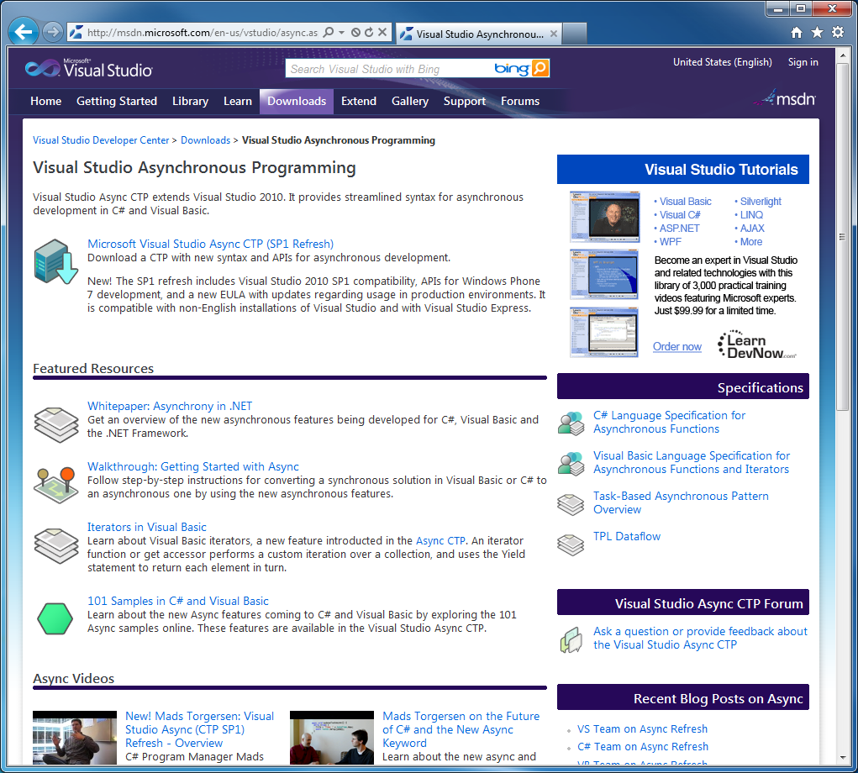
Track Resources
Required Slide
Track PMs will supply the content for this slide, which will be inserted during the final scrub.
Visual Studio Async CTP – http://msdn.com/vstudio/async

Slide 42






Related Sessions
VS Languages Booth
DEV328: How We Do Language Design at Microsoft
  May 16 at 1:15-2:30 PM, by Lisa, Don, Alex and Lucian
DEV372-INT: Meet the Microsoft Visual Studio Professional Team
  May 17 at 3:15-4:30 PM, by All
DEV317: Using Visual Basic to Build Windows Phone 7 Apps
  May 18, 8:30-9:45 AM, by Lucian Wischik
DEV323: A Taste of F#: Today and Future
  May 18, 5:00-6:15, by Don Syme
DEV318 - Upgrading Your C# Programming Skills
  May 19, 2:45-4:00PM, by Mark Michaelis

Slide 43
DEV Track Resources
http://www.microsoft.com/visualstudio
http://www.microsoft.com/visualstudio/en-us/lightswitch
http://www.microsoft.com/expression/
http://blogs.msdn.com/b/somasegar/
http://blogs.msdn.com/b/bharry/
http://www.microsoft.com/sqlserver/en/us/default.aspx
http://www.facebook.com/visualstudio

Slide 44





Resources
  Connect. Share. Discuss.
http://northamerica.msteched.com
Learning
  Sessions On-Demand & Community
  Microsoft Certification & Training Resources
www.microsoft.com/teched
www.microsoft.com/learning
  Resources for IT Professionals
  Resources for Developers
http://microsoft.com/technet
http://microsoft.com/msdn

Slide 45












Complete an evaluation on CommNet and
enter to win!

Slide 46

Notes:
New for TechEd 2011, we will be working with Microsoft Tag (http://tag.microsoft.com/overview.aspx) to create unique Tags for every session at the event. Your session Tag will appear on both the room signage and at the end of your presentation. With your session Tag, attendees will be able to scan as they enter the room to retrieve session details, view speaker bios, and engage in discussions; or scan at the end of the presentation to evaluate your session and download materials. We’re excited to integrate Microsoft Tag across the My TechEd mobile experience this year.

Slide 47

© 2011 Microsoft Corporation. All rights reserved. Microsoft, Windows, Windows Vista and other product names are or may be registered trademarks and/or trademarks in the U.S. and/or other countries.
The information herein is for informational purposes only and represents the current view of Microsoft Corporation as of the date of this presentation. Because Microsoft must respond to changing market conditions, it should not be interpreted to be a commitment
on the part of Microsoft, and Microsoft cannot guarantee the accuracy of any information provided after the date of this presentation. MICROSOFT MAKES NO WARRANTIES, EXPRESS, IMPLIED OR STATUTORY, AS TO THE INFORMATION IN THIS PRESENTATION.

