Slide 2
A Taste of F#:
Today and Future
DEV323
Don Syme
Principal Researcher
Microsoft Research

Slide 3

Today’s talk is very simple

Slide 4
Proposition 1
The world is information-rich

Slide 5
Proposition 2
Modern applications are information-rich

Slide 6
Proposition 3
Our languages are information-sparse

Slide 7
Proposition 4
This is a problem

Slide 8
The future of F# is about fixing this

Slide 9
To fix it we will use magic ☺

Slide 10
The magic we’re adding to F# is called Type Providers

Slide 11
Type Providers + LINQ
=
Language Integrated Data and Services

Slide 12
But first…
What is F# and why should I care?

Slide 13

F# 2.0 ships with Visual Studio 2010

Slide 14
F# is…
...a productive, supported, interoperable, functional programming language that allows you to write simple code to solve complex problems.

Slide 15
Simple Code, Strongly Typed

Slide 16
Simplicity: Functions as Values
abstract class Command {
public virtual void Execute();
}
abstract class RoverCommand : Command {
protected Rover Rover { get; private set; }
public RoverCommand(MarsRover rover) {
this.Rover = rover;
}
}
class BreakCommand : RoverCommand {
public BreakCommand(Rover rover)
: base(rover) { }
public override void Execute() {
Rover.Rotate(-5.0);
}
}
class TurnLeftCommand : RoverCommand
{
public TurnLeftCommand(Rover rover)
: base(rover) {
}
public override void Execute() {
Rover.Rotate(-5.0);
}
}
OO
F#
type Command = Command of (Rover -> unit)
let BreakCommand =
Command(fun rover -> rover.Accelerate(-1.0))
let TurnLeftCommand =
Command(fun rover -> rover.Rotate(-5.0<degs>))

Slide 17
Simplicity: Functional Data
C#
let swap (x, y) = (y, x)
let rotations (x, y, z) =
[ (x, y, z);
(z, x, y);
(y, z, x) ]
let reduce f (x, y, z) =
f x + f y + f z
Tuple<U,T> Swap<T,U>(Tuple<T,U> t)
{
return new Tuple<U,T>(t.Item2, t.Item1)
}
ReadOnlyCollection<Tuple<T,T,T>> Rotations<T>(Tuple<T,T,T> t)
{
new ReadOnlyCollection<int>
(new Tuple<T,T,T>[]
{ new Tuple<T,T,T>(t.Item1,t.Item2,t.Item3);
new Tuple<T,T,T>(t.Item3,t.Item1,t.Item2);
new Tuple<T,T,T>(t.Item2,t.Item3,t.Item1); });
}
int Reduce<T>(Func<T,int> f,Tuple<T,T,T> t)
{
return f(t.Item1) + f(t.Item2) + f (t.Item3);
}
F#

Slide 18
The Big Trends
THE CLOUD
MULTICORE

Slide 19
Async.Parallel [ httpAsync "www.google.com"; httpAsync "www.bing.com"; httpAsync "www.yahoo.com"; ]
Parallel I/O
|> Async.RunSynchronously

Slide 20
Async.Parallel [ for i in 0 .. 200 -> computeTask i ]
Parallel CPU
|> Async.RunSynchronously

Slide 21
Demo
Notes:
If you would like to host your demo on the Virtual Server, please use the myVPC demo slide, not this slide.

Slide 22
F# can be used for everything, but excels at analytical engines

Slide 23
Example #1 (Power Company)
I have written an application to balance the national power generation schedule … for an energy company.
...the calculation engine was written in F#.
The use of F# to address the complexity at the heart of this application clearly demonstrates a sweet spot for the language … algorithmic analysis of large data sets.
Simon Cousins (Eon Powergen)

Slide 24
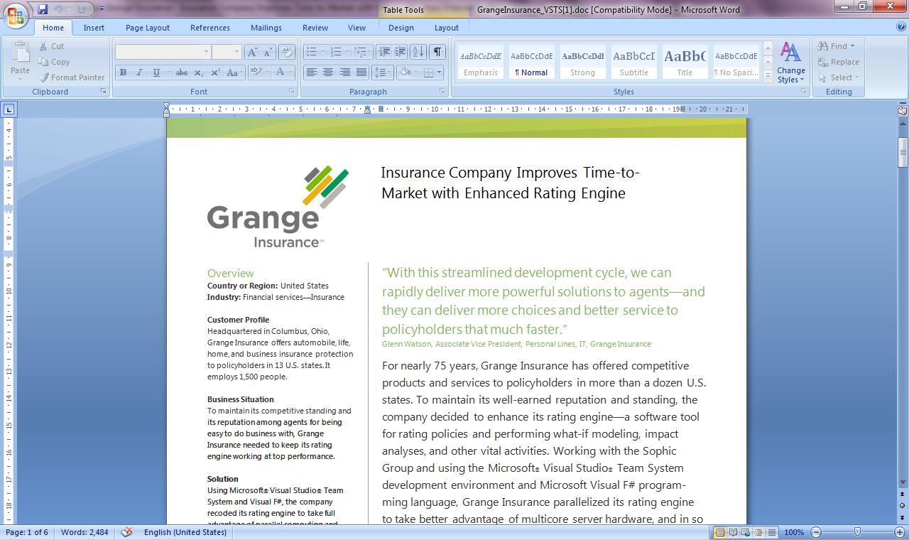
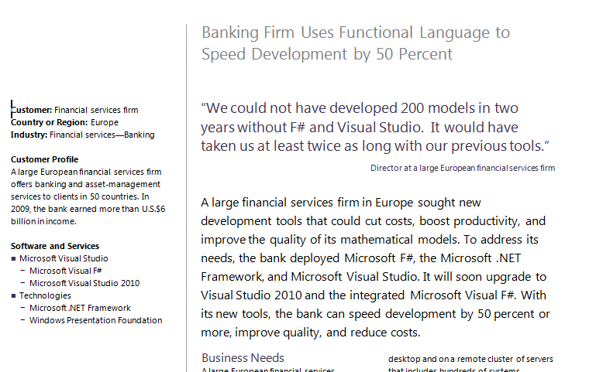
Examples #2/#3: Finance companies

Slide 25
Example #4: Biotech
...F# rocks - building algorithms for DNA processing
and it's like a drug. 12-15 at Amyris use F#...
F# has been phenomenally useful. I would be writing a lot of this in Python otherwise and F# is more robust, 20x - 100x faster to run and faster to develop.
Darren Platt, Amyris BioTechnologies

Slide 26
Some Basics
topic
Notes:
If you would like to host your demo on the Virtual Server, please use the myVPC demo slide, not this slide.

Slide 27
Fundamentals - Whitespace Matters
let computeDerivative f x =
let p1 = f (x - 0.05)
let p2 = f (x + 0.05)
(p2 – p1) / 0.1
Offside (bad indentation)

Slide 28
Fundamentals - Whitespace Matters
let computeDerivative f x =
let p1 = f (x - 0.05)
let p2 = f (x + 0.05)
(p2 – p1) / 0.1

Slide 29
Your First F# Application
printfn "Hello World"
C:\test> fsc test.fs
C:\test> test.exe
Hello World
C:\test>

Slide 30
Your Second F# Application
open System.Windows.Form
let form = new Form (Visible=true)
form.Click.Add (fun _ -> printfn "click")
Application.Run form

Slide 31
Functional– Pipelines
x |> f
The pipeline operator

Slide 32
Functional– Pipelines
x |> f1
|> f2
|> f3
Successive stages
in a pipeline

Slide 33
F# - Objects + Functional
type Vector2D (dx:double, dy:double) =
let d2 = dx*dx+dy*dy
member v.DX = dx
member v.DY = dy
member v.Length = sqrt d2
member v.Scale(k) = Vector2D (dx*k,dy*k)
Inputs to object
construction
Object internals
Exported properties
Exported method

Slide 34
C# is joining us too!
let! ≈ await
async { let! res = <async-event>
... }
React to a GUI Event
React to a Timer Callback
React to a Query Response
React to a HTTP Response
React to a Web Service Response
React to a Disk I/O Completion
Agent reacts to Message

Slide 35
F# async + immutable
Parallel
Server
Agents

Slide 36
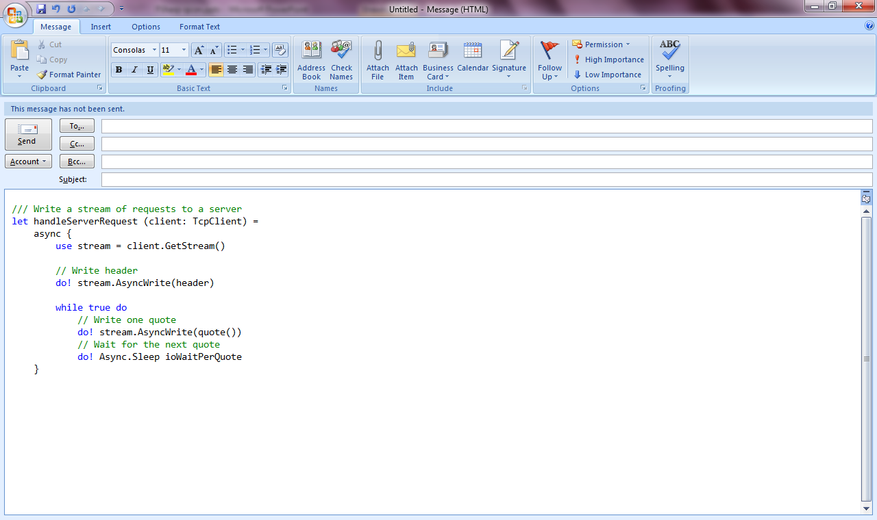
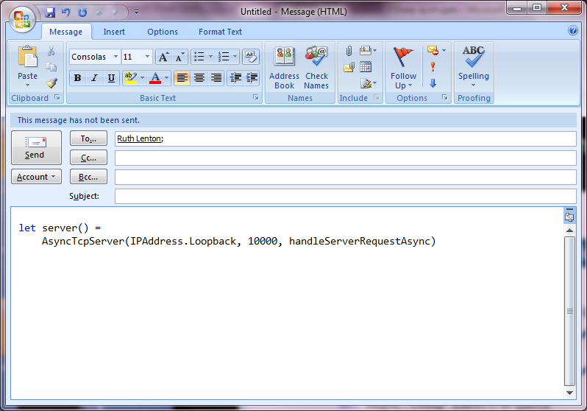
F# example: Serving 50,000+ simultaneous TCP connections with ~10 threads
Await!
Await!
Await!

Slide 37
F# Futures: Information Rich Programming

Slide 38
Caveat: No CTP today

Slide 39
A Coding Challenge
Task: A Chemical Elements Class Library
Time Allowed: 30 Seconds

Slide 40
Language Integrated Web Data
demo

Slide 41
The Magic: Type Providers
F#
Web Data
Cloud Data
Enterprise
Data
Local Data
Web Services
Your Data

Slide 42
A Type Provider is….
A design-time component that provides a computed space of types and methods…
A compiler/IDE extension…
An adaptor between data/services and .NET languages…

Slide 43
// Freebase.fsx
// Example of reading from freebase.com in F#
// by Jomo Fisher
#r "System.Runtime.Serialization"
#r "System.ServiceModel.Web"
#r "System.Web"
#r "System.Xml"
open System
open System.IO
open System.Net
open System.Text
open System.Web
open System.Security.Authentication
open System.Runtime.Serialization
[<DataContract>]
type Result<'TResult> = {
[<field: DataMember(Name="code") >]
Code:string
[<field: DataMember(Name="result") >]
Result:'TResult
[<field: DataMember(Name="message") >]
Message:string
}
[<DataContract>]
type ChemicalElement = {
[<field: DataMember(Name="name") >]
Name:string
[<field: DataMember(Name="boiling_point") >]
BoilingPoint:string
[<field: DataMember(Name="atomic_mass") >]
AtomicMass:string
}
How would we do this today?
let Query<'T>(query:string) : 'T =
let query = query.Replace("'","\"")
let queryUrl = sprintf "http://api.freebase.com/api/service/mqlread?query=%s" "{\"query\":"+query+"}"
let request : HttpWebRequest = downcast WebRequest.Create(queryUrl)
request.Method <- "GET"
request.ContentType <- "application/x-www-form-urlencoded"
let response = request.GetResponse()
let result =
try
use reader = new StreamReader(response.GetResponseStream())
reader.ReadToEnd();
finally
response.Close()
let data = Encoding.Unicode.GetBytes(result);
let stream = new MemoryStream()
stream.Write(data, 0, data.Length);
stream.Position <- 0L
let ser = Json.DataContractJsonSerializer(typeof<Result<'T>>)
let result = ser.ReadObject(stream) :?> Result<'T>
if result.Code<>"/api/status/ok" then
raise (InvalidOperationException(result.Message))
else
result.Result
let elements = Query<ChemicalElement array>("[{'type':'/chemistry/chemical_element','name':null,'boiling_point':null,'atomic_mass':null}]")
elements |> Array.iter(fun element->printfn "%A" element)

Slide 44
Note: F# still contains no data
Open architecture
You can write your own type provider

Slide 45
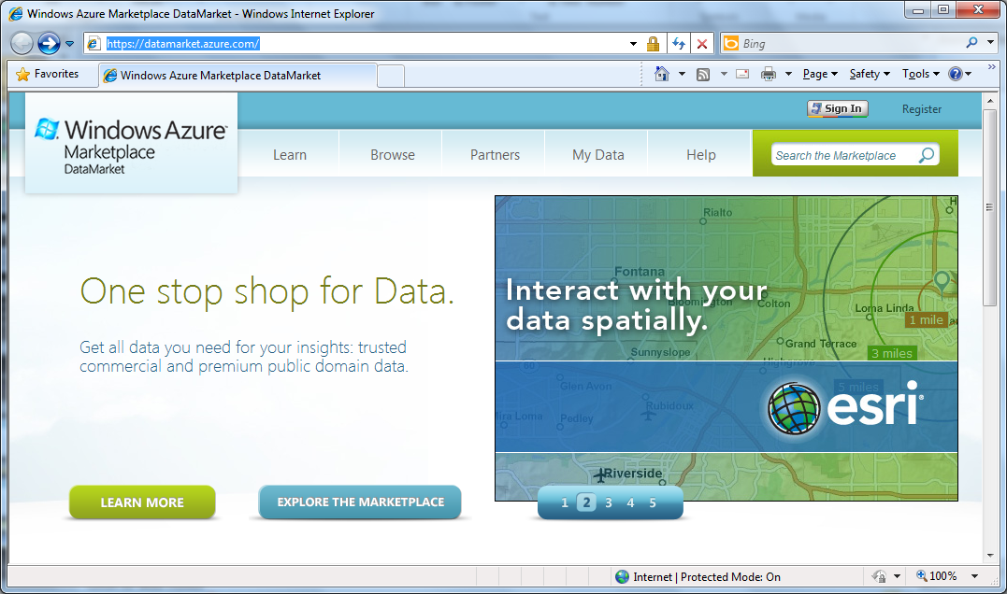

Slide 46
Language Integrated Data Market Directory
demo

Slide 47
OData
type Netflix = ODataService<"http://odata.netflix.com">
Fluent, Typed Access To OData

Slide 48
SQL Server
type SQL = SqlConnection<"Server='.\SQLEXPRESS'... ">
Fluent, Typed Access To SQL

Slide 49
SharePoint
type EmeaSite = SharePointSite<"http://myemea/">
Fluent, Typed Access To SharePoint Lists

Slide 50
F# Futures: Queries
let avatarTitles =
query { for t in netflix.Titles do
where (t.Name.Contains "Avatar") }
Declarative LINQ queries

Slide 51
F# Futures: Queries
let avatarTitles =
query { for t in netflix.Titles do
where (t.Name.Contains "Avatar")
sortBy t.Name
take 100 }
Declarative LINQ queries

Slide 52
Type Providers: The Vision
…web data
…data markets
…WMI & active directory
…a spreadsheet
…web services
…CRM data
…social data
…SQL data
…XML data
...
strongly typed
without explicit codegen
extensible, open

Slide 53
Summary
The world is information rich
Our languages need to be information-rich too
The F# Manifesto? Consume anything! Directly! Strongly typed! No walls!

Slide 54
In Summary
F#
Ready for supported use in VS2010
F# greatly simplifies parallelism
An amazing data-rich future ahead
Simple, expressive, productive addition to .NET

Slide 55
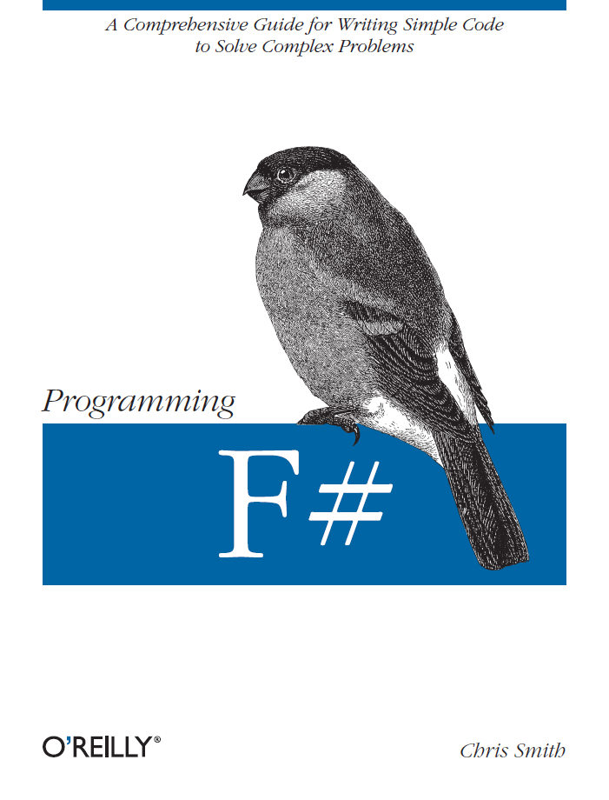
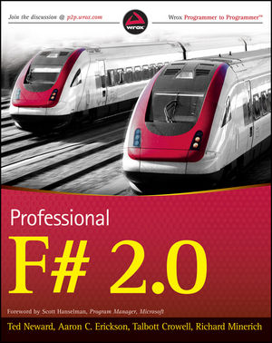
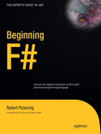
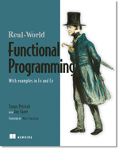

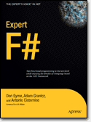
Latest Books about F#
Visit www.fsharp.net

Slide 56

Related Content
COS307 Building Applications with the Windows Azure DataMarket
DEV328 How We Do Language Design at Microsoft (C#, Visual Basic, F#)
DEV324 C# and Visual Basic Future: Async Made Simple
WSV206 Taking High Performance Computing to the Cloud: Windows HPC and Windows Azure

Slide 57
Resources
www.fsharp.net
www.tryfsharp.org

Slide 58
Resources
http://www.fsharp.net
http://www.tryfsharp.net
http://www.microsoft.com/visualstudio
http://www.microsoft.com/expression/
http://blogs.msdn.com/b/somasegar/
http://www.microsoft.com/sqlserver/en/us/default.aspx
http://www.facebook.com/visualstudio

Slide 59





Resources
  Connect. Share. Discuss.
http://northamerica.msteched.com
Learning
  Sessions On-Demand & Community
  Microsoft Certification & Training Resources
www.microsoft.com/teched
www.microsoft.com/learning
  Resources for IT Professionals
  Resources for Developers
http://microsoft.com/technet
http://microsoft.com/msdn

Slide 60












Complete an evaluation on CommNet and
enter to win!

Slide 61

Notes:
New for TechEd 2011, we will be working with Microsoft Tag (http://tag.microsoft.com/overview.aspx) to create unique Tags for every session at the event. Your session Tag will appear on both the room signage and at the end of your presentation. With your session Tag, attendees will be able to scan as they enter the room to retrieve session details, view speaker bios, and engage in discussions; or scan at the end of the presentation to evaluate your session and download materials. We’re excited to integrate Microsoft Tag across the My TechEd mobile experience this year.

Slide 62

© 2011 Microsoft Corporation. All rights reserved. Microsoft, Windows, Windows Vista and other product names are or may be registered trademarks and/or trademarks in the U.S. and/or other countries.
The information herein is for informational purposes only and represents the current view of Microsoft Corporation as of the date of this presentation. Because Microsoft must respond to changing market conditions, it should not be interpreted to be a commitment
on the part of Microsoft, and Microsoft cannot guarantee the accuracy of any information provided after the date of this presentation. MICROSOFT MAKES NO WARRANTIES, EXPRESS, IMPLIED OR STATUTORY, AS TO THE INFORMATION IN THIS PRESENTATION.

Slide 63
Which talk?
F#
Today?
F# Advanced?
F# Tomorrow?

Slide 64
Which talk?
F#
Today!
F# Advanced?
F# Tomorrow!

Slide 65
Which talk?
F#
Today!

