Slide 1
Automating Database Migration to SQL Server
DBI307
Welly Lee (Welly.Lee@microsoft.com)
Sr. Program Manager
SQL Server Migration Assistant (SSMA)
Microsoft

Slide 2
Agenda
Why Migrate to SQL Server
Database Migration Process
SQL Server Migration Assistant (SSMA)
Database Migration Challenges
Migration Best Practices
Resources

Slide 3
Why Migrate to SQL Server
What some of our customers say …
We moved nine-terabyte system migrated from Oracle using SSMA that resulted in significant TCO savings.
We were going for Better - Faster - Cheaper. And we attained all three!
We not only reduce $63,000 in annual licensing cost but we also improved uptime.
We improved development productivity and lowered cost after migrating our mission-critical system from Oracle.

Slide 4
Database Migration Process
Scoping and Planning
Microsoft Assessment
and Planning Toolkit
Database Migration
Database Discovery
Migration Impact Assessment
Application Remediation
Schema Conversion
Data Migration
Migration Assistant
Application Deployment
Embedded SQL Statement
Database connectivity
User Login and Permission

Slide 5
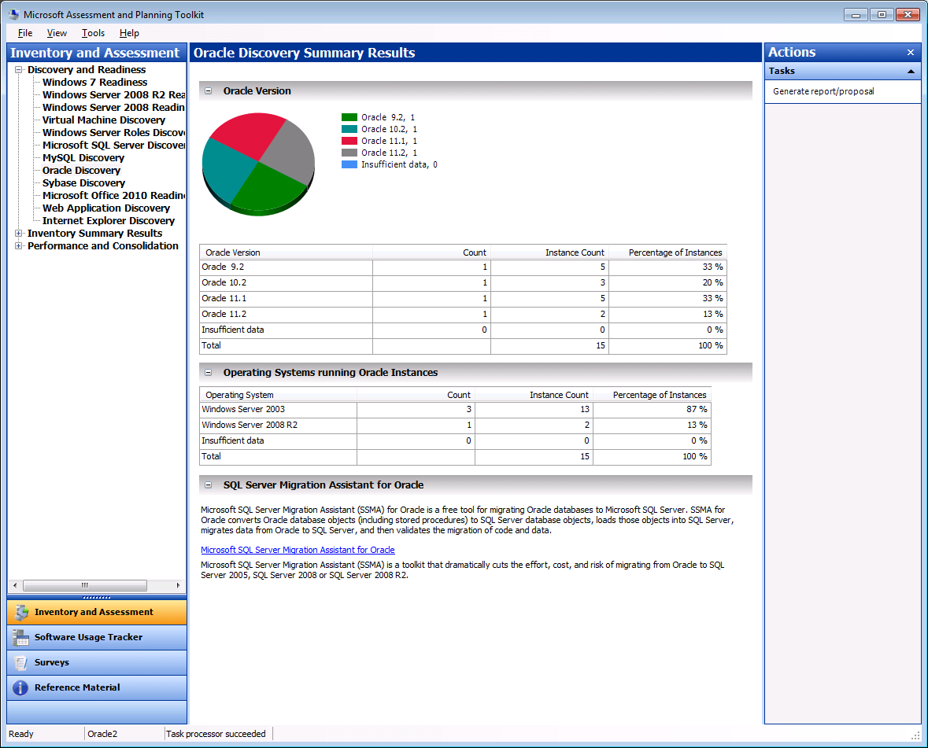
Microsoft Assessment and Planning (MAP) Toolkit
Agentless inventory and assessment tool
Provides readiness assessments for
Windows 7, Office 2010, Internet Explorer
Windows Server 2008 R2, Hyper-V
Windows Azure Platform
Oracle, MySQL, and Sybase Discovery
Generates customizable proposals and reports
It is free!
http://www.microsoft.com/map

Slide 6
SQL Server Migration Assistant
demo

Slide 7
SQL Server Migration Assistant
Automates and simplifies all phases of database migration
Assess migration complexity
Migration Analyzer
Migrate schema and business logic
Schema Converter
Migrate data
Data Migrator
Validate converted database
Migration Tester
Support migration from Oracle, Sybase, MySQL and Access database

Slide 8
Database Migration Challenges
Feature and dialect differences requires non-direct mapping and emulation
Oracle
SQL Server
Table/View
Table/View
Data Types
Data Types
T-SQL
User
Db
Procedure
Procedure
User Function
User Function
Package
Sequence
Trigger
Trigger
System Function
System Function
SysDb
Emulator
Standard Package
Master
PL/SQL

Slide 9
A Closer Look at Schema Conversion
demo

Slide 10
Migration Best Practices
Customize SSMA project setting
65 configuration options for Oracle Migration
55 configuration options for Sybase Migration
65 configuration options for MySQL Migration
25 configuration options for Access Migration
Customize data type mapping
Leverage SQL Server native data type (money, int)
Use the smallest possible data type (tinyint, int, varchar)
Re-engineer code
Return dataset from procedure (vs. using output parameter)
Use functions only for simple code
Use procedures for more complex code

Slide 11
SSMA 5.0
announcement

Slide 12
What’s New in SSMA 5.0
Migration to SQL Server “Denali.”
Multi-thread data migration
Globalization support
Oracle User Defined Type discovery
Sybase migration enhancements

Slide 13
SSMA Migration Path

Slide 14
Migrating Access Database to SQL Azure
demo

Slide 15
Resources
Database Migration Resources & Whitepaper
http://www.microsoft.com/sqlserver/en/us/product-info/migration.aspx
Free Technical Product support
ssmahelp@microsoft.com (FREE technical support from Microsoft CSS)
Discussion Forums
http://social.msdn.microsoft.com/Forums/en-US/sqlservermigration
SSMA Team Blog
http://blogs.msdn.com/b/ssma/
Video Demonstration: http://blogs.msdn.com/b/ssma/archive/2011/02/05/introduction-to-ssma.aspx

Slide 16
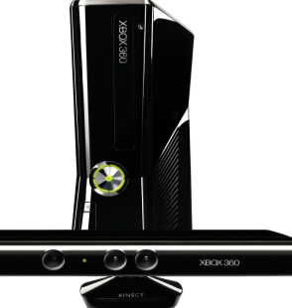
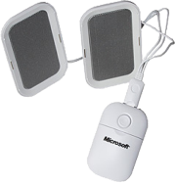
Complete an evaluation on CommNet and enter to win!

Slide 18
question

Slide 19
© 2011 Microsoft Corporation. All rights reserved. Microsoft, Windows, Windows Vista and other product names are or may be registered trademarks and/or trademarks in the U.S. and/or other countries.
The information herein is for informational purposes only and represents the current view of Microsoft Corporation as of the date of this presentation. Because Microsoft must respond to changing market conditions, it should not be interpreted to be a commitment on the part of Microsoft, and Microsoft cannot guarantee the accuracy of any information provided after the date of this presentation. MICROSOFT MAKES NO WARRANTIES, EXPRESS, IMPLIED OR STATUTORY, AS TO THE INFORMATION IN THIS PRESENTATION.

