Slide 1

How to Troubleshoot
DirectAccess
WSV403
John Craddock (john.craddock@xtseminars.co.uk)
Infrastructure and Security Architect
XTSeminars Ltd

Slide 2

DirectAccess a VPN on Steroids
Corporate Network
Pre log on
Always On
Patch management, health check and GPOs
Network level computer/user authentication and encryption
Automatically
connects through
NAT and firewalls
VPNs connect the user to the network
DirectAccess extends the network to the remote computer and user

Slide 3
End-to-End IPv6
Client and Server applications must be IPv6 compatible
Client app
Server app
IPV6
IPV6
Internet
Corporate intranet
Not all applications will be IPv6 compatible

Slide 4



Simple?
May Be Not
Internet
Corporate intranet
Tunnelling technologies for the Internet and intranet to support IPv6 over IPv4
Internet tunnelling selection based on client location – Internet, NAT, firewall
Encryption/authentication of Internet traffic (end-to-edge/end-to-end)
PKI required
Client location detection: Internet or corporate intranet

Slide 5
Troubleshooting Environment
EX1
DA1
DC1
DNS
IIS for CRL
distribution
DC, DNS,CA
NAT1
WIN7
Home
Internet
Corporate intranet
WIN7
UAG
APP1
WIN7

Slide 6
IPv4 Only Resources
Applications that are not IPv6 capable will need to be reached via an IPv6/IPv4 translation device such and NAT64 and DNS64
Examples of IPv4 only resources
  Windows 2000
  Built-in applications and services running on Windows XP and Server 2003
Check with the vendor for IPv6 capabilities
Upgrade where possible

Slide 7
Connectivity Summary
Forefront Unified Access Gateway (UAG)
Native IPv6
IPv4 Internet
ISATAP
6to4 tunnel
IPv6 in IPv4 protocol 41
IPv6 in IPv4 protocol 41
Corporate Network
Teredo tunnel
DNS64
NAT
IPv6 in UDP port 3544
NAT64
IPv4
IPHTTPS tunnel
NAT
IPv6 in HTTPS
UDP port 3544 blocked

Slide 8

Securing the Tunnels
intranet
Integrity / encryption / authentication
Secured with IP Sec
1St
Auth
2nd
Auth
Infrastructure Tunnel
Computer account
credentials
Computer cert
Intranet Tunnel
Computer cert
or health cert
User / Smartcard

Slide 9
IPsec Primer
Create shared secret between hosts
Main mode
security association
Key life configurable
Default: 1 hour
AuthIP
AuthIP
Uses Diffie-Hellman
Authenticate over secure channel
AuthIP
AuthIP
Kerberos / certificates
Computer and/or user authentication
Establish IPSec session Keys
Quick mode:
IPsec SA
Key life configurable
Default 1 hour/100 MB
Drops after 3 Mins
of inactivity
AuthIP
AuthIP
IPsec SA
Create Security Association for session
IPsec SA
Exchange data
Integrity
or
Integrity + encryption

Slide 10
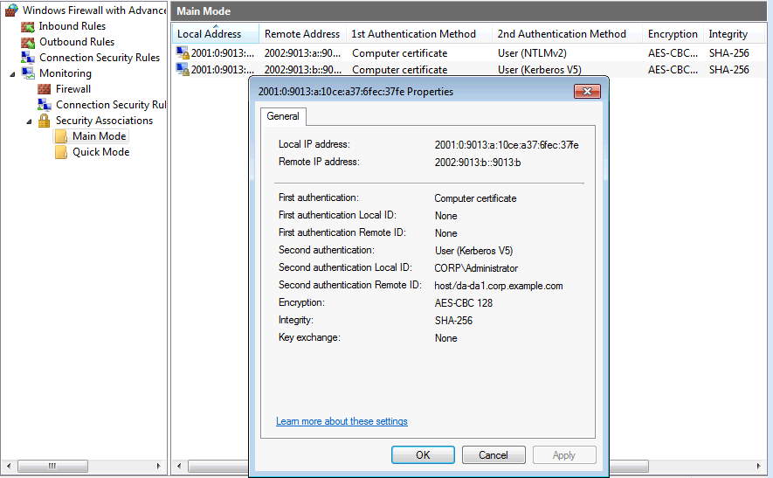
Main Mode Association

Slide 11
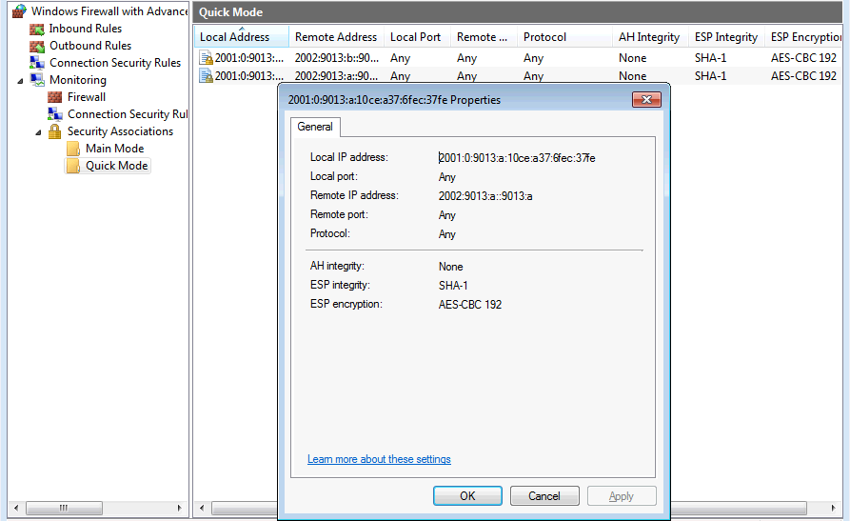
Quick Mode Association

Slide 12
DirectAccess Wizard
GPO
GPO
GPO(s)
For end-point servers
if required
GPO creation
IPsec Rules
NRPT Rules
Configuration for
transition Technologies:
6to4
Teredo
IPHTTPS
GPM
Configuration for
transition Technologies:
6to4
Teredo
IPHTTPS
ISATAP
DNS64
NAT64
UAG Wizard
UAG
Server
IPsec Rules
Identification of certificates
IPHTTPS
Root or intermediate to
validate client certs

Slide 13
Troubleshooting
No SA = No IPsec
ICMPv6 is exempt from IPsec
  Check connectivity using IPv6 ping
Use Netsh to check:
  Transition tunnels
  IPv6 configuration
  IPsec status
  Everything
    NETSH, IT’S YOUR NEW BEST FRIEND

Slide 14
Demo:
EX1
DA1
DC1
DNS
IIS for CRL
distribution
DC, DNS,CA
Internet
Corporate intranet
WIN7
UAG
APP1
Windows 7 client cannot connect to intranet resources

Slide 15
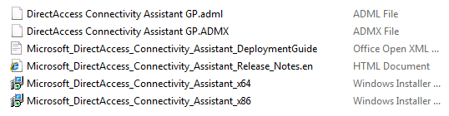
A Helping Hand
DirectAccess Connectivity Assistant
  Download from Microsoft
Install the MSI on the Direct Access client
Copy the .admx file to
  %systemroot%\PolicyDefinitions.
Copy the .adml file to
  %systemroot%\PolicyDefinititions\<language>

Slide 16
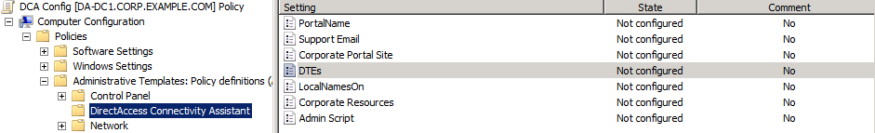
Group Policy for DCA
To get DCA functioning
  Add settings for the Dynamic Tunnel End points
  Identify CorporateResources to test
    PING:da-app1.corp.example.com
    HTTP:http://da-app1.corp.example.com
    FILE:\\da-app1.corm.example.com\data\test.txt

Slide 17
Demo:
EX1
DA1
DC1
DNS
IIS for CRL
distribution
DC, DNS,CA
Internet
Corporate intranet
WIN7
UAG
APP1
Configuring DCA

Slide 18

Certificate requirements
Web server with CRL
X
X
IPv6 Host
X
NAT
Device
UAG
server
IPHTTPS
Host
IPv6
intranet
IPv4 Internet
Tunnel IPv6 in HTTPS
Certificate
URL of CRL distribution point published in certificate

Slide 19
Demo:
EX1
DA1
DC1
DNS
IIS for CRL
distribution
DC, DNS,CA
Internet
Corporate intranet
WIN7
UAG
APP1
Troubleshooting IPHTTPS

Slide 20
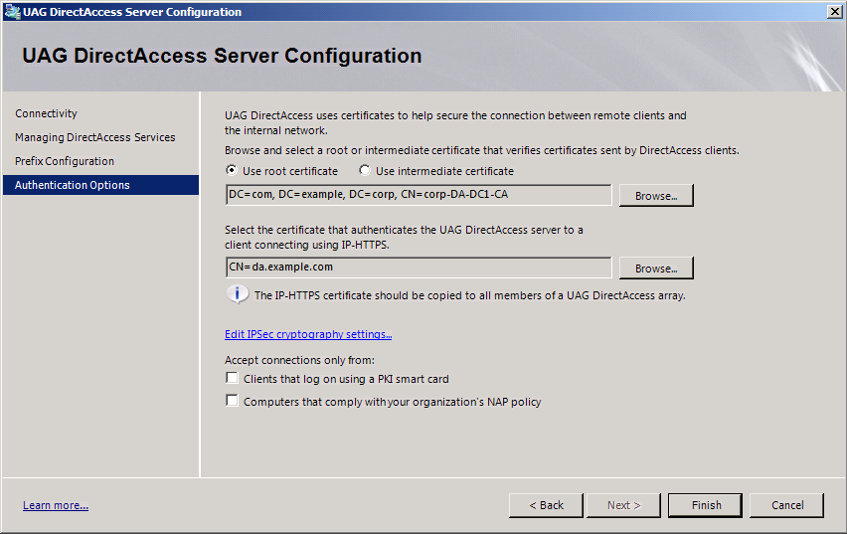
Wizard Step 2
Root certificate of client certificate
HTTPS certificate
The root certificate must be installed on the client

Slide 21
Demo:
EX1
DA1
DC1
DNS
IIS for CRL
distribution
DC, DNS,CA
Internet
Corporate intranet
WIN7
UAG
APP1
Troubleshooting IPHTTPS

Slide 22
Client Location
corp.example.com zone
IP configured
DNS address
DNS 1
DNS 2
Corporate intranet
Internet
To resolve names on the Internet
  DirectAccess host queries DNS 1
To resolve names on the intranet
  DirectAccess host queries DNS 2

Slide 23
How Does It Do that?
Name Resolution Policy Table (NRPT) to the rescue
NRPT allows the definitions of which DNS servers to query based on the namespace to be resolved
  The NRPT can point DNS queries for corp.example.com to the intranet DNS server
  All other DNS queries are sent to the DNS server address configured in the client IP settings

Slide 24
NRPT
corp.example.com zone
IP configured
DNS address
DNS 1
DNS 2
nls.corp.example.com
Internet
Corporate intranet
No NRPT
NRPT:
corp.example.com: query DNS 2
All other name spaces query DNS server configured in client IP settings
There is a special entry in the table to direct DNS queries for an internal HTTPS website to the DNS servers configured in the client IP settings
For example: queries for nls.corp.example.com always go to IP configured DNS address and this is not resolvable on the internet

Slide 25
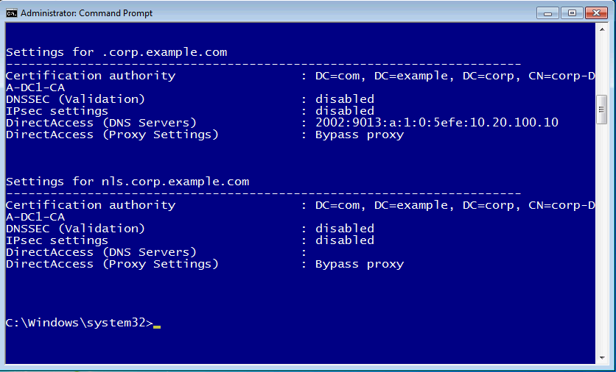
Viewing the NRPT

Slide 26
NRPT Inside/Outside
NRPT enabled by default
If the client can access an internal HTTPS website (https://nls.corp.example.com)
  Considered to be on the intranet
  NRPT disabled
No access to secure website
  Considered to be on the Internet
  NRPT remains enabled

Slide 27
Demo: Troubleshooting DNS
EX1
DC1
DNS
DC, DNS,CA
NAT1
UAG
WIN7
Home
Internet
Corporate intranet
IIS for CRL
distribution
WIN7
APP1
DirectAccess running

Slide 28
Where Next?
EX1
DC1
DNS
DC, DNS,CA
NAT1
DA1
WIN7
Home
Internet
Corporate intranet
IIS for CRL
distribution
WIN7
APP1
WIN7
RT1
Branch
Create a test lab
WIN7

Slide 29
More on IPv6 and DirectAccess
XTSeminars one-day event:
  MICROSOFT WINDOWS SERVER 2008 R2 AND WINDOWS 7 DIRECTACCESS
    All you need to know about IPv6, IPsec, DirectAccess and more…
info@xtseminars.co.uk for more information
Get your local Microsoft subsidiary to run the event!

Slide 30

Consulting Services on Request
John.craddock@xtseminars.co.uk
John has designed and implemented computing systems ranging from high-speed industrial controllers through to distributed IT systems with a focus on security and high-availability. A key player in many IT projects for industry leaders including Microsoft, the UK Government and multi-nationals that require optimized IT systems. Developed technical training courses that have been published worldwide, co-authored a highly successful book on Microsoft Active Directory Internals, presents regularly at major international conferences including, TechEd, IT Forum and European summits. John can be engaged as a consultant or booked for speaking engagements through XTSeminars. www.xtseminars.co.uk

Slide 31

Related Content
Required Slide
Speakers, please list the Breakout Sessions, Interactive Discussions, Labs, Demo Stations and Certification Exam that relate to your session. Also indicate when they can find you staffing in the TLC.
SIM316 | Troubleshoot Microsoft Forefront Unified Access Gateway (UAG) DirectAccess in 45 Minutes Flat!
WSV404 | DirectAccess Implementation and Integration Deep Dive
WSV272-INT | End-to-End Remote Connectivity with DirectAccess
WSV288-HOL | Windows Server 2008 R2: Implementing DirectAccess

Slide 32
Related Content
Required Slide
Speakers, please list the Breakout Sessions, Interactive Discussions, Labs, Demo Stations and Certification Exam that relate to your session. Also indicate when they can find you staffing in the TLC.
SIM316 | Troubleshoot Microsoft Forefront Unified Access Gateway (UAG) DirectAccess in 45 Minutes Flat!
  Speaker(s): Tom Shinder
  Wednesday, May 18 | 1:30 PM - 2:45 PM | Room: B313
Product Demo Stations (demo station title and location)
Related Certification Exam
Find Me Later At…

Slide 33
Track Resources
Don’t forget to visit the Cloud Power area within the TLC (Blue Section) to see product demos and speak with experts about the Server & Cloud Platform solutions that help drive your business forward.
You can also find the latest information about our products at the following links:
Cloud Power - http://www.microsoft.com/cloud/
Private Cloud - http://www.microsoft.com/privatecloud/
Windows Server - http://www.microsoft.com/windowsserver/
Windows Azure - http://www.microsoft.com/windowsazure/
Microsoft System Center - http://www.microsoft.com/systemcenter/
Microsoft Forefront - http://www.microsoft.com/forefront/

Slide 34





Resources
  Connect. Share. Discuss.
http://northamerica.msteched.com
Learning
  Sessions On-Demand & Community
  Microsoft Certification & Training Resources
www.microsoft.com/teched
www.microsoft.com/learning
  Resources for IT Professionals
  Resources for Developers
http://microsoft.com/technet
http://microsoft.com/msdn

Slide 35












Complete an evaluation on CommNet and
enter to win!

Slide 36


