Slide 1
“Tricks-of-the-trade” after a Decade+ of Microsoft Active Directory
WSV401
Jairo Cadena
Program Manager
Microsoft Corporation

Slide 2
Session Objectives and Takeaways
Discover root problem causes more effectively
Design closer to optimal AD topologies
Upgrade AD more reliably and cost effectively
Decode what’s needed when most needed
Approach AD in a more integrated way
Many others that will apply to your situation…

Slide 3
Selected Set of Topics
DC locator
Time service
Deployment
Troubleshooting
Replication
Protocol head surface

Slide 4
DC Locator
Fundamentals of discovery

Slide 5

DC Locator
Used everywhere
AD troubleshooting and management tools
Critical AD processes use it
DC discovery
DC location, site coverage and DC registration
In a domain resides in NetLogon srv (lsass.exe process)
Uses cLDAP (UDP 389) and DNS (UDP/TCP 53)
Exposed in nltest.exe
Location: dsgetdc
Site coverage: dsgetsite, dsgetsitecov, dsaddresstosite
Registration: dsregdns, dsderegdns
Configurable
GP: Computer Config\Admin Templates\System\NetLogon
Registry: HKLM\System\CCS\Services\Netlogon\Parameters

Slide 6
How Does DC Locator Work?
List of registered DCs, please?
ADAC
Hey! ADWS, please?
DNS Server
DC2
DC Locator
DC1 and DC2
Ping!
(cLDAP)
My info
“My info” includes client site
Client improves opinion on site
No match? ERROR_NO_SUCH_DOMAIN
DC1
DC2
ADWS

Slide 7

How Does DC Locator Work?
What is the LDAP Ping?
DNS only provides the starting point
  Lacks data to fully satisfy most DC Locator queries
DC Locator narrows the list
  Contacts each DC using a connectionless, unauthenticated ping over LDAP (UDP/389)
  Limited to 55 DCs
Caller
DNS Server
DC Locator
Ping!
(cLDAP)
My info
Ping!
DC1
DC2

Slide 8
What Capabilities Can Be Located?
Can
Can’t
DNS registered services
  GC
  PDC
Provided by the DC through the LDAP ping
  TimeServ
  GTimeServ
  ADWS
Other FSMO roles
Optional features
Specific features provided
by functional levels
  KDC
  Sites
  DS
  DS_6
  WRITABLE

Slide 9
Deconstructing an nltest /dsgetdc output
C:\>nltest /dsgetdc:
DC: \\PDC-01.corp.contoso.com
Address: \\172.31.79.145
Dom Guid: ca21b03b-6dd3-11d1-8a7d-b8dfb156871f
Dom Name: corp.contoso.com
Forest Name: corp.contoso.com
Dc Site Name: PDC-Site
Our Site Name: Client-Site
Flags: GC DS LDAP KDC TIMESERV WRITABLE DNS_DC DNS_DOMAIN DNS_FOREST FULL_SECRET WS
The command completed successfully
C:\>nltest /dsgetdc:contoso.nonexisting
Getting DC name failed: Status = 1355 0x54b ERROR_NO_SUCH_DOMAIN
C:\>
Our Site Name: Client-Site
WS
ERROR_NO_SUCH_DOMAIN

Slide 10
DC Locator
Auto site coverage and WS03 and RODC interop

Slide 11


AutoSiteCoverage
Enabled through policy or registry
  AutoSiteCoverage (DWORD: 0 or 1)
DC-10
WS03
DC-11
WS08
RODC-01
WS08
Client

Slide 12
With AutoSiteCoverage
AutoSiteCoverage = 1 or default
Site DC request on Client gets WS03
  WS03 doesn’t know about RODCs by default
  Assumes no DC covers client site
DC-10
WS03
DC-10
WS03
DC-11
WS08
RODC-01
WS08
Client

Slide 13
Without AutoSiteCoverage
AutoSiteCoverage = 0
Site DC request on Client gets RODC
DC-10
WS03
DC-11
WS08
RODC-01
WS08
RODC-01
WS08
Client

Slide 14
DC Locator
TryNextClosestSite and RODC site filtering

Slide 15
TryNextClosestSite
DC-01
DC-10
DC-11
DC-02
Enabled through flag, policy or registry
  nltest /dsgetdc: /try_next_closest_site
  TryNextClosestSite (DWORD: 0 or 1)
Not enabled by default
RODC-01
Client

Slide 16
Without TryNextClosestSite
DC-01
DC-10
DC-11
DC-02
RODC-01
Client
TryNextClosestSite = 0 or not set

Slide 17
With TryNextClosestSite
DC-01
DC-10
DC-11
DC-02
RODC-01
Client
TryNextClosestSite = 1

Slide 18
NextClosestSiteFilter
Enabled through policy or registry
  NextClosestSiteFilter (DWORD: 0, 1, 2)
Not enabled by default = 2
RODC-02
DC-03
125
DC-01
150
DC-02
Client
100
RODC-01

Slide 19
NextClosestSiteFilter = 2
NextClosestSiteFilter = 2 or not set
RODC sites are filtered out
RODC-02
DC-03
125
DC-01
150
DC-02
Client
100
RODC-01

Slide 20
NextClosestSiteFilter = 1
NextClosestSiteFilter = 1
RODC sites with no writable
DCs are filtered out
RODC-02
DC-03
125
DC-01
150
DC-02
Client
100
RODC-01

Slide 21
NextClosestSiteFilter = 0
NextClosestSiteFilter = 0
RODC sites are NOT filtered out
RODC-02
DC-03
125
DC-01
150
DC-02
Client
100
RODC-01

Slide 22
Windows Time Service
Time “discipline”

Slide 23
Time Service
Critical to AD
AD and system components have time dependencies
Problems in time sync’?
  Authentication issues, replication issues, lingering objects…
Time sync’
Algorithm to keep time synchronized: “domain hierarchy”
Implemented as a service: W32Time (own process)
Uses NTP (UDP 123)
Accuracy
Accuracy is an artifact of synchronization
High accuracy is *not* a goal of Time Service
Extensible model: time providers plug-in framework
Configurable
GP: Computer Config\Admin Templates\System\W32Time
Registry: HKLM\System\CCS\Services\W32Time\Config

Slide 24
A Tale of Two Clocks…
Hardware-based
Soft
The one from the BIOS
It is a timer
  Produces a ‘tick’ at a regular interval
It is a chunk of memory
  Used to store the current ‘tick count’
Samples hardware-based clock upon boot
Maintained by the Windows OS kernel
Time is set to hardware
clock upon shutdown
Samples hardware-based clock upon boot
Maintained by the Windows OS kernel
Time is set to hardware
clock upon shutdown
Samples hardware-based clock upon boot
Maintained by the Windows OS kernel
Time is set to hardware
clock upon shutdown
Q: What does W32Time do with the soft clock?
A: It disciplines it!

Slide 25

A Tale of Two Clocks…
Timestamp, please?
Slow down!
Time Service (Client)
Time Service (DC)
20:52!
20:55
20:53
20:54
20:54
20:52
20:55
20:54

Slide 26
What’s with the Soft Clock Discipline?
W32Time modifies soft clock frequency if time difference
Is the difference “large”?
  W32Time sets the time to the sample
  “large” is defined by MaxAllowedPhaseOffset
Is the difference “too large”?
  W32Time ignores the sample
  Used to protect system from large time jumps
  “too large” is defined by MaxPosPhaseCorrection and MaxNegPhaseCorrection
  Since Windows 2008 the default values are +/- 48 hours

Slide 27
Windows Time Service
Time synchronization and RODCs

Slide 28
How Time Synchronization Authenticates?
SAM
NT4 password hash?
NT4 password hash for RID?
Directory
Time Service (Client)
This is my RID
Time Service (DC)
0FADE89…
0FADE89…
#$$FSA$%^
#$$FSA$%^
→ 20:55
20:55

Slide 29
What Does This Have to Do with RODCs?
RODCs don’t store passwords by default
  Still a time server but request is chained to a writable DC
  Open UDP 123 if there is a firewall in between!
Client machine password cached locally?
  RODC acts as a time server as any other DC
RODC as time client
  Sync from any writable DC in domain or parent domain

Slide 30
Windows Time Service
Time synchronization on a virtual DC

Slide 31
Time Service on a Virtual DC
Let Time Service algorithm do its thing!
So, disable Integration Services completely?
  NO… and again, no! ☺
  Needed during boot or VM operations such as Resume
Disable the VMIC time-sync’ provider in the guest
  Key: HKLM\System\CurrentControlSet\Services\ W32Time\TimeProviders\VMICTimeProvider
  Value: Enabled set to 0 (zero) (REG_DWORD)

Slide 32
Windows Time Service
Service start up type

Slide 33
W32Time, On, Off, Auto Start, Demand Start?
To run or not to run…
  On domain controllers and domain joined machines it runs always
  On non-domain joined machines it is off by default
    Task runs every week to start service
    When started, service syncs’ time and then shuts itself down
Start type?
  It is set to DEMAND_START, so don’t worry…it is by design
    Includes “most” domain controllers, domain joined machines and
    non-domain joined machines
    A trigger starts service upon boot
  One exemption
    The first domain controller in the forest it is set to AUTO_START

Slide 34
Deployment
Upgrading Active Directory

Slide 35
Upgrading Active Directory
DC-01.Contoso.com
Forest Schema
DC-03.Corp.Contoso.com
Domain Infrastructure
DC-02.Contoso.com
Domain Infrastructure
DC-04.Corp.Contoso.com
New up-level machine

Slide 36
Upgrading Active Directory – ForestPrep
1
DC-01.Contoso.com
Forest Schema
DC-03.Corp.Contoso.com
Domain Infrastructure
DC-02.Contoso.com
Domain Infrastructure
1
Forest and schema preparation
  ADPrep.exe /ForestPrep (from media)
  Run on forest Schema Master
  Enterprise + Schema admin credentials
DC-04.Corp.Contoso.com
New up-level machine

Slide 37
Upgrading Active Directory – DomainPrep
Replication
2
2
DC-01.Contoso.com
Forest Schema
DC-03.Corp.Contoso.com
Domain Infrastructure
DC-02.Contoso.com
Domain Infrastructure
2
Domain preparation
  Requires updated schema (prerequisite)
  ADPrep.exe /DomainPrep (from media)
  Run on domain Infrastructure Master
  Domain admin credentials
DC-04.Corp.Contoso.com
New up-level machine

Slide 38
Upgrading Active Directory – RODCPrep
Partition ACL’ing
3
DC-01.Contoso.com
Forest Schema
DC-03.Corp.Contoso.com
Domain Infrastructure
Partitions ACL’ing
DC-02.Contoso.com
Domain Infrastructure
3
NC preparation for RODCs
  ADPrep.exe /RODCPrep (from media)
  Run from any DC (once in a lifetime)
  Contacts domain NC and NDNCs Infrastructure Master
  Enterprise admin credentials
DC-04.Corp.Contoso.com
New up-level machine

Slide 39
Upgrading Active Directory – GPPrep
Replication
4
4
DC-01.Contoso.com
Forest Schema
DC-03.Corp.Contoso.com
Domain Infrastructure
DC-02.Contoso.com
Domain Infrastructure
4
Domain group policy preparation
  Requires updated schema (for DomainPrep)
  ADPrep.exe /DomainPrep /GPPrep (from media)
  Run on domain Infrastructure Master (once in a lifetime)
  Domain admin credentials (+ GPO write rights)
DC-04.Corp.Contoso.com
New up-level machine

Slide 40
Upgrading Active Directory – DCPromo
DC-01.Contoso.com
Forest Schema
DC-03.Corp.Contoso.com
Domain Infrastructure
DC-02.Contoso.com
Domain Infrastructure
5
5
Domain controller promotion
  DCPromo.exe on machine being promoted
  Domain or delegated admin credentials
  Helper DC needs SM and domain IM changes
  An alternative is to do in-place upgrade in existing DCs
DC-04.Corp.Contoso.com
New up-level machine

Slide 41
Troubleshooting Miscellanea
Directory Services Restore Mode administrator

Slide 42
DSRM Admin Password Synchronization
C:\Windows\system32\ntdsutil.exe: set dsrm password
Reset DSRM Administrator Password: ?
? - Show this help information
Help - Show this help information
Quit - Return to the prior menu
Reset Password on server %s - Reset directory service re...
Sync from domain account %s - Perform one-time password ...
Note: You cannot use ntdsutil to reset or synchronize this ...
Reset DSRM Administrator Password:
Sync from domain account %s
sync from dom acc CONTOS...

Slide 43
Troubleshooting miscellanea
Network authentication

Slide 44
Network Authentication
Authentication type | Thread context | Credential | Authenticated as
Kerberos | LocalSystem | NULL | Machine account
 |  | $MachineName | Machine account
 | LocalService | NULL | Anonymous
 |  | $MachineName | Anonymous
 | NetworkService | NULL | Machine account
 |  | $MachineName | Machine account
NTLM | LocalSystem | NULL | Anonymous
 |  | $MachineName | Machine account
 | LocalService | NULL | Anonymous
 |  | $MachineName | Anonymous
 | NetworkService | NULL | Machine account
 |  | $MachineName | Machine account
Machine account
Anonymous

Slide 45
Troubleshooting miscellanea
ETW Tracing

Slide 46
ETW Tracing
To enable tracing
To see what available tracing providers
netsh trace start provider=[ProviderName | ProviderGUID]
netsh trace show providers

Slide 47
Tracing
Active Directory
Kerberos
NTLM
LDAP Client
Security: Kerberos Authentication
Active Directory: Kerberos Client
Security: NTLM Authentication
Microsoft-Windows-NTLM
Microsoft-Windows-LDAP-Client
ADSI
SAM
Microsoft-Windows-ADSI
Active Directory Domain Services: SAM
Microsoft-Windows-Directory-Services-SAM
Time Service
LSA
Microsoft-Windows-Time-Service
Networking
LsaSrv
Local Security Authority (LSA)
NetLogon
Microsoft-Windows-TCPIP
DC Locator
DNS Client
Active Directory: NetLogon
Microsoft-Windows-Security-NetLogon
Microsoft-Windows-DCLocator
Microsoft-Windows-DNS-Client

Slide 48
A Couple of Tracing Scenarios Examples
User reports not being able to connect to ADSI application
Connection failures
See ADSI traces
DC Locator issues
See LDAP client traces
See DC Locator traces
Binding as anonymous
Not able to reach live DCs
See Kerberos/NTLM traces
See DNS client traces
NTLM auth due to lack of
3-part SPN
DNS gateway is not set

Slide 49
Troubleshooting miscellanea
Windows file time interpretation

Slide 50
Windows File Time
A count of 100ns intervals since January 1st, 1601
  Used by time-related attributes in AD e.g. lastLogon
  Allows time to be effectively queried
To decode
  w32tm.exe /ntte
  nltest /time

Slide 51
Windows File Time
PS C:\Users\JairoC>
Get-ADUser JairoC -Properties lastLogon
DistinguishedName : CN=Jairo Cadena,CN=Users,DC=Contoso,DC=com
Enabled : True
GivenName : Jairo
lastLogon : 129491260758440342
Name : Jairo Cadena
ObjectClass : user
ObjectGUID : 21b08867-d024-403d-8848-1e0374f21824
SamAccountName : jairoc
SID : S-1-5-21-397955417-626881126-188441444-3405689
Surname : Cadena
UserPrincipalName : jairoc@contoso.com
129491260758440342
PS C:\Users\JairoC>
w32tm.exe /ntte 129491260758440342
149874 03:27:55.8440342 - 5/5/2011 8:27:55 PM
PS C:\Users\JairoC>
"{0:X}" -f 129491260758440342
1CC0B9D97063996
1CC0B9D97063996
PS C:\Users\JairoC>
nltest /time:97063996 1CC0B9D
97063996 01cc0b9d = 5/5/2011 20:27:55
The command completed successfully

Slide 52
Replication
Connection objects ownership

Slide 53
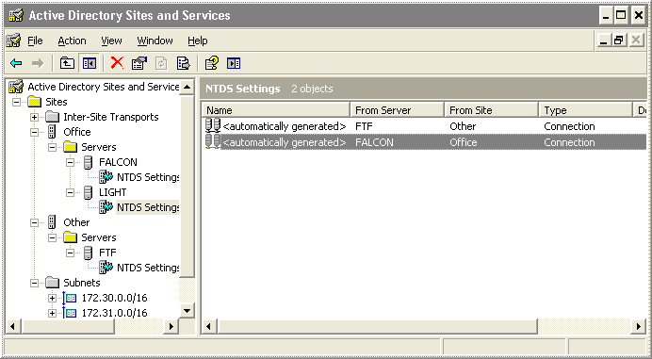
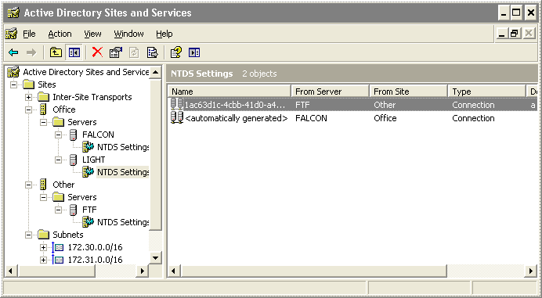
Connection Object Ownership
Managed by KCC
Non KCC-managed
  Schedule will not
  follow site-links
  New application
  partitions missing
  Connection remains
  even when no
  longer needed

Slide 54
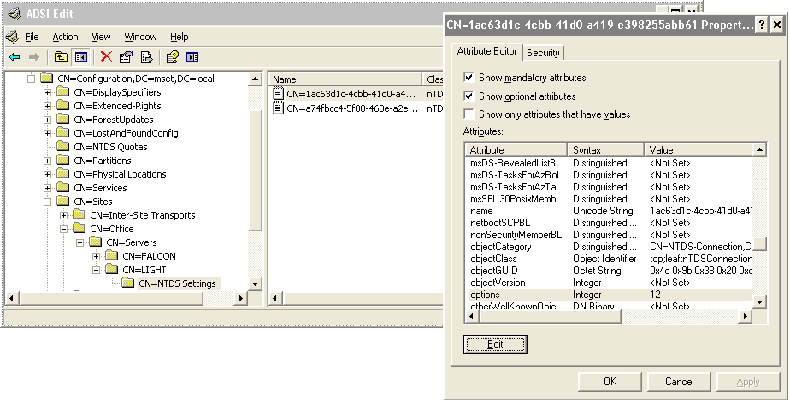
Connection Object Non-managed by KCC
What does ‘12’ mean in options attribute?

Slide 55
Connection Object Options Attribute Details
Bit order | Decimal value | Meaning
0 | 1 | Owned (managed by) by the KCC
1 | 2 | Reciprocal replication
2 | 4 | Override notify defaults (typically indicates compression)
3 | 8 | Change notification
4 | 16 | Disable compression
5 | 32 | User-defined schedule
6 | 64 | RODC topology
4
8

Slide 56
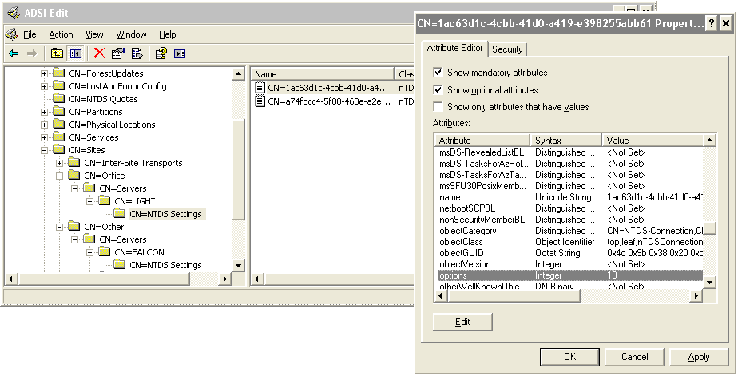
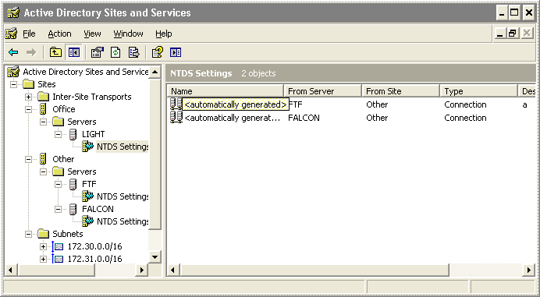
Restore Connection Object Ownership to KCC
Bring bit ‘0’ back into play i.e. make it an odd number

Slide 57
Protocol Head-surface Area of AD
Protocol and ports considerations

Slide 58
Big-picture Protocol Surface
Domain joined member to DC
Some considerations
  LDAP variations
    AD DS SSL: TCP 636
    AD DS GC: TCP 3268
    AD DS GC SSL: TCP 3269
  PowerShell or Active Directory Administrative Center (ADAC) ADWS port TCP 9389
  AD LDS: LDAP just about any high port
  Password change: UDP and TCP 464
Transport | TCP |  |  |  |  |  |  |  |  |  | UDP
Application | Kerb. | LDAP | SMB |  |  | RPC |  |  | SMB |  | C-LDAP | DNS | NbtNs
Port | 88 | 389 | 445 |  |  | 135 | Static (0xE000) |  | 445 |  | 389 | 53 | 137
Interface | - | - | LsaRpc | NetLogonR | SamR | EPM | DRSUAPI | NetLogonR | - | DFS | - | - | -
Computer join | x | x | x | x | x | x | x | x | x |  | x | x | x
DC Locator |  |  |  |  |  |  |  |  |  |  | x | x
Logon after join | x | x |  |  |  | x | x | x | x | x | x | x

Slide 59
Big-picture Protocol Surface
DC (e.g. RODC) to DC (e.g. perimeter network)
Transport | TCP |  |  |  |  |  |  |  |  |  |  |  |  |  | UDP
Application | DNS | EPM | Kerb | LDAP | RPC |  |  |  |  |  |  | SMB |  |  | C-LDAP | DNS | NTP
Port | 53 | 135 | 88 | 389 | 135 | Static | Static (0xE000) |  |  |  |  | 445 |  |  | 389 | 53 | 123
Interface | - | - | - | - | EPM | FrsRpc | DRSUAPI | NetLogonR | DRSUAPI | LsaRpc | NetLogonR | - | DFS | NbtSS | - | - | -
AD Replication |  |  | x |  | x |  | x |  |  |  |  | x |  |  |  | x
Authentication |  |  | x |  | x
GPO refresh at RODC |  |  |  |  |  |  |  |  |  |  |  |  |  |  |  | x
Time syncronization |  |  |  |  |  |  |  |  |  |  |  |  |  |  |  |  | x
Reboot after Join | x |  | x | x | x |  |  |  | x | x | x |  | x | x | x | x | x
File Replication (NTFRS) |  |  |  |  | x | x
If using DFSR instead of FRS TCP port 5722 is required

Slide 60
Replication through Static RPC Port
Dynamic RPC port range
  Since Vista/WS08: from 1024 (TCP)/49152 (UDP) to 65535
  WS03 and before: 1025 to 5000
How to configure static RPC ports for replication?
  AD replication
    HKLM\System\CCS\Services\NTDS\Parameters
      REG_DWORD: TCP/IP Port
  FRS replication
    HKLM\System\CurrentControlSet\Services\NTFRS\Parameters
      REG_DWORD: RPC TCP/IP Port Assignment
  DFSR replication
    dfsrdiag StaticRPC /port:<port-number> /member:<DC-name>

Slide 61
Questions?
discussion

Slide 62
Related Content
Required Slide
Speakers, please list the Breakout Sessions, Interactive Discussions, Labs, Demo Stations and Certification Exam that relate to your session. Also indicate when they can find you staffing in the TLC.
Breakout Sessions
  SIM 406 | Impact of Cloning and Virtualization on AD Domain Services
Interactive Sessions
  SIM 376-INT | Meet the Active Directory (Identity and Access) Product Group
  BOF17-ITP | Active Directory Change Auditing: Pains and Solutions
Related Certification Exam
  Microsoft Certified IT Professional (MCITP)
  Microsoft Certified Technology Specialist (MCTS)
Find Me Later At…
  SIM 39 - Directory Services, Wednesday at 3:00pm and Thursday at 12:30pm

Slide 63
Track Resources
Don’t forget to visit the Cloud Power area within the TLC (Blue Section) to see product demos and speak with experts about the Server & Cloud Platform solutions that help drive your business forward.
You can also find the latest information about our products at the following links:
Cloud Power - http://www.microsoft.com/cloud/
Private Cloud - http://www.microsoft.com/privatecloud/
Windows Server - http://www.microsoft.com/windowsserver/
Windows Azure - http://www.microsoft.com/windowsazure/
Microsoft System Center - http://www.microsoft.com/systemcenter/
Microsoft Forefront - http://www.microsoft.com/forefront/

Slide 64





Resources
  Connect. Share. Discuss.
http://northamerica.msteched.com
Learning
  Sessions On-Demand & Community
  Microsoft Certification & Training Resources
www.microsoft.com/teched
www.microsoft.com/learning
  Resources for IT Professionals
  Resources for Developers
http://microsoft.com/technet
http://microsoft.com/msdn

Slide 65












Complete an evaluation on CommNet and
enter to win!

Slide 66


Slide 67

© 2011 Microsoft Corporation. All rights reserved. Microsoft, Windows, Windows Vista and other product names are or may be registered trademarks and/or trademarks in the U.S. and/or other countries.
The information herein is for informational purposes only and represents the current view of Microsoft Corporation as of the date of this presentation. Because Microsoft must respond to changing market conditions, it should not be interpreted to be a commitment
on the part of Microsoft, and Microsoft cannot guarantee the accuracy of any information provided after the date of this presentation. MICROSOFT MAKES NO WARRANTIES, EXPRESS, IMPLIED OR STATUTORY, AS TO THE INFORMATION IN THIS PRESENTATION.

Slide 68
Appendix
Additional topics to refer when you return to work ☺

Slide 69
Evolution of Active Directory

Slide 70
Active Directory across a decade
Functional level (AD version) OS Version
0/1 Windows 2000
2 Windows 2003
3 Windows Server 2008
4 Windows Server 2008 R2

Slide 71
Windows 2000
Microsoft’s first standards-based directory-service offering
  vs. the more proprietary Windows NT products that preceded it
    Kerberos
    TCP/IP
    DNS
    LDAP
    X.500 (ish)
More much flexible Policy distribution engine based on scoping data from the directory (OUs, Sites, etc.)
Extensive backward compatibility with Windows NT domains

Slide 72
Windows 2003
First to introduce notion of functional levels
  step up from domain-modes
Install from Media (DCpromo’s IFM)
Cross-forest trusts
Linked-value replication
Schema re-use

Slide 73
Windows Server 2008
Fine Grain Password Policy
Read Only Domain Controllers
Active Directory as a service
Snapshot browser
DFSR
Server Core
IPv6

Slide 74
Windows Server 2008 R2
Recycle Bin
Active Directory Web Services
Active Directory PowerShell
Active Directory Administrative Center
Active Directory Best Practices Analyzer
Authentication Mechanism Assurance
Offline Domain Join

Slide 75
DC Locator

Slide 76
DC Locator
Used everywhere
  almost every directory tool for managing or troubleshooting the directory
    dsa.msc, domain.msc, ldp.exe, ntdsutil.exe, nltest.exe, etc.
  critical AD processes use it
    replication, authentication, logon, time synchronization, etc.

Slide 77
What is DC Locator?
A mechanism that locates DCs
  influenced by rules and hints provided by specific criteria
  runs inside NetLogon for domain-joined machines and DCs
    for non-domain-joined, it is called in-process by the application
That’s not the whole story, though
  functionality that supports entire DC registration & discovery process
  exposed through nltest.exe via the following commands
    dsgetdc, dsgetsite, dsgetsitecov, dsaddresstosite, dsregdns, dsderegdns
  Settings configurable through policy or registry
    GP: Computer Configuration\Administrative Templates\System\NetLogon
    registry: HKLM\System\CurrentControlSet\Services\Netlogon\Parameters

Slide 78
What is DC Locator? (continued)
Examples of DC Locator APIs you may be familiar with
  DsGetDcName
  DsGetDcNameWithAccount
  DsGetSiteName
  DsAddressToSiteNames/Ex
  DsValidateSubnetName
  DsGetDcOpen/Next/Close
  DsGetDcSiteCoverage
  DsDeregisterDnsHostRecords

Slide 79
How does DC Locator work?
Caller asks DC Locator “give me a DC that meets this criteria…”
DC Locator on client bootstraps the process against DNS
  gets list of DCs that meet certain criteria known to DNS
  sorts based on priority and then weight for load balancing
For each DC returned
  (client) DC Locator sends LDAP-ping
  (server) pinged DC defers control to DC Locator component and returns
  (client) receives DC information (IP address, site, capabilities) and client site
Client improves opinion of its site if different from DC’s opinion
  go to step #2 and repeat site-specific query if different
Iterates through list until criteria is matched and returns to caller
  if match is not found, returns ERROR_NO_SUCH_DOMAIN

Slide 80
What is the LDAP ping?
DNS only provides the starting point
  Lacks data to fully satisfy most DC Locator queries
DC Locator narrows the list
  Contacts each DC using a connectionless, unauthenticated ping over LDAP (UDP/389)
  Limited to 55 DCs… is this a cause for concern?

Slide 81
What’s with the LDAP ping limit?
There is a limit on the number of DCs that are pinged
  Magic number = 55 ☺ Seriously…
  It sets an approximate time-out cap of 15 seconds
    For the first 5 DCs the wait time is 0.4 seconds per ping
    For the next 5 DCs the wait time is 0.2 seconds per ping
    For the rest of 45 DCs the wait time is 0.1 seconds per ping
    Per IP address

Slide 82
What capabilities can be located?
DNS registered services
  GC, PDC, KDC, Sites
Provided by the DC through the LDAP ping
  TimeServ, GTimeServ, ADWS, DS, DS_6, WRITABLE
Not discoverable through DC Locator
  FSMO roles (except PDC as noted above)
  optional features
  specific features provided by functional levels

Slide 83
Deconstructing an nltest /dsgetdc output
C:\>nltest /dsgetdc:
DC: \\PDC-01.corp.contoso.com
Address: \\172.31.79.145
Dom Guid: ca21b03b-6dd3-11d1-8a7d-b8dfb156871f
Dom Name: corp.contoso.com
Forest Name: corp.contoso.com
Dc Site Name: PDC-Site
Our Site Name: Client-Site
Flags: GC DS LDAP KDC TIMESERV WRITABLE DNS_DC DNS_DOMAIN DNS_FOREST FULL_SECRET WS
The command completed successfully
C:\>nltest /dsgetdc:contoso.nonexisting
Getting DC name failed: Status = 1355 0x54b ERROR_NO_SUCH_DOMAIN
C:\>

Slide 84
What Else Does DC Locator Provide?
DC location
DC advertisement
Caching
DC Locator
NetBIOS discovery
Site coverage

Slide 85
What else does DC Locator provide?
DC advertisement
  DNS SRV records registration
    DnsRefreshInterval
  NetBIOS domain name 1C and 1B records for PDC in WINS
Caching
  In NetLogon (lsass.exe) global to all clients of the machine
  RefreshInterval to maintain cache up to date
  ForceRediscoveryInterval to avoid stickiness
NetBIOS discovery
  List of DCs obtained from WINS Server
  Ping sent to DC’s known mailslot “\mailslot\net\netlogon”
Site awareness and coverage

Slide 86
Try next closest site
If enabled
  DC Locator tries to find a DC in the client’s site
  if none found, tries next closest site (based on site links cost)
  if none found, tries any DC (non-site specific)
Not on by default, enabled through flag, policy or registry
  nltest /dsgetdc: /try_next_closest_site
  TryNextClosestSite (DWORD, values 0 or 1)

Slide 87
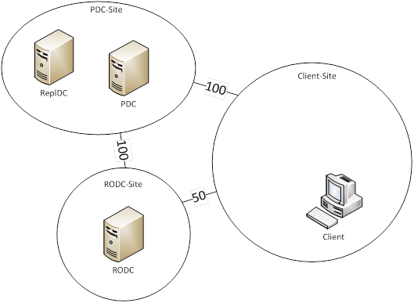
Next closest site filtering based on RODC
Server side setting (set by registry key or policy)
  NextClosestSiteFilter (DWORD, values 2, 1 and 0)
RODC sites are not considered by default
  Setting set to 2 or not set
  No RODC are returned
RODC sites are considered if contain at least one RWDC
  Setting set to 1
  RODC can be returned
RODC sites are considered
  Setting set to 0 (no filter applied)

Slide 88
Windows Time Service

Slide 89
Time synchronization
Time is critical for Active Directory to function
Problems in time synchronization can lead to
  authentication problems
  lingering objects
AD components have time dependencies
  e.g. Kerberos requires no more than a 5-minute discrepancy between trusted parties
    configurable through policy
    authentication depends on Kerberos (RFC 4120)

Slide 90
Windows Time service
Implemented as a service: W32Time
  extensible model time providers plug-in framework
  HKLM\System\CurrentControlSet\Services\W32Time\Config
Keeps your computer clock synchronized
  accuracy is an artifact of synchronization
  high accuracy is not a goal of Time Service
Many components in AD have time dependencies
  e.g. Kerberos requires no more than a 5-minute discrepancy between trusted parties
    Configurable through policy
    Authentication depends on Kerberos (RFC 4120)
Supports SNTP, NTP (RFC 1305)
UDP port 123

Slide 91
A tale of two clocks…
Hardware-based clock
  the one from the BIOS
  a timer, that produces a ‘tick’ at a regular interval
  a chunk of memory, used to store the current ‘tick count’
Soft clock
  Sample of hardware-based clock upon boot
  Maintained by the kernel of the OS
  Time is held in the hardware clock when machine is off

Slide 92
What does W32Time do with the soft clock?
How does soft clock work?
  The kernel grabs the time from the hardware clock upon startup
  W32Time service “disciplines” the clock when machine is running
  Time is held in the hardware clock when machine is off

Slide 93
How does Windows Time service work?
Client-server model
  Client makes a request for a timestamp at time t1
  Server (time source) receives the request at time t2
  Server sends back a response at time t3
  Client receives the response at time t4
Clock offset
  ((t2 - t1) + (t3 - t4)) / 2
Skewing and setting
  Too small: adjust the time gradually
  Too large: simply set the time
  The concept of "too large" or "too small" is relative, defined by the registry key: MaxAllowedPhaseOffset
  Protect from large time jumps: MaxPosPhaseCorrection and MaxNegPhaseCorrection

Slide 94
Time source selection
NTP
  Used on computers that are not joined to a domain
  Tries to sync with the peer specified
  If it can’t, it waits until it can
NT5DS
  Used on computers in a domain
  Complex algorithm to find a peer (Domain Hierarchy)
  W32Time service is responsible for distributing the time throughout the domain

Slide 95
Score to select a time source (NT5DS)
Select the best peer with the highest score
  8 points if the machine is in-site
  4 points if the machine is set as ‘reliable’
  2 points if the machine is in the parent domain
  1 point if the machine is a PDC
Two special cases
  The Root PDC
    Use Local CMOS Clock by default
    Can manually set it in NTP mode
  DC configured as Reliable (Good Time Server)
    W32tm /config /reliable:YES
    All DCs in the same site will sync time from it, be careful when using it!
    Discoverable through DC Locator (GTimeServ flag)

Slide 96
Time synchronization and RODCs
There are special considerations when dealing with RODCs
  branch office scenarios
Time Service protocol uses NT hash to encrypt time-sample returned to client
  client sends the RID of the machine account
  server (DC) needs the password of the account to compute response
  This impacts RODCs…

Slide 97
So then what’s the story for RODCs?
RODC as time client
  Sync from any writable DC in domain or parent domain
RODC as time server
  machine password cached locally?
    act as any other DC
  otherwise chaining to a writable DC occurs
    if across a firewall, UDP 123 between RODC and writable DC is required

Slide 98
Key settings and administration commands
Key settings
  HKLM\SYSTEM\CurrentControlSet\Services\W32Time
    \Parameters\Type
    \Parameters\NtpServer
Common administration commands (W32tm.exe)
  w32tm /resync [/rediscover]
  w32tm /query /source
  w32tm /debug /enable /file:C:\windows\temp\w32time.log /size:10000000 /entries:0-300

Slide 99
Time Service on a virtual DC
If you have followed our existing guidance…
  we’ve changed our minds ☺
  documentation changes are on the way
Time Service has a well-defined algorithm for time synchronization on a domain (Domain Hierarchy)
  let it do its thing
So, disable Integration Services completely?
  NO… and again, no! ☺
  time host synchronization is still needed, e.g.
    W32Time is not using Domain Hierarchy
    during boot or other VM operations such as Resume
Disable the VMIC time-sync provider in the guest
  HKLM\SYSTEM\CCS\Services\W32Time\TimeProviders\
    DWORD: VMICTimeProvider:0 ← that’s a zero

Slide 100
W32Time, on, off, auto start, demand start?
To run or not to run…
  On domain controllers and domain joined machines it runs always
  On non-domain joined machines it is off by default
    Task runs every week to start service
    When started, service syncs’ time and then shuts itself down
Start type?
  It is set to DEMAND_START, so don’t worry it is by design
    Includes “most” domain controllers, domain joined machines and non-domain joined machines
    A trigger starts service upon boot
  One exemption
    On the first domain controller in the forest it is set to AUTO_START

Slide 101
Troubleshooting miscellanea

Slide 102
DSRM admin logon options
HKLM\System\CurrentControlSet\Control\Lsa
  DSRMAdminLogonBehavior (REG_DWORD)
Values
  0: cannot log on unless in DSRM
  1: can log on if NTDS service is stopped
  2: can log on at any time

Slide 103
Windows file time
A count of 100ns intervals since January 1st, 1601
  Used by time-related attributes in AD
    e.g. lastLogon
  Allows time to be effectively queried
To decode w32tm.exe /ntte or nltest /time
  w32tm.exe /ntte 129491260758440342
  nltest /time:97063996 1CC0B9D
    Hex representation of windows file time - LSL comes first and then MSL
    HEX(129491260758440342) = 1CC0B9D97063996

Slide 104
DCDiag
Undocumented switch
  /d = debug
  spews a bunch of semi (at best) formatted output
  useful for collecting forest structure
  debugging information
    represents an internal view of your forest
    subject to change at any time
e.g. dcdiag /d

Slide 105
Protocol head-surface area of AD

Slide 106
Protocol-head surface of AD
Needed to control AD traffic e.g. across network segments
  Firewalls, IPSec rules
Possible scenarios
  Machine domain-join process
  DC replication
  User-logon
  RODC in branch office to DC in hub

Slide 107
What is AD protocol-head surface area?
Aggregate communication requirements of components that comprise Active Directory
  Their semantics and requirements dictate protocol choices
  e.g. we wanted to provide standards-based authentication in AD
    We selected Kerberos and for interoperability, Kerberos must present a standards-compliant protocol-surface (e.g. TCP 88, TCP 464)
… let’s review the specifics of one example

Slide 108
Domain-joined machine during boot
Machine
1. DHCP server discovery
DHCP broadcast
Ethernet
00-12-3F-5B-9E-3D
ARP / RARP / DHCP
Network

Slide 109
Domain-joined machine during boot
Machine
1. DHCP server discovery
DHCP broadcast
2. Request of IP information (host, DNS, gateway, …)
DHCP (UDP 67/68)
TCP/IP
DNS server: 10.10.0.1
Address: 10.10.0.21
Ethernet
00-12-3F-5B-9E-3D
DHCP
DHCP Server

Slide 110
Domain-joined machine during boot
Machine
1. DHCP server discovery
DHCP broadcast
2. Request of IP information (host, DNS, gateway, …)
DHCP (UDP 67/68)
3. DC lookup: IP addresses for domain Contoso.com
DNS (UDP/TCP 53)
Netlogon
(DC Locator)
DCs: 10.10.0.1, 10.10.10.2, 10.20.1.3
TCP/IP
DNS server: 10.10.0.1
Address: 10.10.0.21
Ethernet
00-12-3F-5B-9E-3D
DNS lookup
DNS Server

Slide 111
Domain-joined machine during boot
Machine
1. DHCP server discovery
DHCP broadcast
2. Request of IP information (host, DNS, gateway, …)
DHCP (UDP 67/68)
3. DC lookup: IP addresses for domain Contoso.com
DNS (UDP/TCP 53)
4. DC Locator pings the DCs and one is chosen
LDAP (UDP 389)
Netlogon
(DC Locator)
DCs: 10.10.0.1, 10.10.10.2, 10.20.1.3
TCP/IP
DNS server: 10.10.0.1
Address: 10.10.0.21
Ethernet
00-12-3F-5B-9E-3D
c-LDAP
Directory

Slide 112
Domain-joined machine during boot
Machine
1. DHCP server discovery
DHCP broadcast
2. Request of IP information (host, DNS, gateway, …)
DHCP (UDP 67/68)
3. DC lookup: IP addresses for domain Contoso.com
DNS (UDP/TCP 53)
4. DC Locator pings the DCs and one is chosen
LDAP (UDP 389)
Netlogon
(DC Locator)
DCs: 10.10.0.1, 10.10.10.2, 10.20.1.3
5. Machine connects to DC and secure channel is established
SMB (TCP 445) and RPC
TCP/IP
DNS server: 10.10.0.1
Address: 10.10.0.21
Ethernet
00-12-3F-5B-9E-3D
SMB
Directory

Slide 113
Domain-joined machine during boot
Machine
1. DHCP server discovery
DHCP broadcast
2. Request of IP information (host, DNS, gateway, …)
DHCP (UDP 67/68)
3. DC lookup: IP addresses for domain Contoso.com
DNS (UDP/TCP 53)
Kerberos
Kerberos ticket
4. DC Locator pings the DCs and one is chosen
LDAP (UDP 389)
Netlogon
(DC Locator)
DCs: 10.10.0.1, 10.10.10.2, 10.20.1.3
5. Machine connects to DC and secure channel is established
SMB (TCP 445) and RPC
TCP/IP
DNS server: 10.10.0.1
6. Machine queries KDC (DC Locator), authenticates and ticket is retrieved
Kerberos (TCP 88)
Address: 10.10.0.21
Ethernet
00-12-3F-5B-9E-3D
LDAP + Kerberos
Directory

Slide 114
Domain-joined machine during boot
Machine
1. DHCP server discovery
DHCP broadcast
Group Policy
Policy objects
2. Request of IP information (host, DNS, gateway, …)
DHCP (UDP 67/68)
Scripts
3. DC lookup: IP addresses for domain Contoso.com
DNS (UDP/TCP 53)
Kerberos
Kerberos ticket
4. DC Locator pings the DCs and one is chosen
LDAP (UDP 389)
Netlogon
(DC Locator)
DCs: 10.10.0.1, 10.10.10.2, 10.20.1.3
5. Machine connects to DC and secure channel is established
SMB (TCP 445) and RPC
TCP/IP
DNS server: 10.10.0.1
6. Machine queries KDC (DC Locator), authenticates and ticket is retrieved
Kerberos (TCP 88)
Address: 10.10.0.21
Ethernet
00-12-3F-5B-9E-3D
RPC
LDAP (TCP 389)
SMB (TCP 445)
7. Policy downloaded and executed: policy query (RPC + LDAP), policy download (SMB)
RPC + LDAP + SMB
Directory

Slide 115
Big-picture protocol surface
Domain joined member to DC
Transport | TCP |  |  |  |  |  |  |  |  |  | UDP
Application | Kerb. | LDAP | SMB |  |  | RPC |  |  | SMB |  | C-LDAP | DNS | NbtNs
Port | 88 | 389 | 445 |  |  | 135 | Static (0xE000) |  | 445 |  | 389 | 53 | 137
Interface | - | - | LsaRpc | NetLogonR | SamR | EPM | DRSUAPI | NetLogonR | - | DFS | - | - | -
Computer join | x | x | x | x | x | x | x | x | x |  | x | x | x
DC Locator |  |  |  |  |  |  |  |  |  |  | x | x
Logon after join | x | x |  |  |  | x | x | x | x | x | x | x
Some considerations
  LDAP variations
    AD DS SSL: TCP 636
    AD DS GC: TCP 3268
    AD DS GC SSL: TCP 3269
  PowerShell or Active Directory Administrative Center (ADAC)?
    ADWS port TCP 9389
  AD LDS: LDAP just about any high port
  Password change: UDP and TCP 464

Slide 116
Big-picture protocol surface
DC (e.g. RODC) to DC (e.g. perimeter ntwrk)
If using DFSR instead of FRS TCP port 5722 is required
Transport | TCP |  |  |  |  |  |  |  |  |  |  |  |  |  | UDP
Application | DNS | EPM | Kerb | LDAP | RPC |  |  |  |  |  |  | SMB |  |  | C-LDAP | DNS | NTP
Port | 53 | 135 | 88 | 389 | 135 | Static | Static (0xE000) |  |  |  |  | 445 |  |  | 389 | 53 | 123
Interface | - | - | - | - | EPM | FrsRpc | DRSUAPI | NetLogonR | DRSUAPI | LsaRpc | NetLogonR | - | DFS | NbtSS | - | - | -
AD Replication |  |  | x |  | x |  | x |  |  |  |  | x |  |  |  | x
Authentication |  |  | x |  | x
GPO refresh at RODC |  |  |  |  |  |  |  |  |  |  |  |  |  |  |  | x
Time syncronization |  |  |  |  |  |  |  |  |  |  |  |  |  |  |  |  | x
Reboot after Join | x |  | x | x | x |  |  |  | x | x | x |  | x | x | x | x | x
File Replication (NTFRS) |  |  |  |  | x | x

Slide 117
Big-picture protocol surface considerations
Dynamic RPC port range
  Since Vista/WS08: from 1024 (TCP) / 49152 (UDP) to 65535
  WS03 and before: 1025 to 5000
How to configure static RPC ports for replication?
  AD replication
    HKLM\System\CCS\Services\NTFRS\Parameters
      “TCP/IP Port” (reg_dword) with value of the port number
  FRS replication
    HKLM\System\CCS\Services\NTFRS\Parameters
      “RPC TCP/IP Port Assignment” (reg_dword) with value of the port number
  DFSR replication
    dfsrdiag StaticRPC /port:<port-number> /member:<domain-controller-name>

Slide 118
Core directory behaviors

Slide 119
Schema
First, let’s address some commonplace misnomers
  the schema is indeed extensible-safe
    this doesn’t mean you should disregard best practices, though
    extensions can be switched off
    critical ownership attributes (OID etc) can be redefined
      excluding attributeClass definitions used as RDNattrIDs
  schema is NOT read-only on everything but the schema FSMO
    PERHAPS PEDANTIC: it’s read-only to originating writes, replicated writes are peachy – otherwise, we’d never converge
A couple of talking points
  Dynamic auxiliary classes
  Dynamic objects (RFC 2589)

Slide 120
Has your schema been modified?
Has the schema been modified since the forest’s creation?
Specifics are pretty difficult to determine…
  sheer lack of tools
  one property holds a useful gem of knowledge: has the schema changed since the forest’s creation?
    attribute: schemaInfo
    object DN: schema NC head
  review its version metadata
  incremented by 1 per schema modification
    tracks all changes to new or existing objects
    no value is present if schema unaltered
  C:\>repadmin /showobjmeta . "cn=schema,cn=configuration,dc=<domain DN>"

Slide 121
dsHeuristics
Controls various characteristics of the Directory’s behavior
  CN=Directory Service,CN=Windows NT, CN=Services, CN=Configuration, DC=<forest DN>
Uses bytes (not bits) since some features have more than 2 states
  every 10th character must equal <the number of characters up to that point > / 10
    assists with validation of byte positions
  counted from the left, so pad where necessary with zeros
If a value is already present such as 100, edit the value such that only the relevant (3rd byte per my example) is changed
  100 becomes 101
See http://msdn2.microsoft.com/en-us/library/ms675656(VS.85).aspx

Slide 122
dsHeuristics
A few well-known examples
  1: suppress First/Last ANR
  2: suppress Last/First ANR
  3: enforce list object rights if 1
  7: set to 2 to allow anonymous LDAP queries
  …
  10: validation character – 1
  …
  15: SD Propagator
  …
  30: validation character – 3

Slide 123
Attribute behavior – searchFlags
128
64
32
16
8
4
2
1
bit 7
bit 6
bit 5
bit 4
bit 3
bit 2
bit 1
bit 0
Subtree index
(ADAM)
Copy attribute when user account is copied
Member of ANR set
Attribute
index
Confidential attribute
Containerized
index
Tuple
index
Preserve upon logical deletion (tombstone)
Enabled = 1, disabled = 0
  Values changed programmatically or via ADSIEDIT etc.
  Limited access via Schema Manager interface

Slide 124
Display specifiers
Stores user interface display information for each object
  affects property sheets, context menus, icons, creation wizards,
  attribute names…
Display
specifiers
(UK)
interface configuration for each class defined here
User Shell
affects
Object
classes
affects
Administrative
tools
Display
specifiers
(US)
Stored in locale-specific container in the configuration NC
Stored in locale-specific container in the configuration NC
Display specifiers are
defined for each locale

Slide 125
Ambiguous Name Resolution
ANR greatly simplifies LDAP queries that filter on Names
  a search algorithm that searches for a match between the input string and any of the attributes defined in the ANR set
  default ANR set includes
    GivenName, Surname, DisplayName, RDN, sAMAccountName and more…
ANR medial queries have special handling (optimization)
  *name not permitted
  nam*e truncated to nam*
If input string consists of two words, additional check is made –
(First word = GivenName AND Second Word = Surname)
… or
(First word = Surname AND Second Word = GivenName)

Slide 126
Ambiguous Name Resolution
Many GUI interfaces use ANR queries against Users
  can also be specified in your own queries as follows
An attribute is a member of the ANR set if searchFlags has the ANR bit
  searchFlags OR 0x04
  attribute must also be indexed (0x01)
(&(ANR=Jairo Cadena)...)

Slide 127
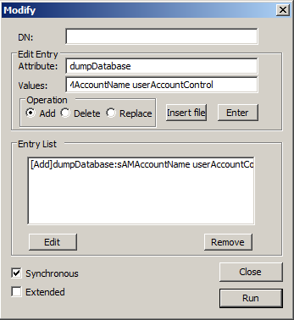
RootDSE modifications a.k.a. “mods”
RootDSE mods provide a mechanism for triggering remote actions via LDAP
  many/most are not defined in the schema
  writing to the attributes causes the server to perform a predefined action
Actions include –
  triggering the SD Propagator Thread
  updating the schema cache
  transferring FSMO roles
  group membership cache refresh (GC’less logon)
  dumping the Active Directory database
  triggering the Infrastructure FSMO (phantom staleness check)
  initiate garbage collection
    … many others

Slide 128
Dumping Active Directory
What on earth does this mean?
  a ~raw dump of the DIT that lists ~everything
  not all attributes available
    e.g. unicodePwd
  allows us to look for hidden objects or corruption or …
How?
  RootDSE modification called dumpDatabase
    accepts space delimited list of attributes to include in the dump as its value
  creates ‘<NTDS Folder Path>\NTDS.DMP’ file
    could be HUGE, consider disk space

Slide 129
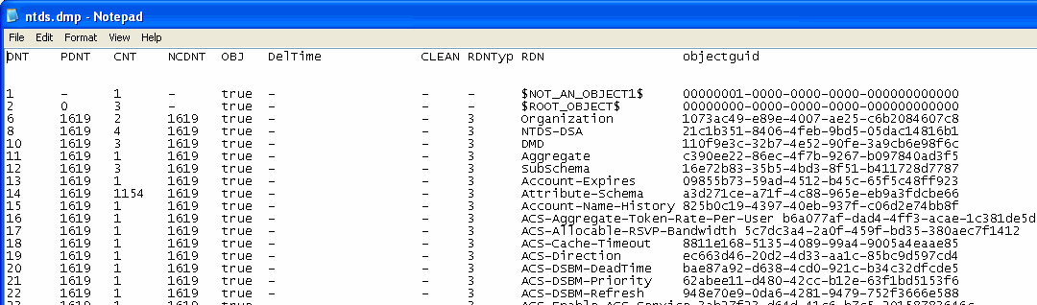
Dumping Active Directory
DNT distinguished name tag (primary DB key)
PDNT parent DNT (used to build the DN)
CNT ref. count / # of objects that refer to me (subordinates - PDNT, NCDNT, BDNT, etc.)
NCDNT naming context DNT
OBJ is it an object, TRUE/FALSE (structural phantoms)
DelTime time stamp when object was deleted
Clean DS background maintenance work required for this object (nothing for you to do)
RDNType normal object (3), OU (11), domain DNS object (1376281)

Slide 130

SD Propagator
Let’s start with what it is…
Security descriptor is replaced (including inheritance flags)
Member-object’s ACL
Template ACL (a container)
ACL
ACL
Members of administrative group(s)
cn=AdminSDHolder,cn=System,dc=<domain>…
The Security Descriptor of user accounts that are members (directly or transitively) of significant administrative groups are automatically set and refreshed
  note that ‘Distribution group’ members (where the group is a member of the affected Administrative groups) are also affected due to the simple transitive enumeration process of the propagator thread

Slide 131
SD Propagator
Groups considered for transitive membership evaluation
  Some critical user accounts also protected – Administrator, krbtgt
Enterprise Admins
Schema Admins
Domain Admins
Administrators
Account Operators
Server Operators
Print Operators
Backup Operators
Cert Publisher
Replicator (*)
Domain Controllers (*)

Slide 132
SD Propagator
Where and when?
    PDC FSMO
    15 minutes after DS restart
    60 minute cycle thereafter (by default)
Frequency can be adjusted
    HKLM\System\CurrentControlSet\Services\NTDS\Parameters
    VALUE: AdminSDProtectFrequency [REG_DWORD]
    RANGE: 60 to 7200 [seconds]
Changes become effective at next interval

Slide 133
SD Propagator
Default ACL template on AdminSDHolder not easily edited through user interface
  e.g. there is no Change Password ACE for a container
  consider changing template with DSACLS
    or use advanced ACL editor within the user interface
dsacls cn=adminsdholder,cn=system,dc=…. /G “Password Admins:CA;Change Password”

Slide 134
SD Propagator
Minimal controls govern which groups are considered
  control permits exclusion of four well-known groups
Configured via dsHeuristics
  byte 15 (hexadecimal)
    RANGE: ‘0’ through ‘F’
  one bit represents each configurable group
    Bit 0 (1): Account Operators / Bit 1 (2): Server Operators
    Bit 2 (4): Print Operators / Bit 3 (8): Backup Operators
  for example
    "1" excludes only ‘Account Operators’
    “C” (8+4) excludes ‘Print Operators’ and ‘Backup Operators’
Triggered manually via a RootDSE mod.

Slide 135
List Object mode
A means of altering the directory service’s behavior such that the ability to see an object is governed by the “List Object” permission of the object itself
  exception – if the user has the “List Contents” permission to the parent object, all child objects will be visible regardless of the “List Object” permission assigned individually to them
Active Directory does NOT use List Object mode by default as additional CPU time is required in order to generate a subordinate object list as the ACL of each subordinate object must be checked individually
Two ACEs are relevant to List Object mode –
  List Contents
    Generally assigned to containers (this is a general definition since
    any object can be defined as a Possible Superior)
  List Object
    Assigned to both containers and leaf nodes

Slide 136
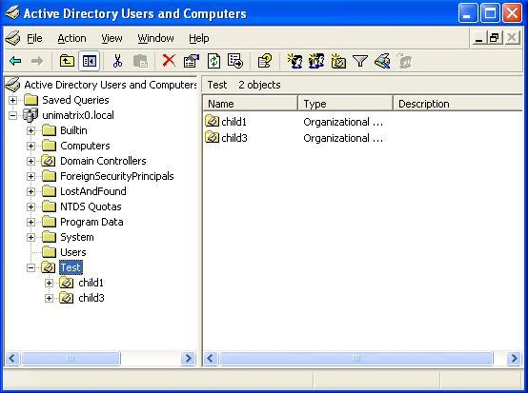
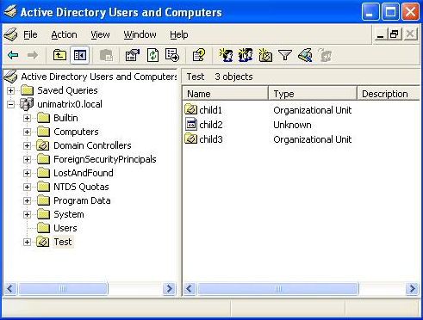
List Object mode
Without List Object mode
  List Content allowed to parent
With List Object mode
  List Content denied to parent
  List Object allowed to children
List Content permission must be granted when not using List Object mode or all subordinate objects (regardless of List Object permission) remain invisible

Slide 137
List Object mode
To use List Object mode → edit the dSHeuristics property of the following object –
CN=Directory Service,CN=Windows NT,CN=Services,CN=Configuration,DC=<forest root>
Set the 3rd byte (not BIT) to 1 –
  i.e. – 001
  uses bytes since some features have more than 2 states
Value defaults to <not set>
If a value is already present such as 100, edit the value accordingly
such that only the 3rd byte is changed
  i.e. – 101
No reboot is required following this behavior alteration
NOTE – The 1st and 2nd byte alter ANR behavior

Slide 138
Tombstone reanimation (undelete)
Re-animate tombstones (object undelete)
  requires Windows Server 2003 Domain Controller / ADAM
  requires “Reanimate tombstones ACE” on NC head
    permission to “Deleted Objects” container not required
    permission to tombstoned object is required
  “lastKnownParent” property maintained on tombstones
  only selected properties reanimated
    defined by attributeSchema’s searchFlags property (bitwise OR “8”)
    no linked attributes (member, manager, etc)
    a number of SAM attributes maintained, but overwritten at reanimation
  some objects within the configuration NC CANNOT be reanimated
    due to default systemFlags value → prohibits object move operations
Default tombstone lifetime increased for
  forest’s deployed using Windows Server 2003 SP1
    Pre-Windows Server 2003 SP1: 60 days
    Post-Windows Server 2003 SP1: 180 days

Slide 139
Miscellaneous
Schema re-use of critical ownership attributes (OID etc)
Dynamic objects (RFC 2589)
  rootDSE does not publish the “dynamicSubtrees” attribute per the RFC
Support for inetOrgPerson RFC 2798 (including logon)
Efficient medial string queries
  wildcard prefix and suffix or tuple indexing
Attribute scoped query
  e.g. return fax numbers of group members

Slide 140
Deleted objects (w/o recycle bin)

Slide 141
Deleted objects
To see deleted objects, use the ‘Return Deleted Object’ control
    1.2.840.113556.1.4.417
  required for any LDAP operation
To undelete, requires “Reanimate tombstones ACE” on NC head
  permission to “Deleted Objects” container not required
  permission to tombstoned object is required
A ‘lastKnownParent’ property is maintained on tombstones
Only certain properties are reanimated
  defined by attributeSchema’s searchFlags property
    OR 0x08
  no linked attributes (member, manager, etc)
    can be achieved through via NTDSUTIL and LDIF
  a number of SAM attributes maintained
    but overwritten at reanimation

Slide 142
Detecting reincarnated objects
If you ever need to locate an object that has been
  undeleted
  authoritatively restored
  moved to the “Lost and Found” container
    through conflict resolution
Use this –
  (&(objectcategory=*)(lastKnownParent=*))
    ‘lastKnownParent’ value identifies DN of last parent object

Slide 143
Related to deleted objects
Security principal creations that generate a constraint violation, e.g.
    user’s password doesn’t meet policy
    mandatory attribute not populated
  … will result in the object being created and immediately deleted
Scenario –
  admin configures minimum password length policy = ‘9’
  existing provisioning system that runs as delegated sub-admin
    fails to meet requirements of new policy
  result
    potential for unintended RID-pool consumption
NB: once you run out of RIDs, unless you don’t need any more users, groups, computers or MSAs → it’s time to migrate

Slide 144
Replication

Slide 145
Fundamentals
Multi-master replication
Change sequence driven by USNs
Operations that are replicated
  object creation / object manipulation
    excludes attributes defined as “non-replicated”
      dirsync control does not encompass such attributes
  object move / object deletion
    deletions create tombstones
      excludes dynamic objects
Originating updates
  record of which DC originally received the update
Replicated updates
  anything that’s not originating ☺

Slide 146
DC identification
DC identification properties used by replication are –
  DC GUID
    maintained by objectGUID property of DC’s NTDSDSA instance
    registered in DNS under “_msdcs” subdomain (CNAME record)
      represented using “network” or “pretty” byte ordering
      required for replication
    used by high-watermark vector table
    used by KCC for replication topology generation
  invocation ID
    maintained by invocationID property of DC’s NTDSDSA instance
    invocation ID retired and regenerated when
      DC is restored
      application partition is added, removed and later re-added
        re-addition requires knowledge of DC’s NC history
        maintained by msDS-RetiredReplNCSignatures
    retired invocation ID maintained by property
      retiredReplDSASignatures property of DC’s NTDSDSA instance

Slide 147
Replication topology
Replication topology generated by KCC/ISTG
KCC = Knowledge Consistency Checker
ISTG = Intersite Topology Generator
  intersite topology generation limitations
    (D+1)xS <= 100,000

Slide 148
KCC / ISTG
ISTG failover detection
  ISTG similar in nature to a FSMO
  a per-site role
  assigned to first DC in site
  role remains with original DC until –
    role is administratively moved (no interface provided)
      nTDSSiteSettings: interSiteTopologyGenerator
    up-level DC moved into site where down-level DC holding ISTG role
    automatic failover mechanics –
      UTD timestamp not improved for existing role holder for 60 minutes

Slide 149
KCC / ISTG
Bridgehead load balancing
  KCC randomly selects bridgehead for each connection
  distributes load when building new connections
  does not redistribute when new hub DCs added
  does not stagger schedules automatically
    ADLB.EXE able to force schedule-staggering
Segmented networks by firewalls?
  See DC to DC communication in “Protocol-head surface area of AD” section

Slide 150

Replication topology generation
Contoso.com forest configuration/schema NC
Contoso.com domain NC
Contoso.com
Connection Object
DC2
DC1
DC4
DC3

Slide 151
Replication topology generation
Contoso.com forest configuration/schema NC
Contoso.com domain NC
Corp.Contoso.com domain NC
Contoso.com
Connection Object
Corp.Contoso.com
DC2
DC5
DC1
DC6
DC4
DC3

Slide 152
Replication topology generation
Contoso.com forest configuration/schema NC
Contoso.com domain NC
Corp.Contoso.com domain NC
Contoso.com
Connection Object
Corp.Contoso.com
DC2
GC5
DC1
DC6
GC4
DC3

Slide 153
Replication model
Intrasite
replication
Intersite
replication
Transport
Topology
Schedule
Replication
Model
Compression
RPC
Ring
Frequency Schedule
Notify & Pull
None
RPC or SMTP
Spanning Tree
Availability Schedule
Pull / Store and Forward
Configurable

Slide 154
Naming contexts (NCs)
Portion of the LDAP namespace
Partition inside a DC’s DIT
  DIT = Directory Information Tree or Table
NC types
  configuration
  schema
  domain
    replication scope limited to same-domain DCs
    enterprise-wide replication scope for GC partial replication
  application partitions (NDNCs)
    customizable replication scope
      cross domain / same forest
    NDNC = Non-Domain Naming Context

Slide 155
Update Sequence Numbers (USNs)
64 Bit QWORD
USN’s are local to each DC
Assigned to new object update transaction
  if transaction is aborted → USN skipped, remains unused
Each object carries two USN’s
  uSNCreated, uSNChanged
Each attribute carries two USN’s
  local USN, originating-DSA USN
Independent from system time

Slide 156
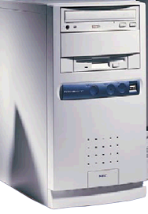
Object creation & metadata
DS1
Add new user on DS1
  DS1 USN increases to 4711
  DS1 object metadata below
USN: 4710
USN: 4711
Object usnCreated = 4711
Object usnChanged = 4711
Property
Value
USN
Version#
Timestamp
Originating GUID
Orig. USN
P1:
Value
4711
1
<time>
DS1
4711
P2:
Value
4711
1
<time>
DS1
4711
P3:
Value
4711
1
<time>
DS1
4711
P4:
Value
4711
1
<time>
DS1
4711

Slide 157
Object replication & metadata
DS1
DS2
User replicated to DS2
  DS2 USN increases to 2052
  DS2 object metadata below
USN: 2052
USN: 4711
USN: 2051
Object usnCreated = 2052
Object usnChanged = 2052
Property
Value
USN
Version#
Timestamp
Originating GUID
Orig. USN
P1:
Value
2052
1
<time>
DS1
4711
P2:
Value
2052
1
<time>
DS1
4711
P3:
Value
2052
1
<time>
DS1
4711
P4:
Value
2052
1
<time>
DS1
4711

Slide 158
High watermark vector (HWV) table
Table per NC per DC
Maintains
  replication partners using DC’s DC GUID
  highest known USN from last replication
Used to detect recent changes on replication partners

Slide 159

High watermark vector (HWV) table
DS1
DC GUID
Highest known USN
USN: 4711
DS1 GUID
4711
DS3 GUID
1217
DS2
DS4
USN: 2052
USN: 3388
DS4’s high-watermark vector
  assumes that DS1 and DS3 are its replication partners
DS3
USN: 1217

Slide 160
Up-to-dateness (UTD) vector table
Table per NC per DC
Used to detect updates already received via another replication route
  propagation dampening
Maintains
  originating DC’s invocation ID
  highest originating USN
  timestamp of last successful replication cycle
Only those DCs are added from which originating updates have been received
  this is typically (eventually) ~all DCs that maintain a read/write replica
    does not necessarily apply to schema NC

Slide 161
Up-to-dateness (UTD) vector table
DS1
Invocation
ID
Highest
originating USN
Replication
timestamp
USN: 4711
DS1 GUID
4691
12:02.31
DS2 GUID
2052
12:02.29
DS3 GUID
1216
12:02.36
DS2
DS4
USN: 2052
USN: 3388
DS4’s up-to-dateness vector
  assumes that DS1, DS2 and DS3 have all originated writes against the partition
DS3
USN: 1217

Slide 162
Conflict resolution
What is a conflict?
  changes occur to same property of same object on two DCs
    caveats apply to multi-valued properties
  changes occur with timeframe defined by replication latency
    i.e. neither of the changes had reached the opposite DC
General resolution logic
  higher version → later UTC timestamp →higher originating GUID
    DC time *IS* important for things other than Kerberos…
  the resulting behavior of the resolution logic differs according to the type of conflict

Slide 163
Conflict resolution
Attribute value conflict, e.g. –
  user changes his phone number on DC1 whilst an administrator changes same user’s phone number on DC2
    result: the losing value is discarded
Move under deleted parent, e.g. –
  administrator creates user in OU1 on DC1 whilst second administrator deletes OU1 on DC2
    result:
      OU1 deleted
      user moved to “Lost and Found” container
      (TBD: See if recycle objects behavior)

Slide 164
Conflict resolution
Object creation name conflict, e.g. –
  two administrators create two user objects with identical RDNs on two DCs
  result:
    the losing object receives a system-wide unique value on the conflicting attribute (in this case, the RDN)
    losing object identified by its GUID
      version metadata effectively useless since it will always be “1”

Slide 165
Replication throttles
Information sent prior to replication
  naming context for which changes are requested
  maximum objects/values requested
  high-USN-change value of naming context for replication partner
  complete up-to-dateness vector
    used for propagation dampening

Slide 166
Replication protocol negotiation
Allows DCs to identify features supported by other DCs, e.g. –
  supported compression algorithms
  support for linked value replication
  replication epochs
View features available for a DC using
  repadmin /bind <DC FQDN>

Slide 167
Replication compression
Algorithm improvements
  MSZIP for compression ratio of 75+%
    computationally very expensive
    Off by default
  Xpress Compress
    compression ratio of about 60%
    less computationally expensive
  Xpress Compress algorithm can be scaled to achieve better compression
    CPU overhead incurred
  ability to disable intersite compression per site/per DC
  compression configurable via “NTDS Site Settings object”
  or DC specific values within registry

Slide 168
Replication compression
Configure compression algorithm per DC
  HKLM\CurrentControlSet\Services\NTDS\Parameters
  REG_DWORD: Replicator compression algorithm
    0 – Disable Compression
    1 – Value not used
    2 – Force MSzip algorithm
    3 – Default, use Xpress algorithm
Adjusting CPU load
  HKLM\CurrentControlSet\Services\NTDS\Parameters
  REG_DWORD: Replicator compression level
    Values: 0 through 9
    Default=3
    0=faster = less compression / 9= slower = more compression
    values beyond 3 provide little compression benefit

Slide 169
MSzip replication compression
Projected replication overhead in bytes
#Objects | Users | Global Groups | Universal Groups | Volumes
1 | 14,108 “13,019” | 10,437 “11,309” | 11,227 “11,145” | 9,667 “10,277”
10 | 45,563 “47,037” | 25,683 “26,902” | 26,741 “26,823” | 21,691 “22,848”
100 | 39,583 “386,148” | 28,743 “187,754” | 29,675 “185,606” | 22,602 “149,736”
500 | 173,105 “1,914,087” | 102,404 “905,015” | 119,180 “906,079” | 81,691 “715,577”
1,000 | 291,041 “3,818,256” | 194,926 “1,815,170” | 199,054 “1,803,090” | 151,989 “1,436,085”
Intersite replication
“Intrasite replication”

Slide 170
Replication epochs
DCs exchange replication epoch values prior to initiating a replication event
  if they match → replication proceeds
  if not → replication is NOT permitted
Replication epochs → per-DC integers
Maintained by each DC’s “NTDS Settings” object
  NTDSDSA: ms-DS-ReplicationEpoch”
  attribute is NOT replicated and has meaning only when originated against the owning DC’s NTDSDSA instance
  can be manually adjusted (increased or decreased)
Incremented when domain names change
Potential for usage in later releases to identify other
significant structural changes to the directory

Slide 171
Replication notification intervals
Honored from registry and directory
  internal defaults
    Hold back timer: 15 seconds
    Replicator Notify Pause: 3 seconds
  maintained by partition’s crossRef (not populated by default)
    cn=<crossRef RDN>,cn=Partitions,cn=Configuration,dc=<forest DN>
      msDS-Replication-Notify-First-DSA-Delay
      msDS-Replication-Notify-Subsequent-DSA-Delay
  registry values supported / not populated by default

Slide 172
Replication notification intervals
Notification intervals (continued)
  registry locations
    Hold back timer
      HKLM\SYSTEM\CCS\Services\NTDS\Parameters
        Replicator notify pause after modify (secs)
    Replicator Notify Pause
      HKLM\SYSTEM\CCS\Services\NTDS\Parameters
        Replicator notify pause between DSAs (secs)
  DC behavior when both settings present
    registry takes precedence

Slide 173
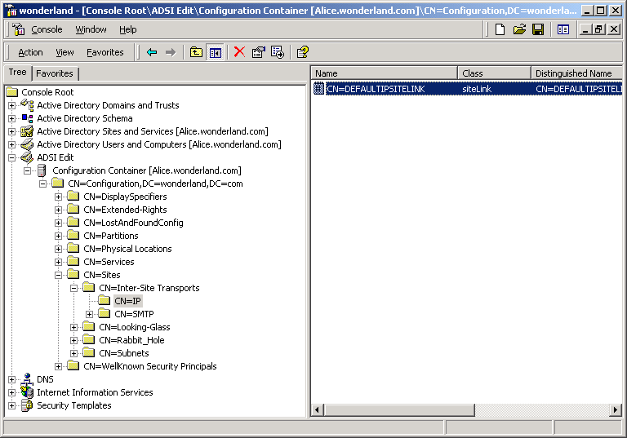
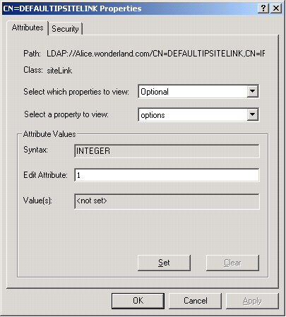
Intersite change notification
Intersite change notification
  permits replication notification between sites
  facilitates urgent replication between sites

Slide 174
Reciprocal replication
Reciprocal Replication
  when replication completes, encourage replication partner to
  initiate replication (i.e. notify them)
  important in one-way connection initiation scenarios

Slide 175
Urgent replication
Sadly, not admin-extensible
Initiated by SAM or LSA (not by LDAP writes)
  changing an LSA secret (trust account)
  replicating a newly locked out account
  user account password reset
  user's password set to expire immediately
    does not apply to computer accounts
  RID Master state changes
  userAccountControl is modified
    e.g. member becomes DC or DC becomes member
Triggers immediate replication cycle within a site
Uses notification with an “urgent” flag
  therefore, requires notification
  functional between sites when configured for change
  notification

Slide 176
Password replication
Password changes can be made at any DC
Password change “pushed” to PDC FSMO on a best effort basis
Other DCs receive password via normal replication
Failed logon authentication retried at the PDC FSMO
  known as PDC chaining
  initiated by authenticating DC

Slide 177
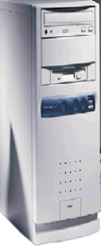
PDC chaining
DC
PDC
User
Administrator
Administrator changes user password
User attempts to logon with new password
DC fails password
DC chains authentication to PDC
PDC accepts the password
PDC sends updated data for single user to DC
  ReplicateSingleObject
Logon proceeds

Slide 178
Lingering objects
Lingering objects primarily occur due to replication failures
No downlevel mechanism was provided for their removal
Windows Server 2003 provides a manually invoked means of removing such objects
Requires REPADMIN.EXE from the Support Tools
  … or some creative scripting ☺
  REPADMIN /removelingeringobjects
Symptoms of lingering objects
  mail messages not delivered to a user whose object was moved between domains
  user account that no longer exists still appears in the global address list
  Universal group that no longer exists still appears in user's access token

Slide 179
Replication consistency
Strict prevents reincarnation of objects when insufficient properties to build a locally non-existent object are replicated from a partner DC
  fails replication for NC in question from offending partner until resolved
Loose causes target DC to re-request entire object
  locally reincarnated
  not the same as reanimation
Strict and loose are mutually exclusive settings per DC
Enabled through the registry
Downlevel support added through hotfixes and/or Windows 2000 SP3
Windows Server 2003 DC behavior –
  upgraded: loose replication consistency
  install to downlevel forest: loose replication consistency
    regardless of functional level
  clean install: strict replication consistency

Slide 180
Replication consistency
Configuring replication consistency
  HKLM\System\CurrentControlSet\Services\NTDS\Parameters
    Windows 2003
      REG_DWORD: Strict Replication Consistency
        1 = do NOT permit reincarnation / 0 = permit reincarnation
      REG_DWORD: Allow Replication With Divergent and Corrupt Partner
        1 = yes / 0 = no
    Windows 2000
      REG_DWORD: Correct Missing Objects
        1 = permit reincarnation / 0 = do NOT permit reincarnation
No restart required

Slide 181
Intersite replication compression
Goal is to reduce the computational impact
Configure compression algorithm per DC
  HKLM\CurrentControlSet\Services\NTDS\Parameters
  REG_DWORD: Replicator compression algorithm
    0 – Disable Compression
    1 – Value not used
    2 – Force MSzip algorithm
    3 – Default, use Xpress algorithm
Adjusting CPU load
  HKLM\CurrentControlSet\Services\NTDS\Parameters
  REG_DWORD: Replicator compression level
    values: 0 through 9
    default=3
    0 = faster = less compression / 9 = slower = more compression
    values beyond 3 provide little compression benefit

Slide 182
Intersite replication – disabling compression
Goal is to eliminate computational impact
Disabling compression on the Site Link (& connection) objects
  raise bit 2 in the options attribute on a ‘Site Link’ object
  at the next KCC cycle, all KCC owned connection objects created as a result of the affected site link inherit the new configuration

Slide 183
SID history and SID filtering

Slide 184
SID history
What is SID history?
How do we get one/some?
  via DSaddSIDhistory API
  API caller MUST meet the following criteria -
    Administrator in source and target domains
    source principal and destination principal MUST be -
      user or security-enabled Group
    source principal and destination principal object classes MUST match
      two minor exceptions -
        if Source Principal is a Local or Domain Local Group, Destination Principal must be a Domain Local Group
        if Source Principal is a Global or Universal Group, Destination Principal must be a Global or Universal Group

Slide 185
SID history (DSaddSIDhistory)
(continued…)
  Source or destination principals may NOT be -
    computer (Workstation or Domain Controller)
    inter-domain trust account
    temporary duplicate account (legacy feature of LANman)
  Well-known SID constraints
    if source principal has well-known RID and domain-specific prefix
      then destination principal MUST use same well-known RID
  Trusts are required if –
    domains span forests

Slide 186
SID filtering
Provides a means of verifying authorization data as it traverses trust-boundaries
  prevents identity spoofing
  supported over external trusts and cross-forest trusts
  PAC checked by opposite DC during ticket referral
  SID’s domain component checked against known list of domain SID’s from source domain/forest
    SID filtered if no match found (or if it’s well-known)

Slide 187
SID filtering
sIDHistory added to user’s authorization data (PAC/NTtoken) during authentication
  attribute available to users, inetOrgPersons and groups
Configurable via NETDOM
  two filtering options available
    /quarantine
    /enableSIDhistory

Slide 188
SID filtering – gotchas
May inadvertently remove sIDHistory
  intra-forest migration not affected
  inter-forest migration requires direct trust
May prevent delegation beyond two forests
Disabling a Domain SID
  blocks authentication for its accounts and authorization for its Universal Groups
  not recommended for controlling who can authenticate from a trusted forest

Slide 189
SID filtering – forest trusts
Configuration maintained by trustedDomain class
Information of relevance
  TopLevelNames / Tree Names
  UPN-suffixes / SPN-suffixes
  TLNExclusions
  FQDN / NetBIOS name / SID
Forest A
Forest B
Cross Forest Trust

Slide 190
LDAP

Slide 191
LDAP connection specifics
Protocol
  Mainly TCP
  UDP used only for LDAP “ping” (DC Locator)
LDAP server and port
  AD DS
    LDAP: 389, 636
    Global Catalog: 3268, 3269
  AD LDS
    could be just about anything
Authentication information
  three formats
    distinguishedName: cn=user,ou=someou,dc=domain,dc=com
    Windows NT: domain\userid
    userPrincipalName: user@domain.com
  Negotiate, simple, digest

Slide 192
LDAP authentication security
Different types of bind
  Negotiate
  Simple
In Windows Negotiate means Kerberos first if possible otherwise NTLM
Kerberos requires 3-part SPNs
If using machine context if Kerberos fails LDAP will bind anonymous
  NTLM maps system to anonymous

Slide 193
LDAP query requirements
Required items when querying directory
  protocol
    TCP or UDP
      TCP
  LDAP server and port
    what machine and service port
      auto-discover
  authentication information
    security context to connect as
      current user
  scope
    how deep the search should go (base, onelevel, subtree)
      subtree
  attributes to return
    what do you want to see?
      * set
  base DN
    where in directory to start looking
  query filter
    what you are looking for

Slide 194
LDAP query options
Optional items when querying directory
  enables functionality or gives additional information
  session options
    control how entire LDAP session is handled
    integer values
    examples
      host record only lookup for resolution (name supplied is dnshostname)
      modify DC Locator options (require the PDC)
      specify LDAP server version required
  extended controls
    control how single LDAP operation is handled
    OID values
    examples
      attribute scoped queries
      allow deleted objects to be returned
      return query statistics data

Slide 195
More LDAP query options
“Not-so-optional” optional items when querying AD
  paging
    allows you to return large numbers of records with reduced impact on the server
    AD allows 1000 records returned by default
    implemented with a server control - ldap_search_init_page
  ranging
    allows you to return large numbers of values
    AD allows 1500 values returned by default (1000 in Windows 2000)
    only needed for linked value attributes
    implemented as an attribute modifier (attribute option)
      attribute;range=x-y
  if a program doesn’t do this properly, what other bad coding?

Slide 196
Connection specifics
Protocol
  UDP used only for LDAP “ping” with Active Directory
LDAP server and port
  AD
    LDAP: 389, 636
    Global Catalog: 3268, 3269
  ADAM
    could be just about anything
Authentication information
  three formats
    distinguishedName: cn=user,ou=someou,dc=domain,dc=com
    Windows NT: domain\userid
    userPrincipalName: user@domain.com

Slide 197
Query specifics
Scope
  some information can only be returned with BASE level queries
    tokenGroups
  scope can impact index selection
    containerized indexes
Base DN
  formats
    distinguishedName – cn=users,dc=domain,dc=com
    GUID - <GUID=D88EE4BB-F3F6-4A65-BA8B-0211368AE369>
      <GUID=bbe48ed8f6f3654aba8b0211368ae369>
    SID - <SID=S-1-5-21-1862701446-4008382571-2198042679-512>
      <SID=0105000000000005150000008691066f6b10ebee3778038300020000>
      does not function against GC
      not all objects have a SID
    Well Known GUID –
    <WKGUID=18E2EA80684F11AA0004F79F805,dc=domain,dc=com>

Slide 198
Query filter specifics
Basic query component
  (attribute matching rule value)
    matching rules
      equality “=“
      exists “=*”
      greater than equal to “>=”
      less than equal to “<=“
  substring match wildcard is “*”, no character wildcard such as “?”
  example
    (name=j*)
Combine multiple basic queries together with operands
  & - AND
  | - OR
  ! – NOT
  example
    (&(objectCategory=computer)(|(name=dc*)(name=exch*)))
Bitwise operations
  attribute=:matching_rule_OID:=value
    bitwise AND 1.2.840.113556.1.4.803
    bitwise OR 1.2.840.113556.1.4.804
  example
    (userAccountControl:1.2.840.113556.1.4.803:=2)

Slide 199
LDAP queries/modifications/etc.
LDAP matching rule extensions:
  accessible to any LDAP client (including VBScript)
    filter of attribute:matching_rule_oid:=value
  http://msdn2.microsoft.com/en-us/library/aa746475.aspx
  Bitwise matching
  InChain / Nested / Linked matching

Slide 200
LDAP queries
Bitwise matching
  all versions of Active Directory
  OIDs
    LDAP_MATCHING_RULE_BIT_AND -> 1.2.840.113556.1.4.803
    LDAP_MATCHING_RULE_BIT_OR -> 1.2.840.113556.1.4.804
  use Case: Find disabled users
    "&(objectcategory=person)(useraccountcontrol:1.2.840.113556.1.4.803 :=2)"
  Careful, though:
    potentially heavy compute impact on DCs
    query performance will slow

Slide 201
LDAP queries
LDAP Server Control extensions
  LDAP client needs to send special server side controls
    LDP = YES ☺
    ADSIEDIT, VBScript = NO ☹
  attribute Scoped Query
  deleted objects
  DIRSYNC
  sorted Results
  STATS
  much more…
    http://msdn2.microsoft.com/en-us/library/aa366108(VS.85).aspx

Slide 202
DIRSYNC control
DIRSYNC
  all versions of Active Directory
  server control
    LDAP_SERVER_DIRSYNC_OID ->1.2.840.113556.1.4.841
  use case: Track “replicated” changes in the directory.
    Ex: repadmin /showchanges dc1.domain.com dc=domain,dc=com /cookie:trackcookie.bin
  comments
    ONLY changes that replicate will show up and not even all of them… No badPwdCount, no unicodePwd, etc

Slide 203
Sort control
SORT
  All versions of Active Directory
  Server Control
    LDAP_SERVER_SORT_OID ->1.2.840.113556.1.4.473
  Use case: Objects listed in created date order.
  Comments
    if attribute being sorted on does not have an index, limited to Temp Table row count (default: 10,000). Unavailable Critical Extension
    Can’t sort on constructed attributes

Slide 204
Locating security enabled groups
Bitwise query
  "&(objectcategory=group)(grouptype:AND:=2147483648)"
Grouptype <= -1
  "&(objectcategory=group)(grouptype<=-1)“

Slide 205
Query efficiency
Query efficiency can vary based on the Active Directory population and configuration
Generic “rules” or “best practices”
  use the most focused search base and scope possible
  use at least one indexed attribute in every query
  use paged queries
  avoid complex filters
  avoid ANR (ambiguous name resolution)
  avoid NOT operations
  avoid bitwise operations
  avoid medial searching (name=*airo) or (name=j*iro)
Use the STATS control to verify efficiency in specific directory
  LDP.exe

Slide 206
VLV / Containerized index
Containerized indexing
  uses PDNT index
  RDN (name) is implicitly indexed
VLV = Virtual list view
  windowed result set = show me results 100-200
  constraints apply to Windows Server 2003 implementation
    ADAM, enable subtree index with searchFlags OR 64 = no limitation
  Windows Server 2003 limitation
    query will work if result set <= MaxTempTableSize (LDAP Policy)
      default: 10,000 (objects)
    if subtree query exceeds MaxTempTableSize
      increase table size using NTDSUTIL or other
    if onelevel query exceeds MaxTempTableSize
      use container index with searchFlags OR 2

Slide 207
Returned attributes
Default attribute set
  star “*” set
  no constructed/operational attributes
Must specifically request constructed attributes
  tokenGroups – requires base level query
  msDS-PrincipalName
  msDS-ReplValueMetaData
Optional modifiers to attribute return values
  attributeName[;option]
    range=x-y
      member;range=1-*
    binary
      msDS-ReplValueMetaData;binary

Slide 208
LDAP policies
LDAP Policies are configured per DC (or ADAM Instance), site, or forest
  queryPolicyObject attribute on nTDSDSA object of server
  queryPolicyObject attribute on nTDSSiteSettings object of site
  no queryPolicyObject attribute value, use Default Query Policy
don’t change unless you know what and why
  opportunity to experience all sorts of unique failures
  little guidance from Microsoft on value ranges and what to watch out for
  do not hack Active Directory to support poor applications
    even when they come from big 3-letter companies…
  increasing max values could steal resources from other components
two modification mechanisms
  NTDSUTIL
    LDAP Policies
      Default Query Policy only
  LDAP modification of queryPolicy object(s)
    CN=Query-Policies,CN=Directory Service,CN=Windows NT,CN=Services,CN=Configuration…

Slide 209
LDAP policies
MaxPageSize
  maximum number of entries returned in a single page
  don’t touch, use paging queries - easy
  default: 1000 records
MaxValRange
  max number of values returned for a MV attribute in single request
  don’t touch, use attribute ranging - easy
  default: 1500 values
MaxQueryDuration
  max time a single query is allowed to run prior to termination
  don’t touch, use proper timeout values and paged queries - easy
  default: 120 seconds

Slide 210
LDAP policies
MaxPoolThreads
  Number of threads available for processing I/O and LDAP requests
  increasing can be useful on big busy DCs
    DCs used by Exchange
    slow bind times
  guideline only, DC may or may not increase to that number of threads
  default: 4 per processor
MaxActiveQueries
  not used in ADAM and Windows Server 2003 AD, use MaxPoolThreads
  default: 20 queries
MaxConnections
  maximum simultaneous connections, any connections above this value are dropped
  useful to increase for big DCs handling lots of LDAP clients or multithreaded clients opening lots of connections
  can be dangerous and used for DOS attacks
  default: 5000 connections

Slide 211
LDAP policies
MaxTempTableSize
  size of temporary table space available for various internal query ops such as sort, VLV, OR query optimization, etc
  increase *might* help OR queries
  increase to assist large sort or VLV operations
    instead use container indexing and one level queries with AD
    instead use container indexing or subtree indexing with ADAM
  default: 10000 records
MaxResultSetSize
  max space available for intermediate results sets for paged queries
  increase *might* speed up paged queries
  default: 262144 bytes
MaxReceiveBuffer
  largest LDAP packet that can be received by DC
  do not touch
  default: 10485760 bytes

Slide 212
LDAP policies
MaxDatagramRecv
  largest single datagram that can be received
  don’t recommend modifying this
  default: 4096 bytes
MaxNotificationPerConn
  maximum change notification handles that can be opened against a DC per connection
  do not touch, dangerous
  default: 5 change notifications per connection
MaxConnIdleTime
  maximum time a connection can be idle prior to disconnect
  don’t recommend increasing this
  default :900 seconds
InitRecvTimeout
  time to wait for client to make request after connecting
  don’t recommend increasing this
  default : 120 seconds

Slide 213
Some interesting session options
LDAP_OPT_AREC_EXCLUSIVE
  name specified is DNS HostName, do not lookup SRV records
LDAP_OPT_ENCRYPT
  enable kerberos encryption for LDAP packets
    Windows 2003/XP will use NTLM encryption if kerberos not available
LDAP_OPT_FAST_CONCURRENT_BIND
  allows multiple simple binds through single LDAP connection
  no token generation so much faster
LDAP_OPT_GETDSNAME_FLAGS
  Access to flags to control behavior of DsGetDcName call for DC location when connecting
    PDC
    writable
LDAP_OPT_PING_KEEP_ALIVE
  keeps an LDAP session from disconnecting due to idle timeout
LDAP_OPT_PROTOCOL_VERSION
  specify required LDAP version for session
LDAP_OPT_REFERRALS
  Specify whether or not LDAP client should automatically follow referrals
LDAP_OPT_SIGN
  Enable kerberos signing for LDAP packets
    Windows 2003/XP will use NTLM signing if kerberos not available

Slide 214
Some interesting controls
LDAP_SERVER_ASQ_OID
  specify an attribute scoped query
LDAP_SERVER_DIRSYNC_OID
  return changes from previous state
    only changes that will replicate
LDAP_SERVER_EXTENDED_DN_OID
  return extended DNs
    <GUID=xxxxxxxx>;<SID=yyyyyyyyy>;distinguishedName
LDAP_SERVER_NOTIFICATION_OID
  notify client when changes made in directory
    all changes
LDAP_SERVER_SD_FLAGS_OID
  specify portions of Security Descriptor should be returned/updated

Slide 215
Some interesting controls
LDAP_SERVER_SEARCH_OPTIONS_OID
  control additional search options for query
    SERVER_SEARCH_FLAG_PHANTOM_ROOT - phantom root
LDAP_SERVER_SHOW_DELETED_OID
  allows deleted objects to be returned in query
LDAP_SERVER_GET_STATS (1.2.840.113556.1.4.970)
  retrieve query statistics
  no documentation on returned data
    LDP / ADFIND
LDAP_SERVER_SORT_OID
  specifies server should sort results by specified attribute
LDAP_CONTROL_VLVREQUEST
  virtual list view

Slide 216
RootDSE
Anonymous
  LDAP V3 requirement
  some info requires authentication
LDAP bootstrap
  server capabilities/controls
  naming contexts
  available LDAP policies
  authentication mechanisms
  DC/Domain/Forest functional levels
Relatively unknown “cool” attributes
  dsSchemaAttrCount
  dsSchemaClassCount
  dsSchemaPrefixCount
  msDS-ReplAllInboundNeighbors
  msDS-ReplAllOutboundNeighbors
  msDS-ReplQueueStatistics
  msDS-ReplPendingOps
  msDS-TopQuotaUsage

Slide 217
Extended error messages
Extended Error: 0000217A: SvcErr: DSID-031401A2, problem 5010 (UNAVAIL_EXTENSION), data 0
  Application should display the message
    can be pulled out of network trace for non-encrypted calls
    duplicate query/modification with LDP or ADFIND/ADMOD
  0000217A can be decoded with ERR.EXE from Microsoft downloads
  DSID value is alias pointing to specific line of code in specific directory service source code file.
    decoded with internal application – DSID.EXE
    specific to versions of binaries
    when getting help in newsgroups, listservs, or Microsoft, specify OS, SP, and full extended error including DSID

Slide 218
FSMO roles

Slide 219
Basics
Flexible Single Masters of Operation (FSMO)
Each role holder masters updates to the directory that,
in the event of a conflict, are either impossible or inconceivably complex to resolve
Roles holder assigned via
  Forest/Domain creation/demotion
  MMCs
  NTDSUTIL.EXE
  LDAP operation
Roles may be transferred or seized
Advertisement requirements (INITSYNC)

Slide 220
Basics
5 roles defined
  2 per enterprise roles
    Schema master
    Domain Naming master (ADAM: Naming Master)
  3 per domain roles (n/a to ADAM)
    PDC (Primary Domain Controller)
      often referred to as the PDC emulator; a misleading name
    Relative Identifier master (RID)
    Infrastructure master

Slide 221
Schema master
DC permitted to originate schema changes
  all DCs maintain writable copy of the schema
    only replicated writes are supported
Per enterprise role
Defaults to first DC installed
Targeted when
  increasing forest functional levels
  running “forestprep” operations (e.g. Exchange)

Slide 222
Schema master
Role placement controlled via
  Schema manager
    REGSVR32 SCHMMGMT.DLL
  NTDSUTIL
  Operational attribute
    becomeSchemaMaster

Slide 223
Domain Naming master
DC permitted to
  add or remove partitions and cross-references
Targeted by
  domain renames
  creation of application partitions (NDNCs)
    requires Windows Server 2003 or later role holder
Per enterprise role
Defaults to first DC installed

Slide 224
Domain Naming master
Windows 2000 Domain Naming masters
  required communication with a GC
  recommended that role resides on a GC where possible
  moot point for Windows Server 2003
    GC was used to verify uniqueness of subordinate partition’s name
    no longer able to do so since GC’s do NOT necessarily maintain
    knowledge of NDNCs (application partitions)
      important to note that Active Directory enforces RDN naming
      uniqueness regardless of object class
Role placement controlled via
  Active Directory Domain and Trusts
  NTDSUTIL
  Operational attribute
    becomeDomainMaster

Slide 225
PDC
DC provides
  PDC role for downlevel BDCs and clients
  password changes for downlevel clients
  Windows NT Master Browser
  password retry server (PDC chaining)
  target for out-of-band password changes from other DCs
  account lockout handling
  preferential update for Group Policy objects
  default time source
Per domain role
Defaults to first DC installed per domain

Slide 226
PDC
Targeted when increasing domain functional levels
Role placement controlled via
  Active Directory Users and Computers
  NTDSUTIL
  Operational attribute
    becomePDC
      requires domain’s SID as operation value

Slide 227
RID master
RID = Relative Identifier
Allocates unique pools of RIDs to DCs
  RIDs used to construct unique SIDs
  block size defaults to 500
  pool is replenished by each DC when
    Windows 2000 Pre-SP4: 80% exhausted
    Windows 2000 SP4: 50% exhausted
    Windows 2003: 50% exhausted
  larger RID pools supported since Windows 2000 SP4
    HKLM\SYSTEM\CCS\Services\NTDS\RID Values
      RID Block Size (REG_DWORD)

Slide 228
RID master
Per domain role
Defaults to first DC installed per domain
Targeted when migrating security principals
Role placement controlled via
  Active Directory Users and Computers
  NTDSUTIL
  Operational attribute
    becomeRidMaster (NOT recommended)

Slide 229
Infrastructure master
Maintains validity of cross-domain references
  e.g. a group containing a member within same forest but different domain
    groups containing members from different forests are maintained similarly but utilize a special class – a “Foreign Security Principal”
  necessary changes replicated by unique mechanism
  role is necessary because of the manner in which cross references between two objects are expressed
    relationship expressed using local DNT (or row) references
      DNT = distinguished name tag / DNTs local to each ESE instance
    hierarchy expressed through PDNT
      PDNT = parent DNT / i.e. the DNT of an object’s parent
Per domain role
  redundant in single domain forests

Slide 230
Infrastructure master
Targeted by ADPrep /DomainPrep operation
Must not reside on a GC except
  in single domain forests
  in domains where all DCs are GCs
    domain contains only one DC
  when you just can’t bring yourself to care ☺
Role placement controlled via
  Active Directory Users and Computers
  NTDSUTIL
  Operational attribute
    becomeInfrastructureMaster

Slide 231
Infrastructure master
Why do we need an Infrastructure FSMO?
  core role required in multi-domain forests only
    we’re not talking about things like ‘DomainPrep’
  caused by dblayer’s implementation of cross-references
    something known as ‘link pairs’
    cool technology but only works if both halves of the pair exist locally

Slide 232
Infrastructure master
What are Link pairs
  defined in the schema by a ‘linkID’
  ‘linkID’ must be unique within the schema
    value has local significance only
  they implement the notion of ‘forward’ and ‘back’ links
  ‘forward’ links are writeable
    e.g. ‘member’ property (think group membership)
    always uses an even number
    can exist without back-link
  ‘back’ link is read-only and constructed
    e.g. ‘memberOf’ property (user is a member of …)
    always uses an odd number
    CANNOT exist without forward-link

Slide 233
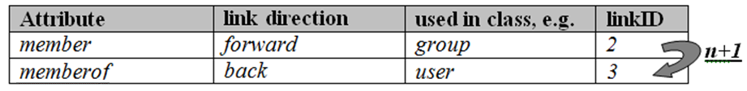
Infrastructure master
The schema expresses the relationship between linked attributes mathematically
  each linked attribute is given a ‘linkID’
  <back link attribute> = <forward link attribute> + 1
  i.e.
    the ‘linkID’ of the ‘member’ property is ‘2’
      this tells us it’s a ‘forward’ link
    the ‘linkID’ of the ‘memberOf’ property is ‘3’
      this tells us it’s a ‘back link’
Schema snippet

Slide 234
Infrastructure master
How do we store this stuff?
  Regular (non-linked) attributes written to –
    ‘data-table’
  Linked attributes written to –
    ‘link-table’
Remember, only the forward link is writable
  back linked values derived by simply reversing the forward link

Slide 235
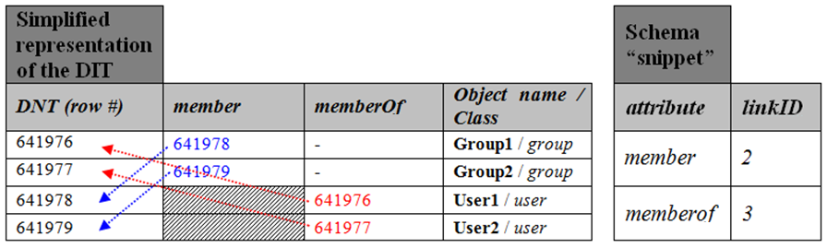
Infrastructure master
If we assume that
  ‘user1’ is a member of ‘group1’
  ‘user2’ is a member of ‘group2’
NOTE – the ‘memberOf’ property is actually constructed as mentioned earlier
  we show it above as fixed data only to aid the explanation

Slide 236
Infrastructure master
Assume then that –
  Active Directory represents cross references by pointers between rows
  each row uniquely and sequentially identified by its DNT
  DNTs have local meaning only
  link pairs, therefore, also have local meaning only, i.e. –
    two DCs in the same domain will ~NOT use the same DNT for the same object
    therefore, their link-tables will also differ
Problem –
  if a user in ‘Dom-A’ is added to a group in ‘Dom-B’, how can the Domain Controller in ‘Dom-B’ express a relationship between an object it DOES store and one that it DOES NOT?

Slide 237
Infrastructure master
Solution –
  inject entry into the local DIT that serves as a ‘pointer’ to a remote object
    locally injected entries are called ‘phantoms’
  ‘phantoms’ consume one row in the DIT and, therefore, have a DNT
  ‘phantoms’ contain only the following attributes –
    objectGUID
    objectSID
    DN
Problem solved –
  create the link-pair between the local object’s DNT and the phantom’s DNT

Slide 238
Infrastructure master
This causes a problem of its own –
  we know the ‘phantom’ represents an object in a foreign domain
  we know that DCs do NOT replicate objects from foreign domains
    only GCs do
    so make ‘em all GCs
      well we already mentioned that possible solution
What if the object the phantom represents is
  deleted, renamed or moved?
  … enter the ‘Infrastructure FSMO’

Slide 239
Administrative tools

Slide 240
ADSIEDIT
Ever used ADSIEDIT.MSC?
Ever examined the schema?
  you may have also noticed things missing
    recent schema extensions … but why?
  they’re cached
    ADSIEDIT's local schema cache is maintained here
      %SystemRoot%\schcache\<forest root FQDN>.sch
  to flush it
    delete the corresponding <forest root FQDN>.sch file

Slide 241
ADSIEDIT – a similar but different issue…
Ever used ADSIEDIT.MSC to look at an object with an auxiliary class dynamically bound to it?
Ever noticed that it’s missing some attributes?
  those defined in the auxiliary class … why?
  CAUSE
    schema cache only honors statically bound auxiliary classes
  SOLUTION
    use another tool ☹

Slide 242
DSSEC.DAT
A means of adding or removing the available ACE’s presented in the ACL editor within the user interface
Located in %windir%\system32\dssec.dat per computer
Can be edited using notepad (i.e. it’s a text file)

Slide 243
Enhancing ADUC UI (Users and Computers)
Done through display specifiers
Provides a means to tailor many aspects of the administrative tools
Region specific
  region ‘409’ (1033 decimal) covers English locales
  http://msdn2.microsoft.com/en-us/library/0h88fahh.aspx
Able to alter icons, columns, menu options, property sheets, etc.
Maintained in the configuration partition
    changes therefore affect everyone within the forest
    requires significant permission to edit

Slide 244
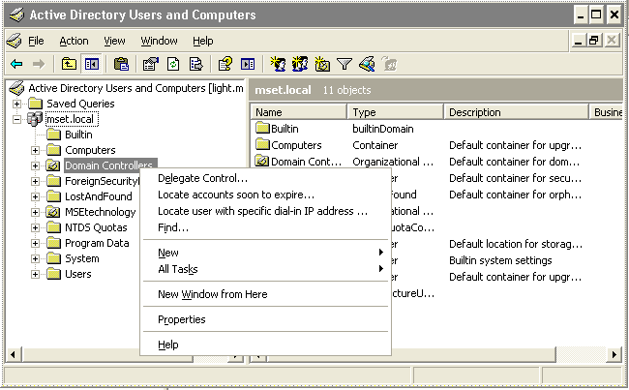
Enhancing ADUC
For example

Slide 245
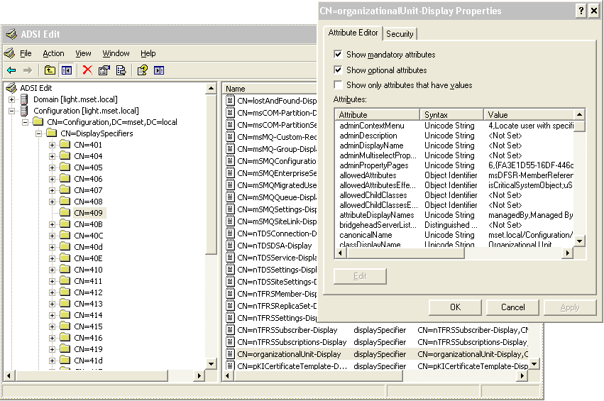
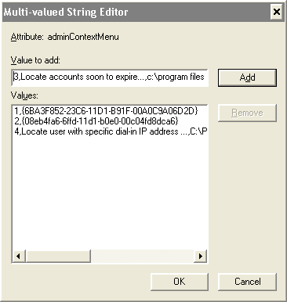
Enhancing ADUC
How do we get that?
SYNTAX: <ordinal>,<display text>,<executable path>

Slide 246
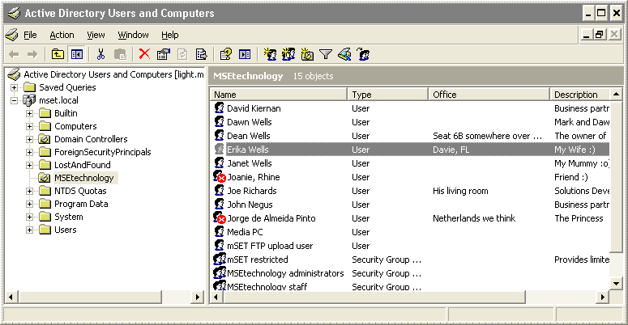
Enhancing ADUC
To add an extra column

Slide 247
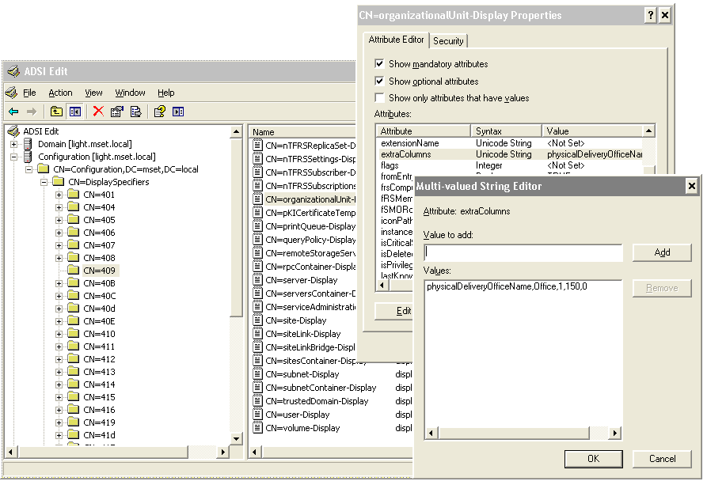
Enhancing ADUC
To add an extra column
SYNTAX: <ldapdisplayname>,<column header>,<default visibility>,<width>,<reserved/unused>

Slide 248
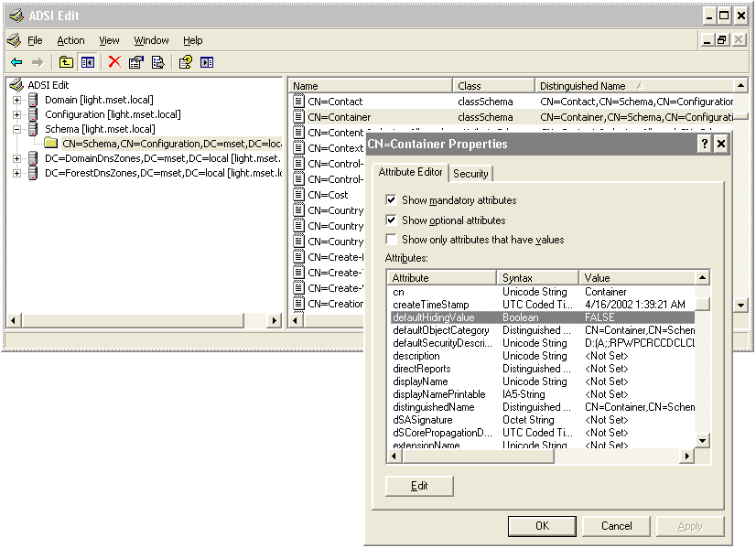
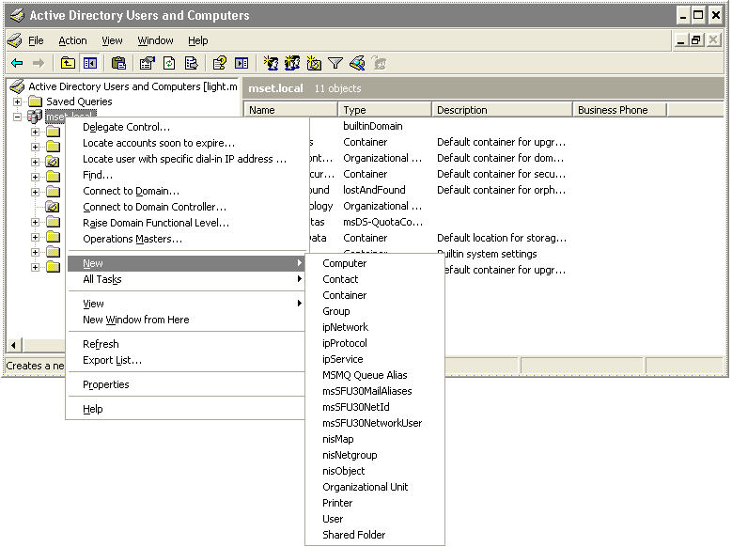
Enhancing ADUC
To add ‘Container’ to new item drop-off menu
Modify ‘container’ structural
class in the schema and set
‘defaultHidingValue’ to ‘FALSE’

Slide 249
Disable drag and drop in administrative tools
Configure the –
  ‘flags’ property
  configure bit 0 to 1
  on the ‘displaySpecifiers’ container
    within the configuration NC
Requires 2003 SP1 minimum
NOTE – this is not a regional setting
  the bit IS changed on the ‘displaySpecifiers’ container itself

Slide 250
AD LDS points of interest

Slide 251
AD LDS points of interest
Windows Server 2003 or Windows XP
No domain requirements
  workgroup, NT4 domain, any Active Directory domain in any mode
  NO DNS requirements except Host Records
  provide ability to create custom NCs outside of Active Directory
  instances hosting replicas of NCs strictly controlled
  cross-domain, cross-forest, even cross-workgroup replication supported
Unlimited # of replicas
  NO GC
  multi-master
    observes site topology, schedule defined within LDS
  contain any objects including security principals in all NCs except schema

Slide 252
AD LDS points of interest
Multiple instances on single machine
  separate schemas
  define IP ports to use
  stop/start as a service
Minimal schema
  not even a user class defined by default
NC head can be any container types
  OU, container, organization name, locality name, user…
Security
  domain, local machine, or LDS security principals
  default security is considerably tighter
  authenticated users have no default permissions – none
  use local machine security policy which can be inherited from domain
    XP – unfortunately no security policy available
  LDS administrators do not have to be admin of local machine

Slide 253
AD LDS points of interest
Not quite identical to Active Directory
  locating resources is handled differently
  account policy not present in directory
  security principal differences could be confusing
  ACL manipulation with ADSI can be a challenge
  ports can be different
  don’t assume something will work the same, test

