Slide 1

Information Governance for Unstructured Data Using the Data Classification Toolkit for
Windows Server 2008 R2
WSV323
Nir Ben Zvi (Principal Program Manager Lead)
Gunjan Jain (Senior Program Manager)
Microsoft

Slide 2
Session Objectives and Takeaways
Session Objectives
  Insight into data governance for unstructured data
  Introducing the Data Classification Toolkit for data compliance
  Making it real through demos!
Key Takeaways
  Data Classification Toolkit
    Helps manage the unmanageable
    Reduces cost and complexity of data compliance

Slide 3
Common Challenges in Addressing Data Compliance

Slide 4

How do I meet regulatory compliance and business requirements?
How do I start managing my unstructured data?
Should I move all my data to SharePoint?
My file shares are a mess, what can I do?

Slide 5

From regulatory requirements to implementation
CSO/CIO department
Regulation translated to control objectives
Information Worker
Perform job without needing to worry about regulations
Content Business Owner
Helps identify the information and drives business case for compliance
Infrastructure Support
Control objectives turned into control activities and monitoring

Slide 6


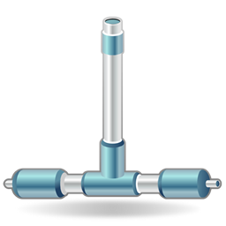



Managing the unmanaged
Data governance for unstructured data
  Access Controls,
  Rights Management
  Retention, Auditing
  Expiration, Backup
Option 1: Reactive - Do nothing until you have to
Predictable cost (just add storage)
Potentially enable Bitlocker to encrypt the disk that the data resides on
Potential high cost when a need comes up (Audit, eDiscovery, Leakage …)
Option 2: Proactive – Taking steps towards Data governance on file servers
Get insight into information and apply policy
Start with one department (e.g.: Finance) and expand to additional departments
Expire data to reduce cost and risk
Apply common data governance policies: Encryption, Retention

Slide 7
Addressing Data Compliance using File Classification Infrastructure & Data Classification Toolkit for Windows Server 2008 R2

Slide 8

Manage Data Based On Business Value
  Step 1
Classify
Data
Apply policy according to classification
  Step 2

Slide 9

How do we do it?
  File Server
  Classify
  (Manual/Automatic)
Properties
  Classification
  Engine
  File Shares
Rules
File Management Tasks
  Apply Policies
  Access Controls,
  Rights Management
  Retention, Auditing
  Expiration, Backup
High Business Value
Low Business Value

Slide 10
Introducing Data Classification Toolkit For Windows
Server 2008 R2
Solution Accelerator

Slide 11
Data Classification Toolkit
Solution Accelerator
Knowledge
Establish Classification Baseline
IT GRC Integration
Map to compliance requirements
Demonstrate IT data governance & compliance for audits
Multiple File Server Support
Reduce manual labor
Provide Information governance policies
Maintain Consistency across file Servers
Aggregated Reporting
Reporting

Slide 12
Knowledge Development Approach
Goals
Simple ontology to be used across Windows Servers
Actionable based on data governance and protection policies
Harmonized
Validated
Ships required terms, extensible by customers
Authoritative
Health Industry (HIPAA/HITECH)
Privacy Laws (PII)
Applicable to hundreds of authority documents
Reviewed by IT pros, legal, auditors, customers in the Industry
Financial Industry (Sarbanes-Oxley)
US Government (NIST 800-60)
Credit Card Industry (PCI-DSS)

Slide 13
Knowledge – Classification Properties
Area | Properties | Values
Information Privacy | Personally Identifiable Information | High; Moderate; Low; Public; Not PII
 | Protected Health Information | High; Moderate; Low
Information Security | Confidentiality | High; Moderate; Low
 | Required Clearance | Restricted; Internal Use; Public
Legal | Compliancy | SOX; PCI; HIPAA/HITECH; NIST SP 800-53; NIST SP 800-122; U.S.-EU Safe Harbor Framework; GLBA; ITAR; PIPEDA; EU Data Protection Directive; Japanese Personal Information Privacy Act
 | Discoverability | Privileged; Hold
 | Immutable | Yes/No
 | Intellectual Property | Copyright; Trade Secret; Parent Application Document; Patent Supporting Document
Records Management | Retention | Long-term; Mid-term; Short-term; Indefinite
 | Retention Start Date | <Date Value>
Organizational | Impact | High; Moderate; Low
 | Department | Engineering ;Legal; Human Resources …
 | Project | <Project>
 | Personal Use | Yes/No

Slide 14
Making it real!!
Gunjan Jain
Solution Accelerator Team
demo

Slide 15






Scenario: Data Compliance Requirements from PCI-DSS
  Payment Card Industry - Data Security Standard
Board of Dir./CEO
Audit Committee
Control Objectives
Data Classification
Data Protection
CIO/CSO
Control Activities
Classify Data containing PII
RMS Protect Data containing PII
IT Pro

Slide 16
Implementing control activities
Gunjan Jain
Solution Accelerator Team
demo

Slide 17
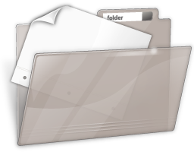



Scenario: Data Classification & Protection
PCI-DSS
Implement
Controls for PCI-DSS
Create
Classification Baseline
for PCI-DSS
(Import & Customize)
IT Pro
Classify & Apply Policies

Slide 18
Apply classification baseline across multiple file servers
Gunjan Jain
Solution Accelerator Team
demo

Slide 19

Scenario: Apply classification baseline to all File Servers
PCI-DSS
Create Baseline
for PCI-DSS
(Import & Customize)
Implement
Controls for PCI-DSS
IT Pro
Classify & Apply Policies
Export Baseline
Apply Baseline to all
File Servers
Baseline
Classify & Apply Policies

Slide 20
Validate and monitor controls through reporting
Gunjan Jain
Solution Accelerator Team
demo

Slide 21



Scenario: Validate and Monitor
PCI-DSS
Create Baseline
for PCI-DSS
(Import & Customize)
Implement
Controls for PCI-DSS
IT Pro
Classify & Apply Policies
Export Baseline
Validate
Auditor / Compliance Manager
Apply Baseline to all
File Servers
Baseline
Reports
Classify & Apply Policies
Monitor
IT Pro

Slide 22
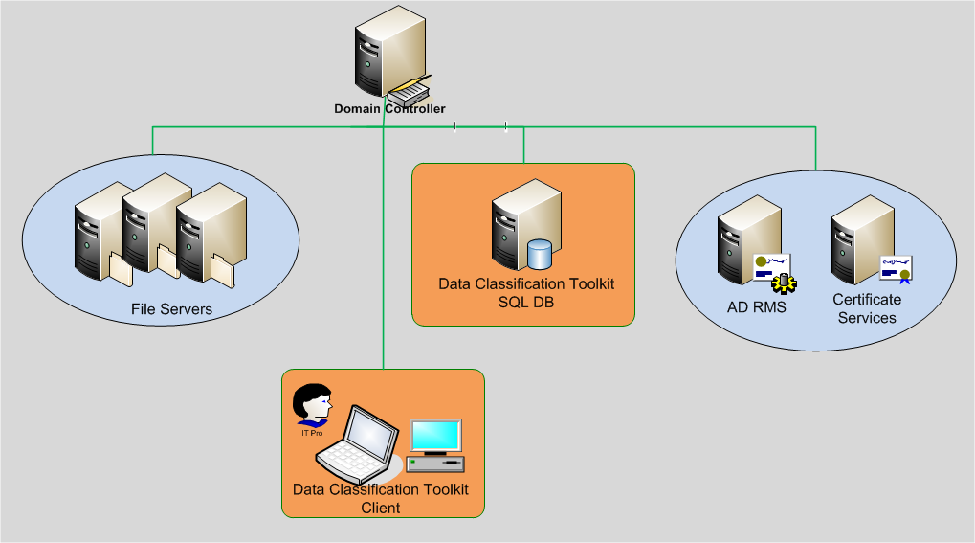
Demo – Tying it all together!
2. Classify & Apply Policies
3. Collect
1. Configure
4. Report

Slide 23




Data Classification Toolkit & System Center
Working together!
IT GRC Process Management Pack
(Regulations, Controls)
  PCI – DSS (Regulation)
Board of Dir./CEO
Audit Committee
Control Objectives
Data Classification
Data Protection
CIO/CSO
Control Activities
Data Classification Toolkit
(Knowledge + Multiple File Server Support)
Classify Data containing PII
RMS Protect Data containing PII
File Server & FCI
IT Pro

Slide 24
An Auditor’s View…
Shahed K. Latif
Partner / Information Protection
KPMG
partner

Slide 25

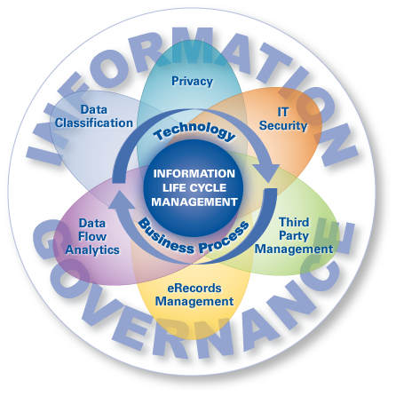
Information Governance
Does the business comply with employee, customer, and third party privacy requirements?
Are controls designed in accordance with information asset value and risk?
Are resources allocated in accordance with value and risk?
Are data protection needs communicated to the PMO, Internal Audit, Legal, BI, etc.?
Who has access to what?
Do incident response programs adequately address data breaches?
Are tools used to restrict data leakage and loss?
Do controls protect the quality, integrity, completeness, and availability of data?
How are employees trained?
Shahed K. Latif
Partner
Information Security
KPMG
Where does information come from and where does it go?
Is the organization adequately profiting from the use of information?
Which processes, and what data, drives business value and risk?
Do contract terms and/or SLAs reflect information asset requirements and controls (owned and managed)?
Is proper notification provided in the event of data breach?
Is IT effectively collecting, organizing, storing, retrieving, and disposing of electronic data and content?
Is data duplication, redundancy, and exposure minimized?

Slide 26
Case Study
Global Manufacturer and Marketer of Major Home Appliances
Client Industry / Description
Consumer Products
Client Challenge
The client requested assistance with identifying, defining, classifying, and locating information assets and (data) owners for the organization’s consumer data, employee data, and intellectual property related to product engineering. This project was the first component of a larger initiative to implement a global security risk management program for the organization.
Approach
KPMG began by conducting a current state assessment to identify existing data classification procedures and to evaluate high-level information handling practices. KPMG then designed a data classification framework to identify, label , and define security control requirements for confidential data. Utilizing a GRC tool, we then utilized end-user surveys to identify and define confidential data types across several departments and calculate an inherent risk of each of those data types based on the sensitivity of the information and its usage. In addition, KPMG created a data classification charter for the organization, provided recommendations for updating their existing corporate information classification policy, and developed technical data handling standards.
Outcomes
This project allowed the client to identify and locate its most critical data across the organization, as well as established policies and processes for assessing the risks and controls related to the storage, processing, and transmission of those information assets.

Slide 27
What’s next?!

Slide 28



Call To Action – Sign up Now for Beta!
Beta Q2 2011, RTW Q3 2011
Q3
DCT RTW
DCT Beta
Q3
WS08 R2 SP1
Q2
IT
GRC PMP SP1
2011
IT GRC PMP
Q1
2010
Q4

Slide 29

Related Content
WSV325: Security configurations simplified with the Microsoft Security Compliance Manager (Wed 3:15pm - 4:30pm)
WSV317 Windows Server 2008 R2 File Services Consolidation: Technology Update (Thurs 10:15am – 11:30am)
WSV314 Microsoft Assessment and Planning (MAP) Toolkit 5.5 Enhanced Server Consolidation Assessments for Hyper-V (Thurs 4:30pm – 4:45p)
Find Us Later in Exhibition Hall At…
  WSV23 - File Services & Windows Storage Server 2008 R2 Booth
  Microsoft Solutions Accelerators Booth

Slide 30
Track Resources
Sign Up now for Data Classification Toolkit for Windows Server 2008 R2 Beta
Submit feedback for Solution Accelerator through secwish@microsoft.com
Compliance Solution Accelerators Home: www.microsoft.com/grc
File Classification Infrastructure: www.microsoft.com/fci

Slide 31
Track Resources
Don’t forget to visit the Cloud Power area within the TLC (Blue Section) to see product demos and speak with experts about the Server & Cloud Platform solutions that help drive your business forward.
You can also find the latest information about our products at the following links:
Cloud Power - http://www.microsoft.com/cloud/
Private Cloud - http://www.microsoft.com/privatecloud/
Windows Server - http://www.microsoft.com/windowsserver/
Windows Azure - http://www.microsoft.com/windowsazure/
Microsoft System Center - http://www.microsoft.com/systemcenter/
Microsoft Forefront - http://www.microsoft.com/forefront/

Slide 32





Resources
  Connect. Share. Discuss.
http://northamerica.msteched.com
Learning
  Sessions On-Demand & Community
  Microsoft Certification & Training Resources
www.microsoft.com/teched
www.microsoft.com/learning
  Resources for IT Professionals
  Resources for Developers
http://microsoft.com/technet
http://microsoft.com/msdn

Slide 33












Complete an evaluation on CommNet and
enter to win!

Slide 34


Slide 35

© 2011 Microsoft Corporation. All rights reserved. Microsoft, Windows, Windows Vista and other product names are or may be registered trademarks and/or trademarks in the U.S. and/or other countries.
The information herein is for informational purposes only and represents the current view of Microsoft Corporation as of the date of this presentation. Because Microsoft must respond to changing market conditions, it should not be interpreted to be a commitment
on the part of Microsoft, and Microsoft cannot guarantee the accuracy of any information provided after the date of this presentation. MICROSOFT MAKES NO WARRANTIES, EXPRESS, IMPLIED OR STATUTORY, AS TO THE INFORMATION IN THIS PRESENTATION.

