Slide 2

Windows Server 2008 R2: Tips for Automating the Breadth of Your
IT Environment
WSV316
Dan Harman & Mir Rosenberg
Senior Program Managers
Microsoft Corporation

Slide 3
AGENDA – Hidden
DH – 5 – Intro
MR – 10? -
DH – TBD -
MR – 10? -
DH – TBD -

Slide 4
DH

Slide 5
What We Hear from Customers
Why and what should I automate?
How do I automate my IT operations?
How do I automate hardware operations?
How do I automate across Firewalls?
How do I automate ALL of my machines?
Notes:
The biggest difference is our focus on addressing real customer problems. We’ve spent a lot to time talking to you and here are some the questions I get asked all the time.

Slide 6
How We Think About Management
User Experience
I have the right tools to get the job done
Access
I can manage anything from anywhere
Automation
I can reduce errors, complexity, and repetition through automation
Access
User Experience
Automation
Notes:
The other major difference is the comprehensiveness of the approach we are taking to answer those questions. We’ve come a long way from the days of putting a GUI on top of a developer API and calling it a management GUI. We now have what we call the Windows Management Framework. This is the conceptual view of the WMF.

Slide 7


Windows Management Framework
UX
Server Management
Rich Solutions
  Task oriented
  User customizable
  3rd party extensible
Server
Manager
Migration
PowerShell
ISE
BPA
Access
Remote & Multi-Machine Management
Remote Access
  Scalable and flexible
  Ubiquitous
  Firewall friendly
RSAT
PS Remoting
Automation Platform
Automation Environment
Windows PowerShell
  Intuitive command shell
  Powerful scripting language
  Universal execution environment
PowerShell Engine
Services
Management Protocols
Protocols & Services
  Standards-based
  OS or bare hardware
  Robust and network-aware
BITS
WSMan
WMI

Slide 8
How Do I Automate
My IT Operations?
Notes:
Each time we release an Server OS it is faster, more secure, more reliable and has a ton of great features that users have asked for. And yet, it always takes a while for customers to deploy it.
Benefits vs costs and risks.
Automation is a key source of cost & risk.

Slide 9
Mir

Slide 10
Automating IT Operations
Formal
  Standards-based management
  Formal schemas and protocols
  Nice world, when you can get it
  WMI
Informal
  Glue together text, COM, WS, AD, .NET, XML, native code, etc.
  Create your own abstractions and/or community scripts
  Cope with the world as you find it
  PowerShell

Slide 11
What Is CIM?
Common Information Model
Open standard defined by the Distributed Management Task Force (DMTF) for managing systems, networks, applications, and services
CIM defines:
  Schema - standardized model for management objects: processes, computers, printers, etc.
  Profiles - collections of CIM models and associated behaviors for particular management areas: power, virtualization, storage, etc.
CIM defines a consistent way to manage everything in your environment

Slide 12
What Is WMI?
Windows Management Instrumentation
DCOM access to CIM on Windows
  Common way to expose management objects from COM and .NET
  Common interface for clients: VBScript, C++, .NET, command-line tools, Windows PowerShell
  Remoting over DCOM and eventing for all management objects
Windows components and 3rd party applications include WMI providers to manage them
Windows PowerShell provides a consistent user experience that simplifies discovery and manipulation of WMI objects
WMI allows formal remote management of Windows

Slide 13
Automating IT Operations:
WMI
Mir Rosenberg
Senior Program Manager
Microsoft Corporation
demo
Notes:
Basic WMI, WSMAN, PowerShell demo

Slide 14
DH

Slide 15
What Is Windows PowerShell?
Microsoft’s strategic automation platform
Implements a revolutionary scripting language
Includes a set of default interactive shells and basic commands
  Windows PowerShell console host
  Windows PowerShell Integrated Scripting Environment (ISE)
Provides hosting and extension APIs
  Embed PowerShell engine into other applications, including GUIs
  Expand default functionality with custom cmdlets, providers, etc.
Adapts many type systems and data formats to a common user experience
PowerShell enables IT Pros to create their own solutions
Notes:
Many → many different

Slide 16
Remote Management via PowerShell
Ubiquitous remoting and execution environment
  Local or remote
  On a single or multiple machines
  Interactively or in the background
  Immediately or in response to events
  Full, unrestricted or delegated, restricted environments
  Variety of authentication schemes
Support for delegated administration and hosted services
  Control over who can run what and where using restricted runspaces
  Ability to host PowerShell over WSMan in IIS for delegated administration
    Support for LiveID, custom authorization, and quotas
    Customize or restrict per-session environment based on user role
    Dynamically create and clean up PowerShell sessions as users connect / disconnect

Slide 17
Automating IT Operations:
PowerShell Remoting
Dan Harman
Senior Program Manager
Microsoft Corporation
demo
Notes:
Basic WMI, WSMAN, PowerShell demo

Slide 18
Mir

Slide 19
How Do I Automate
Hardware Operations?
How Do I Automate
Across Firewalls?

Slide 20
What Is WSMan?
DMTF standard network protocol: Web Services for Management
Industry standard protocol to access CIM
  Defines client and server roles
  Defines a common set of operations to access management objects
  Works across firewalls
  Implemented by various hardware and software vendors
Windows exposes WMI classes via WSMan
Microsoft extensions to WSMan enable PowerShell remoting
  1-1
  1-many
  many-1
WSMan is Web Services access to CIM on heterogeneous devices

Slide 21
Managing Devices with WSMan
SMASH: Systems Management Architecture for Server Hardware
DMTF initiative designed to provide out-of-band management of servers independent of:
  Hardware machine state
  Operation system state
  Server system topology
  Access method
DASH: equivalent of SMASH for Desktops
SMASH / DASH Profiles define modules to administer machines directly
  SMASH: Power on / off, configure BIOS, upgrade firmware, configure hypervisor, etc.
  DASH: Manage disk volumes, boot order, software inventory, network settings, etc.
WSMan cmdlets enable access to DASH/SMASH capabilities
Scripts from the PowerShell community make the most common tasks easy

Slide 22

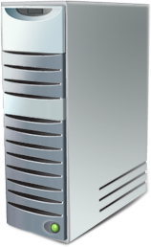
Remote Management via WSMan
Admin
Client
Managed
Server
PowerShell client calls WSMan client APIs
WSMan securely sends and receives SOAP messages
WSMan service calls into the PowerShell plug-in
Commands are executed in their own host process within PowerShell session
PowerShell
Client
WSMan Listener Process
(PowerShell Plug-in)
WSMan Host
Process
PowerShell
Session
PowerShell Provider
WSMan
Client
HTTP(S)
WSMan
WSMan Provider Proxy

Slide 23
Automating Hardware
Operations
Mir Rosenberg
Senior Program Manager
Microsoft Corporation
demo

Slide 24
How Do I Automate
ALL of My Machines?

Slide 25
Server Core
WMI and WSMan on by default
SConfig for initial configuration
PowerShell

Slide 26
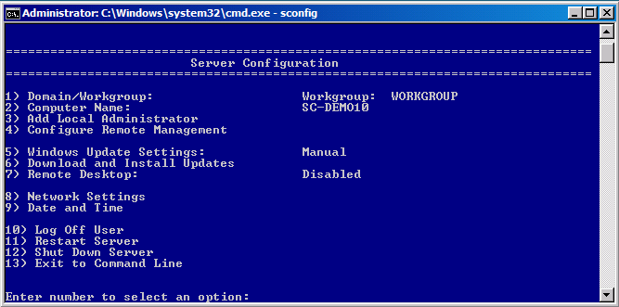
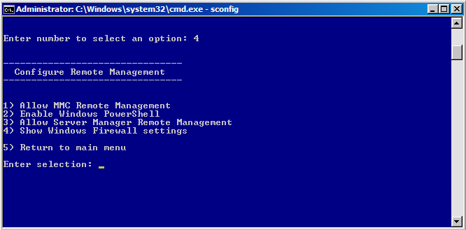
SConfig
New script to ease initial configuration

Slide 27

PowerShell in Server Core
Full Command-line PowerShell
  Dism /Online /Enable-Feature /FeatureName:MicrosoftWindowsPowerShell
Server Manager cmdlets
  Dism /Online /Enable-Feature /FeatureName:ServerManager-Psh-Cmdlets
  Import-Module ServerManager
  Get-WindowsFeature
  Add-WindowsFeature
  Remove-WindowsFeature
Best Practice Analyzer cmdlets
  Dism /Online /Enable-Feature /FeatureName:BestPractices-Psh-Cmdlets
  Import-Module BestPractices
  Invoke-BPAModel
  Get-BPAResult
  Set-BPAResult
Notes:
# Scripts and cmdlets are limited like any other code or script

Slide 28
DH

Slide 29
Windows Management Framework
Downloadable to all machines XP SP2 and above
  http://support.microsoft.com/kb/968929
Contains:
  Windows PowerShell 2.0
  WinRM 2.0 (WSMan)
  BITS 4.0

Slide 30
Cmdlet Remoting
Cmdlet remoting predates ubiquitous PowerShell remoting
Implemented on a per-cmdlet basis
Cmdlet does its own remoting, typically over RPC / DCOM
Look for ComputerName parameter
  Get-Help * -Parameter ComputerName
Examples:
  Get-Counter
  Get-HotFix
  Get-Process
  Test-Connection
  *-EventLog
  *-Service
  *-WMI*
  *-Computer

Slide 31
Cmdlet Remoting
Dan Harman
Senior Program Manager
Microsoft Corporation
demo

Slide 32
Mir

Slide 33
Scripting Battle!
Dan Harman & Mir Rosenberg
Senior Program Managers
Microsoft Corporation
demo

Slide 34
DH

Slide 35
What We Hear from Customers
Why and what do I automate?
  Automate to reduce costs, increase quality and speed
How do I automate my IT operations?
  WMI, WSMan, Windows PowerShell
How do I automate hardware operations?
How do I automate across firewalls?
  WSMan
How do I automate ALL of my machines?
  Windows Management Framework
Notes:
The biggest difference is our focus on addressing real customer problems. We’ve spent a lot to time talking to you and here are some the questions I get asked all the time.

Slide 36
Windows PowerShell Community Resources
Team blog: http://blogs.msdn.com/PowerShell
PowerShell Community: http://www.powershellcommunity.org
PowerShell Forum: http://social.technet.microsoft.com/Forums/en-US/winserverpowershell/threads
Channel 9: http://channel9.msdn.com/tags/PowerShell
Wiki: http://channel9.msdn.com/wiki/default.aspx/Channel9.WindowsPowerShellWiki
Script Center: http://www.microsoft.com/technet/scriptcenter/hubs/msh.mspx
CodePlex: http://codeplex.com/Project/ProjectDirectory.aspx?TagName=powershell
Some good books
  PowerShell in Action, 2nd Edition by Bruce Payette
  http://www.manning.com/payette2
  Windows PowerShell Cookbook, 2nd Edition by Lee Holmes http://oreilly.com/catalog/9780596801519/
  Professional Windows PowerShell Programming http://www.wrox.com/WileyCDA/WroxTitle/productCd-0470173939.html
  PowerShell Comics! http://borntolearn.mslearn.net/comics/b/weblog/archive/2011/04/20/climbing-mt-powershell-comic-book-first-pages.aspx

Slide 37

Related Content
Breakout Sessions
  WSV406 | Advanced Automation Using Windows PowerShell 2.0
  WSV315 Windows PowerShell for Beginners
  WCL321 | Windows PowerShell Remoting: Definitely NOT Just for Servers
  WSV322 | Managing the Registry with Windows PowerShell 2.0
  WSV471-INT | Build Reusable Tools in Windows PowerShell
  WSV473-INT | Windows PowerShell 3.0: Why Wait? Get Next-Generation PowerShell…
  EXL321 | Microsoft Lync Server 2010: Administering Lync Server Deployment
Hands-on Labs
  WSV276-HOL Introduction to Windows PowerShell Fundamentals
  WSV371-HOL Advanced Windows PowerShell Scripting
  WSV378-HOL Server Management and Windows PowerShell V2
Product Demo Stations
  WSV 1 – Windows PowerShell and Server Management

Slide 38
Track Resources
Don’t forget to visit the Cloud Power area within the TLC (Blue Section) to see product demos and speak with experts about the Server & Cloud Platform solutions that help drive your business forward.
You can also find the latest information about our products at the following links:
Cloud Power - http://www.microsoft.com/cloud/
Private Cloud - http://www.microsoft.com/privatecloud/
Windows Server - http://www.microsoft.com/windowsserver/
Windows Azure - http://www.microsoft.com/windowsazure/
Microsoft System Center - http://www.microsoft.com/systemcenter/
Microsoft Forefront - http://www.microsoft.com/forefront/

Slide 39





Resources
  Connect. Share. Discuss.
http://northamerica.msteched.com
Learning
  Sessions On-Demand & Community
  Microsoft Certification & Training Resources
www.microsoft.com/teched
www.microsoft.com/learning
  Resources for IT Professionals
  Resources for Developers
http://microsoft.com/technet
http://microsoft.com/msdn

Slide 40












Complete an evaluation on CommNet and
enter to win!

Slide 41

Notes:
New for TechEd 2011, we will be working with Microsoft Tag (http://tag.microsoft.com/overview.aspx) to create unique Tags for every session at the event. Your session Tag will appear on both the room signage and at the end of your presentation. With your session Tag, attendees will be able to scan as they enter the room to retrieve session details, view speaker bios, and engage in discussions; or scan at the end of the presentation to evaluate your session and download materials. We’re excited to integrate Microsoft Tag across the My TechEd mobile experience this year.

Slide 42

© 2011 Microsoft Corporation. All rights reserved. Microsoft, Windows, Windows Vista and other product names are or may be registered trademarks and/or trademarks in the U.S. and/or other countries.
The information herein is for informational purposes only and represents the current view of Microsoft Corporation as of the date of this presentation. Because Microsoft must respond to changing market conditions, it should not be interpreted to be a commitment
on the part of Microsoft, and Microsoft cannot guarantee the accuracy of any information provided after the date of this presentation. MICROSOFT MAKES NO WARRANTIES, EXPRESS, IMPLIED OR STATUTORY, AS TO THE INFORMATION IN THIS PRESENTATION.
Notes:
34 without hidden slides

Slide 43
Why Learn PowerShell?

Slide 44
PowerShell Value Proposition
Pathway to a “Think, Type, Get” world of automation
YOUR high-level, task-oriented abstractions
  Built on someone else’s high-level, task-oriented abstractions
    Windows’, Microsoft’s, ISVs’, the community’s, your buddy’s, etc.
  Enables you to cope and tame a messy heterogeneous world
    Support for .NET, COM, AD, XML, Text parsing, Web Services, native code
Supports the full range of automation
  “Quick and dirty” ⬄ “Formal production quality”
Easy to change as your environment changes
Automation at the speed of thought

