Slide 1

Get Out Of Dodge:
Migrating to Server 2008 R2
WSV310
Rick Claus
Sr. Technology Evangelist
Microsoft - Canada, eh?
Twitter: @rickstercdn

Slide 2
Agenda – Real Simple…
Set the stage – where’s your infrastructure at?
Intro Session Scenario – Contoso inc.
Demos
More Demos…
Even More Demos!
Action Plan

Slide 3
Favourite Quote from a Customer:
If I had a dog when I deployed my infrastructure…
…it would be dead by now.

Slide 4
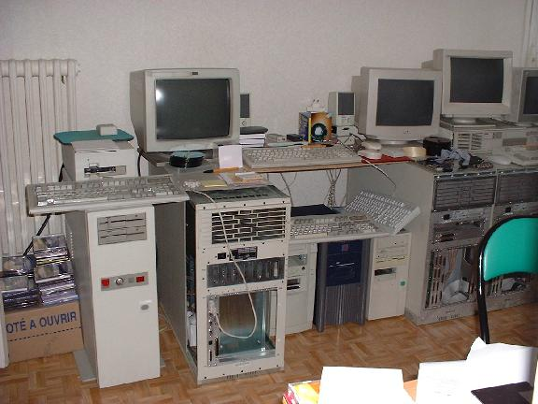
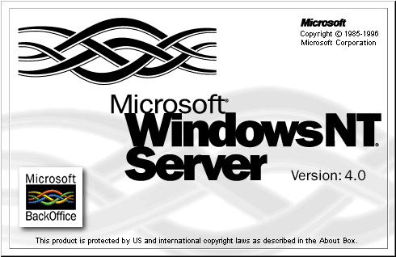
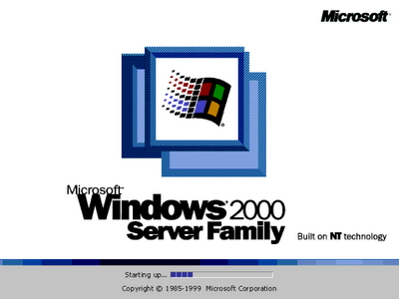
Core Infrastructure services could be over
11 years old…
What did their infrastructure look like?
What projects were they workin’ on?
Customer Motto:
If it ‘ain’t broke, don’t touch it!

Slide 5
Scenario for this Session – Contoso Bank
Running Active Directory @ 2003 levels
  Upgrade process underway
Multiple regional offices
Core infrastructure on aging hardware
  AD Integrated DNS
  DHCP
  File & Print
  Certificate services
No external consulting resources available to assist

Slide 6
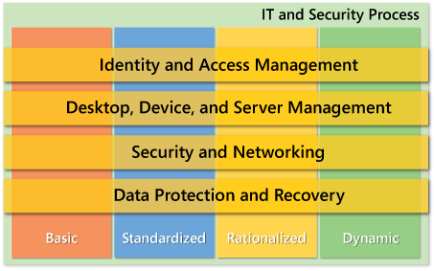
“Challenges” at Contoso
Time constraints
Budgetary / project status recognition
IT Department viewed as a cost center
Evaluated at the Basic level for IO Maturity model

Slide 7
Migration vs. In-Place Upgrade
Migration moves configurations and data
  Sources an existing server
  Targets a computer with a clean installation of an
  Operating System
In-place Upgrade replaces the Operating System
on an existing computer
  Configurations and data are carried forward
  Just the OS is replaced

Slide 8
Upgrade or Migration?
X86 = NO DIRECT “in place” UPGRADE PATH
:-(

Slide 9
Benefits of Migration
Provides a transition path from:
  x86 to x64 OS (WS08R2 is x64 only)
  Physical to virtual (and vice versa)
  Full server to server core (and vice versa)
Clean operating system installs = stability
Reduces risk and downtime
  OS installation and most migration tasks are performed while the source server is still live
  Allows migration verification and performance benchmarking prior to bringing the target server “online”
  Source server remains available if migration fails

Slide 10
Why Don’t You Do It?
Overwhelmed
We
Can
Help
No budget – no line of site
Lack of expertise
Lack of time
Keeping the lights on
Overloaded
Always other priorities
Waiting for SP1
Is it going to be better?
Fear of the unknown?
Don’t know where to start
Working on other projects
It just works, why change?

Slide 11
TechNet Portal (now TN Library article)
Single place for all Windows Server 2008 R2
migration information
Provides links to important related docs and tools
(e.g. Infrastructure Assessment and Planning, Solution Accelerators)
Links to the related community content (migration
forums, blogs, tools and scripts)

Slide 12
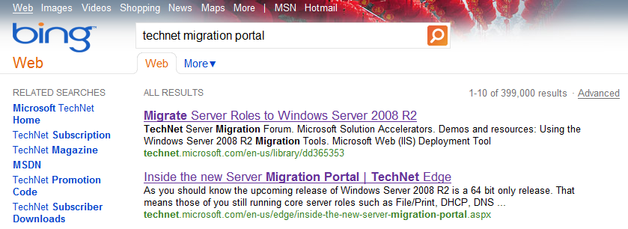
I’m in – Where can I find this?
Shorter URL:
  http://www.microsoft.com/migration

Slide 13
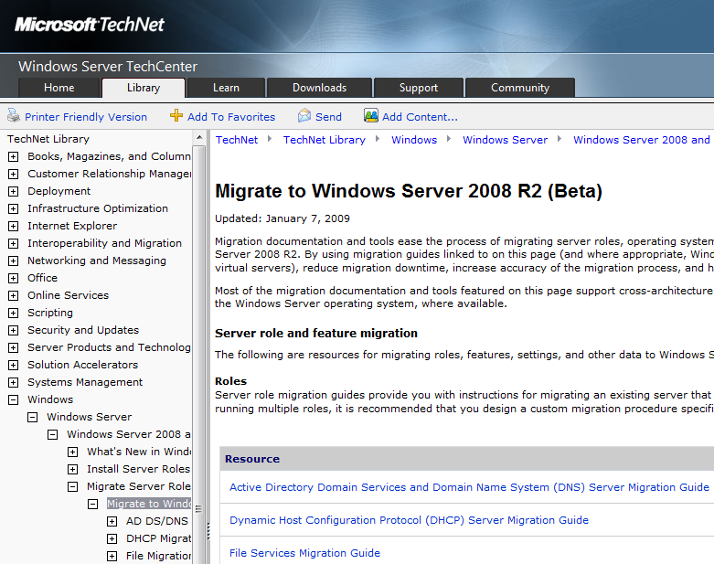
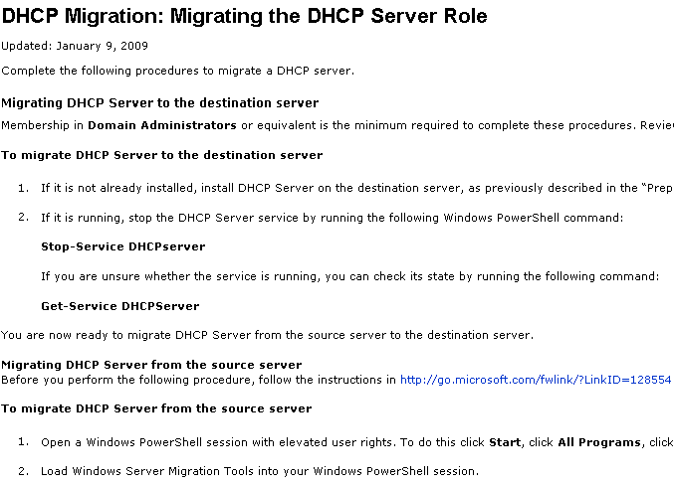

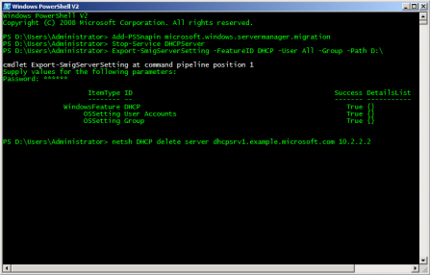
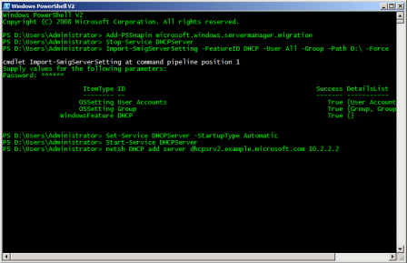
Migration Process
?
TechNet Migration Portal
Migration Guidelines
Discover
Prepare
Temp Storage
Export
Settings
Import
Settings
Source Server
Destination Server
Transfer Configuration and Shares
Export-SmigServerSetting
Send-SmigServerData
Import-SmigServerSetting
Receive-SmigServerData

Slide 14
Supported Scenarios
Source Server OS | WS03, WS03R2, WS08 Full, WS08 R2 Full or Core
Source Server Architecture | x86 or x64
Source Server Platform | Physical or Virtual
Destination Server OS | WS08R2, x64; Full Server, Server Core; Physical, Virtual
Server Roles | ADDS, DHCP, DNS, File, Print
Server Features | BranchCache ™
Settings and Data | Local Users and Groups, IP Configuration (IPv4 and IPv6), Data and Shares

Slide 15
Seize the Opportunity
Doing same thing will lead to same results
Core Installs of Server 2008 R2 vs full installs
Physical or Virtual?
Minimize impact on rollout process

Slide 16
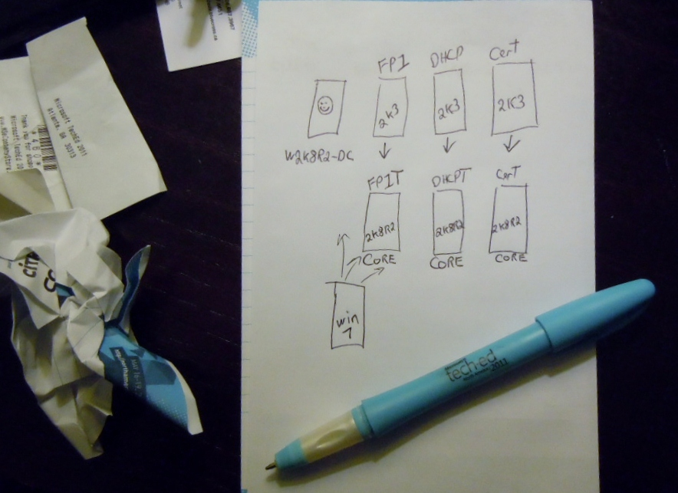
Let’s Get ‘er done!
(insert diagram of reference network of Contoso)
Planning Guide for Contoso Inc

Slide 17
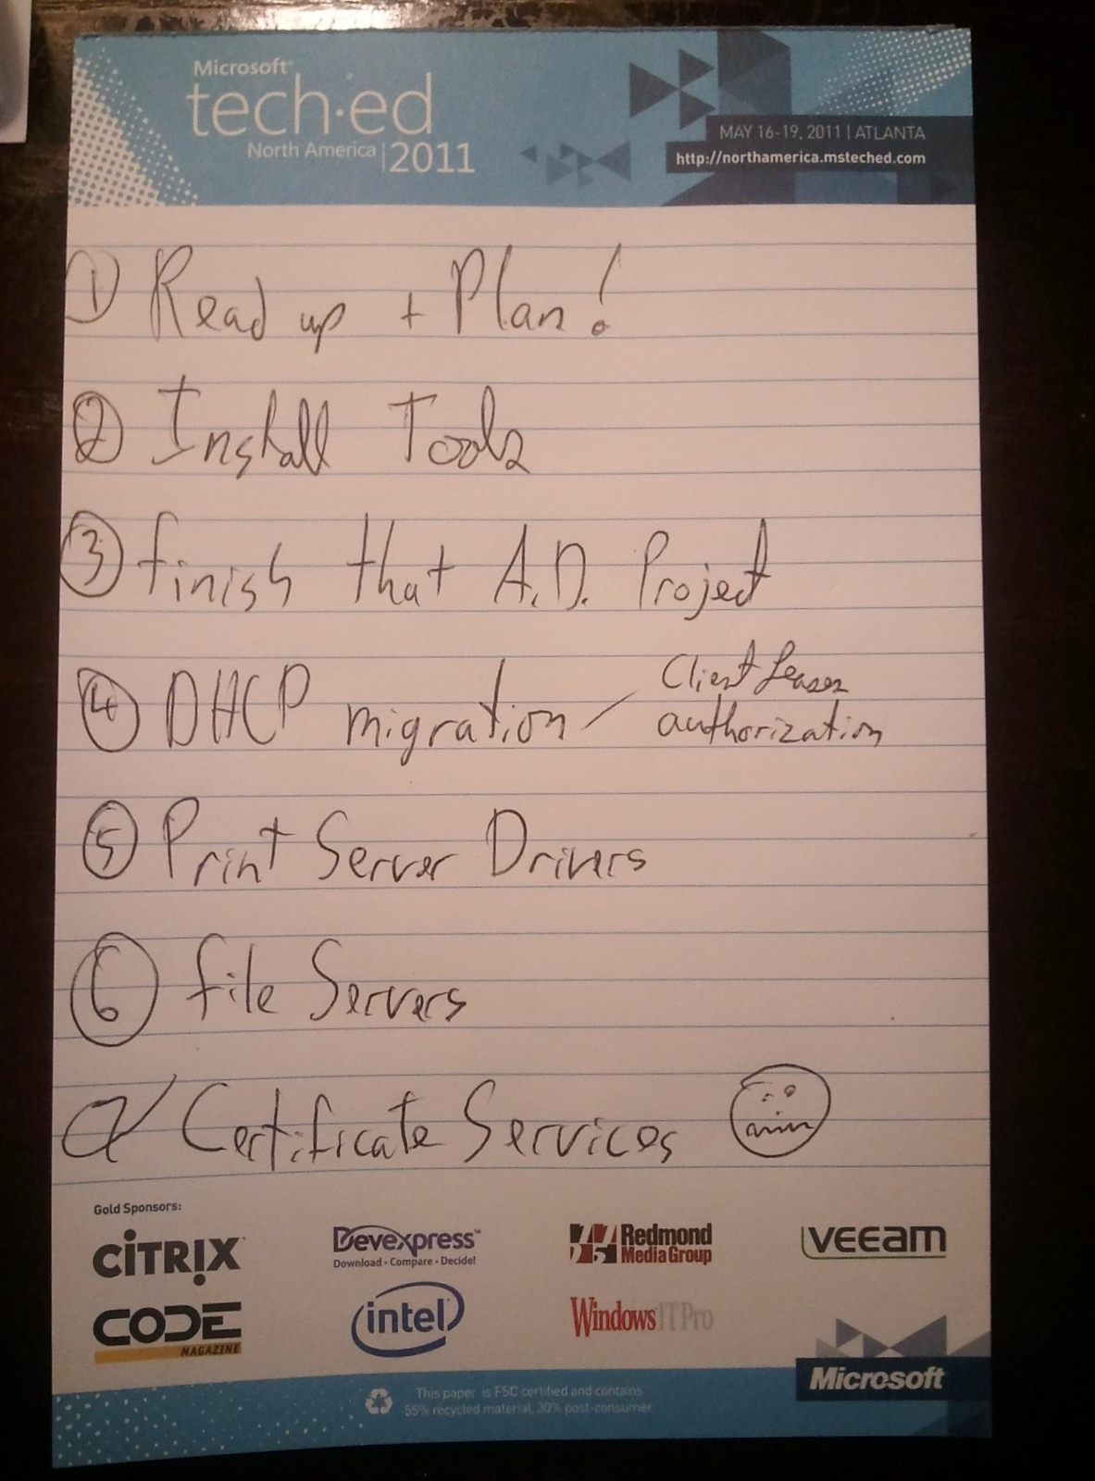

Slide 19
Destination Server Setup
Windows Server 2008 R2
Step 1
Step 2
Step 3
Add the Windows Server Migration Tools Feature
Generate Windows Server Migration Tools deployment folder for appropriate source OS
Use SmigDeploy with appropriate switches

Slide 20
Source Server Setup
Windows Server 2003 SP2 / R2
Step 1
Step 2
Step 3
Step 4
Ensure sufficient disk space for the Windows Server Migration Tools deployment folder (~25MB)
Install prerequisites:
  Microsoft .NET Framework 2.0 or higher
  Windows PowerShell 1.0 or higher
Copy the Windows Server Migration Tools deployment folder locally
Register the Windows Server Deployment Tools

Slide 21
Migration Tools Install
It ain’t pretty, but it’s easy enough.
demo

Slide 22
Windows Server Migration
Get-SmigServerFeature | Discovers features available for migration and features in the migration store available for import
Export-SmigServerSetting | Exports specified role, feature and OS settings to a migration store
Import-SmigServerSetting | Imports specified role, feature and OS settings from a migration store
Send-SmigServerData | Transfers data and shares preserving local and domain permissions
Receive-SmigServerData | Receives transferred data

Slide 24
Active Directory & DNS
Migration
Step 1
Step 2
Step 3
Search for
“Rick Claus WSV330”
on Bing
Get a coffee
Watch TechEd
Recorded Session

Slide 26
DHCP Migration
Pre-Migration
Step 1
Step 2
Step 3
Step 4
Verify that the number of NICs match on the source and destination servers
On the Source:
  Back up
  Install the migration tools
  Register the migration tools
  Stop the DHCP service
On the Destination:
  Install OS and migration tools
  Join domain
  Optional – install DHCP and stop the service
Proceed to Migration

Slide 27
Migration of DHCP
The good, the bad, the DHCPACK.
demo

Slide 28
DHCP Migration
Post-Migration
Step 1
Step 2
Step 3
Troubleshoot migration if necessary
Roll back migration if necessary
Retire Source Server if migration successful

Slide 30

Print Server Migration
Pre-Migration
Migration
Post-Migration
Access migration tools
Prepare source server
Back up printer settings on source server
Restore printer settings to the destination server
Migrate server identity
Verify the migration
If problems, troubleshoot migration
Roll back migration
If successful, retire source server

Slide 31
Print Server Migration
.Mix of tools – choose your pain
demo

Slide 33
File Server Migration
Pre-Migration
Step 1
Step 2
Step 3
Step 4
On the Source:
  Back up full server or system state
  If you are migrating DFS, back up ADDS
Inventory files, settings, DFS namespaces and replication settings to be migrated
Determine the File Services installed
On the Destination:
Install OS and migration tools
Join domain
Install the same File Services
Notify users and ask them to stop using the server
Proceed to migration

Slide 34
File Server Migration
Migration
Step 1
Step 2
Step 3
Step 4
On the Source:
Freeze administrative changes
Export settings
Migrate local Users and Groups
Migrate the data from source to destination servers twice*
Migrate server identity
Optional – Migrate IP address
On the Destination:
Configure DFS replication
Import settings

Slide 35
File Server Migration
.Sending the bits – encrypted like.
demo

Slide 36
File Server Migration
Post-Migration
Step 1
Step 2
Step 3
Step 4
Verify the migration
Troubleshoot migration if necessary
Roll back migration if necessary
Retire Source Server if migration successful

Slide 38
Certificate Services Migration
Step 1
Step 2
Step 3
Step 4
Prepare you destination server
Enable remote management
Backup CA Template List (for ent. CA)
Record CA’s CSP and signature algorithm
Publish a CRL with extended validity period
Backup CA database and private key
Backup CA registry settings
Backup CAPolicy.inf
Remove the CA role
Remove the source server from the domain
Rename & join destination server to domain
Add CA role
Restore CA database & config
Grant permissions on AIA and CDP containers

Slide 39
Certificate Services Migration
.Not about the tools –
It’s the person and the process
demo

Slide 41
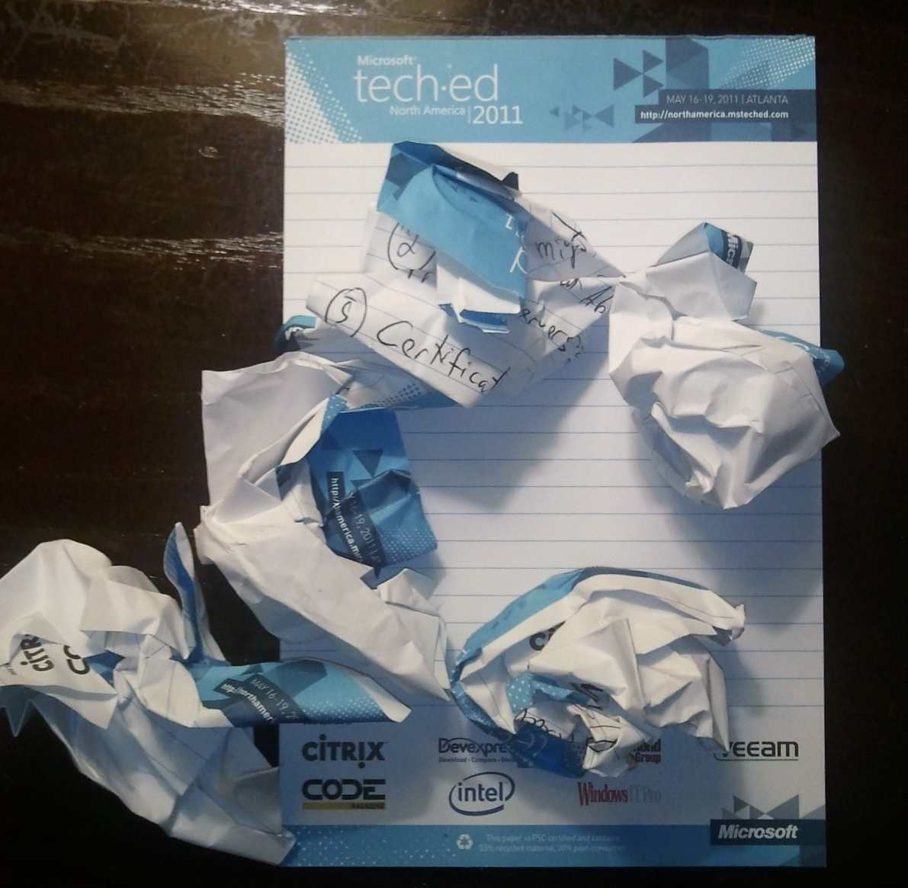

Slide 42


Slide 43
We
YOU
Can
Help

Slide 44
Action Plan
Do you planning
Test tools out and trial in lab
Seize Opportunity for change
  Virtualization
  Core Installs
Test your back out strategy
Document your plan

Slide 45
Resources – TechNet Articles
Migrate Server Roles to Windows Server 2008 R2
Windows Server Migration Tools Installation
DHCP Server Migration: Preparing to Migrate
Print Services Migration Guide
File Services Migration: Preparing to Migrate
Certificate Services Upgrade and Migration

Slide 46

Track Resources
Don’t forget to visit the Cloud Power area within the TLC (Blue Section) to see product demos and speak with experts about the Server & Cloud Platform solutions that help drive your business forward.
You can also find the latest information about our products at the following links:
Cloud Power - http://www.microsoft.com/cloud/
Private Cloud - http://www.microsoft.com/privatecloud/
Windows Server - http://www.microsoft.com/windowsserver/
Windows Azure - http://www.microsoft.com/windowsazure/
Microsoft System Center - http://www.microsoft.com/systemcenter/
Microsoft Forefront - http://www.microsoft.com/forefront/

Slide 47





Resources
  Connect. Share. Discuss.
http://northamerica.msteched.com
Learning
  Sessions On-Demand & Community
  Microsoft Certification & Training Resources
www.microsoft.com/teched
www.microsoft.com/learning
  Resources for IT Professionals
  Resources for Developers
http://microsoft.com/technet
http://microsoft.com/msdn

Slide 48












Complete an evaluation on CommNet and
enter to win!

Slide 49


Slide 50

© 2011 Microsoft Corporation. All rights reserved. Microsoft, Windows, Windows Vista and other product names are or may be registered trademarks and/or trademarks in the U.S. and/or other countries.
The information herein is for informational purposes only and represents the current view of Microsoft Corporation as of the date of this presentation. Because Microsoft must respond to changing market conditions, it should not be interpreted to be a commitment
on the part of Microsoft, and Microsoft cannot guarantee the accuracy of any information provided after the date of this presentation. MICROSOFT MAKES NO WARRANTIES, EXPRESS, IMPLIED OR STATUTORY, AS TO THE INFORMATION IN THIS PRESENTATION.

