Slide 1

Taking High Performance Computing to the Cloud: Windows HPC and Windows Azure
WSV206
Wenming Ye
Technical Evangelist
Microsoft Corp.

Slide 2
Agenda
Goals
  Understand on-premises HPC vs in Windows Azure
  Learn what’s best suited for burst to Azure from HPC
  See how to scale up and out in the Cloud
How we’ll get there
  Introduction
  Applications in Azure
  Applications on-premises
  Azure and HPC integration
  Summary

Slide 3
Introduction

Slide 4
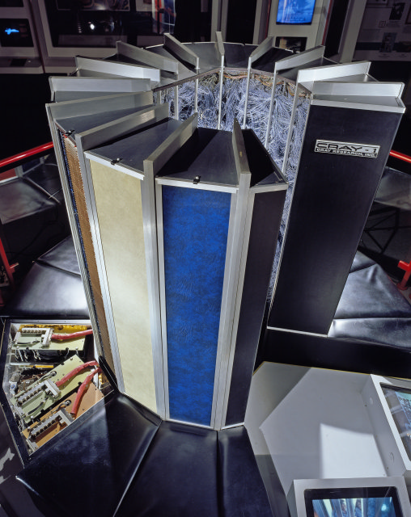









What is High Performance Computing?
Solve large computational problems
HPC is best described as massively parallel
High bandwidth, low latency, cluster-based
Becoming critical part of R&D for businesses
Traditionally required specialized staffing
1991
1998
2008
X64 Server
$40,000,000
$1,000,000
$1,000

Slide 5
Zero-One-Infinity Goal for Computational Workload
0: Your Initial Investment or barrier for entry
1: Utilization Efficiency of your Application (100%)
∞: Scale your Application to as many cores as possible

Slide 6
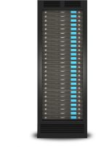

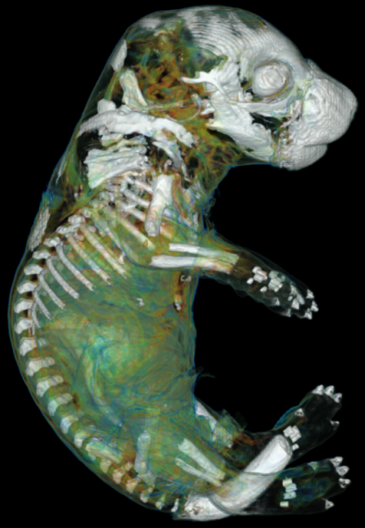
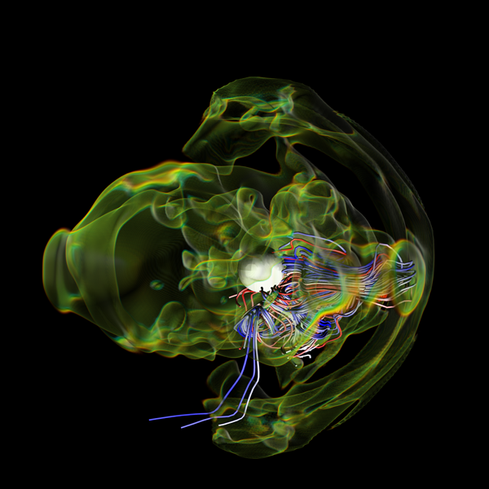
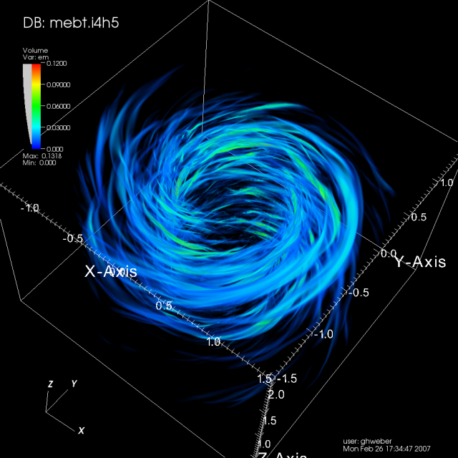
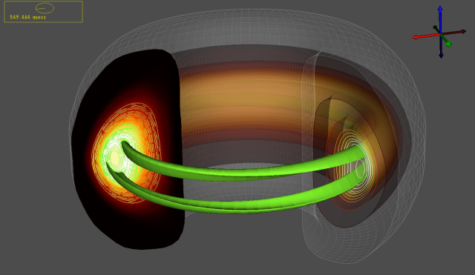
Advances in technical computing and research are powered by access to computing resources
Barrier to entry for technical workloads
Fast, powerful hardware cheaper more readily available, but…
Windows Azure lowers the startup and administrative costs to almost nothing
How Do we take existing technical workloads onto azure?

Slide 7
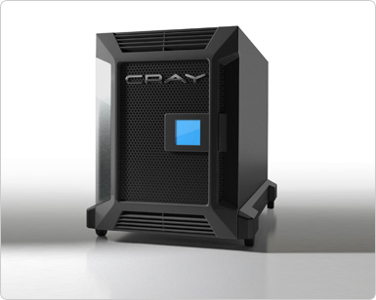
My Cray CX1 Cluster vs. Windows Azure
 | My CRAY CX1 | Windows Azure Only
Initial cost: | Planning, Hardware, Space, Power, Cooling, $10000s | Get an account.
Cost of ownership: | Maintenance, Staff, Power, Backups, Internet, Storage, Down time, Disk failures, Paying for idle computing! | Pay as you go, limited only by your budget
Suitable Applications: | MPI problems require high speed network. HPC Batch Scheduler System | Applications without much traffic. No HPC batch submission engine
Node interconnects: | 20 Gbps Infini-band! | 1 Gbps Ethernet
As an officemate: | No! | Silent and Invisible
CPU & Memory Hardware: | Dedicated 8 nodes with 8 cores &16gb | N+1 nodes 8 cores &16gb
Access to My data: | LAN Connection | Internet Connection first upload LAN Connection if already in blob

Slide 8


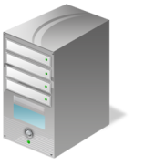




Windows HPC + Windows Azure Burst!
On-premise
Desktop Compute Cloud via
Idle Win 7 Workstation Cores
HPC Head Node
Desktop User
HPC Cluster
Broker Node(s)
Azure Compute Proxies
Azure Compute Instances

Slide 9
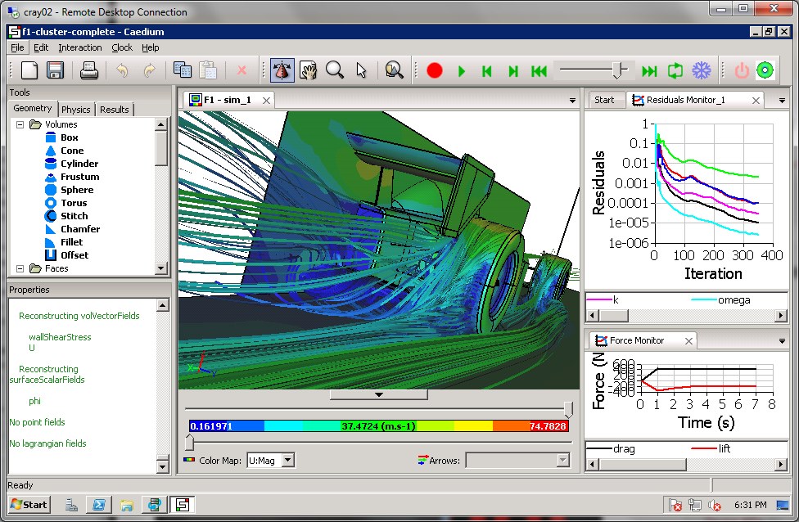
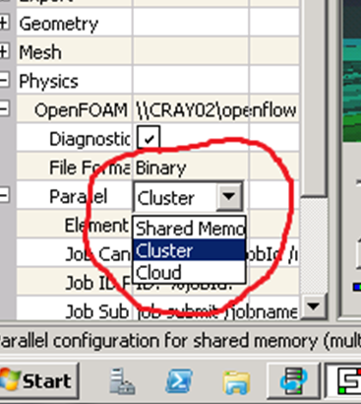
Simplicity of Microsoft HPC Compute Intensive Paradigms
Run on:
Client
Cluster
Cloud
Transparently

Slide 10
Applications in Azure

Slide 11


Windows Azure Services
A closer look
Web Role
Worker Role
HTTP
ASP.NET, WCF, etc.
main()
{ … }
Load Balancer
IIS
Agent
Agent
Fabric
Application
Compute
Storage
Fabric
VM
…

Slide 12

TaskParallel Application:
Traveling Salesman
Resources
One Azure instance (multi-core)
Limitations and challenges
Scaling beyond a single Node
Scheduling is manual
demo

Slide 13
Applications on-premises

Slide 14
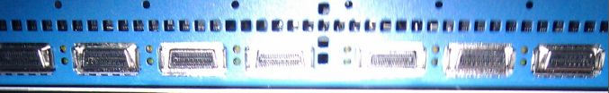
MPI Application: OpenFoam Computational fluid dynamics
Resources
Dedicated nodes
InfiniBand network
Limitations and challenges
Cost of ownership
Fixed number of resources
demo
Infiniband running at 20Gbps!

Slide 15
MPI Application:
Weather Forecast
Resources
Dedicated nodes
InfiniBand network
External data source
Limitations and challenges
Cost of ownership
Fixed number of resources
demo

Slide 16
Azure and HPC integration
Embarrassingly parallel, no data
Embarrassingly parallel + data
Embarrassingly parallel + complex data
Sharing HPC results through Azure

Slide 17

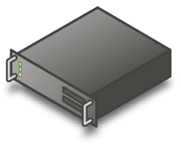

Windows HPC on Azure
Mixed Mode Deployment On-premise and Azure
Compute Nodes On-Premise and in Azure Simultaneously
“Burst” into cloud on-demand while keeping control over data and corporate policies
Pay only for what you use
A stepping stone to hybrid and public clouds.
Dynamically adjust how much runs on-premise and in the cloud
Azure computer instances include both worker role and VM role
HPC Head Node
Desktops
Broker Node
On-premise
Compute Nodes
Azure
Internet
Azure
Compute Proxies
Compute Instances

Slide 18
SOA app: Asian Options
Embarrassingly parallel, no data
Work
No code change!
Resources
Azure & Dedicated Node instances
HPC head node
Benefits
Flexible resources
Scaling and scheduling handled by HPC
demo

Slide 19
Parametric app: Movie Rendering
Embarrassingly parallel + data
Work
  Data staging
Resources
All Azure Node instances
HPC head node
Benefits
Flexible resources
Scaling and scheduling handled
by HPC
demo

Slide 20

An example : Better Faster Product Design
Shape Optimization with Sculptor
Cut design times
Cut design costs
Provide better products
Geometric optimization
New trend in design

Slide 21
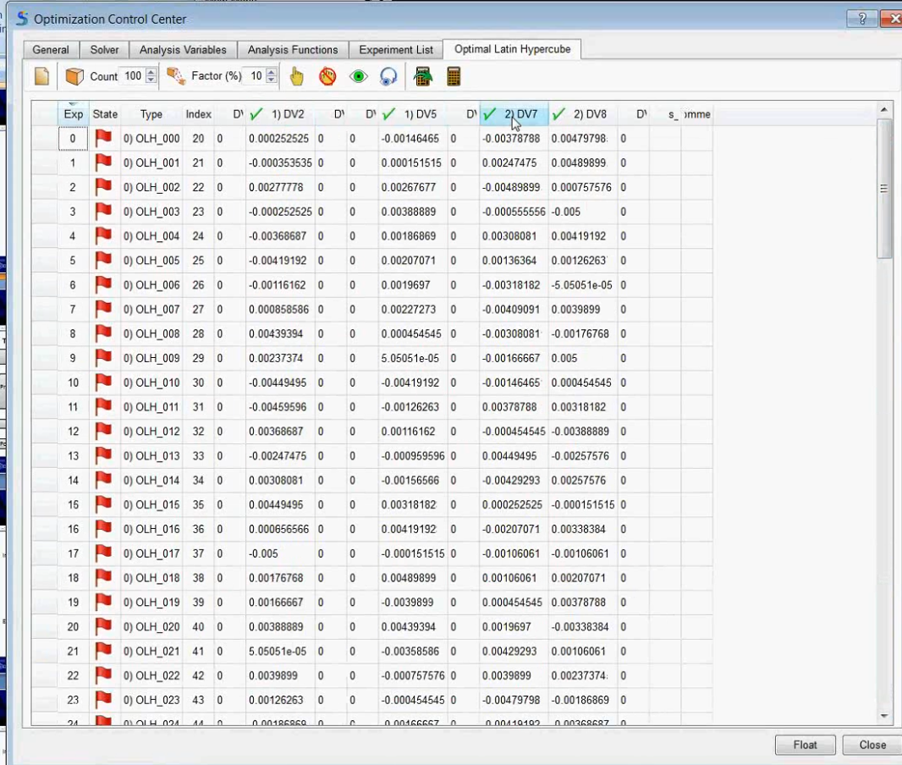
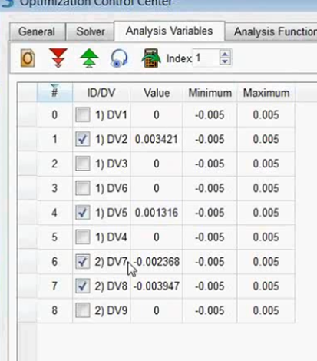
Latin HyperCube – compute what you can afford
Latin hyperCube sampling
A Statistical method
Know your cost up front
Know you time to solution
More design insight
Best statistical accuracy

Slide 22
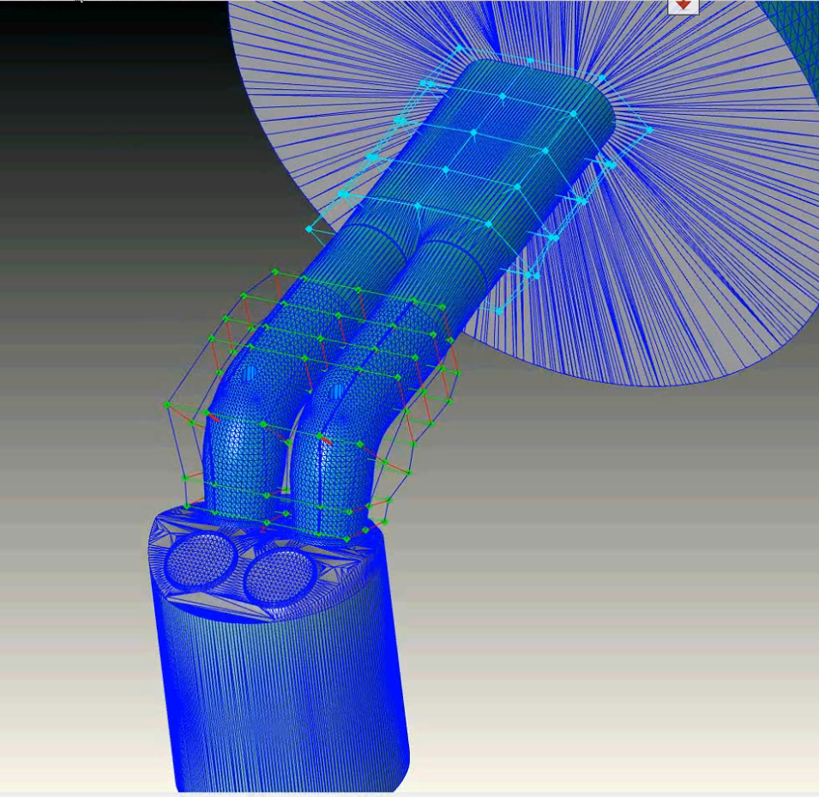
Automotive Intake Manifold Design
3% performance enhancement vs. over 60 humans working for months to get less than 0.6%.
Change shape of intake
Improve flows
Better gas mileage
Better performance
Courtesy of Ford Motor Company

Slide 23
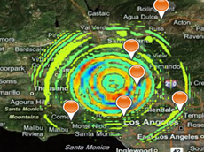
Sharing results: Earthquake simulation
MPI on-premises + data shared in Azure
Work
  Transfer data to SQL Azure
  Visualization app
Resources
  HPC cluster
  SQL Azure
  Visualization app hosted in Azure
demo
Benefits
  Share results

Slide 24
Summary

Slide 25
Nine Tips for Best Practices
Always consider total cost of ownership when making decisions
Use .Net Parallel Libraries to take advantage of multi-core on Azure
Use HPC Azure burst solution for scaling out to multi-node
Embarrassingly parallel CPU intensive jobs are best suited for Azure
Parametric sweep engine is a powerful yet simple way to scale
Have multi-user design considerations for HPC Apps as a service
Hide cloud from your users by providing a transparent experience
Minimize data transfer between on-premises and the cloud
Be creative and focus on what you can do on Azure today

Slide 26
The Microsoft Windows Computing Experience
Run on:
Client
Cluster
Cloud
Transparently

Slide 27
Developer Benefits of Windows
Easier binary distribution
  Compile once, run everywhere
  from laptop, to desktop, to Windows HPC, to Windows Azure
Better tools, first class developer support
  Visual Studio and other tools make development easier
More potential new users and developers
  Run on World’s most popular OS
  Reveal issues by exercising code on commercial platform

Slide 28
Building a Healthy App Ecosystem to Support HPC and Azure
Developer Tools
Intel
Libraries
Solvers:
Popular HPC Apps
Chemistry
Analysis Tools
Parallel Visualization
Build:
IO:
Bio Science*
Python
PGI
Compilers:
Unix Env:
Cygwin
SUA
MinGW
CMake
Visual Studio
Trilinos
PETSc*
HDF5MPI
FFTW
GCC
NetCDF
CFD
Structure
Climate*
Physics
Data Mining
Computer Science
VisIT*
ParaView*
Ipython*
NumPY
SciPY

Slide 29

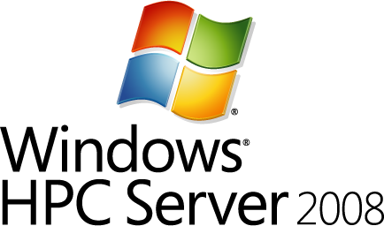




HPC Server 2008 R2 Roadmap
July 2010
Dec 2010
June 2011
Microsoft HPC Server 2008 R2
Microsoft HPC Server 2008 R2 SP1 &
LINQtoHPC CTP
Microsoft HPC Server 2008 R2 SP2*
Excel on HPC clusters
Schedule jobs to workstations
Business critical SOA
Scale to 1000+ nodes out-of-the-box
Dual boot clusters
Diskless compute nodes
Extensible diagnostics and troubleshooting framework
Flexible, customizable color-coded Heat map
Integration with Windows Azure:
“Burst” SOA and Parametric sweep jobs to Azure as worker roles.
All compute nodes in Azure with head-node only on-premise.
User activity scheduling for workstation nodes
C# cluster SOA debugger for VS 2010.
LINQ to HPC for large scale data analytics
MPI runtime in Windows Azure
Azure VM role
New job scheduler policies
Lend/Borrow resource pools
Over/under subscribe nodes
Common data for SOA Apps
Multi-domain support for workstation nodes
Web Portal for job submission and job status
Smart Card authentication

Slide 30
The Matrix can not be told, try it yourself!
Subscribe to my blog http://blogs.msdn.com/hpctrekker
Read Application Models and Data Considerations
Download SP2 Beta from http://connect.microsoft.com
Get a free Trial of Azure for 30 days
Download and try out the Azure Burst Samples
Implement your own solution and let us know!

Slide 31
Related Content
Required Slide
Speakers, please list the Breakout Sessions, Interactive Discussions, Labs, Demo Stations and Certification Exam that relate to your session. Also indicate when they can find you staffing in the TLC.
WSV205 | Dryad: Running “Big Data” Applications on a Windows HPC Server Cluster
WSV207 | Distributed Scale-Out Applications On-Premises and in the Cloud: An Introduction to Windows HPC Server
WSV472-INT | Building Scale Out Clusters with Windows HPC Server 2008 R2: Cluster Deployment, Troubleshooting and Basic Job Submission Techniques
Product Demo Stations (Windows HPC Server 2008 R2 SP2)
Find Me Later At…Server HPC Booth Thursday 10:30am – 1:00pm

Slide 32
Track Resources
Required Slide
Track PMs will supply the content for this slide, which will be inserted during the final scrub.
My Blog: http://blogs.msdn.com/hpctrekker
The Azure Burst Samples and White paper
Windows HPC ResourceKit
Windows HPC Server TechCenter

Slide 33
Track Resources
Don’t forget to visit the Cloud Power area within the TLC (Blue Section) to see product demos and speak with experts about the Server & Cloud Platform solutions that help drive your business forward.
You can also find the latest information about our products at the following links:
Cloud Power - http://www.microsoft.com/cloud/
Private Cloud - http://www.microsoft.com/privatecloud/
Windows Server - http://www.microsoft.com/windowsserver/
Windows Azure - http://www.microsoft.com/windowsazure/
Microsoft System Center - http://www.microsoft.com/systemcenter/
Microsoft Forefront - http://www.microsoft.com/forefront/

Slide 34





Resources
  Connect. Share. Discuss.
http://northamerica.msteched.com
Learning
  Sessions On-Demand & Community
  Microsoft Certification & Training Resources
www.microsoft.com/teched
www.microsoft.com/learning
  Resources for IT Professionals
  Resources for Developers
http://microsoft.com/technet
http://microsoft.com/msdn

Slide 35












Complete an evaluation on CommNet and
enter to win!

Slide 36


Slide 37

© 2011 Microsoft Corporation. All rights reserved. Microsoft, Windows, Windows Vista and other product names are or may be registered trademarks and/or trademarks in the U.S. and/or other countries.
The information herein is for informational purposes only and represents the current view of Microsoft Corporation as of the date of this presentation. Because Microsoft must respond to changing market conditions, it should not be interpreted to be a commitment
on the part of Microsoft, and Microsoft cannot guarantee the accuracy of any information provided after the date of this presentation. MICROSOFT MAKES NO WARRANTIES, EXPRESS, IMPLIED OR STATUTORY, AS TO THE INFORMATION IN THIS PRESENTATION.

