Slide 1

Lessons Learned About Application Performance on Windows Phone
WPH311
Maarten Struys
Windows Phone Evangelist
Alten PTS

Slide 2
Agenda
Introduction
Identifying performance issues
Solving ‘simple’ performance bottlenecks
Background processing
Performance and Mango
Conclusions

Slide 3

Introduction
Performance is very important
Windows Phones are powerful
  Modern, fast CPU/GPU combination
    Devices are useless with empty batteries
    Increased functionality = decreased battery life
  Performance influenced by
    Managed code features
    Graphic features used inside applications
    Data binding strategies
    Data storage strategies
Less is more!

Slide 4
Introduction
Performance-aware software development
Balance performance with other requirements
  Don’t look at performance in isolation
  Turn performance into a functional requirement
Identify and evaluate performance issues
  Maximum allowed (acceptable) execution time/resource usage
Test early and frequently
  Use common scenarios
  Test on (multiple) device(s)
  Watch out for regression

Slide 5
Introduction
Important assumptions
Emulator performance ≠ device performance
Test on real device(s)
Test realistic scenarios
  Use Mobile Network for data connections
  Use release builds of your application
  Run detached from the debugger
≠

Slide 6
Identifying Performance Issues
Performance influenced by
Threading Model
Graphics Stack
  Frame rate
  Animation
  Media
Networking
UI Model
  Layout
  Virtualization
  Data binding
Scrolling

Slide 7
Identifying Performance Issues
All applications contain multiple threads
UI Thread
  Handles device input (separate input thread in Mango)
  Executes user and control code (all OS calls will run here)
  Handles ‘complex’ animations
Compositor Thread
  Handles ‘simple’ animations of ‘simple’ properties
Background Thread(s)
  Media Decoding
  Networking

Slide 8
Identifying Performance Issues
Use ‘cool’ UI elements carefully
Panorama Control and Pivot Control
  When are items loaded?
ListBox
  Virtualizing StackPanel versus StackPanel
Images
  Hard coded versus dynamic size
ProgressBar
  Use PerformanceProgressBar (SL for Windows Phone Toolkit)

Slide 9
Identifying Performance Issues
Using common sense
Don’t execute hidden animations
  Pivot/page with running animation only when visible
Be careful in hiding UI elements
  Opacity 0 still means rendering activity
  Use Visibility instead
Do you really need a full functional Bing Map Control?
  Static Maps (created through REST APIs) might be enough
Programming Language/Class Library Features
  String versus StringBuilder
  Leaking memory (anonymous event handlers)

Slide 10
Measuring Performance
An iterative action, execute frequently
You should know something about startup time,
frame rate, and memory issues inside your applications
  Depends on the different types of applications you are building
Monitor different attributes regarding screen updates
  Make sure to test on real devices regularly
  Emulator is not sufficient (except for finding trends)
    Too many applications run fine on 2 GHz multi-core development machines but fail on a 1 GHz device

Slide 11
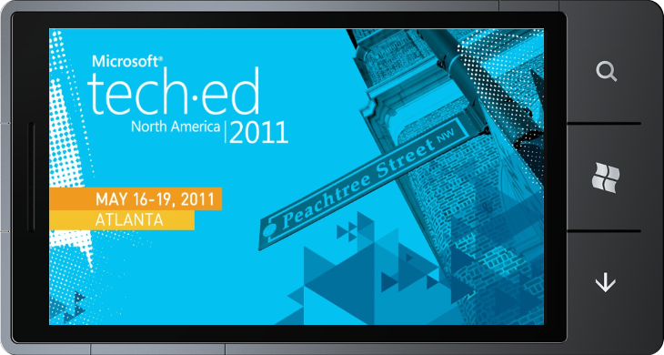
Solving Performance
Bottlenecks Today!
demo

Slide 12
Background Processing
Do not occupy the UI Thread
Long lasting operations will influence performance unless
  Running on separate threads
    Today: Use BackgroundWorker or ThreadPool
    Tomorrow: Also use Asynchronous Methods
      Almost as easy as synchronous methods without blocking the hosting thread
      Typical scenarios include network calls and IsolatedStorage operations
  Application complexity increases (slightly)
  Better end user experience
Be also aware of battery consumption

Slide 13
The WebClient Lesson
Do not occupy the UI thread
WebClient returns always on the UI thread, not on
a separate thread like HttpWebRequest does
To overcome this, use your own separate thread
Be aware of updating UI controls on threads

Slide 14
Background Processing
demo

Slide 15
What’s next for performance?
Benefit from Fast Application Switching
Better user experience
  Switching between applications often transparent for end users
Enabled for all Mango applications
  Recompile, test, and resubmit your existing WP7 applications
Cookbook
  OnNavigatedFrom/Deactivated
    Save page/application state (just like today)
  OnNavigatedTo/Activated
    Restore page/application state if tombstoned only
  Investigate resource usage (detach/attach manually)

Slide 16
What’s next for performance?
Benefit from the new Garbage Collector
Generation-based
Allocation strategies that work on the desktop will
now work better on the phone as well
Try to limit the amount of long living objects
  Get promoted to higher generation
  More expensive to collect when turned into garbage
Try to limit the number of large objects

Slide 17
What’s Next for Performance?
Use the new profiler to investigate application performance
Multiple Profiling options with the same tool
  Code Profiler
  Memory Profiler
Visual Feedback about possible bottlenecks
You should really see the profiler in action

Slide 18
Profiling your Windows
Phone Applications
demo

Slide 19
Summary and Call to Action
Performance is crucial, especially on devices
Know what is going on under the hood of your application
Don’t execute code on the device …
… unless it is absolutely necessary
Visit http://create.msdn.com to get the tools and to
register as Windows Phone Developer
Mango tools will be available later this month
Developing Windows Phone Applications is FUN!

Slide 20
Track Resources
http://create.msdn.com
Windows Phone Blog
Windows Phone Developer Blog
Windows Phone Documentation on MSDN

Slide 21
Windows Phone Related Content
Monday, May 16
WPH201: Windows Phone: What’s New?
WPH371-INT: Building a Mobile Message Queue for Windows Phone
WPH312: What’s New for Windows Phone Development with
Microsoft Silverlight?
WPH302: Windows Phone Productivity Scenarios with Microsoft Exchange Server 2010 and Microsoft Office 365
WPH373: Meet the Windows Phone Application Platform
Engineering Team

Slide 22
Windows Phone Related Content
Tuesday, May 17
WPH308: Multi-tasking and Application Switching for Windows Phone
OSP312: Developing Microsoft Office Business Solutions that Span
the PC, Windows Phone, and the Web
WPH309: Enhanced Push Notifications and Live Tiles for
Windows Phone
WPH303: Understanding the Windows Phone Development Tools
COS315: Building Windows Phone Applications with the
Windows Azure Platform

Slide 23
Windows Phone Related Content
Tuesday, May 17
WPH305: Internet Explorer 9 on Windows Phone
OSP209 Building Your First Windows Phone Application for
Microsoft SharePoint 2010
WPH203: Understanding Windows Phone Marketplace
WPH375-INT: Building Multi-tasking Enabled Windows Phone Applications

Slide 24
Windows Phone Related Content
Wednesday, May 18
WPH202: Windows Phone at Microsoft
DEV317: Using Microsoft Visual Basic to Build Windows Phone Applications
WPH310: Building Your First Windows Phone Game with XNA
WPH374-INT: Hardcore Windows Phone Development Questions
DEV205: Microsoft Expression for Developers: Demystifying User Interface Design
WPH306: Building Windows Phone Applications with Microsoft Silverlight and XNA
WPH304: New Windows Phone Data Access Features

Slide 25
Windows Phone Related Content
Thursday, May 19
WPH301: Deploying Windows Phone in the Enterprise
DPR303: Developing Enterprise-Grade Mobile Solutions
WPH307: Connecting Windows Phones and Slates to Windows Azure
WPH372-INT: Windows Phone Marketplace: Interactive
WPH311: Lessons Learned about Application Performance on Windows Phone
WPH311: Lessons Learned about Application Performance on Windows Phone
SIM323: User Identity and Authentication for Desktop and Phone Applications

Slide 26
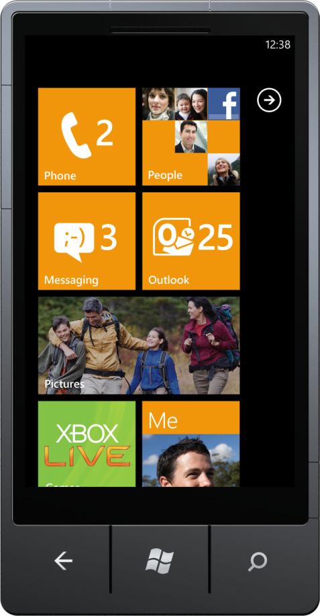
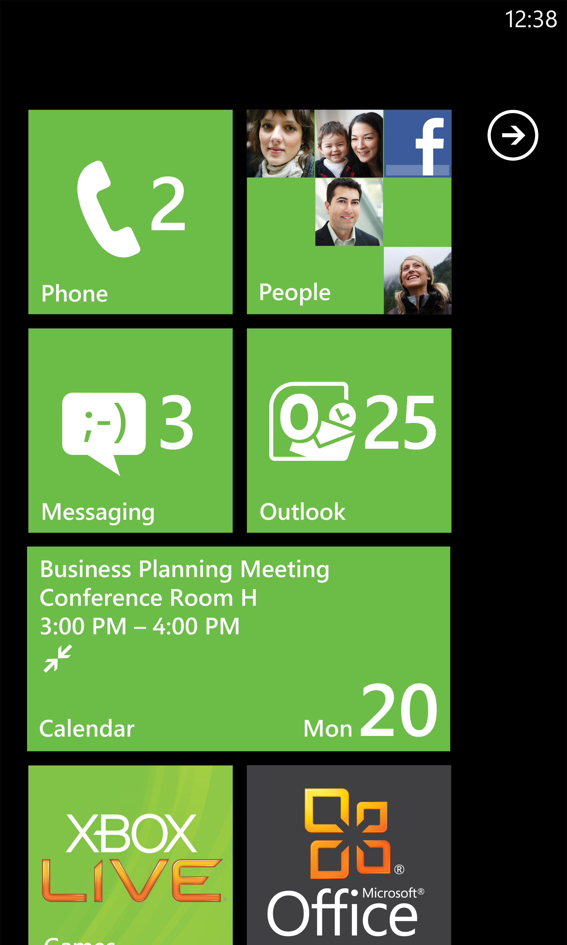
Windows Phone Resources
Questions? Demos? The latest phones?
Visit the
Windows Phone Technical Learning Center for demos and more…
Business IT resources
  blogs.technet.com/b/
  windows_phone_4_it_pros
Developer resources
craete.msdn.com
Experience Windows Phone 7 on-line
and get a backstage pass
www.windowsphone.com

Slide 27
Win a Windows Phone Contest
HAT CONTEST*
SESSION CONTEST*
  QUESTIONS?
  How do you enter?
  During each
  Windows Phone session the moderator will post a question; the first person to correctly answer the question and is called on by the moderator will potentially win
Go to the
WPC Information Counter
at the TLC
Enter by visiting the
Windows Phone booth, accepting a free
Windows Phone branded
hat, and wearing that hat during the Event
  How am I selected?
* Restrictions apply please see contest rules for eligibility and restrictions. Contest rules are displayed in the Technical Learning Center at the
WPH info counter
  Each day of the event,
  a Windows Phone representative will randomly select up to 5 people who
  are observed wearing their
  Windows Phone branded hat

Slide 28





Resources
  Connect. Share. Discuss.
http://northamerica.msteched.com
Learning
  Sessions On-Demand & Community
  Microsoft Certification & Training Resources
www.microsoft.com/teched
www.microsoft.com/learning
  Resources for IT Professionals
  Resources for Developers
http://microsoft.com/technet
http://microsoft.com/msdn

Slide 29












Complete an evaluation on CommNet and
enter to win!

Slide 30


