Slide 2
Understanding the Windows Phone 7
Development Tools
WPH303
Maarten Struys
Windows Phone Evangelist
Alten PTS

Slide 3
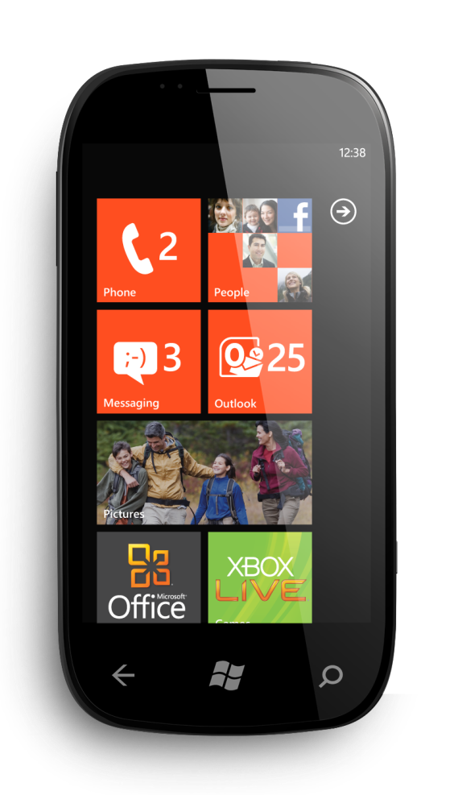
During this Session
You have a Chance to
Win a Windows Phone
announcement

Slide 4
PLEASE READ (hidden slide)
This template is designed for use with Office PowerPoint 2007 and 2010.
This template uses Arial, a standard font that is included in Office 2007, Office 2010, Windows Vista and Windows 7.

Slide 5
Deadlines & Resources
Thank you for taking part in TechEd North America 2011.
Below is a list of key dates and resources:
Important Content Deadlines – detailed instructions are found on the Speaker Portal at https://northamerica.msteched.com/signin:
  March 21 at Noon: Upload a DRAFT of your PPT for subject-matter expert (SME) review.
    March 21 to April 8: CONTENT REVIEW (track specific instructions are found on the speaker portal)
    May 10 at 5 pm PDT: Upload FINAL PPT presentation on the Speaker Portal. This is the version that
    you will use at the event.
    YOUR PROMPT FINAL PPT SUBMISSION IS APPRECIATED.
    No design support will be offered onsite.
  Slide Design Resources – Located on the Speaker Portal (graphics, webinar, etc.)
  If you include any third-party photography or art, licensing information and permission must be credited
  in the PPT or it will be deleted.
  Points of Contact
  Direct presentation questions to tespkr@microsoft.com
  Direct content questions to your Track PM
  PRINTING: This template is intentionally set to print in color or grayscale, not black and white
Notes:
© 2010 Microsoft Corporation. All rights reserved. Microsoft, Windows, Windows Vista and other product names are or may be registered trademarks and/or trademarks in the U.S. and/or other countries.
The information herein is for informational purposes only and represents the current view of Microsoft Corporation as of the date of this presentation. Because Microsoft must respond to changing market conditions, it should not be interpreted to be a commitment on the part of Microsoft, and Microsoft cannot guarantee the accuracy of any information provided after the date of this presentation.
MICROSOFT MAKES NO WARRANTIES, EXPRESS, IMPLIED OR STATUTORY, AS TO THE INFORMATION IN THIS PRESENTATION.

Slide 6
Scrub Checklist
Upload your final deck on the speaker portal on or before May 10, 2011 at 5 pm PDT.
PowerPoint presentations undergo a brief scrub process and are posted to CommNet for attendee access
at least 48 hours prior to the session. No design support will be available onsite.
The Scrub Process will:
Verify that required slides are included
Remove any non-template logos and graphics from the walk-in slide
Remove all comments, hidden slides and speaker notes from slides
Set file properties box
Reset printability to grayscale
Notify Presentation Manager of any images identified as unlicensed for escalation
Rename files to match naming convention
Correct session title and session code to match printed Mini Guide and Schedule Builder
Speakers:
Use the provided event template and associated colors, fonts, layout and transition slides
Correct product names to follow applicable branding rules

Slide 7
Agenda
Objectives and takeaways
Introduction
Designing Windows Phone Applications
  Expression Blend for Windows Phone
Developing Windows Phone Applications
  Visual Studio 2010 (Express for Windows Phone)
Testing Windows Phone Applications
  Device Emulator and Windows Phone hardware resources
Submitting Windows Phone Applications
Q&A

Slide 8

Introduction
Getting the tools
Windows Phone Design/Development tools are free
Integrate seamlessly in already installed SKUs
  All versions of Expression Blend 4 and Visual Studio 2010
Visit the Windows Phone App Hub right after this talk:
http://create.msdn.com
  Get all Windows Phone Tools in one single download
  Learn about Windows Phone Development
  Submit your Windows Phone Applications
  Get download and sales information for all your applications

Slide 9
Introduction
Windows Phone 7 developers
Windows Phone Applications use managed code
Windows Phone Applications separate UI from logic
  ‘Natural’ separation between designers and developers
Windows Phone Applications can be Silverlight-based
  Keep in mind you are developing for a phone
Windows Phone Applications can be XNA Framework-based
  Keep in mind you are developing for a small device
Windows Phone Applications can combine Silverlight and
XNA Framework functionality (Mango)

Slide 10
Introduction
The right tool at the right time
Expression Blend 4 [for Windows Phone]
  Design great User Interfaces for Windows Phone Applications
  No code/software development skills required
Visual Studio 2010 [Express for Windows Phone]
  Develop great Windows Phone Applications
  Debug your applications
  Find performance bottlenecks in your applications (Mango)
Both tools integrate seamlessly with each other
Use Device Emulator as initial target device

Slide 11

Designing a Windows Phone Application
Using Expression Blend
Create prototypes and user interfaces
for Windows Phone
  SketchFlow for Windows Phone included (Mango)
Full Silverlight 4 support (Mango)
  PathListBox
  Shapes
  New Behavior (MVVM made easier)
Create sample data prior to ‘real’ data availability
No code/software development skills required
  Learning curve for Software Developers

Slide 12
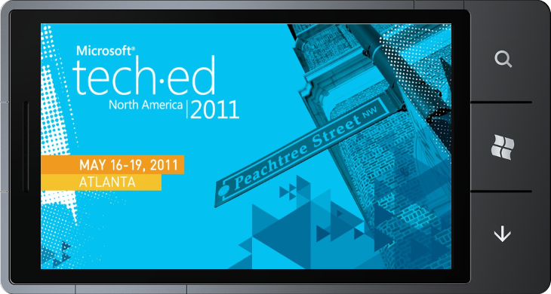
Designing a Windows
Phone Application
demo

Slide 13

Developing a Windows Phone Application
Using Visual Studio 2010
Support for both Windows Phone 7 and Mango
Target Silverlight, XNA Framework, or both
Add functionality to a Windows Phone Application
  Develop in C# or Visual Basic.NET
  Remote debugging capabilities for Emulator/Device
  Profiling capabilities (Mango)
No design skills required
Runs side-by-side with Visual Studio 2008

Slide 14
Developing a Windows
Phone Application
demo

Slide 15
Testing a Windows Phone Application
Target devices
Device Emulator
  More realistic performance characteristics with Mango tools
  Emulate accelerometer readings
  Emulate location readings
Any Windows Phone Device
  Real performance characteristics
  Needed to test the UI experience
  Location Aware applications hard to test
Use both during your development life cycle

Slide 16
Testing a Windows Phone Application
Visual Studio 2010 debugging capabilities
Target any Windows Phone Device
Setting breakpoints
Inspecting/setting variables
Direct execution of individual methods
View trace/debug information in the Output Window
Test tombstoning scenarios
Profile your applications (Mango)
  Memory and code profiling supported

Slide 17
Testing a Windows
Phone Application
demo

Slide 18
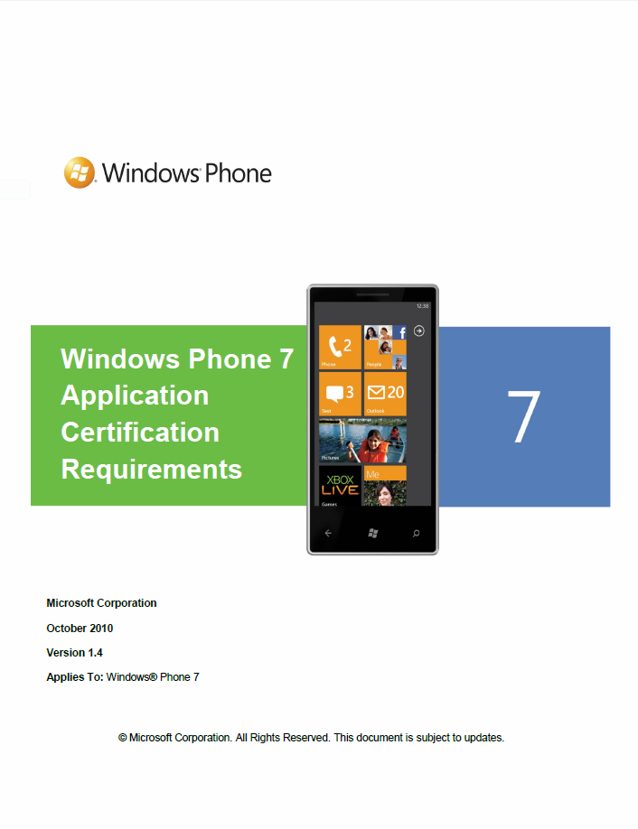
Publishing a Windows Phone Application
Submit your application to Marketplace
Register as Windows Phone developer
on Marketplace
Unlock one or more phones through the tools
Test your application
Think about a compelling application description
Create compelling artwork
Price your application
Submit your application for certification

Slide 19
Publishing a Windows Phone Application
Pitfalls during submission process
Artwork resolution
Networking issues in the application
Memory footprint of the application (< 90 MB)
Application theme awareness
Application crashes
Back button behavior
User consent dialogs and settings
Pausing/resuming the user’s music

Slide 20

Submitting a Windows Phone Application to Marketplace
demo

Slide 21
Summary and Call to Action
Windows Phone Developers are first class citizens
  Use the latest versions of Microsoft’s design/development tools
All tools integrate seamlessly with each other
Windows Phone Developers are productive
Don’t wait for Mango but start developing your
Windows Phone Applications TODAY!
Visit http://create.msdn.com to get the tools and to
register as Windows Phone Developer
Mango tools will be available later this month
Developing Windows Phone Applications is FUN!

Slide 22

Track Resources
http://create.msdn.com
Windows Phone Blog
Windows Phone Developer Blog
Windows Phone Documentation on MSDN

Slide 23
Windows Phone Related Content
Monday, May 16
WPH201: Windows Phone: What’s New?
WPH371-INT: Building a Mobile Message Queue for Windows Phone
WPH312: What’s New for Windows Phone Development with
Microsoft Silverlight?
WPH302: Windows Phone Productivity Scenarios with Microsoft Exchange Server 2010 and Microsoft Office 365
WPH373: Meet the Windows Phone Application Platform
Engineering Team

Slide 24
Windows Phone Related Content
Tuesday, May 17
WPH308: Multi-tasking and Application Switching for Windows Phone
OSP312: Developing Microsoft Office Business Solutions that Span
the PC, Windows Phone, and the Web
WPH309: Enhanced Push Notifications and Live Tiles for
Windows Phone
WPH303: Understanding the Windows Phone Development Tools
COS315: Building Windows Phone Applications with the
Windows Azure Platform

Slide 25
Windows Phone Related Content
Tuesday, May 17
WPH305: Internet Explorer 9 on Windows Phone
OSP209 Building Your First Windows Phone Application for
Microsoft SharePoint 2010
WPH203: Understanding Windows Phone Marketplace
WPH375-INT: Building Multi-tasking Enabled Windows Phone Applications

Slide 26
Windows Phone Related Content
Wednesday, May 18
WPH202: Windows Phone at Microsoft
DEV317: Using Microsoft Visual Basic to Build Windows Phone Applications
WPH310: Building Your First Windows Phone Game with XNA
WPH374-INT: Hardcore Windows Phone Development Questions
DEV205: Microsoft Expression for Developers: Demystifying User Interface Design
WPH306: Building Windows Phone Applications with Microsoft Silverlight and XNA
WPH304: New Windows Phone Data Access Features

Slide 27
Windows Phone Related Content
Thursday, May 19
WPH301: Deploying Windows Phone in the Enterprise
DPR303: Developing Enterprise-Grade Mobile Solutions
WPH307: Connecting Windows Phones and Slates to Windows Azure
WPH372-INT: Windows Phone Marketplace: Interactive
WPH311: Lessons Learned about Application Performance on Windows Phone
WPH311: Lessons Learned about Application Performance on Windows Phone
SIM323: User Identity and Authentication for Desktop and Phone Applications

Slide 28
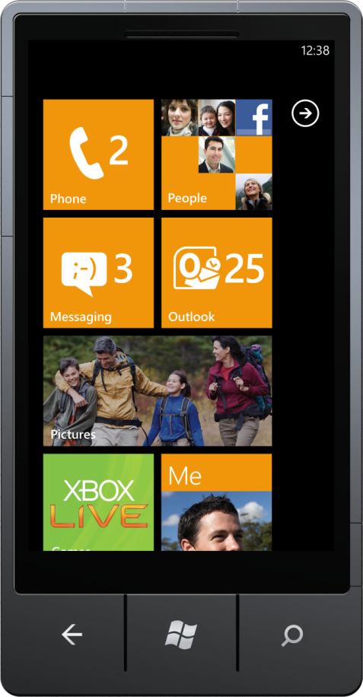
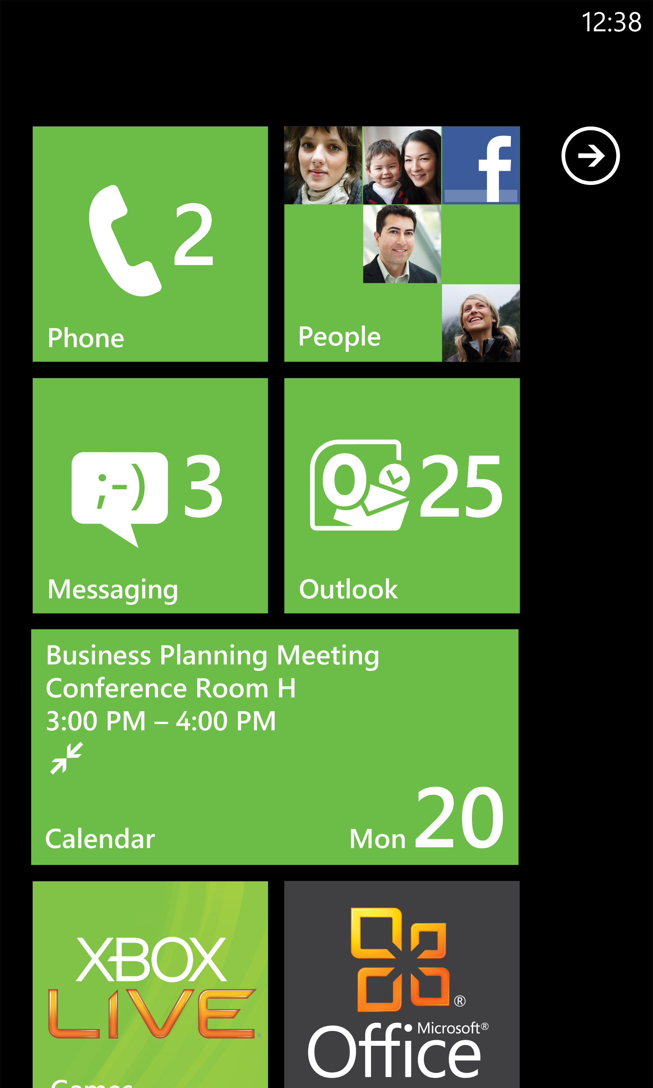
Windows Phone Resources
Questions? Demos? The latest phones?
Visit the
Windows Phone Technical Learning Center for demos and more…
Business IT resources
  blogs.technet.com/b/
  windows_phone_4_it_pros
Developer resources
craete.msdn.com
Experience Windows Phone 7 on-line
and get a backstage pass
www.windowsphone.com

Slide 29
Win a Windows Phone Contest
HAT CONTEST*
SESSION CONTEST*
  QUESTIONS?
  How do you enter?
  During each
  Windows Phone session the moderator will post a question; the first person to correctly answer the question and is called on by the moderator will potentially win
Go to the
WPC Information Counter
at the TLC
Enter by visiting the
Windows Phone booth, accepting a free
Windows Phone branded
hat, and wearing that hat during the Event
  How am I selected?
* Restrictions apply please see contest rules for eligibility and restrictions. Contest rules are displayed in the Technical Learning Center at the
WPH info counter
  Each day of the event,
  a Windows Phone representative will randomly select up to 5 people who
  are observed wearing their
  Windows Phone branded hat

Slide 30





Resources
  Connect. Share. Discuss.
http://northamerica.msteched.com
Learning
  Sessions On-Demand & Community
  Microsoft Certification & Training Resources
www.microsoft.com/teched
www.microsoft.com/learning
  Resources for IT Professionals
  Resources for Developers
http://microsoft.com/technet
http://microsoft.com/msdn

Slide 31












Complete an evaluation on CommNet and
enter to win!

Slide 32

Notes:
New for TechEd 2011, we will be working with Microsoft Tag (http://tag.microsoft.com/overview.aspx) to create unique Tags for every session at the event. Your session Tag will appear on both the room signage and at the end of your presentation. With your session Tag, attendees will be able to scan as they enter the room to retrieve session details, view speaker bios, and engage in discussions; or scan at the end of the presentation to evaluate your session and download materials. We’re excited to integrate Microsoft Tag across the My TechEd mobile experience this year.

