Slide 1
Troubleshooting Windows 7 Deployments: In Depth
WCL403
Michael Niehaus
Sr. Software Development Engineer
Microsoft
Keith Garner
Principal Consultant
Xtreme Consulting Group

Slide 2
Windows 7 Deployment
An introduction
There are many ways to deploy Windows 7
  Leveraging common tools and techniques
  Assembled together into a full deployment process
So there are often many moving parts
  Lots of moving parts = lots of points for failure
  You need to be able to troubleshoot all parts
Different solutions have different parts

Slide 3
Windows 7 Deployment
A range of solutions
We will spend some time
on each of these
System Center Configuration Manager 2007 SP2
Microsoft Deployment Toolkit 2010
MDT 2010
Windows Deployment Services
Core Windows AIK Tools
Build your own
(or third-party)
Simple scenarios
More features
Complete control

Slide 4
Stumped?
Contact Microsoft Support
  Have all logs ready, they will ask for them
Use the “MDT” and ConfigMgr OSD forums on TechNet
  http://social.technet.microsoft.com/Forums/en-US/mdt
  http://social.technet.microsoft.com/Forums/en-US/configmgrosd
  Post your error messages, or even logs
Use the MDTOSD mailing list, hosted by http://www.myitforum.com
E-mail me directly at mniehaus@microsoft.com
  Have some patience ☺
  Do not use profanity
  I understand you do not like Microsoft, but you do not need to tell me about it
  Keep it short and sweet–my attention span is measured in seconds
  Do not “bump”

Slide 5
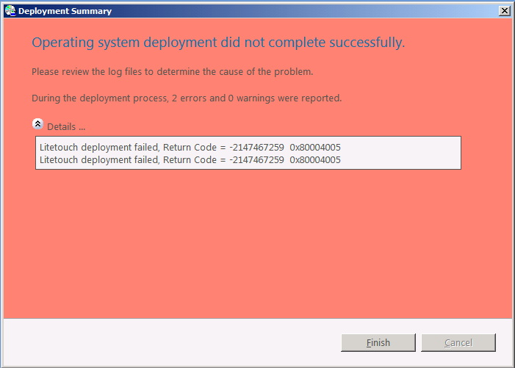
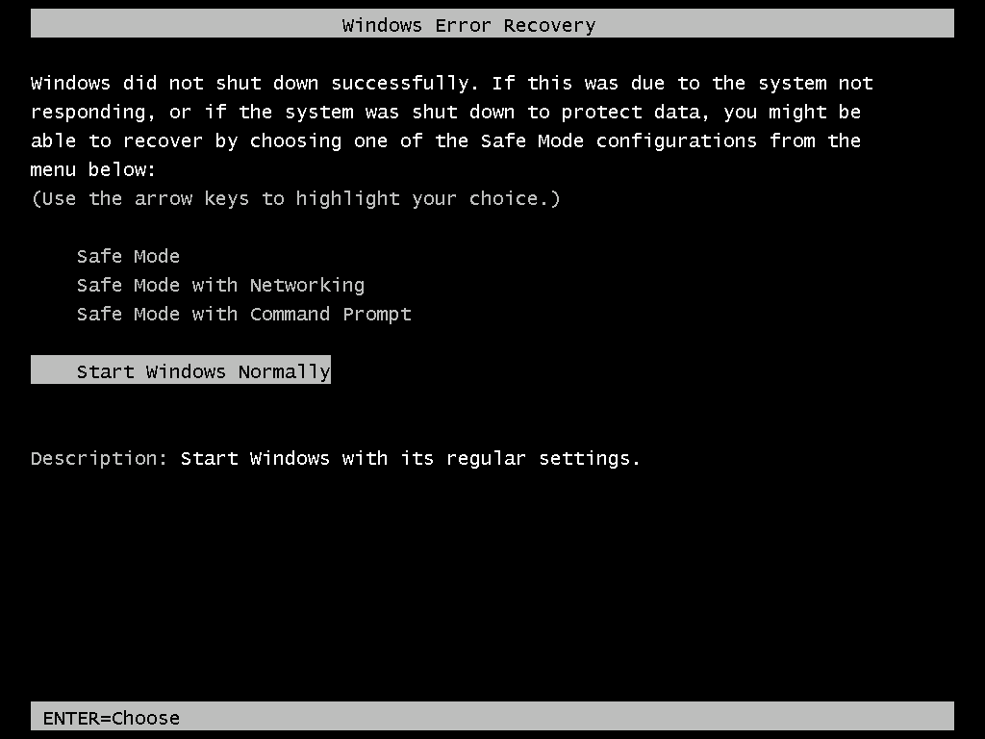
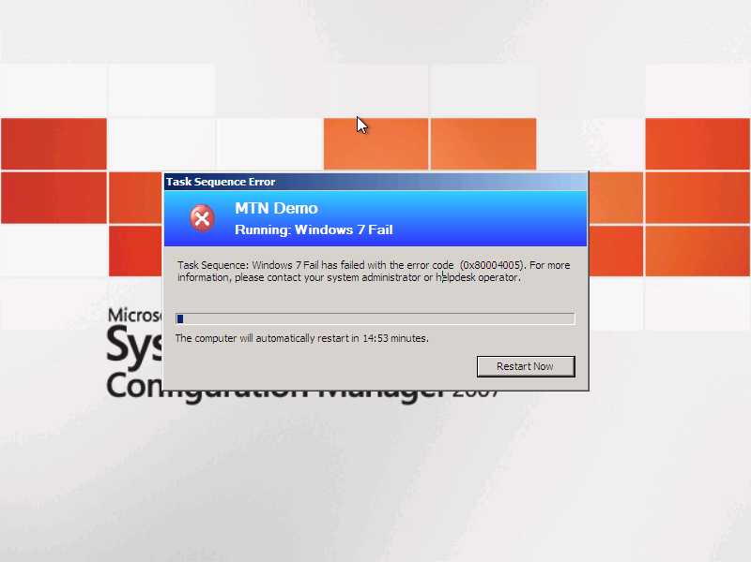
Windows 7 Deployment
Typical Errors
Obviously these are not always very useful

Slide 6
Windows 7 Deployment
Getting to the root cause
You will need to take the next step
  Error messages are often too high level, so you need to
  dig deeper
  Log files provide additional (often excessive) detail
  Identifying the cause from these messages is a critical skill
Each tool creates its own logs (sometimes more than one)
  That is a lot of logs

Slide 7
Log files

Slide 8
Operating System Logs
Windows 7 and Windows Vista
Two key logs created by the SETUP process
  Setupact.log: Contains information about setup actions during the installation process
  Setuperr.log: Contains only the error messages (subset of what is in Setupact.log)
Depending on when the failure occurs, the files can be located in
different places
  C:\$WINDOWS.~BT\Sources\Panther, X:\$WINDOWS.~BT\Sources\Panther (Windows PE)
  C:\WINDOWS\Panther (specialize)
  C:\WINDOWS\Panther\UnattendGC (OOBE)
  C:\WINDOWS\System32\Sysprep\Panther (sysprep)
http://support.microsoft.com/kb/927521

Slide 9
Operating System Logs
Windows 7 and Windows Vista
More useful logs
  Cbs.log: Shows results of DISM commands to inject drivers, language packs, security updates, etc. during the OS
  installation process
  Setupapi.dev.log: Resides in %WinDir%\inf; useful when investigating failed driver installations
  Netsetup.log: Resides in %WinDir%\Debug; useful when troubleshooting domain join issues
  WindowsUpdate.log: Resides in %WINDIR%\; useful for detecting issues installing updates from Windows Update, WSUS, or ConfigMgr (SUP)

Slide 10
Operating System Logs
Windows PE
Two main logs
  Wpeinit.log: Resides in X:\WINDOWS\system32 (so grab it before rebooting); useful when investigating start-up issues
  or slow initialization times
  Setupapi.dev.log: Resides in %WinDir%\inf; useful when investigating failed driver installations (just like in the full OS)

Slide 11
Operating System Logs
Windows Deployment Services
Logging to a file is disabled by default, so you first need
to turn it on
  http://support.microsoft.com/kb/936625
Once enabled, there is one main log
  WDSServer.log: Resides in X:\WINDOWS\Tracing; useful
  when confirming if WDS is seeing and processing requests

Slide 12
User State Migration Tools
Useful logs
Logs depend on what is being done
  USMTEstimate.log: Created when estimating the USMT space requirements (not always created)
  USMTCapture.log or Scanstate.log: Created by the USMT when capturing data
  USMTRestore.log or Loadstate.log: Created by the USMT when restoring data

Slide 13
Task Sequencer
Useful logs
SMSTS.log: This file is created by the Task Sequencer
and describes all Task Sequencer transactions
  Depending on the deployment scenario, it may move around
    %TEMP%\SMSTSLog
    %WinDir%\System32\ccm\logs
    %WINDIR%\Syswow64\ccm\logs
    C:\_SmsTaskSequence\Logs
    C:\SMSTSLog
    X:\SMSTSLog

Slide 14
Microsoft Deployment Toolkit
Useful logs
Each script generates its own log file in the log path
The log path will change based on the type of deployment
and phase
  X:\MININT\SMSOSD\OSDLOGS
  C:\MININT\SMSOSD\OSDLOGS
  C:\_SmsTaskSequence\SMSOSD\OSDLOGS
BDD.log contains a summarized view of all other MDT
log files
  Some pieces might require looking at other files
  (e.g., ZTIBackup_ImageX.log, USMTCapture.log)

Slide 15
Configuration Manager 2007
Useful logs
Other useful logs beyond the SMSTS.LOG include:
  DriverCatalog.log: Contains information that may be useful
  when getting errors while importing drivers
  TaskSequenceProvider.log: Useful when getting errors while saving or importing a task sequence
  SMSPXE.LOG: Used when troubleshooting PXE boot issues
  SMSPROV.LOG: May have more error details while saving or importing a task sequence
More at http://technet.microsoft.com/en-us/library/bb932135.aspx

Slide 16
Getting to the Logs
Magic keystrokes
  With ConfigMgr 2007, check the “Enable command support (testing only)” box to enable F8 while in
  Windows PE
    No reboot until the command prompt exits
  With MDT 2010 Lite Touch, F8 always works while in Windows PE
    No reboot until the command prompt exits
  While Windows Setup is running, press Shift-F10 to
  get a command prompt

Slide 17
Common Issues
Windows 7

Slide 18
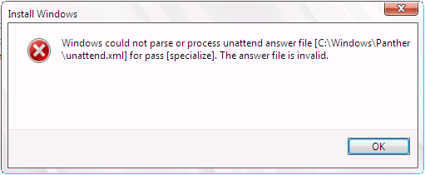
Windows Setup Failures
Bad computer name
From setuperr.log
  [windeploy.exe] Setup failed,
  returning exit code [0x1f]
From BDD.LOG (Lite Touch)
  Setup failed applying image <path>, rc = 31
Dig into details in setupact.log
  [setup.exe] SMI data results dump: Source = Name: Microsoft-Windows-Shell-Setup, …, /settings/ComputerName
  [setup.exe] SMI data results dump: Description = Value is invalid
Cause
  Computer names can be at most 15 characters long (may be a problem using OSDComputerName=%SerialNumber%)
Key learning: Error 31 means “something is wrong with unattend.xml”
How to shoot yourself in the foot

Slide 19
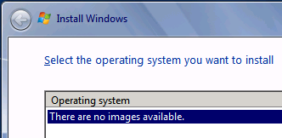
Windows Setup Failures
Mismatched product key
From setuperr.log
  CallBack_SelectImageOrShowUi: There are no
  matching OS images
Dig into details in setupact.log
  CallBack_ProductKey_Validate: EditionID for product
  key is Professional
  CDepImageXMLInfo::GetEditionID:EditionID=Enterprise,
  Flags=Enterprise : Returning Enterprise
  SelectOSImages: Using EditionID as a constraint and could not find any matching image
Cause
  Product key specified didn’t match the image
  May also mean no EditionID was captured (Windows 7 with certain patches or old ImageX) or Flags
  was not specified (Windows Vista)
Key learning
  “No images” might mean “no matching images”

Slide 20
Windows Setup Failures
Broken domain join
Simplest scenario
  Create an autounattend.xml with domain join details, prompting for the computer name
  Install Windows from media
Issue
  Domain join happens with a random computer name, and the later computer rename
  breaks the domain trust
Cause
  http://support.microsoft.com/kb/944353, “by design”
Workaround
  Run a command (e.g., NETDOM) or script later to do the join
  Build an unattend with all the needed information, then install
Key learning
  That is why other tools do not do it this way
IBM, acronym, “broken as design”

Slide 21
Windows Setup Failures
Deploying with a KMS key
Scenario
  Get a Windows 7 KMS key from the Licensing web site
  Use this key to deploy many Windows 7 clients
Issue
  After a “few” computers, activation is unsuccessful
Cause
  KMS keys are intended only for activating the few (1-2) machines that will provide KMS services to all the other computers in your organization
  You have just created a lot of KMS servers
Resolution
  Contact Microsoft Support to clean up the mess
Key learning
  Read the Volume Activation Deployment Guide http://technet.microsoft.com/en-us/library/dd772269.aspx

Slide 22
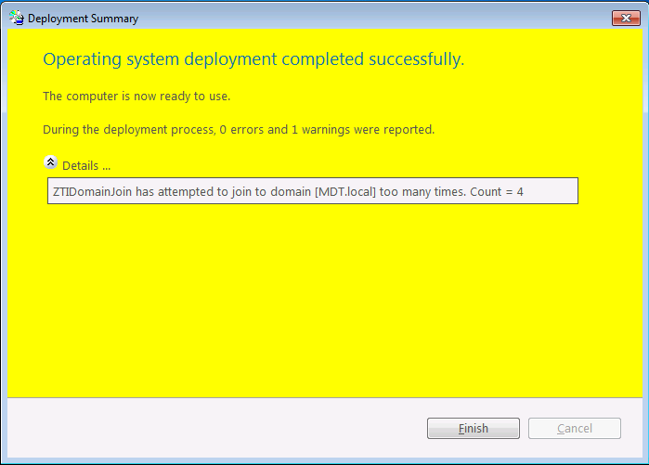
Windows Setup Failures
Domain join issues
Issue
  OS deployment is successful, but the computer is still
  in a workgroup
  From SETUPACT.LOG
    [DJOIN.EXE] Unattended Join: NetJoinDomain failed error code is [1355]
  From %WINDIR%\Debug\Netsetup.log
    NetpGetComputerObjectDn: Specified path
    ‘CN=Computers,DC=domain,DC=com’ is not an OU
Causes
  Incorrect join settings
Key learning
  Do not specify CN=Computers, leave the OU blank instead
  “NET HELPMSG 1355” is “invalid domain” – kind of misleading
  It is a quiet “failure”, unless using MDT Lite Touch
Insanity is doing the same thing over and over and expecting a different result.

Slide 23
Windows Setup Failures
Domain join issues
Issue
  Computer joins the domain but does not end up in the specified OU
Causes
  “By design”, the existing computer object is updated but it will not be moved to another OU
Key learning
  It may be necessary to move the computes to another OU manually or using a script
  You can use WMI filters to exclude GPOs if necessary
Issue
  Join fails if the computer object already exists but works otherwise
Causes
  Join account needs to update the existing computer object

Slide 24
Windows Setup Failures
Crashes
Issue
  You see this screen instead of new OS
  Rebooting has the same result
Causes
  Blue screen crash
    Bad driver (e.g., x64 injected into x86)
    Missing mass storage driver
Key learning
  To get more information, uncheck “Automatically restart” on
  system failure or set registry key in the OS image
    HKLM\System\CurrentControlSet\Control\CrashControl\AutoReboot=0
    http://support.microsoft.com/kb/307973
  STOP 0x7B: Mass storage driver issue
    http://support.microsoft.com/kb/324103
  Status 0xc0000359: Wrong driver platform
    http://support.microsoft.com/kb/2008373
  Dumps may be required
    Blue screen pictures

Slide 25
Common Issues
Windows PE

Slide 26
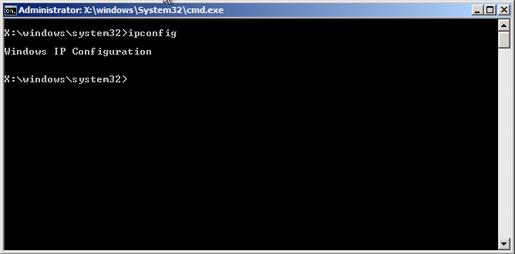
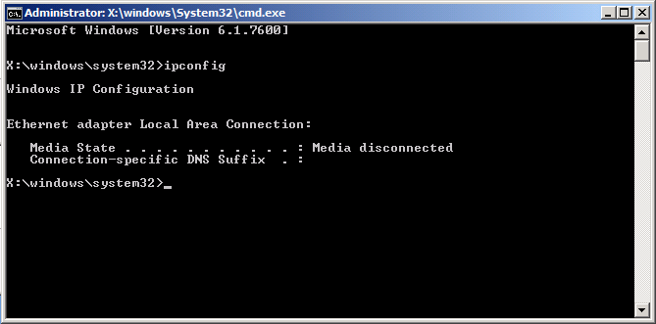
Windows PE Failures
Networking issues
Issue
  A connection to the deployment
  share <share> could not be made
  Failed to find a valid network adapter
  An error occurred while retrieving
  policy for this computer (0x80072EE7)
Causes
  No DHCP address received (portfast)
  No network driver
  Name resolution issue
Key learning
  Press F8 to get to a command prompt,
  IPCONFIG to see networking details,
  PING/NSLOOKUP to check name resolution

Slide 27
Common Issues
Microsoft Deployment Toolkit

Slide 28
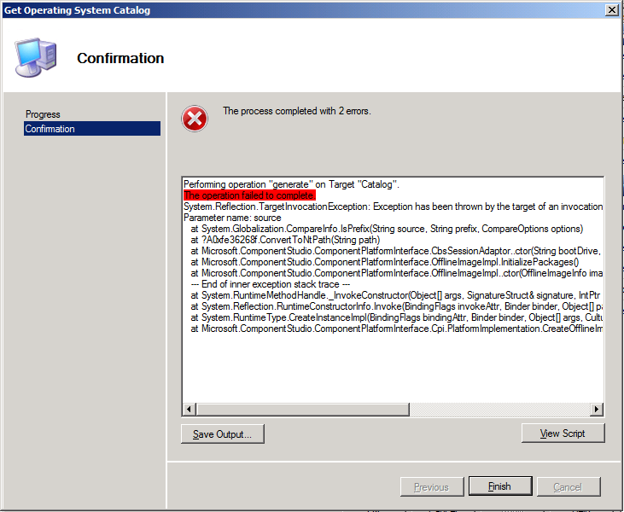
Microsoft Deployment Toolkit
Catalog generation error
Issue
  When trying to edit an unattend.xml associated with
  a custom WIM image, a catalog (CLG) file needs to
  be generated matching what is in the image
  Catalog generation fails
Causes
  Unable to mount the WIM (fails quickly), often a
  WIMGAPI issue
  Issues with antivirus software (fails slowly) when it tries
  to mount registry hives from the image
  Unsupported for an x86 WIM on an x64 OS (fails slowly)
    See note at http://technet.microsoft.com/en-us/library/dd744500(WS.10).aspx
Key learning
  You might need to use an x86 OS to generate a catalog for x86 OSes

Slide 29
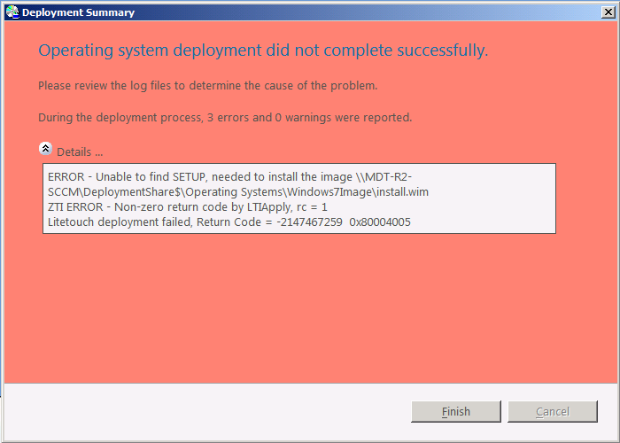
Microsoft Deployment Toolkit
Unable to find SETUP
Issue
  When deploying Windows 7 via MDT Lite Touch,
  the OS install fails with an error
    ERROR - Unable to find SETUP, needed to install
    the image
Cause
  MDT Lite Touch always uses SETUP.EXE to
  install the OS
  If you import an image without SETUP files from the
  original media, it will try to find another copy of the
  deployment share
  If there are no matching copies, it fails
Key learning
  Make sure at least one image on the deployment share (or media) has source files
  See the MDT troubleshooting guide

Slide 30
Microsoft Deployment Toolkit
Task Sequence Failures
Issue
  Task sequence failure, return code -2147467259 (80004005)
Cause
  A step in the task sequence failed
  Could be just about anything
    Incorrect command lines
    Batch files run without “cmd.exe /c”
    Batch files using relative file references (issue when run via a UNC)
    MSU files without “wusa.exe /quiet”
    Unexpected return codes
  Find the SMSTS.LOG to see the real reason
Key learning
  This error does not mean “access denied”
  Use TRACE32 or similar tools to look up errors
  Use tools to capture the errors
Red herring

Slide 31
Common Issues
ConfigMgr 2007 OS Deployment

Slide 32
ConfigMgr OS Deployment
Looping
Issue
  Task sequence hangs once in the new operating system
  BDD.LOG shows one line over and over
    Property LogPath is now = C:\MININT\SMSOSD\OSDLOGS
Cause
  Deploying Windows 7 x64 image captured using MDT Lite Touch with improper TSProgress registry keys
  Scripts (e.g., ZTISCCM.wsf) are unable to create an instance of the “Microsoft.SMS.TSEnvironment” COM control
Resolution
  Fixed in MDT 2010 Update 1
  Registry workaround prior to “Use Toolkit Package” step in new OS
    Reg. add HKCR\Wow6432Node\TypeLib\{D5E1749D-832D-4587-AFC3-9462187FE2F5}\1.0\0\win64 /ve /d "%WINDIR%\SysWOW64\CCM\tscore.dll" /f

Slide 33
ConfigMgr OS Deployment
Task Sequence Failures
Issue
  Task sequence failure, return
  code -2147467259 (80004005)
Cause
  A step in the task sequence failed
  Most of the same causes as with Lite Touch
  Find the SMSTS.LOG to see the real reason, or
  check the status messages (they contain the last
  1024 characters of output)
Key learning
  This error does not mean “access denied”
  Use TRACE32 or similar tools to look up errors
  Use tools to capture the errors

Slide 34
ConfigMgr OS Deployment
Windows is running from D:\WINDOWS
Issue
  Using the original INSTALL.WIM as an OS image package, the OS ends up on the D: drive
Cause
  When using an OS image package, ConfigMgr forces the OS to use the same drive letter as where it was captured
    Technically this is not needed any more for Windows 7
  Windows 7 is originally installed on D
    Done in the Windows build lab before sysprepping and capturing
Key learning
  Install from an OS install package (as SETUP will fix the drive letter)
  Create a custom image using an OS install package (captured from C:) and deploy
  that instead

Slide 35
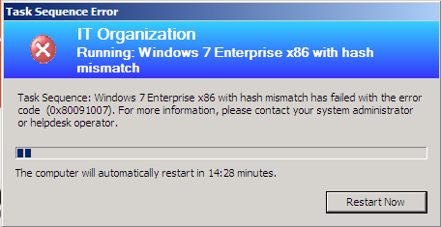
ConfigMgr OS Deployment
Hash mismatch
Issue
  Task sequence will fail if the
  downloaded content hash
  does not match what was
  previously calculated
Cause
  Usually unknown
Resolution
  Refresh the DPs for the affected package
Key learning
  Test your task sequence to make sure it works before targeting large
  groups of machines

Slide 36
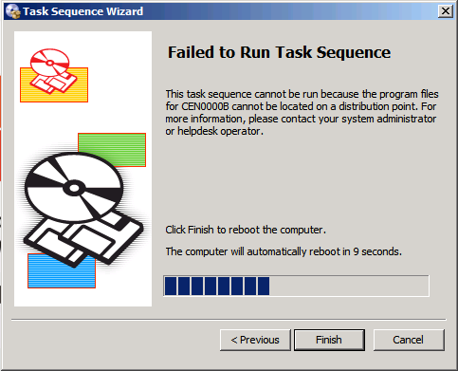
ConfigMgr OS Deployment
Packages not available
Issue
  Task sequence will not run if all packages
  are not available on DPs
Cause
  Packages never distributed to
  accessible DPs
  Pending package distributions
  Out-of-date task sequence policies
  (clients need to poll again)
Resolution
  Push the required packages, wait for policy update
  Scripted

Slide 37
Using PowerShell to Check Packages
demo

Slide 38
ConfigMgr OS Deployment
PXE boot issues
Issues
  Computers will not PXE boot
Causes
  Networking issues (BOOTP forwarders, PORTFAST configuration)
    PXE-E53: No boot filename received
  DHCP option configuration
    Same versus different server, options 60/66/67
  Unknown computer support not enabled
  No task sequence advertisements
    “All Systems” does not include “All Unknown Computers”
    ABORTPXE
  No boot images available for task sequence advertisements
    Both are needed in order to extract needed files
  Cached information on server
    Default cache time of 60 minutes (including negative)
    ABORTPXE

Slide 39
ConfigMgr OS Deployment
PXE boot issues
Resolutions and troubleshooting instructions
  Distribute both boot images (x86, x64)
  Check SMSPXE.LOG and WDSSERVER.LOG
    Ignore dummy “ping” requests, search for computer’s MAC or UUID
    Look at lines after “LookupDevice” and “GetBootAction”
  Set the cache expire time
  http://support.microsoft.com/kb/2019640
  Know the meanings of different PXE error codes
  http://h18013.www1.hp.com/products/servers/management/rdp/knowledgebase/00000138.html
  More troubleshooting notes
  http://blogs.technet.com/smsandmom/archive/2008/09/17/configmgr-2007-troubleshooting-pxe-service-point-issues-and-wds-service-not-starting.aspx
Key learning
  Troubleshooting requires an understanding of what is going on, pay attention to subtle details

Slide 40
Next Steps
Become a fan of MDT
  http://www.facebook.com/MicrosoftDeploymentToolkit
Join the distribution lists, use the forums

Slide 41

Related Content
Required Slide
Speakers, please list the Breakout Sessions, Interactive Discussions, Labs, Demo Stations and Certification Exam that relate to your session. Also indicate when they can find you staffing in the TLC.
Breakout Sessions (session codes and titles)
Interactive Sessions (session codes and titles)
Hands-on Labs (session codes and titles)
Product Demo Stations (demo station title and location)
Related Certification Exam
Find Me Later At…

Slide 42
Track Resources
Required Slide
Track PMs will supply the content for this slide, which will be inserted during the final scrub.
Resource 1
Resource 2
Resource 3
Resource 4

Slide 43





Resources
  Connect. Share. Discuss.
http://northamerica.msteched.com
Learning
  Sessions On-Demand & Community
  Microsoft Certification & Training Resources
www.microsoft.com/teched
www.microsoft.com/learning
  Resources for IT Professionals
  Resources for Developers
http://microsoft.com/technet
http://microsoft.com/msdn

Slide 44












Required Slide
Complete an evaluation on CommNet and
enter to win!

Slide 45


Slide 46

© 2011 Microsoft Corporation. All rights reserved. Microsoft, Windows, Windows Vista and other product names are or may be registered trademarks and/or trademarks in the U.S. and/or other countries.
The information herein is for informational purposes only and represents the current view of Microsoft Corporation as of the date of this presentation. Because Microsoft must respond to changing market conditions, it should not be interpreted to be a commitment
on the part of Microsoft, and Microsoft cannot guarantee the accuracy of any information provided after the date of this presentation. MICROSOFT MAKES NO WARRANTIES, EXPRESS, IMPLIED OR STATUTORY, AS TO THE INFORMATION IN THIS PRESENTATION.

