Slide 1
Top 10 Windows Deployment Service Common Issues and How to Resolve Them WCL313
Rhonda J. Layfield
Sr. Deployment Specialist
Deployment Done Right

Slide 2
Rhonda Layfield
IT industry 30 years
Contribute articles to Windows IT Pro mag
Setup and Deployment MVP
Desktop Deployment Product Specialist (DDPS)

Slide 3
What We’ll Cover
Installation and configuration issues
WDS and other services
DNS and DHCP
WinPE problems
PXE Boot
Create an Image to Deploy
Deploy an Image
Known client settings not recognized
Multicast issues

Slide 4
WDS Requirements
DHCP
1
2
AD/DNS
3
Bare-Metal
WDS
NTFS Partition

Slide 5
Configure WDS
Choose where to store your images
DHCP Options
PXE Server Settings

Slide 6
Configure WDS
Demo

Slide 7
Dynamic Host Configuration Protocol DHCP

Slide 8
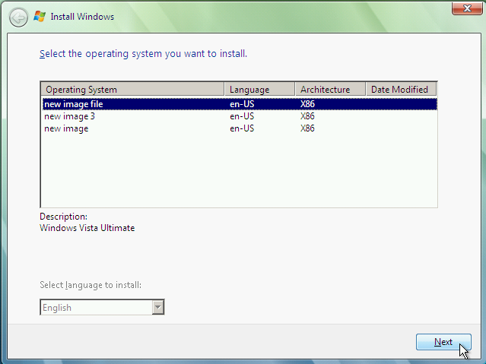
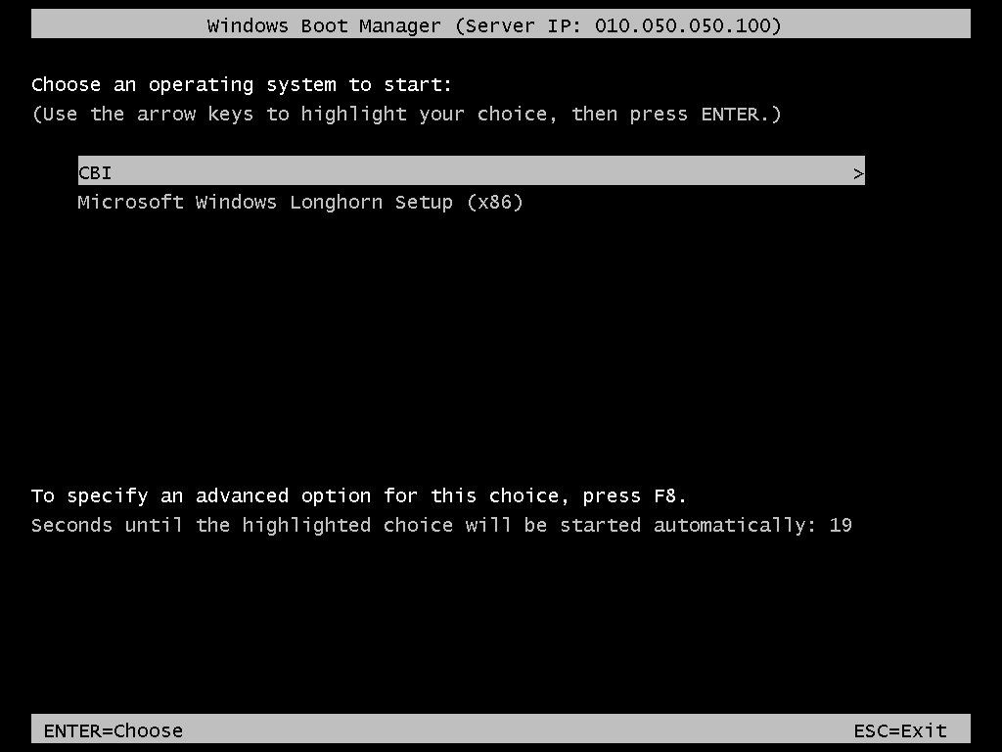
DHCP And WDS
Discover IP
DHCP/WDS
Offer IP/PXE Server
Request
Bare-Metal
Acknowledge

Slide 9
WDS & DHCP
3 Scenarios
WDS and DHCP on the same subnet/ different servers
Client will find WDS by broadcasting
WDS and DHCP on different subnets
Client must find WDS through options 66 and 67 set in DHCP
WDS & DHCP on same server
Client must find WDS through Option 60 in DHCP

Slide 10
WDS & DHCP Same Subnet
DHCP
Bare-Metal
Request
Acknowledge
Discover IP/PXE Server
Offer IP
Discover IP/PXE Server
WDS
I’m WDS

Slide 11
WDS & DHCP Different Subnets
DHCP
Bare-Metal
Discover IP/PXE Server
Offer IP Option 66 Option 67
Acknowledge
Request
WDS

Slide 12
WDS & DHCP on The Same Server
Discover IP
DHCP / WDS
Bare-Metal
Offer IP Option 60 I’m also WDS
Request
Acknowledge

Slide 13
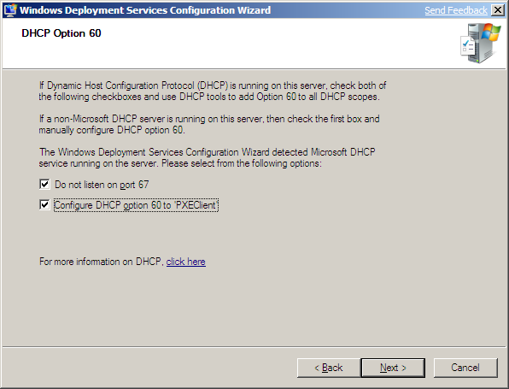
WDS And DHCP on The Same Server?

Slide 14
10) What I’ve seen…
Infrastructure team sets up a new DHCP server
De-commission the old one
AND they forget to set the options for WDS

Slide 15
WDS and DHCP
Demo

Slide 16
WDS and DNS

Slide 17
9) WDS and DNS
WDS and DNS running on the same server may introduce a problem
The DNS service binds to all ports needed by WDS
The default WDS port range is 64,000 to 65,000
I’ve run into this when DNS is installed first
Like on a DC running DNS
Or after installing MS08-037
To resolve the issue change the ports for WDS

Slide 18
WDS Ports
Demo

Slide 19
PXE Boot

Slide 20
8) Pre-Boot Execution Environment aka…PXE
PXE Protocol is an extension of DHCP
Created by Intel as a standard with a set of pre-boot services stored in the boot firmware
The goal:
Perform a network boot
Find and download a network boot program (NBP) from a Network Boot Server (NBS)
Notes:
Created by intel as a standard with a common and consistent set of pre-boot services that are stored in the boot firmware.

Slide 21
The PXE Process
From the client
Client receives an IP address
Discovers a Network Boot Server (NBS)
Downloads the Network Boot Program (NBP) from the NBS (TFTP) and executes it

Slide 22
Subnets, Routers and Switches OH NO!
All PXE / DHCP traffic is local traffic only
DHCP – port UDP 67
PXE traffic – port UDP 4011

Slide 23
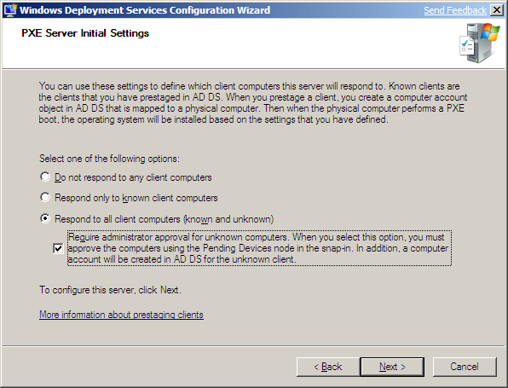
PXE Server Settings

Slide 24
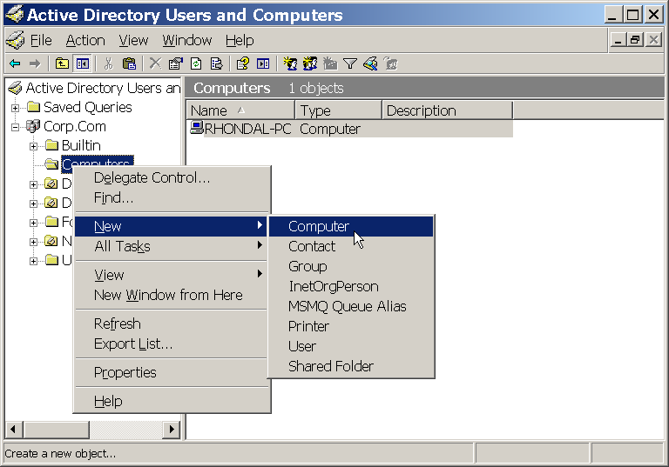
Known clients are Prestaged in Active Directory

Slide 25
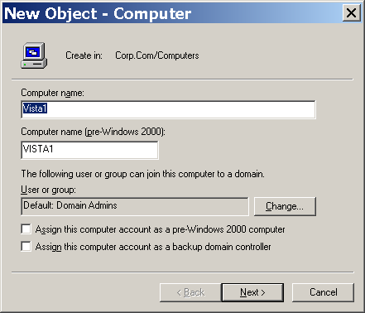
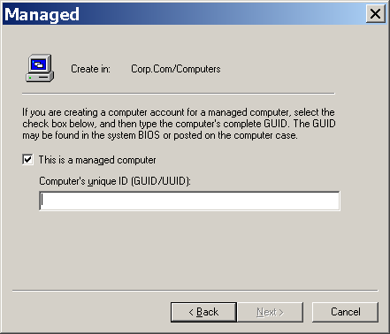
Prestaging and The GUID
564D49219C768546A956C310ED7D2BF6
00000000000000000000005056C00008

Slide 26
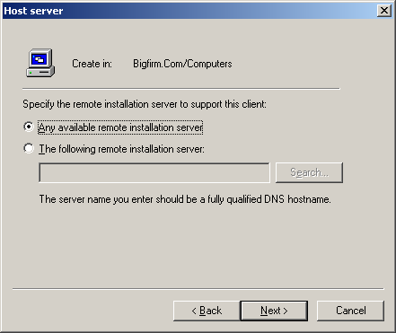
Use a Specific WDS Server

Slide 27
From The Client

Slide 28
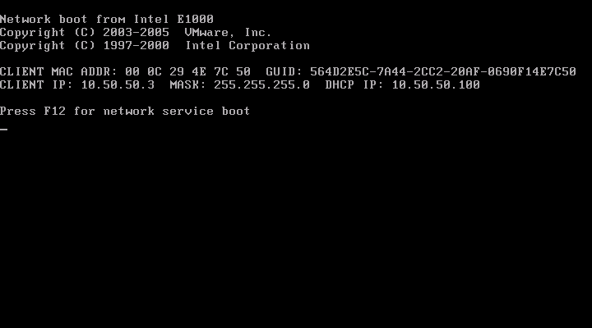
Known Client PXE boot

Slide 29
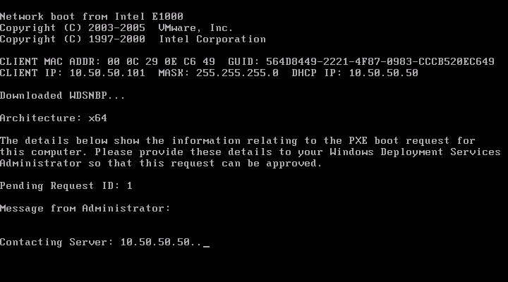
Unknown Clients

Slide 30
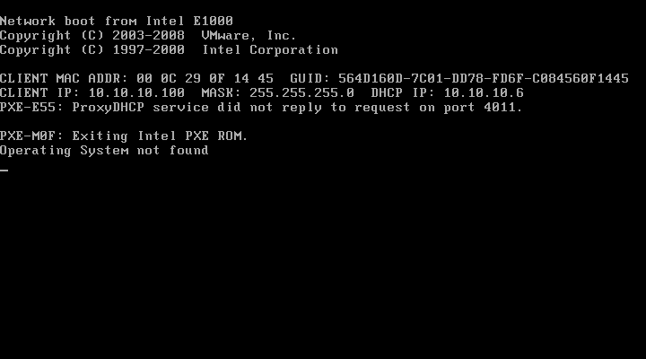
No NBS or NBP
Mis-configured Switch or Router

Slide 31
PXE Issues
IP helpers configured properly on your switches and routers are more reliable
Older PXE ROMs have issues with DHCP options 60,66,67
Options 66 & 67 are referred to as a Network Boot Referral (NBR)
Notes:
Created by intel as a standard with a common and consistent set of pre-boot services that are stored in the boot firmware.

Slide 32
Windows Pre Installation Environment: WinPE

Slide 33
7) WinPE
You can create your own custom WinPE
Using the Windows Automated Installation Kit (WAIK)
Copype utility
WinPE found on a Windows 7 or Server 2008 R2 DVD (or .ISO)
\Sources folder
Named Boot.wim

Slide 34
Which WinPE To Use…
The most current is always best
Windows 7 SP1 Boot.wim can deploy
Vista SP1
Windows Server 2003 R2
Windows 7 & SP1
Server 2008 & R2 & SP1
Accidently use a Vista or Vista SP1 boot.wim?
Vista boot.wim cannot deploy W7 or 2K8 R2
Failure on the Offline servicing pass even if it’s not configured to install patches
The error looks like this:

Slide 35
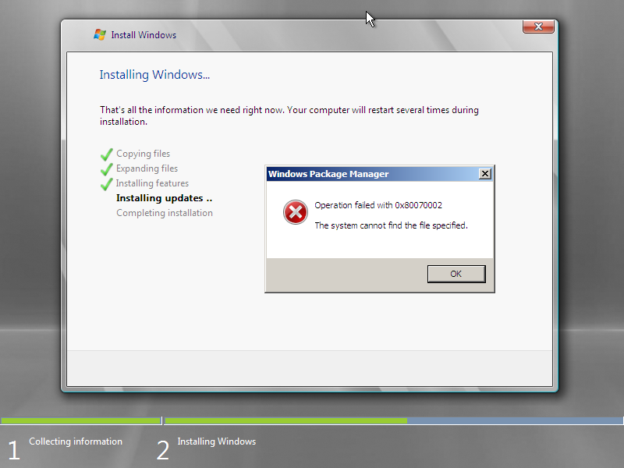
Using an Old Boot.wim

Slide 36
WinPE
Demo

Slide 37
WinPE and Archictectures
Boot a x86 WinPE
Both x86 and x64 install images
Boot a x64 WinPE
Only x64 install images

Slide 38
WDS Permissions

Slide 39
What I’ve seen…
The Domain Administrator account being used for deploying images
Not necessary

Slide 40
6) Locking Down Permissions
Default Permissions
Local administrator on the WDS server
Full Control of the RemoteInstall folder
Full Control permissions on HKEY_LOCAL_MACHINE\System
Domain administrator (domain where the WDS server resides)
Full Control permissions on the Service Control Point (SCP) in AD DS for the WDS server.

Slide 41
Permissions Continued
Enterprise administrator
Dynamic Host Configuration Protocol (DHCP) authorization permissions
Admin Approval
The computer account is created using the server’s authentication token (not the admins token performing the approval)
WDSSERVER$ must have “create computer account objects” on the containers / OUs where the approved pending computers will be created

Slide 42
Admin Approval Continued
Admin Approval of Pending Computers
R/W to the F:\RemoteInstall\MGMT
contains Binlsvcdb.mdb
Active Directory Users and Computers
Create a custom task to delegate on OU where the computer account will be created -> Write all properties on Computer Objects

Slide 43
Joining a Machine To a Domain
ADUC
R-click the container or OU and go to Properties
Click the Advanced button and add a user or group then click the Edit button
Under Apply to: This object and all descendant objects
Allow “Create Computer objects” Ok (3x)
BUT now that user can create computer objects and join machines to the domain
What if you only want someone to be able to join a machine to the domain?

Slide 44
The JoinRights Setting Part 1
JoinRights registry setting determines the set of security privileges
located at: HKEY_LOCAL_MACHINE\SYSTEM\CurrentControlSet\Services\WDSServer\Providers\WDSPXE\Providers\BINLSVC\AutoApprove\<arch> Name: JoinRights Type: DWORD Value: 0 = JoinOnly.; 1 = Full
Notes:
A user that has Join only rights cannot join the domain without administrator assistance (an administrator with proper permissions on the computer account object must reset the computer account before the client installation and domain join). A user that has Full rights can reset the account and join the domain without administrator assistance.

Slide 45
The JoinRights Setting Part 2
The User registry setting determines which users have the right to join the domain
User setting located at: HKEY_LOCAL_MACHINE\SYSTEM\CurrentControlSet\Services\WDSServer\Providers\WDSPXE\Providers\BINLSVC\AutoApprove\<arch> Name: User Type: REG_SZ Value: group or user.

Slide 46
Common Permissions
TASK | Permission
Prestage a computer | ADUC -> Create a custom task to delegate on OU where you are putting the computer account -> Write all properties on Computer Objects
Add/Remove Image or Image Group | FC F:\RemoteInstall\Images\ImageGroup
Disable an image | R/W for the image (on image properties in WDS)
ADD boot image | R/W F:\RemoteInstall\Boot R/W F:\RemoteInstall\Admin (if upgrading from 2K3 server)
Remove boot image | R/W F:\RemoteInstall\Boot

Slide 47
Common Permissions
TASK | Permission
Manage properties on an OS image | R/W on image Res.rwm file found: F:RemoteInstall\Images\<ImageGroup>
Convert a RIPREP image | R original RIPREP image R/W %TEMP% and destination folder
Create Discover / Capture image | R original boot image R/W %TEMP% and destination folder
Create a multicast transmission | FC on: HKEY_LOCAL_MACHINE\SYSTEM\CurrentControlSet\Services\WDSServer\Providers\Multicast R F:\RemoteInstall\Images\<ImageGroup>

Slide 48
5) Renaming/Moving WDS Server
Renaming a machine
Moving a machine from one domain to another
You’ll need to uninitialize & reinitialize WDS server
From a cmd on the WDS server
Wdsutil /uninitialize-server
Wdsutil /initialize-server /reminst:E:\RemoteInstall

Slide 49
4) Create an Image to Deploy
WDSCapture WinPE
Add boot.wim from a 2K8 Server .iso
Right-click the boot.wim and choose “Create capture image…”
Add the new .wim file that you just created
Sysprep
-reseal
generalize

Slide 50
Boot WDS Capture
No Volume to capture?

Slide 51
3) Known Client Settings Ignored
Ensure there are not duplicate machine accounts pre-staged for the same machine
Pre-stage using the MAC address
Swap the NIC to another machine
Dual Admins
1st admin creates a computer object in ADUC
2nd admin pre-stages a computer object with the NIC or GUID
The first one found is used

Slide 52
2) Multicast Issues
Multicast traffic running really slow
Which version of IGMP is being used?
V3 or v2?
Multiple WDS servers multicast traffic
Overlapping IP addresses
WDS snap-in -> Properties of Server -> Multicast tab -> change the IP addresses

Slide 53
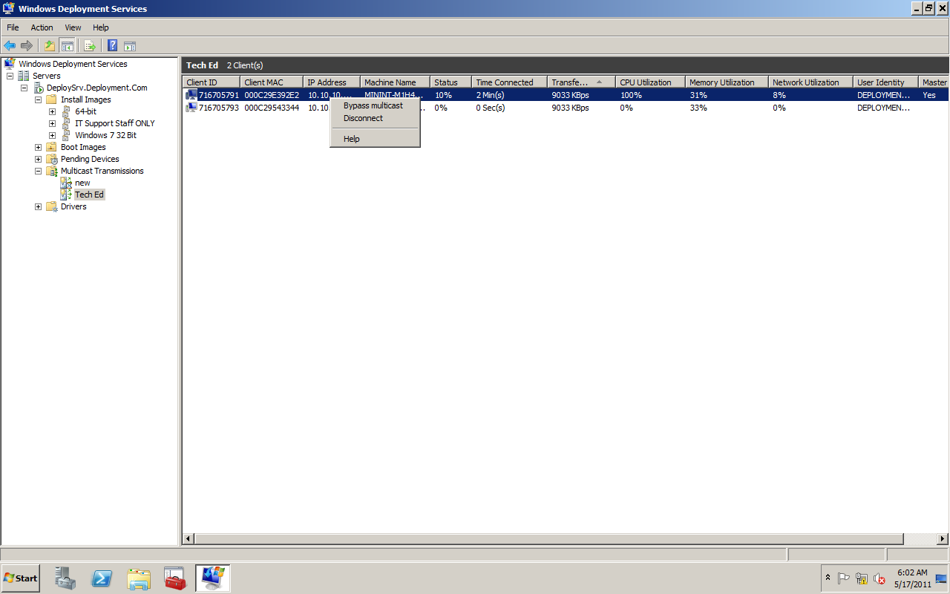
Bypass multicast = unicast
Disconnect = ends the deployment

Slide 54
1) IMHO: Not Integrating With MDT 2010 U1
Microsoft Deployment Toolkit 2010 Update 1 is a free download
Gives you so much more flexibility
Management of your images is much simpler
To get the most out of your deployments integrate WDS and MDT

Slide 55
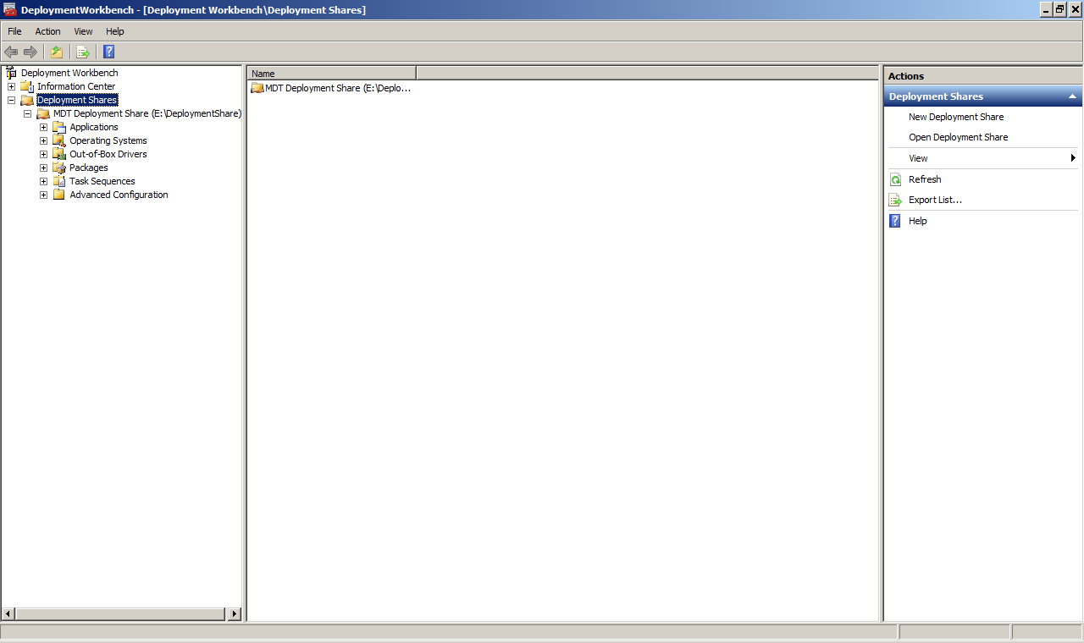

Slide 56
MDT & WDS Together
MDT
Deployment Server
W7 DVD
MDT WinPE
Model
Store Image
Download Image
WDS Server
MDT WinPE
MDT can use WDS Multicast feature
F12
Targets
Notes:
56
IMAGING: Late 1990s
1. Install OS and applications, configure model computer.
2. Use imaging tool to create image of hard drive.
3. Image typically stored on an image distribution server.
4. Deploy image to target computers using image distribution tool.
5. Target computers are exact clones of the model, which is problematic because they have the same SID as the model. So a SID changing tool is required on the target computers to generate unique SIDs.

Slide 57
What We Covered
Installation and configuration issues
WDS and other services
DNS and DHCP
WinPE problems
PXE Boot
Create an Image to Deploy
Deploy an Image
Known client settings not recognized
Multicast issues

Slide 58
Wrapping IT UP..
Look for upcoming articles from Windows ITPro magazine
.vhd vs .wim image formats
TrainSignal Video
Promo sessions – taste of their authors
$1000 daily gift card give away at the booth
$5,000 on Thursday
Visit booth for details
Available for training and consulting (short term)
www.DeploymentDr.Com

Slide 59
Troubleshooting Resources
Required Slide
Track PMs will supply the content for this slide, which will be inserted during the final scrub.
Error codes for WDS & AD Integration (BINLSVC)
http://technet.microsoft.com/en-us/library/dd299753(WS.10).aspx
Permissions for Server & Client
http://technet.microsoft.com/en-us/library/cc754005(WS.10,printer).aspx

Slide 60
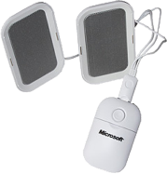
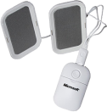
Required Slide
Complete an evaluation on CommNet and enter to win!

Slide 61
© 2011 Microsoft Corporation. All rights reserved. Microsoft, Windows, Windows Vista and other product names are or may be registered trademarks and/or trademarks in the U.S. and/or other countries.
The information herein is for informational purposes only and represents the current view of Microsoft Corporation as of the date of this presentation. Because Microsoft must respond to changing market conditions, it should not be interpreted to be a commitment on the part of Microsoft, and Microsoft cannot guarantee the accuracy of any information provided after the date of this presentation. MICROSOFT MAKES NO WARRANTIES, EXPRESS, IMPLIED OR STATUTORY, AS TO THE INFORMATION IN THIS PRESENTATION.

