Slide 1

Raiders of the Elevated Token: Understanding
User Account Control and Session Isolation
(repeats on May 19 at 1pm)
WCL310
Raymond P.L. Comvalius MCT, MVP
Independent IT Infrastructure Specialist
The Netherlands

Slide 2
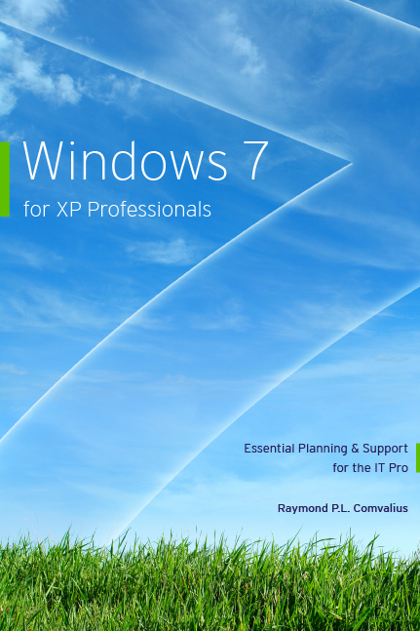
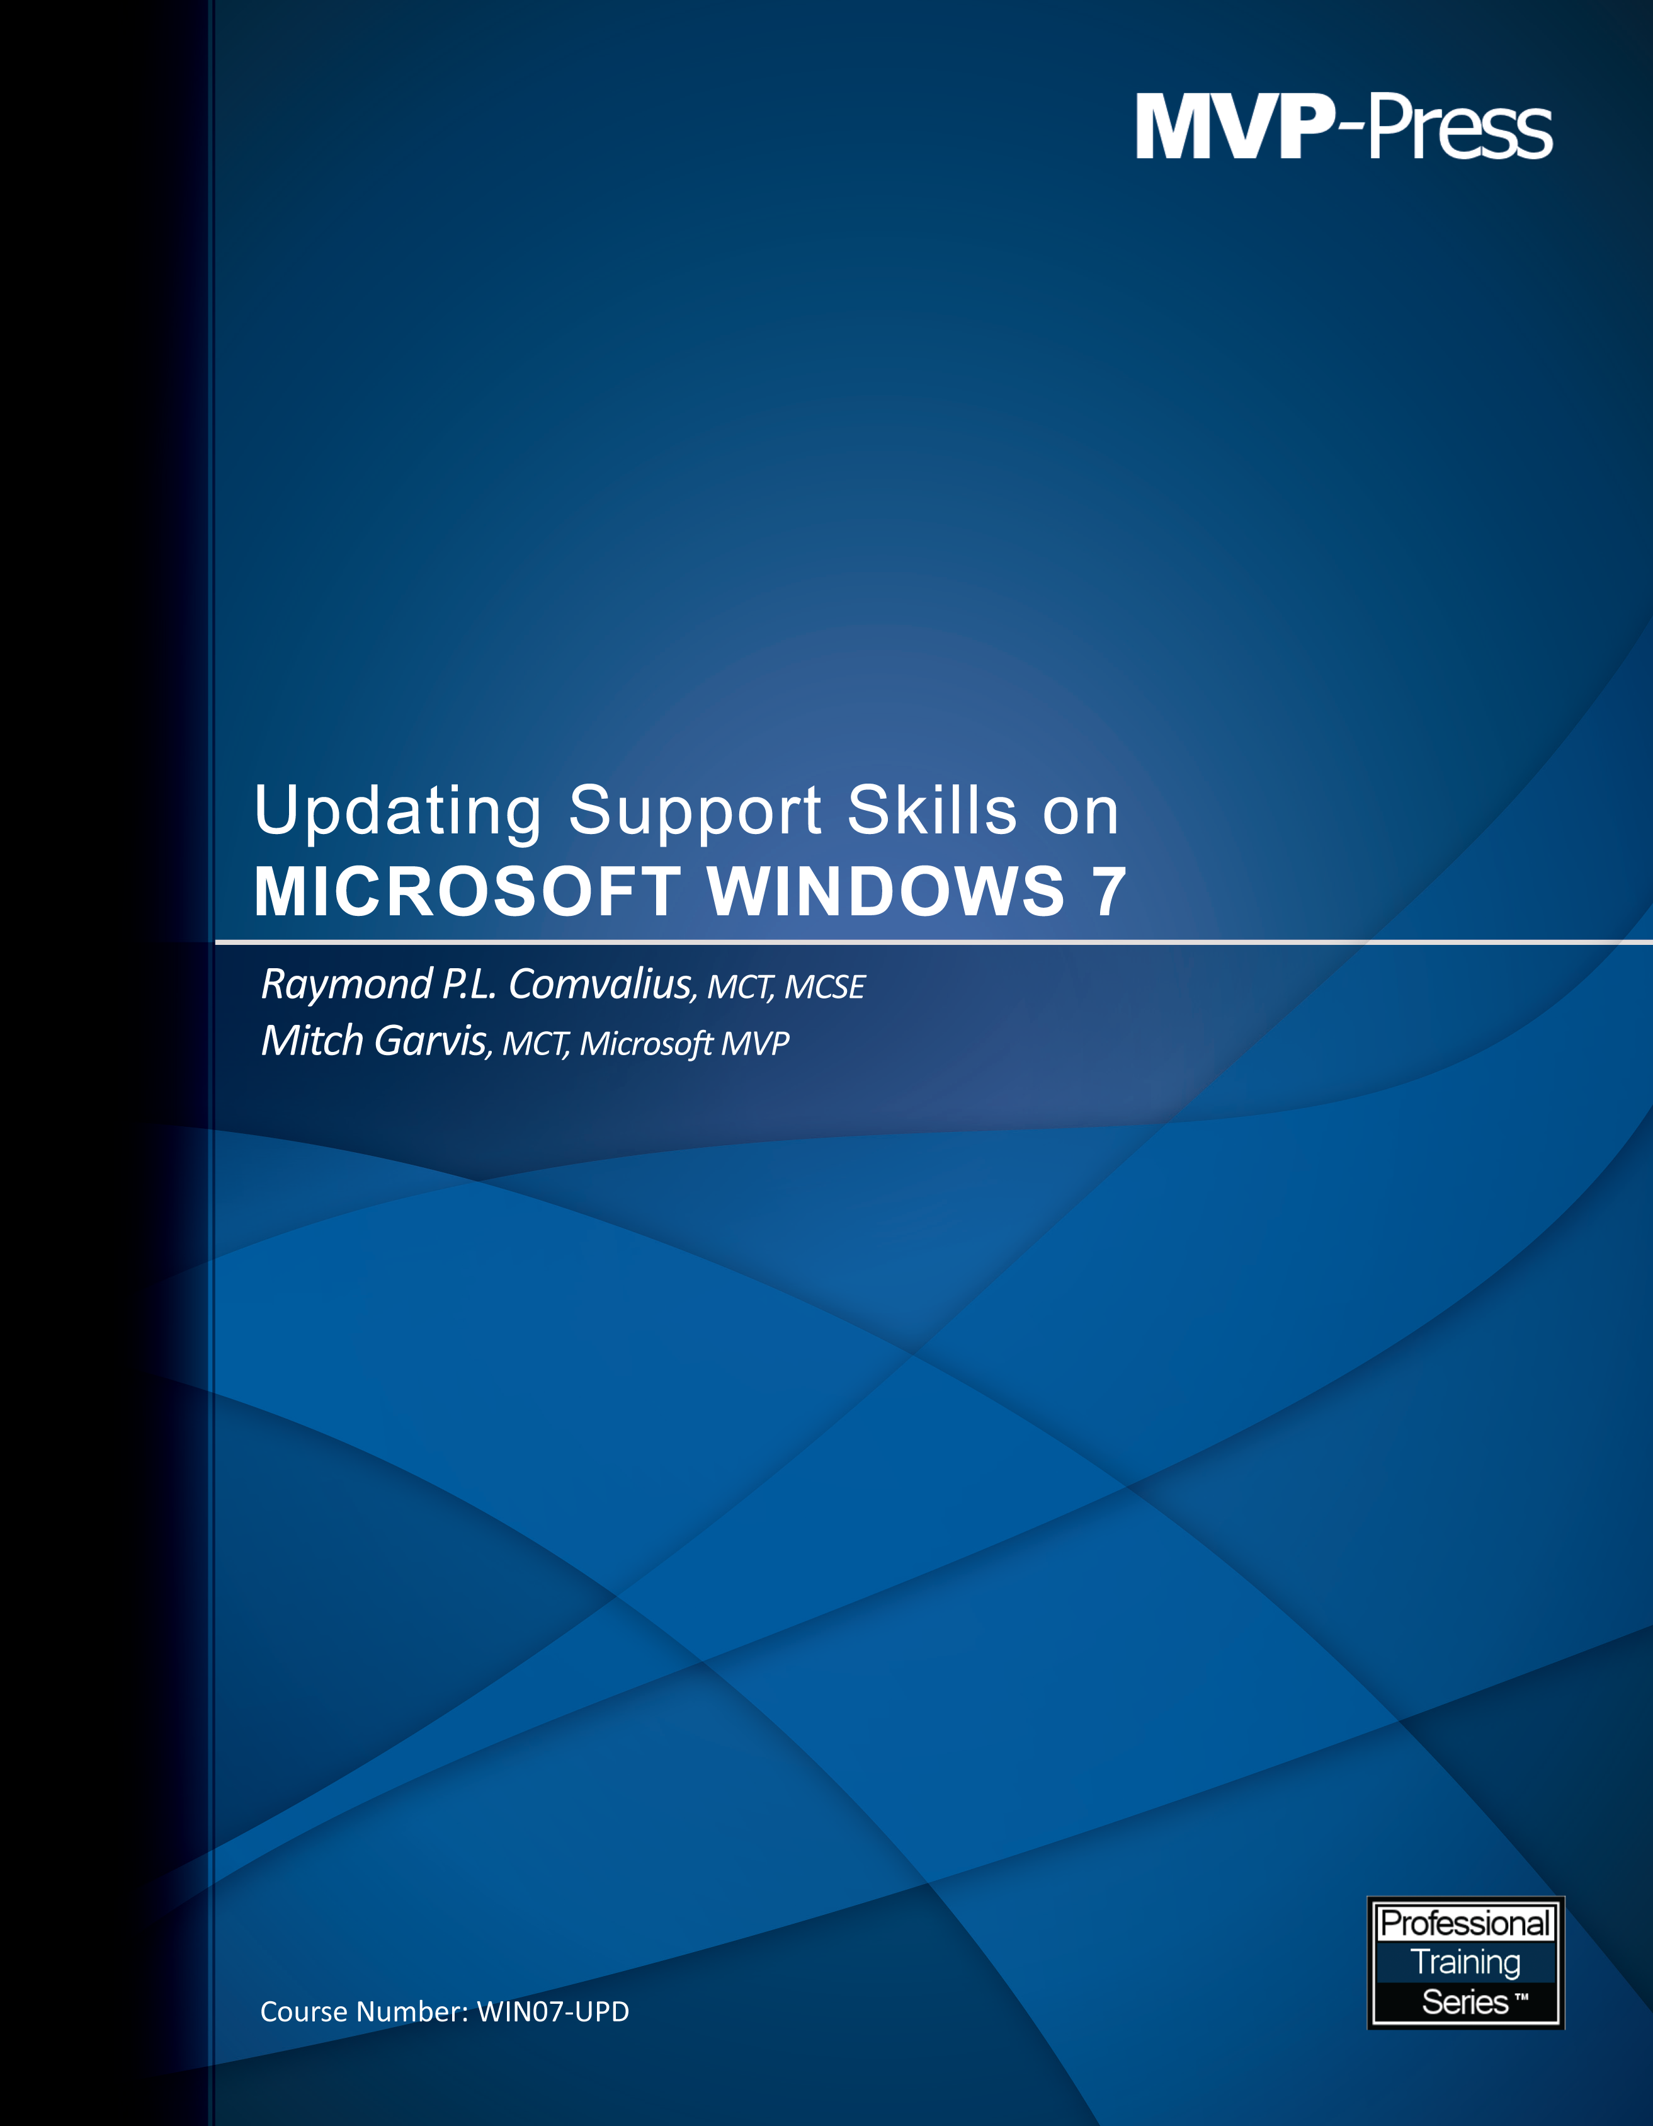

Introducing Raymond Comvalius
Independent Consultant, Trainer, and Author
MVP: Expert Windows IT Pro
Blog: www.xpworld.com
Twitter: @xpworld
Editor for bink.nu
www.books4brains.com
www.mvp-press.com

Slide 3
Agenda
User Account Control
  What is UAC?
  Configuring User Account Control
  Integrity Levels
  File & Registry Virtualization
  How to Control Elevation
Session 0 Isolation
Service ID

Slide 4
Windows User Types
Disabled by Default in Windows 7 and Vista
The Administrator
  The account named ‘administrator’
An Administrator
  Your name with administrator privileges
Protected Administrator
  AKA: ‘Administrator in Admin Approval Mode’
Standard User
  Your name without administrator privileges
XP Default
Windows 7 and Vista - Default
Most Secure – Best Choice for IT

Slide 5

Standardizing the User Token
  Administrators
  Backup Operators
  Power Users
  Network Configuration Operators
User-SID
Local/Builtin Group SIDs
Group Policy Creator Owners
Schema Admins
Enterprise Admins
Denied RODC Password Replication Group
Domain Group SIDs
  Create a token object
  Act as part of the operating system
  Take ownership of files and other objects
  Load and unload device drivers
  Back up files and directories
  Restore files and directories
  Impersonate a client after authentication
  Modify an object label
  Debug programs
Mandatory Label
Rights/Privileges

Slide 6
Examining the Access Token
demo

Slide 7
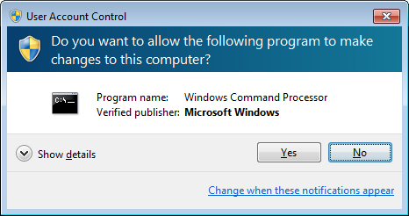
Consent UI
The ‘face’ of UAC
Warns you for a User State change
(AKA new token creation)
Secure Desktop
  Screen mode like pressing Ctrl-Alt-Del
  Creates screenshot of the desktop (programs keep running in the background)
  Keeps scripts etc. from pressing keys or clicking the mouse

Slide 8
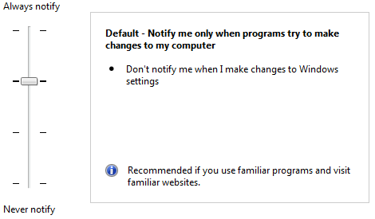
Configuring UAC in the Control Panel
From the Control Panel
  Always notify
  Default
  Do not dim the display
  Never notify
With Group Policy
  More granular controls

Slide 9
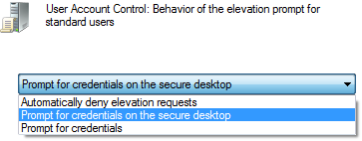
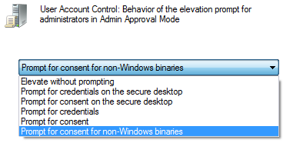
Configuring UAC in Group Policy
Behaviour for Standard Users
  Deny Access
  Prompt for Credentials
Admin Approval Mode for the built-in Administrator account
For Administrators in Admin Approval Mode
  Prompt for Consent
  Prompt for Credentials
  Elevate without prompting
    Not same as disable UAC!

Slide 10
Configuring UAC
demo

Slide 11
UIAccess Applications
Software alternatives for the mouse and keyboard
  For example Remote Assistance
User Interface Accessibility integrity level
Windows always checks signature on UIAccess Applications
UIAccess applications must be installed in secure locations
Optionally these applications can disable the secure desktop (used with Remote Assistance)

Slide 12
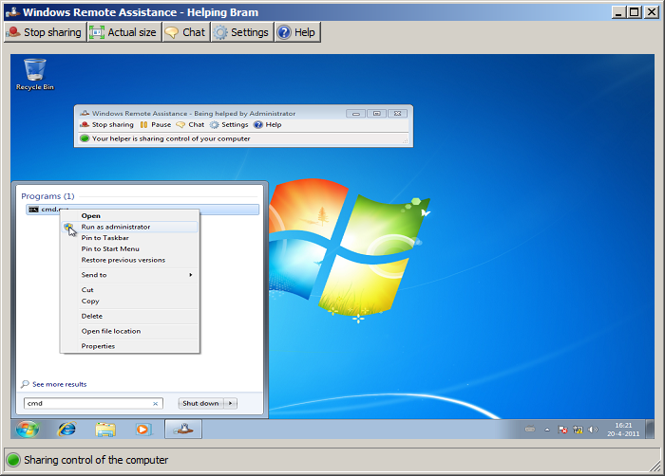
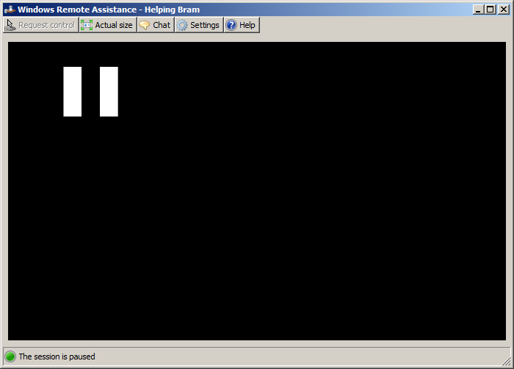
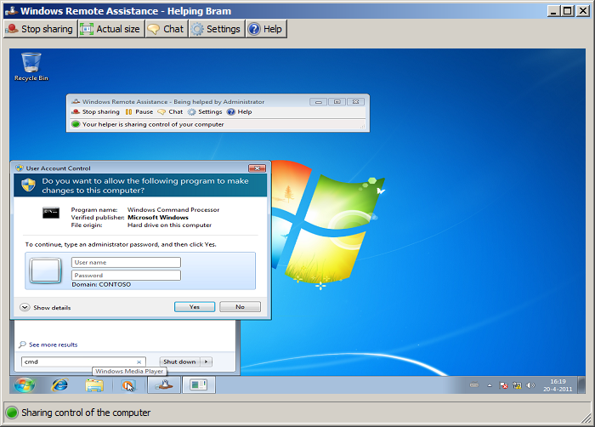
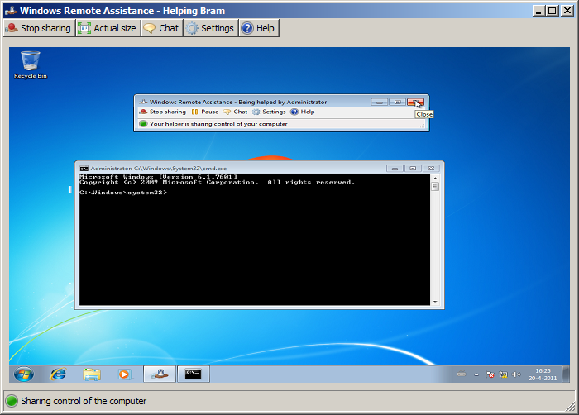
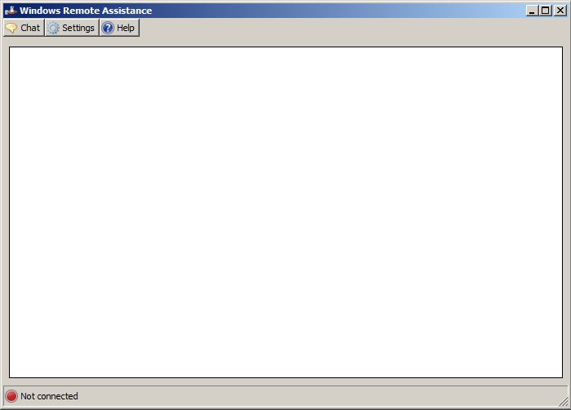
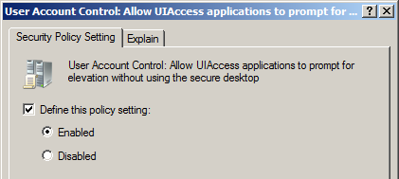
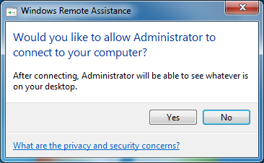
Remote Assistance and the Secure Desktop
for non-administrative users

Slide 13
Integrity Levels
Mandatory Access Control
Levels are part of the ACLs and Tokens
Lower level object has limited access to higher level objects
Used to protect the OS and for Internet Explorer Protected Mode
Services
Administrators
Standard Users
IE Protected Mode
Medium
(Default)
System
High
Low

Slide 14
Standardizing the User Token
User-SID
Local/Builtin Group SIDs
Domain Group SIDs
  Integrity level: High (Elevated Token)
Mandatory Label
  Integrity level: Medium
Rights/Privileges

Slide 15

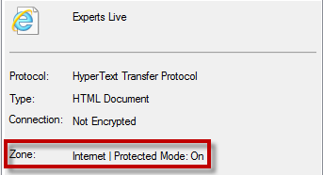

IE protected mode
Only with User Account Control enabled
iexplore.exe runs with Low Integrity Level
User Interface Privilege Isolation (UIPI)
Internet Explorer 9
Internet Explorer 8

Slide 16


IE Broker mechanism
iexplore.exe
Protected-mode Broker Object
UI frame
Favorites Bar
Command Bar
Low Integrity Level
Protected Mode = On
Medium Integrity Level
Protected Mode = Off
iexplore.exe (tab process 1)
iexplore.exe (tab process n)
Tab 1
Tab n
Tab 1
Tab n
Toolbar Extensions
Toolbar Extensions
Trusted Sites
Internet/Intranet
ActiveX Controls
ActiveX Controls
Browser Helper Objects
Browser Helper Objects

Slide 17
Integrity Levels
demo

Slide 18
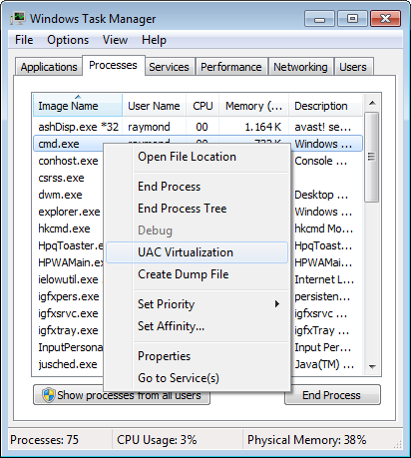
File Virtualization
File Virtualization is a compatibility feature
The following folders and subfolders are virtualized:
  %WinDir%
  \Program Files
  \Program Files (x86)
Virtual Store:
  %UserProfile%\AppData\Local\VirtualStore
Troubleshooting file virtualization
  Event Log: UAC-FileVirtualization
Disabling file virtualization

Slide 19
Registry Virtualization
Virtualizes most locations under HKLM\Software
Keys that are not virtualized:
  HKLM\Software\Microsoft\Windows
  HKLM\Software\Microsoft\Windows NT\
  HKLM\Software\Classes
Per user location: HKCU\Software\Classes\VirtualStore
Flag on a registry key defines if it can be virtualized
  “Reg flags HKLM\Software” shows flags for HKLM\Software
Registry Virtualization is NOT logged in the EventLog

Slide 20
File & Registry Virtualization
demo

Slide 21
What defines a UAC state change
Executables that are part of the Windows OS
File Name
Manifest
Compatibility Settings
Shims

Slide 22
UAC for the Windows OS
Default no warning when elevating Windows OS programs
Except for:
  CMD.exe
  Regedit.exe

Slide 23
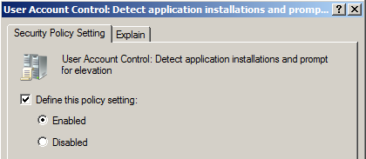
What’s in a name?
Evaluation of the file name determines need for elevation
  Setup
  Instal
  Update
Disable this feature in Group Policy when needed

Slide 24
UAC and Manifests
Configure the need for elevation per file:
  asInvoker
  highestAvailable
  requireAdministrator
External or Internal
Use mt.exe from the SDK to inject a manifest
Use SigCheck.exe from SysInternals to view the manifest

Slide 25
File names and manifests
demo

Slide 26
UAC and compatibility settings
Configure the shortcut
  RequireAdministrator
  RunAsInvoker
Create a Shim
  Need the Application Compatibility Toolkit
  Compatibility Administrator
  Compatibility Modes
  Compatibility Fixes

Slide 27
Compatibility Settings
demo

Slide 28
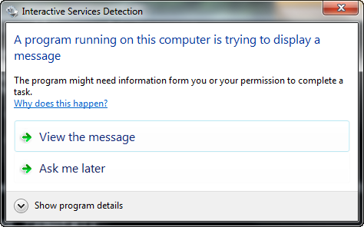
Does this look familiar?

Slide 29
Session 0 isolation
Services run in session 0
Before Vista, session 0 belonged to the console
Users logon to session 1 and higher
If a service interacts in session 0 you see this message

Slide 30
Session 0 isolation
demo

Slide 31
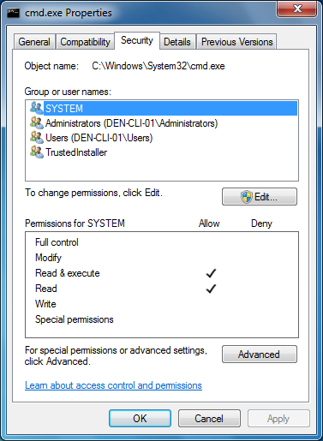
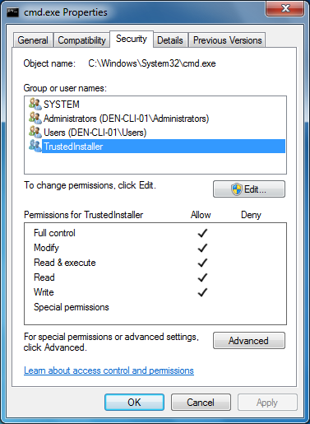
Why is this?

Slide 32
Services SID
A service can be a security entity
Windows uses TrustedInstaller (Windows Installer Service)
Only TrustedInstaller has Full Control access
TrustedInstaller = “NT Service\TrustedInstaller”
TrustedInstaller installs:
  Windows Service Packs
  Hotfixes
  Operating System Upgrades
  Patches and installations by Windows Update

Slide 33
TrustedInstaller
demo

Slide 34
Yes you can!
User Account Control is no black magic
UAC makes Internet Explorer a safer browser
Analyze your applications
Get to know the tools
Whoami.exe
icacls.exe
SysInternals
Application Compatibility Toolkit (ACT)
Windows SDK

Slide 35

Related Content
Required Slide
Speakers, please list the Breakout Sessions, Interactive Discussions, Labs, Demo Stations and Certification Exam that relate to your session. Also indicate when they can find you staffing in the TLC.
WCL312: Sysinternals Primer: Autoruns, Disk2vhd, ProcDump, BgInfo and AccessChk
WCL402: Troubleshooting Application Compatibility Issues with Windows 7
Find Me At The Springboard booth

Slide 36
Track Resources
Don’t forget to visit the Cloud Power area within the TLC (Blue Section) to see product demos and speak with experts about the Server & Cloud Platform solutions that help drive your business forward.
You can also find the latest information about our products at the following links:
Cloud Power - http://www.microsoft.com/cloud/
Private Cloud - http://www.microsoft.com/privatecloud/
Windows Server - http://www.microsoft.com/windowsserver/
Windows Azure - http://www.microsoft.com/windowsazure/
Microsoft System Center - http://www.microsoft.com/systemcenter/
Microsoft Forefront - http://www.microsoft.com/forefront/

Slide 37





Resources
  Connect. Share. Discuss.
http://northamerica.msteched.com
Learning
  Sessions On-Demand & Community
  Microsoft Certification & Training Resources
www.microsoft.com/teched
www.microsoft.com/learning
  Resources for IT Professionals
  Resources for Developers
http://microsoft.com/technet
http://microsoft.com/msdn

Slide 38












Complete an evaluation on CommNet and
enter to win!

Slide 39


