Slide 1

Optimizing Group Policy in Virtual Desktop (VDI) Environments
WCL309
Darren Mar-Elia
CTO
SDM Software & GPOGUY.COM

Slide 2
Agenda
What’s so special about Virtual Desktops?
GPO design considerations for VDI
GPO Settings that impact VDI performance
Use of Loopback (when does it make sense)
Image considerations with GPOs
User State Virtualization and VDI

Slide 3
Virtual Desktop Infrastructure (VDI) Defined
Desktop PC (e.g. Windows 7 PC) running in a VM on a Hypervisor (e.g. Hyper-V Host)
Remote “access device” accessing that virtual PC using a remoting protocol (RDP/RemoteFX, Citrix HDX, etc.)
Connection Broker (directs user requests for virtual desktop resources to the appropriate “pool” of VMs)

Slide 4
Design Considerations for VDI
All desktops run in the data center, usually on shared or centralized storage
Host resources are shared across hypervisor guests
If you are implementing “non-persistent” desktops, then additional considerations arise around configuration of desktops “on-the-fly”

Slide 5
How is VDI Different?
Why do you have to be concerned about VDI systems? Aren’t they really just the same as physical systems?
Much more sensitive to performance concerns—bad behavior by one or a few virtual machines can impact a whole host
  Disk performance (IOPS I/O Operations per second) and memory usage can be critical in VDI environments
User experience issues—controlling the user differently on VDI systems than regular desktops
Must be sensitive to “access device” performance, especially on high-latency links

Slide 6
Where to Put VDI?
Consider a separate OU for virtual desktops in Active Directory
  Provides easy separate for Group Policy targeting
  Allows you to manage these systems separately and in an obvious way
  If you decide to use GP Loopback processing (more on this later) it becomes much easier to implement

Slide 7
Performance Concerns - Disk
Because use of shared hypervisor resources can have a critical impact on end-user experience, Group Policy can help optimize VDI desktops for performance
Disk IOPS are always a major concern with VDI
Some desktop operations are naturally disk intensive
  Startup and shutdown of VMs
  Anti-virus scans
  Windows Search (indexing), Defrag, etc.
Can be exacerbated by insufficient memory (paging)

Slide 8
Performance Concerns - Memory
Memory pressures on VMs can have cascading impact on disk (paging)
Pay attention to memory allocation and usage on your VMs
Use Group Policy to turn off unneeded services (more on this)
Dynamic Memory feature in Hyper-V Server 2008-R2, SP1 can help here by dynamically allocating memory based on demand.

Slide 9
Measuring Performance
Before you move to VDI, it’s a good idea to baseline performance (esp. disk & memory) for your physical population.
Perfmon is a good starting point here, for tracking system resource usage over time.

Slide 10
Performance Concerns -- Video
Access Device you are using (e.g. Thin Client, Windows PC) to connect to VDI instance receives screen, keyboard, mouse, etc. updates
Depending upon what is going on with the VDI instance, and your protocol, this traffic can be very sensitive to network latency
Applications with a lot of graphical activity and multi-media can perform poorly on slow or high-latency links
RDP provides good performance over high-latency links for basic applications. RemoteFX—good for multi-media rich applications on high-speed, low latency links

Slide 11
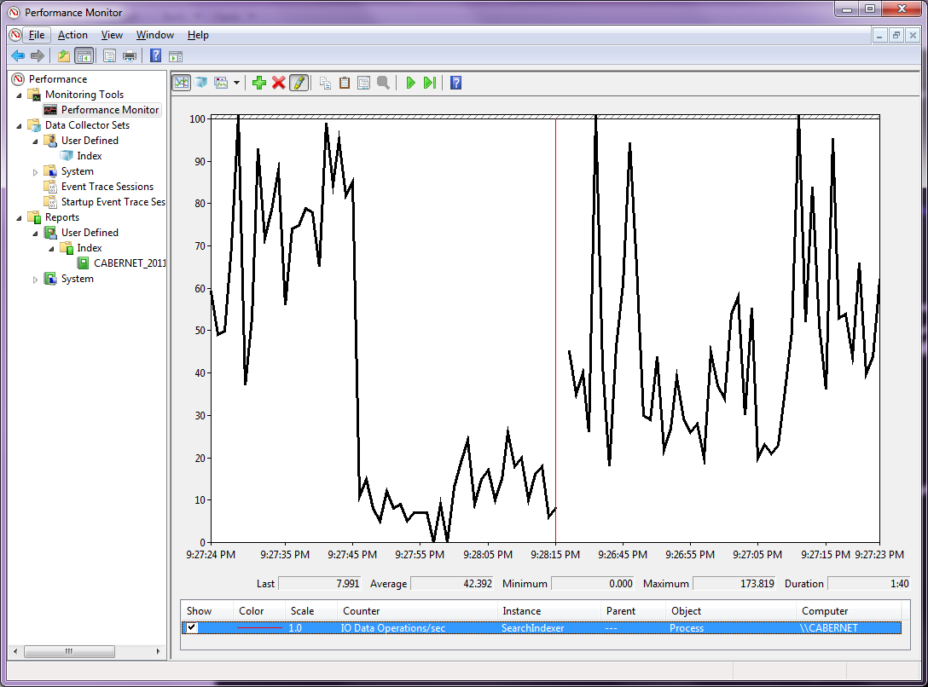
Measuring Disk IOPS for Windows Search

Slide 12
Services & Components To Disable for VDI
Defrag –this is a scheduled task on Windows 7. Should disable on shared storage, which usually does its own optimizations
Windows Search –depends upon your needs here for indexing disk content
Windows Update – do you need it if you are using non-persistent desktops or managing patching using 3rd party tools
Windows Defender – may not be needed if using 3rd party anti-malware solutions

Slide 13
More Services & Components to Disable
System Restore – may not be needed, depending upon how you maintain your VDI images
Offline Files – another service where you probably don’t need this for systems running in the data center
BitLocker – same as Offline Files—probably not needed for data center-based VDI

Slide 14
What Can Group Policy Do for Performance
Look to Group Policy for turning off un-needed services
  Either Using Computer Configuration\Policies\Windows Settings\Security Settings\System Services
  Or, GP Preferences, under Computer Configuration\Preferences\Control Panel Settings\Services
GP can also help with disabling components:
  Computer Configuration\Policies\Administrative Templates\System\System Restore\Turn off System Restore
  Computer Configuration\Policies\Administrative Templates\Network\Offline Files\Allow or Disallow use of Offline files feature

Slide 15
Disabling Services using Group Policy
Demo

Slide 16
Group Policy Performance Tweaks for Video
Lots of knobs you can turn in GP for RDP and RemoteFX performance
Look under Computer Configuration\Administrative Templates\Windows Components\Remote
Desktop Services
Particularly within the Remote Session Environment folder
Target these at your VDI VM machines accounts in AD to control behavior.

Slide 17
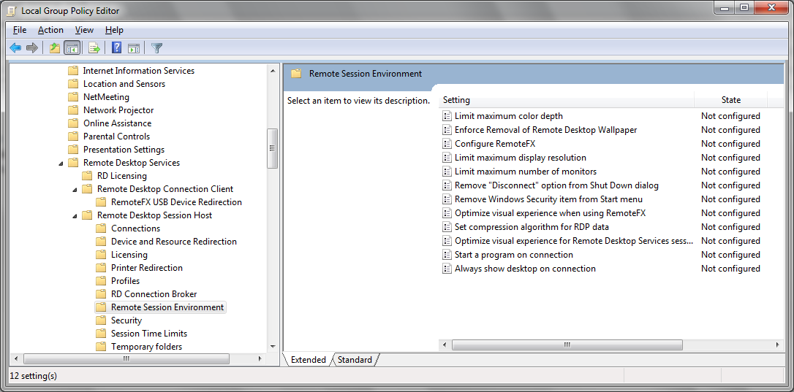
Modifying Remote Session Behavior

Slide 18
Other Settings to Consider
If your users are using Outlook & Exchange, consider turning off Exchange Cached Mode, which is likely not needed on VDI and can cause unneeded disk writes
Can be turned off using GP & Administrative Templates
for Office
  For example, in Office 2010, It’s under User Configuration\Policies\Administrative Templates\Microsoft Outlook 2010\Account Settings\Exchange\Cached Exchange Mode\Use Cached Exchange Mode for new and existing
  Outlook profiles – you can DISABLE this policy to disable Outlook caching.

Slide 19
Group Policy Settings to Avoid
Avoid settings that cause a lot of unnecessary disk activity
  Computer Configuration\Policies\Windows Settings\Security Settings\File System or Registry
  These policies let you re-permission file folders or registry keys
  Run every 16 hours regardless of what has changed in the GP environment
  If you’re trying to permission large trees of file or registry resources, can be very disk-write-intensive
  Probably better to do this using a one time utility such as Secedit.exe, within your base image

Slide 20
Other Settings That Impact Performance
Be mindful of per-user settings that could cause bad behavior in VDI systems
  Some screensavers can burn a lot of CPU cycles; you can force a blank screensaver using User Configuration\Policies\Administrative Templates\Control Panel\Personalization\Force Specific Screen Saver
  Visual effects that can impact client access device performance…
    The more things that are going on visually, the more bandwidth RDP or whatever client access protocol you are using has to handle

Slide 21
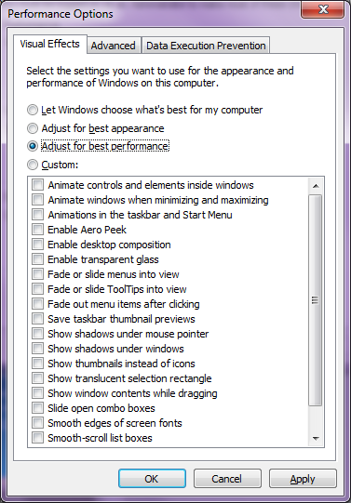
Visual Effects Adjustments

Slide 22
Granting Access to VDI Systems Using GP
If you’re using RDP, you’ll need allow your users the ability to remote desktop to your VDI instances
Group Policy can help, using either Restricted Groups policy or Group Policy Preferences to add users to the local “Remote Desktop Users” group
  Computer Configuration\Policies\Windows Settings\Security Settings\Restricted Groups
  Computer Configuration\Preferences\Control Panel Settings\Local Users and Groups

Slide 23
Using Group Policy to Manage VDI Performance & Experience
Demo

Slide 24
Using Loopback for VDI
What is Loopback?
  Lets you configure Group Policy for particular computers such that any use that logs into those computers get a specific, non-standard set of user policies applied to them.
  Enabled under Computer Configuration\Policies\Administrative Templates\System\Group Policy\User Group Policy Loopback Processing Mode
  Comes in two flavors—merge & replace ; replace is probably good for most situations

Slide 25
Using Loopback for VDI
When Does it Make Sense?
  If your users who use VDI switch between physical and
  virtual desktops
  To ensure that certain per-user policies are always in place
  for VDI systems
    (e.g. screen savers, Exchange cached-mode, etc.)
Easy to manage if all of your VDI systems are in their
own OU.

Slide 26
Implementing Loopback for VDI
Step 1: Create “Loopback GPO” that enables loopback processing (Merge or Replace)
Step 2: Define per-user optimizations within Loopback GPO
Step 3: Link Loopback GPO to the “VDI” OU—users log on and get per-user optimizations

Slide 27
Implementing GP Loopback for VDI
Demo

Slide 28
VDI Imaging and Group Policy
When creating your VDI templates—you have a couple considerations related to GP
  Are you creating your “golden images” on domain-joined machines? If so, are they getting Group Policy?
  Some policies (e.g. Security Policy) tattoo a system’s configuration. If that happens, is it desirable for all of your VDI systems based on that template?
  In Windows 7, there is no 100% method for reverting a system’s security configuration back to the default in-the-box state
  Persistent vs. non-persistent desktops may have different requirements

Slide 29
Best Practices for non-Persistent VDI and GP
If you’re creating non-persistent virtual desktops, then having GP setting “pre-baked” into your template is probably a good thing.
  Create the image in the domain, let it process policy as normal and then prepare your image as your template with GP settings
  Each time a new VM is created it will have the correct “starting” settings and will get new ones through the normal GP processes

Slide 30
Best Practices for Persistent VDI & GP
Different user populations (with different GP requirements) sharing an image should get an image clear of GP settings
  Let them receive GP settings normally after their
  VM is provisioned

Slide 31
Path to Creating a GP-Free Persistent Image
Create a “staging” OU, with the “Block Inheritance” flag set.
If you can, build your image in the staging OU to prevent any per-computer policies from being applied.
If you need to build your image in another OU, then move your image master machine to the staging OU and do a gpupdate /force to ensure that any policies that don’t tattoo, are removed
Tattooed policies will remain but can be overwritten through normal GP processing

Slide 32
User State Virtualization & VDI
User State Virtualization—the process of separating user settings and data from a particular OS image
Especially useful in VDI with non-persistent desktops
Composed two key Windows 7 technologies:
  Roaming User Profiles
  Folder Redirection
Group Policy is the key management tool for enabling these technologies

Slide 33
User State Virtualization and Group Policy
The goal is to de-couple as much of the user’s settings and data from a single machine as possible
Roaming Profiles are enabled by setting a profile path on the user’s AD user object

Slide 34
Defining a Roaming Profile Path

Slide 35
Roaming Profiles and Group Policy
Roaming Profile behavior can be controlled via Group Policy at Computer (and User) Configuration\Administrative Templates\System\User Profiles
You can control elements such as:
  Slow network behavior
  Background upload of ntuser.dat
  Profile unload retries
  Excluding directories from roaming

Slide 36
Folder Redirection and Roaming Profiles
Folder Redirection let’s you redirect user data to
server shares
The goal is to redirect as much of the user’s persistent
data that resides in their profile as possible
When used in conjunction with roaming profiles, it’s possible to redirect most of the user’s settings and data
So, whichever Virtual or Physical desktop they sit at, they will get the same user experience

Slide 37
Folder Redirection and Group Policy
Folder Redirection is controlled through Group Policy
Much more capable and robust in Windows 7
Let’s you redirect most of the user’s data folders:
  Documents
  Desktop
  Start Menu
  AppData
  Music
  Pictures
  And more…

Slide 38
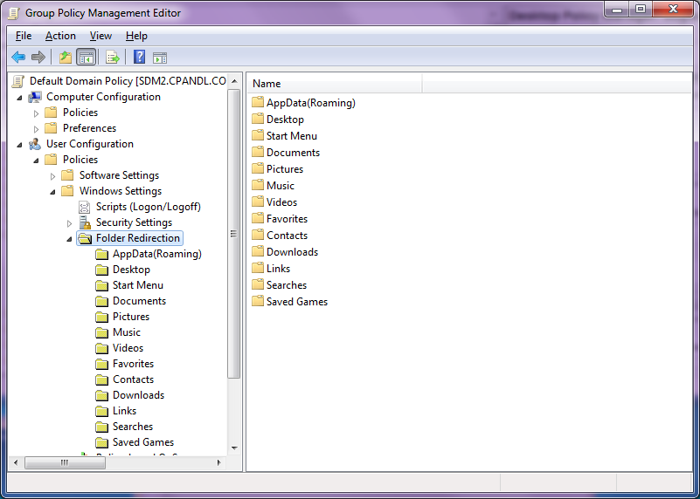
Folder Redirection Policy

Slide 39
Folder Redirection Options
Let’s you redirect to the same location for everyone processing the policy or to different locations based on user group membership
The first time through, it will do the work to copy data to the server share before the user logs in
You can also specify the data movement behavior when Folder Redirection no longer applies

Slide 40
Folder Redirection Best Practices
Set Folder Redirection on the user’s AD object—not as
part of loopback policy (this ensures that the user’s data
is always redirected)
Think about the removal behavior before you set the policy—ensure that if you need the data to move back locally when redirection no longer applies, that you set
it that way
For VDI, consider NOT using Offline Files with Folder Redirection (for reasons stated earlier)

Slide 41
Implementing User State Virtualization
Demo

Slide 42
Summary
VDI Presents some unique challenges compared to physical desktops
  Shared Resources required different approaches for configuring Windows desktops
Group Policy can provide the mechanism for improving VDI performance and user experience
Because of how VDI images differ from physical desktops, ensure that you make the right choice around GP configuration when creating your master template
Use User State Virtualization to separate user data from the OS

Slide 43

Related Content
Breakout Sessions:
VIR202 | Creating “One Consistent Experience” across Your PC, Laptop and Tablet Desktops
VIR311 | Planning and Deploying VDI and Remote Desktop Services (Repeats on 5/19 at 3:15pm)
WCL311 | Solving Common IT Pro Pain Points with the Microsoft Desktop Optimization Pack (MDOP)
Product Demo Stations: Microsoft Windows 7 & MDOP Station
Related Certification Exam: C4E263 | Cram4Exam on Windows Server 2008 R2 Desktop Virtualization Technology Specialist Series: Exam 70-669

Slide 44
Track Resources
Don’t forget to visit the Cloud Power area within the TLC (Blue Section) to see product demos and speak with experts about the Server & Cloud Platform solutions that help drive your business forward.
You can also find the latest information about our products at the following links:
Cloud Power - http://www.microsoft.com/cloud/
Private Cloud - http://www.microsoft.com/privatecloud/
Windows Server - http://www.microsoft.com/windowsserver/
Windows Azure - http://www.microsoft.com/windowsazure/
Microsoft System Center - http://www.microsoft.com/systemcenter/
Microsoft Forefront - http://www.microsoft.com/forefront/

Slide 45





Resources
  Connect. Share. Discuss.
http://northamerica.msteched.com
Learning
  Sessions On-Demand & Community
  Microsoft Certification & Training Resources
www.microsoft.com/teched
www.microsoft.com/learning
  Resources for IT Professionals
  Resources for Developers
http://microsoft.com/technet
http://microsoft.com/msdn

Slide 46












Required Slide
Complete an evaluation on CommNet and
enter to win!

Slide 47


