Slide 1

Manage Group Policy with Microsoft Advanced Group Policy Management (AGPM) 4.0
WCL308
Jeremy Moskowitz, Group Policy MVP
Chief Propeller-Head
GPanswers.com
@jeremymoskowitz

Slide 2


(While you’re sitting there, sign up for the GPanswers.com Tip of the Week …
(Scan a tag .. Fill out the little form…)
and enter to win a copy my (Jeremy’s) book !)

Slide 3
AGPM: A Play in Three (plus 1) Acts
3
Act 0: The built-in delegation model
  And definition of the problem
Act I: Why you care, architecture and installation
Act II: You’re an island
  ie: Get to know the features
Act III: You are not alone.
  Work with “other” admins

Slide 4
Life Without AGPM
4
No “Are you sure”
  Not when creating GPO
  Not when editing GPO
  Not when linking GPO
Not “awesome” granular management
No way to “roll back” if problems detected
No history of changes to GPOs

Slide 5
Built-in Delegation Model
demo

Slide 6
Life with AGPM (…or “Why you should care”)
6
Check-out/ Check-in Workflow management
Version control (ie: Rollback)
Difference reporting and history
Role based delegation
Offline Editing
Extra bonus: “Templates”

Slide 7


The General Philosophy
7
Create new GPOs – offline
  Possible to create them online too
Newly created GPOs are “controlled”
  Can also control “existing” GPOS
Check out GPO
  Can’t be edited by anyone else
Edit the GPO
  It’s offline still, remember?
Check in GPO
  Others could now edit, but it’s still not live
Review the changes
Approve changes
Deploy GPO

Slide 8
What about existing GPOs?
8
No problem. Like “wild horses” they need to be “Controlled.”
Find original GPOs in “Uncontrolled” tab then right-click over all of them and select “Control.”

Slide 9
Quick AGPM Control and Creation Demo
demo

Slide 10
Architecture
10
AGPM Service
  DC, Member Server
  Acts as “proxy” to live GPOs
AGPM “client” run on your (ie: Mr. and Ms. Admin’s) management stations
  Not your client systems (ie: The Boss, or the worker-bee.
Big Need: AGPM 4.0 requires
  Windows Server 2008 R2 (Server)
  Windows 7 (clients)
Neat Fact:
  AGPM built upon GPMC APIs

Slide 11
Server Installation – Not hard. Some tips:
Service account
  “Broker” for all actions
  LocalSystem for DCs
  Domain Admin account if not on Domain Controller
Archive owner
  NT or single group
  suggest: AGPM-OWNERS group

Slide 12
Client Installation – Not hard. Some tips:
Open up firewall port 4600
  Use Group Policy to do it globally for your admins
Common mistake #1:
  Not installing the client on all your management stations
Common mistake #2:
  Installing it anywhere except your management station (and maybe your DCs if you use them for admin.)

Slide 13
AGPM Installation Demo
demo

Slide 14
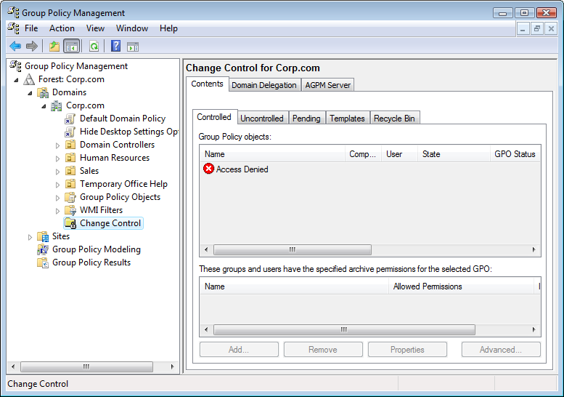
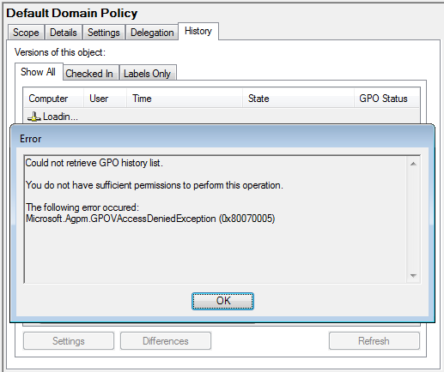
Right after loading server – Don’t panic !
Clicking in AGPM = this
But, you still have direct edit rights on GPOs you own
Use the AGPM-OWNER account to grant right to admins

Slide 15
Act II: General Features
“Go with the flow”…
  Controlling of uncontrolled GPOs
  Creating new controlled GPOs (live and in offline)
  Check-out of a GPO
  Offline edit a Checked-out GPO
  See reports of Checked-out GPO
  Check-in a GPO
  Deploy a checked-in GPO

Slide 16
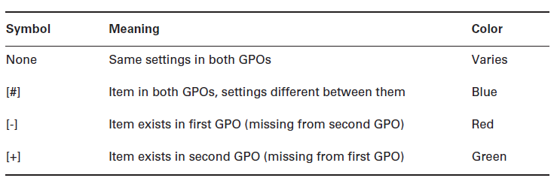
History, Differences and Rollback
History report on any (controlled) GPO over time
Differences between ANY GPO and anything else:
  Live GPO, controlled GPO, old history
Can choose a history item and deploy (to recover)

Slide 17
AGPM Features Demo
demo

Slide 18
Act III: Working with others

Slide 19
Roles
19
Full Control:
  Whatever they want. Can affect live environment.
  Assigns who gets other roles
  Default account set at installation time
Reviewer
  “Read only” copy to GPO (and history)
Approver:
  Ability to make GPOs go “live.”
  Think “Approver / Reviewer”, because you also get Reviewer permissions
Editor
  “Requests stuff”
  Makes offline changes
  Requests changes for live environment change
Special Permissions
  Some blend (see next page)

Slide 20
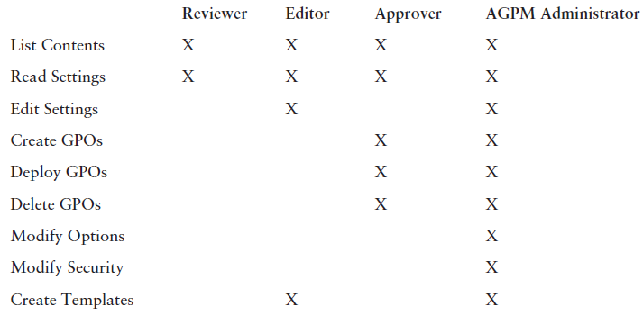
Roles vs. Permissions
20
Roles are really wrapped up “permissions”
Basics listed here
More in downloadable eChapter

Slide 21
The story at Company.com
Three admins, with different levels of ability
Eddie:
  Branch Office Admin. New-ish to GPOs.
Regis:
  The IT Manager. Knows about GPOs enough to be dangerous. If there’s a problem, it’s his butt on the line.
April:
  IT Goddess. Knows the company inside and out. Really knows Group Policy too.

Slide 22
Reviewing Roles
22
Full Control (AGPM-OWNER):
  Whatever they want. Can affect live environment.
  Assigns who gets other roles
  Default account set at installation time
Editor (Eddie)
  Requests new GPOS
  Makes offline changes
  Request for live deploy
Approver (April):
  Ability to make GPOs go “live.”
Reviewer (Regis)
  “Read only” copy to GPO (and history)

Slide 23
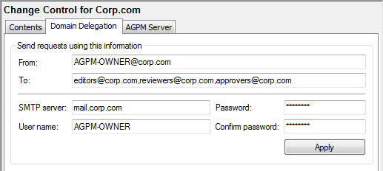
AGPM is all about Workflow via Email
If you use Exchange:
  Must make Exchange talk “SMTP”
Else, use 3rd party SMTP tool
Everyone gets emailed during “requests”

Slide 24
When do Requests occur?
Request occur upon:
  Control / Creation
  Deploy
  Delete
  Restore
Approvers get:
  Emails
  “Pending” tab item
Approver must:
  Accept or Reject
Requester can:
  Withdraw request
  Email doesn’t magically get recalled ! ☺

Slide 25
A decent story
Eddie:
  Requests a live GPO
  Doesn’t get it
April:
  Approves his offline GPO request
Eddie:
  Edits the GPO.
  Checks it in. Requests deployment by selecting “Deploy.” (He can’t deploy.)
Regis:
  Reviews the GPO. Comments.
April:
  Approves or rejects the deployment

Slide 26
AGPM Workflow Demo
demo

Slide 27
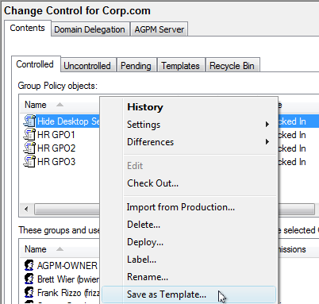
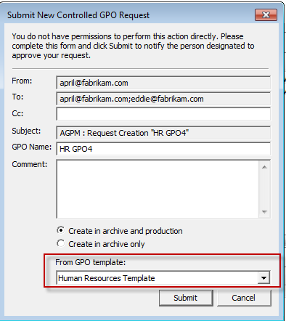
Bonus: AGPM Templates
Any controlled GPO can be a template
Then create new live / offline GPO from template

Slide 28
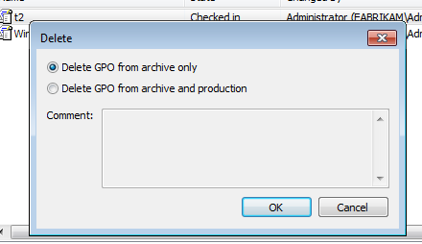
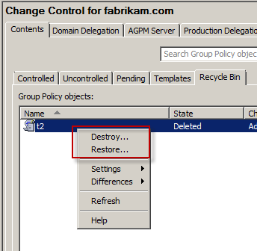
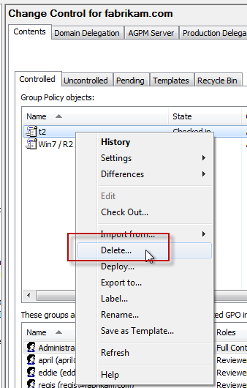
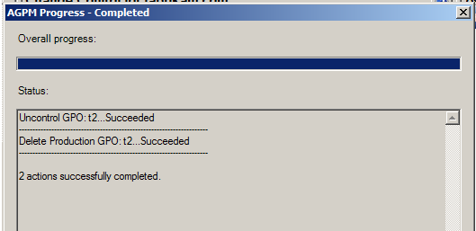
Misc Stuff: Recycling + Deleting GPOs

Slide 29
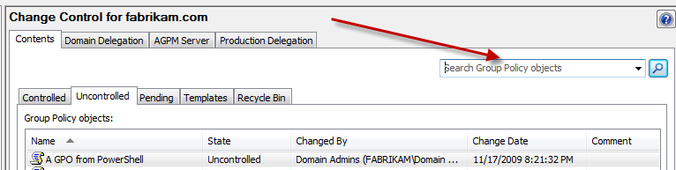
Misc Stuff: Searching on GPOs

Slide 30
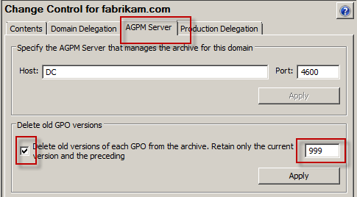
Advanced Stuff: Auto-delete versions
Keep X copies in the archive

Slide 31
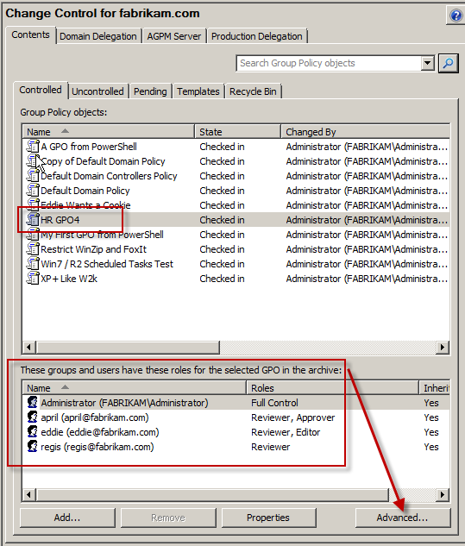
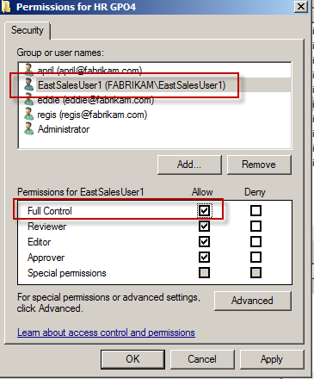
Advanced Stuff: Permissions on a GPO itself

Slide 32
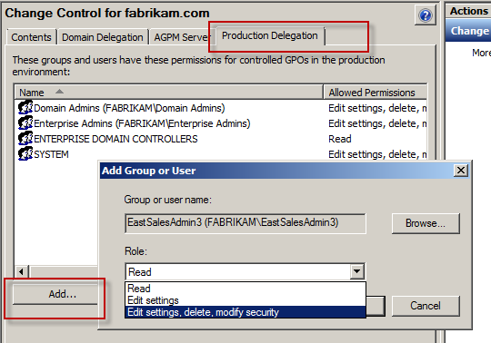
Advanced Stuff: Production Delegation

Slide 33
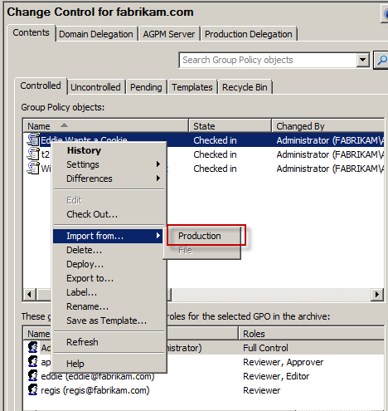
Advanced Stuff: “Import / Production” aka Catching up”
Catch-up / Import from production when…
AGPM goes offline and you know you made a “live edit.”

Slide 34
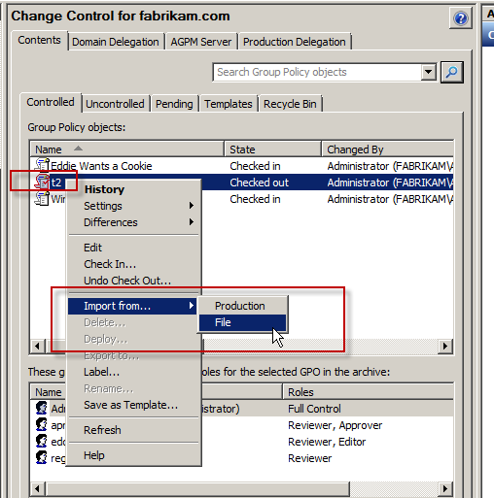
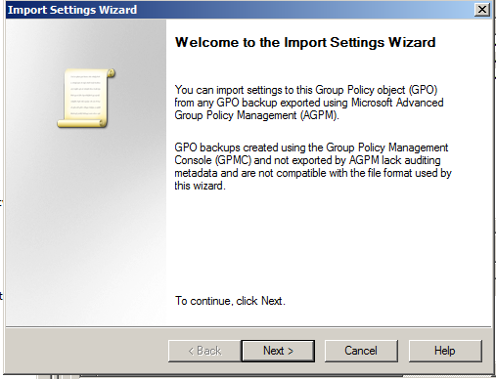
Advanced Stuff: “Importing / File”
Backup and Import between domains scenario
Overwrites archive GPO

Slide 35
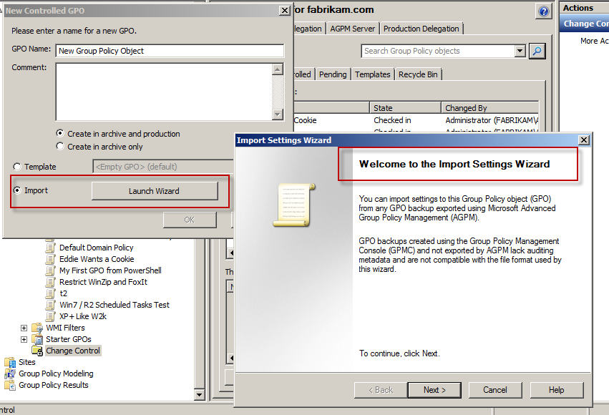
Advanced Stuff: “Importing File”
Alternate way to do same thing
But with new GPOs

Slide 36
Parting Thoughts…
AGPM is not hard to deploy
Have a big “group hug”
Biggest issue:
  Not having everyone on board.

Slide 37


Everyone who scans will get emailed the PDF chapter from my book !
Instantly lock down your OS and applications’ settings using Group Policy
Fully AGPM compatible !
…and AppV compatible!
Group
Policy Tips!
Live Training
Online Training

Slide 38
Related Content
Required Slide
Speakers, please list the Breakout Sessions, Interactive Discussions, Labs, Demo Stations and Certification Exam that relate to your session. Also indicate when they can find you staffing in the TLC.
WCL376-HOL | Managing a Domain Environment More Effectively
WCL311 | Solving Common IT Pro Pain Points with the Microsoft Desktop Optimization Pack (MDOP)
Find Me Later At… “Secret GPanswers.com Tweet-Up” @jeremymoskowitz

Slide 39
Track Resources
Don’t forget to visit the Cloud Power area within the TLC (Blue Section) to see product demos and speak with experts about the Server & Cloud Platform solutions that help drive your business forward.
You can also find the latest information about our products at the following links:
Cloud Power - http://www.microsoft.com/cloud/
Private Cloud - http://www.microsoft.com/privatecloud/
Windows Server - http://www.microsoft.com/windowsserver/
Windows Azure - http://www.microsoft.com/windowsazure/
Microsoft System Center - http://www.microsoft.com/systemcenter/
Microsoft Forefront - http://www.microsoft.com/forefront/

Slide 40





Resources
  Connect. Share. Discuss.
http://northamerica.msteched.com
Learning
  Sessions On-Demand & Community
  Microsoft Certification & Training Resources
www.microsoft.com/teched
www.microsoft.com/learning
  Resources for IT Professionals
  Resources for Developers
http://microsoft.com/technet
http://microsoft.com/msdn

Slide 41












Complete an evaluation on CommNet and
enter to win!

Slide 42


