Slide 2

Unleashing the Power of Consumerization:
How We Can Help
WCL215
Jason Leznek
Director of Product Management
Microsoft Corporation

Slide 3







Life and Work are Becoming Indistinguishable
At home…
At work…
And anywhere in between
Notes:
Timing: 2 minutes
Key Points:
The ubiquitous and always-connected nature of today’s technology has made it possible to work from anywhere and to bring our personal lives into the workplace.
The boundaries between work and home are blurring.
Script:
Technology has permeated every aspect of our lives. At home, it has become a tool for learning, for entertainment, and for social connections. At work, in particular for information workers, technology is the foundation for how we conduct business.
And with constant connectivity regardless of location, it’s becoming impossible to separate the personal from the professional. At home, you might use your personal laptop to clear your work email or to put the finishing touches on a presentation and load it up to the company intranet after dinner. At work, you might arrange to meet a friend for drinks using instant messaging (IM), check out your colleague’s Facebook page, or help out with your kid’s homework by doing a little web research. In fact, according to a study that IDC recently conducted, between a third to more than a half of devices (including laptops, mobile phones, and smartphones) and web-based applications (including IM, professional social networks, and blogs) used in the workplace are used for both work and personal purposes.
The days of the 8–5 workday, at least for the information worker, are essentially over. Today the lines between personal and professional have blurred, and we take both our personal and professional lives with us nearly everywhere we go.
Additional Information:
John Gantz, “A Consumer Revolution in the Enterprise” (sponsored by Unisys), IDC, June 2010, http://www.unisys.com/unisys/ri/report/detail.jsp?id=1120000970003910071

Slide 4
Consumerization of IT
video

Slide 5
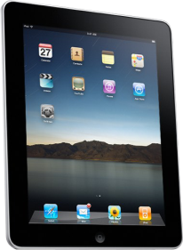
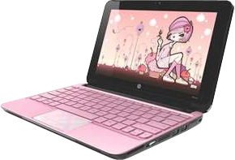
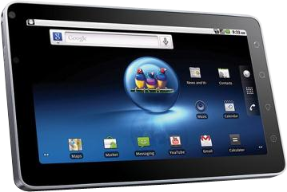

Unmanaged Devices Have Hidden Costs
Business Risks
Theft
Security
Privacy
Corporate and government regulatory compliance
Intellectual property (IP) protection
IT Challenges
Unknown patched state
Unknown application vendors
Unknown application compatibility
Complexity to access corporate data
Unique management requirements for each device
Notes:
Timing: 2 minutes
Key Points:
There are hidden costs and risks in permitting the use of unmanaged devices to access internal resources and the corporate network.
For the business, unmanaged devices present risks in terms of security, privacy, compliance, and intellectual property protection.
For IT, unmanaged devices increase complexity and the management burden.
Script:
There are huge potential productivity benefits with consumer technology, but this device proliferation also means that most enterprises now have numerous unmanaged devices being brought into the enterprise, trying to access the corporate network and confidential business resources. This presents some real challenges and risks:
Business risks: Picture this scenario. Someone, let’s say an executive, needs to review the latest specifications for an innovative new product that’s about to launch or perhaps a highly confidential financial report. He or she is ready to leave the office for the day, and the perfect solution seems to be to put it on a slate to read later in the evening. But, worst case scenario, that slate never actually makes it home, because it gets lost in transit. Maybe it’s forgotten on the train or someone smashes the window of the executive’s car and steals it from the backseat. What do you do? Theft—and the consequent loss or exposure of sensitive information or confidential intellectual property (IP)—is a very real risk with unmanaged devices if they have no way to be encrypted, locked, and/or remotely wiped. And if that slate was a personal device, who is ultimately responsible for keeping that information secure and private? How are you preventing regulatory breaches?
IT challenges: For IT, the challenges of device proliferation really come down to the added complexity of the IT environment. If a user has problems with a personal, unmanaged device being using for work purposes, he or she is likely to call the enterprise help desk for support, even if that device isn’t IT sanctioned. This raises new headaches for IT: If the device doesn’t have up-to-date patches, will it be stable? If the device has applications from an unknown or unverified vendor, how can they be sure there is no spyware? And will those applications introduce compatibility issues? How do they manage access to corporate information given these concerns? The more devices IT has to contend with, the more complicated and difficult it is to ensure the stability, performance, and security of those devices and the wider network.
Regardless of what the device is, if it’s unmanaged, it poses some risks. We’re certainly not excluding Windows-based devices here. If an employee brings in a personal, unmanaged Windows-based tablet, you have no way of knowing whether it is compromised by spyware or infected with a virus that could put your other devices or your confidential business information at risk.

Slide 6


Challenges
How do I…
Address the work/life blur?
Ensure anywhere productivity?
Protect data and maintain compliance?
Handle PC and device management?
Notes:
Key Point: Many of companies today are experiencing consumerization in full force.
Address the work/life blur?
Ensure anywhere productivity?
Protect data & maintain compliance?
Streamline pc & device management?

Slide 7
Consider the Essentials
1
Create the Conditions for Success.
How will you control access to sensitive data?
How will you manage data backup/restore?
DATA
How will you deliver business applications?
How will you support compliance reporting?
APPS
Who owns the IP on the device?
Who fixes the device if it breaks?
OS/HW
How will you enforce network security?
NETWORK
Notes:
Key Point: Next step is to create conditions for success by managing the essentials.
DATA
How will you control access to sensitive data?
How will you manage data backup/restore?
APPS
How will you deliver business applications?
How will you support compliance reporting?
OS/HW
Who owns the IP on the device?
Who fixes the device if it breaks?
NETWORK
How will you enforce network security?

Slide 8


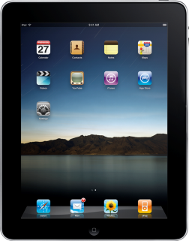
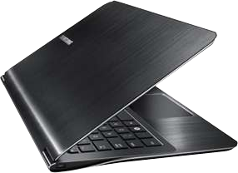
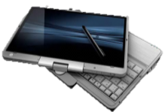

Understand Principles to Enable Consumerization
2
Access to Corporate
Information based on:
Who you are
  Read, Read/Write, Full Access
How much you trust the device
  Unmanaged, Managed, Partially Managed
Where the device is
  Corporate network
  Internet
  Untrusted network

Slide 9
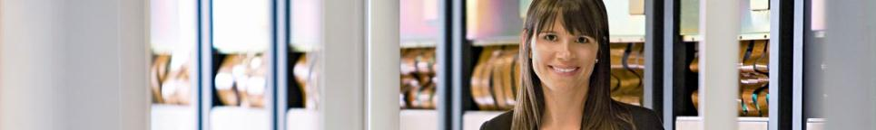
Evaluate Enabling Technologies
3
Enabling Technologies Can Help.
Virtualization
Enterprise
Management
Terminal Server
Computing
Cloud
Computing
Support User Choice
Manage the Essentials
Notes:
Key Point: Microsoft technologies such as desktop virtualization and cloud computing can help enable consumerization scenarios in a way that supports user choice and IT’s ability to manage and secure systems
Microsoft server hosted Desktop Virtualization solutions offer the following potential benefits for users and IT:
Simplify remote connectivity by enabling access to a rich desktop or web page or seamlessly integrated with a local desktop
Enable flexible work scenarios such as hot-desking and work from home
Desktop environments centralized in the datacenter provide better business continuity and faster return to productivity for disaster recovery scenarios
Accelerate and extend deployment of desktops and applications to a wide array of client devices, including clients on which the desktop operating system can’t run natively
Enable rapid OS upgrades and patching by installing desktops only once in the data center and not locally on end point devices
When evaluating Desktop Virtualization technologies, enterprises can consider Remote Desktop Services (RDS) and Virtual Desktop Infrastructure (VDI). RDS provides session based desktops in the datacenter with higher scale and lower cost than VDI. VDI offers better user operating system isolation than RDS as well as better native application compatibility. VDI also provides the users with the ability to be admins of their own images.
Cloud computing with Microsoft Windows InTune offers the following potential benefits for users and IT:
Centrally manage the deployment of Microsoft updates and service packs to all PCs
Help protect PCs from malware threats with malware protection that can be managed from Web-based console
Receive alerts on updates and threats to proactively identify and resolve problems with PCs
Resolve PC issues, regardless of location, with remote assistance
Track hardware and software assets used in your business
Centrally manage update, firewall, and malware protection policies, even on remote machines outside corporate network
As organizations evaluates technologies that enable them to embrace the reality of consumerization of IT, Microsoft offers a wide range of solutions to meet particular demands of users and IT.
Didn’t know if all DV technologies e.g. App-V, System Center, should be mentioned here

Slide 10
Using Technology to Enable Consumerization
Enforce Policy
Password Policy
Remote Wipe
Authorized Device
Isolate Devices
and Data
Server and
Domain
Isolation (IPSec)
Network Access
Protection (NAP)
Rights Management Service
Access to
Corporate
Applications
Unified Access
Gateway (UAG)
Terminal Server
Access Gateway (TSG)
Virtual Desktop Infrastructure (VDI)
1
2
3

Slide 11
Enforce Policy
1

Slide 12
SCCM 2012: Mobile Device Management Through Exchange
Provide basic management for all Exchange ActiveSync (EAS) connected devices
Features Supported:
  Discovery/Inventory
  Settings policy
  Remote Wipe
Supports on-premises Exchange 2010 and hosted Exchange

Slide 13
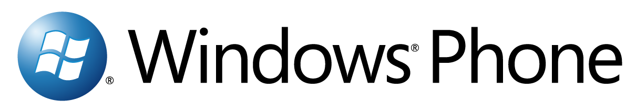
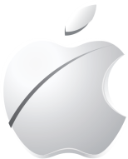
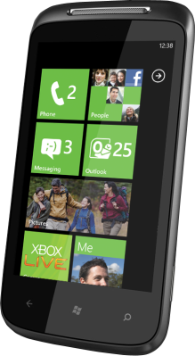

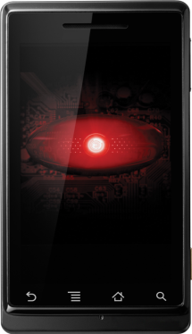

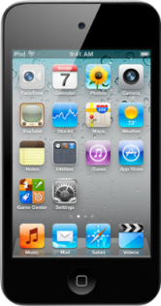
Announcing: SCCM 2012
.
‘Light’ Management support
EAS Based policy delivery
Support includes:
  Discovery/Inventory
  Settings policy
  Remote Wipe
Connection Method to Exchange: EAS
Configuration Manager Client Support only for WM 6.1, WP6.5,Symbian

Slide 14
SCCM 2012 Beta
Device Management
demo

Slide 15
Isolate Devices and Data
2

Slide 16

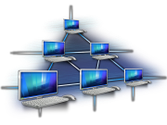




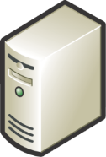

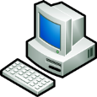



Isolate: IPSec Server and Domain Isolation
Define the logical isolation boundaries
Distribute policies
and credentials
Managed computers
can communicate
Block inbound connections
from untrusted
Enable tiered-access
to sensitive resources
Active Directory
Domain Controller
Corporate
Network
T
Resource Server
X
HR Workstation
Servers with
Sensitive Data
Unmanaged
X
Server
Isolation
Untrusted
Managed
Computer
Managed
Computer
Domain Isolation

Slide 17
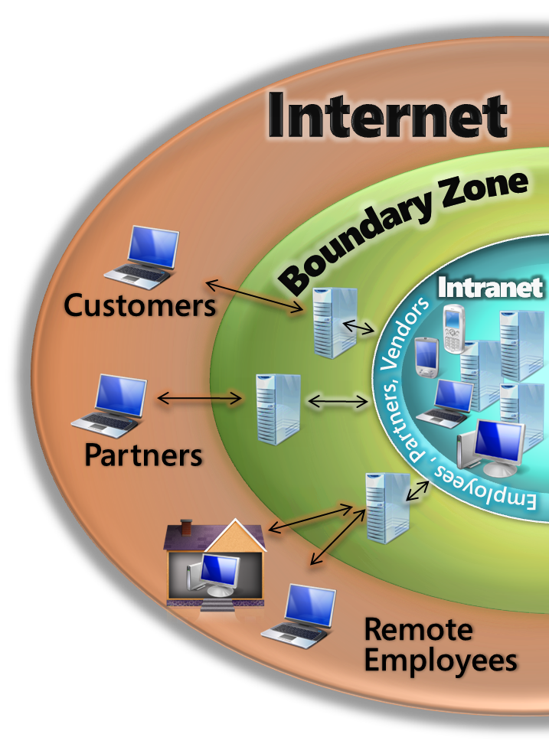
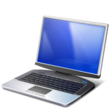
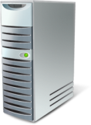

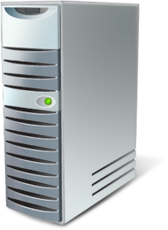
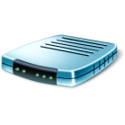
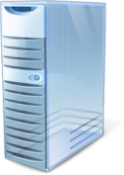
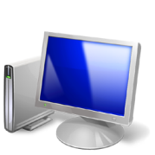
Isolate: Network Access Protection
Policy Servers
e.g., Patch, AV
1
1
Access requested
Health state sent to NPS (RADIUS)
NPS validates against health policy
If compliant, access granted
If not compliant, restricted network access and remediation
Microsoft NPS
3
2
Not policy compliant
5
Remediation
Servers
e.g., Patch
3
2
Restricted
Network
4
Policy compliant
DCHP, VPN
Switch/Router
5
Corporate Network
4

Slide 18



Data Isolation: RMS
SQL Server
Active Directory
1. Author receives a client licensor certificate the
“first time” they rights-protect information
2. Author defines a set of usage rights and rules for their file; Application creates a “Publish License”
and encrypts the file
Windows Server running RMS
3
1
4
3. Author distributes file
2
5
4. Recipient clicks file to open, the RMS-enabled application calls to the RMS server which validates the user and issues a “Use License.”
3
5. The RMS-enabled application renders file and enforces rights
Author using Office
The Recipient

Slide 19
Isolation Technologies: OS Support
 | Windows 7 | Mac OSX | iOS | Android | Windows Phone 7
AD integrated iPsec Domain Isolation | ☑ Yes | ☑ Yes *3rd Party Offering | ☒ No | ☒ No | ☒ No
Network Access Protection | ☑ Yes | ☑ Yes *3rd Party Offering | No | ☒ No | ☒ No
RMS | ☑ Yes | ☒ No | ☒ No | ☒ No | ☒ No

Slide 20
Access to Corporate Applications
3

Slide 21

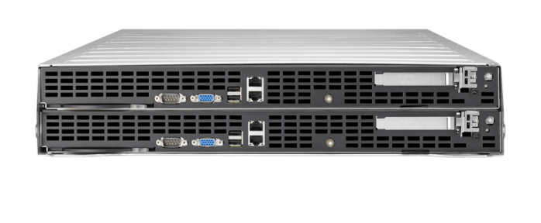
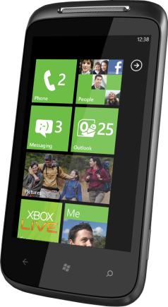
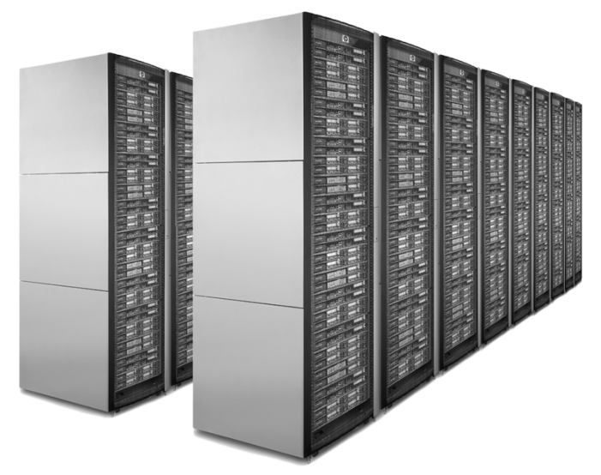
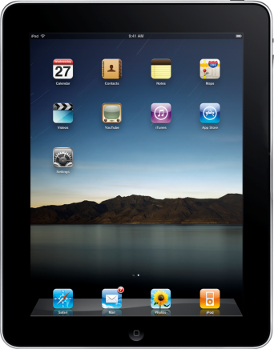
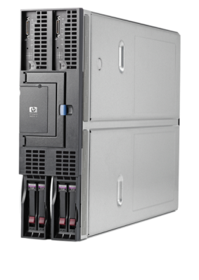
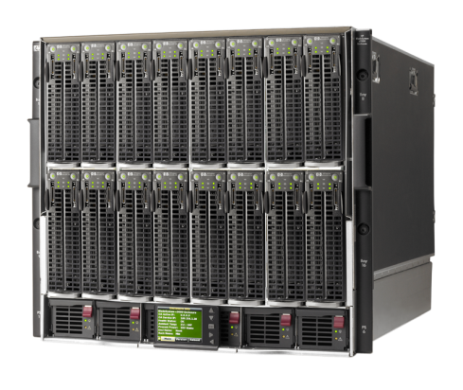
Access from Unmanaged Devices
Data Center/Corporate Network
Internet

Slide 22

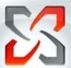








Access:
Forefront Unified Access Gateway
Exchange
CRM
SharePoint
IIS based
IBM, SAP, Oracle
Mobile
UAG
Home/Friend/Kiosk
Read Only Access
HTTPS / HTTP
HTTPS (443)
TS/RDS
Internet
Direct Access
Non web
Authentication
End-point health detection
Enterprise Readiness
Edge Ready
Information Leakage Prevention
Non-Windows
Business Partners/Subcontractors
Read/Write only to subset of sites
on SharePoint
AD, ADFS, RADIUS, LDAP…
Data Center/
Corporate Network
Employees Managed Machines
Full Access only to sites defined User role
Notes:
UAG application publishing: http://technet.microsoft.com/en-us/library/ee406221.aspx
Client Health: http://blog.msedge.org.uk/

Slide 23
Forefront
Unified Access Gateway
demo

Slide 24




Access:
Terminal Services Gateway
Remote access to internal server resources
Internet
DMZ
Corp LAN
External
Firewall
Internal
Firewall
Terminal Server
Home
Internet
HTTPS/443
Terminal Server
Hotel
Terminal Services
Gateway Server
E-mail Server
Business Partner/Client Site
Notes:
24

Slide 25

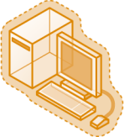

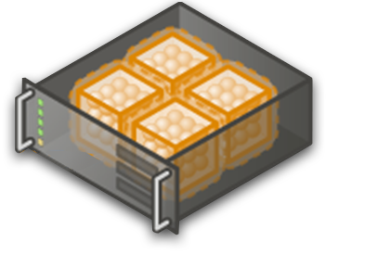








Server Hosted Virtual Desktops
Virtual Desktop Infrastructure (VDI): Another way to deliver the Windows desktop
  Technology from Microsoft-Citrix
  Description
  Windows desktop and session delivery
  on-demand
  Personalized desktops hosted in datacenter
  Integrated Management with SC, Application
  Virtualization and RDS CAL
  Desktop Virtualization platform (hypervisor)
  Full-fidelity user experience over LAN and WAN
  Lightweight, universal software client
  Self-service 'storefront' for enterprise applications
  Key Considerations
  Better Together
  Access desktop, applications, data on any device, anywhere
  Best user experience on LAN or WAN
  Integrated desktop management
  IT
  Investments in server, management, storage, and network infrastructure
  Unified, centralized
  management of physical
  and virtual environments
  User/VM Density
  Business continuity
  User
  Flexibility of access
  User Experience (personalization, graphics)
  Performance & Scalability is best in class (over LAN, WAN)
  Our Advantage
  Best in class technologies combined to provide most comprehensive and most
  Cost Effective solution
  Most scalable with Hyper-V and Sessions
  Better User Experience than PCoIP
  Single Management Console for physical and virtual assets
Notes:
Virtual Desktop Infrastructure (VDI): Another way to deliver the Windows desktop
Key Messages:
Best in class technologies combined to provide most comprehensive and most Cost Effective solution (See slide 17)
Most scalable with Hyper-V and Sessions (See slide 18)
Better User Experience than PCoIP
Single Management Console for physical and virtual assets (See Slide 24)
Additional Resources:
Telecom Italia VDI Case Study (Appendix)

Slide 26

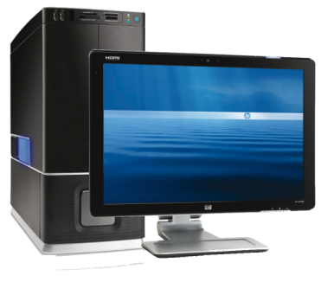
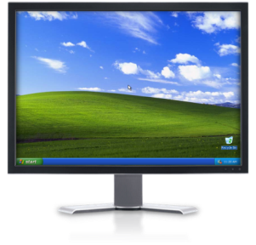
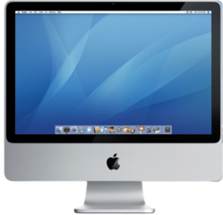
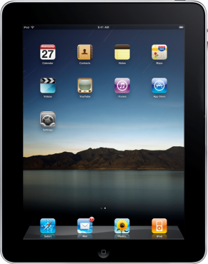

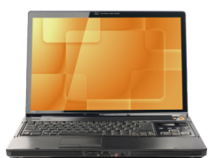

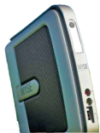

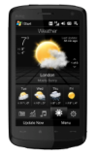
Extending Virtualization to Unmanaged Devices:
Citrix Receiver
Leverage Windows, iOS, Android, RIM devices
with universal client
Access your VDI Desktop or Remote PC
Self-service installation and auto-updates
Thin and Diskless PCs
PCs
Smartphones
Tablets
Notes:
Any device, anywhere with Receiver™. Today’s digital workforce demands the flexibility to work from anywhere at any time using any device they’d like. Leveraging Citrix Receiver as a lightweight universal client, XenDesktop users can access their desktop and corporate applications from the latest tablets, smartphones, PCs, Macs, or thin client. This enables virtual workstyles, business continuity and user mobility.
XenDesktop 5 includes new Citrix Receivers for all the latest tablets, smartphones, Macs and thin clients.

Slide 27
VDI Access
demo

Slide 28
Access Technologies OS Support
 | Windows 7 | Mac OSX | iOS | Android | Windows Phone 7
UAG SSL VPN | ☑ Yes | ☑ Yes | ☑ Yes | ☑ Yes | ☑ Yes
Citrix Receiver Remote Desktop | ☑ Yes | ☑ Yes | ☑ Yes | ☑ Yes | ☑ Yes
Terminal Services Gateway | ☑ Yes | ☑ Yes | ☑ Yes | ☑ Yes | ☒ No

Slide 29
Using Technology to Enable Consumerization
Enforce Policy
Isolate Devices
and Data
Access to
Corporate
Applications
1
2
3

Slide 30
Microsoft Windows 7 Commercial Slate
Strategy and roadmap

Slide 31
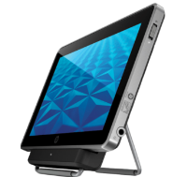
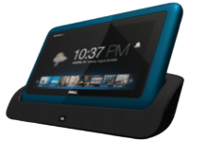
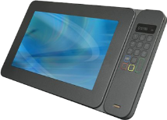
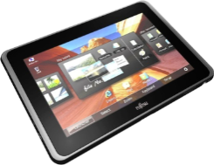
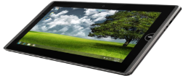
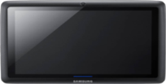
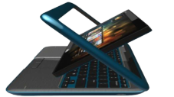
Building the Windows 7 Slate PCs
We’re working with…
Chipset manufacturers to build a heterogeneous high performance platform
OEMs to deliver slate PCs to meet enterprise end user and IT needs
Customers to understand how they will use slates in the enterprise
Taking advantage of hardware innovations to optimize Slate Experience
Working with developers to deliver consumer and enterprise touch apps for Windows

Slide 32
Why Windows 7:
This is What Enterprise Customers Are Telling
Us is Important:
Core Enterprise Requirements | Solution Capabilities
Enterprise Security | Device Encryption Support, Document DRM Support, Remote Data Wipe
Enterprise Manageability | Automated Application Delivery and Updates, OS and Application Patch Management, End User Remote Assistance
Choice In Hardware | Device form factors available to support multiple vertical needs and end user preferences
Enterprise Application Support | Support for mainstream and vertical enterprise LOB Applications, Microsoft Office Support, Flash and Silverlight Support
Enterprise Device Support | Support for wide range of enterprise peripheral devices
Enterprise Collaboration | Support for Audio and Videoconferencing, Full SharePoint Support, Office Communicator Support
Offline Application Usage | Support for Offline Usage of Mainstream and Vertical Applications
Enterprise Support | 24x7 Support available, Design Change Request options available
Infrastructure Integration | Integrates easily with existing access, authentication, policy, and single sign on infrastructure

Slide 33
Hardware Innovations
Optimize Windows Slates
SSD drives for Rapid boot up and Fast System responsiveness
Intel Oaktrail Chipset enabling 8–10 hour battery life on Slates
Working with OEMs to optimize system speed and performance
Windows 7 trigger start services
Rapid wake from sleep delivers “instant on”

Slide 34


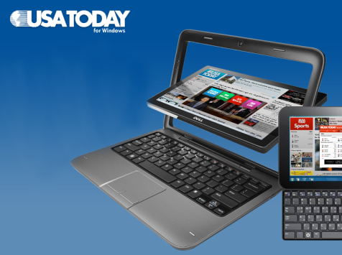

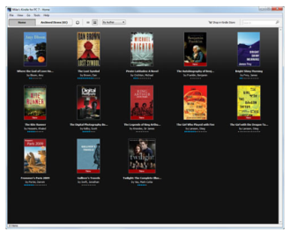
Working with ISVs to deliver Touch Apps for Windows 7
Published developer guidance for touch on Windows 7
Immersive Consumer Apps on Windows Product Scout
Working with Enterprise ISVs to develop Enterprise Touch Apps
Notes:
Engineering and design guidance for slate PC apps -- http://code.msdn.microsoft.com/wintouchguide
Windows Product Scout: http://www.microsoft.com/windows/product-scout/
ISV Engagement through ACE Framework

Slide 35
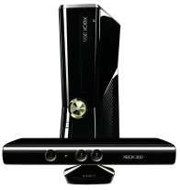
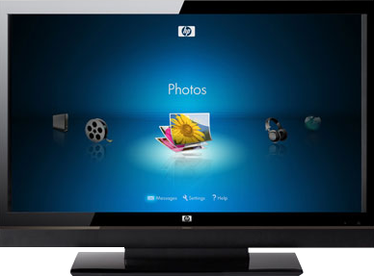
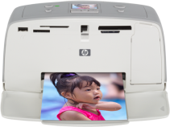






Windows Slates Connect to Your Devices
Devices at home
Devices at Work
Devices for Vertical
Use Cases

Slide 36






Windows 7 Helps IT Embrace Consumerization
Devices
Empowered End Users
Data and Apps
Provide the choice of devices and form factors users desire
Enable seamless collaboration through existing investments and infrastructure

Slide 37

Related Sessions
SIM214 | Client Management and Security Roadmap and Vision
Monday, May 16 | 1:15 PM - 2:30 PM | Room: B407
VIR201 | Virtualization: State of the Union
Monday, May 16 | 1:15 PM - 2:30 PM | Room: B402
WCL209 | Windows Intune: PC Management with Cloud Services and Windows 7
Wednesday, May 18 | 3:15 PM - 4:30 PM | Room: B213

Slide 38





Resources
  Connect. Share. Discuss.
http://northamerica.msteched.com
Learning
  Sessions On-Demand & Community
  Microsoft Certification & Training Resources
www.microsoft.com/teched
www.microsoft.com/learning
  Resources for IT Professionals
  Resources for Developers
http://microsoft.com/technet
http://microsoft.com/msdn

Slide 39












Required Slide
Complete an evaluation on CommNet and
enter to win!

Slide 40

© 2011 Microsoft Corporation. All rights reserved. Microsoft, Windows, Windows Vista and other product names are or may be registered trademarks and/or trademarks in the U.S. and/or other countries.
The information herein is for informational purposes only and represents the current view of Microsoft Corporation as of the date of this presentation. Because Microsoft must respond to changing market conditions, it should not be interpreted to be a commitment
on the part of Microsoft, and Microsoft cannot guarantee the accuracy of any information provided after the date of this presentation. MICROSOFT MAKES NO WARRANTIES, EXPRESS, IMPLIED OR STATUTORY, AS TO THE INFORMATION IN THIS PRESENTATION.

