Slide 1
Windows Intune: PC Management with Cloud Services and Windows 7
WCL209
Marc Shepard
Principal Program Manager Lead
Microsoft Corporation

Slide 2
Session Objectives and Takeaways
Introduction to Windows Intune
Closer look at the Windows Intune service (demo)
Overview of which customers are best served by
Windows Intune
How to buy Windows Intune

Slide 3




















Microsoft Commercial Cloud Services
  Used by Over 50% of the Fortune 500
  58% CIOs selected Microsoft cloud
  Enabled by 7,000 Partners WW
GA
3/23
  PRODUCTIVITY
  COMMUNICATIONS
  COLLABORATION
  BUSINESS APPS
  MANAGEMENT & SECURITY
  STORAGE
  PLATFORM

Slide 4






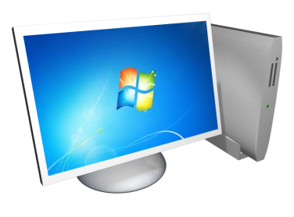


The Value of Windows Intune
Manage & Secure
PCs Anywhere
The Best Windows Experience
Fits Your Business
All you need is an internet connection
Standardize your OS on the latest technology
Get big results with a small investment

Slide 5
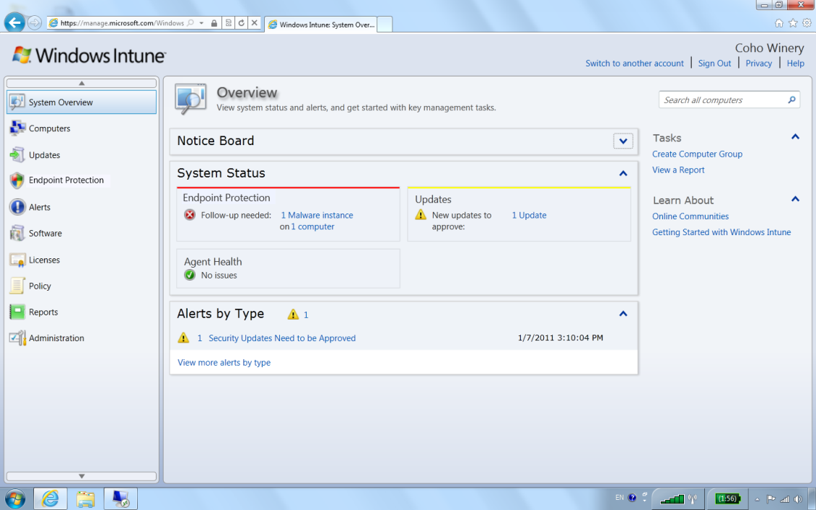
Help Manage & Secure PCs Anywhere
Delivering management essentials to lightly managed PCs
  Protect PCs from malware
  Manage updates
  Proactively monitor PCs
  Provide remote assistance
  Inventory hardware and software
  Set security policies

Slide 6

Benefits of Management as a Service
Stuff you don’t need to do
Build and maintain server infrastructure
  Purchase server hardware, OS licenses, management software, etc.
  Install and configure each server (OS, database, security software, management software, etc.)
  Integrate into our networking environment
Secure it
  Design for security (physical, networking, database, etc.)
  Assess and manage security on an ongoing basis
Make it highly available
  Design and implement a high-availability configuration (no single point of failure)
  Design and implement health monitoring (so you can respond to issues quickly)
  Design and implement a disaster recovery plan (backup, recovery, document the plan, fire drills, redundancy across physical locations, etc.)
Support roaming machines
  Deploy internet-facing servers with additional hardening
Capacity planning
  Design for current capacity with plans to scale as your business grows

Slide 7





Getting Started
Sign Up
Log In
  Create additional administrators (Tenant Admins)
  Create additional administrators
  Initial Configuration
    Update Products/Classifications
    Auto approval rules
    Agent policy
    Groups
    Alerts and notifications
Enroll your computers
Download enrollment package from console

Slide 8
Getting Windows Intune Up and Running in Under 10 Minutes
demo

Slide 9
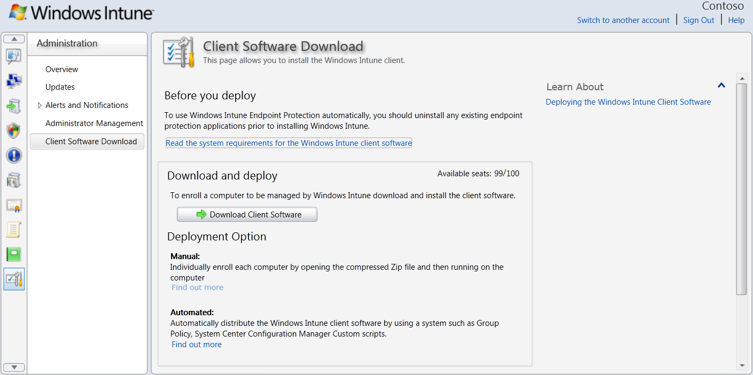


Windows Intune Client Enrollment Package
The installation package includes a private certificate that is specific to the Windows Intune account

Slide 10

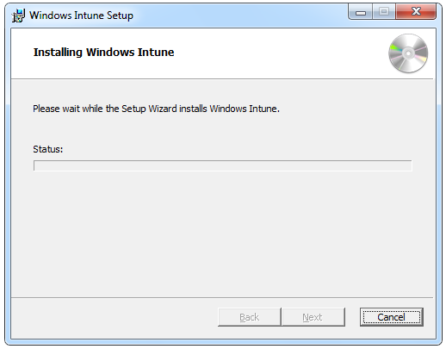
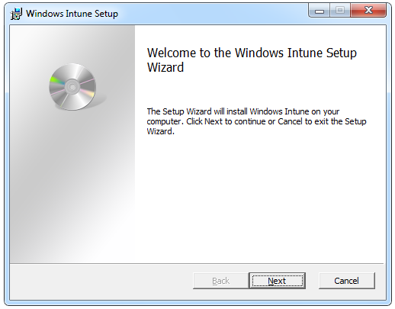
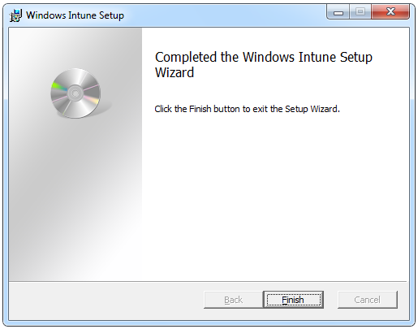
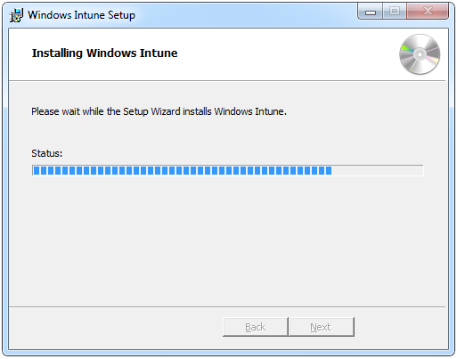
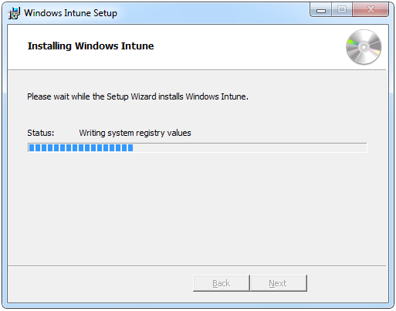
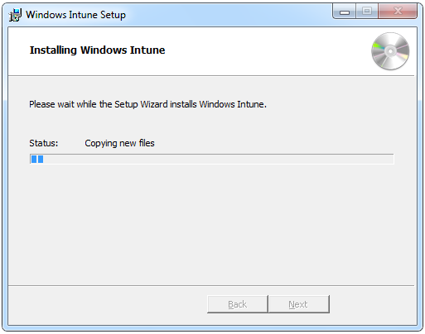
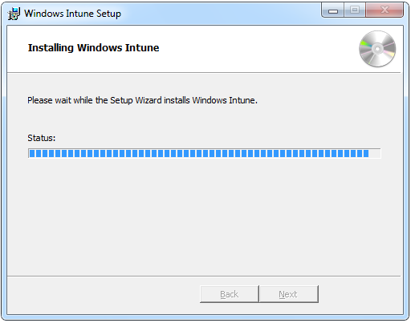
Using the Installation Executable File (.EXE)
Windows_Intune_Setup.exe
Invokes Setup Wizard
Can operate in “Quiet” mode
Contains MSIs
Requires administrator privileges
Requires certificate
Works for both 64-bit and
32-bit installations
Command-line options
/Quiet
/Extract %temp%

Slide 11








Install with Windows Installer Files (.MSI)
Two platform specific MSI files can be extracted from Windows_Intune_Setup.exe
Provided as an alternative to the Setup executable
Deployment scripts must determine which version to run for operating system

Slide 12

The Windows Intune Client Installation Process
Enrollment
The Windows Intune agent starts
It authenticates against the cloud service and enrolls the client computer
The computer can be viewed in the Unassigned Computers group in the administrator console
Agent installation
The installation downloads agents from the Windows Intune service
Each agent starts up as it is downloaded and installed
Each agent reports information to the Windows Intune service
Agents with failed installations raise alerts on the administrator console
A restart is (most likely) required for the Windows Intune Endpoint Protection
Installation completes and all agents report to Windows Intune within 30 minutes
Check Control Panel on the managed computer for the installed services
Check the Unassigned Computers group for newly enrolled computers
Computer restart

Slide 13



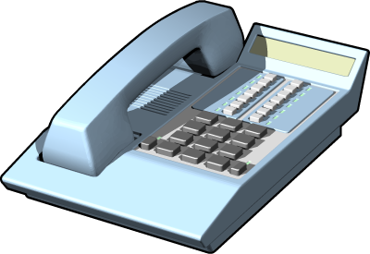
Troubleshooting Client Installation
Detect
  Interactive exe installs: Failures shows in installer UI
  Always (including MSI and automated installs): Failures also shown in System event log
  If internet connection: Failures shown as an alert in the Windows Intune admin console (if computer can connect to the internet)
Test Connection
  If no alerts in admin console, check the client computer’s Internet connectivity and proxy configuration
  Make sure that the computer can connect to the Windows Intune service at http://manage.microsoft.com
Go Deeper
  If problems persist, go to http://go.microsoft.com/fwlink/?LinkID=186758
  Save the Enrollment and Windows Update logs for the client computer:
    %programfiles%\Microsoft\OnlineManagement\Logs\Enrollment.log
    %windir%\windowsupdate.log

Slide 14
Network Bandwidth Considerations
Scenario | Content size per client
Initial deployment | About 100 MB - one time Initial client enrollment package: 15 MB Boot-strapping additional agents: ~90MB (65MB for EP)
Endpoint protection | About 35 MB per month Daily (3x/day) signature updates: 40 KB – 2 MB range Monthly engine update: 5 MB
Patch Tuesday | About 30 MB per month Delivered twice a month (2nd/4th Tuesdays)
Service pack | Depends on content Windows 7 SP1 (535 Mb for 32-bit and 900 Mb for 64-bit)
Can reduce network load by deploying a caching proxy

Slide 15
Management Experience
Work anywhere
  Browser based (SilverLight)
Manage by exception
  Action based status (red, yellow, green)
Multi-account administration
Filtered views for easy administration
Reporting data export to html or csv

Slide 16
Managing your PCs
Demo

Slide 17
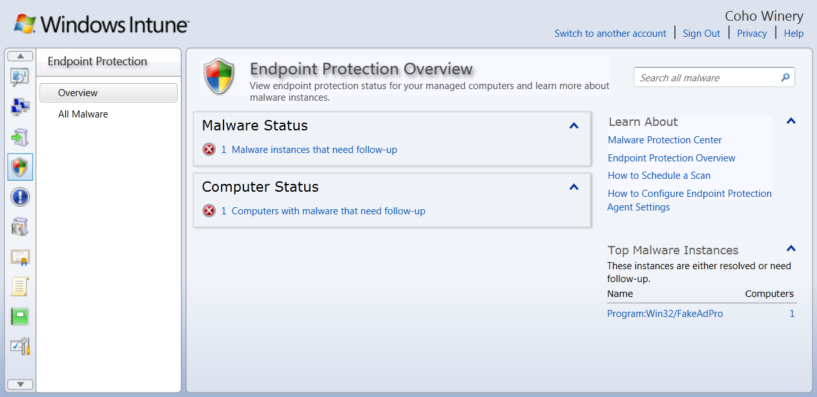
Endpoint Protection
Built on the same enterprise grade protection engine used by FEP 2010
System-wide, per group and per
computer status
Centralized reporting
Policy based configuration

Slide 18
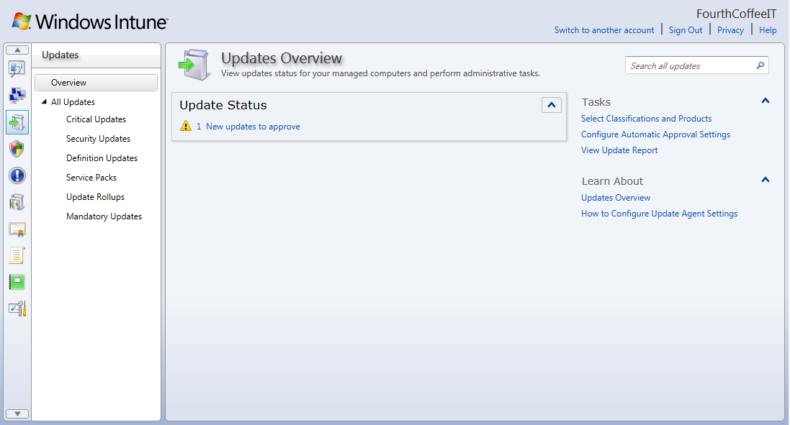
Update Management
Builds on WSUS and
Microsoft Update
framework
Design your update
management workflows
Easy ongoing
management
(Patch Tuesdays
are easy)
Configuration options to choose updates to manage and customize the updates agent

Slide 19
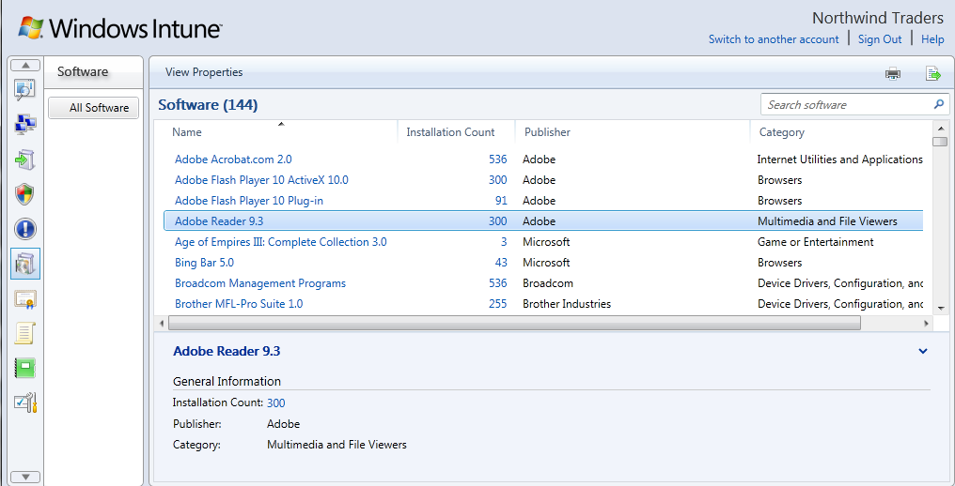
Asset Management
Comprehensive software inventory
  Crisp, uncluttered reporting based on software catalog
Easy management of Microsoft Volume Licenses
  Reports to compare licenses to software inventory
In-depth Hardware Reporting
  Physical and virtual
  Grouping and status
  Detailed system properties

Slide 20
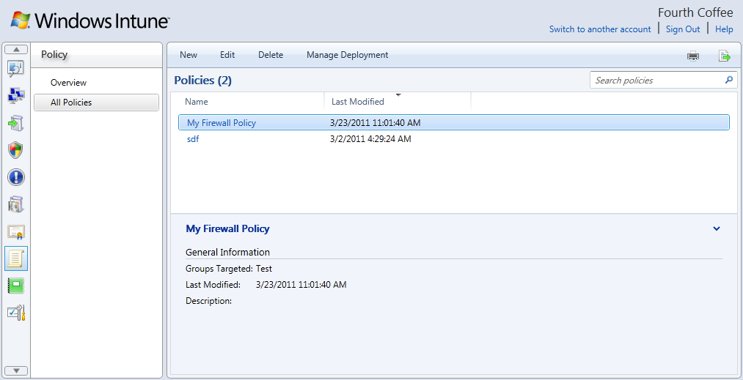
Security Policy Management
Set Update, Endpoint protection and Windows Firewall policies
Deploy policies to computer groups
Policies are enforced even on remote machines outside the corporate network
Based on Microsoft Policy Platform

Slide 21
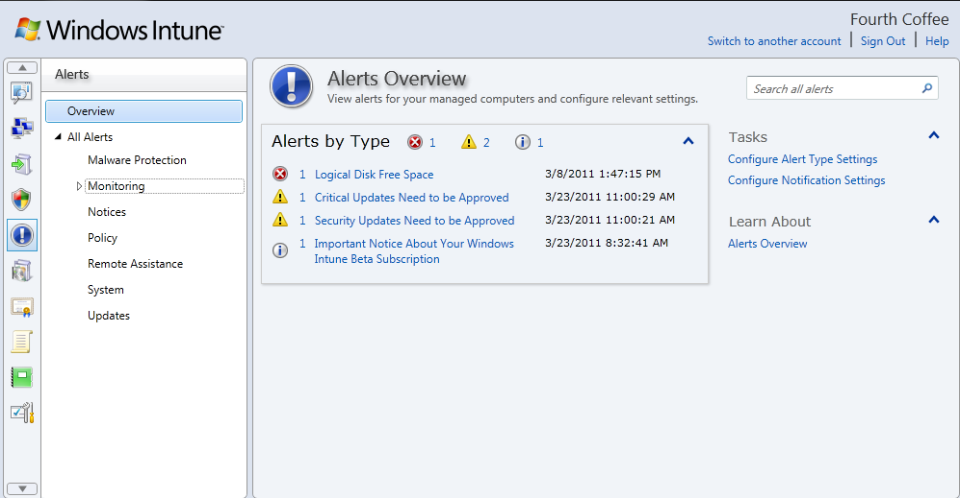
Alerts and Monitoring
Predefined Alerts
  Security
  Update
  Monitoring (e.g. low
  disk space)
  Remote Assistance
View by alert type, computer groups, individual computer
Leverages System center Operations Manager 2007 R2 Agent

Slide 22
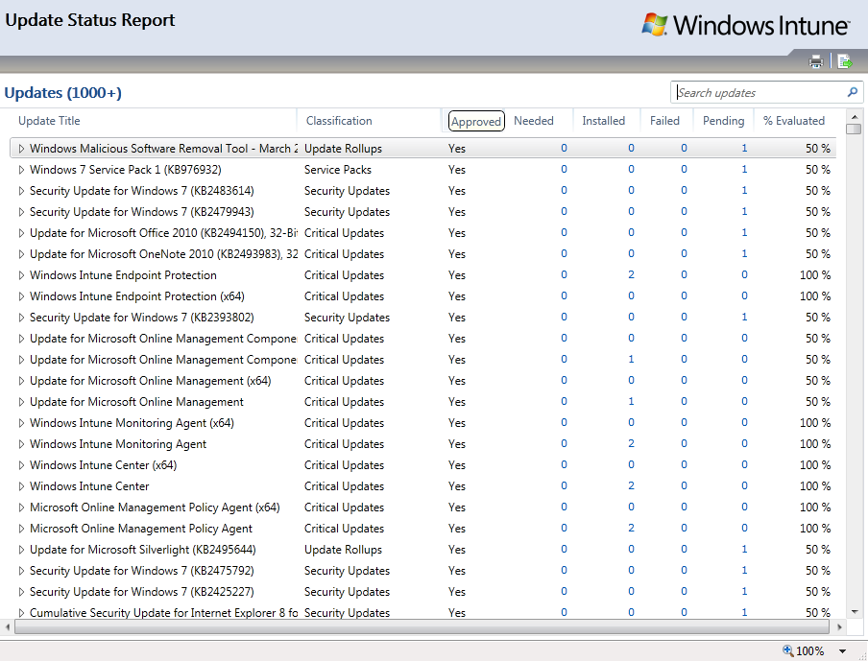
Views and Reports
Views
  Every workspace
  Filters, search
Reports
  Update
  Software
  License purchase
  License installation
Exportable
  CSV, HTML

Slide 23
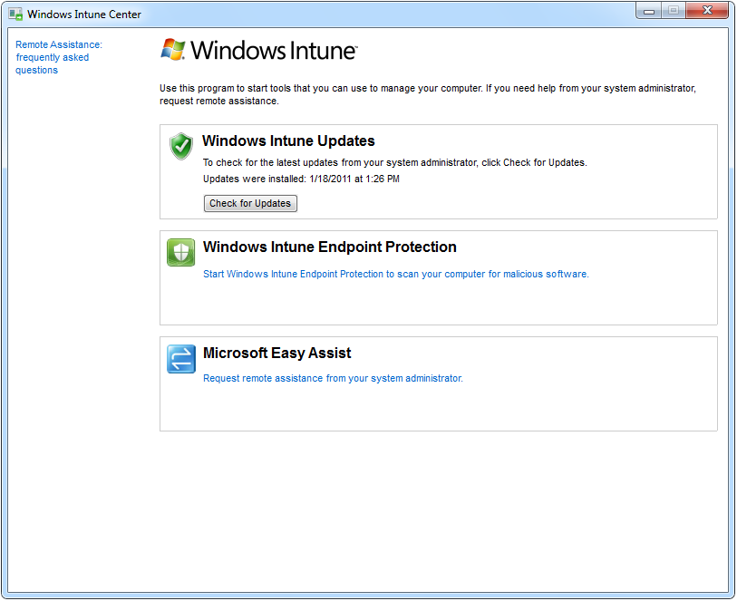
The End-User Experience
  Local application installed on managed PC
  Update Management tasks for end users
  Endpoint Protection options for end user
  Remote Assistance initiated by end user

Slide 24
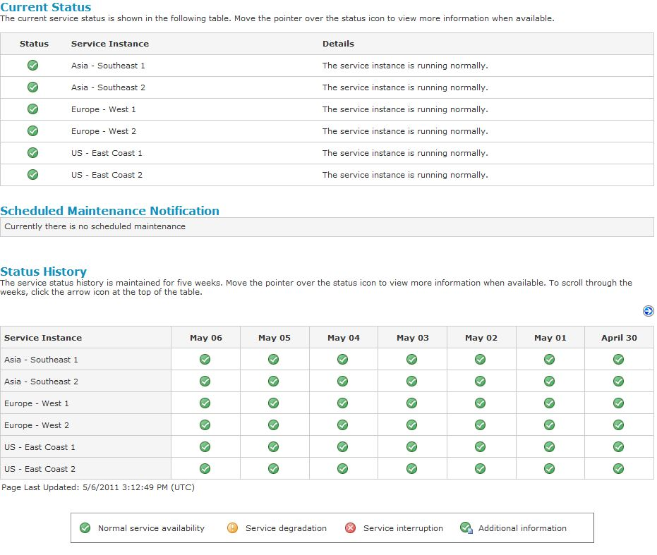
http://status.manage.microsoft.com
  Service status page
  Provides transparency of current and historical service issues
  Goals: build trust, reduce need to call support

Slide 25
Customer Promises
Reduces Cost of Managing and Protecting PCs
  No need to purchase and manage the management infrastructure
Secure by default
  Client-service communications secured (https)
  Administrator authentication
  Datacenters (physical, networking, database, etc.)
Privacy & Compliance
  Privacy statements
  Compliance with regional regulations & standards (IS027001)
High Availability
  Financially backed SLAs (99.9%)
Scalable & Performance
  Support for up to 20,000 PCs per account

Slide 26
Windows Intune Compared to On-Premises Solution
Delivering a subset of rich functionality common to on-premises solutions today
  Key Benefits
  Cloud
  On-premises
Operating system distribution
Software Deployment
Full Group Policy Support
Alerts & Monitoring*
Remote Assistance
Hardware, software, and license inventory
Malware protection
Microsoft Update management
Windows 7 Enterprise
*The “alerts” workspace within Windows Intune manages an optimized list of pre-defined system events. Access to comprehensive monitoring events is available in our on-premises solution.

Slide 27





Our Vision for Windows Intune
Smart Parity
Switch to the Cloud
Better in the Cloud
Achieve the same management results as on premise solutions.
Easy migration from on premise solutions to Windows Intune.
New innovations only delivered via the cloud.
Rapid Release Cycles

Slide 28






Opportunity for Windows Intune today in the Enterprise
A choice for every customer with unmanaged PC’s that needs core management
  Delivering Management & Security Essentials For Unmanaged PCs Today
Non-domain joined PCs
Field Employees
Highly Distributed Office
Contract Employees
Mergers & Acquisitions
Limited Staff

Slide 29





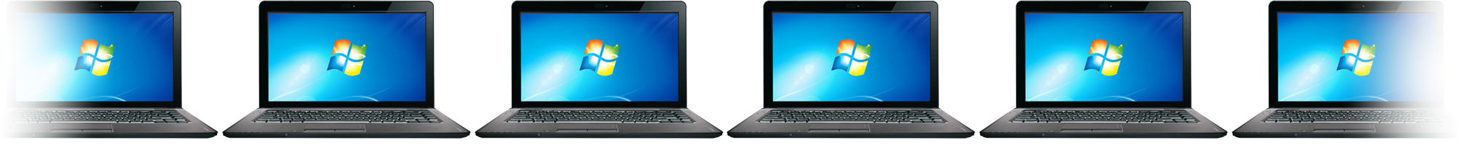







WINDOWS INTUNE GIVES YOU
THE BEST WINDOWS EXPERIENCE
Upgrade to
Windows 7
Enterprise
Standardize
on Single OS
Rights to Future Upgrades
Software Assurance & Virtualization Benefits
Enterprise
EVERYDAY TASKS EASIER, ANYWHERE
NEXT-GENERATION
SECURITY & CONTROL
STREAMLINE PC
MANAGEMENT
Windows 7 customer satisfaction: 94%*
*Technologizer, March 2010

Slide 30






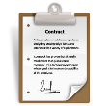

Licensing & Pricing
  Pricing
Windows Intune: $11 USD*/Device/Month
Windows Intune Add-On SKU $5*/Device/Month (for customer existing Windows EA)
Microsoft Desktop Optimization Pack Add On: $1 USD/Device/Month
  Discounts
$
PCs Already Covered by Software Assurance
Volume Purchases (>250 PCs)
  Available to Purchase Through
Microsoft Online Services Portal
Volume Licensing: Enterprise Agreement (EA and EAS) and Campus & School Agreement (CASA)
  Terms
Windows Intune software & services are non-perpetual, subscription licenses
“Buyout” available for Windows enterprise license
Device Subscription License (DSL)
  Qualified OS Requirements
Windows Professional, Enterprise, or Ultimate SKU
* Pricing may vary by region

Slide 31
Key Takeaways
Windows Intune is an easy-to-deploy all-in-one subscription based solution
Cloud based security and management service
Includes the latest version of Windows Enterprise
Highly available, secure, private, scalable service
Simple to use and scales to a large number of machines
  Suitable for those with unmanaged machines, fragmented management tools,
  a mobile workforce, remote branch offices, and partners looking to reduce site visits.
  Not a replacement for System Center since it doesn’t have equivalency.
Roadmap is to get to equivalency with on-premise solution and exceed it

Slide 32
Calls To Action
Sign up for Windows Intune trial and give it a try!!!
Learn more about Windows Intune
  Product Information: http://www.windowsintune.com
  Technical resources: http://technet.microsoft.com/en-us/library/ff598451.aspx
  Forum: http://social.technet.microsoft.com/Forums/en-US/windowsintune/threads
  Team Blog: http://blogs.technet.com/windowsintune
  Facebook: http://www.facebook.com/WindowsIntune
  Twitter: http://twitter.com/windowsintune
Give us your feedback

Slide 33

Related Content
WCL271-INT Under the Hood with Windows Intune: IT Pro Deep Dive
WCL320 Windows Intune in Real Life
OSP324 The Taming of the Clouds: Integrating SaaS with On-Premise
Microsoft TLC Windows Intune

Slide 34
Track Resources
Don’t forget to visit the Cloud Power area within the TLC (Blue Section) to see product demos and speak with experts about the Server & Cloud Platform solutions that help drive your business forward.
You can also find the latest information about our products at the following links:
Cloud Power - http://www.microsoft.com/cloud/
Private Cloud - http://www.microsoft.com/privatecloud/
Windows Server - http://www.microsoft.com/windowsserver/
Windows Azure - http://www.microsoft.com/windowsazure/
Microsoft System Center - http://www.microsoft.com/systemcenter/
Microsoft Forefront - http://www.microsoft.com/forefront/

Slide 35





Resources
  Connect. Share. Discuss.
http://northamerica.msteched.com
Learning
  Sessions On-Demand & Community
  Microsoft Certification & Training Resources
www.microsoft.com/teched
www.microsoft.com/learning
  Resources for IT Professionals
  Resources for Developers
http://microsoft.com/technet
http://microsoft.com/msdn

Slide 36












Complete an evaluation on CommNet and
enter to win!

Slide 37


Slide 38

© 2011 Microsoft Corporation. All rights reserved. Microsoft, Windows, Windows Vista and other product names are or may be registered trademarks and/or trademarks in the U.S. and/or other countries.
The information herein is for informational purposes only and represents the current view of Microsoft Corporation as of the date of this presentation. Because Microsoft must respond to changing market conditions, it should not be interpreted to be a commitment
on the part of Microsoft, and Microsoft cannot guarantee the accuracy of any information provided after the date of this presentation. MICROSOFT MAKES NO WARRANTIES, EXPRESS, IMPLIED OR STATUTORY, AS TO THE INFORMATION IN THIS PRESENTATION.

