Slide 2
Redelivering a Users Old Windows XP Environment inside Their New Windows 7 PC via Microsoft Deployment Toolkit w/P2V
WCL203
Stephen L Rose
Windows IT Pro Community Manager
stephen.rose@microsoft.com
@stephenlrose

Slide 3
P2V Migration for SA Customers
P2V Migration will convert a user’s existing Windows XP environment to a virtual hard disk then automates the delivery of an updated and personalized Windows 7 operating system containing a virtual machine with the user’s previous Windows environment, applications and Web browser.

Slide 4
How did it start?

Slide 5
We had some key ingredients ready
Microsoft Deployment Toolkit as an infinitely customizable engine
Sysinternals Disk2VHD to P2V the starting OS
Virtual PC with shell integration
RemoteApp Hotfixes for everything XP SP3 and newer
Fix for Hardware-Assisted Virtualization Emulation work had started

Slide 6
More Specifically
Disk2VHD.exe. Sysinternals tool for performing P2V hard disk conversion
KB961742-v3.exe. Update for Windows XP with SP3 to enable RemoteApp support
Windows6.0-KB961741-x86.msu. Update for Windows Vista with SP1 or later to enable RemoteApp
Windows6.1-KB958559-x64.msu. 64-bit Windows Virtual PC for Windows 7
Windows6.1-KB958559-x86.msu. 32-bit Windows Virtual PC for Windows 7
Windows6.1-KB977206-x64.msu. 64-bit update to remove the hardware-assisted virtualization prerequisites for Windows Virtual PC
Windows6.1-KB977206-x86.msu. 32-bit update to remove the hardware-assisted virtualization prerequisites for Windows Virtual PC

Slide 7
The idea grows
MDT 2010 or ConfigMgr
Initiates and Runs
Fully-Automated
OS Migration Process
(Then) new Sysinternals Disk2VHD.exe Converts XP to a VHD
Windows 7 is Installed with Applications, User State and Previous Windows XP + Apps

Slide 8
What is Sysinternals Disk2VHD?
Uses Volume Snapshot capabilities introduced in Windows XP/2003
VHD conversions can be performed online and saved to the same volume
It’s free and very powerful

Slide 9
When does this make sense?
“Not for every desktop, but for every organization”
When we cannot fix or purchase a native working application
Where a standardized Virtual PC image will not suffice
For critical users with highly specialized desktops – and everything must return
When the deployment must go on…

Slide 10
Limitations?
Windows XP activation can only be retained in VHD if customer installed themselves (not OEM) using VL media and customer has reimaging rights
VPC only supports VHD captured disks up to 127GB
Companies may be too slow to replace Windows XP applications with Windows 7 native applications

Slide 11
Comparing Application Compatibility Mitigations…
Problem | Fix/shim the application | XP Mode | MED-V | P2V Migration
Time required to identify and fix issues | High | Low¹ | Low¹ | Low¹
Wait time for ISV support | Varies | Low | Low | Low
User-specific applications and IE6 customizations | Difficult | Manual³ | Difficult³ | Included
Central Manageability | Best | Poor | High | Varies⁴
“Lightweight-ness” | Best | Varies | Good | Heavy
IE6 URL Redirection | N/A | N/A | Exclusive to MED-V | N/A
Network Bandwidth | Low | 600MB | >600MB | Depends⁵
¹ some limited applications do not run in Virtual PC, due to performance requirements or RemoteApp (TS) issues
² standard images cater to global install-base, specialized applications would require custom images
³ would require reinstallation of all applicable fixes – some may not be available anymore
⁴ depends on how well the physical PC was managed before conversion
⁵ depends whether VHD needs to leave the machine for computer refresh, high bandwidth for replace scenario

Slide 12
Let’s Look At The Big Picture
MDT

Slide 13
How Many Images Do You Manage
1 image
2 - 5 images
6 - 10 images
11 -20 images
More than 20 images

Slide 14



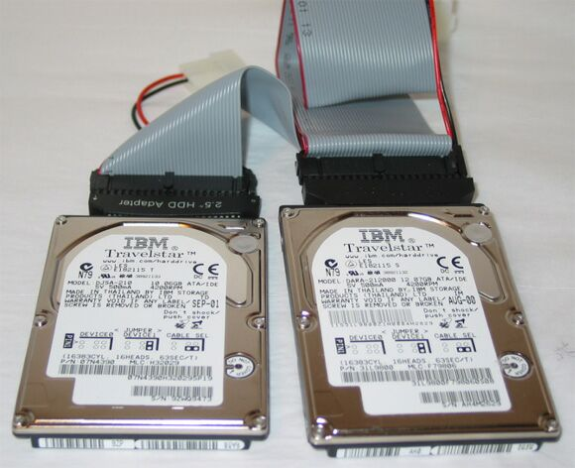

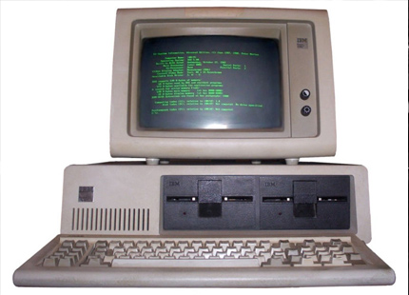
Do You Still Use Any of These??
Sector Based Imaging

Slide 15
The Magic of The PiXiE Stick
My boss has XP. She needs Windows 7 before she lands.
I want to enable my remote workers to migrate to Windows 7 without sending in their laptops.
I have 10 machines I want to pilot Windows 7 on.

Slide 16
Here’s The Best Part….
MDT 2010
Windows Deployment Server
(WDS)
FREE!

Slide 17
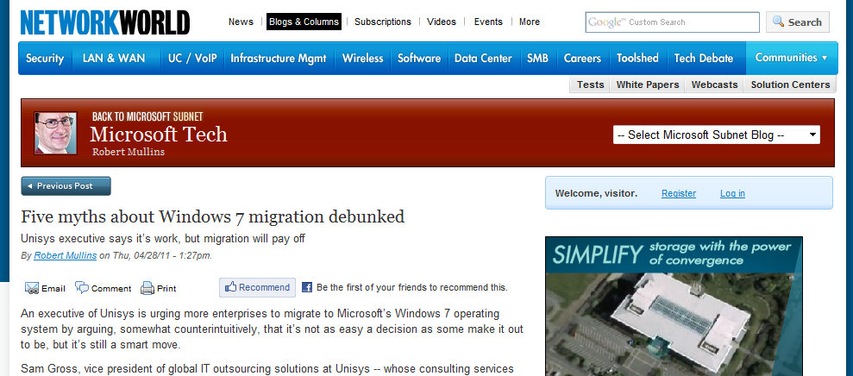
Five myths about Windows 7

Slide 18
Five Myths
Myth 1: You have an accurate sense of the scope of the migration.
  Truth: Gross says IT managers may have a “ballpark figure” of the number of PCs in their enterprise, but they will likely overlook a number of other devices and software that comes in contact with the OS. To avoid problems later, he suggests companies take the time up front, perhaps three months, to conduct a thorough inventory of all hardware and software that touches the desktop.

Slide 19
Five Myths – from Network World
Myth 2: Windows 7 will fit seamlessly into your current desktop infrastructure..
  Truth: You do need to determine compatibility with the local area network, support servers and management tools that make up the desktop infrastructure and upgrade or replace components as necessary

Slide 20
Five Myths – from Network World
Myth 3: Windows 7 will extend the life of your current PCs.
  Truth: While Windows 7 does make more efficient use of the CPU and memory in a computer, don’t let that be an excuse to hold onto ancient desktop PCs. A newer PC will be able to take advantage of the enhanced graphics capabilities and other performance improvements in Windows 7.

Slide 21
Five Myths – from Network World
Myth 4: Migrating to Windows 7 will automatically lower IT costs.
  Truth: While Windows 7 does offer efficiencies that can lower IT costs, the OS alone won’t deliver optimum efficiency, Gross writes. Enterprises should use the migration as an opportunity to introduce other efficiencies such as establishing standard desktop images and removing unnecessary apps.

Slide 22
Five Myths – from Network World
Myth 5: Windows 7 will automatically reduce your management burden.
  Truth: You wish. “No OS can manage your desktop environment for you,” Gross states, adding that a new OS can help IT managers start with a “clean slate ... and clear away much of the desktop chaos that’s grown organically over the past years.”

Slide 23
What is this Hard Links Migration
You Speak Of?

Slide 24




How Hard-Link Migration works?
...index files, create links to each, map links to the right spots
Index of
Hard-Links -
files don’t move
Files
Files
User Accounts
User Accounts
Application Settings
Application Settings

Slide 25
MDT - How Does It Work?
...add your ingredients, create a build, and install
Drivers
Applications
Operating Systems
Microsoft Deployment Toolkit 2010 or
System Center Configuration Manager 2007

Slide 26
Planning for Windows 7 and Office 2010

Slide 27
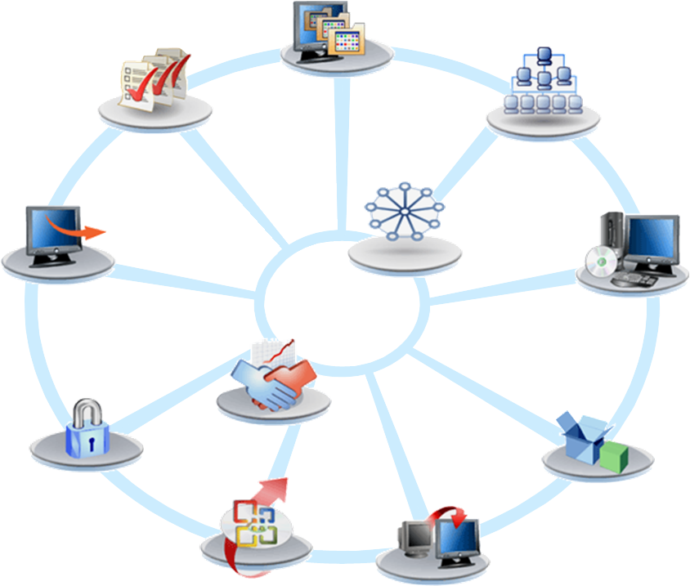

The Deployment Project…
Do I need to invest in test
hardware, personnel,
and infrastructure?
How is this going to impact
users and the helpdesk?
Testing Process
Do I replace all of my
users’ hardware?
Operations
Readiness
Infrastructure
Remediation
Do my users need to send their hardware to IT or be without
their PCs for a day?
Do I need to build and maintain
an image for each hardware class?
Project
Process and
Team Guidance
Deployment
Image
Engineering
How do I think about
policies, data, and security now?
Business Case
for Deployment
Are my applications
going to work?
Office, too? Does that
mean more testing
and images?
Application
Management
Security
Do my techs need to manually
migrate everyone’s files at
their desk or in the lab?
Office
Deployment
Migration
Notes:
Key Message
Deployment projects are divided into discreet tasks – or feature teams – to ensure that all prerequisites are in place and tested prior to the deployment taking place. Microsoft Deployment Toolkit provides guidance and tools to help automate key tasks, including:
Hardware and software inventory
Application inventory and compatibility analysis
File repository for centrally managing operating systems, applications, drivers, and packages
User data and settings migration from the previous operating system to the deployed operating system
Security guidance for establishing a security strategy tailored to the new operating system
Deployment task sequencer for defining pre- and post-installation tasks

Slide 28
Fact
Windows architecture and deployment tools change for a reason.
  Hardware changes are not an issue, just load the drivers
  No need to have more than 1 image to manage
  User data migration is automatic
  Security updates are easier to integrate into the project
Hardware specs and application requirements pretty static for 3+ years

Slide 29
…What it Means
Refresh existing hardware - don’t wait for hardware replacement
Make the process fast and not disruptive for users
Test wisely, but don’t expect things to break as often as before
That means fewer helpdesk calls than with previous
OS deployments

Slide 30

The Migration Process
Plan
Assess hardware and applications, and plan
for the new features or services you want
Deliver
Prepare applications, infrastructure, and
images for deployment and migrate users
Expand functionality coverage, transition applications, and manage the desktop environment
Operate

Slide 31














Windows Application Compatibility Tools
Collect
Analyze
Test & Mitigate
  Application Compatibility Toolkit
  Asset Inventory Service
  Microsoft Assessment
  and Planning
  System Center Family
  Application Compatibility Toolkit
  Windows Compatibility Center
  Compatible Applications List
  Application Quality Cookbook
  Application Verifier
  Application Compatibility Toolkit
  Application Virtualization
  Application Quality Cookbook
  Virtual Legacy Windows OS (MED-V, XP Mode)

Slide 32

Application Compatibility Toolkit (ACT) 5.6
Provides tools to inventory applications, hardware, and devices in the production environment
Synchronizes collected inventory with current application and hardware compatibility data from Microsoft
Includes tools to test and repair individual applications
Version 5.6 has x64 support for inventory, compatibility fixing, and standard user account issue detection
Notes:
Key Message: An overview of the Application Compatibility Tool and the ACM. The following is detailed info regarding the usage, options, and new features within the ACT and ACM.
The Application Compatibility Manager (ACM) is a tool that enables you to configure, to collect, and to analyze your data, so that you can fix any issues prior to deploying a new operating system in your organization. When you configure the ACT using it’s wizard, the ACM automatically starts. Detailed info on ACM can be referenced at http://technet.microsoft.com/en-us/library/cc766464.aspx.
You can use the ACT features to:
Verify your application's, device's, and computer's compatibility with a new version of the Windows operating system, including determining your risk assessment
Verify a Windows update's compatibility, including determining your risk assessment
Become involved in the ACT Community, including sharing your risk assessment with other ACT users
Use the provided developer and test tools to test your Web applications and Web sites for compatibility with new releases and security updates to Internet Explorer®, to determine potential compatibility issues due to the User Account Control (UAC) feature, to create compatibility fixes for your application compatibility issues, and to determine any potential application installation and setup issues
What’s New in ACT 5.5:
Updated issue detection and supported operating systems
Integration of data from the Windows Vista Compatibility Center
Ability to audit your application data and to selectively synchronize your applications with Microsoft
Updated documentation for the Windows compatibility fixes
Ability to customize your Quick Reports view
Ability to label your individual data-collection packages
Removal of the Internet Explorer Compatibility Evaluator (IECE)
Ability to participate in the Customer Experience Program
Compatibility Evaluators
The Application Compatibility Toolkit (ACT) includes several compatibility evaluators that can be deployed as part of a data-collection package to collect information from your client computers including:
Inventory Collector
User Account Control Compatibility Evaluator (UACCE)
Windows Compatibility Evaluator (WCE)
Update Compatibility Evaluator (UCE)
Detailed info on each of these can be found at…
http://technet.microsoft.com/en-us/library/dd638366.aspx
Timing: Prepare for this discussion using the info above. This is a full-featured, in-depth tool and timing can run long unless an abbreviated subset of data is discussed. If the audience is particularly interested in this topic there is a large amount of info here, however a complete breakdown of the toolkit can be found at…
*http://technet.microsoft.com/en-us/library/cc722055.aspx

Slide 33
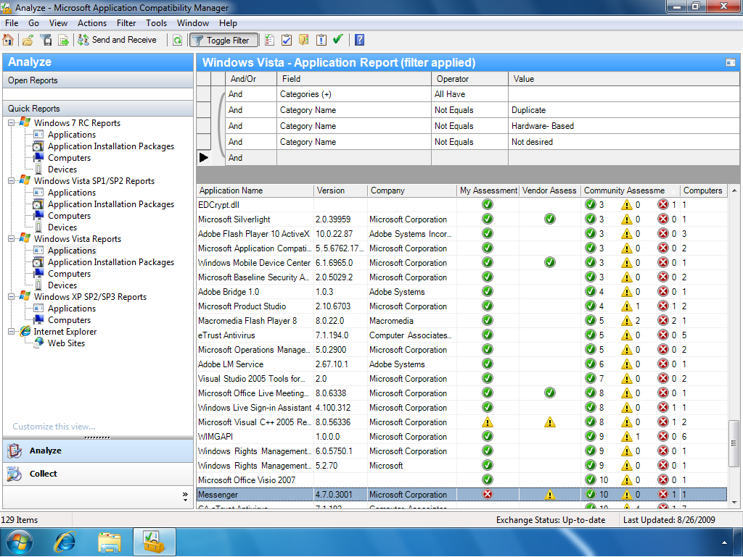
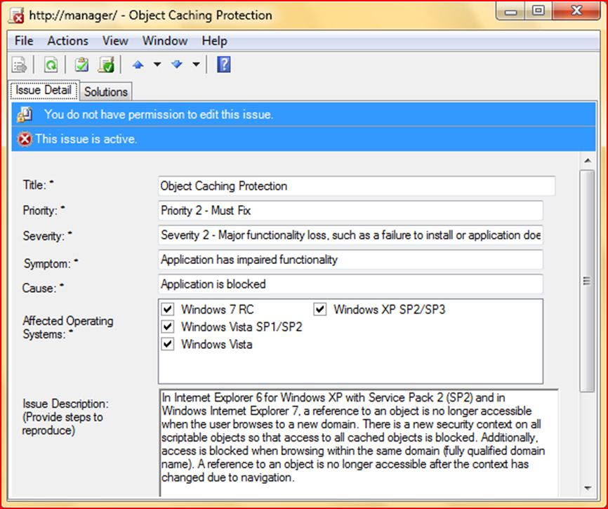
Application Compatibility Toolkit (ACT)
Notes:
Key Message: An overview of the Application Compatibility Tool and the ACM. The following is detailed info regarding the usage, options, and new features within the ACT and ACM.
The Application Compatibility Manager (ACM) is a tool that enables you to configure, to collect, and to analyze your data, so that you can fix any issues prior to deploying a new operating system in your organization. When you configure the ACT using it’s wizard, the ACM automatically starts. Detailed info on ACM can be referenced at http://technet.microsoft.com/en-us/library/cc766464.aspx.
You can use the ACT features to:
Verify your application's, device's, and computer's compatibility with a new version of the Windows operating system, including determining your risk assessment
Verify a Windows update's compatibility, including determining your risk assessment
Become involved in the ACT Community, including sharing your risk assessment with other ACT users
Use the provided developer and test tools to test your Web applications and Web sites for compatibility with new releases and security updates to Internet Explorer®, to determine potential compatibility issues due to the User Account Control (UAC) feature, to create compatibility fixes for your application compatibility issues, and to determine any potential application installation and setup issues
What’s New in ACT 5.5:
Updated issue detection and supported operating systems
Integration of data from the Windows Vista Compatibility Center
Ability to audit your application data and to selectively synchronize your applications with Microsoft
Updated documentation for the Windows compatibility fixes
Ability to customize your Quick Reports view
Ability to label your individual data-collection packages
Removal of the Internet Explorer Compatibility Evaluator (IECE)
Ability to participate in the Customer Experience Program
Compatibility Evaluators
The Application Compatibility Toolkit (ACT) includes several compatibility evaluators that can be deployed as part of a data-collection package to collect information from your client computers including:
Inventory Collector
User Account Control Compatibility Evaluator (UACCE)
Windows Compatibility Evaluator (WCE)
Update Compatibility Evaluator (UCE)
Detailed info on each of these can be found at…
http://technet.microsoft.com/en-us/library/dd638366.aspx
Timing: Prepare for this discussion using the info above. This is a full-featured, in-depth tool and timing can run long unless an abbreviated subset of data is discussed. If the audience is particularly interested in this topic there is a large amount of info here, however a complete breakdown of the toolkit can be found at…
*http://technet.microsoft.com/en-us/library/cc722055.aspx

Slide 34
Office 2010 Compatibility Toolkit
Office
Environment
Assessment Tool
(OEAT)
Content
Application Compatibility
Office 2010
Compatibility
Inspector Tool
Office
Migration
Planning Manager
(OMPM)
Notes:
OMPM – existing tool
New tools are OEAT and CI
OEAT aimed at It Pros to scan desktops to get a view of add-ins and programs that interface with Office – this tool will verify with the ISV compatibility list, thus highlighting areas for drill down
CI – targeted at developers to locate potential breaking points based on known changes being introduced

Slide 35
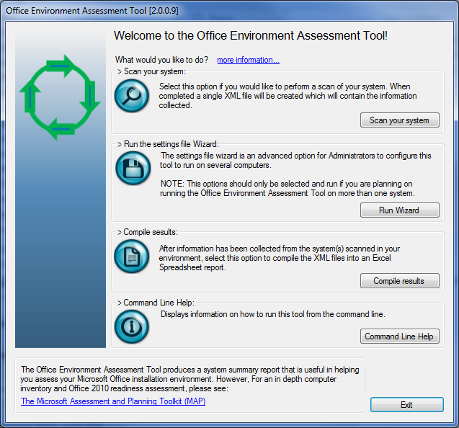
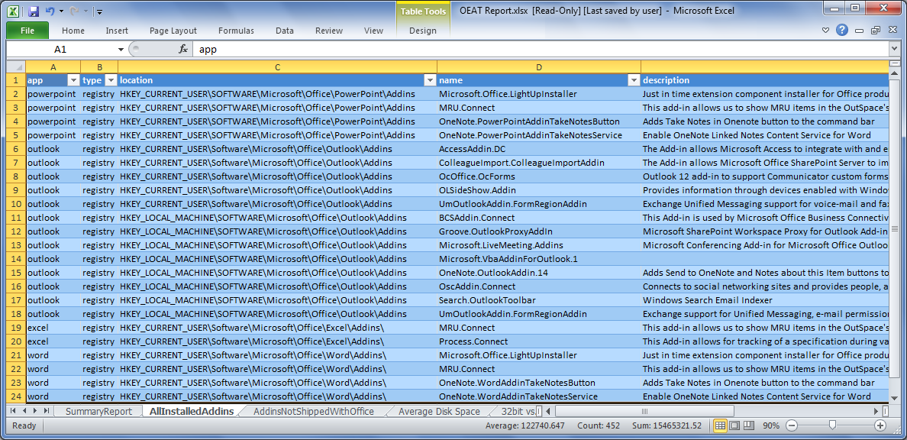
App Compat – Office Environment Assessment Tool
Identifying the add-ins & interfacing applications
Notes:
The Office Migration Planning Manager (OMPM) is a resource provided by Microsoft to help customers and partners size up potential file migration issues.
This slide is offered to provide a snapshot of what OMPM provides – the tools drill down module provides additional details this tool and how it can be leveraged.
OMPM is a collection of tools that enables you to prepare your environment for migration to the 2010 Microsoft Office system. OMPM checks for, and reports on, file properties to help you analyze your environment and determine any issues that you might experience converting from Office 97-Office 2003 file formats to the new 2010 Office system file format. OMPM includes the following features: OMPM focuses primarily on converting old files to the new file formats. When OMPM shows an error or highlights a warning on a file; That does not mean the file will not open in the 2010 Office system (almost all older files can open in compatibility mode). It only means that saving it into the new Open XML format might cause problems. OMPM has 4 components discussed in more detail below: 1. Scanner 2. Database 3. Reporting Tools
See http://technet.microsoft.com/en-us/library/cc179179.aspx for additional information (Note only the Office 2007 is available until near Office 2010 RTM – this version can be used to begin assessments)

Slide 36
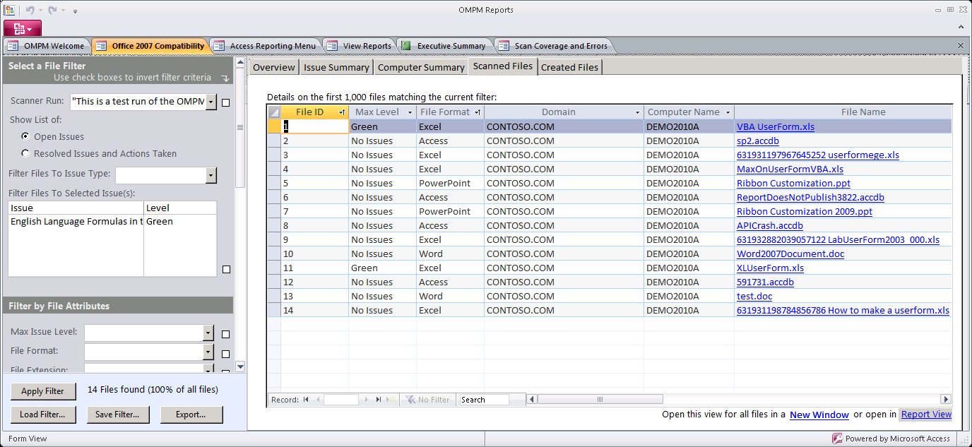
Office Migration Planning Manager (OMPM)
Evaluate, identify, & migrate Office files for OpenXML migration
Notes:
The Office Migration Planning Manager (OMPM) is a resource provided by Microsoft to help customers and partners size up potential file migration issues.
This slide is offered to provide a snapshot of what OMPM provides – the tools drill down module provides additional details this tool and how it can be leveraged.
OMPM is a collection of tools that enables you to prepare your environment for migration to the 2010 Microsoft Office system. OMPM checks for, and reports on, file properties to help you analyze your environment and determine any issues that you might experience converting from Office 97-Office 2003 file formats to the new 2010 Office system file format. OMPM includes the following features: OMPM focuses primarily on converting old files to the new file formats. When OMPM shows an error or highlights a warning on a file; That does not mean the file will not open in the 2010 Office system (almost all older files can open in compatibility mode). It only means that saving it into the new Open XML format might cause problems. OMPM has 4 components discussed in more detail below: 1. Scanner 2. Database 3. Reporting Tools
See http://technet.microsoft.com/en-us/library/cc179179.aspx for additional information (Note only the Office 2007 is available until near Office 2010 RTM – this version can be used to begin assessments)

Slide 37
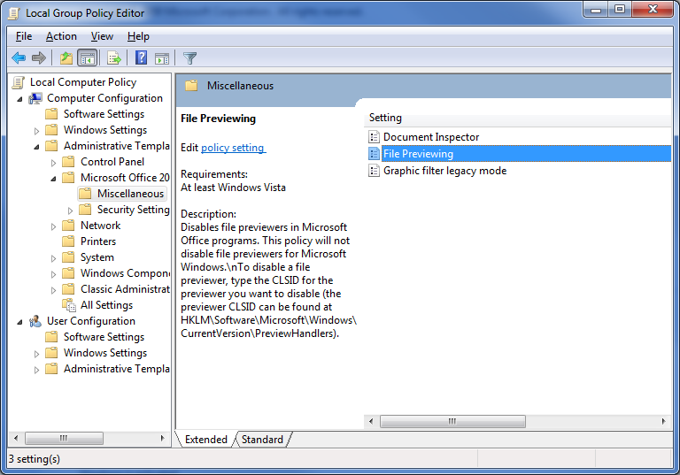
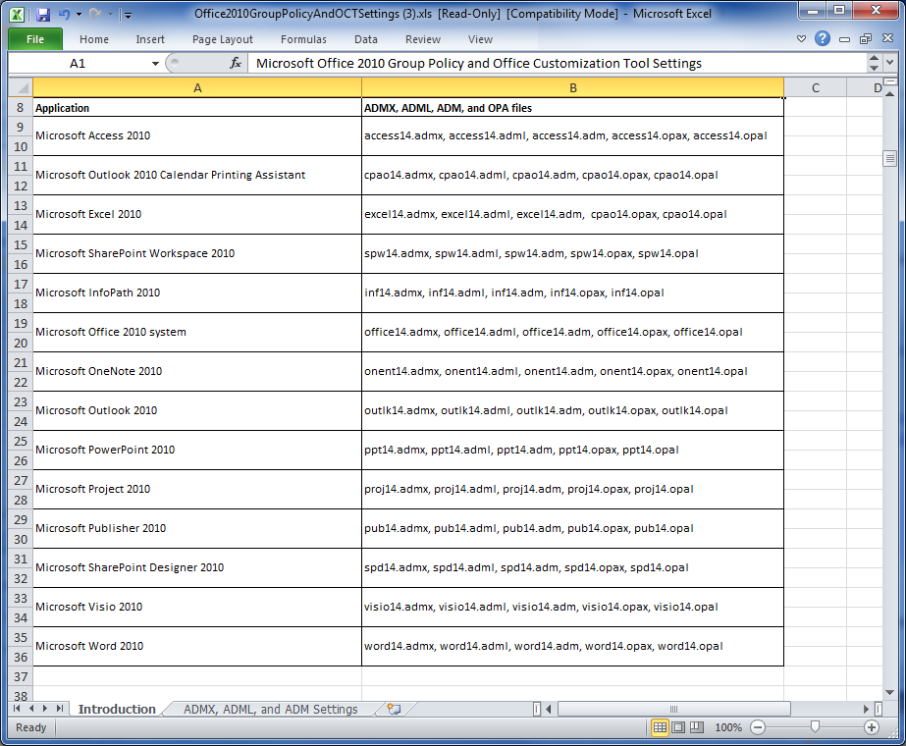
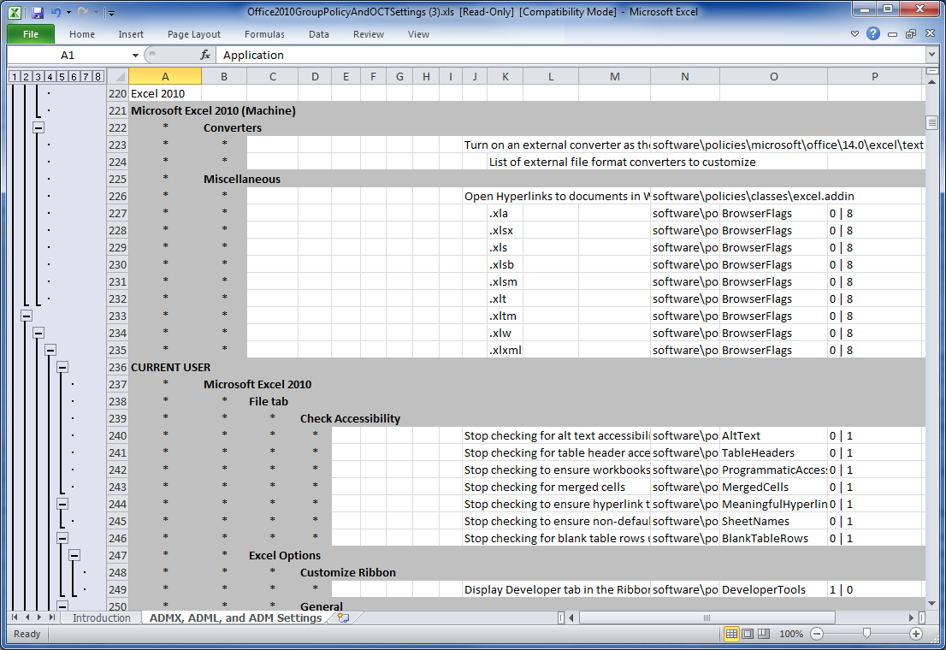
Group Policy
Office admin templates allow IT to control features available for end users
Notes:
Group Policy Admin templates
By setting policies, you can define and maintain a particular Office 2010 configuration on users' computers. Unlike other customizations, such as default settings that are distributed in a transform (also known as an .mst file), policies are reapplied every time that a user logs on to the network. Alternatively, policies can be reapplied at some other interval that is set by the administrator. Users cannot edit the registry to change the policies.
You can set policies that apply to the local computer (and to every user of that computer), or you can set policies that apply only to individual users.
You set per-computer policies under Computer Configuration in the Group Policy snap-in. Per-computer policies are applied the first time that any user logs on to the network from that computer.
You set per-user policies under User Configuration in the Group Policy snap-in. Per-user policies are applied when the specified user logs on to the network from any computer.
To use an Office 2010 policy template, you must load the template in the Group Policy Microsoft Management Console snap-in.

Slide 38
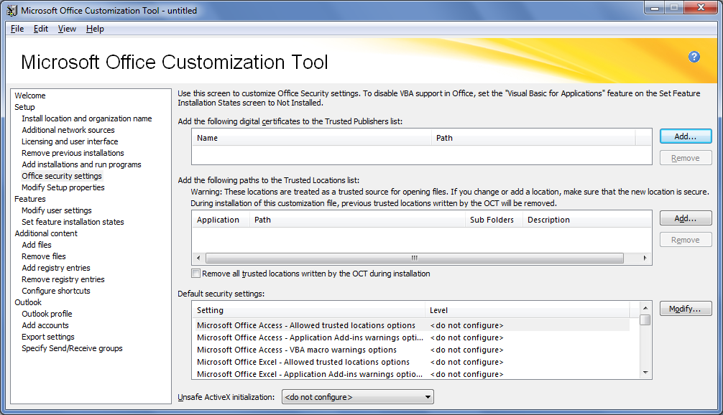
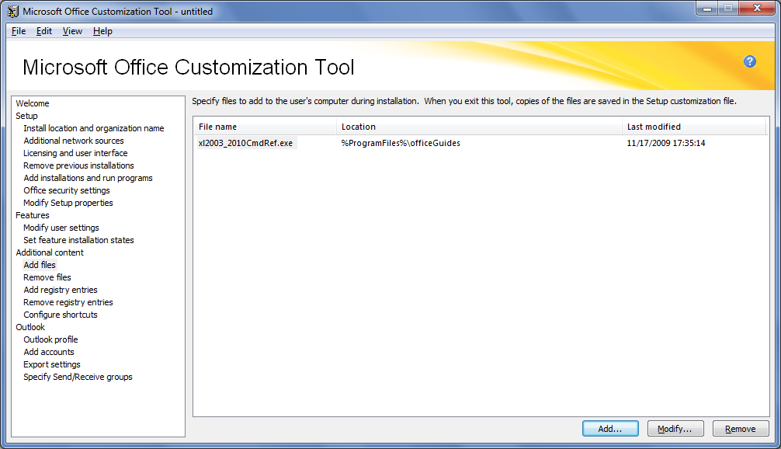
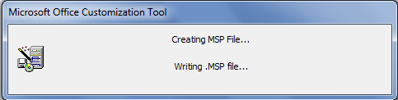
Office Customization Tool
Build deployment packages to fit business requirements
Notes:
The Office Customization Tool (OCT) is used to create patches that customize the Office 2010 installation. The OCT patches are slipstreamed in at the install time, or can be applied post install for maintenance of existing installations: * Using the Office Customization Tool (OCT) * Using the Config.xml file as an override feature * Setting up command-line options * Enabling group policies Using the OCT to configure user settings establishes the initial default values for the settings. Users can modify most of the settings after Office is installed. You can use the OCT to provide default user settings for the following Office applications: * Microsoft Office Access 2010 * Microsoft Office Outlook 2010Printing Assistant * Microsoft Office Excel 2010 * Microsoft Office Groove 2010 * Microsoft Office InterConnect 2010 * Microsoft Office InfoPath 2010 * Microsoft Office 2010 system * Microsoft Office OneNote 2010 * Microsoft Office Outlook 2010 * Microsoft Office PowerPoint 2010 * Microsoft Office Project 2010 * Microsoft Office Publisher 2010 * Microsoft Office SharePoint Designer 2010 * Microsoft Office Visio 2010 * Microsoft Office Word 2010

Slide 39
MDT 2010 Workbench
Demo

Slide 40
How Is Our Demo Doing?

Slide 41
Some good reference content
Your Building a LiteTouch Bootable USB Image Questions Answered!
Your Adding Office 2010 to MDT 2010 Environment Questions Answered!
Improving Your Image: Sector-Based, File-Based, and Sysprep - What Makes the Most Sense?
  Part 1: Terms and Windows Tools Primer
  Part 2: The Pros and Cons.
  Part 3: Deploy-time Build Automation and Recommendations
Manually Performing P2V Migration for Software Assurance
http://windowsteamblog.com/windows/b/springboard/

Slide 42

Track Resources
Don’t forget to visit the Cloud Power area within the TLC (Blue Section) to see product demos and speak with experts about the Server & Cloud Platform solutions that help drive your business forward.
You can also find the latest information about our products at the following links:
Cloud Power - http://www.microsoft.com/cloud/
Private Cloud - http://www.microsoft.com/privatecloud/
Windows Server - http://www.microsoft.com/windowsserver/
Windows Azure - http://www.microsoft.com/windowsazure/
Microsoft System Center - http://www.microsoft.com/systemcenter/
Microsoft Forefront - http://www.microsoft.com/forefront/

Slide 43





Resources
  Connect. Share. Discuss.
http://northamerica.msteched.com
Learning
  Sessions On-Demand & Community
  Microsoft Certification & Training Resources
www.microsoft.com/teched
www.microsoft.com/learning
  Resources for IT Professionals
  Resources for Developers
http://microsoft.com/technet
http://microsoft.com/msdn

Slide 44












Complete an evaluation on CommNet and
enter to win!

Slide 45

Notes:
New for TechEd 2011, we will be working with Microsoft Tag (http://tag.microsoft.com/overview.aspx) to create unique Tags for every session at the event. Your session Tag will appear on both the room signage and at the end of your presentation. With your session Tag, attendees will be able to scan as they enter the room to retrieve session details, view speaker bios, and engage in discussions; or scan at the end of the presentation to evaluate your session and download materials. We’re excited to integrate Microsoft Tag across the My TechEd mobile experience this year.

Slide 46

© 2011 Microsoft Corporation. All rights reserved. Microsoft, Windows, Windows Vista and other product names are or may be registered trademarks and/or trademarks in the U.S. and/or other countries.
The information herein is for informational purposes only and represents the current view of Microsoft Corporation as of the date of this presentation. Because Microsoft must respond to changing market conditions, it should not be interpreted to be a commitment
on the part of Microsoft, and Microsoft cannot guarantee the accuracy of any information provided after the date of this presentation. MICROSOFT MAKES NO WARRANTIES, EXPRESS, IMPLIED OR STATUTORY, AS TO THE INFORMATION IN THIS PRESENTATION.

