Slide 1

Anatomy of HP Cloud
Foundation for Hyper-V
VIR325
Brad Kirby
Group Manager – Microsoft Partnership
Hewlett-Packard Co.

Slide 2
Agenda
HP, Microsoft, and Cloud Computing
HP Cloud Foundation for Hyper-V
  Understanding HP BladeSystem Matrix
  Integration with Microsoft System Center
HP Cloud Foundation for Hyper-V use case deep dive
  IT Services Fabric initialization
  Flexing IT Services
  Transparent Failure Resolution
HP Cloud Foundation for Hyper-V at MMS

Slide 3
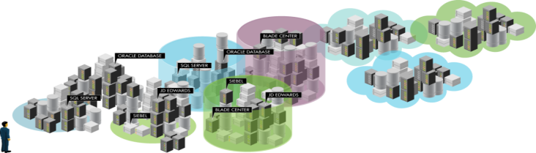
What’s Driving the Move to Cloud?
>70% of businesses considering or using private clouds ⁽¹⁾
Business drivers: Speed, flexibility and economics
Business is adopting cloud 5x faster than IT operations ⁽²⁾
IT challenges: sprawl, control, and integration
70% of IT resources captive in maintenance and operations ⁽³⁾
IDC Survey, Cloud Computing Attitudes, Doc.#223077, April 2010
You're Not Ready For Internal Cloud, Forrester Research, Inc., July 2010
2009 InformationWeek Analytics Survey
Notes:
Notes
From a business perspective, appeal of cloud is clear: speed, flexibility, economics. The idea of going to a portal to request a service that is instantly provided has innate appeal, particularly compared to the experience they have with most internal IT departments.. For many years, businesses are asking for better user experience with intuitive user interface, access to data and their business processes anytime, anywhere. They want access fast at Internet speed now and last but not least they want a flexible model that adapts to the business changes.
So, businesses are adopting cloud 5X faster than IT expected.
While end users believe it is allowing them to respond faster to their business needs, without a comprehensive plan and governance model, they could jeopardize the security of their enterprise data and applications. Additionally, CIO’s cannot effectively track, measure and budget for this shadow IT so businesses don’t have a true picture of how their resources are used. CIO’s are struggling with 70% of resources captive in maintenance & operations.
So, CIO’s are looking to private clouds to allow them to bring many of the benefits of public cloud with the control and security of internal IT.

Slide 4



What Constitutes Cloud Computing?
SOFTWARE
AS A SERVICE
PLATFORM
AS A SERVICE
INFRASTRUCTURE
AS A SERVICE
Notes:
What constitutes Cloud Computing?
Infrastructure as a Service (IaaS) is a model for provisioning hardware (compute, storage, networking, etc...) to the end user where management of the underlying fabric is controlled by the provider, but the end user deploys and maintains control of the applications installed within.
Platform as a Service (PaaS) is a model for delivering complete development platforms as a cloud service. PaaS offerings facilitate development, testing, deployment and on-going maintenance of applications without the cost of buying the underlying infrastructure and software environments. Examples include: Microsoft Azure Platform, Google App Engine, VMforce.com
Software as a Service (SaaS) is a model where an application is delivered over the Internet and customers pay on a per-use basis. It is the most common form of cloud computing delivered today. Examples include: BPOS, Salesforce.com, Hosted Exchange, Salesforce.com
HP Cloud Foundation for Hyper-V delivers infrastructure as a service.

Slide 5



Public vs. Private Clouds
Public Cloud
Private Cloud
Public cloud represents the core cloud attributes of self-service, shared, scalable/elastic and usage based on shared resources.
Private cloud represents the core cloud attributes of self-service, shared, scalable/elastic and usage based on dedicated resources.
Enterprise
Enterprise
Cloud Provider
Service
IT Department
Service
Service
Service
Service
Service
Service
Notes:
HP Cloud Foundation for Hyper-V is a private cloud solution.

Slide 6








What Makes a Private Cloud a Private Cloud?
REDUCED
COSTS
AGILITY
HIGHLY AUTOMATED
REDUCED
COSTS
BENEFITS
SELF
SERVICE
AGILITY
SCALABLE
AND ELASTIC
HIGHLY AUTOMATED
CORE ATTRIBUTES
“Top performers [of virtualization and private cloud management] with advanced use of change and configuration tools, capacity planning, and inventory management can achieve a 20% staffing efficiency gain.”
“Reducing Operational Expense (OpEx) with Virtualization and Virtual Systems Management.” EMA, November 2009
Notes:
Benefits
Reduce Costs – ongoing IT operational costs and capital investment costs (servers, datacenter equipment) reduced, cloud technology is paid incrementally, saving organization money
Agility- No longer having to worry about constant server updates and other computing issues, organizations will be free to concentrate on innovation.
Highly Automated – No longer do IT personnel need to worry about keeping software up to date
Core Attributes
Self-Service – Providing self-service IT infrastructure to business units and departments with an SLA. This forces service-level discussion and removes the burden to procure, provision and manage infrastructure on a per application, ad-hoc basis
Scalable and Elastic – Enabling faster delivery of capacity when resource needs change.
(Read Slide Quote)

Slide 7

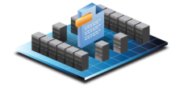

HP Cloud Foundation for Hyper-V
Designed to help customers save money by deploying HP and Microsoft infrastructure and virtualization technologies
Simplify
Reference architecture detailing framework for the Private Cloud, based on proven HP and Microsoft technologies.
Includes a detailed bill of materials and implementation guideline documentation
Optimize
Allow customers to dynamically provision, flex, and automate responses to faults for physical and virtual infrastructure.
Templates to ensure services are deployed the same way every time.
Accelerate
Jointly validated under Hyper-V Cloud Fast Track Program
Delivered through HP Technical Services
Notes:
Purpose of the architecture
This architecture is designed to help customers save money by deploying HP and Microsoft infrastructure and virtualization technologies.
The reference architecture value proposition provides the following key benefits:
• Simplify: This jointly validated HP reference architecture is designed to help customers build a framework for the Private Cloud. It is based on proven HP and Microsoft technologies, and contains a detailed bill of materials and best practices that enable customers to seamlessly manage both physical and virtual environments.
• Save: You can reduce the cost of running your HP ProLiant servers by $73,482 USD per 100 users, with a 600%+ return on investment and 4.23 month payback period.1
• Optimize: A solution based on this reference architecture will allow customers to optimize their infrastructure by dynamically provisioning and allocating the infrastructure and virtual environments, while also insulating the virtual machines (VMs) and applications from changes in the physical infrastructure.
−−Total three-year costs
−−Total cost of ownership savings of moving 100 1U servers to HP BladeSystem Matrix: $1,626,656 or 56%2
• Accelerate: Jointly validated best-of-breed components from HP and Microsoft, combined with best practices developed jointly by HP and Microsoft, will help reduce the cost and complexity for our joint customers, as well as help customers accelerate their journey to the Private Cloud.
1 IDC, “Gaining Business Value and ROI with HP Insight Control,”
September 2010
2 “The business case for HP BladeSystem Matrix,” HP white paper,
August 2010
7

Slide 8
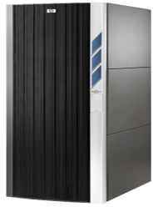
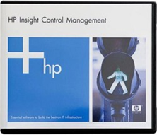
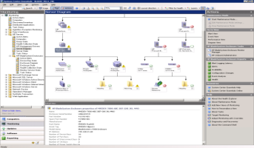
HP Cloud Foundation for
Hyper-V Core Components
HP BladeSystem Matrix
HP Insight Control for
System Center
Microsoft System Center
+
+
Designer
Self-service portal
Service provisioning
Service recovery
Monitor HW, OS, apps.
Monitor, Migrate VMs
Option: Patch OS, apps
Option: Data protection
Integrate

Slide 9
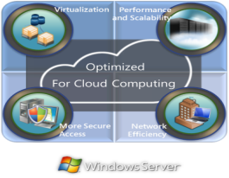
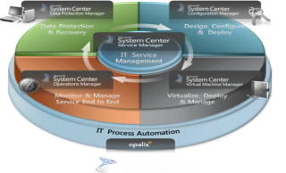
Windows Server and Microsoft System Center
HP Cloud Foundation for Hyper-V
Reduce server sprawl with hyper-v and live migration
Flexibility to deploy applications and workloads throughout the organization
Secure, flexible and cost effective remote access
Up to 45 times faster network performance
Simplify with integrated physical, virtual, and cloud management
Improve agility with private cloud computing infrastructure
Optimize service delivery across datacenter infrastructure and business critical services
Lower costs through automation
Notes:
Windows Server offers a core set of features which can help customers enable and really benefit from cloud computing
Virtualization
With Windows Server 2008 R2 (and specifically Hyper-V™ virtualization technology) customers can reduce their server sprawl; decrease complexity in the datacenter; and reduce hardware, software, and utilities costs.
With Hyper-V plus flexible licensing policies, it’s now easier than ever for you to take advantage of the cost savings of virtualization through Windows Server 2008 R2. You can make the best use of server-hardware investments by consolidating multiple server roles as separate virtual machines running on a single physical machine.
You can also efficiently run multiple operating systems—like Windows, Linux, and others—on a single server, fully leveraging the power of 64-bit computing.
Performance and Scalability
Windows Server 2008 R2 was designed to give enterprise you unprecedented performance and scalability through a set of tools for protecting, monitoring, and maintaining the enterprise server infrastructure. It has new scalability and reliability capabilities, like support for up to 256 logical cores for single instances of Windows Server 2008 R2 and up to 32 logical cores for a single virtual machine instance.
Microsoft has added specific reliability features, like Dynamic Host Configuration Protocol (DHCP) failover and Domain Name System Security Extensions (DNSSEC), which uses public-key technologies to ensure the integrity of DNS name queries and verify that zone transfers are from trusted sources.
Application Flexibility
Windows Server provides an on-premises solution to enable organizations the flexibility they need to deploy applications and workloads throughout the organization, whether at a corporate headquarters location, to branch offices, or to mobile workers wherever they may be.
Controlled Access
Windows Server 2008 R2 and Windows 7 enable DirectAccess (DA), which is a comprehensive “anywhere access” solution that enables organizations to provide always-on, secure connectivity to on-premises and remote users alike.
DA improves security and lowers total cost of ownership (TCO).
DA eliminates the need to connect explicitly with the corporate network while roaming, and it provides organizations with the next generation of policy-based, secure connectivity.
DA and Windows 7 combine to present users with an always-on connection to their corporate network, whether they’re attached to a local, remote, or even public network.
Network Efficiency
In addition with Windows Server 2008 R2, customers benefit from network performance that is 45 times faster than previous versions of Windows Server. (2003 and before)

Slide 10

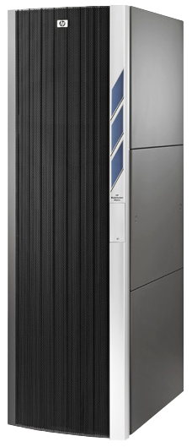














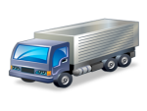






HP BladeSystem Matrix
HP Cloud Foundation for Hyper-V
Matrix
Resource Pool
Matrix
Service Catalog
HP-UX
Windows
Linux
Personalize your cloud
  Billing/chargeback
  Approval flows
  Other processes
HP
Converged Infrastructure
Matrix
Cloud APIs
Matrix
Cloud APIs
Matrix
Self Service Portal
Matrix
Capacity & Management
Matrix
Service Delivery
Notes:
Executive notes:
I mentioned that BladeSystem Matrix is the most obvious and easiest onramp to Private Cloud in the industry but what did I mean by this.
Well much of what you need to implement a Private Cloud comes ‘right out the box’ with Matrix. In the future we see this extended to public cloud, as well. This includes
A Self Service Portal
A Service Catalog of infrastructure deployment best practices that is partner and customer extensible
The resource pool itself with compute, storage, networking resources
Automated infrastructure provisioning that delivers the service in minute not months.
And Capacity planning and management tools to keep the resources and services healthy and optimized.
With this you can see we have provided the bulk of what is needed for a Private Cloud. A BladeSystem Matrix customer need only to use the Matrix Cloud APIs to integrate approval flows, billing/chargeback, etc in thus implementing their own private cloud
Key points:
Matrix includes a Self-service Portal, from where users can pick from a service catalog a service (note: the service catalog can be easily created within Matrix), Resource pools are checked and allocated, and the service gets delivered. Once the service is up running Matrix will optimize the environment and perform capacity planning and other management tasks as needed. The request can be delivered in minutes!!!
Matrix includes a cloud API (as of version 6.0), which allows a lot of additional integration capabilities customers want to do on the path to a private cloud.
That combined with workflow customization via the embedded Orchestration Operations allows customization of additional process, e.g. the approval process or post provisioning processes.
Sound bites:
Matrix is the foundaton of your Private Cloud solution.
Additional information:
Cloud API background information: Web service SOAP APIs allowing customers and partners to integrate infrastructure orchestration capabilities
It allows for example the following operations: Catalog
List, import, export
Service
List, Get, Create, Delete, Activate, Deactivation, Power On/Off
Requests
List, Get, Approve, Reject, Continue, Cancel
Etc.
Note: We have submitted these Cloud APIs to the DMTF Cloud Incubator
Nigel Cook wrote some blogs regarding the Cloud API integration use cases:
Charge back integration: http://www.communities.hp.com/online/blogs/eyeonblades/archive/2010/02/21/integrating-bladesystem-matrix-into-a-chargeback-or-billing-system.aspx
Multi-tenancy rules engine for identity-based allocation / placement decisions: http://www.communities.hp.com/online/blogs/eyeonblades/archive/2010/04/06/customizing-bladesystem-matrix-allocation-rules-engine-for-multi-tenancy-solutions.aspx

Slide 11
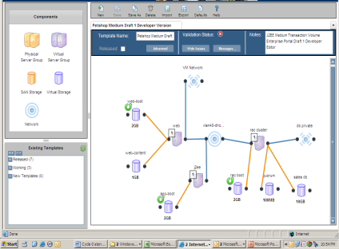
Easily Design Best-Practice
Infrastructure Templates
Infrastructure design using drag-and-drop designer
Captures detailed requirements needed for a service:
  Servers
  Storage
  Network
Validation rules check templates for errors
Published as best-practice templates to self-service portal
Cost tracking for components, reporting capabilities for resource requirements
HP Matrix Operating Environment
infrastructure orchestration

Slide 12
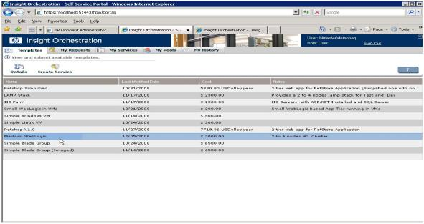

Reliably Provision from Shared Infrastructure via a Self-Service Portal
Browse, select, and request provisioning of infrastructure from library of service templates
Automated provisioning is driven from templates for consistency
View status and progress of service requests
Manage your infrastructure services, such as suspending or adding servers
Lease periods allow resources to be reclaimed when no longer in use
Self-service portal
HP Matrix Operating Environment
infrastructure orchestration

Slide 13
Adjust resources for demanding applications
….. using logical servers
Logical server
HP logical server technology
A server profile that is easily created and freely moved across physical and virtual machines
Logical servers can be:
Active physical blade servers
Active virtual machines
Offline templates
Image
Configuration requirements
Unique IDs
Server
Server
Virtual Fabric
Notes:
HP Logical capability offers the same mobility and flexibility to physical blade servers you are used to from virtual machines – we call that logical server capability. Logical server capability enables physical and virtual server identities to be managed as one and to be easily provisioned and freely moved. This new functionality will leverage the HP BladeSystem and Virtual Connect technologies.
Logical servers can be easily applied to a physical blade server or a virtual machines. Deactivated logical servers can be stored in templates, which are ready to go when they are needed again.
Logical servers can be managed through an easy to use interface, which allows to create them, copy them, activate them, de-activate them, edit them, migrate them, etc.
The activation time required is basically the boot time.

Slide 14





Insight Control for System Center Integrates the Solution
Integrated Value
Configuration Manager
Integration with bare metal deployment engine
Automated driver and firmware updates
Deep component level inventory
Deep insight into HP physical infrastructure
Graphical characterization of server and blade enclosures
Remote control using iLO Advanced
Operations Manager
Virtual Machine Manager
Integration with task engine – automated VM
migration on pre-failure alerts
Notes:
Microsoft System Center:
Configure HP hardware and deploy Windows OS and apps. HP extends System Center Configuration Manager OS Deployment (OSD) with the ability to configure ProLiant hardware. This enables an unattended installation from within SCCM instead of having to first prep the hardware and then install the operating system.
Integrated OS, application and firmware patch management. HP extends System Center Configuration Manager with the ability to deploy HP firmware, driver, and management agent components through the same mechanism used to deploy OS and application patches.
Detailed monitoring and full remote control of HP servers: HP extends System Center Operations Manager with detailed monitoring, health state, and alerting for ProLiant and BladeSystem servers as well as BladeSystem enclosures. There is also contenxt sensitive launching of iLO Advanced, System Management Homepage, and BladeSystem On Board Administrator
Automated response to events on virtualized server hosts via Performance Resource Optimization (PRO). With support for PRO, Insight Control for System Center enables System Center VMM to respond intelligently to hardware failures, either by exposing a PRO tip that provides recommended actions or by configuring automated responses such as moving virtual machine guests.

Slide 15




HP Cloud Foundation for Hyper-V
Matrix and System Center working together to deliver the cloud
IT Services Fabric Initialization
Flexing IT Services
1
2
Transparent Failure Resolution
Network Resource Rebalancing
3
4
Notes:
IT Services Fabric Initialization
(Scenario #1)
Matrix configures server, network, storage resources into “private clouds”
System Center creates and manages virtual machines
Flexing IT Services
(Scenario #2)
Physical resources need to be balanced across IT services to support changing workloads
In collaboration System Center/ Matrix moves physical resources between Matrix services on demand
Transparent Failure Resolution
(Scenario #3)
Impending hardware failures are identified and repaired
In Collaboration System Center /Matrix allow application transparent fault isolation
Network Resource Rebalancing
(Scenario #4)
User identifies network imbalances across the IT infrastructure
Matrix admin in conjunction with SCVM admin dynamically adjust flex-10 network bandwidth

Slide 16


























Use Case #1 – IT Services Fabric Initialization
SCVMM Administrator
Backup
FC-SAN
Boot Disk
40 GB (boot)
Production
Management
FC-SAN
OLTP-Cluster Shared Volumes
Matrix Administrator
Define requirements for setting up fabric services
CSV-Disk
200 GB (shared)
OLTP-Live Migration
Insight Dynamics
Hyper-V Cluster
System Center
Deploy logical servers to physical hosts
Enable Hyper-V role and Windows failover clustering feature
Join domain
Format disks – bring disks online
Validate cluster
Build cluster
Enable cluster shared volumes
SCVMM deploys virtual machines
SCOM monitors Hyper-V cluster and workloads

Slide 17
Designing the IT Services
Service name | Physical servers | Boot storage | Shared storage | Networks
OLTP | OLTP-HV1 | BootLUN1 (40 GB) | CSV-OLTP (200 GB) | 2 x Production (1 Gbps) 2 x Backup (1 Gbps) 1 x ClusterSharedVolumes (1 Gbps) 1 x LiveMigration (1 Gbps) 1 x Management (1 Gbps)
 | OLTP-HV2 | BootLUN2 (40 GB)
 | OLTP-HV3 | BootLUN3 (40 GB)
Batch | Batch-HV1 | BootLUN4 (40 GB) | CSV-Batch (200 GB)
 | Batch-HV2 | BootLUN5 (40 GB)
 | Batch-HV3 | BootLUN6 (40 GB)
First step is to create resources that support automation workflows

Slide 18
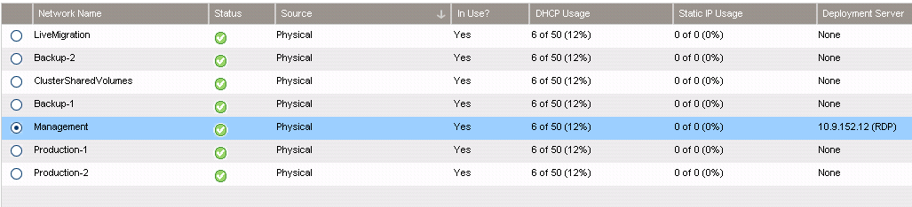
Design Pre-Work: Create Resources
1
Rack, cable, and discover servers
2
Create networks in BladeSystem chassis
(This is done via Virtual Connect Enterprise Manager in Matrix)

Slide 19
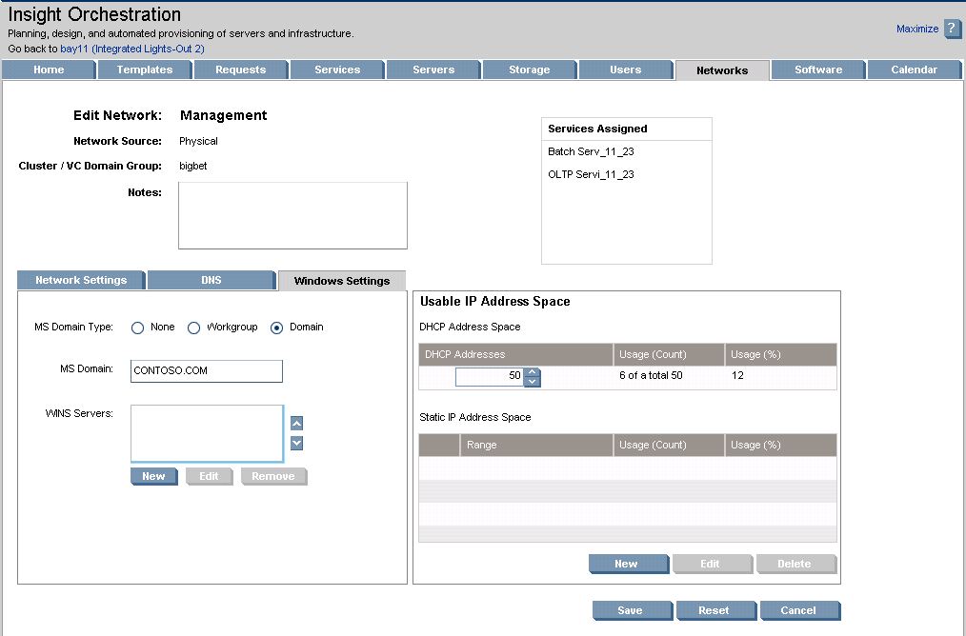
Management Network Configuration
Management network PXE-enabled for automated deployment.
1
Windows Domain pre-configured to enable servers to be automatically joined to domain
2
IP addresses can be DHCP or pull from pool of static addresses sequentially
3

Slide 20
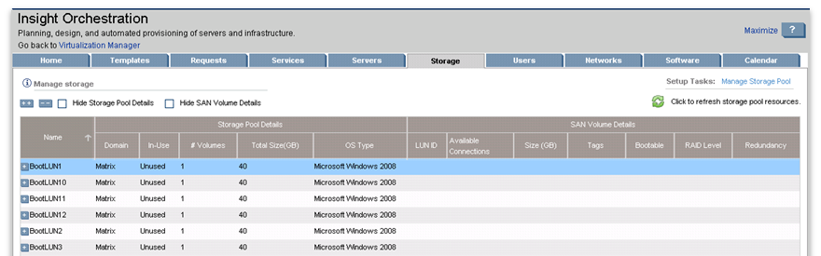
Design Pre-Work: Create Resources
Create Storage Pool Entries in Matrix, create associated storage LUNs, create zones
(LUN creation and zoning done by storage administrator)
3
Notes:
With EVA storage Matrix will validate that the SPE’s are back with LUNs.

Slide 21
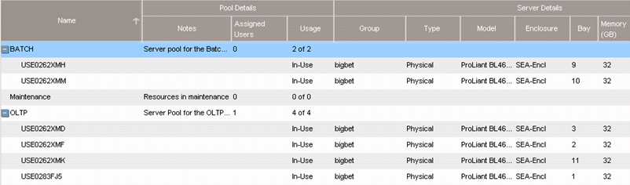
Design Pre-Work: Create Resources
4
Create server pools from list of discovered servers

Slide 22
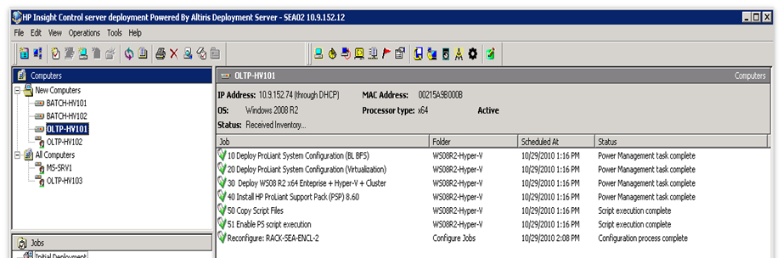
Design Pre-Work: Create Resources
5
Create deployment jobs
(This is done via Insight Control server deployment)

Slide 23
Deployment Job Details
Use case implementation guide contains Insight Control Server deployment jobs used to to facilitate deployment of a Windows cluster in a Matrix environment:
Job includes following elements:
  Configure BIOS to allow boot from SAN.
  Configure BIOS to enable hardware-assisted virtualization
  Install the OS, enable Hyper-V role, and enable Windows failover clustering.
  Install that ProLiant Support Pack (PSP)
  Copy POSH scripts to be used later in process.

Slide 24
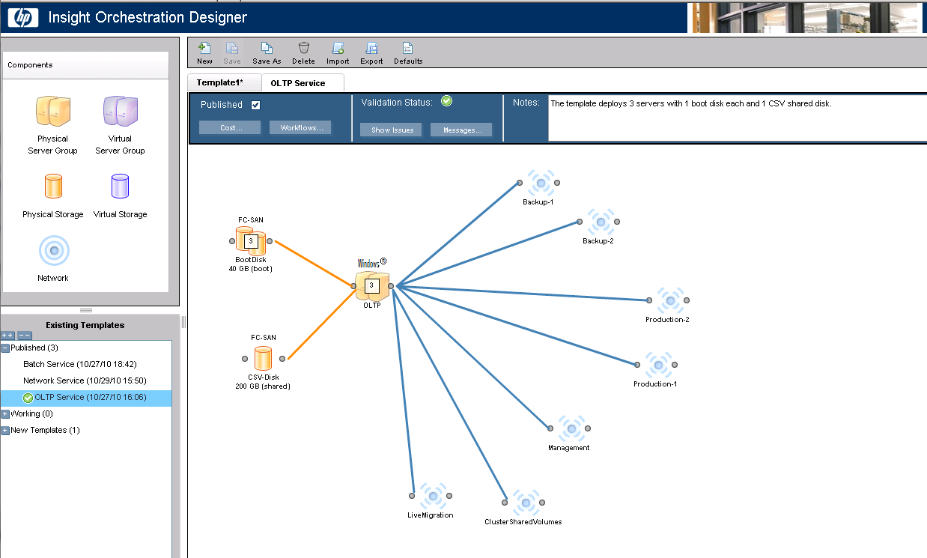
Connect/Config. Service Resources via Templates
z
Server Resources
z
Network Resources
z
Storage Resources

Slide 25
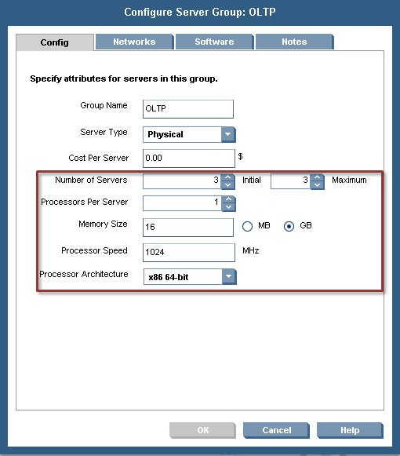
Configure Server Resource Details

Slide 26
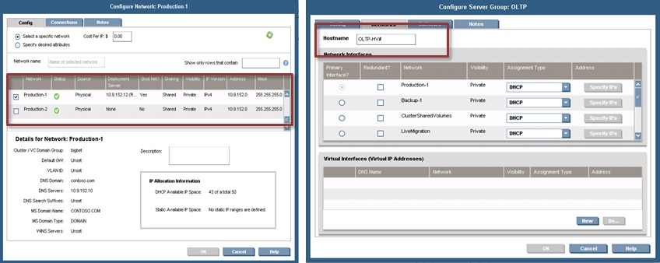
Configure Network and Server Network Settings

Slide 27
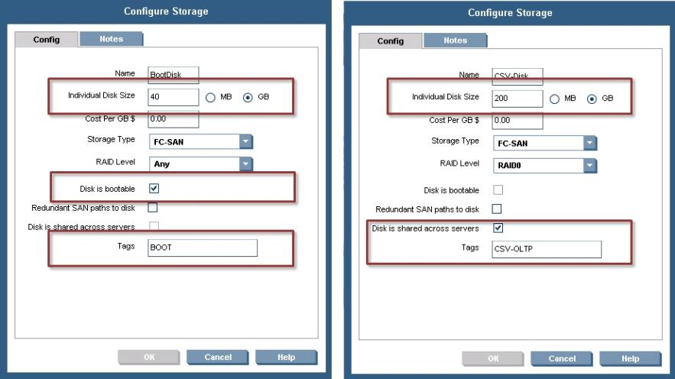
Configure Storage Resources

Slide 28
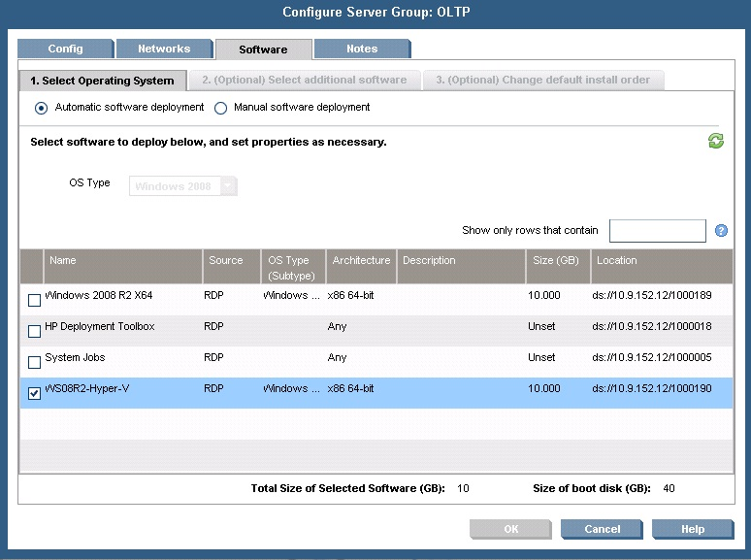
Select OS Deployment Package

Slide 29
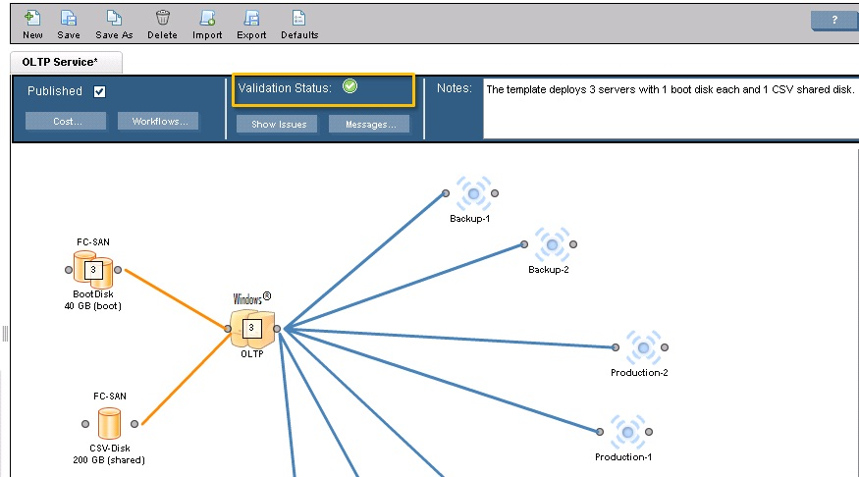
Verify Template Configuration
Green status means no configuration errors

Slide 30
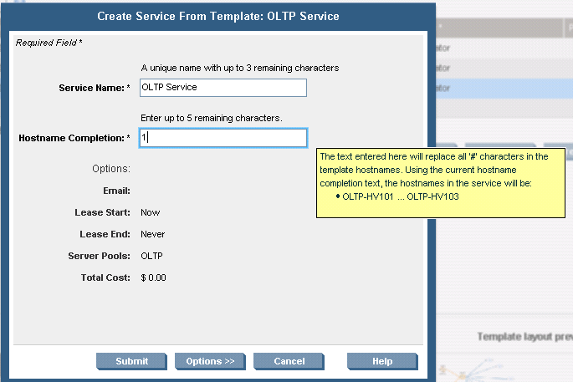
Create Service from Template
After provisioning the service, the following tasks will have completed:
  Physical servers have joined Windows domain
  Computer names set based on definition
  Hyper-V role enabled with MPIO and SNMP
  Server group sharing 200GB CSV.
Notes:
Note to get new screen capture of service that has been published to SSP.

Slide 31
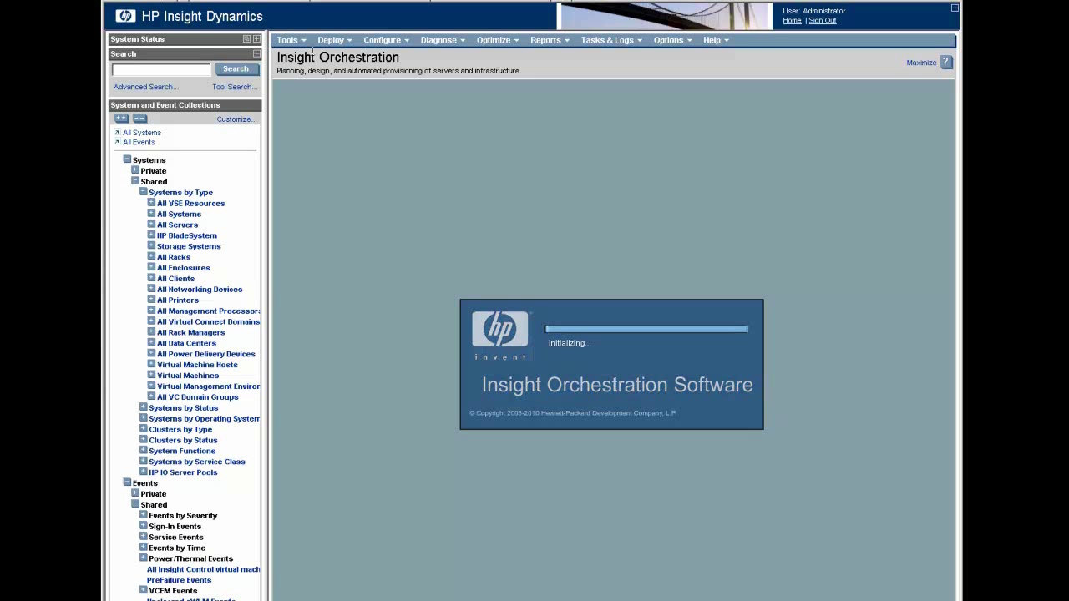
IT Services Fabric Initialization Part 1
video

Slide 32
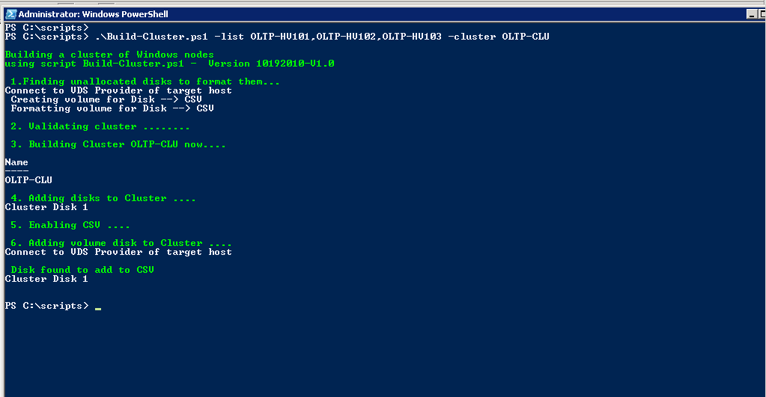
Powershell to Complete Cluster Build
Initiate “Build-Cluster” command with target devices as input parameters
Format and label all RAW disks (shown as available disks in VDS) based on disk size
Run Cluster validation
Create cluster
Add disk to cluster
Enable CSV
Add cluster disk to CSV volumes
Note: Run from any note on cluster.
Note: Cluster host names as input params.
Note: Can be integrated into Matrix workflow
Notes:
Note: script is can be run from any node in the cluster.

Slide 33
Post Cluster Creation Activities
Discover Hyper-V clusters in System Center Operations Manager
Deploy Virtual Machines via System Center VMM or via HP BladeSystem Matrix
  Via PowerShell all activities can be integrated into Matrix workflow.

Slide 34
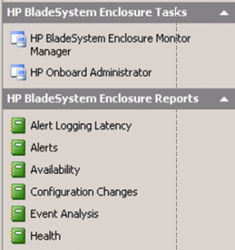
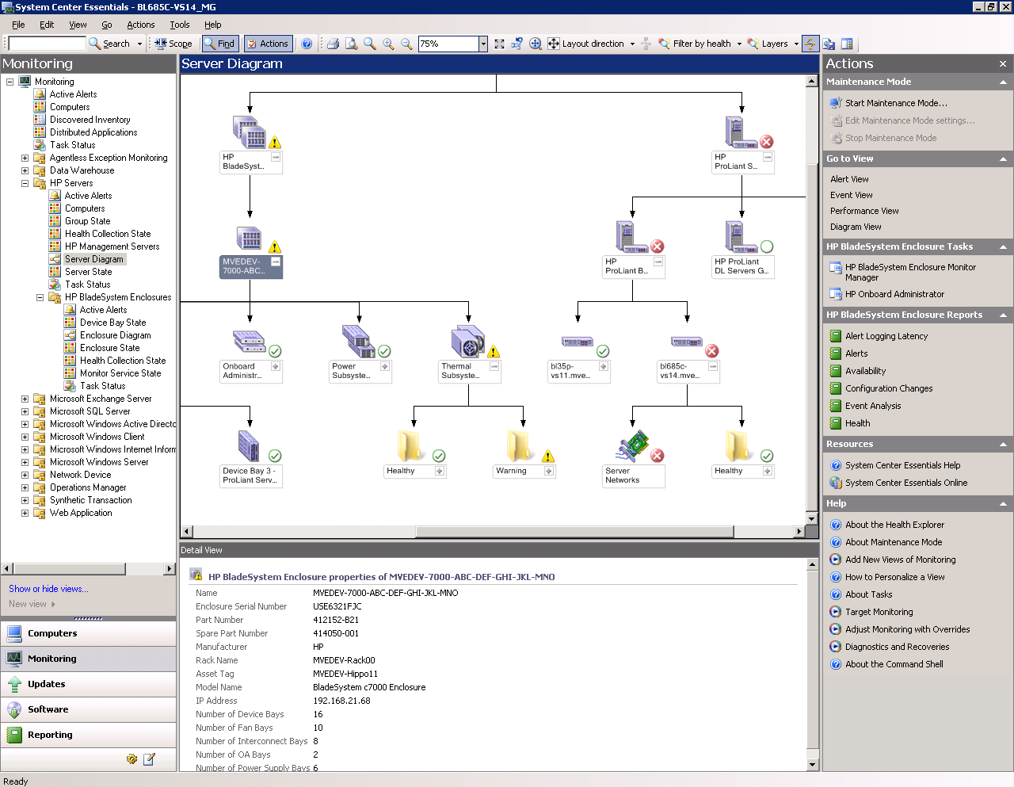
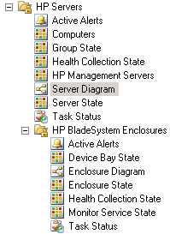
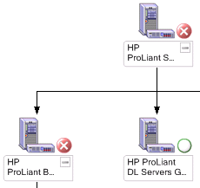
Manage Hyper-V Environment using SCOM
ProLiant and BladeSystem Management Packs
System Center
Operations Manager console
Monitor, view, and get alerts for HP servers and blade enclosures
Easily manage custom data
Graphical view
Directly launch iLO Advanced, SMH, or OA for remote management
Expose the native management capabilities of HP ProLiant and BladeSystem servers through Microsoft System Center Operations Manager
Deployment
Others

Slide 35
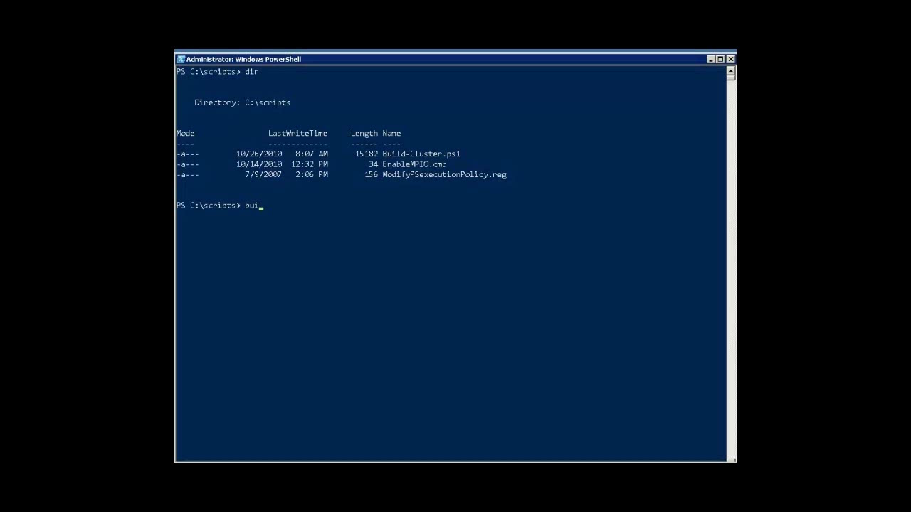
IT Services Fabric Initialization Part 2
video

Slide 36
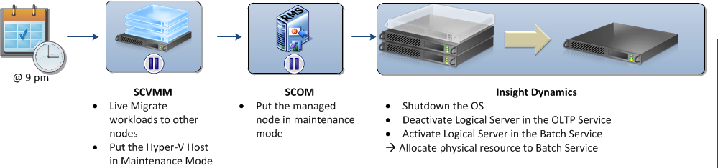




Use Case #2 – Flexing IT Services
@ 9 PM
SCVMM
SCOM
Insight Dynamics
RMS
@ 9 PM
Live migrate workloads to other nodes
Put the managed node in maintenance mode
Shutdown the OS
Deactivate logical server in the OLTP service
Activate physical server in the batch service
Allocate physical resource to batch service
Insight Dynamics
SCOM
SCVMM
RMS
@ 6 AM
Reassign physical server to OLTP service
Activate logical server to OLTP service
Restart the system
Exit maintenance mode
Exit maintenance mode

Slide 37
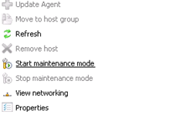
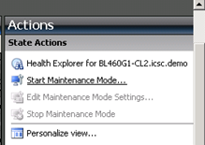
Start/End Maintenance Mode
USE the GUI
USE Powershell
Verifies presence of SC VMM server
Verifies presence of SCOM server
Places target node in SC VMM maint. mode
Places target node in SCOM maint. Mode
& ‘.\1. Set-MaintenanceMode.ps1’ -hostname <Your_host_name> -Enable
Note: SCOM maint. mode default is 8 hours.
Note: Run from any node on cluster.
Note: Cluster host name as input params.
Note: Can be integrated into Matrix workflow
SC VMM
SCOM

Slide 38
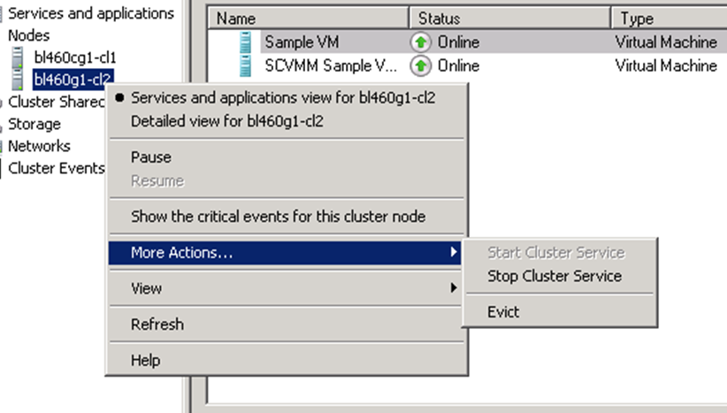
Add/remove node from cluster
USE the GUI
USE Powershell
Take cluster name, node name as params
If “remove” specified, node removed.
Else, node added to cluster
Syntax: & ‘.\2. Set-ClusterNodes.ps1’ -VMHost <Your_host_name> -Remove
Note: Can be run on any cluster node.
Note: If “demo” specified, demo output will be nicely formatted.
Note: Power off node after removal

Slide 39
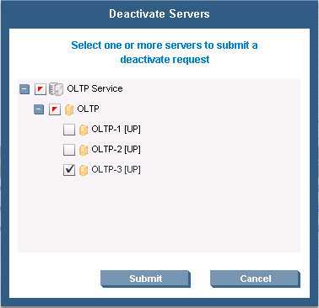
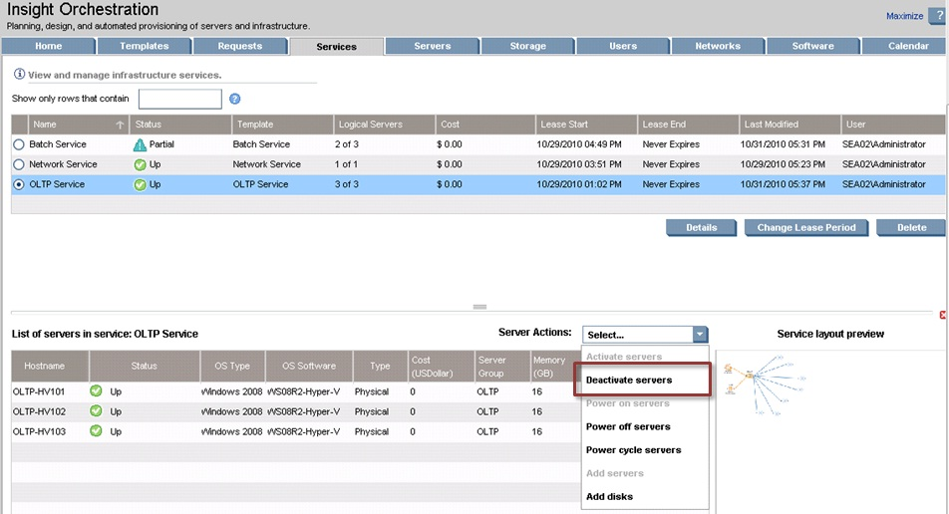
Remove Node from OLTP Pool

Slide 40
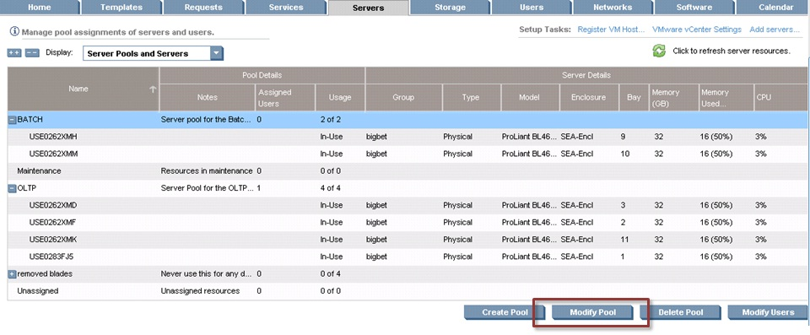
Add Node to Batch Pool (Step 1)
Click modify pool to change pool composition

Slide 41
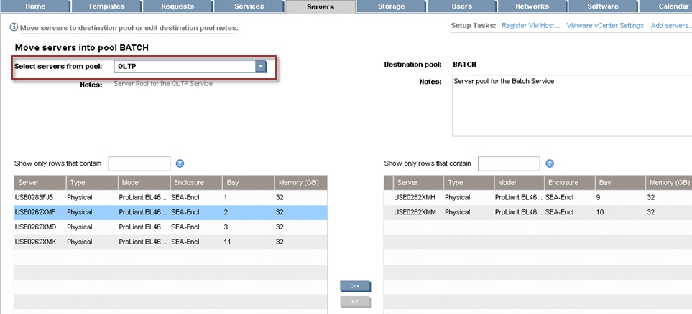
Modify Server Pools
Select node and move from OLTP to Batch pool

Slide 42
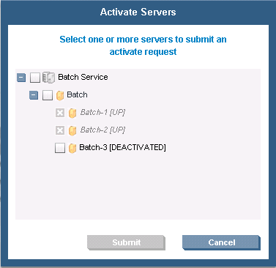
Active Server in Batch Pool
Once server has been activated in batch pool, execute PowerShell scripts in reverse order:
  Add node to Batch cluster
  Remove node from maintenance mode in SCOM
Activities can be performed as part of Matrix workflow

Slide 43
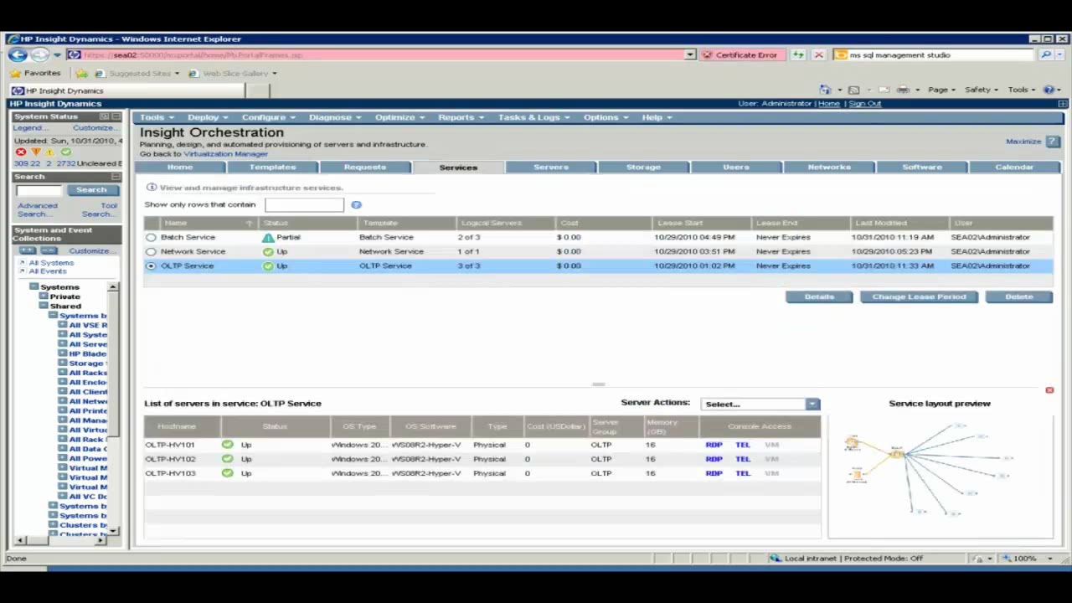
Flexing IT Services
video

Slide 44
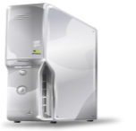







Use Case #3 – Proactive Alert
HP ProLiant
Systems
System Center Management Framework
Hyper-V
Host
RMS
Hardware pre-failure alert sent to Insight Control
SCOM forwards the event to SCOM server
SCOM sends HP PRO Tip to SCVMM server
SCVMM sends action to SCVMM agent on Hyper-V host
SCVMM agent on Hyper-V host live-migrates workloads

Slide 45
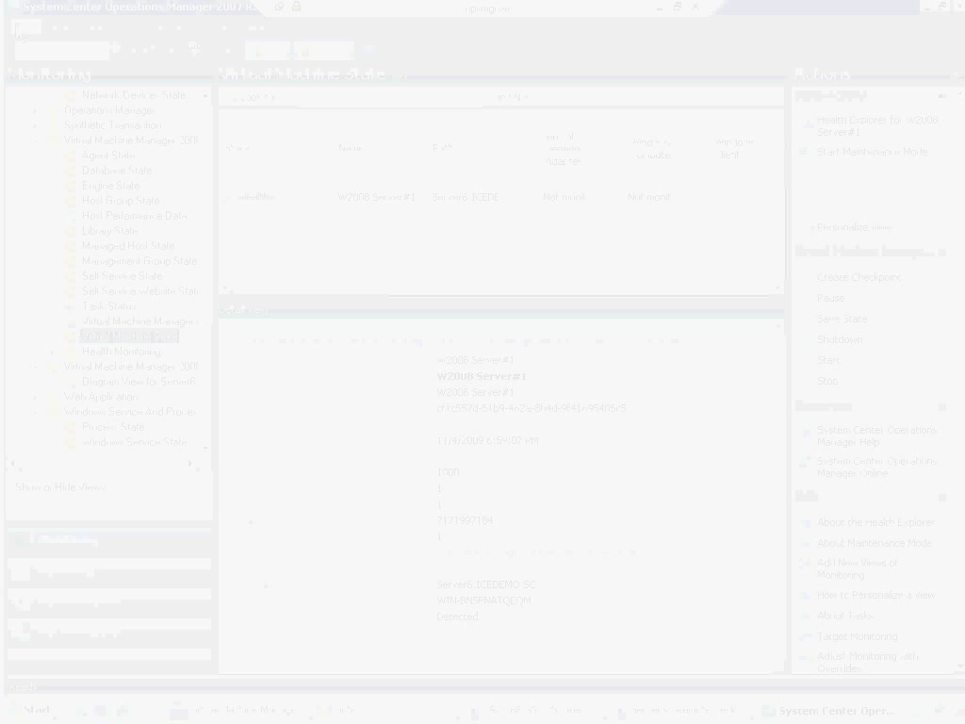
Proactive Alerting
video

Slide 46
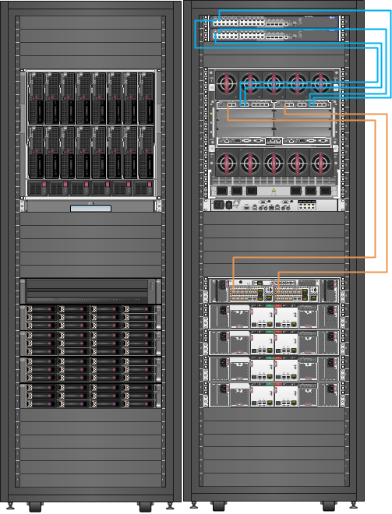
Proof is in the Pudding – 2011 MMS HOL Cloud
HP Flex-Fabric
HP BladeSystem c7000 Enclosure
16x BL 460 G7 Blades
2P x 6 cores
256GB RAM
2x300GB HDD
Launch 1600
VM’s in less
than 10 minutes
EVA 4400
48 x 300GB 15K RPM
~ 29TB
Run over 7200 VMs simultaneously with headroom to spare
(225 VMs per blade)

Slide 47
The Evolution (Racks and Servers)
 | MMS 2010 | MMS 2011 | Delta
Racks | 6 | 2 | -66%
Servers | 41 | 32 | -21%
HP Proliant | DL380 G6 Rack | BL460c G7 Blade
CPUs (2/server) | Intel Xeon E5504 (4M Cache, 2.00 GHz, 4.80 GT/s Intel® QPI) | Intel Xeon X5670 (12M Cache, 2.93 GHz, 6.40 GT/s Intel® QPI)
Cores/server | 8 | 12 (+ Hyperthreading) | + 50%
Total CPU Threads | 328 | 768 | + 134%
Total RAM | 5.125 TB | 4 TB | - 22%
SAN | None | HP EVA 4400
Spinning Drives | 164 | 160 | - 2%
Power Cables | 82 | 52 | - 36%
Network Cables | 82 | 8 Ethernet + 4 Fibre Channel | - 85%
Power | ~ 9,020 Watts | ~ 8,420 Watts | ~ 7%

Slide 48
Important Resources
HP Cloud Foundation for Hyper-V “Use Case Implementation Guide”
HP Cloud Foundation for Hyper-V Toolkit contains
  Deployment jobs described in use case implementation guide
  Powershell scripts described in use case implementation guide
To access resources here.

Slide 49
Summary: Why Microsoft and HP for Private Cloud
Deep engineering integration across infrastructure and applications
Trained pre-sales resources, solution architects, and partner resources available across the world
Best of hardware and software integrated to deliver an
end-to-end private cloud solution
Low TCO, fast to deploy

Slide 50





Resources
  Connect. Share. Discuss.
http://northamerica.msteched.com
Learning
  Sessions On-Demand & Community
  Microsoft Certification & Training Resources
www.microsoft.com/teched
www.microsoft.com/learning
  Resources for IT Professionals
  Resources for Developers
http://microsoft.com/technet
http://microsoft.com/msdn

Slide 51












Complete an evaluation on CommNet and
enter to win!

Slide 52

Notes:
New for TechEd 2011, we will be working with Microsoft Tag (http://tag.microsoft.com/overview.aspx) to create unique Tags for every session at the event. Your session Tag will appear on both the room signage and at the end of your presentation. With your session Tag, attendees will be able to scan as they enter the room to retrieve session details, view speaker bios, and engage in discussions; or scan at the end of the presentation to evaluate your session and download materials. We’re excited to integrate Microsoft Tag across the My TechEd mobile experience this year.

Slide 54
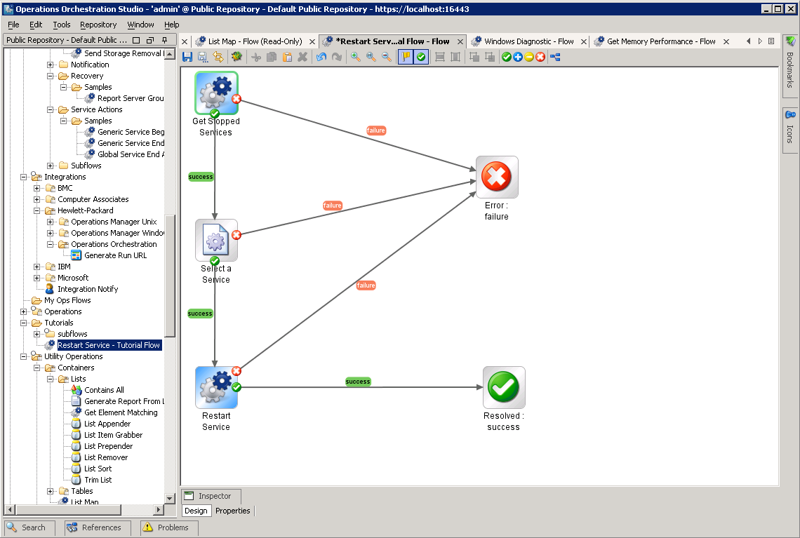
Integrate with Existing Tools and Processes
Powered by workflow technology from HP Operations Orchestration
Customize global workflows to fit customer’s IT process*
  Send email notifications
  Connect to ticketing systems to approve/reject service requests*
  Perform manual tasks as needed
Attach workflows to template for additional pre/post provisioning tasks*
  Configure monitoring or backup
  Run server configuration scripts
  Check server compliance status and provision applications
  Pass service cost data to billing and chargeback systems
Workflow Studio
Notes:
OO Studio embedded to author/modify flows
Limited content for pre/post IO provisioning tasks
Create custom workflows to associate with a template
Option to add integration adapters for connection to HP and 3rd party systems (ticketing, etc.)

