Slide 1

Virtualizing Microsoft SQL Server with Hyper-V
VIR322
Matt McSpirit
Senior Product Marketing Manager
Microsoft Corporation

Slide 2
What We Will Cover
Why Microsoft Virtualization for Microsoft Server Applications?
Base Hypervisor Performance
ESG Performance Results
SQL Server Virtualization Best Practices
Links to Reference Material

Slide 3
Why Microsoft Virtualization for Microsoft Server
Applications

Slide 4





Microsoft Virtualization for Server Applications
Business Critical Applications
Management Platform
Enterprise Applications
Line of Business (LOB) Custom Applications
Microsoft Server Applications
Databases:
Collaboration:
Communication:
Virtualization Platform
Microsoft Virtualization
Windows Server 2008 R2 Hyper-V & System Center

Slide 5


Microsoft Virtualization: The Best Choice for Microsoft Server Applications
Built
for
Windows
Complete
Management
Solution
Low Cost
Complete
Solution
*Built-in Virtualization with one-stop support
*Deep Application Knowledge
*A comparable solution can cost almost 4 times more†
*Large Partner
Ecosystem
*Physical & Virtual Management
*Lower On-going
Costs
Increased Deployment Options
*Cross-Platform & Hypervisor Support
Virtualization-Friendly Licensing
*Only available with Microsoft Virtualization
†Based on a comparison of Microsoft® System Center Server Management Suite Datacenter with VMware® vSphere Enterprise Plus with VMware vCenter Server.. Assumes a five host configuration, 2 processors on each host, 2 years support costs for both products, and no operating system costs included.. The Microsoft solution can use either the free Microsoft Hyper-V Server 2008 R2 hypervisor or an existing Windows Server 2008 R2 hypervisor. Based on Microsoft estimated retail prices and published VMware prices available at https://www.vmware.com/vmwarestore as of 08/04/2009 for purchases in the United States. Actual reseller prices may vary.

Slide 6
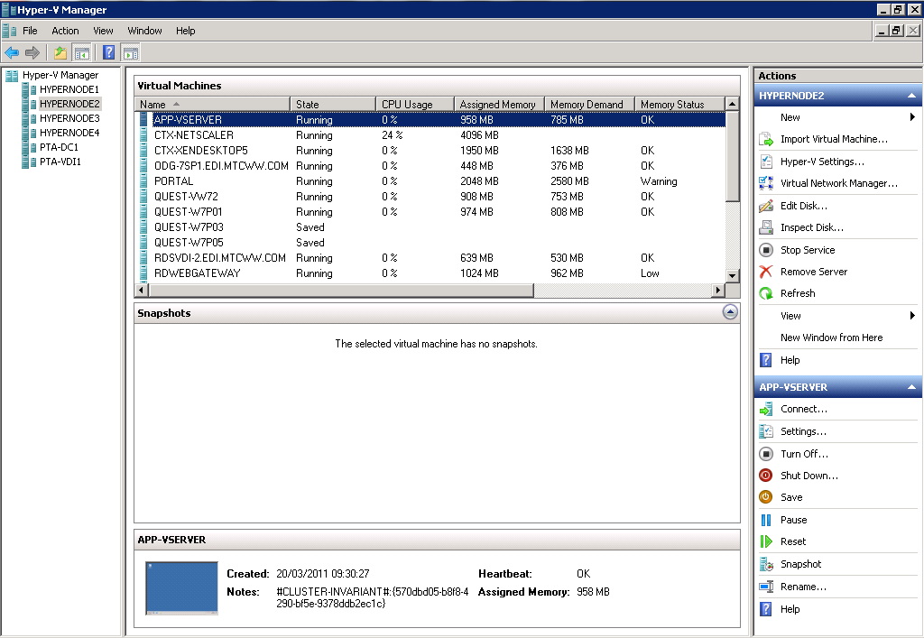
Windows Server 2008 R2 SP1
Many of the scenarios discussed leverage features new to R2 and R2 SP1
Live Migration & HA
New Processor Support
  Improved Performance & Lower Costs
Enhanced Scalability
  Greater VM density & Lower TCO
Networking enhancements
  Improve performance & 10 Gb/E ready
Dynamic VM capabilities
Enhancements to Server Core
  Ease management & Lower TCO
Dynamic Memory & Remote FX
in SP1

Slide 7
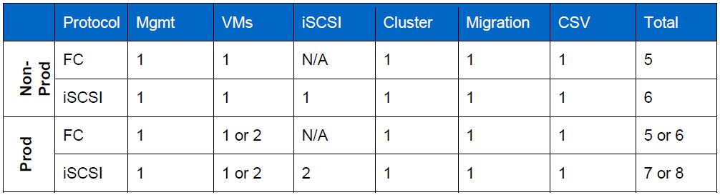
Hyper-V Configuration Guidelines - Parent
Memory Reservation
  512MB for Parent + the Per-VM values:
    For each VM = 32MB for 1st GB VM RAM + 8MB per subsequent 1GB VM RAM
    So, for 16GB VM = 32MB + (15 * 8MB) = 152MB
    If we had 8 of these VMs, the total would be: 152MB * 8 = 1216MB
Networking

Slide 8
Hyper-V Configuration Guidelines - Parent
Networking Continued
  Acquire optimized drivers from OEM
  Teaming provided by NIC Vendor
Storage
  iSCSI, Fiber Channel or FCoE Required for Failover Clustering
  1GB/E Minimum for iSCSI – 10G/E Advantageous
    Jumbo Frame support can boost performance
  DAS Storage is Supported
  Utilize iSCSI Initiator built into Windows Server
  Utilize MPIO for Resiliency & Load Balancing
    Ensure usage of Storage Vendor DSM for Optimal Performance

Slide 9
Hyper-V Configuration Guidelines - Guest
General
  Ensure Integration Components Are Present
    Optimal Performance of Storage, Networking etc.
Networking
  Use Synthetic Network Adaptors when possible (8)
    Legacy NIC must be used for PXE
  Take advantage of in-guest NIC options (Jumbo Frames etc.)
Storage
  Use Virtual IDE for Boot VHD and Pagefile VHD (if applicable)
  Use Virtual SCSI (4) for other VHDs (Hot Add Supported)
  Size VHDs appropriately for contents
  Fixed VHDs offer highest performance
  Utilize In-Guest iSCSI & MPIO if required

Slide 10
Dynamic Memory in SP1
Overview
  A memory management enhancement for Hyper-V
  Enables customers to dynamically grow and decrease the memory of a VM
  Available as a feature in Windows Server 2008 R2 SP1
Benefits
  Better consolidation ratios with predictable performance
  Enables linear scalability for deployment environments
  Designed for production use
  Recommendations for use for server applications still being evaluated.
With the SP1 release, we will meet all the Gartner/Burton group requirements for an Enterprise ready Hypervisor

Slide 11
How does it work?
VM memory configuration parameters:
  Initial (what VM will boot with)
  Maximum (what VM can grow to)
Memory is pooled and dynamically distributed across VMs
Memory is dynamically allocated/removed based VM usage with no service interruption
Guest enlightened: guests & Hyper-V work TOGETHER
Memory is added and removed via synthetic memory driver (memory VSC) support

Slide 12
Base Hypervisor
Performance

Slide 13
Performance & Scalability
Project Virtual Reality Check (www.virtualrealitycheck.net)
  Performed by Ruben Spruijt and Jeroen van de Kamp
  When scaling x86 TS VMs w/o Hyper-threading, vSphere is 5% better than both XenServer and Hyper-V
  When scaling x86 TS VMs w/ Hyper-threading, XenServer and Hyper-V are 15% better than vSphere
  When scaling up to 100 TS sessions, response times for all three hypervisors are fairly equal, but beyond 100 sessions, vSphere response times increases with each new session
  When scaling x64 TS VMs, XenServer and Hyper-V are within 13.6% of bare metal, and are 27% better than vSphere

Slide 14
Performance & Scalability
In 2010, Enterprise Strategy Group (ESG) released a 3rd Party Performance Validation White Paper, sponsored by Microsoft.
Key Points
  Hyper-V is easy to install to get running for those administrators familiar with Windows
  Hyper-V provides high availability with transparent and automatic failover of Virtual Machines (VMs)
  Hyper-V Live Migrations provides for zero-downtime migrations of VMs between Hyper-V servers
  Most importantly, the report shows Hyper-V performance versus physical is excellent, with 95% to 99% of the performance of physical disks and 89% to 98% of performance of the tested workloads versus physical.
Available for download from ESG or Microsoft

Slide 15
Performance & Scalability
Hyper-V R2 on 16 servers with Microsoft Cluster Shared Volumes (CSV) stored on a single SAN attached disk array supported 1,024 virtual machines
http://www.enterprisestrategygroup.com/2010/11/emc-symmetrix-vmax-and-microsoft-server-virtualization-scalable-enterprise-class-virtual-infrastructure/

Slide 16
Performance & Scalability

Slide 17
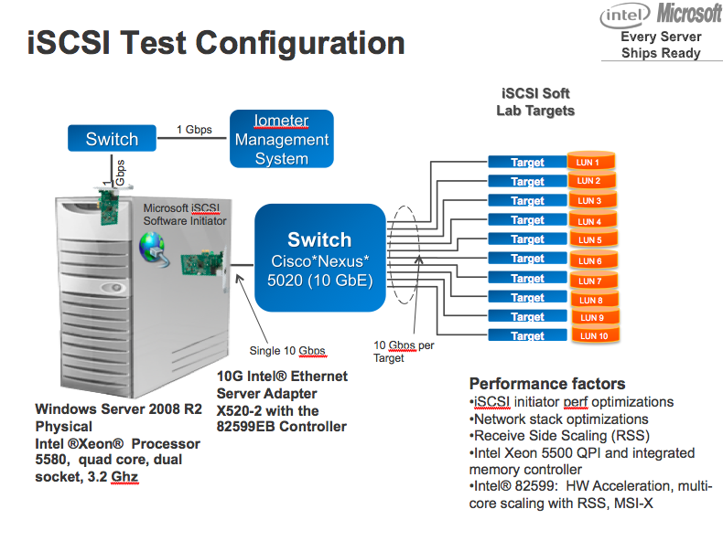
Performance & Scalability
Microsoft/Intel iSCSI Test
Used Windows Server 2008 R2, Intel Xeon 5500 processors, and Intel 10Gbps Ethernet Adapters
Reached over One Million IOPS over a single 10 Gbps Ethernet link using a software iSCSI initiator on Native HW
Reached over 700,000 IOPS over a single 10 Gbps Ethernet link using a software iSCSI initiator on Hyper-V to the Guest OS

Slide 18
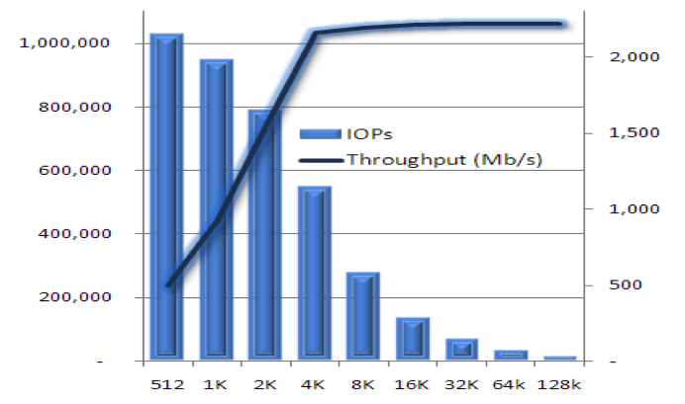
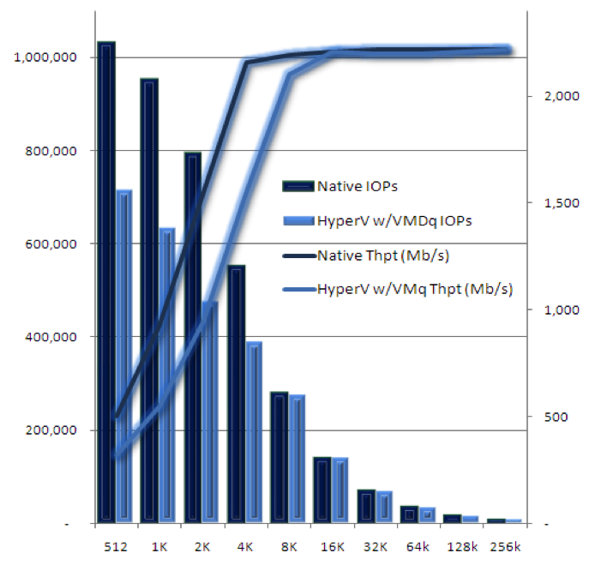
Performance & Scalability
Native Performance
In-Guest VM Performance

Slide 19
ESG Performance
Results

Slide 20
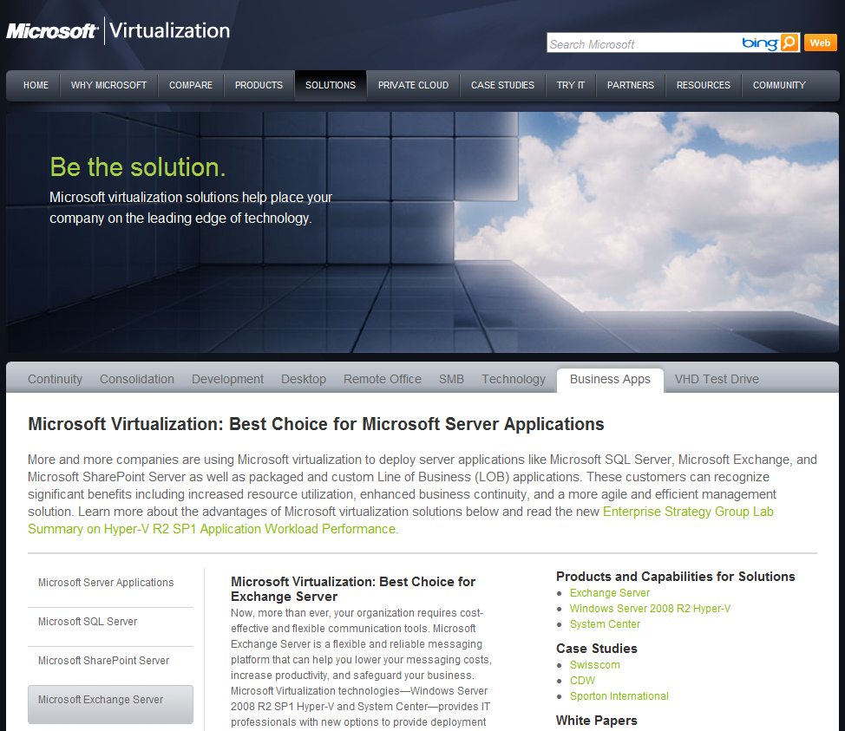
ESG Lab Summary 2011
Available online: http://www.microsoft.com/virtualization/en/us/solution-business-apps.aspx
Useful links, resources, case studies, white papers and webcasts

Slide 21


2011 ESG Test Lab - Physical
SharePoint
SQL Server
Exchange
Utilities
HP BL680C
up to 24 cores and
128 GB RAM per blade
SAN
2x4 Gbps FC per server
RAID-10 Pools:
EMC CX4-960
155 15K RPM FC disk drives
Data (88):
Logs(16):
OS(24):
Apps(16):
http://download.microsoft.com/download/2/7/8/278EAE45-3AB4-4787-A640-B8FFA907E1AB/ESG%20Preso%20Microsoft%20Hyper-V%20Performance%20SQL%20Server%20Mar%2011_Wide.pdf

Slide 22


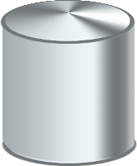
2011 ESG Test Lab - Virtual
SQL Server
SQL Server
SQL Server
SQL Server
Application: SQL Server 2008 R2
VM configuration: 4 vCPU, 16 GB RAM
Guest OS: Windows Server 2008 R2 SP1
Hyper-V R2
Hypervisor: Microsoft Hyper-V R2
Physical OS: Windows Server 2008 R2 SP1
SAN
Virtual machine images: Fixed VHD
SQL data and logs: Fixed VHD
http://download.microsoft.com/download/2/7/8/278EAE45-3AB4-4787-A640-B8FFA907E1AB/ESG%20Preso%20Microsoft%20Hyper-V%20Performance%20SQL%20Server%20Mar%2011_Wide.pdf

Slide 23
Online Transaction Processing (OLTP)
Online brokerage application
One to four SQL Server 2008 R2 VMs
20,000 customer database per VM
“Out of the box” SQL Server settings
http://download.microsoft.com/download/2/7/8/278EAE45-3AB4-4787-A640-B8FFA907E1AB/ESG%20Preso%20Microsoft%20Hyper-V%20Performance%20SQL%20Server%20Mar%2011_Wide.pdf

Slide 24
2011 SQL Workload Results
http://download.microsoft.com/download/2/7/8/278EAE45-3AB4-4787-A640-B8FFA907E1AB/ESG%20Preso%20Microsoft%20Hyper-V%20Performance%20SQL%20Server%20Mar%2011_Wide.pdf

Slide 25
2011 SQL Workload Results
http://download.microsoft.com/download/2/7/8/278EAE45-3AB4-4787-A640-B8FFA907E1AB/ESG%20Preso%20Microsoft%20Hyper-V%20Performance%20SQL%20Server%20Mar%2011_Wide.pdf

Slide 26
2011 SQL Workload Results
http://download.microsoft.com/download/2/7/8/278EAE45-3AB4-4787-A640-B8FFA907E1AB/ESG%20Preso%20Microsoft%20Hyper-V%20Performance%20SQL%20Server%20Mar%2011_Wide.pdf

Slide 27
2011 SQL Workload Results
http://download.microsoft.com/download/2/7/8/278EAE45-3AB4-4787-A640-B8FFA907E1AB/ESG%20Preso%20Microsoft%20Hyper-V%20Performance%20SQL%20Server%20Mar%2011_Wide.pdf

Slide 28
2011 SQL Workload Results Summary
20,000 to 80,000 customers (one to four VMs)
Low response times as VMs are added
Near linear performance scalability
  Transactions
  SQL server batch requests per second
Low Hyper-V R2 overhead compared to physical (12%)
http://download.microsoft.com/download/2/7/8/278EAE45-3AB4-4787-A640-B8FFA907E1AB/ESG%20Preso%20Microsoft%20Hyper-V%20Performance%20SQL%20Server%20Mar%2011_Wide.pdf

Slide 29
2011 SQL Workload Results Summary
Performance scaled with low response times as SQL Server application workloads were consolidated on a physical server.
The manageably low performance impact of Hyper-V R2 won’t be detected by the vast majority of end-users and applications.
The performance, scalability, and low overhead of Hyper-V R2 can be used to reduce costs and improve the manageability, flexibility, and availability of consolidated SQL Server applications.
http://download.microsoft.com/download/2/7/8/278EAE45-3AB4-4787-A640-B8FFA907E1AB/ESG%20Preso%20Microsoft%20Hyper-V%20Performance%20SQL%20Server%20Mar%2011_Wide.pdf

Slide 30
Issues to Consider
Mileage varies; test with your workloads and your data
Hyper-V
  Included for free with Windows Server 2008 R2
  Proven to perform with demanding applications
Size matters
  “Utility-class” SQL Server apps are a great place to start
  Apps that are resource-constrained on a physical server may not be good candidates for virtualization
High Availability matters
Leverage ESG Lab Validations, Microsoft and its partners’ best practices/proof points
http://download.microsoft.com/download/2/7/8/278EAE45-3AB4-4787-A640-B8FFA907E1AB/ESG%20Preso%20Microsoft%20Hyper-V%20Performance%20SQL%20Server%20Mar%2011_Wide.pdf

Slide 31
Virtualization Adoption Characteristics
By the end of 2010, between 18% & 25% of enterprise workloads will execute within virtual machines*
By the end of 2012, that adoption rate will be between 45% and 55%*
Industry wide, for Enterprise IT Servers, IDC predicts 8:1 virtualized consolidation ratios by 2012.^
Existing typical SQL Server consolidation rates range from 4:1 to 18:1+
SQL Server ecosystem memory characteristics
~90% of SQL Server systems have 32GB RAM or less
~65% of SQL Server systems have 8GB RAM or less
~20% of SQL Server systems have 2GB RAM or less
*From data acquired across a range of analysts, published customer quotes and current customer adoption trends.
^IDC Virtualization Study 2008
⁺From customer case studies and industry surveys.

Slide 32
SQL Server
Virtualization
Best Practices

Slide 33
Consolidation &
Resource Pooling

Slide 34
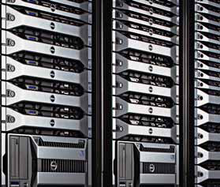
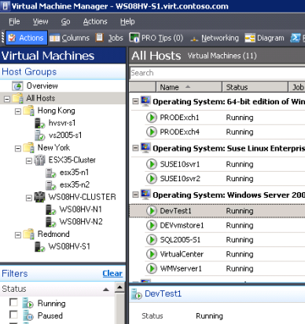

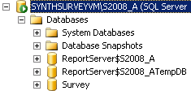
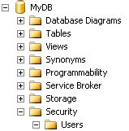
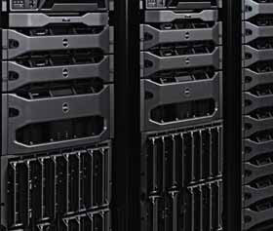

SQL Server Consolidation
Currently a variety of consolidation strategies exist and are utilized.
Typically, as isolation goes up, density goes down and operation cost goes up.
IT Managed
Environment
Virtual
Machines
Instances
Databases
Schemas
Higher Isolation, Higher Costs
Higher Density, Lower Costs
MyServer
Sales_1
Consolidate_1
Marketing_1
Online_Sales
ERP_10
DB_1
DB_2
ERP_10
DB_3

Slide 35
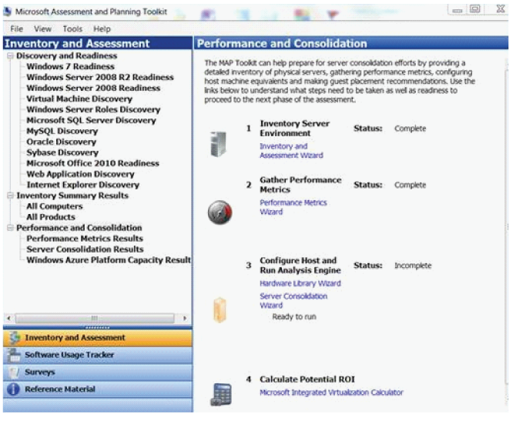
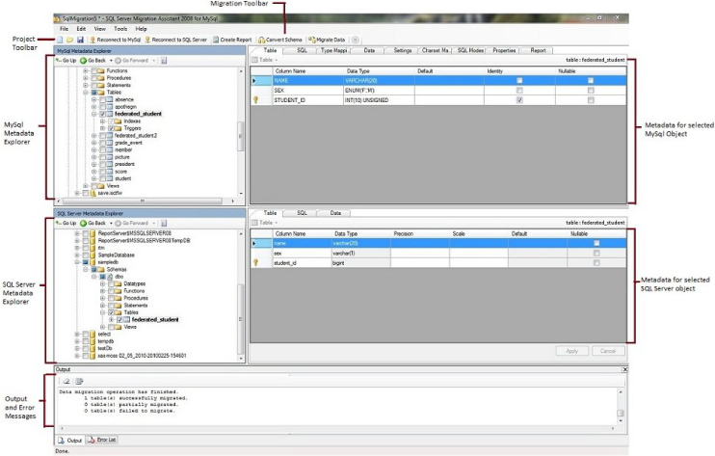
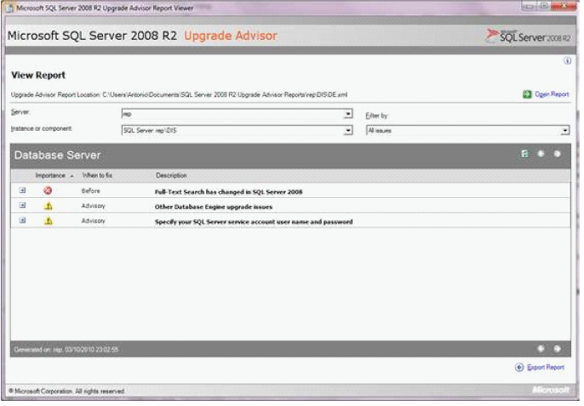
Resource Pooling Key Steps
Consolidate databases
STEPS | TOOLS OR FEATURES
Discover SQL sprawl | Microsoft® Assessment and Planning (MAP) Toolkit 5.5
Capacity planning | Microsoft Consolidation Planning Tool for SQL Server v1.0
Consolidation options | Microsoft SQL Server® 2008 R2 Upgrade Advisor SQL Server Migration Assistant (SSMA)
CONSOLIDATE
MAP Toolkit
Upgrade advisor
SSMA

Slide 36
Discovery
Demo

Slide 37

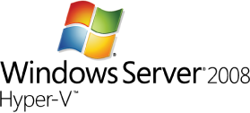


Resource Pooling Key Steps
Consolidate databases
STEPS | TOOLS OR FEATURES
Discover SQL sprawl | Microsoft® Assessment and Planning (MAP) Toolkit 5.5
Capacity planning | Microsoft Consolidation Planning Tool for SQL Server v1.0
Consolidation options | Microsoft SQL Server® 2008 R2 Upgrade Advisor SQL Server Migration Assistant (SSMA)
STEPS | TOOLS OR FEATURES
Physical-to-Virtual Migration | Microsoft System Center Virtual Machine Manager 2008 R2
Virtualize and manage instances | Windows Server® 2008 R2 Hyper-V™ System Center Virtual Machine Manager 2008 R2
CONSOLIDATE
MAP Toolkit
Upgrade advisor
SSMA
SQL Server

Slide 38
Performance &
Availability

Slide 39
SQL Specific Hyper-V Guidance
CPU
  Guest VMs are limited to 4 vCPUs
  Recommended Ratio of 1:1 (Physical Cores : Virtual CPU’s)
    16 LP = 16 vCPUs for use in Guests (16 x 1vCPU, 8 x 2vCPU etc.)
VM Snapshots
  Not supported
Networking
  Utilize Synthetic NICs & Enable vNIC Optimizations
  Utilize MAP Tool to assist capacity planning
Storage
  Fixed Size VHD’s in Production

Slide 40
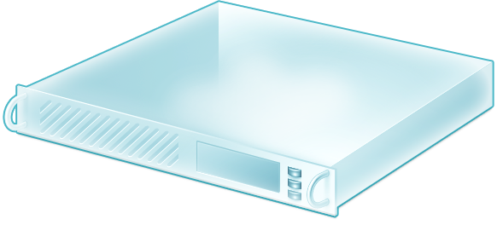

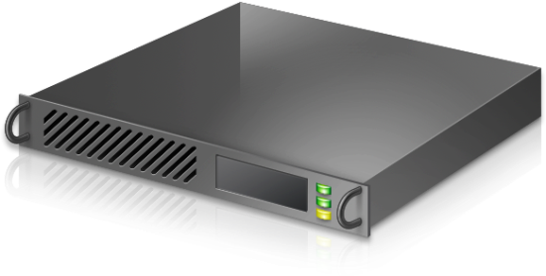
Planning for HA
DB
SQL
DB
DB
Hyper-V
SAN
DB
SQL
DB
Hyper-V
SAN

Slide 41
Planning for HA – Separation & Heartbeat
DB
SQL
DB
Hyper-V
SAN
To keep VM’s apart, we can utilise cluster group property AntiAffinityClassName
  cluster group “SQL1” /prop AntiAffinityClassNames=”SQLCluster”
  cluster group “SQL2” /prop AntiAffinityClassNames=”SQLCluster”
    More info: http://support.microsoft.com/kb/296799 and http://www.windowsitpro.com/blogs/VirtualizationProTips/tabid/2246/entryid/12803/Default.aspx
Heartbeat for Guest Cluster
  May need to increase heartbeat threshold slightly for Live Migration

Slide 42
SQL Server Consolidation Scalability
Configuration:
OS: Microsoft® Windows Server® 2008 R2 Hyper-V™
Hardware:
  HP DL585 (16 core) with SLAT
  HP EVA 8000 storage
VMs: 4 vCPU’s and 7 GB RAM per virtual machine; Fixed size VHD
Results:
Increased throughput with consolidation
Near linear scale in throughput with no CPU over-commit
Improved performance with Windows Server 2008 R2 and SLAT processor architecture
Throughput
(Batch requests/sec)
% CPU
Almost Linear Scale
No CPU over-commit
CPU over-commit
Heavy
Load
Moderate
Load
Low
Load
Relative Throughput for Windows Server 2008

Slide 43
SQL Server and Dynamic Memory
Use of Dynamic Memory is supported for SQL Server (http://support.microsoft.com/?id=956893 )
Best practice guidance is being developed and a whitepaper will soon be published to the SQL Server Customer Advisory Team website (www.sqlcat.com)
The primary scenarios that need to be accounted for are:
  Performance benefit to VM workload
  Failover
  Planned maintenance (Live Migrations)
  Re-balancing based on workload needs or SLA
There are real world situations where events such as unplanned failovers or live migrations that would overcommit a server within a cluster.

Slide 44
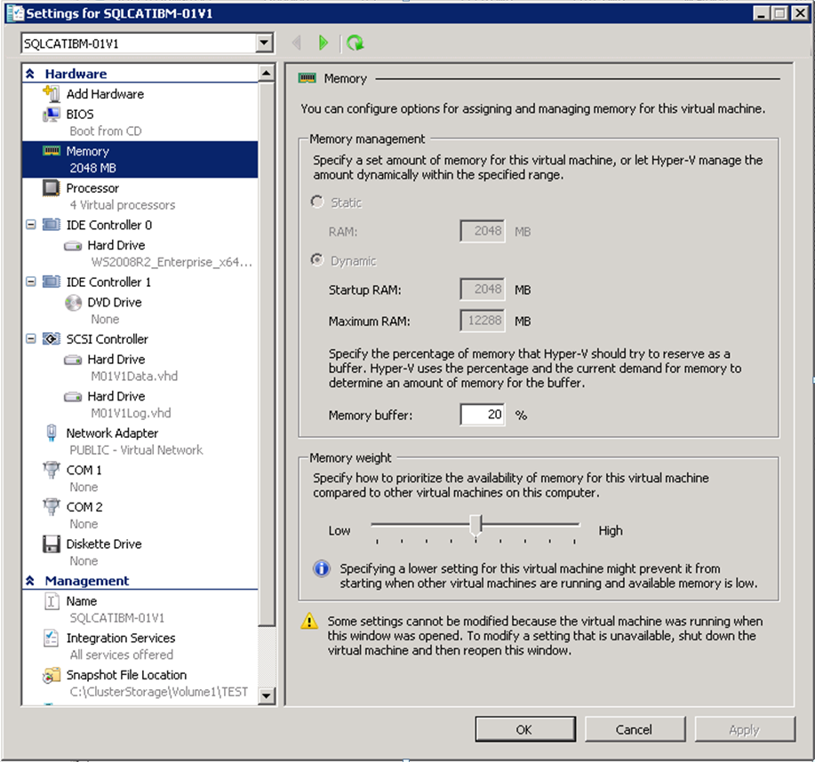
Dynamic Memory Findings and Best Practices
Dynamic Memory is effective in managing memory of VMs and in the rebalancing necessary to ensure reasonable VM performance during overcommit scenarios (planned or unplanned failover).
Memory weight determines priority to memory resources across VMs.
To protect SQL VMs from potentially having memory taken away in an overcommitted scenario, give those VMs heavier memory priority.

Slide 45
Dynamic Memory Findings and Best Practices
Consideration: Adjusting memory weight of VMs may be necessary for Live Migrations to an overcommitted server.
Recommendation: Reduce SQL Server memory using ‘max server memory’ sp_configure setting prior to Live Migrations. May not always be possible.
Best Practice: Grant SQL Server service accounts ‘Lock Pages in Memory’.
  Prevents SQL Server memory from being paged out.
  Reduces overall impact on VM when the Guest OS has memory removed by relying on SQL Server memory management to release memory vs. having the working set paged out by Windows.
  Let SQL do the memory management when possible.
These settings combined, avoid performance drop offs for SQL Server, specifically in DM configurations, where Live Migrations occur with movement to an overcommitted host.

Slide 46

Dynamic Memory Guidelines
Supported SQL Editions:
  SQL Server 2005 Enterprise
  SQL Server 2008 Enterprise / Datacenter Editions
  SQL Server 2008 R2 Enterprise / Datacenter Editions
Hyper-V Dynamic Memory Parameter | Recommendation
Startup RAM | 1 GB + SQL Min Server Memory
Maximum RAM | > SQL Max Server Memory
Memory Buffer % | 5
Memory Weight | Based on performance needs
Set Startup as 1GB + SQL minimum to avoid paging
Use 5% Buffer to ensure SQL manages it’s own buffer pool
      http://blogs.msdn.com/b/sqlosteam/archive/tags/hyper_2d00_v+dynamic+memory/

Slide 47
SQL Elasticity

Slide 48






Elasticity Key Steps
Scale resources efficiently
STEPS | TOOLS OR FEATURES
Minimize planned downtime | Windows Server 2008 R2 Hyper-V Live migration
STEPS | TOOLS OR FEATURES
Increase virtual machine density | Windows Server 2008 R2 SP1 Hyper-V with Dynamic Memory
SQL Server
Live Migration
SQL Server
SQL Server
SQL Server
Hyper-V
Shared Storage
iSCSI, SAS, Fiber
Hyper-V
12Gb
8Gb
SCALE
Manage unplanned downtime | Guest Failover Clustering with - Windows Server 2008 R2 - SQL Server 2008 R2
Virtual machine load balancing | System Center Virtual Machine Manager 2008 R2
SQL Server
Guest Cluster
SQL Server
SQL Server
SQL Server
Guest Cluster
Load Balancing
Shared Storage
iSCSI, SAS, Fiber
Redundant Paths
to Storage

Slide 49
SQL Elasticity
Demo

Slide 50
Enhancing SQL on Hyper-V

Slide 51



System Center Integration
Seamless & efficiently protect SQL Infrastructure
Protect SQL up to every 15 minutes
Automatic protection of new content databases
Proactively monitor key SQL Server Components
Drive down the cost of ensuring service levels
Rich dashboard views, near real-time diagnosis and resolution of detected issues
Rapidly provision SQL infrastructure
Automate migrations for load balancing of VMs
Seamlessly migrate workloads
Integrated with PRO MP’s for Dynamic Scaling

Slide 52
Virtualizing SQL - Resources
Today
  Solution Guidance: http://microsoft.com/SQLServerPrivateCloud
Coming Soon
  Optimized Database Consolidation Reference Architecture
Later this year
  Optimized Database Consolidation Appliance
    Faster Time To Market – all software & hardware configured and tuned at factory
    Optimized for DB OLTP performance
    Can run non DB workloads
    Single point of contact for support

Slide 53
Related Content
Required Slide
Speakers, please list the Breakout Sessions, Interactive Discussions, Labs, Demo Stations and Certification Exam that relate to your session. Also indicate when they can find you staffing in the TLC.
Breakout Sessions:
  VIR317: Understanding How Microsoft Virtualization Compares to VMware
  VIR320: Virtualizing Microsoft Exchange Server with Hyper-V
  VIR321: Virtualizing Microsoft SharePoint Server with Hyper-V
  DBI315: Microsoft SQL Server in Virtualization and Private Cloud
Find Me Later At: Server & Cloud TLC

Slide 54
Track Resources
Don’t forget to visit the Cloud Power area within the TLC (Blue Section) to see product demos and speak with experts about the Server & Cloud Platform solutions that help drive your business forward.
You can also find the latest information about our products at the following links:
Cloud Power - http://www.microsoft.com/cloud/
Private Cloud - http://www.microsoft.com/privatecloud/
Windows Server - http://www.microsoft.com/windowsserver/
Windows Azure - http://www.microsoft.com/windowsazure/
Microsoft System Center - http://www.microsoft.com/systemcenter/
Microsoft Forefront - http://www.microsoft.com/forefront/

Slide 55





Resources
  Connect. Share. Discuss.
http://northamerica.msteched.com
Learning
  Sessions On-Demand & Community
  Microsoft Certification & Training Resources
www.microsoft.com/teched
www.microsoft.com/learning
  Resources for IT Professionals
  Resources for Developers
http://microsoft.com/technet
http://microsoft.com/msdn

Slide 56












Complete an evaluation on CommNet and
enter to win!

Slide 57


Slide 58

© 2011 Microsoft Corporation. All rights reserved. Microsoft, Windows, Windows Vista and other product names are or may be registered trademarks and/or trademarks in the U.S. and/or other countries.
The information herein is for informational purposes only and represents the current view of Microsoft Corporation as of the date of this presentation. Because Microsoft must respond to changing market conditions, it should not be interpreted to be a commitment
on the part of Microsoft, and Microsoft cannot guarantee the accuracy of any information provided after the date of this presentation. MICROSOFT MAKES NO WARRANTIES, EXPRESS, IMPLIED OR STATUTORY, AS TO THE INFORMATION IN THIS PRESENTATION.

