Slide 1

Virtualizing Microsoft SharePoint
Server with Hyper-V
VIR321
Matt McSpirit
Senior Product Marketing Manager
Microsoft Corporation

Slide 2
What We Will Cover
Why Microsoft Virtualization for Microsoft Server Applications?
Base Hypervisor Performance
ESG Performance Presentation
SharePoint Server Virtualization Best Practices
Links to Reference Material

Slide 3
Why Microsoft Virtualization for Microsoft Server
Applications

Slide 4




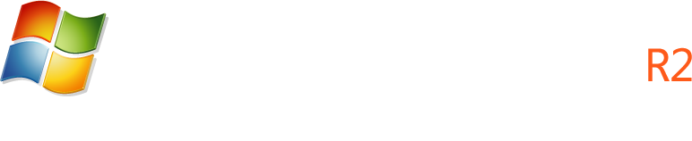
Microsoft Virtualization for Server Applications
Business Critical Applications
Management Platform
Enterprise Applications
Line of Business (LOB) Custom Applications
Microsoft Server Applications
Databases:
Collaboration:
Communication:
Virtualization Platform
Microsoft Virtualization
Windows Server 2008 R2 Hyper-V & System Center

Slide 5


Microsoft Virtualization: The Best Choice for Microsoft Server Applications
Built
for
Windows
Complete
Management
Solution
Low Cost
Complete
Solution
*Built-in Virtualization with one-stop support
*Deep Application Knowledge
*A comparable solution can cost almost 4 times more†
*Large Partner
Ecosystem
*Physical & Virtual Management
*Lower On-going
Costs
Increased Deployment Options
*Cross-Platform & Hypervisor Support
Virtualization-Friendly Licensing
*Only available with Microsoft Virtualization
†Based on a comparison of Microsoft® System Center Server Management Suite Datacenter with VMware® vSphere Enterprise Plus with VMware vCenter Server.. Assumes a five host configuration, 2 processors on each host, 2 years support costs for both products, and no operating system costs included.. The Microsoft solution can use either the free Microsoft Hyper-V Server 2008 R2 hypervisor or an existing Windows Server 2008 R2 hypervisor. Based on Microsoft estimated retail prices and published VMware prices available at https://www.vmware.com/vmwarestore as of 08/04/2009 for purchases in the United States. Actual reseller prices may vary.

Slide 6
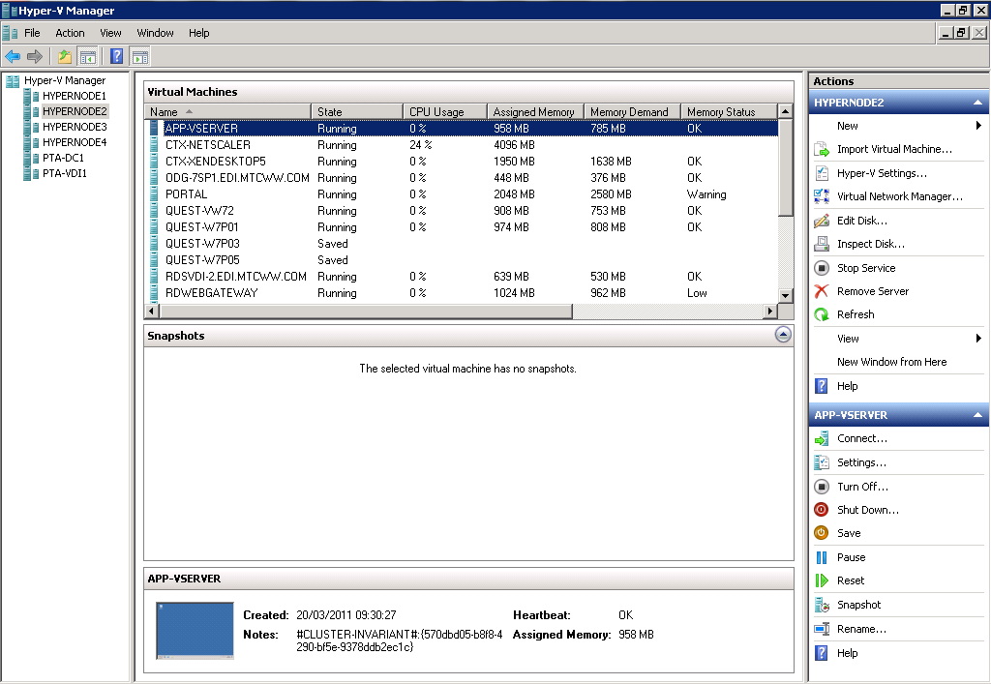
Windows Server 2008 R2 SP1
Many of the scenarios discussed leverage features new to R2 and R2 SP1
Live Migration & HA
New Processor Support
  Improved Performance & Lower Costs
Enhanced Scalability
  Greater VM density & Lower TCO
Networking enhancements
  Improve performance & 10 Gb/E ready
Dynamic VM capabilities
Enhancements to Server Core
  Ease management & Lower TCO
Dynamic Memory & Remote FX
in SP1

Slide 7
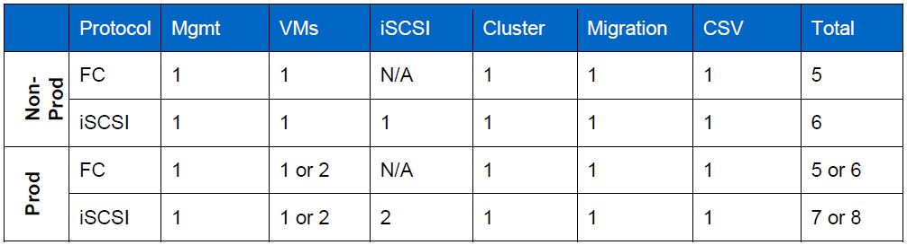
Hyper-V Configuration Guidelines - Parent
Memory Reservation
  512MB for Parent + the Per-VM values:
    For each VM = 32MB for 1st GB VM RAM + 8MB per subsequent 1GB VM RAM
    So, for 16GB VM = 32MB + (15 * 8MB) = 152MB
    If we had 8 of these VMs, the total would be: 152MB * 8 = 1216MB
Networking

Slide 8
Hyper-V Configuration Guidelines - Parent
Networking Continued
  Acquire optimized drivers from OEM
  Teaming provided by NIC Vendor
Storage
  iSCSI, Fiber Channel or FCoE Required for Failover Clustering
  1GB/E Minimum for iSCSI – 10G/E Advantageous
    Jumbo Frame support can boost performance
  DAS Storage is Supported
  Utilize iSCSI Initiator built into Windows Server
  Utilize MPIO for Resiliency & Load Balancing
    Ensure usage of Storage Vendor DSM for Optimal Performance

Slide 9
Hyper-V Configuration Guidelines - Guest
General
  Ensure Integration Components Are Present
    Optimal Performance of Storage, Networking etc.
Networking
  Use Synthetic Network Adaptors when possible (8)
    Legacy NIC must be used for PXE
  Take advantage of in-guest NIC options (Jumbo Frames etc.)
Storage
  Use Virtual IDE for Boot VHD and Pagefile VHD (if applicable)
  Use Virtual SCSI (4) for other VHDs (Hot Add Supported)
  Size VHDs appropriately for contents
  Fixed VHDs offer highest performance

Slide 10
Dynamic Memory in SP1
Overview
  A memory management enhancement for Hyper-V
  Enables customers to dynamically grow and decrease the memory of a VM
  Available as a feature in Windows Server 2008 R2 SP1
Benefits
  Better consolidation ratios with predictable performance
  Enables linear scalability for deployment environments
  Designed for production use
  Recommendations for use for server applications still being evaluated.
With the SP1 release, we will meet all the Gartner/Burton group requirements for an Enterprise ready Hypervisor

Slide 11
How does it work?
VM memory configuration parameters:
  Initial (what VM will boot with)
  Maximum (what VM can grow to)
Memory is pooled and dynamically distributed across VMs
Memory is dynamically allocated/removed based VM usage with no service interruption
Guest enlightened: guests & Hyper-V work TOGETHER
Memory is added and removed via synthetic memory driver (memory VSC) support

Slide 12
Base Hypervisor
Performance

Slide 13
Performance & Scalability
Project Virtual Reality Check (www.virtualrealitycheck.net)
  Performed by Ruben Spruijt and Jeroen van de Kamp
  When scaling x86 TS VMs w/o Hyper-threading, vSphere is 5% better than both XenServer and Hyper-V
  When scaling x86 TS VMs w/ Hyper-threading, XenServer and Hyper-V are 15% better than vSphere
  When scaling up to 100 TS sessions, response times for all three hypervisors are fairly equal, but beyond 100 sessions, vSphere response times increases with each new session
  When scaling x64 TS VMs, XenServer and Hyper-V are within 13.6% of bare metal, and are 27% better than vSphere

Slide 14
Performance & Scalability
In 2010, Enterprise Strategy Group (ESG) released a 3rd Party Performance Validation White Paper, sponsored by Microsoft.
Key Points
  Hyper-V is easy to install to get running for those administrators familiar with Windows
  Hyper-V provides high availability with transparent and automatic failover of Virtual Machines (VMs)
  Hyper-V Live Migrations provides for zero-downtime migrations of VMs between Hyper-V servers
  Most importantly, the report shows Hyper-V performance versus physical is excellent, with 95% to 99% of the performance of physical disks and 89% to 98% of performance of the tested workloads versus physical.
Available for download from ESG or Microsoft

Slide 15
Performance & Scalability
Hyper-V R2 on 16 servers with Microsoft Cluster Shared Volumes (CSV) stored on a single SAN attached disk array supported 1,024 virtual machines
http://www.enterprisestrategygroup.com/2010/11/emc-symmetrix-vmax-and-microsoft-server-virtualization-scalable-enterprise-class-virtual-infrastructure/

Slide 16
Performance & Scalability

Slide 17
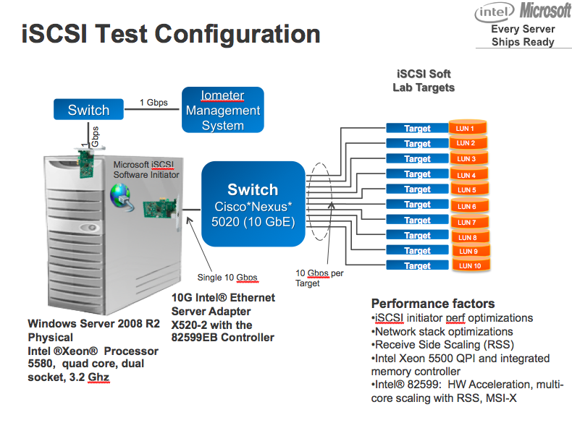
Performance & Scalability
Microsoft/Intel iSCSI Test
Used Windows Server 2008 R2, Intel Xeon 5500 processors, and Intel 10Gbps Ethernet Adapters
Reached over One Million IOPS over a single 10 Gbps Ethernet link using a software iSCSI initiator on Native HW
Reached over 700,000 IOPS over a single 10 Gbps Ethernet link using a software iSCSI initiator on Hyper-V to the Guest OS

Slide 18
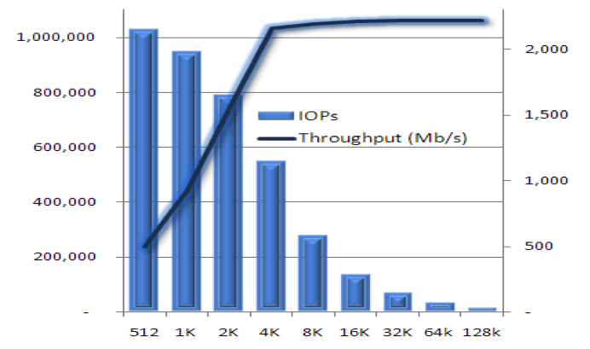
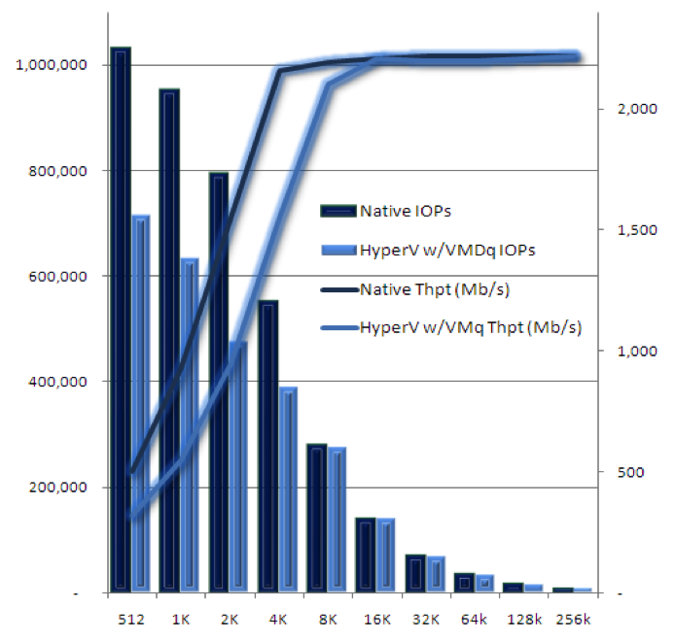
Performance & Scalability
Native Performance
In-Guest VM Performance

Slide 19
ESG Performance
Results

Slide 20
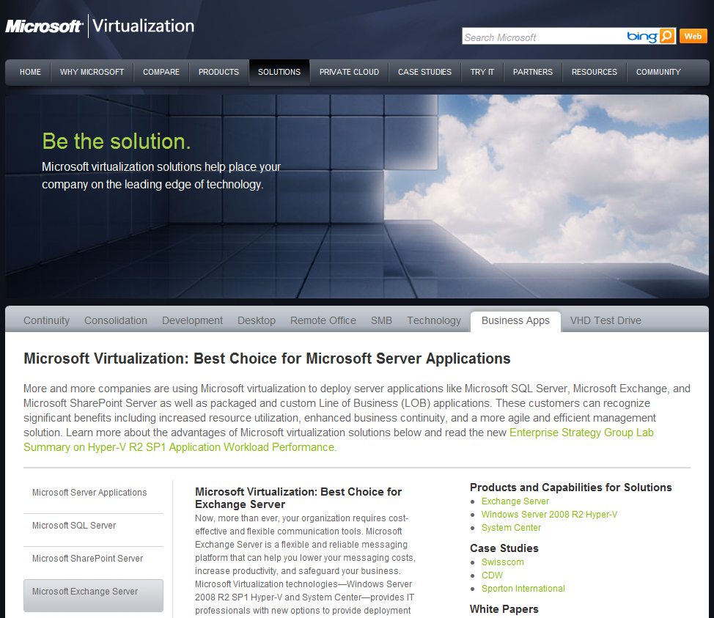
ESG Lab Summary 2011
Available online: http://www.microsoft.com/virtualization/en/us/solution-business-apps.aspx
Useful links, resources, case studies, white papers and webcasts

Slide 21




2011 ESG Test Lab - Physical
SharePoint
SQL Server
Exchange
Utilities
HP BL680C
up to 24 cores and
128 GB RAM per blade
LAN
SAN
F5 BIG-IP
2x4 Gbps FC per server
RAID-10 Pools:
EMC CX4-960
155 15K RPM FC disk drives
Data (88):
Logs(16):
OS(24):
Apps(16):
http://download.microsoft.com/download/1/7/F/17FB551C-0905-4A04-AB46-2EBA616CFDF3/ESG%20Preso%20Microsoft%20Hyper-V%20Performance%20SharePoint%20Mar%2011_Wide.pdf

Slide 22


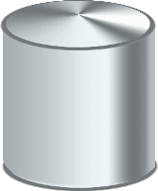
2011 ESG Test Lab - Virtual
Web Server 2
SQL Server
Web Server 1
Web Server 3
SharePoint
Application: SharePoint 2010 / SQL 2008 R2
VMs: 2 vCPU, 4 GB / 4vCPU, 32 GB
Microsoft Windows Server 2008 R2 SP1
Hyper-V R2
Hypervisor: Microsoft Hyper-V R2
Physical OS: Windows Server 2008 R2 SP1
Load generator:
Microsoft Visual Studio 2010
SAN
Virtual machine images: Fixed VHD
SQL data and logs: Fixed VHD
http://download.microsoft.com/download/1/7/F/17FB551C-0905-4A04-AB46-2EBA616CFDF3/ESG%20Preso%20Microsoft%20Hyper-V%20Performance%20SharePoint%20Mar%2011_Wide.pdf

Slide 23
Visual Studio 2010 for SharePoint
Load Generation
Hyper-V stress test with a non-blocking lightweight workload
  89% browse
  10% upload
  1% check in/check out
  22 GB SQL Content Database
Scale from 1 to 3 web server VMs (5 VMs total)
Hardware Load-Balanced Web Traffic
  An F5 BIGIP Local Traffic Manager was used to load balance web server traffic with a round-robin scheduling algorithm.
Constant workload tested against 1, 2 & 3 Web VMs
http://download.microsoft.com/download/1/7/F/17FB551C-0905-4A04-AB46-2EBA616CFDF3/ESG%20Preso%20Microsoft%20Hyper-V%20Performance%20SharePoint%20Mar%2011_Wide.pdf

Slide 24
2011 SharePoint Workload Results
CPU bottleneck
http://download.microsoft.com/download/1/7/F/17FB551C-0905-4A04-AB46-2EBA616CFDF3/ESG%20Preso%20Microsoft%20Hyper-V%20Performance%20SharePoint%20Mar%2011_Wide.pdf

Slide 25
2011 SharePoint Workload Results
http://download.microsoft.com/download/1/7/F/17FB551C-0905-4A04-AB46-2EBA616CFDF3/ESG%20Preso%20Microsoft%20Hyper-V%20Performance%20SharePoint%20Mar%2011_Wide.pdf

Slide 26
2011 SharePoint Workload Results
http://download.microsoft.com/download/1/7/F/17FB551C-0905-4A04-AB46-2EBA616CFDF3/ESG%20Preso%20Microsoft%20Hyper-V%20Performance%20SharePoint%20Mar%2011_Wide.pdf

Slide 27
2011 SharePoint Results Summary
Up to 460,800 simulated SharePoint users*
As expected, the front end is the bottleneck during single web server VM testing
  Adding web server VMs alleviates the bottleneck
  Adding web server VMs increased the number of 1% concurrent SharePoint users from 252,600 to 460,800.
Response times improve and more requests per second are delivered as VMs are added
  Average page response times were faster than the Microsoft-recommended guideline of 1-2 seconds.
90% scaling efficiency from 1 to 2 web servers**
* 1% concurrent users derived from the requests per second measured during the three web server test
** Based on a comparison of requests per second divided by average page response time
http://download.microsoft.com/download/1/7/F/17FB551C-0905-4A04-AB46-2EBA616CFDF3/ESG%20Preso%20Microsoft%20Hyper-V%20Performance%20SharePoint%20Mar%2011_Wide.pdf

Slide 28
2011 SharePoint Results Summary
Performance scaled and response times dropped as Hyper-V R2 web server VMs were added to a consolidated SharePoint deployment on a single physical server.
The manageably low performance impact of Hyper-V R2 won’t be detected by the vast majority of end-users and applications.
The performance, scalability, and low overhead of Hyper-V R2 can be used to reduce costs and improve the manageability, flexibility, and availability of consolidated SharePoint applications.
http://download.microsoft.com/download/1/7/F/17FB551C-0905-4A04-AB46-2EBA616CFDF3/ESG%20Preso%20Microsoft%20Hyper-V%20Performance%20SharePoint%20Mar%2011_Wide.pdf

Slide 29
Issues to Consider
Mileage varies: test with your workloads and your data
Hyper-V
  Included for free with Windows Server 2008 R2
  Proven to perform with demanding applications
Size matters
  Application and web server roles are good candidates for virtualization
  For larger deployments, consider deploying resource-bound SQL Server and Index roles on physical servers
High availability matters
Leverage ESG Lab Validations, Microsoft and its partners’ best practices/proof points
http://download.microsoft.com/download/1/7/F/17FB551C-0905-4A04-AB46-2EBA616CFDF3/ESG%20Preso%20Microsoft%20Hyper-V%20Performance%20SharePoint%20Mar%2011_Wide.pdf

Slide 30
SharePoint Server
Virtualization
Best Practices

Slide 31
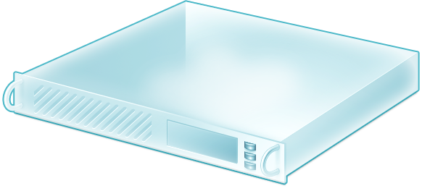


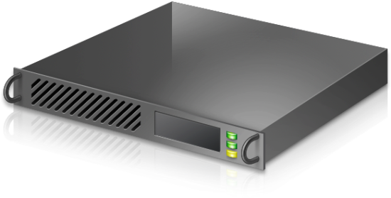

Key SharePoint Farm Elements
Web Front End
Query Component
Central Admin, Search Admin Component, Crawl Component, Query Component
Application Server
DB
CA Configuration, Content DBs, Farm Content DB, Search Admin DB, Crawl DB, Property DB
SQL Server
Hyper-V Host
Hyper-V Cluster
SAN

Slide 32
SharePoint Specific Hyper-V Guidance
CPU
  Recommended Ratio of 1:1 (Physical Cores : Virtual CPU’s)
Auto Start & Stop
  Do not configure VM to ‘Save State’
    On resumption, may be out of sync with rest of farm
  Clean Shutdown Recommended
Do not use snapshots in production – sync issues

Slide 33
Roles & Virtualization Considerations
Role | Virtualization Decision | Considerations and Requirements
Web Role Render Content | Ideal Candidate | Easily provision additional servers for load balancing and fault tolerance
Query Role Process Search Queries | Ideal Candidate | For large indexes, use physical volume over dynamic expanding VHD Requires propagated copy of local index
Application Role Excel Forms Services | Ideal Candidate | Provision more servers as resource requirements for individual applications increase
Index Role Crawl Index | Good Candidate | Accurate Sizing & Capacity Planning Very Important Requires enough drive space to store the index corpus
Database Role | Good Candidate | Accurate Sizing & Capacity Planning Very Important Implement SQL Server alias for the farm required

Slide 34
Example Topologies http://www.microsoft.com/downloads/en/details.aspx?displaylang=en&FamilyID=87f00c5d-1f62-4d3f-ac92-b91eb70d317e

Slide 35
SharePoint Virtualization – POC
Can be used as a POC for a larger deployment
  Used to refine the vision for the scaled deployment
3-tier Deployment Recommended
Useful to establish deployment benchmarks
  Not designed as a performance test
Utilise 3 x 30GB Dynamic VHDs
No resiliency in the solution
Overcommitted CPU
2 x vCPU / 4 GB RAM
WFE & Query
2 x vCPU / 4 GB RAM
CA & CRAWL
DB
2 x vCPU / 6 GB RAM
4 LP / 16 GB RAM

Slide 36
SharePoint Virtualization – Pilot
Adding 2nd Web Server will enhance capacity – increase user targets
Increased DB to 4vCPU & 8GB RAM
Increase VHD size to 40GB and mix Dynamic & Fixed to gather IOPS data
Total RAM Usage = 20GB – may wish to go to 32GB in Host
Slightly Overcommitted on CPU (8:10)
2 x vCPU / 4 GB RAM
WFE & Query
2 x vCPU / 4 GB RAM
WFE & Query
2 x vCPU / 4 GB RAM
CA & CRAWL
DB
4 x vCPU / 8 GB RAM
8 LP / 24 GB RAM

Slide 37
SharePoint Virtualization – Resilient Pilot #1
2 x vCPU / 4 GB RAM
WFE & Query
2 x vCPU / 4 GB RAM
WFE & Query
2 x vCPU / 4 GB RAM
CA & CRAWL
2 x vCPU / 4 GB RAM
CA & CRAWL
DB
DB
4 x vCPU / 8 GB RAM
4 x vCPU / 8GB RAM (Mirror)
8 LP / 24 GB RAM
8 LP / 24 GB RAM
Introduced 2nd Application Server & Clustered/Mirrored SQL DB
Resiliency against WFE, Application Server & DB outage
Could handle complete host failure.
CPU’s not overcommitted

Slide 38
SharePoint Virtualization – Resilient Pilot #2
2 x vCPU / 4 GB RAM
WFE & Query
2 x vCPU / 4 GB RAM
WFE & Query
DB
2 x vCPU / 4 GB RAM
CA & CRAWL
4 x vCPU / 8 GB RAM
8 LP / 24 GB RAM
8 LP / 24 GB RAM
SAN
Resiliency against hardware & WFE outage
If a host fails, VMs will reboot on other available host
  Hence why there is no reduction in host size - Should 1 host fails, these 4 VMs can still run on 1 host
SAN may result in improved performance
Live Migration now an option
CPU’s not overcommitted – 8:6 & 8:4 but would be upon failover (8:10)
Still capacity available to grow but be mindful of single host capacity.
  Dynamic Memory could help!

Slide 39
SharePoint Virtualization – Medium Farm
4 x vCPU / 8 GB RAM - QUERY
4 x vCPU / 8 GB RAM - QUERY
4 x vCPU / 8 GB RAM - QUERY
4 x vCPU / 8 GB RAM - CA
4 x vCPU / 8 GB RAM - CRAWL
DB
DB
4 x vCPU / 16 GB RAM
4 x vCPU / 16 GB RAM (Mirror)
16 LP / 64 GB RAM
16 LP / 64 GB RAM
SAN
Utilising 2 * 8 Core Hosts allows large scalability improvements
Neither node is overcommitted from a CPU perspective.
Host 1 = 40GB RAM & Host 2 = 32GB so 1 host couldn’t support all VMs
  Dynamic Memory may enable this scenario – or N+1 Cluster
This size deployment would typically support tens of thousands of users and a load of 10 to 50 requests per second
Data Store of 1 or 2 TB

Slide 40
Note
The examples given are just a few of the options
Your environment will determine sizing of workloads
  Performance & Capacity Management on TechNet:
  http://technet.microsoft.com/en-us/library/cc262971.aspx
Remember to allow for 1:1 ratio (ideal) LP:vCPU
Utilise Dynamic Memory to free up unused RAM
Plan for failover of VMs upon host failure
More here:
  http://technet.microsoft.com/en-us/library/ff758647.aspx
  http://technet.microsoft.com/en-us/library/ff607968.aspx
  http://technet.microsoft.com/en-us/library/cc262485.aspx

Slide 41
Enhancing SharePoint on Hyper-V

Slide 42



System Center Integration
Seamless & efficiently protect SharePoint Infrastructure
Restore entire SharePoint farm quickly & easily
Automatic protection of new content databases
Proactively monitor entire SharePoint infrastructure
Drive down the cost of ensuring service levels
indicate, correct, and prevent possible service outages or configuration problems
Rapidly provision SharePoint infrastructure
Automate migrations for load balancing of VMs
Seamlessly migrate workloads
Integrated with PRO MP’s for Dynamic Scaling

Slide 43
Citrix NetScaler VPX
Hyper-V Virtual Appliance
  Can be deployed through SCVMM
Speed up deployment with AppExpert templates & configuration wizards
Once deployed, NetScaler will accelerate, load balance and secure SharePoint 2010
Ships with PRO-enabled OpsMgr MP
  Load balance, optimize, secure & report
  Dynamically scale infrastructure based on monitoring

Slide 44
Track Resources
Don’t forget to visit the Cloud Power area within the TLC (Blue Section) to see product demos and speak with experts about the Server & Cloud Platform solutions that help drive your business forward.
You can also find the latest information about our products at the following links:
Cloud Power - http://www.microsoft.com/cloud/
Private Cloud - http://www.microsoft.com/privatecloud/
Windows Server - http://www.microsoft.com/windowsserver/
Windows Azure - http://www.microsoft.com/windowsazure/
Microsoft System Center - http://www.microsoft.com/systemcenter/
Microsoft Forefront - http://www.microsoft.com/forefront/

Slide 45





Resources
  Connect. Share. Discuss.
http://northamerica.msteched.com
Learning
  Sessions On-Demand & Community
  Microsoft Certification & Training Resources
www.microsoft.com/teched
www.microsoft.com/learning
  Resources for IT Professionals
  Resources for Developers
http://microsoft.com/technet
http://microsoft.com/msdn

Slide 46












Complete an evaluation on CommNet and
enter to win!

Slide 47


Slide 48

© 2011 Microsoft Corporation. All rights reserved. Microsoft, Windows, Windows Vista and other product names are or may be registered trademarks and/or trademarks in the U.S. and/or other countries.
The information herein is for informational purposes only and represents the current view of Microsoft Corporation as of the date of this presentation. Because Microsoft must respond to changing market conditions, it should not be interpreted to be a commitment
on the part of Microsoft, and Microsoft cannot guarantee the accuracy of any information provided after the date of this presentation. MICROSOFT MAKES NO WARRANTIES, EXPRESS, IMPLIED OR STATUTORY, AS TO THE INFORMATION IN THIS PRESENTATION.

