Slide 2

Using Microsoft Enterprise Desktop
Virtualization (MED-V) to Solve
Windows 7 Application Compatibility
VIR319
Briton Zurcher
Program Manager
Microsoft – MED-V

Slide 3
Session Objectives and Takeaways
Session Objective:
  Describe MED-V version 2, explain the deployment strategies, and how MED-V v2 can accelerate your Windows 7 deployment
Takeaways:
  MED-V delivers enterprise application compatibility
  MED-V accelerates migrations to Windows 7
  MED-V users can seamlessly access/use legacy XP LOB apps
  MED-V leverages existing infrastructure and roles

Slide 4
Session Agenda
Overview of MED-V
Lifecycle of MED-V
Wrap-Up / Q&A
Create Create a MED-V Workspace
Deploy Methods of Deployment
Maintain Update and Troubleshoot
Enterprise Application Compatibility Challenges
Solutions from Microsoft for Application Compatibility
1
2
DEMOS
3

Slide 5






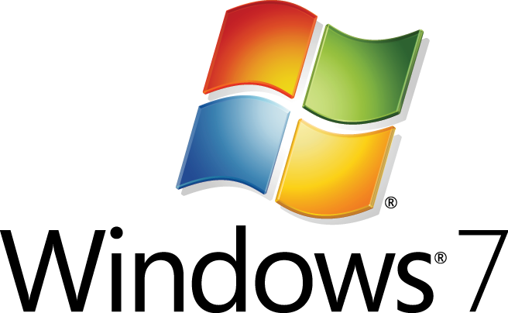

Barriers to Operating System Migration
Dependency on legacy versions of Internet Explorer®
Cost of application testing
Incompatible applications
Time required to test applications
ISV or developer no longer available
Windows 7
Annual Cost Savings/PC
Results: Customers are
not getting full value
from Windows 7.
Service Desk
Desktop Management
Deployment & Provisioning
Power Savings
Total Direct IT Costs Savings
$22-62
$25-98
$12-61
$3-45
$43-268

Slide 6


MED-V Breaks Barriers to Windows 7 Migration
Run legacy Windows XP
and Internet Explorer (IE) applications on Windows 7
Break barriers to
Windows 7 deployment caused by incompatible applications
Migrate incompatible applications on your own schedule without losing productivity

Slide 7
Addressing Application Compatibility
Compatibility Gap
IE 6 dependencies
Cost of Migration
Developer is gone
MED-V Closes the Compatibility Gap
Accelerating
Windows 7 Deployments
100%
LOB Apps
Works with Windows 7
Works using MED-V
0%
+
+
Just Work
Upgrade
Modify App
Start
Finish
Migration Timeline

Slide 8


Microsoft Enterprise Desktop Virtualization
Solves the last mile of application compatibility
  What it Does
  Customer Quotes
      Run legacy applications on Windows 7
      Shares host USB, network printers, and documents
      Redirect legacy web applications to Internet Explorer 6 or 7
      Automates first-time virtual workspace setup
“MED-V helps ensure that we can move forward with an enterprise-wide rollout of Windows 7 without getting sidetracked by application compatibility issues.”
– Alex Ramos Senior Manager, IT Operations
Royal Caribbean Cruises Ltd.
  Benefits
      Unblocks Windows 7 migration projects
      Provides a seamless end user experience
      Allows multiple versions of Internet Explorer to coexist during migration
      Enables deployment and management with existing systems, such as System Center Configuration Manager
      Florida-based Royal Caribbean Cruises Ltd. operates cruise ships that call on approximately 400 destinations. The company has approximately 60,000 employees worldwide.

Slide 9
MED-V 2.0: The Clear Choice for Enterprise Deployment
Feature | Windows XP Mode | MED-V v1 | MED-V v2
Seamless Application Compatibility Environment
Seamless access to documents and data files
Support for USB devices – including Smart Cards
Automatic application publishing
Deploy your custom Windows XP image
Integrates with System Center or third party systems
Seamless redirection of URLs to Internet Explorer 6/7
Shared environment support
Wake-to-patch the virtual environment
Automated first-time setup
Easy-to-use packaging and configuration wizard
WMI monitoring interface
Automatically synchronize host network printers
✓
✓
✓
✓
✓
✓
✓
✓
✓
✓
✓
✓
✓
✓
✓
✓
✓
✓
✓
✓
✓
✓

Slide 10
MED-V 2.0: The Clear Choice for Enterprise Deployment
Feature
Seamless Application Compatibility Environment
Seamless access to documents and data files
Support for USB devices – including Smart Cards
Automatic application publishing
Deploy your custom Windows XP image
Integrates with System Center or third party systems
Seamless redirection of URLs to Internet Explorer 6/7
Shared environment support
Wake-to-patch the virtual environment
Automated first-time setup
Easy-to-use packaging and configuration wizard
WMI monitoring interface
Automatically synchronize host network printers
Feature | MED-V v2
Seamless Application Compatibility Environment
Seamless access to documents and data files
Support for USB devices – including Smart Cards
Automatic application publishing
Deploy your custom Windows XP image
Integrates with System Center or third party systems
Seamless redirection of URLs to Internet Explorer 6/7
Shared environment support
Wake-to-patch the virtual environment
Automated first-time setup
Easy-to-use packaging and configuration wizard
WMI monitoring interface
Automatically synchronize host network printers
MED-V v2
✓
✓
✓
      New for
      MED-V v2
✓
✓
✓
✓
✓
✓
✓
✓
✓
✓

Slide 11
User Experience
demo

Slide 12



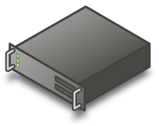


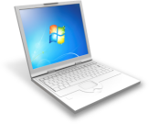
MED-V Architecture
Windows XP VHD
MED-V Packager
MED-V Workspace
Enterprise Software
Distribution Tool
Windows Components
& Applications
MED-V Workspace
Incompatible Apps
MED-V Components
Host – Windows 7
Guest – Windows XP sp3
ESD Agent
IE 8+
ESD Agent
IE 6
Redirection
MEDV Host Agent
Incompatible Published Apps
RDP
Incompatible Apps
MEDV Guest Agent
Windows Virtual PC
Diff Disk
Parent

Slide 13
MED-V Lifecycle Management
Create
Deploy
Manage
Step 1
Step 2
Step 3

Slide 14
MED-V Lifecycle Management
Create
VHD
Sysprep
Package
Step 1

Slide 15
Create a VHD for the MED-V Workspace
Create the VHD
  Create an XP SP3 image
    new VPC image, existing VHD, convert WIM to VHD, etc.
  Update the XP SP3 image
    Install latest OS patches
  Install MED-V Requirements
    Install VPC Integration Components (available with Windows Virtual PC)
      Including the update for “Remote App”
    .NET 3.5 SP1 and KB959209
    No MED-V agent needs to be installed – this is done as part of first time setup
  Install any 3rd-party applications your base image requires
    ESD agents, AV software, etc.
    The MDOP license grants license rights for the virtual XP instance – other apps may require additional licenses

Slide 16
MED-V VHD Creation Best Practices
The following are recommendations when creating a
MED-V Workspace:
  Delete unnecessary files (uninstallers, temp files, log files, page file,
  recycle bin, etc.)
  Install XP Terminal Services redirected drive performance hotfix (KB972435)
  Block IE7 and IE8 automatic updates
    IE7BlockerToolkit.EXE
      http://www.microsoft.com/downloads/details.aspx?FamilyId=4516A6F7-5D44-482B-9DBD-869B4A90159C&displaylang=en
    IE8BlockerToolkit.EXE
      http://www.microsoft.com/downloads/details.aspx?FamilyID=21687628-5806-4ba6-9e4e-8e224ec6dd8c&displaylang=en
  Disable system restore points (via Sysprep.inf)
  After running sysprep on the image defragment and compact the VHD

Slide 17
Sysprep Configuration for the VHD
MED-V leverages standard sysprep process for VHD setup
  Select Mini-Setup (or use -mini switch) and automate with Sysprep.inf
  Sysprep provides the Volume License Key for Windows XP, Domain Join Account, Admin Password, and Workstation Naming
‘FtsCompletion.exe’ must be called as the final step in sysprep
  It is installed during first time setup from the host agent
  FtsCompletion.exe completes first time setup – and does the following:
    Adds the user to “Remote Desktop Users” group and/or “Administrator” group in the guest
    Copies setup log files to the host to assist with troubleshooting
    Signals to MED-V that the setup process is complete
    Reboots the MED-V Workspace

Slide 18
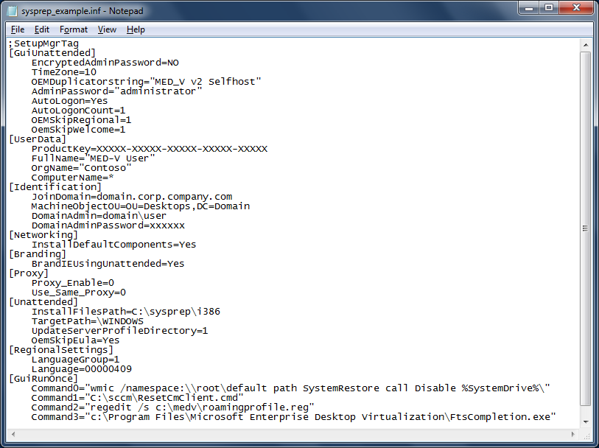
Sysprep.inf Overview
These are required for MED-V. The absence of these items will cause setup to fail.
These items may be configured by MED-V – set in the MED-V Workspace Packager
These items are MED-V best practices and setup calls

Slide 19

MED-V Workspace Packager
Guides administrator through common package authoring tasks and settings
Workspace Packager GUI
PowerShell
Setup.exe
Workspace.msi
VHD_File_Name.medv
.reg Configuration File
.ps1 PowerShell Script

Slide 20
MED-V Workspace Packager
demo

Slide 21


MED-V on a Shared Computer
A Unique Workspace
for Each User
A Workspace that all users will share
Overview
  Recommended for knowledge-worker and single-user machines
  Single parent VHD, unique differencing disk per user
  MED-V data and settings located in user space
  MED-V end-user setup run for each unique user
Details
  Each user is added as a member of the remote desktop users group
  Could create multiple workspaces on a single machine
Overview
  Recommended for task-workers and multi-user machines
  Single parent VHD, one differencing disk for all users
  MED-V data and settings located in global location
  MED-V end-user setup only run once per machine
Details
  All authenticated users are added to the remote desktop users group
  Guarantees a single workspace per machine

Slide 22

Internet Explorer Web Redirection
Automatic redirection from the host browser to the workspace browser
  Users type the URL in the IE host browser, click a link, or access a bookmark
  MED-V evaluates the destination against the list of admin-controlled URL’s
  Matched URL’s are automatically open in the redirected guest browser
Redirected Web Address Setup
  Administrators can define a set of redirected URL’s during the package setup
  Post-deployment, redirected URL’s can be easily removed and added by deploying a registry update
Examples
Wildcard Redirections:
http://*.contoso.com
Site Redirections:
http://intranet.contoso.com/HR
Page or Application Redirections: https://intranet.contoso.com/HR/benefits.asp
Port redirection
http://vpn.contoso.com:1025

Slide 23
MED-V Lifecycle Management
Deploy
Components
Methods
Configuration
Step 2

Slide 24
Components to be deployed
Deploy Components Not Infrastructure
  MED-V is client based – there are no servers
  Existing enterprise infrastructure and processes will need to be used to deliver and manage MED-V.
Files to be deployed
  Host Software:
    Windows Virtual PC for Windows 7
    Non Hardware-Assisted Virtualization (HAV) Patch (KB977206)
  MED-V Host Agent
    MED-V_HostAgent_Setup.exe
  Workspace
    Setup.exe
    Workspace_Name.msi
    VHD_File_Name.medv

Slide 25
Methods of Deploying MED-V
User Initiated (lab and testing only)
Enterprise Software Distribution (ESD) Product
  Deploy as you would any other application
  VPC can be delivered with MED-V (requires reboot)
Configuration Manager – additional integration
  Manage with collections of MED-V Workspaces
  Manage Applications to the guest VM using CM and AppV
  NAT configured workspaces use same CM servers as the host
  Uses host IP configuration to resolve MP/DP
  Requires SCCM 2007 R2 or better
Configure as part of the base Windows 7 image
  Deploy the bits with the image
  Workspace Setup is Launched by the user

Slide 26
Configuring MED-V for the User
Configuration is done as part of MED-V First Time Setup (FTS)
  The Workspace Setup publishes to the registry HKLM RUN key – MedvHost.exe
  When the MED-V client is launched it validates whether FTS has run been for that user or workstation
What happens during FTS
  User prompted for domain credentials
  Differencing Disk is created for the Workspace and launched
  Mini-Setup is run w/ MED-V overrides (if applied)
  FTScompletion.exe is run
  Workspace is Started
    Applications are published
    Web Apps are ready to be redirected

Slide 27
Deploy Example: Configuration Manager
Administrative Steps
  Create packages for Windows VPC, non-HAV patch, MED-V Host Agent, Packaged Workspace
  Create or integrate with task sequence
  Create advertisement for the target collection
  Clients get the advertisement and perform the assigned task
User Experience
  VPC is silently installed and the user is prompted to reboot
  MED-V Client and Workspace are installed silently
  User is prompted for domain credentials and FTS runs
  Applications are available once FTS completes

Slide 28
Deploy Example: Windows 7 Image
Administrative Steps
  Install the Windows VPC and other MED-V prerequsites
  Install the MED-V Host Agent
  Copy the MED-V Workspace package files to the image base
  Create a shortcut to the Workspace installer – do not install the workspace
  Prepare for distribution
User Experience
  Image is setup on the new hardware
  The user logs-on to the Win7 host
  The user then launches the MED-V Workspace install when directed
  User is prompted to launch MED-V
  MED-V starts and runs FTS runs and applications become available

Slide 29
Deploying MED-V
demo

Slide 30
MED-V Lifecycle Management
Manage
Workspace Management
Troubleshooting
Toolkit
Step 3

Slide 31
MED-V Workspace Management
Application Publishing
  Deploy applications as you do today to the MED-V guest – the workspace is simply a “virtual” desktop
  Applications are auto-published to the Host in-context
Wake-to-Patch
  Configuration to wake the Workspace on a schedule to ensure delivery of updates
  Enhances the experience for Workspace reboots
  Featured designed for Configuration Manager but can be utilized by other ESD’s
Settings
  All settings are maintained/updated in the Registry

Slide 32
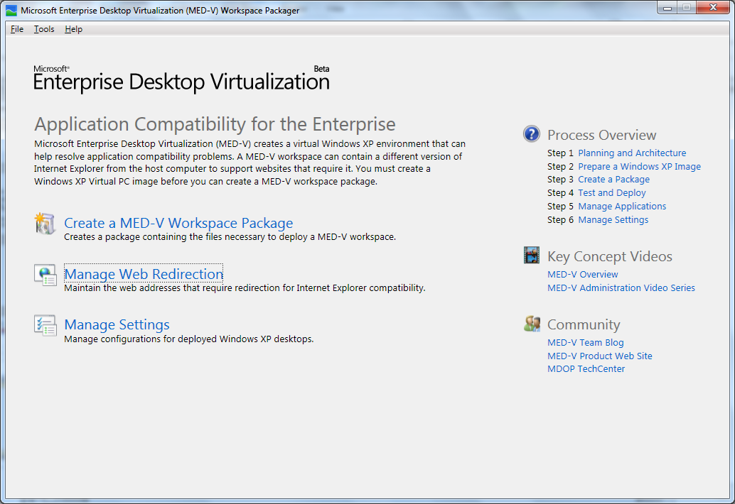
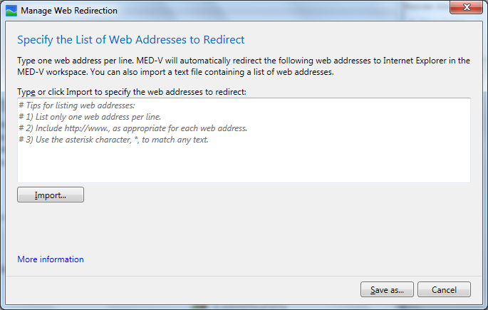
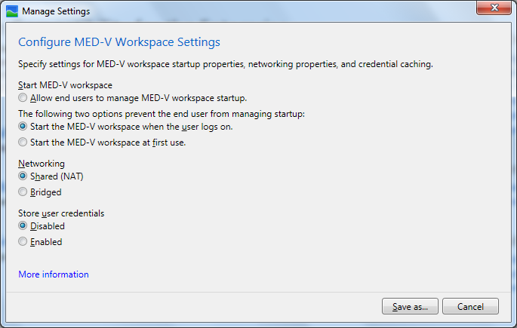

Update Settings
Save as a *.reg
Import as required

Slide 33
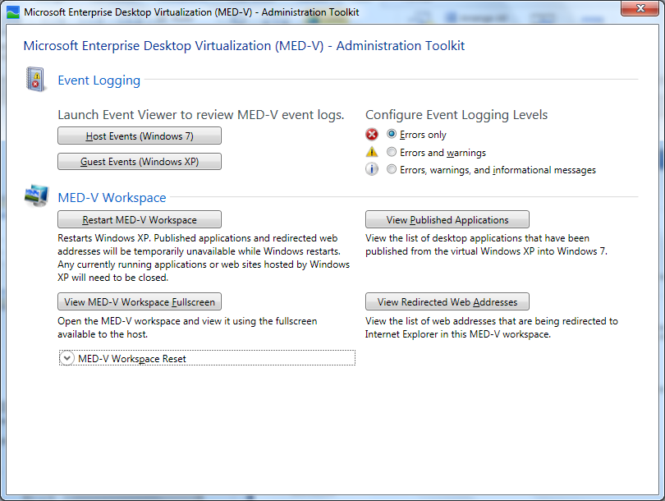
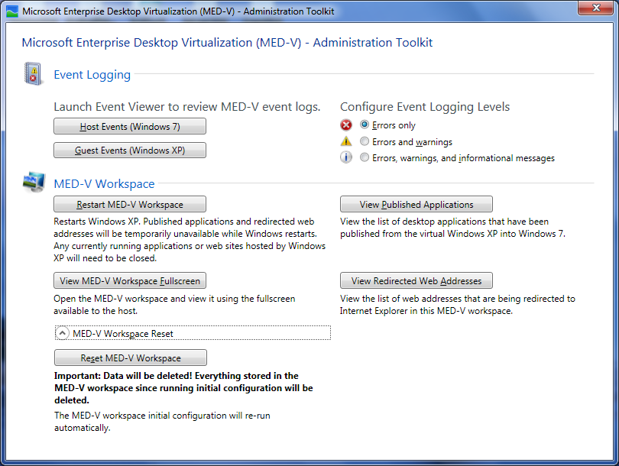
MED-V Admin Toolkit
C:\Program Files\Microsoft Enterprise Desktop Virtualization\medvhost.exe /toolkit

Slide 34


Customer Success with MED-V
  Applied Materials
  Customer Quotes
“With MED-V, we can address compatibility issues that we don’t even know exist. If an application runs on Windows XP or Internet Explorer 6, it can run on Windows 7. It’s that simple and that monumental.”
– James Van Ryn
Windows Systems Engineer
Applied Materials
“The fact that we didn’t need to build a separate infrastructure for MED-V 2.0 was key. It enabled us to shorten our development time. All we had to do was build a functioning image and we were ready to go.”
– Patrick Healy
Systems Management Engineer,
Applied Materials
  Benefits
      Provides safety net for unforeseen compatibility issues
      Avoids remediation downtime and urgency
      Easy upgrade to Windows 7
*Additional customer case studies can be found here.

Slide 35

Wrap Up – Move to Windows 7 Now
Test your applications and identify your “difficult” applications
Test
  Migrate
Difficult
Apps
Upgrade OS
“Difficult” applications don’t have to stop your move to Windows 7, with MED-V these can run seamlessly for users – NOW!
  Use MED-V to Unblock and Accelerate Your Windows 7 Deployment

Slide 36
Questions and Answers
Conclusion

Slide 37

Related Content
Required Slide
Speakers, please list the Breakout Sessions, Interactive Discussions, Labs, Demo Stations and Certification Exam that relate to your session. Also indicate when they can find you staffing in the TLC.
Breakout Sessions:
  WCL311 | Solving Common IT Pro Pain Points with the Microsoft Desktop Optimization Pack (MDOP)
Hands-on Labs:
  VIR383-HOL | Microsoft Enterprise Desktop Virtualization (MED-V) 2.0
Interactive Sessions:
  VIR375-INT | Deploying MED-V 2.0 with Microsoft System Center Configuration Manager 2007
Find Me Later At:
  briz@microsoft.com
  twitter: @bzurc - #teched

Slide 38
Track Resources
Don’t forget to visit the Cloud Power area within the TLC (Blue Section) to see product demos and speak with experts about the Server & Cloud Platform solutions that help drive your business forward.
You can also find the latest information about our products at the following links:
Cloud Power - http://www.microsoft.com/cloud/
Private Cloud - http://www.microsoft.com/privatecloud/
Windows Server - http://www.microsoft.com/windowsserver/
Windows Azure - http://www.microsoft.com/windowsazure/
Microsoft System Center - http://www.microsoft.com/systemcenter/
Microsoft Forefront - http://www.microsoft.com/forefront/

Slide 39





Resources
  Connect. Share. Discuss.
http://northamerica.msteched.com
Learning
  Sessions On-Demand & Community
  Microsoft Certification & Training Resources
www.microsoft.com/teched
www.microsoft.com/learning
  Resources for IT Professionals
  Resources for Developers
http://microsoft.com/technet
http://microsoft.com/msdn

Slide 40


Slide 41












Required Slide
Complete an evaluation on CommNet and
enter to win!

Slide 42

© 2011 Microsoft Corporation. All rights reserved. Microsoft, Windows, Windows Vista and other product names are or may be registered trademarks and/or trademarks in the U.S. and/or other countries.
The information herein is for informational purposes only and represents the current view of Microsoft Corporation as of the date of this presentation. Because Microsoft must respond to changing market conditions, it should not be interpreted to be a commitment
on the part of Microsoft, and Microsoft cannot guarantee the accuracy of any information provided after the date of this presentation. MICROSOFT MAKES NO WARRANTIES, EXPRESS, IMPLIED OR STATUTORY, AS TO THE INFORMATION IN THIS PRESENTATION.

