Slide 1

Microsoft System Center Virtual Machine Manager 2012: Deployment, Planning, Upgrade
VIR316
Chaitanya Garikiparthi
Program Manager
Microsoft Corporation

Slide 2
Session Objectives and Takeaways
Empower you to deploy VMM 2012 with minimum effort
Empower you so you can take advantage of new setup improvements
What do I need to do to…
  Deploy and run a brand new VMM 2012 environment
  Upgrade my existing VMM environment to VMM 2012

Slide 3
System Center Virtual Machine Manager 2012
Deployment
Fabric
Cloud
Services
Infrastructure Enhancements
Cloud Management
Application Owner Usage
Delegation and Quota
Capacity and Capability
Service Management
Application Deployment
Image Based Servicing
Custom Command Execution
Service Templates
Fabric
Management
HA VMM Server
Hyper-V Bare Metal Provisioning
Update Management
Upgrade
Hyper-V,
VMware, Citrix XenServer
Dynamic Optimization
Custom properties
Network Management
Power Management
Powershell
Storage Management
Monitoring Integration

Slide 4
Topology

Slide 5

Deployment Planning
Supported Operating Systems and Servers
VMM Server
  Windows Server 2008 R2 - 64bit (Standard, Enterprise, Datacenter)
  Windows Server 2008 R2 SP1 - 64bit (Standard, Enterprise, Datacenter)
HA VMM Server
  Windows Server 2008 R2 - 64bit (Standard, Enterprise, Datacenter)
  Windows Server 2008 R2 SP1 - 64bit (Standard, Enterprise, Datacenter)
Database Server
  SQL Server 2008 SP2 - (Standard, Enterprise, Datacenter)
  SQL Server 2008 R2 - (Standard, Enterprise, Datacenter)
  No SQL Server 2005
  No SQL Server Express (2005 or 2008)

Slide 6
Deployment Planning
Supported Operating Systems and Servers
VMM Console
  Windows Server OS support same as VMM server
  Windows7 32 and 64bit (Professional, Enterprise, Ultimate)
Self-Service Portal
  IIS Server: Windows Server OS support same as VMM server
  Browser: Internet Explorer 8 and Internet Explorer 9
VMM Library Servers
  Windows Server OS support same as VMM server + Win2k8 SP2 (32 and 64bit)
  No Windows Server 2003 support

Slide 7
Deployment Planning
Software needed to be pre-installed on VMM Server box
  Windows Automated Installation Kit 2.0 (AIK) only
    AIK 1.0 is no longer included and supported
  .Net 3.5.1(enabled in W2K8 R2)
  PowerShell 2.0, WinRM 2.0
  Other pre-installed software
  SQL Server 2008 or SQL Server 2008 R2 (SQL Server Express is not included anymore) - local on VMM Server or remote

Slide 8
Deployment Planning
VMM 2012 Feature Requirements
  Bare Metal Provisioning
    Windows Deployment Services (Windows Server 2008 R2 only)
  Patching
    WSUS 3.0 SP2 64bit
  PRO
    Operations Manager 2007 R2+

Slide 9
Deployment Planning
VMM 2012 Feature Requirements
  Citrix XenServer
    XenServer Integration Suite for SCVMM
    Needs to be installed on XenServers
  Storage Automation (SMI-S)
    EMC, NetAPP (talks ongoing with other vendors)
  Load Balancer Integration
    Custom provider (F5, Citrix, Brocade (RTM))
    Needs to be installed on VMM server(s)
  Power Management/OSD (IPMI, SMASH, Custom Providers)
    No action is needed for SMASH and IPMI supported hardware since these are built in
    To use the custom iLO provider install it on the VMM server(s)

Slide 10

Deployment Planning
Redistributables
  SQL DAC Framework
    Data-Tier Application Framework
    SQL Server 2008 R2
    Management Objects
    SQL System CLR Types
    Transact-SQL Language Service
  Windows/IIS
    Web Deployment Tool (WebDeploy)
  Server App-V
    Application Virtualization Sequencer
    Server Application Virtualization Agent
    App-V Cmdlets for PowerShell

Slide 11
Setup Improvements
Highly Available VMM Management Server (HA VMM)
Cluster aware, fault tolerant VMM
  Guards against OS and VMM failures
  There can be one active management server at anytime
  Can failover automatically or manually
    Manual failover may be helpful in planned maintenance scenarios
Requires a (pre-created) container in AD to store Distributed Key Management (DKM) group
  DKM manages crypto keys in Active Directory, VMM keeps its encryption keys in this container
  E.g: CN=DKMGroup,DC=contoso,DC=com

Slide 12
Setup Improvements
Highly Available VMM Management Server (HA VMM)
Highly Available VMM Console Connectivity
  VMM console will connect to VMM service cluster name so that no connectivity is lost during migrations or failures
Make sure to follow HA best practices
  Make sure all Library servers are on HA File Servers
  Make sure VMM DB is on HA SQL Server

Slide 13
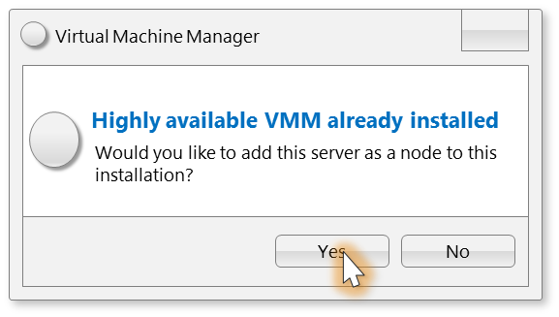
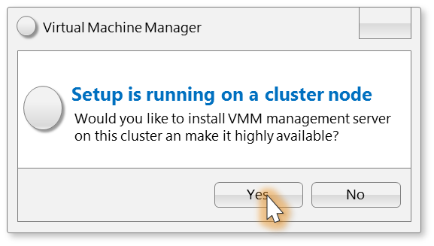



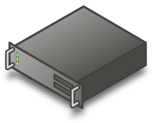





HA VMM Server Setup
Cluster Resources
VMM Cluster Resources
Node1
Windows Server 2008 R2 Failover Clustering
Node 2
Windows Server 2008 R2
Failover Clustering
VMM 2012 Mgmt Server
VMM 2012 Console (Active)
VMM 2012 Mgmt Server
VMM 2012 Console (Passive)
Active Directory
DKM Group
VMM Encryption Keys
VMM 2012 Database

Slide 14
HA VMM Server Setup
First Node
demo

Slide 15
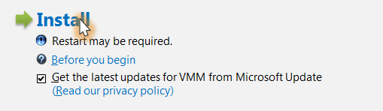
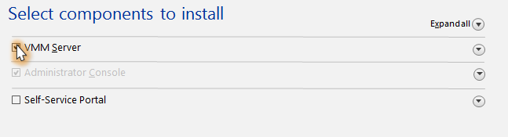
Setup Improvements
Update Setup*
  Setup can update itself before it starts
Chained Installation and Uninstallation of Components
  VMM Management Server, VMM Console, Self-Service Portal
* Will be available at RTM timeframe

Slide 16
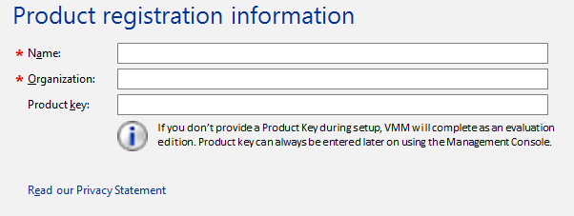
Setup Improvements
No need to type CDKEY, will complete as “Evaluation Edition” if no key is entered
Upgrade “Evaluation Edition” to “Licensed Build” using Console
Use VMM console to upgrade your evaluation version to a
licensed version
In case of HA VMM you only do this in one node

Slide 17
Upgrading to VMM 2012
Preparation
Support for only (n-1) VMM Server version
  VMM 2008 R2 SP1
Make sure to upgrade your VMM 2008 R2 Server to VMM 2008 R2 SP1
No support for “direct” upgrade from VMM 2007, VMM 2008 or VMM 2008 R2

Slide 18
Upgrading to VMM 2012
Preparation
Uninstall Windows AIK 1.0 from VMM server
  VMM 2012 does not come with Windows AIK anymore
  Windows AIK 2.0 does not support direct upgrade
  WAIK 1.0 needs to be uninstalled and WAIK 2.0 must be downloaded and installed manually (on all nodes if HA VMM)
If upgrading directly to HA VMM make sure DKM group is pre-created
  HA VMM requires DKM group name at setup time

Slide 19
Upgrading to VMM 2012
Preparation
Make sure the database server you will use for VMM is SQL Server 2008 and higher version
  Make sure to upgrade your SQL Server for VMM 2012 prior
  to upgrade
  Alternate approach to upgrading SQL Server:
    Example: VMM 2008 R2 SP1 database on SQL Server 2005
Backup
SQL Server 2005
Database
Restore to
SQL Server 2008+
Server
Install
VMM 2012 using this database, it will be upgraded during installation

Slide 20
Upgrading to VMM 2012
Upgrade Paths
RTM Versions
  VMM 2008 R2 SP1 RTM -> VMM 2012 RTM
In-Place Upgrade
  Standalone VMM server
  Upgrade Directly to HA VMM Server
Database Upgrade
  Standalone VMM server
  Upgrade Directly to HA VMM Server

Slide 21

In-Place Upgrade (to HA VMM)
Cluster Resources
VMM Cluster Resources
Node1
Failover Clustering
Windows Server 2008 R2
Windows Server 2008 R2
Node2
Failover Clustering
VMM 2012 Mgmt Server
VMM 2012 Console (Active)
VMM 2012 Mgmt Server
VMM 2012 Console (Passive)
VMM 2008 R2 SP1 Server
VMM 2008 R2 SP1 Administrator Console
Install VMM 2012
Prereqs
Install VMM 2012
Prereqs
Active Directory
DKM Group
VMM 2012 Database
VMM Encryption Keys
VMM 2008 R2 SP1 Database

Slide 22
Database Upgrade (HA VMM or Standalone)
When do you need to do this?
  SQL Express or SQL 2005
What do you need to do?
  Uninstall VMM and retain database
  Migrate database over to a supported SQL
  Start VMM installation and point to existing DB

Slide 23
HA VMM Server Setup
Additional Node
demo

Slide 24
Upgrading to VMM 2012
VMM Component Upgrades
VMM Console
  Run VMM 2012 Setup on computers that have VMM 2008 R2 SP1 Administrator Console installed
  Setup will detect and ask you if you want to upgrade the component
Self-Service Portal
  Uninstall VMM 2008 R2 SP1 Self-Service Portal
  Install VMM 2012 Self-Service Portal

Slide 25
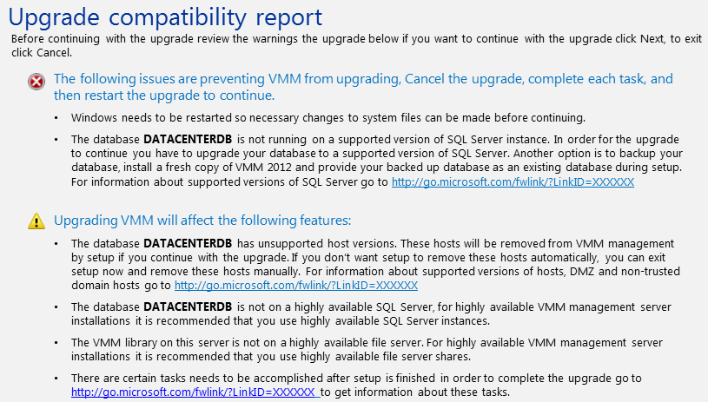
Upgrading to VMM 2012
VMM Component Upgrades
Host Agents
  N-2 agents will be supported
    VMM 2008 R2
    VMM 2008 R2 SP1
  These hosts are not supported and will be removed by setup during upgrade
    Virtual Server hosts
    VMware vCenter versions lower than 4.1
    ESX host versions 3.5 or below
  Upgrade Compatibility report will warn you about this fact

Slide 26
Upgrading to VMM 2012
VMM Component Upgrades
Host Agents
  After upgrade all agents will need to be re-associated
    There will be a optional way for setup to start re-association at the end of upgrade wizard
    After re-association all agents will have status “Update Needed”
    Multi-select agents and select “update”
    DMZ/Untrusted Domain hosts will be in “Access Denied” state, they can’t be re-associated, they will need to be removed and re-added to VMM 2012 management
Library Agents are treated same as host agents therefore same procedure needs to be applied

Slide 27
Upgrading to VMM 2012
VMM Component Upgrades
HA VMM Library Considerations
  VMM 2012 HA VMM install does not create a local library share
  But if upgraded directly to HA VMM server it doesn’t remove the existing one
    You will end up with a library server on HA VMM Server Recommendation is not to use this and create new library server and share on an HA file server

Slide 28
Upgrading to VMM 2012
VMM Component Upgrades
HA VMM Library Considerations
  Suggested library content transfer methods
    All objects with “disk representation” VHDs, Scripts, ISOs etc..
      File copy
    VM Templates
      Use new VMM 2012 template export/import wizard
    Saved VMs
      Deploy and save to the new HA library file share
      This way Custom fields will be preserved
    OS and HW profiles
      Need to be recreated on the new library share

Slide 29
HA VMM Server
Failover Simulation
demo

Slide 30
VMM 2012 Community Evaluation Program
Session * | Session Date
Overview SCVMM 2012 Overview (Demo Installing Demo Evaluation VHD) | 26-May
Adding Hyper-V Host, Deploying Bare Metal Hyper-V hosts | 9-Jun
DPM - Disaster Recovery in a Hyper-V Environment | 23-Jun
Overview of Networking | 7-Jul
Overview of Storage | 21-Jul
Cluster Creation, Update Management, Dynamic Optimatization | 4-Aug
Overview of Clouds (creation, SSU delegation) | 18-Aug
Overview of Server App-V in VMM | 1-Sep
Overview of Service Creation | 15-Sep
Modeling virtualized services in VMM (creation and deployment) | 29-Sep
Maintaining virtualized services | 13-Oct
Importing/Exporting Service Templates | 27-Oct
Overview of Concero | 10-Nov
Overview of Multi-Hypervisor Support (XenServer/Vmware) | 24-Nov
Wrap - up Customer success stories | 8-Dec
Guided evaluation of Management & Security Products
  Access to evaluation bits and VHDs
  Access to product group at Virtual Chalk Talks
Community of Participants
  Share feedback on product and documentation
  Share best practices and experiences
Learn more about programs at
  https://connect.microsoft.com/site1211
  Or email mscep@microsoft.com with your interest
* Proposed Sessions, dates and Session details subject to change

Slide 31
Related Sessions
VIR211 | VMM 2012: What’s in it and How it enables the Private Cloud
VIR315 | VMM 2012: Modeling and maintaining virtualized services in VMM 2012
VIR316 | VMM 2012: Deployment, Planning, Upgrade
SIM336 | VMM 2012: 1 of 3 Server Fabric Lifecycle – Configuring Network and Storage
SIM361 | VMM 2012: 2 of 3 Server Fabric Lifecycle OSD, OOB, and Agent Management
SIM357 | VMM 2012: 3 of 3 Server Fabric Lifecycle Cluster Creation,Update Management
VIR373-INT | SCVMM 2008 R2 SP1 deep dive- Advanced Troubleshooting
SIM212 | Cloud Management with System Center “Concero”
VIR314 | Understanding Server App-V and Sequencing and Deploying Datacenter Applications

Slide 32
Track Resources
Don’t forget to visit the Cloud Power area within the TLC (Blue Section) to see product demos and speak with experts about the Server & Cloud Platform solutions that help drive your business forward.
You can also find the latest information about our products at the following links:
Cloud Power - http://www.microsoft.com/cloud/
Private Cloud - http://www.microsoft.com/privatecloud/
Windows Server - http://www.microsoft.com/windowsserver/
Windows Azure - http://www.microsoft.com/windowsazure/
Microsoft System Center - http://www.microsoft.com/systemcenter/
Microsoft Forefront - http://www.microsoft.com/forefront/

Slide 33
Q & A

Slide 34





Resources
  Connect. Share. Discuss.
http://northamerica.msteched.com
Learning
  Sessions On-Demand & Community
  Microsoft Certification & Training Resources
www.microsoft.com/teched
www.microsoft.com/learning
  Resources for IT Professionals
  Resources for Developers
http://microsoft.com/technet
http://microsoft.com/msdn

Slide 35












Complete an evaluation on CommNet and
enter to win!

Slide 36


Slide 37

© 2011 Microsoft Corporation. All rights reserved. Microsoft, Windows, Windows Vista and other product names are or may be registered trademarks and/or trademarks in the U.S. and/or other countries.
The information herein is for informational purposes only and represents the current view of Microsoft Corporation as of the date of this presentation. Because Microsoft must respond to changing market conditions, it should not be interpreted to be a commitment
on the part of Microsoft, and Microsoft cannot guarantee the accuracy of any information provided after the date of this presentation. MICROSOFT MAKES NO WARRANTIES, EXPRESS, IMPLIED OR STATUTORY, AS TO THE INFORMATION IN THIS PRESENTATION.

Slide 38


Architecture
Console
Self Service Web Portal
Operations Manager
Management Group
Windows PowerShell
VMM Connector
Virtual Machine Manager
Management Server
Management Interfaces (Virtualization Abstraction, Storage, Networking)
Windows Deployment Services Server (WDS)
Windows Software Update Services Server
(WSUS)
VMM Library
Server
VMware vCenter
VMware vCenter
Hyper-V
Hosts and Clusters
Citrix XenServer Hosts and Clusters
VMware ESX
Hosts and Clusters
VMware ESX
Hosts and Clusters

Slide 39
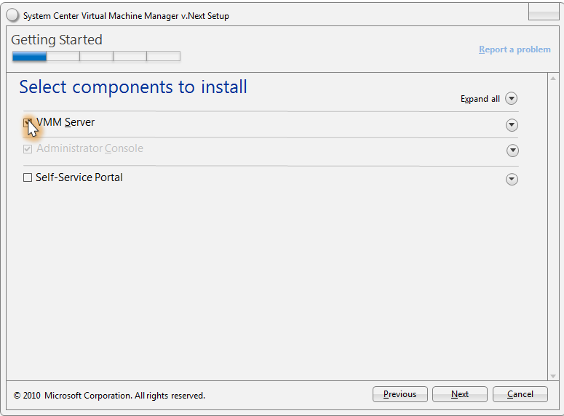
Incorporated in to Regular Installation

Slide 40
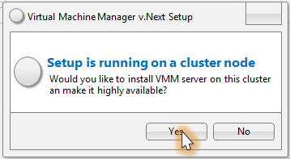
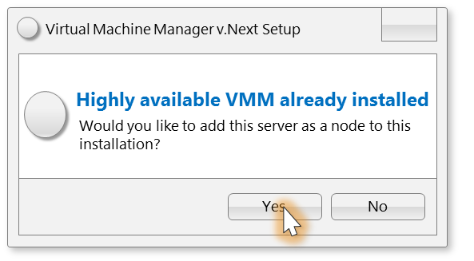
HAVMM Setup Node Validations
1. First installation
2. Additional node installations

Slide 41
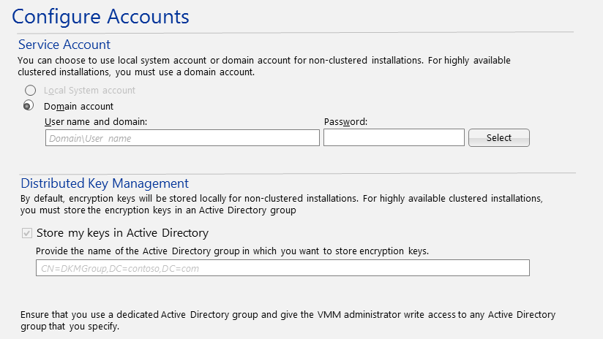
HAVMM Setup Account Configuration Page

Slide 42
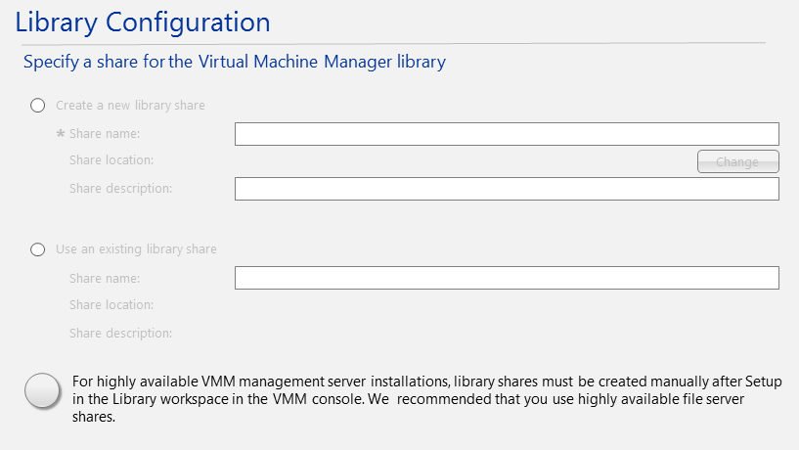
HAVMM Setup Library Page

