Slide 2

Modeling and Maintaining Virtualized Services in Microsoft System Center Virtual Machine Manager 2012
VIR315
Stephen Baron
Senior Program Manager
Microsoft Corporation

Slide 3
Session Objectives
Session Objective(s)
  Understand the benefits of Services in VMM
  Provide a detailed overview of Service lifecycle
  Enable easy deployment of Services to the Private Cloud
  Enable repeatable and predictable updating of a Service

Slide 4
System Center Virtual Machine Manager 2012
Deployment
Fabric
Cloud
Services
Infrastructure Enhancements
HA VMM Server
Upgrade
Custom properties
Powershell
Cloud Management
Application Owner Usage
Delegation and Quota
Capacity and Capability
Service Management
Application Deployment
Image Based Servicing
Custom Command Execution
Service Templates
Fabric
Management
Hyper-V Bare Metal Provisioning
Update Management
Hyper-V,
VMware, Citrix XenServer
Dynamic Optimization
Network Management
Power Management
Storage Management
Monitoring Integration

Slide 5

Services in VMM 2012
Template
      Starting point for services and source of truth
      Specifies machine and connectivity requirements
      Deployed services are always linked to their templates
      Enables servicing of the instances
Instance
      Groups of machines that work together
      Includes machine definitions as well as applications
      Native application types:
        Web Applications (WebDeploy)
        Virtual Applications (Server App-V Package)
        Database Applications (SQL DAC)

Slide 6
Why use Services?
Manage multi-tier applications across multiple servers as a single unit
Scale out based on demand
Composibility of OS and Applications, allows users to manage fewer OS images

Slide 7
Service Lifecycle Management
Create Template
Deploy
Service
Update Template and Apply to Service
Customize
Deployment

Slide 8
Create Service Template
Create Template
Deploy
Service
Update
Service
Customize
Deployment
Template is a starting point
  Author the template in the new Service Designer
Defines machines and their connectivity
  Tiers, Hardware, Logical Networks, OS, Apps, Load Balancer templates etc.
Deployed services are always linked to their templates
Typically information like hosts or load balancers is not available while creating template

Slide 9
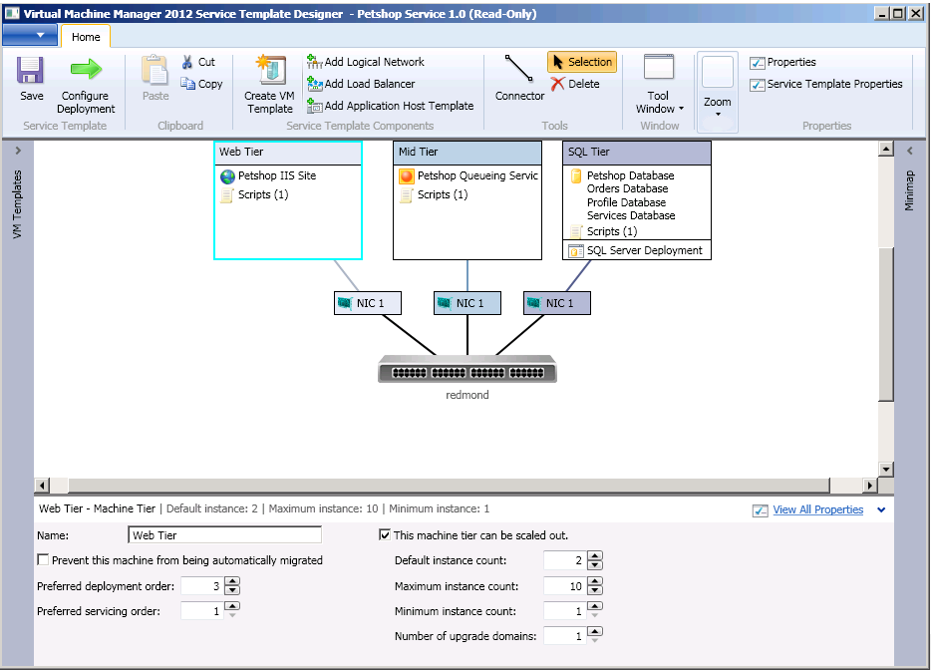
New! Service Designer
Ribbon
Designer canvas
Properties

Slide 10
Service Template and Instance
Single Tier Service
Service Template
Service Instance
Service Instance
VM Template
VM Template
Machine01
Machine02
Machine01
Application
Server App-V Package
Hardware Configuration
Server App-V Package
OS Roles/Features
Deploy
Hardware Configuration
WS08 R2
OS
.NET 3.51
.NET 3.51
WS08 R2
WS08 R2
OS
Notes:
Remove pink replace with dark blue, take off bevelling

Slide 11
Service Template Components
Service Template
Settings
Load Balancer Template
Computer Tier (1..n)
Application Host Profile (1…n)
VHDs
VM Template
Application Profile
Hardware Profile
Guest OS Profile
SQL Profile
SQL DAC Deployment
Pre/Post Install GCEs
Application Profile
Application Deployment (1..n)
Roles and Features
SQL Deployment
Pre/Post Install GCEs
Existing objects
New Objects
Extensibility points

Slide 12
Customize Deployment
Create Template
Deploy
Service
Update
Service
Customize
Deployment
Prepares the template for deployment
Specify OS settings
  Computer name, Admin password etc.
Specify Application Settings
  e.g. SQL connection string
Allows usage of same template in different environments
  Development, Staging, Production etc.

Slide 13
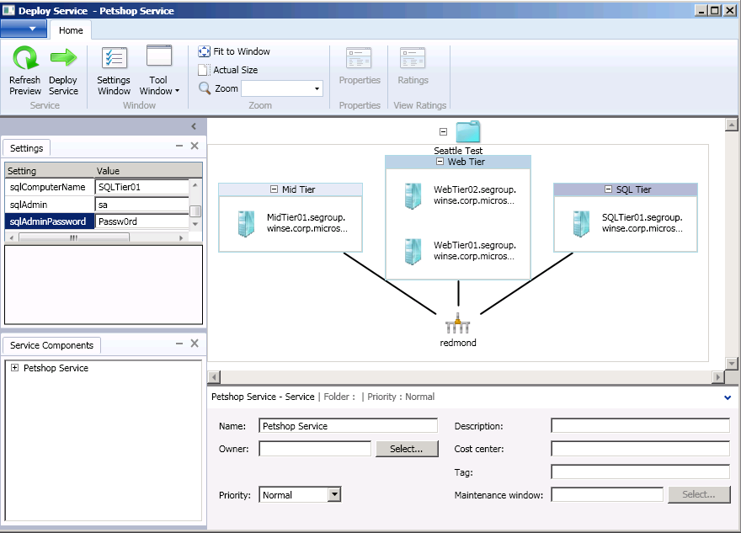
Deployment Preview
Create Template
Deploy
Service
Update
Service
Customize
Deployment
Deploy the service
Deploy to Cloud
Settings to override

Slide 14
Create Template
Deploy
Service
Update
Service
Customize
Deployment
Per Service
Per Machine
Per Guest OS
Per Application
Select Tier Based on Deployment Order
Create New VM from Template
Power On and Wait for VM
Install VMM guest agent
Application Profile Level Pre-Install GCE
Application Pre-Install GCE
Install Application
Application Profile Level Post-Install GCE
Application Post-Install GCE
Built-In Step
Done
Add to Load Balancer
Generic Command Executes in Guest

Slide 15
Create Service Template and Deploy
demo

Slide 16


Update Process
Associated machine templates
Update the machine templates
1
Apps or OS updated outside of VMM
Instance ready for update
Updated Service Instance
2
Original Service Template
Updated (New Version)
Service Template
4
Pending Service Template
3
Set the updated template
Original Service Instance
5
Deploy update in
Maintenance Window
Original Service Instance

Slide 17
Update Types
Create Template
Deploy
Service
Update
Service
Customize
Deployment
Regular updates
  Changes in template settings are applied without replacing OS image
  (e.g.) Change memory, update applications
Image based updates
  Replaces old OS image with new OS image
  Reinstalls the applications and restores state. e.g. moving from WS08 to WS08 R2

Slide 18
Regular Updating
Per Service
Per Machine
Per Guest OS
Per Application
Select Tier Based on Servicing Order
Select Machine Based on Upgrade Domain
Remove from Load Balancer
Application Pre-Service GCE
Application Pre-Uninstall GCE
Application Pre-install GCE
Apply Application Level Changes
Uninstall Application
Install Application
Done
Add to Load Balancer
Application Post-Service GCE
Application Post-Uninstall GCE
Application Post-install GCE
Built-In Step
Generic Command Executes in Guest

Slide 19
Image Based Updating
Per Service
Per Machine
Per Guest OS
Per Application
Select Tier Based on Servicing Order
Select Machine Based on Upgrade Domain
Remove from Load Balancer
Add Data Disk to Machine
Application Level Store State GCE
Swap OS Disk
Server App-V Backup State
Customize New OS
Application Profile Level Pre-Install GCE
Application Level Pre-Install GCE
Install Application
Application Level Post-Install GCE
Server App-V Restore State
Built-In Step
Done
Add to Load Balancer
Application Profile Level Post-Install GCE
Application Level Apply State GCE
Generic Command Executes in Guest

Slide 20
Update Services (Conventional)
demo

Slide 21
Service Level Refresher
Service level refresher updates all of the service information
  Identifies any virtual machines that have gone missing from the service
Service Refresher supports 2 states
  OK - All the VMs are OK
  Needs Attention
    At least one VM has a problem of some type
    VM refresher state indicates the actual problem

Slide 22
Service/Tier Level Actions
Service Level Actions
  Simple actions at the Service level cascade to the Virtual Machines
    Start, Pause, Resume, Stop, Shutdown, Delete
Tier Level Actions
    Scale out
    New Wizard enables this functionality
VM Level Actions
    Migrate VMs
    Store Virtual Machines to Library
    Deploy Virtual Machines from Library
    Clone Virtual Machines
    Create Checkpoints
    Scale in

Slide 23
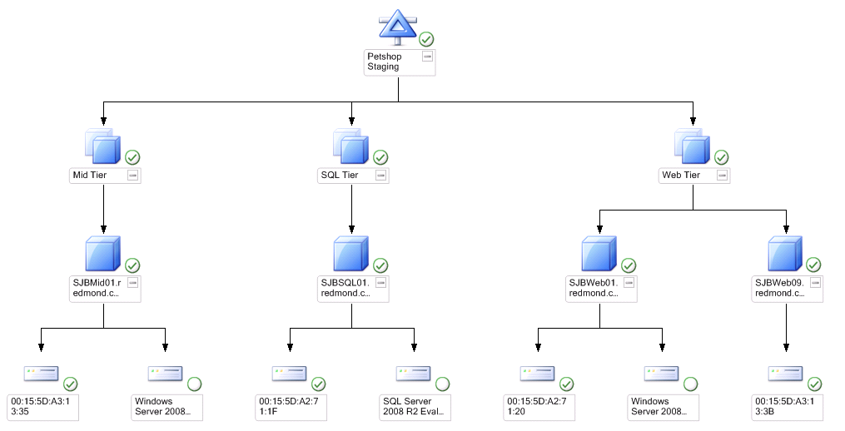
New! Deployed Service (OpsMgr Diagram)
Service
Computer Tiers
VM instance
VM Details

Slide 24
Scale Out / Operations Manager Integration
demo

Slide 25
Service Template Import and Export
Benefits
  Share templates between different environments
  Backup Service templates/VM templates
  VMM server synchronization in multi VMM installations
Template meta-data exported to XML file
  Secured settings are encrypted and stored
Allows for resources to be mapped during the import process

Slide 26
Service Template Import
demo

Slide 27
Related Content
Required Slide
Speakers, please list the Breakout Sessions, Interactive Discussions, Labs, Demo Stations and Certification Exam that relate to your session. Also indicate when they can find you staffing in the TLC.
VIR316 – VMM 2012 Deployment, Planning and Upgrade
SIM361 – VMM 2012 Fabric Lifecycle Part 2 – OSD, OOB and Agent
SIM357 – VMM 2012 Fabric Lifecycle Part 3 – Cluster Creation and Update Management
SIM212 – Hybrid Cloud Management with Microsoft System Center Code-Named “Concero”
VIR314 – Understanding Server App-V, Sequencing and Deploying Datacenter Applications

Slide 28
Track Resources
Don’t forget to visit the Cloud Power area within the TLC (Blue Section) to see product demos and speak with experts about the Server & Cloud Platform solutions that help drive your business forward.
You can also find the latest information about our products at the following links:
Cloud Power - http://www.microsoft.com/cloud/
Private Cloud - http://www.microsoft.com/privatecloud/
Windows Server - http://www.microsoft.com/windowsserver/
Windows Azure - http://www.microsoft.com/windowsazure/
Microsoft System Center - http://www.microsoft.com/systemcenter/
Microsoft Forefront - http://www.microsoft.com/forefront/

Slide 29





Resources
  Connect. Share. Discuss.
http://northamerica.msteched.com
Learning
  Sessions On-Demand & Community
  Microsoft Certification & Training Resources
www.microsoft.com/teched
www.microsoft.com/learning
  Resources for IT Professionals
  Resources for Developers
http://microsoft.com/technet
http://microsoft.com/msdn

Slide 30












Complete an evaluation on CommNet and
enter to win!

Slide 31

Notes:
New for TechEd 2011, we will be working with Microsoft Tag (http://tag.microsoft.com/overview.aspx) to create unique Tags for every session at the event. Your session Tag will appear on both the room signage and at the end of your presentation. With your session Tag, attendees will be able to scan as they enter the room to retrieve session details, view speaker bios, and engage in discussions; or scan at the end of the presentation to evaluate your session and download materials. We’re excited to integrate Microsoft Tag across the My TechEd mobile experience this year.

Slide 32

© 2011 Microsoft Corporation. All rights reserved. Microsoft, Windows, Windows Vista and other product names are or may be registered trademarks and/or trademarks in the U.S. and/or other countries.
The information herein is for informational purposes only and represents the current view of Microsoft Corporation as of the date of this presentation. Because Microsoft must respond to changing market conditions, it should not be interpreted to be a commitment
on the part of Microsoft, and Microsoft cannot guarantee the accuracy of any information provided after the date of this presentation. MICROSOFT MAKES NO WARRANTIES, EXPRESS, IMPLIED OR STATUTORY, AS TO THE INFORMATION IN THIS PRESENTATION.

