Slide 1

Inside the LAB: Building Your Own Private Cloud Infrastructure
VIR310
Mikael Nystrom
MVP Setup/Deployment
TrueSec

Slide 2
About the Speaker
Lives in Sweden but works globaly
Works with
  Deployment, Virtualization, Microsoft based infrastructure
Works as
  Consultant, Speaker, Trainer
MCT, MVP, Member of STEP

Slide 3
About the session
Hey Mikey, if I want to build a small private cloud, you just a small one, but have all the fancy stuff I need. How???
Ok, I’ll try to submit a session on TechEd about that then…

Slide 4
Things we will cover
Hyper-V
System Center Virtual Machine Manager
iSCSI
Failover Cluster (CSV)
SelfService portals
Deployment
Managment

Slide 5
Infrastructure
Active Directory – Check
Deployment Solution – Need one now

Slide 6
Deployment
Why do I need a deployment solution?
  Repeatable installs
  Disaster Recovery
What are my options?
  DVD with an autounattend.xml (bad choice)
  Microsoft Deployment Toolkit (good choice)
  System Center Configuration Manager (good choice)

Slide 7
Deploying HOST’s and VM’s using MDT
DEMO

Slide 8
Infrastructure
Active Directory – Check
Deployment Solution – Check
Hyper-V Hosts Deployed – Check
Shared Storage - ???

Slide 9
Shared Storage
Why do I need shared storage?
  CSV needs that, and you need CSV for failover cluster
  Shared storage offloads the Parent Partition
What are my options
  iSCSI (cheap, works, god enough in most cases)
  SAS (limited hardware design, could be expensive)
  FC (high performance but also expensive)

Slide 10
Using iSCSI as shared storge
DEMO

Slide 11
Infrastructure
Active Directory – Check
Deployment Solution – Check
Hyper-V Hosts Deployed – Check
Shared Storage – Check
Failover Cluster – Check
Management - ???

Slide 12
What do you mean?
Hyper-V manager works for me…
Why do I need better management then Hyper-V manager?
  You need automation
  You need templates
  You need to move machines around, park, and destroy machines from ONE location
  You need PowerShell scripting
What are my options?
  System Center Virtual Machine Manager (Need to have)
  PowerShell Library for Hyper-V (Nice to have in some cases)

Slide 13
System Center
Virtual Machine Manager and
PowerShell Library for Hyper-V
DEMO

Slide 14
Infrastructure
Active Directory – Check
Deployment Solution – Check
Hyper-V Hosts Deployed – Check
Shared Storage – Check
Failover Cluster – Check
Management – Check
SelfService Portal - ???

Slide 15
What do you mean, what's wrong with SCVMM?
Why do you need a Self Service portal
  To enable users to build their own systems
  To enable provisioning
  To free up time for YOU to manage the envirment
What are my options here?
  SCVMM SelfService Portal 1.0 (Not really god in a cloud scenario)
  SCVMM SelfService Portal 2.0 (Works for internal users/admins)
  Datacenter Toolkit for hosters (Works for external customers)

Slide 16
Self Service Portal 2.0
DEMO

Slide 17
Infrastructure
Active Directory – Check
Deployment Solution – Check
Hyper-V Hosts Deployed – Check
Shared Storage – Check
Failover Cluster – Check
Management – Check
SelfService Portal – Check
Monitoring - ???

Slide 18
Monitoring?
Yes, you need monitoring?
  You need to be able to se if all systems are healthy
  You need to be able to se performance issues
  You need to be able to see usage
  Basically you need something to look at when the rest is self maintanied…
What are my options?
  System Center Essentials (Small)
  System Center Operations Manager (Bigger)

Slide 19
Monitor using SCE/OpsMgr
DEMO

Slide 20
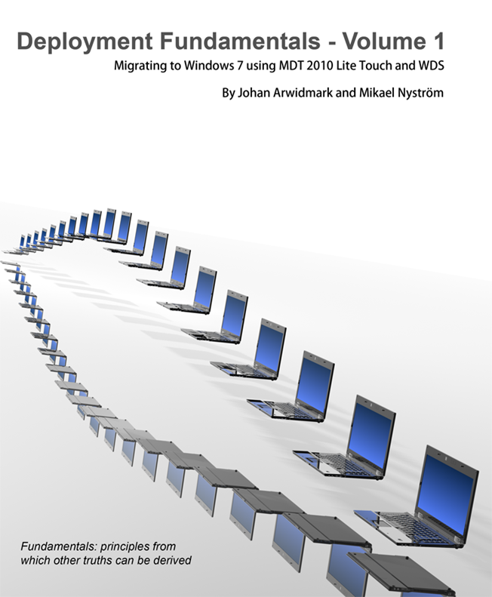
Resources - New Deployment Book!
Based on a True Story - A Real World Deployment Project

Slide 21

Track Resources
Don’t forget to visit the Cloud Power area within the TLC (Blue Section) to see product demos and speak with experts about the Server & Cloud Platform solutions that help drive your business forward.
You can also find the latest information about our products at the following links:
Cloud Power - http://www.microsoft.com/cloud/
Private Cloud - http://www.microsoft.com/privatecloud/
Windows Server - http://www.microsoft.com/windowsserver/
Windows Azure - http://www.microsoft.com/windowsazure/
Microsoft System Center - http://www.microsoft.com/systemcenter/
Microsoft Forefront - http://www.microsoft.com/forefront/

Slide 22





Resources
  Connect. Share. Discuss.
http://northamerica.msteched.com
Learning
  Sessions On-Demand & Community
  Microsoft Certification & Training Resources
www.microsoft.com/teched
www.microsoft.com/learning
  Resources for IT Professionals
  Resources for Developers
http://microsoft.com/technet
http://microsoft.com/msdn

Slide 23












Complete an evaluation on CommNet and
enter to win!

Slide 24


Slide 25

© 2011 Microsoft Corporation. All rights reserved. Microsoft, Windows, Windows Vista and other product names are or may be registered trademarks and/or trademarks in the U.S. and/or other countries.
The information herein is for informational purposes only and represents the current view of Microsoft Corporation as of the date of this presentation. Because Microsoft must respond to changing market conditions, it should not be interpreted to be a commitment
on the part of Microsoft, and Microsoft cannot guarantee the accuracy of any information provided after the date of this presentation. MICROSOFT MAKES NO WARRANTIES, EXPRESS, IMPLIED OR STATUTORY, AS TO THE INFORMATION IN THIS PRESENTATION.

