Slide 2

Creating “One Consistent Experience” across Your PC, Laptop and Tablet Desktops
VIR202
Jon Wallace, Benny Tritsch
AppSense
www.appsense.com

Slide 3
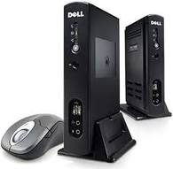




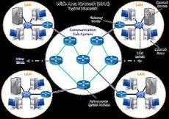
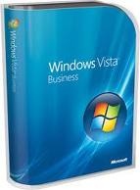
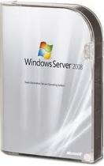

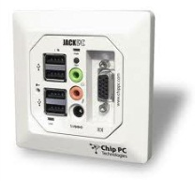
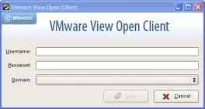
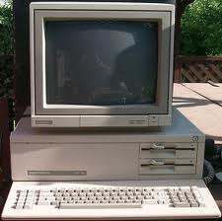
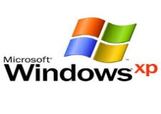

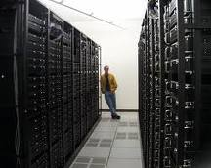
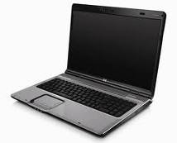
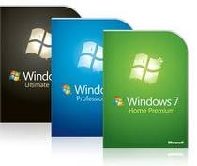
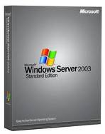
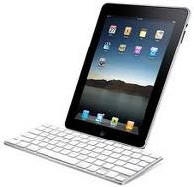

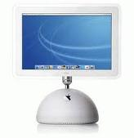
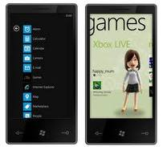
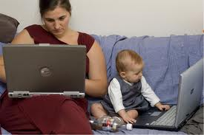

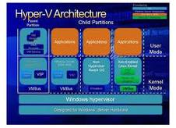

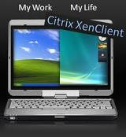

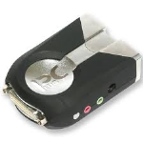

New Desktop World

Slide 4
Complexity: The side-effect of simplicity…
Technology is rapidly evolving to provide easier access to IT resources.
  Desktop Virtualization
  Technology which provides users with a hosted windows desktop, accessible from a range of devices or access points.
  Application Virtualization
  Technology which simplifies the deployment of corporate applications while minimizing traditional issues like compatibility.

Slide 5
Complexity: The side-effect of simplicity…
The main problem is that such technology is “phased-in” over a period of time.
  Users will operate in a “mixed technology” environment.
  Users will access their applications and data using a variety of ways.
  Users will need to re-learn (and re-personalize) due to the technology changes put into place.

Slide 6
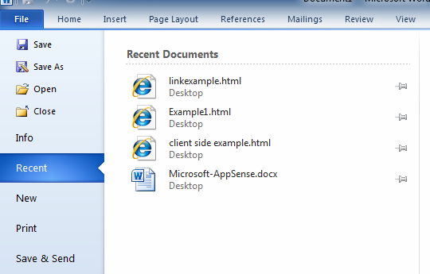
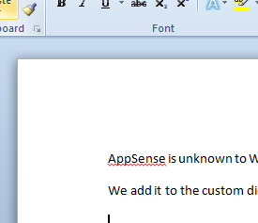

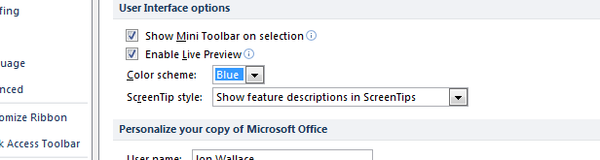


Microsoft Windows User Profile
Operating System

Slide 7


App-V Engine
Microsoft Windows User Profile
Operating System

Slide 8

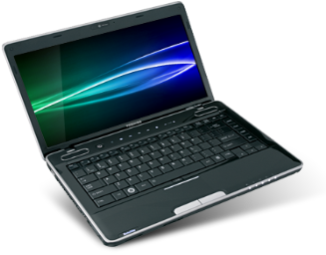

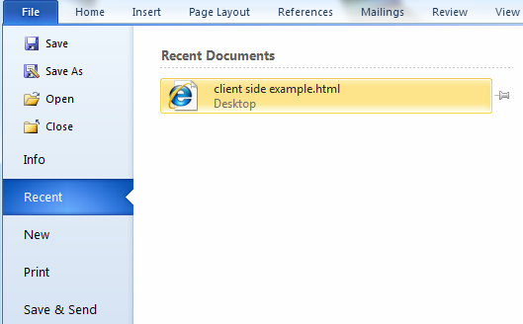


App-V Engine
Microsoft Windows User Profile
Microsoft Windows User Profile
Operating System
Operating System

Slide 9
App-V technology and its effect on an application’s look and feel…
demo

Slide 10












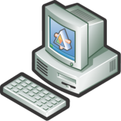
Individual Requirements
Remote Access
local
Security,
Performance
remote
Offline Capabilities
cloud

Slide 11




User Desktop Options
Local
Hosted
PC
Mobile
VDI
RDS/TS

Slide 12
Windows User Profiles Fundamentals
Internet Explorer Settings
Application 1 Settings
Files and Folders
Application 2 Settings
Workspace Settings
User Profile = User State = Persona = Individual Settings

Slide 13
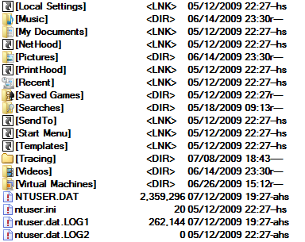


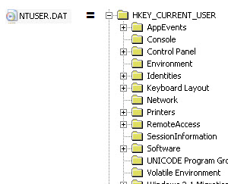
Windows User Profiles Fundamentals
Folder structure
Profile
User
Registry - HKCU

Slide 14


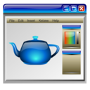

Local Profiles
File
Server
User Account 1
Profile 1
Profile 1
Profile 1
Domain
Controller

Slide 15
Roaming Profiles
Profile 1
Profile 1
Profile 1
File
Server
User Account 1
Profile 1
Profile 1
Domain
Controller

Slide 16
Mandatory Profiles
Profile
File
Server
User Account 1
Profile 1
Profile 1
Domain
Controller

Slide 17
Comparing Profile Types
 | Local | Roaming | Mandatory
Personal settings | yes | yes | no
Configuration | automatic | by admin | by admin
Backup | challenging | no problem | no problem
Transfer between computers | difficult | easy | easy
Performance | high | medium to low | medium
“Last write wins” issue | no | yes | no
Management | easy | hard | easy
Storage | local | central | central

Slide 18
Microsoft’s Profile Solutions
User State Virtualization (USV)
  Roaming User Profiles (RUP)
  Folder Redirection (FR)
  Offline Files (OF)
Built-in features around user profiles
  User Profile Service
  AppData redirection
  IntelliMirror
User Profile Migration
  User State Migration Tool (part of the WAI Kit for Windows 7)

Slide 19

Folder Redirection
Profile 1
Profile 1
Profile 1
File
Server
File
Server

Slide 20
Folder Redirection
Folder Redirection gives administrators the ability to move user data out of the profile, giving users real-time access to their data
  Can be done on a server by server basis
  Can be configured in Group Policy
  Can redirect multiple folders to many locations
Hard-coded folder redirection is possible
  HKCU\Software\Microsoft\Windows\CurrentVersion \Explorer\ User Shell Folders

Slide 21
User Profile Versions
User Profiles – V 1
  Applies to Windows 2000, Windows XP and Windows Server 2003
  Individual profile path: \Documents and Settings\<username>
  Contains folders specific to operating system language
User Profiles – V 2
  Applies to Vista, Windows 7 and Windows Server 2008 R2
  Individual profile path: \Users\<username>
  Folder names are not localized, but still contain localized directory junctions for compatibility
  Separates machine and application-specific data

Slide 22
Profile Folder Structure
Windows 7 Folder Name | Windows XP Folder Name | Description | Windows XP Folder Location
Contacts | Not applicable | Default Location for Users’s Contacts | Not applicable
Desktop | Desktop | Desktop items, including files and shortcuts | Documents and Settings\%username%\Desktop
Documents | My Documents | Default location for all user created documents | Documents and Settings\%username%\My Documents
Downloads | Not applicable | Default location to save all downloaded content | Not applicable
Favorites | Not applicable | Internet Explorer Favorites | Documents and Settings\%username%\Favorites
Music | My Music | Default location for user’s music files | Documents and Settings\%username%\My Music
Videos | My Videos | Default location for user’s video files | Documents and Settings\%username%\My Videos
Pictures | My Pictures | Default location for user’s picture files | Documents and Settings\%username%\My Pictures
Searches | Not applicable | Default location for saved searches | Not applicable
AppData | Not applicable | Default location for user application data and binaries (hidden folder) | Not applicable
Links | Not applicable | Contains Windows Explorer Favorite Links | Not applicable
Saved Games | Not applicable | Used for Saved Games | Not applicable
Notes:
AppData
- Roaming - Symbolic Link: Application Data
- LocalLow
- Local

Slide 23
Profile Folder Structure
Windows 7 Profile Location Users\username\... | Windows XP Profile Location Documents and Settings\username\...
…\AppData\Roaming | Application Data
N/A | Local Settings
…\AppData\Local | Local Settings\Application Data
…\AppData\Local\Microsoft\Windows\History | Local Settings\History
…\AppData\Local\Temp | Local Settings\Temp
…\AppData\Local\Microsoft\Windows\Temporary Internet Files | Local Settings\Temporary Internet Files
…\AppData\Roaming\Microsoft \Windows\Cookies | Cookies
…\AppData\Roaming\Microsoft\Windows\Network Shortcuts | Nethood
…\AppData\Roaming\Microsoft\Windows\Printer Shortcuts | PrintHood
…\AppData\Roaming\Microsoft\Windows\Recent | Recent
…\AppData\Roaming\Microsoft\Windows\Send To | SendTo
…\AppData\Roaming\Microsoft\Windows\Start Menu | Start Menu
…\AppData\Roaming\Microsoft\Windows\Templates | Templates
…\Contacts | Not applicable
…\Desktop | Desktop
…\Documents | My Documents
…\Downloads | Not applicable
…\Favorites | Favorites
…\Music | My Music
…\Videos | My Videos
…\Pictures | My Pictures
…\Searches | Not applicable
…\Links | Not applicable
…\Saved Games | Not applicable

Slide 24
Profile Folder Structure
AppData\Local (Win7) = Documents and Settings\username\Local Settings\Application Data (WinXP)
AppData\Roaming (Win7) = Documents and Settings\username\Application Data (WinXP)

Slide 25
Traditional Profile Management
demo

Slide 26
Challenge: Profile Bloat
Logon Times
Ntuser.dat
Time in seconds
Managed profile
Time in months

Slide 27





Windows User Profiles
Windows Settings
Application Settings
Profile Data
Windows API
User Session
Windows Operating System

Slide 28
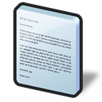




Solutions – Streaming and Segmentation
Profile Streaming
Profile Segmentation
Profile Data
Base
Segmentation Runtime
Windows API
Windows API
User Session
User Session
Windows OS
Windows OS

Slide 29
User Virtualization
Virtualize the user and treat it as a layer

Slide 30
What is User Virtualization?
A technology layer (like Desktop Virtualization) which allows a users experience to be portable and consistent regardless
Encompasses many elements of the user experience including personality, data and user applications
Applies to a desktop stack regardless of delivery (physical, virtual or remote / streamed)

Slide 31
What is User Virtualization?
User State
User Data
User Apps
User Policy
Enterprise Management
User Virtualization
Virtual
Streamed
Cloud
App Virtualization
Hardware Virtualization

Slide 32
So What Is USV, What’s The Difference?
A Microsoft Windows component (like DFS) which allows a user personality to roam between different machines
A combination of Windows Roaming Profiles and Folder Redirection
Mature technology which has been in the operating system for many years
Serves a distinct purpose – to roam user settings

Slide 33
So What Is USV, What’s The Difference?
Remember, UV is a technology whereas USV is a component – USV is actually part of UV
UV has a broad reach and set of requirements, USV is a component focused on a specific task
USV is Microsoft Windows OS specific – other such components apply to their relevant OS’s – all are part of UV

Slide 34
What is AppSense User Virtualization?
AppSense provides User Virtualization technology, just like Oracle provides database technology and Salesforce.com provides CRM technology
AppSense UV technology consists of multiple capabilities including those that extend Microsoft Windows USV

Slide 35
A consistent personality between locally installed and virtual applications
demo

Slide 36
App-V Engine
Microsoft Windows User Profile
Microsoft Windows User Profile
Operating System
Operating System
Notes:
When a mixture of technology is in use within an environment for example App-V based applications on the corporate desktop but locally installed applications on a laptop, the user maintains 2 separate set of settings. This means that configuration information such as recently used document lists, custom dictionaries and GUI settings are not shared or maintained between the different instances of the same application resulting is a poor user experience.

Slide 37

User Virtualization
User Virtualization
App-V Engine
Microsoft Windows User Profile
Microsoft Windows User Profile
Operating System
Operating System
Notes:
When AppSense User Virtualization technology is in use, a user layer is inserted dynamically between the application and the environment allowing AppSense to intercept the various reads and writes made by the application regardless of whether it is virtual or locally installed. AppSense can then synchronize these settings ensuring a consistent experience across the different delivery mechanisms.

Slide 38
Providing a consistent personality between different versions of the Windows operating system
demo

Slide 39
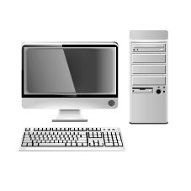



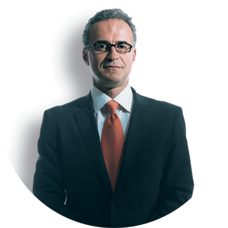










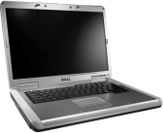











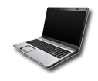


Manage Users Rather than Devices

Slide 40








Managing the whole user…
Data
Rights
Favorites
Policies
Applications
Policies
Rights
Favorites
Applications
Personalization
Personalization
Data
Permissions
Permissions

Slide 41

Track Resources
Required Slide
Track PMs will supply the content for this slide, which will be inserted during the final scrub.
AppSense Homepage: www.appsense.com
Find us at the AppSense booth # 701 here at Tech•Ed

Slide 42





Resources
  Connect. Share. Discuss.
http://northamerica.msteched.com
Learning
  Sessions On-Demand & Community
  Microsoft Certification & Training Resources
www.microsoft.com/teched
www.microsoft.com/learning
  Resources for IT Professionals
  Resources for Developers
http://microsoft.com/technet
http://microsoft.com/msdn

Slide 43












Complete an evaluation on CommNet and
enter to win!

Slide 44

Notes:
New for TechEd 2011, we will be working with Microsoft Tag (http://tag.microsoft.com/overview.aspx) to create unique Tags for every session at the event. Your session Tag will appear on both the room signage and at the end of your presentation. With your session Tag, attendees will be able to scan as they enter the room to retrieve session details, view speaker bios, and engage in discussions; or scan at the end of the presentation to evaluate your session and download materials. We’re excited to integrate Microsoft Tag across the My TechEd mobile experience this year.

Slide 45

© 2011 Microsoft Corporation. All rights reserved. Microsoft, Windows, Windows Vista and other product names are or may be registered trademarks and/or trademarks in the U.S. and/or other countries.
The information herein is for informational purposes only and represents the current view of Microsoft Corporation as of the date of this presentation. Because Microsoft must respond to changing market conditions, it should not be interpreted to be a commitment
on the part of Microsoft, and Microsoft cannot guarantee the accuracy of any information provided after the date of this presentation. MICROSOFT MAKES NO WARRANTIES, EXPRESS, IMPLIED OR STATUTORY, AS TO THE INFORMATION IN THIS PRESENTATION.

