Slide 2

Virtualization: State of the Union
VIR 201
Mike Schutz
Senior Director, Product Management
Server and Cloud Division
Microsoft Corporation

Slide 3
Virtualization: State of the Union
Cloud, Evolution of DC, Cloud Attributes & Benefits, Technology Inflection Points & Microsoft Cloud Platform—(10 minutes)
Microsoft Private Cloud—(5 minutes)
Application Driven—(5 minutes)
System Center 2012 Demo—(6 minutes)
Cross-Platform—(5 minutes)
Cloud on your terms and Hyper-V Cloud—(7 minutes)
NetApp FastTrack Demo—(5 minutes)
Optimized for Business Critical Workloads & Hyper-V Momentum—(7 minutes)
Desktop Virtualization—(7 minutes)
Dynamic Memory Demo—(7 minutes)
Partner Ecosystem—(5 minutes)
Wrap-up—(3 minutes) Total: 72 minutes
NEXT: <next slide title>

Slide 4

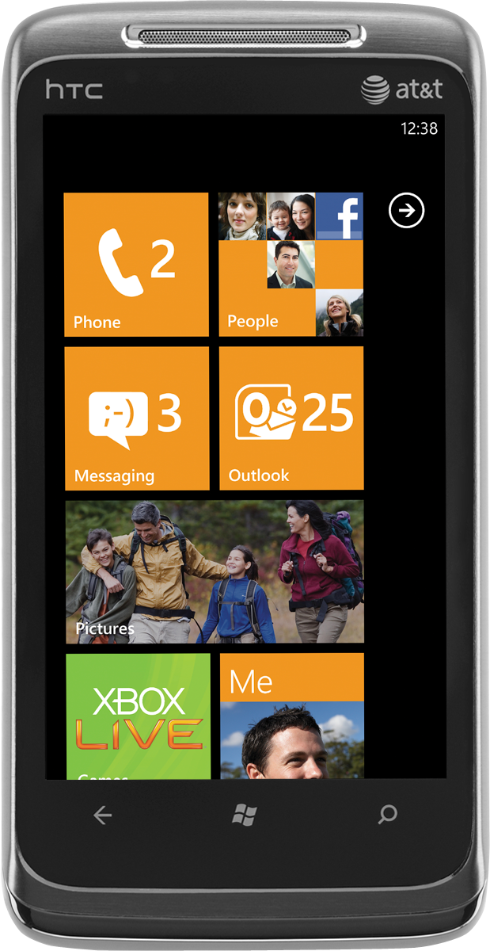
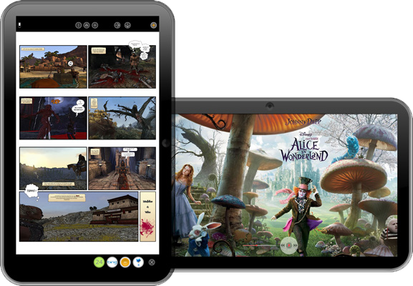

CLOUD
DEVICES

Slide 5

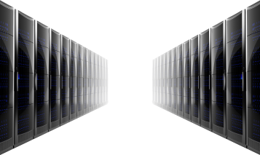

Evolution of Datacenter Computing
Traditional
Virtualized
Cloud
Private Public
Cloud Computing = Delivering IT as a Service
Freeing You Up to Focus on Your Business

Slide 6
Cloud Computing
Attributes
Benefits
Self-service
Agility
Shared
Focus
Scalable and elastic
Economics
Usage-based

Slide 7
Virtualization Adoption
Traditional
Virtualized
Cloud
Private
Public
SHIPPED MACHINES VIRTUALIZED
MACHINE INSTANCES RUN RATE
10.7M
7.8M
Server Shipments (FY11)
Virtualized Server Shipments (FY11)
Source: IDC 2010 Server Virtualization Module, Nov 2010
Source: Microsoft
INSTALL BASE MACHINE INSTANCE
MACHINE SHIPMENTS PROJECTED 2011 - 2014
8.6M
9.0M
28.2M
27.6M
8.2M
Servers (FY11)
7.7M
Virtualized Servers (FY11)
Source: Microsoft
Source: IDC Server Shipment Forecast, Dec 2010 (Converted from CY to Microsoft FY)

Slide 8






Microsoft’s Cloud Approach
PUBLIC CLOUD
COMMON
Identity ▪ Virtualization ▪ Management ▪ Development
PRIVATE CLOUD

Slide 9


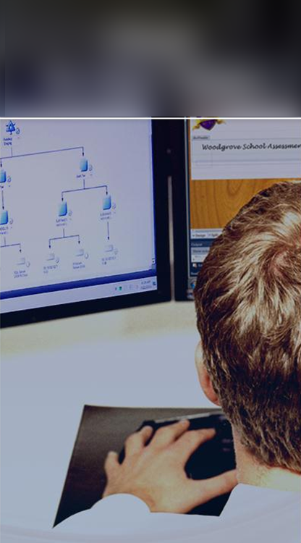
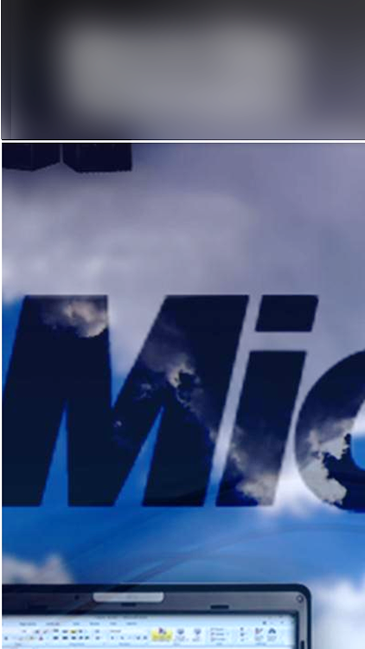

The Microsoft Private Cloud…
Optimized for business-critical applications
Application driven
Cross-platform
Cloud on your terms
  Deep insight into applications
  Manage the service, not just VMs
  Hypervisors
  Guest OS’s
  Development frameworks
  Private to Public
  Common tools and frameworks
  Single pane of glass across clouds
  Best platform to virtualize Microsoft workloads
  Hyper-V is the fastest growing hypervisor

Slide 10
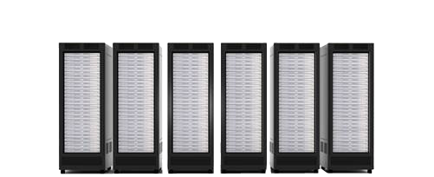


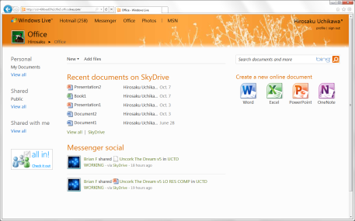
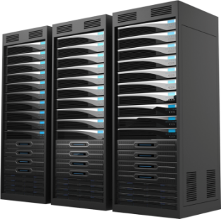
Deep Application Insight with System Center 2012
Predictable
applications
Productive
infrastructure
Your cloud
Predictable application service levels delivered by leading monitoring experiences and deep application insight
Deliver flexible and cost effective infrastructure with what you
already know and own
Private and public cloud computing
on your terms managed with
a common toolset
Notes:
Talking Points:
Cloud Computing is emerging as a major disruptive force in shaping the nature of business and IT conversations. Cloud Computing enables what we call “IT as a Service” which represents IT as being delivered to the business in a manner that’s agile & cost-effective while meeting the quality of service (QoS) parameters that the business has come to expect today. A cloud service demonstrates attributes like self-service, metered by use, elasticity and scalability.
Now, any “as a Service” offering by definition has a “Service Provider” and “Service Consumer”. Simplistically speaking, service consumer is represented by business interests while service provider is represented by IT. These constituencies are incented around different KPIs – for e.g. a business/app owner would care about time to market, costs and ease of use, & simplicity whereas IT optimizes for security, compliance, process controls and availability. To align these interests, we need a mechanism to deliver the agility that the business needs while ensuring the operational efficiencies that IT cares about most.
Enter System Center 2012.
System Center 2012 cloud and datacenter management solutions empower you with a common management toolset for your private and public cloud applications and services. System Center helps you confidently deliver IT as a Service for your business.
For context, our target audience through this conversation is the CIO, Operations leader (CIO -1) & Applications leader (CIO -1). We characterize the Operations leader as our “Service Provider” and the Applications leader as our “Service Consumer”.
Predictable Applications
System Center 2012 cloud and datacenter management solutions help you deliver predictable SLAs to your business by maximizing your applications’ availability and performance.
Comprehensive application manageability
Server Application Virtualization (SAV), which is part of System Center Virtual Machine Manager 2012, optimizes your existing applications for private cloud deployments with sequenced state separation between the application and underlying infrastructure, acting as a bridge in your journey to cloud standardization. SAV simplifies application servicing with image based configuration and management techniques that reduce administrative effort and expense.
Deep application monitoring and diagnosis
System Center 2012 cloud and datacenter management solutions (with System Center Operations Manager 2012 and AVIcode) offer e2e transaction monitoring for .Net/J2EE applications to maximize availability and performance. This also unlocks seamless & agile “dev-ops” collaboration scenarios, thereby improving performance against your SLAs commitments to the business. Easy to use reporting and dash-boarding allows you track and communicate your SLAs more effectively. Additionally, System Center Advisor enables you maximize application performance and availability with proactive configuration monitoring – we’re starting with SQL based workloads.
Service centric approach
System Center cloud and datacenter management solutions offer a service centric approach to help you deliver business agility while unlocking application mobility between your cloud environments when it’s time. From deploying applications (design, composition, provisioning & configuration) to operating applications (monitoring, compliance & protection), we manage the full application lifecycle.
Productive Infrastructure
System Center 2012 cloud and datacenter management solutions helps you deliver agile and cost effective Infrastructure-as-a-Service (IaaS) today with what you already know and own. We also offer best-of-breed management for your business critical Microsoft server workloads (e.g. optimize performance, scale and data protection for Sharepoint, Exchange, SQL). Finally, we support your heterogeneous datacenter investments.
Self-service infrastructure
With System Center 2012 cloud and datacenter management solutions, you can create a private cloud today thus optimizing usage of your datacenter investments. You can pool & dynamically allocate your datacenter resources (i.e. compute, network, and storage) enabling a service catalog based self-service experience for your business, with appropriate role based identity and access (as enabled by Active Directory and the Virtual Machine Manager administrator console).
Process automation
System Center 2012 cloud and datacenter management solutions offer IT process automation with orchestrated workflows across systems and tasks (with System Center Orchestrator). This enables you lower costs and improve datacenter service reliability. With System Center Service Manager, We also offer industry standard service management capabilities (based on ITIL/MOF) which automates core datacenter processes like incident management, problem management, change management, and release Management.
Heterogeneous support
To help you optimally leverage your existing datacenter investments, System Center 2012 cloud and datacenter management solutions support heterogeneous datacenter management. For e.g. we offer multi hypervisor management (with System Center Virtual Machine Manager for VMware and Xenserver), cross platform monitoring of Linux/Unix guests (with System Center Operations Manager), cross platform configuration management (with System Center Configuration Manager) & integrated automation across management toolsets from traditional vendors (with System Center Orchestrator).
Your Cloud
System Center 2012 cloud and datacenter management solutions empower you to deliver and consume private and public cloud computing on your terms, with common management experiences across your hybrid environments.
Flexibility with delegation and control
Construct and manage clouds across multiple customer datacenters, multiple infrastructures (e.g. Microsoft & VMware), and service providers (e.g. Windows Azure). Create and allocate logically distinct clouds in alignment with business goals – for e.g. business requirements might dictate that a marketing cloud has a different service level versus a finance cloud. Provide delegated authority and tools to enable self-service flexibility for your business. Virtual Machine Manager enables these capabilities.
Common console across clouds
System Center cloud and datacenter management solutions empower your application and service owners with a common self-service experience across private cloud and public cloud. With “Project Concero”, we give you full visibility and control of your Windows Azure and Virtual Machine Manager deployed applications, so you can confidently adopt Windows Azure as your Platform as a Service (PaaS) choice.
Physical, virtual & cloud management
System Center has historically been known for physical and virtual management in the datacenter. You can now use your familiar on-premises System Center Operations Manager to monitor your Windows Azure applications (Windows Azure Application Monitoring Management Pack is in RC status now) – thus extending your common management experience to the cloud. With System Center 2012, we’re delivering on a number of unique management experiences for your private cloud. We believe “hybrid” environments will be the norm over the next few years. A common management toolset with integrated Physical, Virtual, IaaS & PaaS management will help you optimize ROI.

Slide 11
System Center 2012
Peter Meister
Senior Technical Product Manager
Windows Server and Private Cloud Product Management
demo

Slide 12
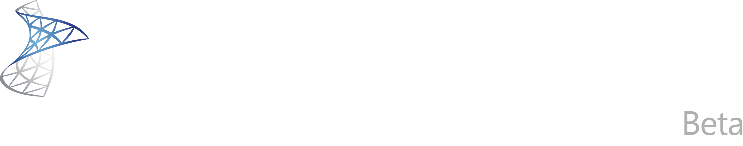
http://www.microsoft.com/systemcenter/vmm2012
beta available now

Slide 13
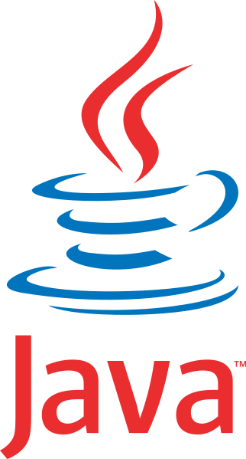







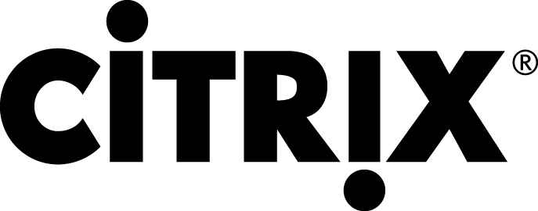

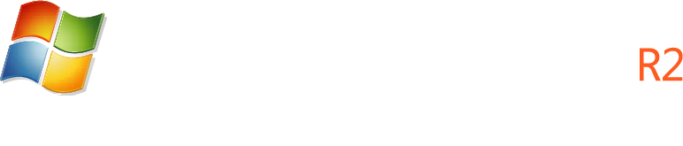


Cross-Platform Support
Storage
Network
Third party management

Slide 14





Cloud On Your Terms
Mobility
Azure VM role
Private Cloud
Public Cloud
Identity
Management
Virtualization
Hyper-V
Development

Slide 15


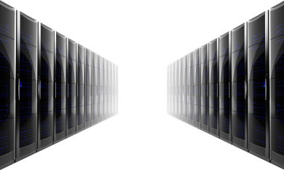
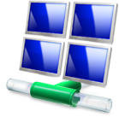






Programs to help accelerate deployment of Infrastructure-as-a-Service (IaaS)
Custom
Pre-configured
Hosted
Deployment
option
Programs
Hyper-V Cloud
Deployment Guides
Hyper-V Cloud
Fast Track
Hyper-V Cloud Service Providers
Hyper-V Cloud Accelerate
Service
delivery

Slide 16
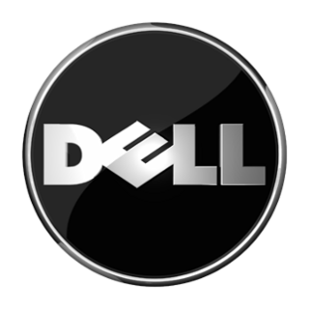


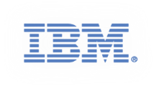
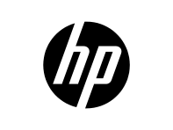



Hyper-V Cloud Fast Track
Windows Server 2008 R2 Hyper-V
Private cloud reference architecture
System Center
Compute
Network
Storage
SCOM
VMM
Portal
Speed to deployment
Reduce risk
Flexibility and choice
!
Notes:
Hyper-V Cloud Fast Track is composed of:
Reference Architecture based on hundreds of MCS deployments with engineering collaboration
Shared with OEM partners who build reference configurations based on the architecture and extended with their own value-added technologies
Configurations are validated to ensure they are consistent with the architecture and meet the required functionality
The key benefits are: Speed to Deployment (deployment guides to build out quickly); Reduced Risk (pre-validated so the components are matched for optimal performance; Flexibility and Choice (work with a broad set of OEM partners to deliver cloud on your terms with your preferred partners)
These leads to the announcement of 2 new partners joining our Fast Track program <Click to next slide>
HP’s Fast track solution is called: HP Cloud Foundation for Hyper-V
It is featured in regards to hosting the Hands on Labs – similar to what they did at MMS – the area is called the “Serverquarium” – putting the rack in the middle of a glassed in area – similar to this at MMS:

Slide 17
NetApp and Cisco join Hyper-V Cloud Fast Track Program
NetApp Hyper-V Cloud Fast Track with Cisco
announcement

Slide 18
NetApp Hyper-V Cloud Fast Track with Cisco
Alex Jauch
Architect, Microsoft Private Cloud
NetApp
demo

Slide 19
Fast Track: Rapid Provisioning
Component of NetApp Cisco Fast Track submission
Rapid provisioning via sub-LUN clones
Integrated with SCSM and SCVMM
Utilizes FlexClone for files
Based on OnCommand 3.0 OIP or PowerShell
For more information:
  VIR327: Tuesday 10:15 in B211
  www.netapp.com/microsoftcloud

Slide 20
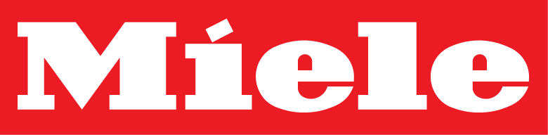

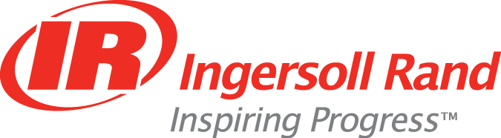





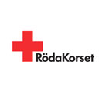


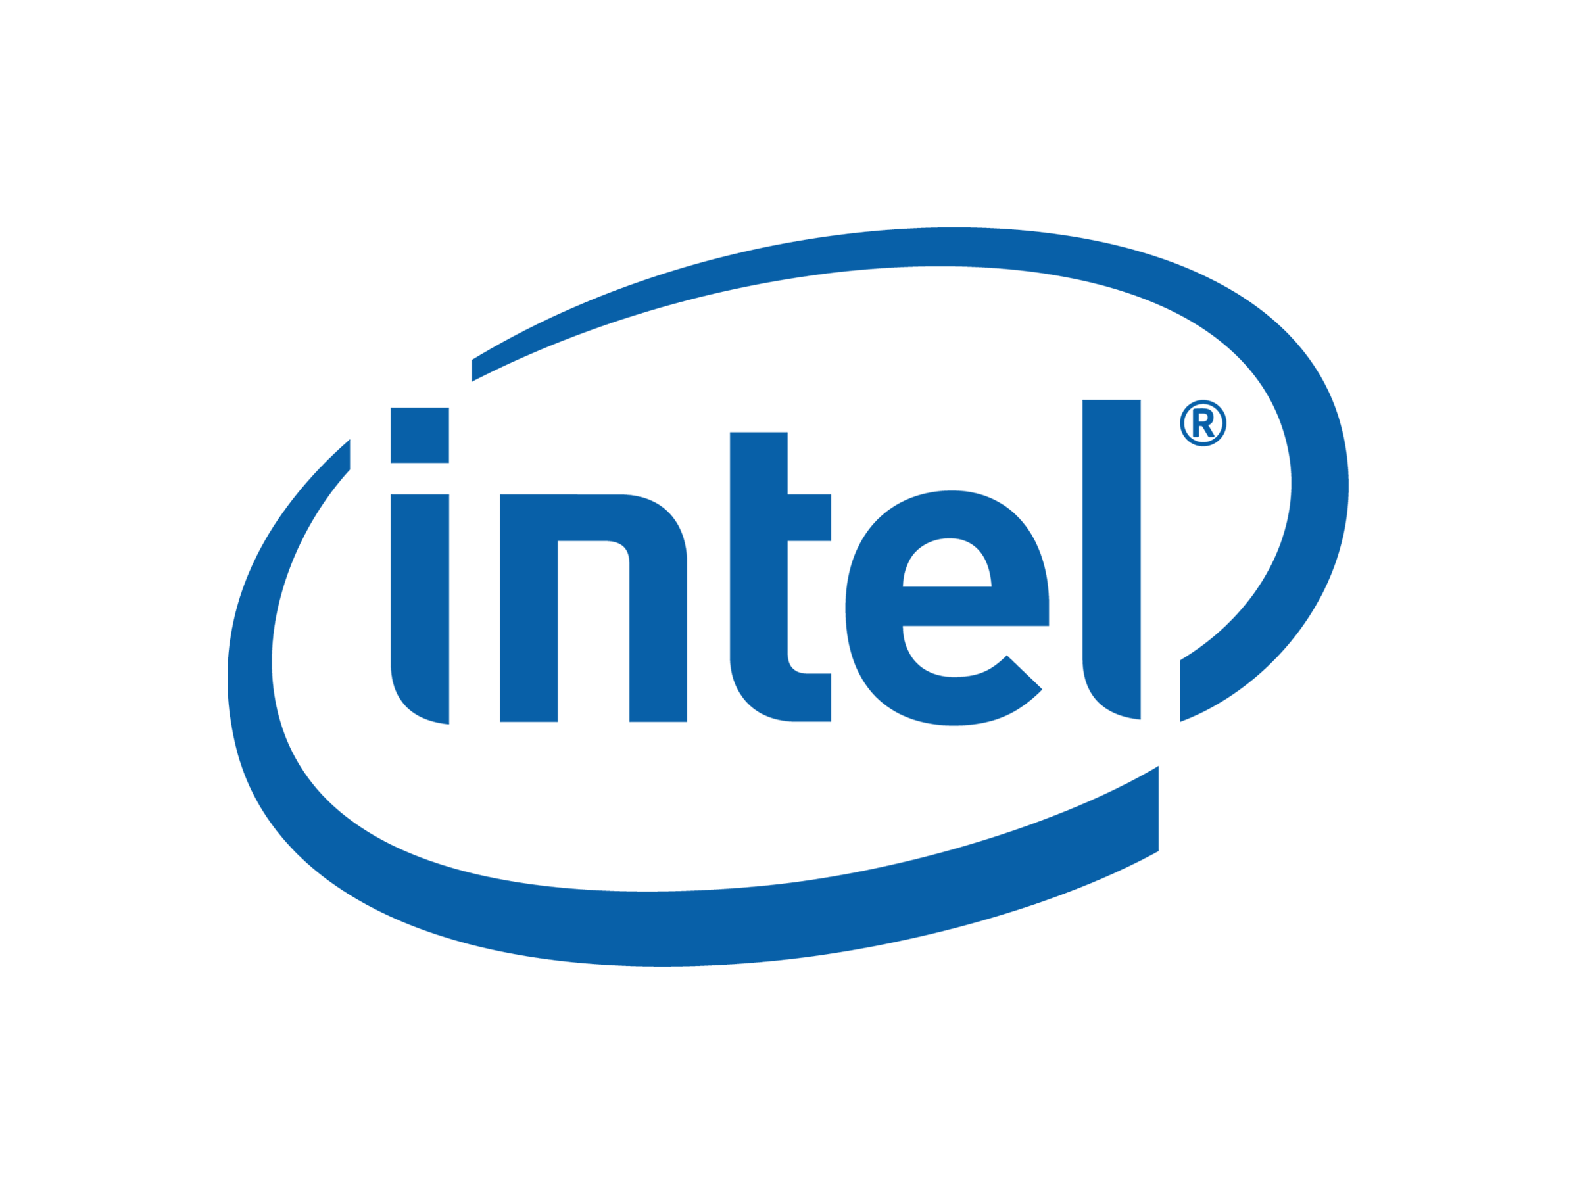


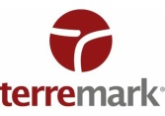





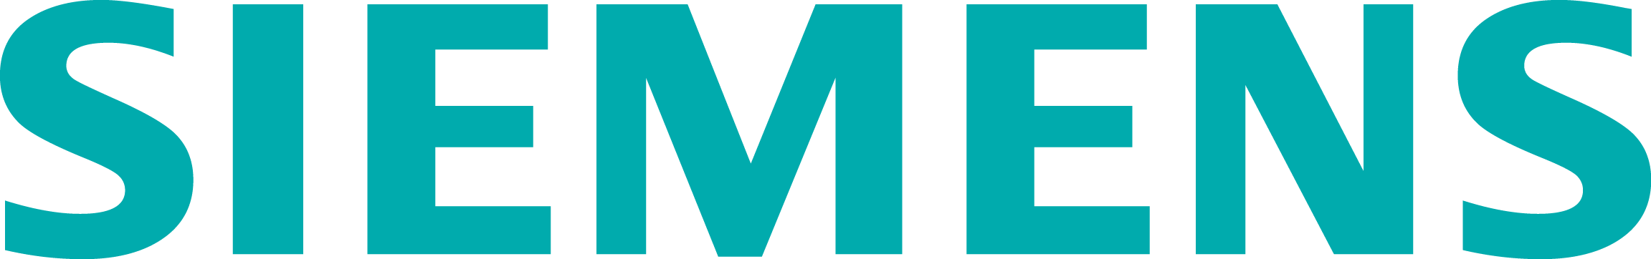
Hyper-V Momentum
“With Hyper-V, Target can reduce our stores’ server footprints without sacrificing the mission-critical application performance that contributes to a superior retail experience for our guests.”
Jeff Mader, Vice President, Target Technology Services

Slide 21

video
video

Slide 22
Tremendous Momentum for Hyper-V
Change in hypervisor market share
over the past 3 years
Source: IDC WW Quarterly Server Virtualization Tracker, March 2011. Data represents x86 + EPIC based servers
“With Hyper-V, Target can reduce our stores’ server footprints without sacrificing the mission-critical application performance that contributes to a superior retail experience for our guests.”
Jeff Mader, Vice President, Target Technology Services

Slide 23
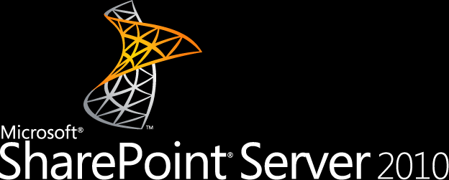
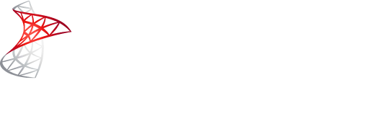
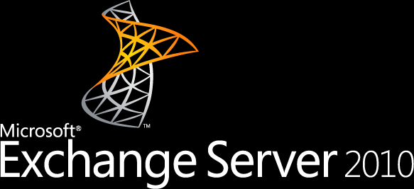
Optimized for Business Critical Applications
460,800 light-weight 1% concurrent users
80,000 simulated OLTP customers
20,000 Exchange 2010 mailboxes
It’s clear that Hyper-V R2 SP1 can be used to virtualize tier-1 data center applications with confidence.
– Enterprise Strategy Group Research, Mark Bowker
Notes:
Sharepoint
SharePoint 2010
ESG Lab tested SharePoint 2010 collaboration software on a physical server with SharePoint roles running in three to five virtual machines. SharePoint roles (SQL Server back-end, web server front-end, and the SharePoint application) were configured to run in separate virtual machines. Testing was performed with one, two, and three web servers to assess the performance and scalability of SharePoint 2010 workloads running within a consolidated infrastructure powered by Hyper-V R2 SP1.
SharePoint and the web server VMs were configured with two virtual CPUs and 4 GB of RAM. The SQL Server 2008 R2 VMs were configured with 4 virtual CPUs and 32 GB of RAM. An F5 BIGIP Local Traffic Manager was used to load balance web server traffic with a round-robin scheduling algorithm.
Microsoft Visual Studio 2010 software was used to generate the SharePoint application workload. A non-blocking workload was tested with a goal of maximizing the stress on the Hyper-V R2 SP1 and SharePoint 2010 infrastructure. A 22 GB content database was tested with simulated users running a mix of light-weight SharePoint operations (89% browsing, 10% upload, 1% check-in/check-out). Visual Studio was installed and ran on a separate physical server with 24 CPU cores and 128 GB of RAM. A constant workload was tested with one, two, and three web servers.
Summary of Results
• As expected, CPU utilization of the front-end was the bottleneck during single web server VM testing.
• Adding web server VMs alleviated the CPU bottleneck.
• Adding web server VMs increased the number of 1% concurrent SharePoint users from 252,600 to 460,800.
• Average page response times improved as web servers were added.
• Average page response times were faster than the Microsoft-recommended guideline of 1-2 seconds.
Why This Matters
Microsoft’s SharePoint suite has quickly attained must-have status for organizations with collaboration needs and large quantities of unstructured data. It is fulfilling an increasing need for global collaborative technology platforms and much of its success lies in the fact that it fundamentally focuses on business—not technology—objectives. Deploying SharePoint in a highly virtualized environment is therefore becoming essential to maintain focus on business process improvement and core company goals. SharePoint is quickly becoming a popular application for server virtualization: 46% of organizations surveyed already have it deployed in a virtualized environment and an additional 42% have plans for or interest in deploying it on a virtualized platform.
SharePoint’s role as an enterprise collaboration platform calls for high availability and data mobility—two key capabilities provided by Microsoft Hyper-V R2 SP1. The immediate deployment of new SharePoint instances on virtual machines suggests that customers are recognizing these benefits.
ESG research and lab testing indicates that more recent SharePoint implementations have a much greater likelihood of being deployed on a virtualized server infrastructure, which suggests that server virtualization has reached a level of maturity that gives IT staffs confidence to leverage it in support of business-critical applications.
SQL Server 2008 R2
ESG Lab tested a multi-user online transaction processing (OLTP) workload on a physical server with SQL Server 2008 R2 database software running in one to four virtual machines. An online brokerage application was used to assess the performance, scalability, and manageably low virtualization overhead of SQL Server 2008 R2 workloads running within a consolidated infrastructure powered by Hyper-V R2 SP1.
Each SQL Server VM was configured with four virtual CPUs and 16 GB of RAM. A 20,000 customer database was configured within each virtual machine with a goal of scaling up to 80,000 customers during the four-VM test. Performance of a single VM virtualized with Hyper-V R2 SP1 was compared to the performance of the physical server configured with the Windows msconfig utility to use the same resources (4 CPU cores, 16 GB of RAM).
Summary of Results
• Hyper-V R2 SP1 on a single physical server was used to deploy virtualized SQL Server 2008 R2 databases for 20,000 through 80,000 OLTP customers.
• Aggregate performance scaled up to 3,526 SQL Server batch requests per second during the four-VM test.
• Average transaction response times remained low (under 150 milliseconds) as VMs were added.
• A single VM performed 12% less transactions per second compared to the physical server configured with the same amount of CPU and RAM.
Why This Matters
Database health is critical to business managers, application owners, and enterprise IT teams; the life of an organization literally resides in its database servers. Take away the ability to reliably run enterprise applications or complete customer transactions and watch business come to a standstill. For IT organizations supporting large numbers of users, hesitation to implement virtualization stems in part from the perception that virtualization adds performance overhead and won’t allow performance to scale predictably, particularly when it comes to multi-user, business-critical applications relied upon by the majority of the business. In a recent ESG survey, 25% of respondents reported that performance issues were a leading factor preventing them from using virtualization more pervasively.
ESG Lab measured manageably-low fixed VHD and virtualized application overhead in a Hyper-V environment. This relatively minor performance impact is easily justified given the compelling consolidation, manageability, and cost saving benefits that can be achieved with Hyper-V R2 SP1; especially given the continuously improving performance of SQL and industry standard server hardware.
ESG research further validates the value of deploying SQL in a virtualized environment, with 39% of respondents having already deployed tier-2 database applications (i.e., Oracle Standard, Microsoft SQL, MySQL, etc.) and an additional 49% having plans or interest in deploying on production virtual machines.
Exchange 2010
ESG Lab validated the IO performance scalability of a Hyper-V R2 SP1 virtualized Exchange environment with the Microsoft Exchange Server Jetstress 2010 utility running in one to four virtual machines deployed on a single physical server. ESG Lab audited the results of Exchange Tested Solutions performed by Microsoft and participating server vendors to confirm that Exchange 2010 solutions fully virtualized with Hyper-V R2 SP1 can scale to meet application level performance and scalability requirements in highly available multi-site deployments.
Jetstress testing was performed with 5,000 250 MB mailboxes stored in two databases with two copies per virtual machine. Jetstress generated 0.15 IOs per second of Exchange traffic per mailbox.
Summary of Results
• A single server virtualized with Hyper-V R2 SP1 scaled to meet the IO performance requirements of 20,000 Exchange 2010 mailboxes. Exchange database read response times remained well below Microsoft’s recommended maximum of 20 milliseconds as VMs were added.
• Exchange Tested Solutions that were fully virtualized with Hyper-V R2 SP1 met the scalability and performance requirements of 9,000 through 32,000 highly available Exchange 2010 mailboxes.
Why This Matters
IT executives treat Microsoft Exchange as one of the most critical applications they support, constantly balancing availability with cost effectiveness. It has become a lifeline for many businesses, functioning as the primary means of communication, collaboration, and business workflow. Microsoft Exchange 2010 introduced a new highly scalable multi-tiered architecture that fits well with corporate IT objectives around IT consolidation and streamlined operations.
Gaining confidence with server virtualization, businesses are now ready—and willing—to move their next tier of applications and IT services, including e-mail, to virtualized environments. Hyper-V R2 SP1 gives administrators deployment flexibility, simplified administration, reduced hardware costs, and the ability to improve service levels. IT organizations can also leverage Hyper-V technology, at no additional expense, to create a test environment that will help them test and plan for a highly successful migration and decrease the time required to move from pilot to production.
ESG Lab has confirmed that the performance, scalability, and low overhead of Hyper-V R2 SP1 can be used to reduce costs and improve the manageability and flexibility of consolidated Exchange 2010 environments.

Slide 24
Expanded Support for Virtualizing Exchange on Hyper-V
Unified Messaging Role
Exchange HA with failover clustering and live migration
announcement

Slide 25
CLOUD
DEVICES

Slide 26










Desktop Virtualization Benefits
  Flexible workspace
  Anywhere productivity
  Maximize hardware
  investments
  Secure corporate data
  Avoid business disruptions
Flexibility to work everywhere
Improve compliance
and business continuity
Simplify management and delivery
  Accelerate deployment
  Centralized and unified infrastructure
Notes:
Speaker Notes
Microsoft Desktop Virtualization offers a comprehensive suite of solutions to address today’s business challenges, enabling organizations to provide their employees the flexibility to work everywhere on a range of devices, while simplifying compliance and business continuity through a centralized and unified management infrastructure. Each component of Microsoft Desktop Virtualization provides its own unique benefits, when combined together, make up our complete end-to-end offering.
Microsoft Desktop Virtualization empowers IT to provide a flexible work experience to users who want to connect from virtually everywhere, on the devices they choose, whether inside or outside the corpnet. It provides users with a consistent, secure and personalized experience regardless of where they log on from.
Microsoft Desktop Virtualization enables IT to improve compliance through centralized control and access to confidential data. It also helps them to improve business continuity by instantly provisioning corporate applications and data in the event of a business disruption.
Microsoft Desktop Virtualization empowers IT to simplify management by unifying IT operations onto a single and centralized infrastructure across physical and virtual assets. It enables instant provisioning of corporate applications and desktops which get users up and running sooner; and equips IT to provide access to legacy applications during migration to Windows 7. Working with System Center management tools Microsoft Desktop Virtualization automatically detects device configurations and network conditions to deliver the most appropriate services for each user. IT can build an infrastructure that is specific to company’s needs by delivering services from datacenters hosted on-premises, third party hosters or in the cloud.
Flexibility to Work Everywhere
Flexible Workspace: Secure access to Windows from any connected device
Anywhere Productivity: Secure access to applications, data, and personal settings on any corporate PC
Maximize Hardware Investments: Provide access to multiple Windows instances from a single device
Improve Compliance and Business Continuity
Secure Corporate Data: Simplify compliance by centralizing corporate data and controlling user access
Avoid Business Disruptions: Improve business continuity by ensuring uninterrupted access to corporate applications and data
Simplify Management and Delivery
Accelerate Deployment: Accelerate provisioning of virtual applications and desktops on demand based on users’ identities and roles
Centralized and Unified Infrastructure: Centralized platform for managing both physical and virtual environments

Slide 27


Microsoft Desktop Virtualization Technology Stack
Data &
User Settings
  Windows folder redirection
  Windows offline files
  Windows roaming user profiles
Applications
  Microsoft Application Virtualization
  Microsoft RemoteApp
Operating
System
  Microsoft Virtual Desktop Infrastructure Suites
  Microsoft Remote Desktop Services Session Virtualization
  Microsoft Enterprise Desktop Virtualization
Notes:
Speaker Notes
Desktop Virtualization is a new approach to managing the desktop.
It separates the bonds between the OS, Applications, Data, and Settings to allow IT to manage each independently while enabling the user to be more productive, both positively impacting the business.

Slide 28
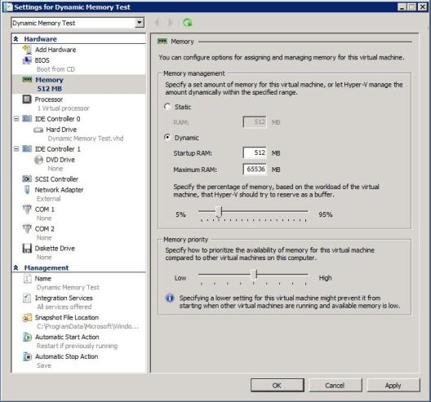
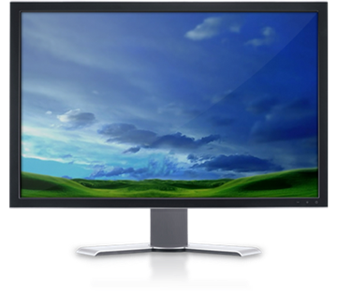
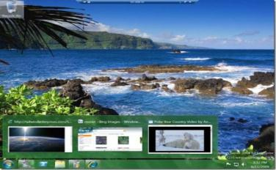



Virtualization Enhancements in Service Pack 1
Dynamic memory
RemoteFX
  Allocate range of memory per VM and dynamically adjust memory usage on demand
  Consistent performance and better manageability
  Uses the power of virtualized graphics resources and advanced codecs to achieve high fidelity
  Enables “local-like” experience for a hosted desktop
Notes:
Speaker Notes
Microsoft is committed to making the end user and IT pro experience with virtual desktops as responsive as possible. Service Pack 1 offers significant improvements to the Microsoft VDI experience.
Dynamic Memory allows the allocation of a range of memory (min and max) to individual VMs, enabling the system to dynamically adjust the VM’s memory usage based on demand. This provides more consistency in system performance enabling better manageability for administrators.
Remote FX changes the game. Organizations can now provide a rich, responsive, “local-like” desktop experience for remote users. Microsoft RemoteFX leverages the power of virtualized graphics resources and advanced codecs to recreate the fidelity of hardware-assisted graphics acceleration, including support for 3D content and Windows Aero, on a remote user’s device.
Benefits:
Best Windows 7 virtual desktop experience
RemoteFX supports rich media, Windows Aero and Flip3D for VDI
Rich Multimedia and 3D Experience
RemoteFX supports rich screen content including for DirectX hardware-accelerated apps, HTML 5 content and 3D business apps
Comprehensive end point support
RemoteFX supports rich clients, zero clients and network monitors along with a broad range of USB peripherals
Works over any network
Rich user experience over the LAN and the WAN with RemoteFX and HDX

Slide 29
Dynamic Memory & RemoteFX
Michael Kleef
Senior Technical Product Manager
Windows Server Product Management
demo

Slide 30

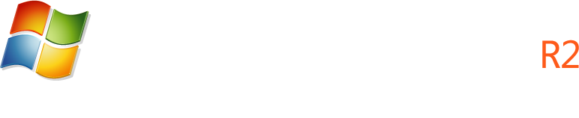

Virtualization Partner Ecosystem Momentum
Dynamic provisioning
  System Center Virtual Machine Manager Self Service Portal 2.0
Deep integration including: HP, NetApp, Citrix, Compellent, F5 Networks and V-Kernel
System Center Alliance > 100% growth in past year to 150 partners
22 Performance and Resource Optimization (PRO) packs; 15 packs since VMM R2 including HP, Dell, IBM, Brocade, QLogic, Emulex and APC
Integrated management
Platform
Innovation on Hyper-V supporting Cluster Shared Volumes, Storage Virtualization, Provisioning, Conversion, Assessment and more with partners including: Datacore, Double-Take, CA, Citrix, NetApp, CA, CommVault , Symantec, Sanbolic and others
Compute
Network
Storage
More than 304 NICs qualified with Windows Server; 160 since R2 release
More than 1,600 storage arrays certified with Hyper-V; 700 since R2 release
More than 1,800 servers certified with Hyper-V; 780 since R2 release
Numerous Joint Solution Blueprints available with partners including:
HP, Dell, NetApp, Citrix, EMC, Hitachi Data Systems
Replication partner cluster integration including HP, HDS, NetApp, EMC, and Double-Take

Slide 31
CLOUD
DEVICES

Slide 32
Next Steps: Learn, Connect & Share
  Attend the virtualization sessions:
    30 Breakout Sessions
    6 Interactive Discussions
    10 Hands-on Labs
  Learn more about Microsoft Virtualization Solutions
    Find more info at www.microsoft.com/virtualization
  Plan your Windows 7 and Windows Server 2008 R2 deployment
    Find more info at www.windows.com/enterprise
  Take advantage of Hyper-V Cloud programs today.
    Contact Microsoft, Hyper-V Cloud Partners or Service Provider
    Find more info at www.microsoft.com/hyper-vcloud

Slide 33





Resources
  Connect. Share. Discuss.
http://northamerica.msteched.com
Learning
  Sessions On-Demand & Community
  Microsoft Certification & Training Resources
www.microsoft.com/teched
www.microsoft.com/learning
  Resources for IT Professionals
  Resources for Developers
http://microsoft.com/technet
http://microsoft.com/msdn

Slide 34












Complete an evaluation on CommNet and
enter to win!

Slide 35

Notes:
New for TechEd 2011, we will be working with Microsoft Tag (http://tag.microsoft.com/overview.aspx) to create unique Tags for every session at the event. Your session Tag will appear on both the room signage and at the end of your presentation. With your session Tag, attendees will be able to scan as they enter the room to retrieve session details, view speaker bios, and engage in discussions; or scan at the end of the presentation to evaluate your session and download materials. We’re excited to integrate Microsoft Tag across the My TechEd mobile experience this year.

Slide 36

© 2011 Microsoft Corporation. All rights reserved. Microsoft, Windows, Windows Vista and other product names are or may be registered trademarks and/or trademarks in the U.S. and/or other countries.
The information herein is for informational purposes only and represents the current view of Microsoft Corporation as of the date of this presentation. Because Microsoft must respond to changing market conditions, it should not be interpreted to be a commitment
on the part of Microsoft, and Microsoft cannot guarantee the accuracy of any information provided after the date of this presentation. MICROSOFT MAKES NO WARRANTIES, EXPRESS, IMPLIED OR STATUTORY, AS TO THE INFORMATION IN THIS PRESENTATION.

