Slide 1

Active Directory Federation Services, Part 2:
Building Federated Identity Solutions
SIM403
John Craddock (john.craddock@xtseminars.co.uk)
Infrastructure and Security Architect
XTSeminars Ltd

Slide 2
Agenda
Working with Partners
ADFS availability
What is Forefront Unified Access Gateway (UAG)
UAG Trunks
Configuring a Trunk for ADFS v2.0
Adding a claims enabled application to the trunk
Using claims authentication with a Kerberos application through Kerberos Constrained Delegation (KCD)

Slide 3
Trusting A Partner
Partner organization
Your organization
Partner ADFS
STS & IP
Your ADFS
STS
Claims Provider Trust
Claims Provider Trust
Relying Party Trust
Claims Provider Trust
Relying Party Trust
Your STS now trusts your partner to
provide a security token containing claims for their users
Your STS is no longer responsible for identifying the user but still processes the claims from the partner as previously described
Relying
Party x

Slide 4
Claims Flow
ADFS1
Claims Pipeline
Claims Pipeline
ADFS2
AD
Acceptance Transform rules
AD
Acceptance Transform rules
Issuance Authorization rules
ST
Permit or Deny
Issuance Authorization rules
ST
Acceptance Transform rules
Acceptance Transform rules
Issuance
Transform rules
RP1
ST
Permit or Deny
IP2
Issuance
Transform rules
RP1
Relying Party Trusts
ST
Relying Party Trusts
Acceptance Transform rules
IP3
Claims Provider Trusts
Issuance Authorization rules
ST
Claims Provider Trusts
Permit or Deny
Issuance
Transform rules
RP3
Depending on the rules, claims flow from a trusted claims provider on ADFS1 to a relying party on ADFS2

Slide 5
Trusting a partner
demo

Slide 6
ADFS Availability
ADFS STS
The ADFS server is a key component
Requires high availability
Must scale to the authentication demands of your / partner organisation(s)
Functionality required from the Internet for remote workers / partners

Slide 7
A Farm is a Must
The ADFS server becomes a critical authentication service
  Always install with the farm option
    Allows other servers to be added
A stand-alone server is only recommended for test and development environments
For environments that need an Internet presence front the ADFS farm with a farm of ADFS proxies
  Alternatively publish the ADFS Federation Server through UAG

Slide 8


Deploymenting a Farm
Intranet
ADFS Federation
Farm
Perimeter Network
ADFS Proxy Farm
Firewall &
Load Balancer
Firewall &
Load Balancer
Active Directory
Internet
Configuration SQL Cluster
Forms Authentication
Windows authentication
(Automatic logon possible)
Remote user
CorpNet users

Slide 9
ADFS Configuration Database
The first server in the farm is referred to as the primary federation server
  Has read/write access to the configuration database
Subsequent servers added to the farm are called secondary federation servers
Two options for the database
  Windows Internal Database (WID)
    Replicated to all farm members
      Maximum of five farm members
  SQL, configured via script
    Add appropriate SQL redundancy to avoid a single-point of failure

Slide 10
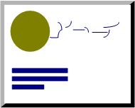
ADFS Proxy Requirements
External clients
adfs.example.com
Internal clients
ADFS
proxy
Domain joined
Does NOT need
to be domain joined
ADFS Federation
HTTPS
HTTPS
SSL certificate matches
ADFS Federation URL
Client authentication certificates are not required
for AD FS 2.0 federation server proxies
SSL
Token-signing
Domain joined proxies simplify management through group policy
May not meet your security requirements
Deploy certificates to all farm members
(private key must be exportable)

Slide 11
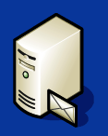
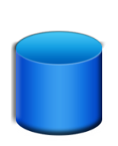

Adding Forefront Unified Access Gateway
ADFS v 2.0
Publishes
ADFS Farm
UAG
Active Directory
Publishes
Applications
Claims aware application
Replaces ADFS Proxy
Kerberos application

Slide 12

Forefront Unified Access Gateway
Application publishing
Optimizer modules for
Exchange
SharePoint
CRM
Layer3 VPN
HTTP/HTTPS
DirectAccess
Third party support
Reverse proxy for
Web farms
Multiple
authentication
options
RemoteApps via
Integrated Remote
Desktop Services Gateway
Single entry-point for all remote access
Service Pack 1 adds support for ADFS v2.0

Slide 13
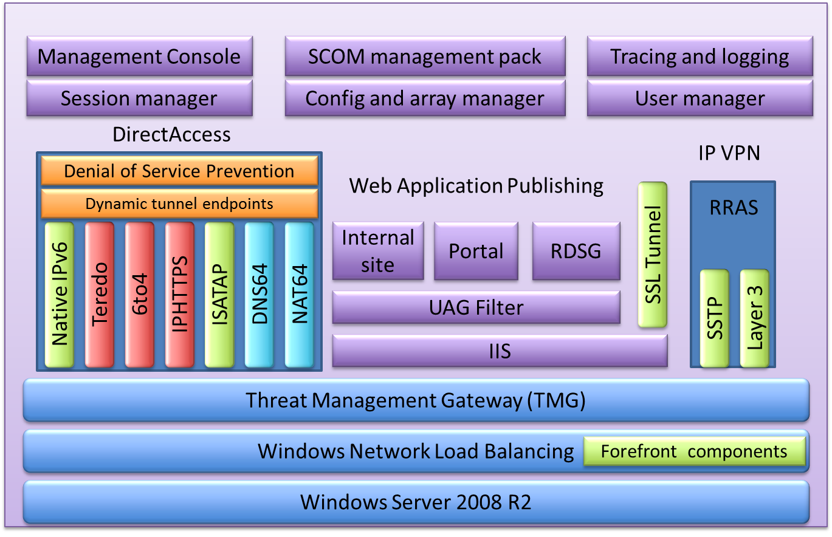
UAG Architecture

Slide 14
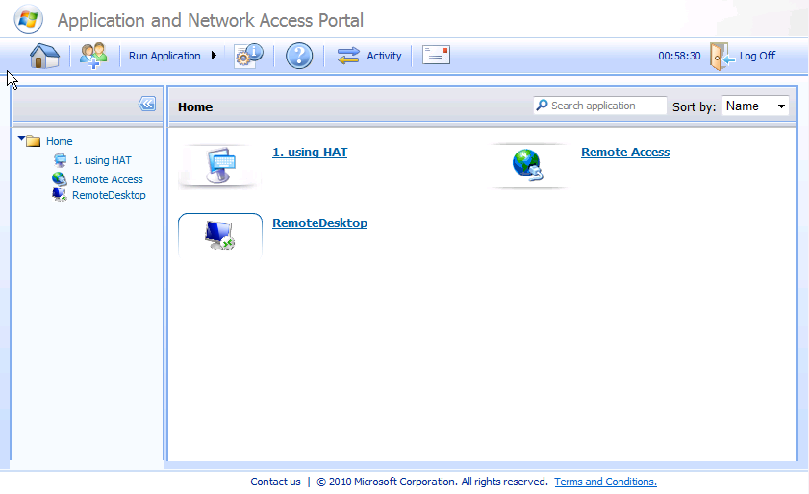
UAG Trunks
Endpoint detection
& clean up
downloaded to client
UAG Trunk
Evaluate Endpoint
Access Settings
Authenticate
user against
authentication
servers
Trunk Portal
External IP and
URL
HTTP or HTTPS
Add Applications to Trunk
Authentication
Servers

Slide 15
Creating a Trunk for ADFS v 2.0
Requires UAG SP1
Define the ADFS STS-IP as an UAG Authentication Server
  Requires federation metadata from the ADFS-IP
  Define the claim that will be used as the lead value
Create an HTTPS Trunk
  Select the ADFS Authentication server defined previously
Don’t forget to run Activate Configuration
  If things don’t work as expected, an iisreset on the UAG server may solve it

Slide 16
Configuring the ADFS Server
On the ADFS server define UAG as a relying party
  Requires the UAG federation metadata
    Only available via an external URL or via XLM stored in
    Program Files\Microsoft Forefront Unified Access Gateway\von\InternalSite\ADFSv2Sites\fed\FederationMetadata\2007-06
On the ADFS server define the appropriate claims to pass in the token (Issuance Transform Rules)
On your client computer connect to the ADFS Trunk
  You should be logged on via ADFS and see an empty portal

Slide 17
Setting up an ADFS trunk
demo

Slide 18
Man-in-the-Middle
Terminates HTTPS and then sends to ADFS Farm
CTB prevents server accepting credentials from new SSL channel
UAG
https://adfs.example.com
https://adfs.example.com
UAG is acting a the Man-in-the-middle between the client and the ADFS server
  Depending on the client and server versions Channel Binding Token (CBT) will be enforced and authentication will fail
  Disable CBT on the ADFS server
    Configured through the Configuration Editor for the Default Website\adfs\ls or via a script
      TechNet “Forefront UAG and AD FS 2.0 supported
      scenarios and prerequisites”

Slide 19
Adding Claims Aware Applications
Select the application
Define name and type
Define endpoint policies
Specify the application’s internal address
Specify how SSO credentials are passed to the published App
Define how the application is shown in Trunk portal
Activate the configuration

Slide 20
Adding a claims aware application
demo

Slide 21
None Claims Aware Applications
ADFS
Domain Controller running KDC
UAG
Request Kerberos Ticket to
APP1 on behalf of user
App1
Authentication &
Authorization via
Kerberos ticket
Authentication via
SAML security token
Authenticate to APP1 using Kerberos
None Claims Aware Applications can be supported via Kerberos Constrained Delegation
  Authentication to internal application via Kerberos
  Shadow accounts required for external users

Slide 22
Kerberos Constrained Delegation (KCD)
Tom
UAG Server
KDC
Data server
Claims Authentication
Request Kerberos token
with user’s identity
TGT
Uses: Kerberos extension
Service-for-User-to-Self (S4U2Self)
Request Kerberos ST
with user’s identity
K-ST
Impersonate user
K-ST

Slide 23
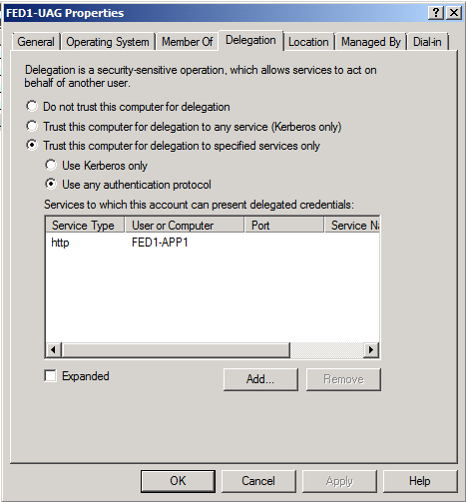
AD UAG Server Object
Automatically configured via UAG
You must supply the Service Principal Name
Backend application must be Kerberos

Slide 24
Adding a Kerberos Application
As before
  Select the application
  Define name and type
  Define endpoint policies
  Specify the application’s internal address
  DON’T specify how SSO credentials are passed to the published App
  Define how the application is shown in Trunk portal
Select the application and change the authentication to KCD
  Specify the SPN and shadow account identifier
Activate the configuration

Slide 25
Adding a Kerberos application
demo

Slide 26
Get Your Certificates Right
The UAG server will require a SSL certificate for the UAG portal and the ADFS server
  For example adfsportal.example.com and adfs.example.com
    Can use a wild card certificate *.example.com
Make sure that the UAG server has the root certificate for the ADFS token signing certificate
Make sure the client has the root certificate for the UAG server certificates
Make sure all CRL distribution points can be resolved
    The client will check the certificates and CRLs for the UAG client components

Slide 27
What Next?
Build a test lab
  Get ADFS working first with a claims aware application
    Try the Microsoft ADFS step-by-step guides
  Read the ADFS Design and Deployment guides
Read the UAG guides for ADFS v 2.0
Deploy UAG into your test environment
Publish ADFS v 2.0 and your application
Make sure all certificates and CRLs are available

Slide 28
More on ADFS and Federation
XTSeminars one-day event:
  Federation and Federated Identity
  info@xtseminars.co.uk for more information
Get your local Microsoft subsidiary to run the event!

Slide 29

Consulting Services on Request
John.craddock@xtseminars.co.uk
John has designed and implemented computing systems ranging from high-speed industrial controllers through to distributed IT systems with a focus on security and high-availability. A key player in many IT projects for industry leaders including Microsoft, the UK Government and multi-nationals that require optimized IT systems. Developed technical training courses that have been published worldwide, co-authored a highly successful book on Microsoft Active Directory Internals, presents regularly at major international conferences including, TechEd, IT Forum and European summits. John can be engaged as a consultant or booked for speaking engagements through XTSeminars. www.xtseminars.co.uk

Slide 30

Related Content
SIM401 | Active Directory Federation Services 2.0 Deep Dive: Deploying a Highly Available Infrastructure
OSP308 | Claims Identity in Microsoft SharePoint 2010
MID342-HOL | Use the Windows Azure Appfabric Access Control Service to Federate with Multiple Business Identity Providers
SIM399-HOL | Managing Claims Authentication Using Microsoft Forefront Identity Manager 2010
SIM377-INT | Claims-Based Identity

Slide 31
Track Resources
Don’t forget to visit the Cloud Power area within the TLC (Blue Section) to see product demos and speak with experts about the Server & Cloud Platform solutions that help drive your business forward.
You can also find the latest information about our products at the following links:
Cloud Power - http://www.microsoft.com/cloud/
Private Cloud - http://www.microsoft.com/privatecloud/
Windows Server - http://www.microsoft.com/windowsserver/
Windows Azure - http://www.microsoft.com/windowsazure/
Microsoft System Center - http://www.microsoft.com/systemcenter/
Microsoft Forefront - http://www.microsoft.com/forefront/

Slide 32

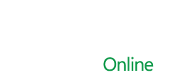

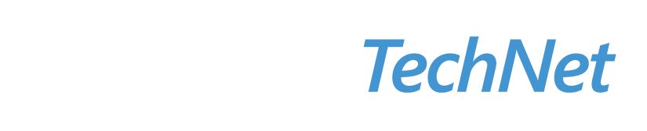

Resources
  Connect. Share. Discuss.
http://northamerica.msteched.com
Learning
  Sessions On-Demand & Community
  Microsoft Certification & Training Resources
www.microsoft.com/teched
www.microsoft.com/learning
  Resources for IT Professionals
  Resources for Developers
http://microsoft.com/technet
http://microsoft.com/msdn

Slide 33












Complete an evaluation on CommNet and
enter to win!

Slide 34


