Slide 1

Monitoring IT as a Service with Microsoft System Center
SIM362
Jason Buffington System Center Operations Manager
JBUFF@microsoft.com, @JBUFF
Sean Christensen System Center Service Manager
SECHRIST@microsoft.com, @SeanC_MSFT
Adam Hall System Center Orchestrator
ADHALL@microsoft.com, @Adman_NZ

Slide 2


Session Objectives and Takeaways
Objectives:
    You understand the capabilities required to Monitor IT as a Service
    You hear us explain how System Center delivers you integrated Monitoring
    You have fun, learn something and see lot’s of Demo!
Key Takeaways:
    Operations Manager is THE monitor for your whole IT infrastructure
    Service Manager is all about Standardization, Self-Service and Compliance
    Orchestrator is all about Integration, Orchestration and Automation

Slide 3
Agenda
System Center delivers Monitoring for IT as a Service
  Operations Manager
  Service Manager
  Opalis -> Orchestrator
Scenarios & Demos !
Q & A

Slide 4


Jason Buffington
Sr. Technical Product Manager
System Center Operations Manager, AVIcode, DPM and SCE …
JBuff@microsoft.com
@JBuff

Slide 5


Operations Manager
2004
2005
2006
2007
2008
2009
2010
2011
MOM 2005
RTM
MOM 2005
SP1
OpsMgr 2007
RTM
OpsMgr 2007
SP1
OpsMgr 2007
R2
OpsMgr 2007
R2 – CU1, CU2, CU3, CU4
OpsMgr
2012

Slide 6
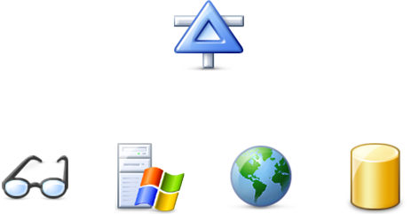

Expanding the IT Pro’s Visibility of your ITaaS
Operations Manager 2007 SP1

Slide 7
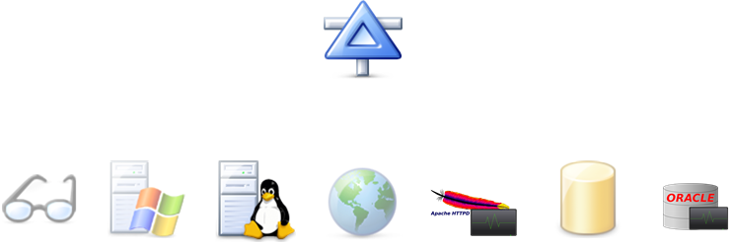





Expanding the IT Pro’s Visibility of your ITaaS
Operations Manager 2007 R2

Slide 8
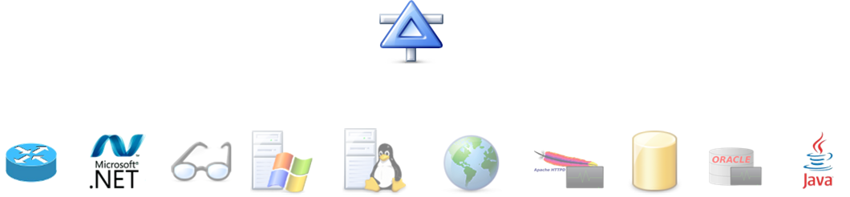



Expanding the IT Pro’s Visibility of your ITaaS
Operations Manager 2012

Slide 9




360 – Holistic View of your ITaaS Health
360 is a function of monitoring that gives customers visibility to the underlying application
environment(s) or infrastructure
Consistent UX
(Console, Web, SharePoint)
End User Experience
(Synthetic Transactions)
CIO
Improved
Application Monitoring
(.NET, J2E)
New
Service Owner
Infrastructure Monitoring
(OS, SQL, IIS)
Infra Owner
Infrastructure Monitoring
(Network)
New
Company Mascots

Slide 10

Sean Christensen
Sr. Technical Product Manager
System Center Service Manager
Sechrist@microsoft.com

Slide 11

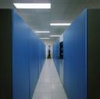









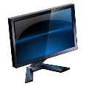


ITaaS – Reality is Complex!
PaaS on Premise
SaaS by an ISV
IaaS on Premise
IaaS by a Hoster
How do you keep costs down?
How do you keep service levels up?
How do you keep everyone informed?
PaaS by Microsoft

Slide 12
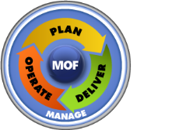

Achieving ITaaS Objectives
MOF®
Automation
ITaaS Objectives
Standardization
Reduce Costs
Increase Service Levels
Faster Time to Delivery
Provide More Data
More Transparency
Compliance
ITIL®
Self-service
COBIT®
Compliance
Process Design
Implementation

Slide 13








Service Manager Enables Automation
IT Data
Warehouse
Configuration Management DB
Work Items
Configuration Items
Knowledge
Automation Interfaces
Centralized Data Storage
Integration

Slide 14
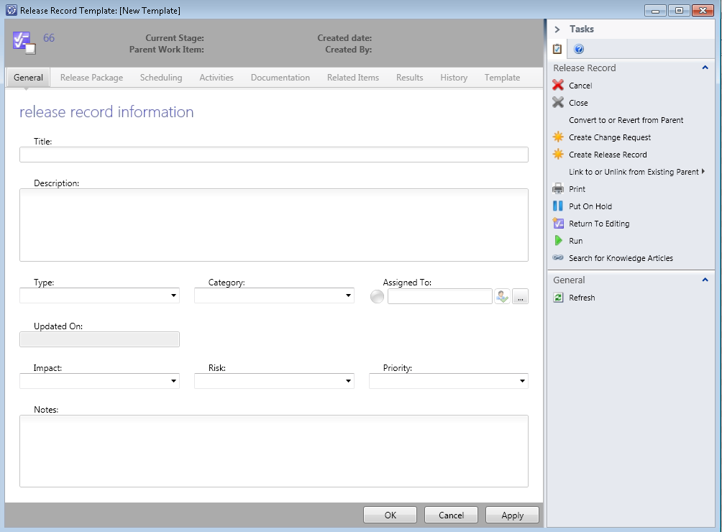
Service Manager Enables Standardization
Business Process Defined in Templates
CMDB Data Standardization
  Common Model
  Reconciliation of Data
Service Catalog

Slide 15

Service Manager Enables Compliance
Compliance is embedded in process, standards, self-service, and automation
Compliance library maps legalese to actionable IT control activities
Compliance is continuously and automatically evaluated in real time

Slide 16
Service Manager & ITaaS
MOF®
Automation
Response & Remediation in line with criticality of Business Services.
Standardization
Consistent view of Services & Infrastructure
Consistent delivery of services offered
ITIL®
Self-service
Choice & Control with Flexibility
COBIT®
Compliance
Embedded in the every day.
Process Design
Implementation

Slide 17

Adam Hall
Sr. Technical Product Manager
System Center Orchestrator
AdHall@microsoft.com

Slide 18

TODAY
Leveraging the Power of Opalis 6.3

Slide 19
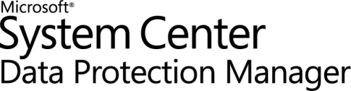

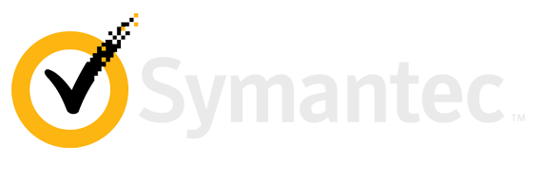
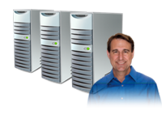
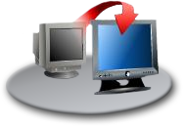


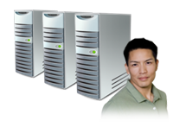



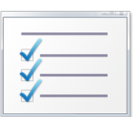


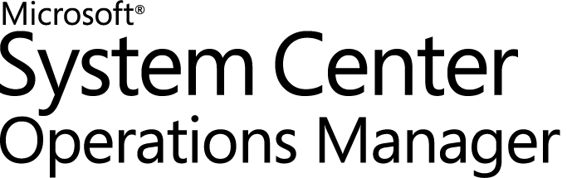
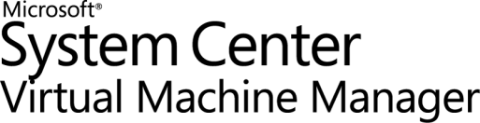

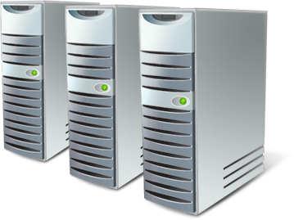


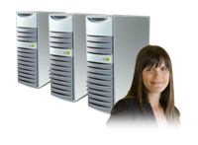

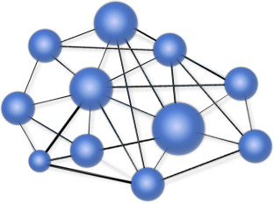



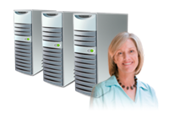
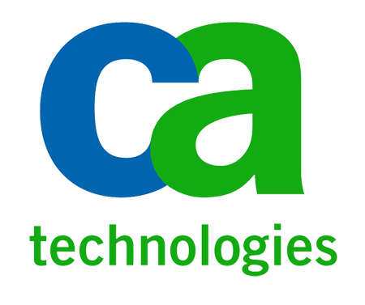

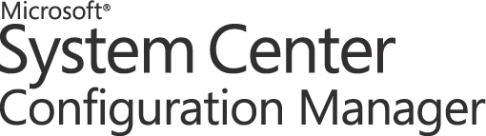

Opalis brings it all together!
Service Management
Configuration
Monitoring
Provisioning
Protection
Service Manager
Automation
Integration
HP Service Manager Software
Make your IT service desk enterprise strength
.
Orchestration
OpenView Operations

Slide 20
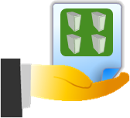
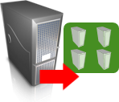

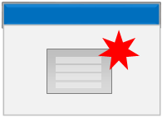

Authoring Made Easy
Get Clone
Requests
Clone
VMs
Add Storage
To Each
Create
Advertisement
Protect
VMs
Opalis Databus
Request ID | VM Size | VM Disk | …
CR3453 | Large | 8GB | …
CR3460 | Small | 1GB | …
CR3750 | Small | 4GB | …
CR2762 | Med | 5GB | …
VM Size | VM Disk
Large | 8GB
Small | 1GB
Small | 4GB
Med | 5GB
VM Disk
8GB
1GB
4GB
5GB
VM ID
233113
233114
233115
233116
VM ID | VM Name | …
233113 | VM233 | …
233114 | VM234 | …
233115 | VM235 | …
233116 | VM236 | …
VM Name
VM233
VM234
VM235
VM236
VM Name
VM233
VM234
VM235
VM236
Disk ID | …
33434 | …
33435 | …
33436 | …
33437 | …
Job ID | …
6655 | …
6657 | …
6659 | …
6670 | …
Protection Group | …
LargeVMs | …
SmallVMs | …
SmallVMs | …
MedVMs | …

Slide 21
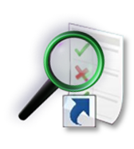
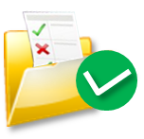



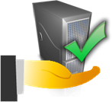


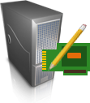
Automating Across Datacenter IT Silos
Event Mgmt
Monitor
for request
Application Service Management
VM Lifecycle Management
Incident
Response
Service Desk
Initiate
Change
Update
CMDB
Close
Request
Change & Compliance
Provisioning
Asset/CMDB
Create
Deployment
Configuration
Clone
VM
Associate
Server to Service
Virtual
Security
Storage
Create
Disk
Connect
Disk to VM
Server
Create
Server
Network
Join
Network

Slide 22

Opalis target scenario examples
Manual tasks
Batch Scripts
Compliance requirements
User request scenarios
Provisioning
Disaster Recovery
Desktop scenarios
Responding to incidents
Change Control
Multiple Service Desks
Capacity Management
Release Management
SLA adherence issues
Rapid change environments
Diverse system integrations
Patch Remediation
  Every customer has at least one scenario that Opalis answers!

Slide 23

TOMORROW
Lets go take a look at System Center Orchestrator!

Slide 24





System Center Orchestrator Investments
IT Pro
Authoring, Debugging & Scripting
Operator
Trigger, Monitor &Troubleshoot
Developer
Application integration
IT Business Manager
Report & Analyze

Slide 25
Scenarios in flight
Jason, Sean, Adam
Lets do some Demo!

Slide 26
Close, Q & A
Adam Hall
Orchestrator
adhall@microsoft.com
Jason Buffington
Operations Mgr
jbuff@microsoft.com
Sean Christensen
Service Manager
sechrist@microsoft.com

Slide 27
Thank You!
And please fill out your evaluations ☺

Slide 28
Track Resources
Don’t forget to visit the Cloud Power area within the TLC (Blue Section) to see product demos and speak with experts about the Server & Cloud Platform solutions that help drive your business forward.
You can also find the latest information about our products at the following links:
Cloud Power - http://www.microsoft.com/cloud/
Private Cloud - http://www.microsoft.com/privatecloud/
Windows Server - http://www.microsoft.com/windowsserver/
Windows Azure - http://www.microsoft.com/windowsazure/
Microsoft System Center - http://www.microsoft.com/systemcenter/
Microsoft Forefront - http://www.microsoft.com/forefront/

Slide 29





Resources
  Connect. Share. Discuss.
http://northamerica.msteched.com
Learning
  Sessions On-Demand & Community
  Microsoft Certification & Training Resources
www.microsoft.com/teched
www.microsoft.com/learning
  Resources for IT Professionals
  Resources for Developers
http://microsoft.com/technet
http://microsoft.com/msdn

Slide 30












Complete an evaluation on CommNet and
enter to win!

Slide 31


Slide 32

© 2011 Microsoft Corporation. All rights reserved. Microsoft, Windows, Windows Vista and other product names are or may be registered trademarks and/or trademarks in the U.S. and/or other countries.
The information herein is for informational purposes only and represents the current view of Microsoft Corporation as of the date of this presentation. Because Microsoft must respond to changing market conditions, it should not be interpreted to be a commitment
on the part of Microsoft, and Microsoft cannot guarantee the accuracy of any information provided after the date of this presentation. MICROSOFT MAKES NO WARRANTIES, EXPRESS, IMPLIED OR STATUTORY, AS TO THE INFORMATION IN THIS PRESENTATION.

