Slide 1

Managing Specialized Devices With Windows Embedded Device Manager 2011
SIM359
Robert Peterson, Sr. Product Manager
Eric Kamont, Solution Specialist
Microsoft

Slide 2
Session Objectives and Takeaways
Session Objectives
  Why managing embedded devices is a challenge
  What is Windows Embedded Device Manager 2011
Key Takeaways
  How to solve challenges with embedded device management
  Windows Embedded Device Manager features, integration with Configuration Manager 2007

Slide 3
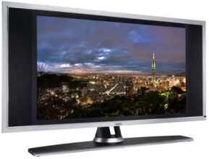
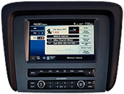
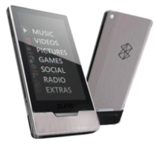
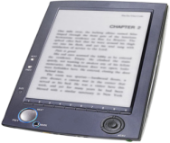
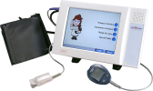
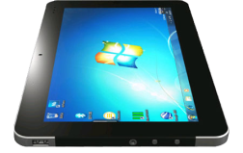
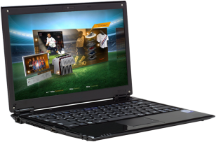
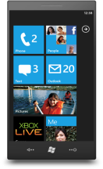

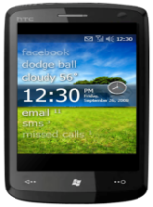
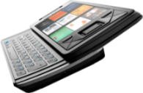


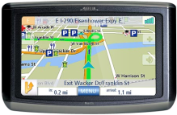


Growth of Specialized/Embedded Devices
100’s Millions
IDC, Gartner
Billions
IDC, Consumer
Electronics Association
10’s Billions
VDC market reach, IDC
PCs/SLATES
PHONES
SPECIALIZED DEVICES

Slide 4




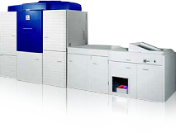
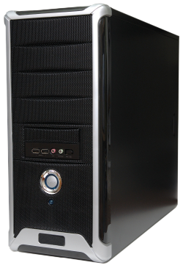
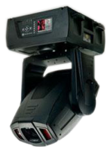
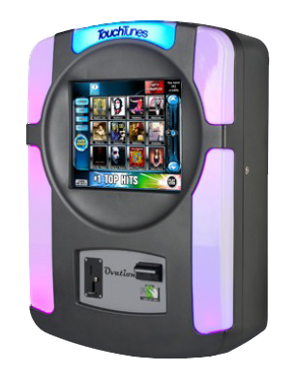
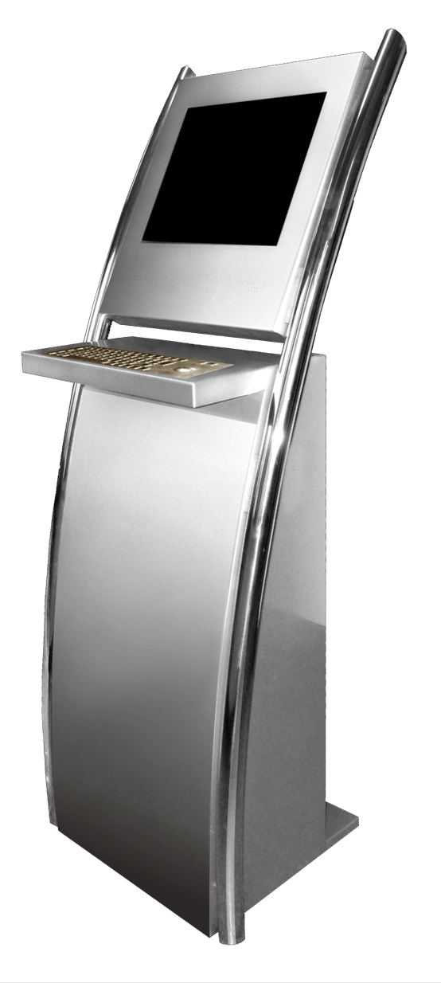

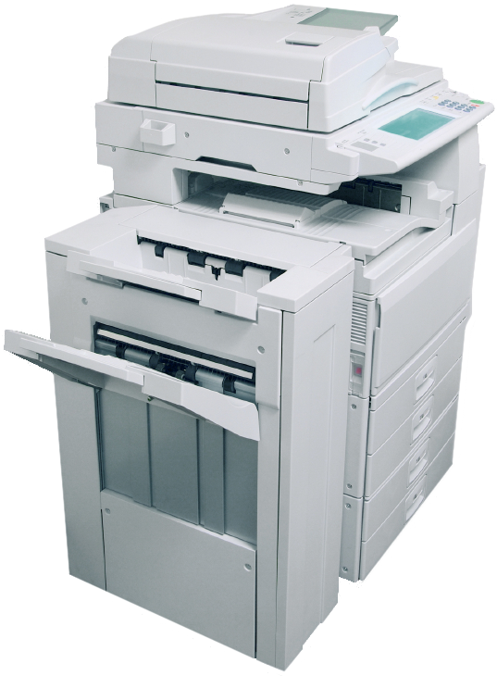
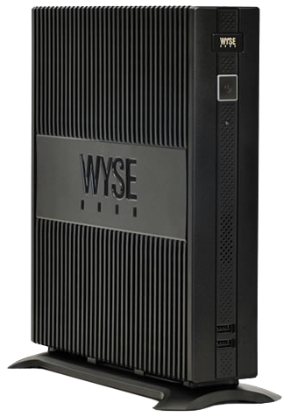
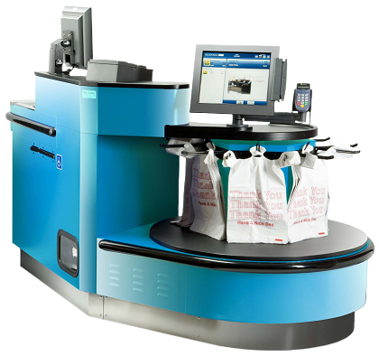
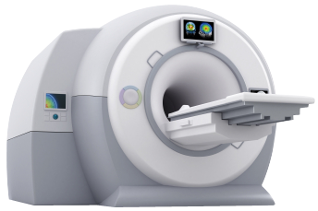

How Embedded Devices are Managed Today
Enterprise IT Pro
Device Manufacturer /
Service Provider
Industry Specific Device

Slide 5

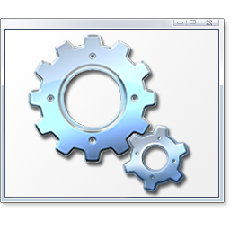
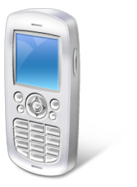

Challenges Managing Embedded Devices
Embedded devices OS are customized vs. the homogeneous OS in PCs/Servers
Embedded devices can lack OS components needed for management software
Specific OS components are required to run Configuration Manager 2007 client
Embedded OEMs do not include OS components required for ConfigMgr 2007 by default
Connecting embedded devices to ConfigMgr 2007
Embedded devices are often misidentified and grouped as a phone in management console
Need to manually configure and map the embedded devices
Enhanced Write Filters are used to help maintain embedded devices
Enhanced Write Filters (EWF) prevent unauthorized changes on embedded devices
If EWF is used, devices cannot remotely updated or managed with ConfigMgr 2007
Choice of not using EWF or managing embedded devices outside of ConfigMgr 2007

Slide 6



Challenges Managing Embedded Devices
Embedded devices are widely varied vs. PCs/Servers
Embedded devices have different capabilities and hardware, even from the same OEM
Need to identify the wide range of hardware and software characteristics
Updating the embedded device/image
  Different devices of the same model can have different components and require different images
OS imaging solution can be customized by OEM
Managing multiple embedded devices may require operating multiple management solutions

Slide 7

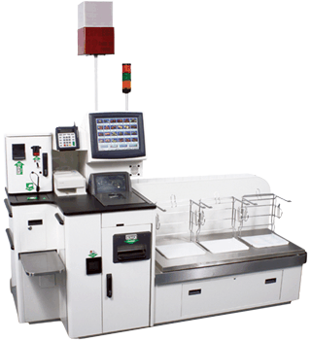





Today’s World: Challenge
System Up
System Fail
Disruption
Call Support
On-site Reactive Response
12+ Hours
Time-to-Repair
FE Fixes
FE Dispatched
FE is paged
Customer Center

Slide 8


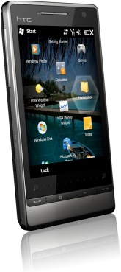
Today’s Need: Management Solution
System Up
System Fail
Disruption
Electronic
Contact
Remote Reactive Response
7+ Hours
Time-to-Repair
FE Fixes
FE digitally contacted
Remote Fix / Assist

Slide 9
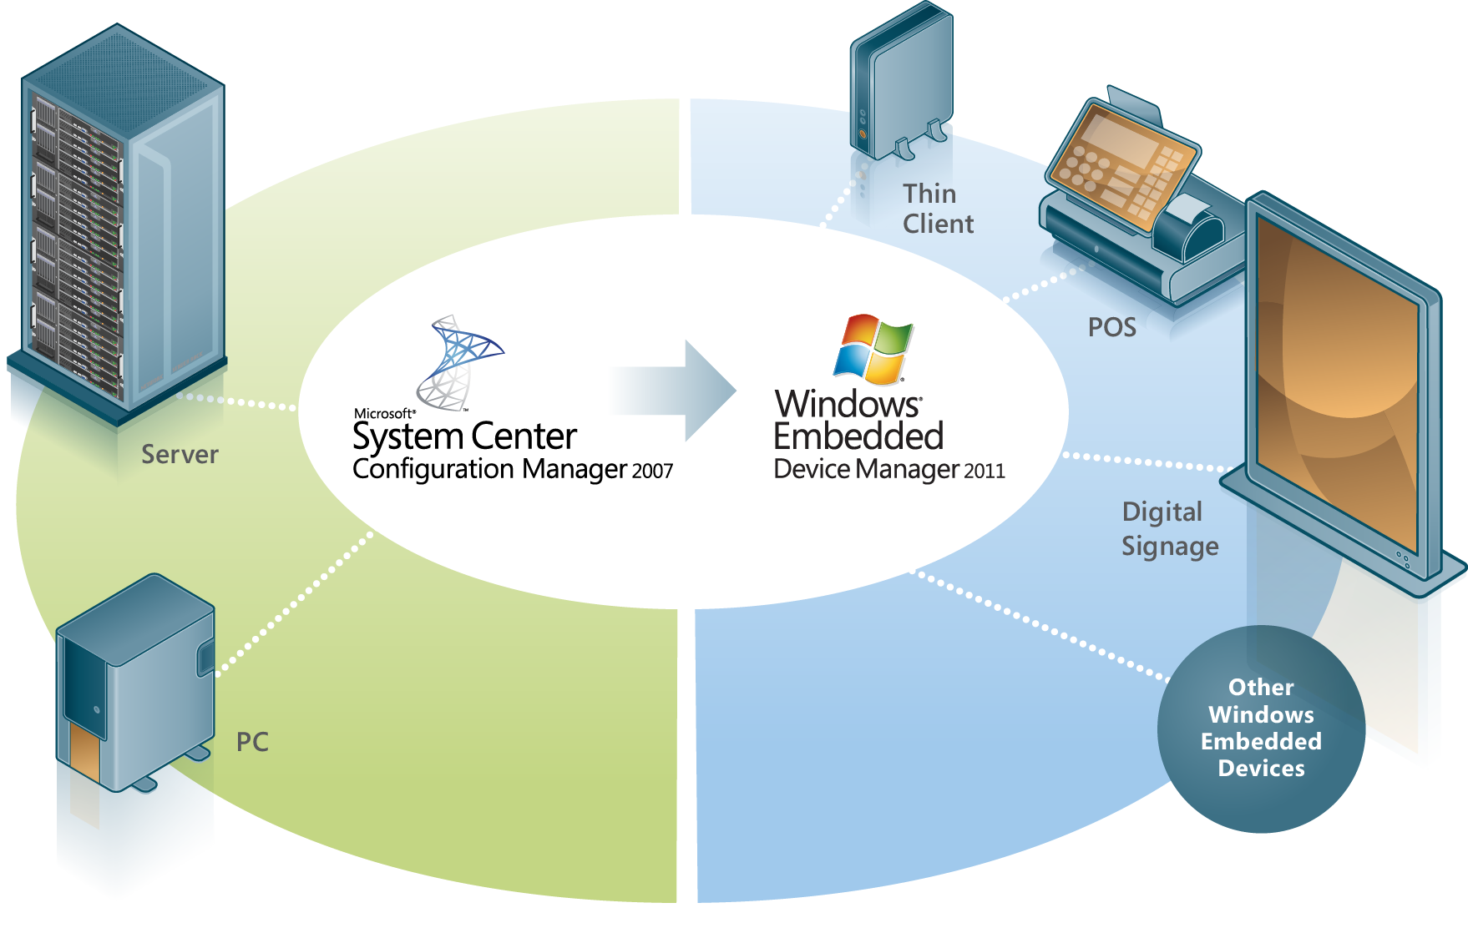
Introducing
Windows Embedded Device Manager 2011
Extends the capabilities of System Center Configuration Manager 2007 to fully manage embedded devices
Enterprises can deploy, assess and update devices built on Windows Embedded Platforms
Supported devices include Thin Clients, Point of Service, and Digital Signage

Slide 10




Features and Benefits
Ease of management: similar to PCs and Servers
Software Distribution and Updates
Automatically included into predefined collections by device type
Devices with Write Filters can be updated
Enhanced IT Infrastructure Insight and Control
Extend System Center Configuration Manager 2007 console to
Windows Embedded devices
Provide richer inventory information unique to embedded devices
Simplify and streamline embedded device administration and
compliance through easy provisioning
Greater Device Integration
Tailor Inventory: Embedded devices can come pre-populated with hardware
inventory extensions providing greater insight into configuration
Tailor Imaging: Simplify integration of custom imaging extensions through
a common interface

Slide 11
Windows Embedded Device Manager 2011
Supported Configurations
Thin Client
Point Of Service
Digital Signage
Windows XP
Embedded
Windows XP
Embedded
Windows Embedded
Standard 2009
Windows Embedded
Standard 2009
Windows Embedded
for Point of Service
Windows Embedded
Standard 7
Windows Embedded
Standard 7
Windows Embedded
POSReady 2009
NOTES
1. The above operating systems require the device manufacturer to have included the necessary
dependencies for the System Center Configuration Manager 2007 SP2 Advanced Client agent
2. Support is limited for generic Enterprise class devices built on Windows XP Embedded or
Windows Embedded Standard Toolkit (2009 and 7)
3. All operating systems must have the appropriate service packs applied to stay within the
Microsoft Support Lifecycle outlined here http://support.microsoft.com/lifecycle/

Slide 12
Product Details
Technical dependency on Configuration Manager 2007 R2 SP2
Extend ConfigMgr 2007 capabilities to embedded devices
OEM can pre-install ConfigMgr and DeviceMgr software
General Availability is 4/1/2011
DeviceMgr 2011
DeviceMgr 2011 ML
ConfigMgr 2007
ConfigMgr 2007 ML
SQL
Licensing:
Similar licensing model as Configuration Manager 2007
Similar licensing programs as Configuration Manager 2007
Windows Server
Windows Embedded Device Manager Client ML
Windows Embedded Device Manager Server or
Windows Embedded Device Manager Server w/ SQL
Server
Device

Slide 13
please welcome
Eric Kamont
Solution Specialist

Slide 14

Embedded Device Collections
Config & Package Deployment
Device Imaging

Slide 15
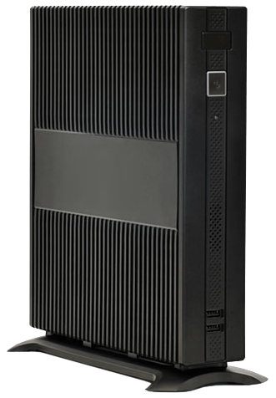



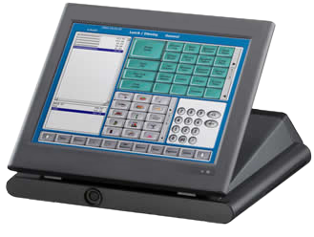
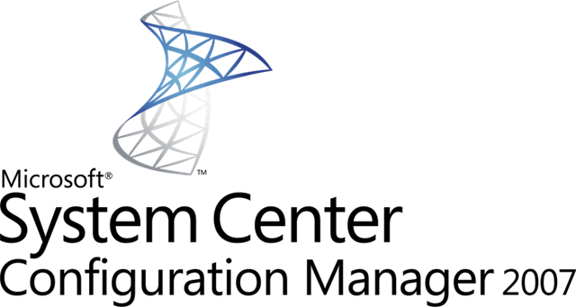


Device Manager 2011
Server installer
Client installer

Slide 16
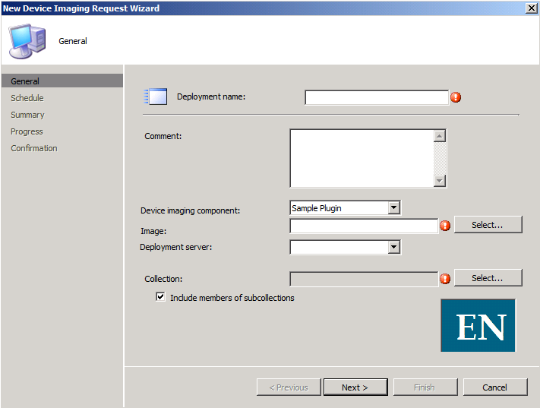
Device Imaging

Slide 17


Device Imaging
OEM
Plugin
OEM
Device
Imaging
solution
Thin Client

Slide 18
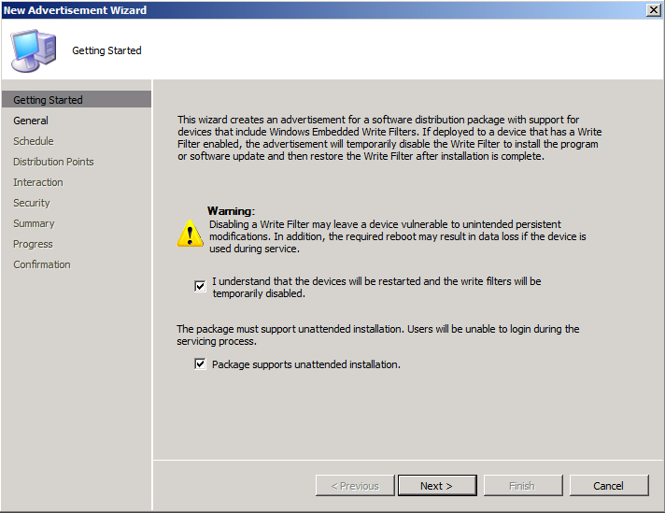

Handling Write Filters
Turn off write filters
Apply configurations / software updates
Turn on write filters

Slide 19

Handling Write Filters
Write Filters
Write Filters
Device
Configurations
Software
Packages
Thin Client

Slide 20
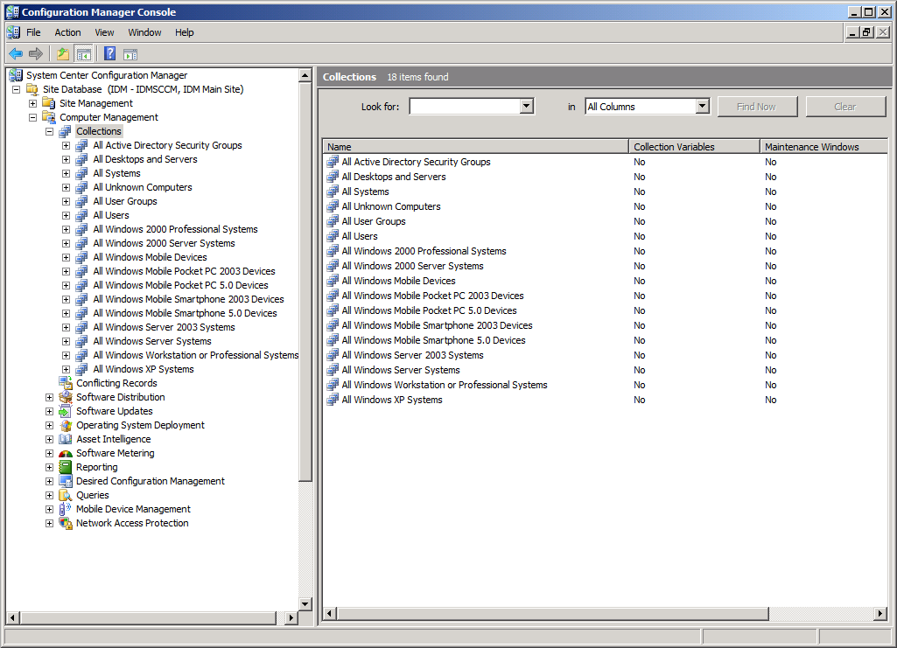
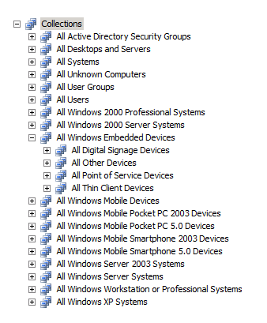
Embedded Device Collections
?
AFTER

Slide 21
Questions?

Slide 22





Resources
  Connect. Share. Discuss.
http://northamerica.msteched.com
Learning
  Sessions On-Demand & Community
  Microsoft Certification & Training Resources
www.microsoft.com/teched
www.microsoft.com/learning
  Resources for IT Professionals
  Resources for Developers
http://microsoft.com/technet
http://microsoft.com/msdn

Slide 23












Complete an evaluation on CommNet and
enter to win!

Slide 24


Slide 25

© 2011 Microsoft Corporation. All rights reserved. Microsoft, Windows, Windows Vista and other product names are or may be registered trademarks and/or trademarks in the U.S. and/or other countries.
The information herein is for informational purposes only and represents the current view of Microsoft Corporation as of the date of this presentation. Because Microsoft must respond to changing market conditions, it should not be interpreted to be a commitment
on the part of Microsoft, and Microsoft cannot guarantee the accuracy of any information provided after the date of this presentation. MICROSOFT MAKES NO WARRANTIES, EXPRESS, IMPLIED OR STATUTORY, AS TO THE INFORMATION IN THIS PRESENTATION.

