Slide 1

SCVMM 2012: Server Fabric Lifecycle – Part 3
High Availability, Update Management & Dynamic Optimization
SIM357
Carmen Summers
Senior Program Manager
Microsoft

Slide 2
Session Objectives and Takeaways
Understand
  High Availability
  Update Management
  Dynamic Optimization
Takeaways
  Creating Hyper-V cluster
  Updating Hyper-V cluster
  Optimizing Hyper-V cluster
    For Resource Usage
    For Power Usage

Slide 3
System Center Virtual Machine Manager 2012
Deployment
Fabric
Cloud
Services
Infrastructure Enhancements
HA VMM Server
Upgrade
Custom Properties
PowerShell
Cloud Management
Application Owner Usage
Delegation and Quota
Capacity and Capability
Service Management
Application Deployment
Image Based Servicing
Custom Command Execution
Service Templates
Fabric
Management
Bare Metal to Hyper-V Cluster
Update Management
Hyper-V, VMware, Citrix XenServer
Dynamic Optimization
Network Management
Power Management
Storage Management
Monitoring Integration

Slide 4

High Availability
Feature available since VMM 2008
Enables VMs to be highly available and easily migrate-able
VMM 2007
Cluster Agnostic
Virtual Server
VMM 2008
Add/Remove Cluster
Create/Delete HAVM
Migrate: Quick, LAN
Overcommit
Hyper-V and VMware
VMM 2008 R2
Cluster Shared Volumes
Migrate: Live, SAN
3rd Party CFS and Storage
Hyper-V R2
VMM 2012
Create/Delete Cluster
Untrusted Domain Clusters
Non-HAVM on Cluster
Citrix XenServer
HA for VMM Server
Intra-Cluster Migration

Slide 5
New Investments
Highly Available VMM Server
  Cluster-aware VMM server
    Can be guarded against OS and VMM failures
  Admin console with reconnect logic
Virtual Machines
  Create non-HAVMs on clustered hosts
  Create/Delete HAVMs on Citrix XenServer clusters
  XenMotion
Host Clusters
  Add/Remove Citrix XenServer clusters
  Add/Remove Hyper-V clusters in untrusted domains
  Hyper-V Cluster Creation

Slide 6
Host Clusters
Creation
  Wizard based experience
  Cluster validation will be run for you
  Allocate cluster disks if VMM is managing storage
  Create cluster-wide virtual network
  For WS08 R2 Hyper-V hosts in trusted domain only
Management
  Add/Remove - Nodes, Cluster disks and Virtual networks
Deletion
  Un-clustered hosts remain managed as standalone hosts
  Cluster disk will be unmasked if VMM is managing storage

Slide 7
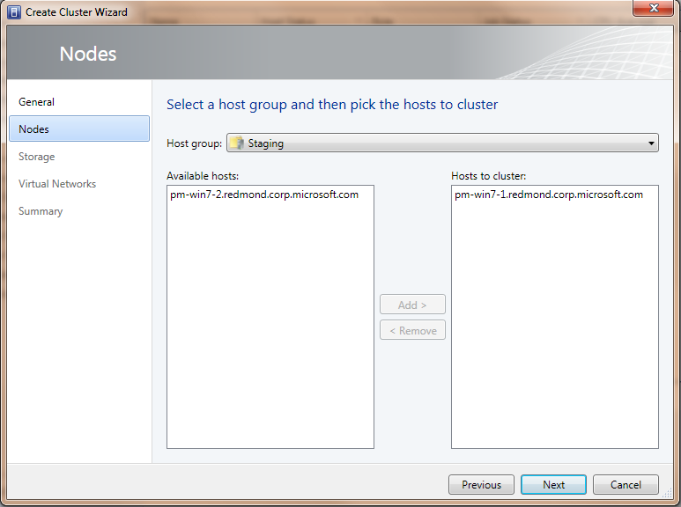
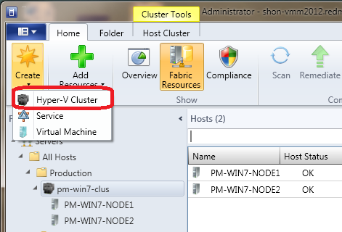
Create Cluster Wizard

Slide 8
Create Hyper-V Cluster
demo

Slide 9

Update Management
Brand new feature of VMM 2012
Keeps Windows fabric servers up-to-date
Enable Feature
Manage Baselines
Scan Servers
Remediate Servers
Manage Exemptions

Slide 10
Enabling Update Management
Point VMM server to an Update server
  Requires pre-existing, dedicated, root WSUS 3.0 SP2 64 Bit server
  Requires WSUS console on VMM server if WSUS server is remote
  Supports WSUS in SSL mode
VMM gets catalog of updates from Update server
  Synchronization of catalog is on demand
VMM points fabric servers to the correct Update server
  Configures WUA agent on each fabric server

Slide 11
Managing Baselines
Create baseline
  Logical grouping updates to assess compliance
  Two sample baselines for Security and Critical updates
Assign baseline
  Choosing the servers to assess compliance
  Can assign to
    Hosts, Host Groups and Host Clusters
    VMM Server Roles – Library Server, PXE Server, Update Server, VMM Server
  Can NOT assign to
    VMs (running or stored), VHDs in library

Slide 12
Scanning and Remediation
Scan
  Check if the server is compliant or not for assigned baseline
  Compliance at update level as well as baseline level
  VMM leverages WUA for applicability and compliance
  Scan is on demand and automatable using PowerShell
Remediate
  Make the server compliant by installing missing updates
  Update installation progress can be tracked in VMM console
  Remediate is on demand and automatable using PowerShell

Slide 13
Compliance View

Slide 14
Remediating Hyper-V Cluster
Orchestrated workflow
  Put a node in maintenance mode
    Evacuates the node using Live Migration
      User can override this to save state the VMs on the node
  Install missing updates based on baselines assigned
  Take the node out of maintenance mode
  Go to next node and repeat
Supports WS08 as well as WS08 R2 clusters
Automatable using PowerShell

Slide 15
Managing Exemptions
Exemptions
  Exempt the server for one or more updates
    Helps troubleshooting without affecting compliance
  Remediation allowed only if not exempt
    Helps remove human error
  Exemptions added/removed on demand

Slide 16
Update Hyper-V Cluster
demo

Slide 17

Dynamic Optimization
Brand new feature of VMM 2012
Keeps cluster balanced for resource usage
  Live Migration avoids VM downtime
  Does not require Operations Manager
Supports Hyper-V, VMware and Citrix XenServer clusters

Slide 18
Dynamic Optimization
Resources
  Optimizes for CPU, Memory, Disk IO and Network IO
  Optimizes when resource usage goes above DO threshold
Manual and Automatic mode
  Default is manual
User defined frequency
  Default is 10 minutes
Configurable aggressiveness
  More aggressive = More migrations = More balanced
  Default is least aggressive

Slide 19
Dynamic Optimization

Slide 20

Power Optimization
Power Optimization
  Extends Dynamic Optimization
  Can be enabled only if Dynamic Optimization is in automatic mode
Resources
  Optimizes for same resources as in Dynamic Optimization
  Optimizes when resource usage goes below PO threshold
User defined schedule
  Hours of the day when to optimize for power
Powering off/on
  Evacuates the host before powering off
  Ensures that evacuation will not cause other nodes to go above DO threshold
  Ensures that powering off will not violate cluster quorum requirement
  Leverages out-of-band management for power off/on

Slide 21
Power Optimization

Slide 22
In Review: Session Objectives and Takeaways
Understand
  High Availability
  Update Management
  Dynamic Optimization
Takeaways
  Creating Hyper-V cluster
  Updating Hyper-V cluster
  Optimizing Hyper-V cluster
    For Resource Usage
    For Power Usage

Slide 23
VMM 2012 Community Evaluation Program
Session * | Session Date
Overview SCVMM 2012 Overview (Demo Installing Demo Evaluation VHD) | 26-May
Adding Hyper-V Host, Deploying Bare Metal Hyper-V hosts | 9-Jun
DPM - Disaster Recovery in a Hyper-V Environment | 23-Jun
Overview of Networking | 7-Jul
Overview of Storage | 21-Jul
Cluster Creation, Update Management, Dynamic Optimatization | 4-Aug
Overview of Clouds (creation, SSU delegation) | 18-Aug
Overview of Server App-V in VMM | 1-Sep
Overview of Service Creation | 15-Sep
Modeling virtualized services in VMM (creation and deployment) | 29-Sep
Maintaining virtualized services | 13-Oct
Importing/Exporting Service Templates | 27-Oct
Overview of Concero | 10-Nov
Overview of Multi-Hypervisor Support (XenServer/Vmware) | 24-Nov
Wrap - up Customer success stories | 8-Dec
Guided evaluation of Management & Security Products
  Access to evaluation bits and VHDs
  Access to product group at Virtual Chalk Talks
Community of Participants
  Share feedback on product and documentation
  Share best practices and experiences
Learn more about programs at
  https://connect.microsoft.com/site1211
  Or email mscep@microsoft.com with your interest
* Proposed Sessions, dates and Session details subject to change

Slide 24
Related Sessions
VIR211 | VMM 2012: What’s in it and How it enables the Private Cloud
VIR315 | VMM 2012: Modeling and maintaining virtualized services in VMM 2012
VIR316 | VMM 2012: Deployment, Planning, Upgrade
SIM336 | VMM 2012: 1 of 3 Server Fabric Lifecycle – Configuring Network and Storage
SIM361 | VMM 2012: 2 of 3 Server Fabric Lifecycle OSD, OOB, and Agent Management
SIM357 | VMM 2012: 3 of 3 Server Fabric Lifecycle Cluster Creation,Update Management
VIR373-INT | SCVMM 2008 R2 SP1 deep dive- Advanced Troubleshooting
SIM212 | Cloud Management with System Center “Concero”
VIR314 | Understanding Server App-V and Sequencing and Deploying Datacenter Applications

Slide 25





Resources
  Connect. Share. Discuss.
http://northamerica.msteched.com
Learning
  Sessions On-Demand & Community
  Microsoft Certification & Training Resources
www.microsoft.com/teched
www.microsoft.com/learning
  Resources for IT Professionals
  Resources for Developers
http://microsoft.com/technet
http://microsoft.com/msdn

Slide 26












Required Slide
Complete an evaluation on CommNet and
enter to win!

Slide 27


Slide 28

© 2011 Microsoft Corporation. All rights reserved. Microsoft, Windows, Windows Vista and other product names are or may be registered trademarks and/or trademarks in the U.S. and/or other countries.
The information herein is for informational purposes only and represents the current view of Microsoft Corporation as of the date of this presentation. Because Microsoft must respond to changing market conditions, it should not be interpreted to be a commitment
on the part of Microsoft, and Microsoft cannot guarantee the accuracy of any information provided after the date of this presentation. MICROSOFT MAKES NO WARRANTIES, EXPRESS, IMPLIED OR STATUTORY, AS TO THE INFORMATION IN THIS PRESENTATION.

