Slide 1

Microsoft System Center
Operations Manager 2012: Overview
SIM355
Jason Buffington
Sr. Tech. Prod. Mgr.
Microsoft Corporation
EMAIL: JBUFF@microsoft.com
BLOG : http://JasonBuffington.com
TWITTER : @JBUFF
Gordon McKenna
Microsoft MVP OpsMgr
CEO, InfraMon
EMAIL: Gordon@inframon.com
WEB: www.inframon.com.com
WEB: www.WARonCOST.com

Slide 2
Session Objectives and Takeaways
Session Objectives:
  Introduce what is new in Operations Manager 2012
Understand how Operations Manager 2012:
  Help reduce your Mean Time to Resolution
  Expands the IT Pro’s visibility of your environment
DISCLAIMER
Session contains product features that are currently under development
and therefore subject to change before final release

Slide 3




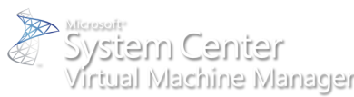
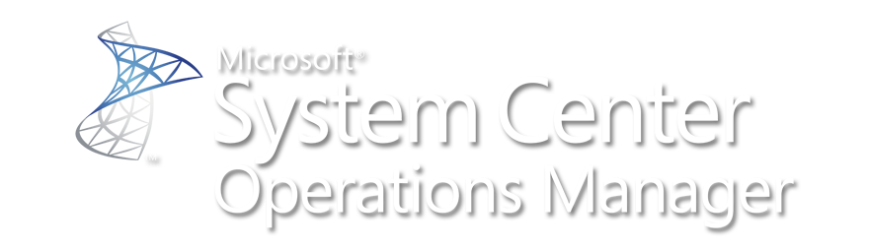

Journey to your Private Cloud with System Center
2010
Application Insight
DATACENTER MANAGEMENT
monitor | configure | backup | virtualize | automate
2010
Service Management
2009
IT Process Automation
2007
2006
Server
Virtualization
Backup
& Recovery
2000
1994
Monitoring
Configuration
ENABLE THE CLIENT
ENTER THE DATACENTER
INTEGRATED
VIRTUALIZATION
HETEROGENEOUS SUPPORT
EMBRACE THE CLOUD
1995
2000
2005
2010

Slide 4
Journey to your Private Cloud with System Center
175 ISV partners invest in System Center solutions as part of the System Center alliance
52% of you are active users of System Center Operations Manager
33% of you consider System Center as your primary server management solution for the datacenter (Source: internal Microsoft research)
100K management pack downloads in 2010!
OpsMgr 2007
OpsMgr 2012
You are licensed to manage almost 50% of your Windows Server infrastructure with System Center today
MOM 2000
MOM 2005
OpsMgr 2007 R2
Monitoring
2000
2005
2010

Slide 5

Operations Manager
2004
2005
2006
2007
2008
2009
2010
2011
MOM 2005
RTM
MOM 2005
SP1
OpsMgr 2007
RTM
OpsMgr 2007
SP1
OpsMgr 2007
R2
OpsMgr 2007
R2 – CU1, CU2, CU3, CU4
OpsMgr
2012
How is each Server?
How is Exchange?
How is the Website?
How is the Service?
Interoperability with other Enterprise Monitoring
Application Insight
thru AVIcode
Cross-Platform Monitoring
You are here!
(soon)

Slide 6
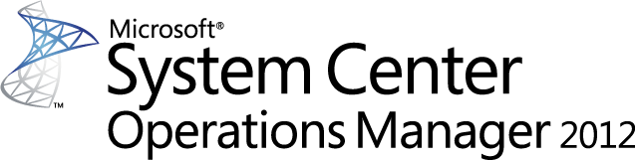
What we’ve heard from you
IT Pro Visibility
MTTR
Simplicity
Reliability
Personalization
Consistency

Slide 7
IT Pro Visibility
Reduced TCO of Management Infra
MTTR
Holistic view of Application Health
Simple and Powerful Visualizations decreasing time to value

Slide 8
Simple Topology requirements enables lower costs in hardware / maintenance / configuration
Reliable Environment enables no blackout in monitoring and reduction in labor costs for troubleshooting
Consistent operational continuity enables focus to shift from support -> innovation in IT organizations
IT Pro Visibility
Reduced TCO of Management Infra
MTTR
Holistic view of Application Health
Simple and Powerful Visualizations decreasing time to value

Slide 9
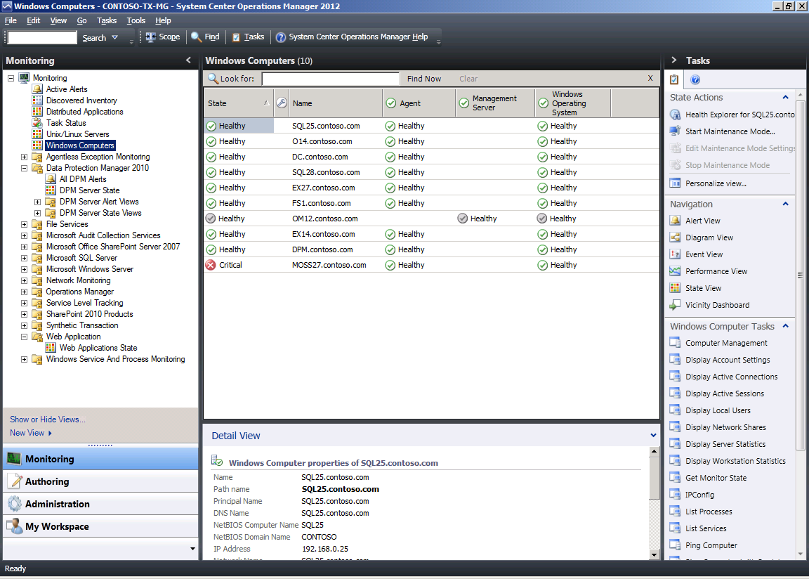
OpsMgr 2007 R2 – Topology
Scale by adding
Management Servers

Slide 10
OpsMgr 2007 R2 – Topology
Resliency by Clustering
the Root Management Server

Slide 11
OpsMgr 2007 R2 – Topology
Provides the following services:
  Console access
  Alert notifications
  Connectors to other mgmt systems
  Health aggregation
Introduces the following challenges:
  Performance and scalability bottleneck
  High end hardware required
  High availability requires clustering

Slide 12
OpsMgr 2012 – Topology
In OpsMgr 2012 :
Out of the box HA
Ability to run on commodity hardware
X
For more info, check out SIM356 OM12:Setup

Slide 13
OpsMgr 2012 – Topology
X
In OpsMgr 2012:
Managed by Pool
In OpsMgr 2007 R2:
Managed by a single MS
For more info, check out SIM356 OM12:Setup

Slide 14
Reducing Mgmt Infra TCO Summary
1 step setup of High Availability on commodity HW
Support for automatic Device monitoring failover
For more info, check out SIM356 OM12:Setup

Slide 15
Simple dashboards enable 360 view in a single tool
Reliable information enables easy reconciliation of internal monitoring with end user experience
Personalized views provides relevant information
Consistent views across multiple interfaces
IT Pro Visibility
Reduced TCO of Management Infra
MTTR
Holistic view of Application Health
Simple and Powerful Visualizations decreasing time to value

Slide 16
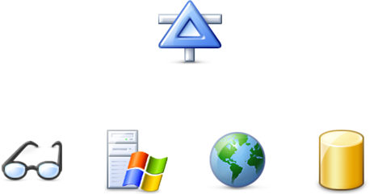

Expanding the IT Pro’s Visibility
Operations Manager 2007 SP1

Slide 17
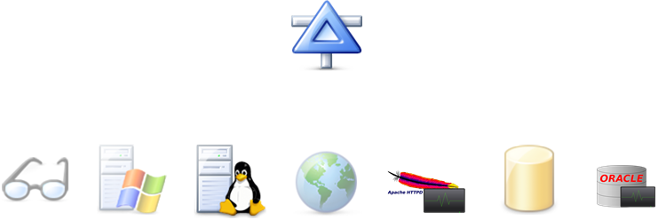





Expanding the IT Pro’s Visibility
Operations Manager 2007 R2

Slide 18
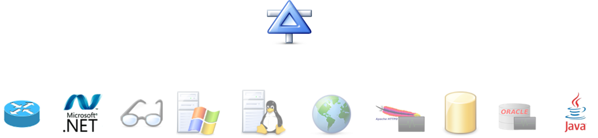



Expanding the IT Pro’s Visibility
Operations Manager 2012

Slide 19
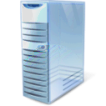


Expanding the IT Pro’s Visibility
Operations Manager 2012
Your App
Your App
Your private cloud

Slide 20



360 – Holistic View of Health
360 is a function of monitoring that gives customers visibility to the underlying application
environment(s) or infrastructure
Consistent UX
(Console, Web, SharePoint)
End User Experience
(Synthetic Transactions)
Improved
CIO
Application Monitoring
(.NET, J2E)
New
Service Owner
Infrastructure Monitoring
(OS, SQL, IIS)
Infrastructure Monitoring
(Network)
New
Infra Owner

Slide 21
Network Monitoring
Discovery
Monitoring
Visualization
Reporting
Multi-vendor support
Multi-protocol support
Server to network dependency discovery
For more info, check out SIM354 OM12:Networking

Slide 22
Network Monitoring
demo
For more info, check out SIM354 OM12:Networking

Slide 23
Holistic View of App Health (Network Infra)
Vicinity Dashboard showing contextual Network Map
Summary Dashboard of Network Devices
See Network Device Details and Health
For more info, check out SIM354 OM12:Networking

Slide 24
360 – Holistic View of Health
360 is a function of monitoring that gives customers visibility to the underlying application
environment(s) or infrastructure
Consistent UX
(Console, Web, SharePoint)
End User Experience
(Synthetic Transactions)
Improved
CIO
Application Monitoring
(.NET, J2E)
New
Service Owner
Infrastructure Monitoring
(OS, SQL, IIS)
Infrastructure Monitoring
(Network)
New
Infra Owner

Slide 25
J2E in OpsMgr 2012
Supported Platforms in OpsMgr 2012:
  Operating Systems
    Windows
  Java EE Application Servers
    WebSphere 6.1 & 7.0
    WebLogic 10gRel3 & 11gRel1
    JBOSS 4.2 & 5.1 (JVM 1.5+), JBOSS 6 (TBD)
    Tomcat 5.5 & 6.0 (JVM 1.5+), Tomcat 7 (TBD)

Slide 26
Application Monitoring
demo

Slide 27
Holistic View of App Health (App Monitoring)
Out of box App Discovery and Monitoring
Easy to understand Application failures via Resource View
Useful Dev information for efficient escalation
Increased time to value without custom MP authoring

Slide 28
Simple creation and customization of Dashboards through Templates and Widgets
Personalized Dashboards enable increased service owner efficiency and troubleshooting
Consistent views across all consoles enable users to see and share Dashboards with various owners (Infra, Service, and Managers)
IT Pro Visibility
Reduced TCO of Management Infra
MTTR
Holistic view of Application Health
Simple and Powerful Visualizations decreasing time to value

Slide 29
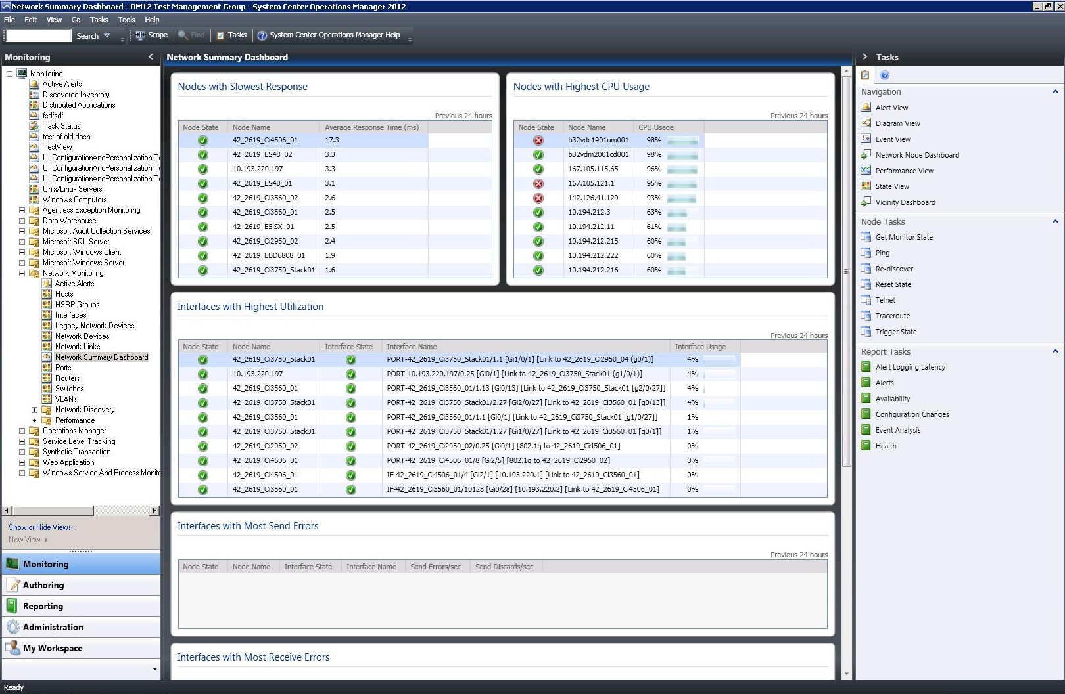
Consistent Experience – Desktop Console
Pre-release Screens – subject to change

Slide 30
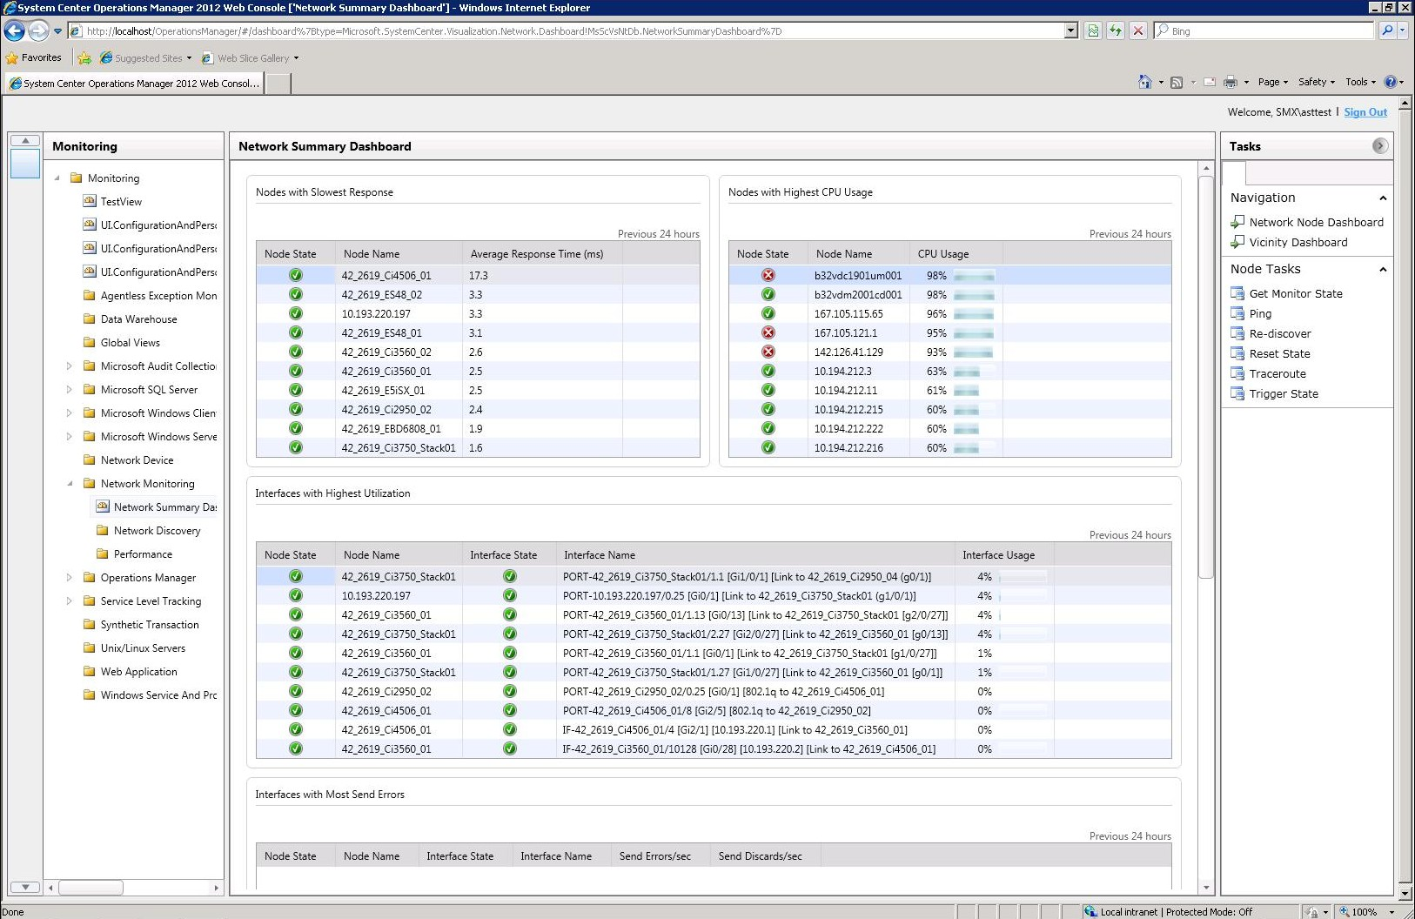
Consistent Experience – Web Console
Desktop Console
Pre-release Screens – subject to change

Slide 31
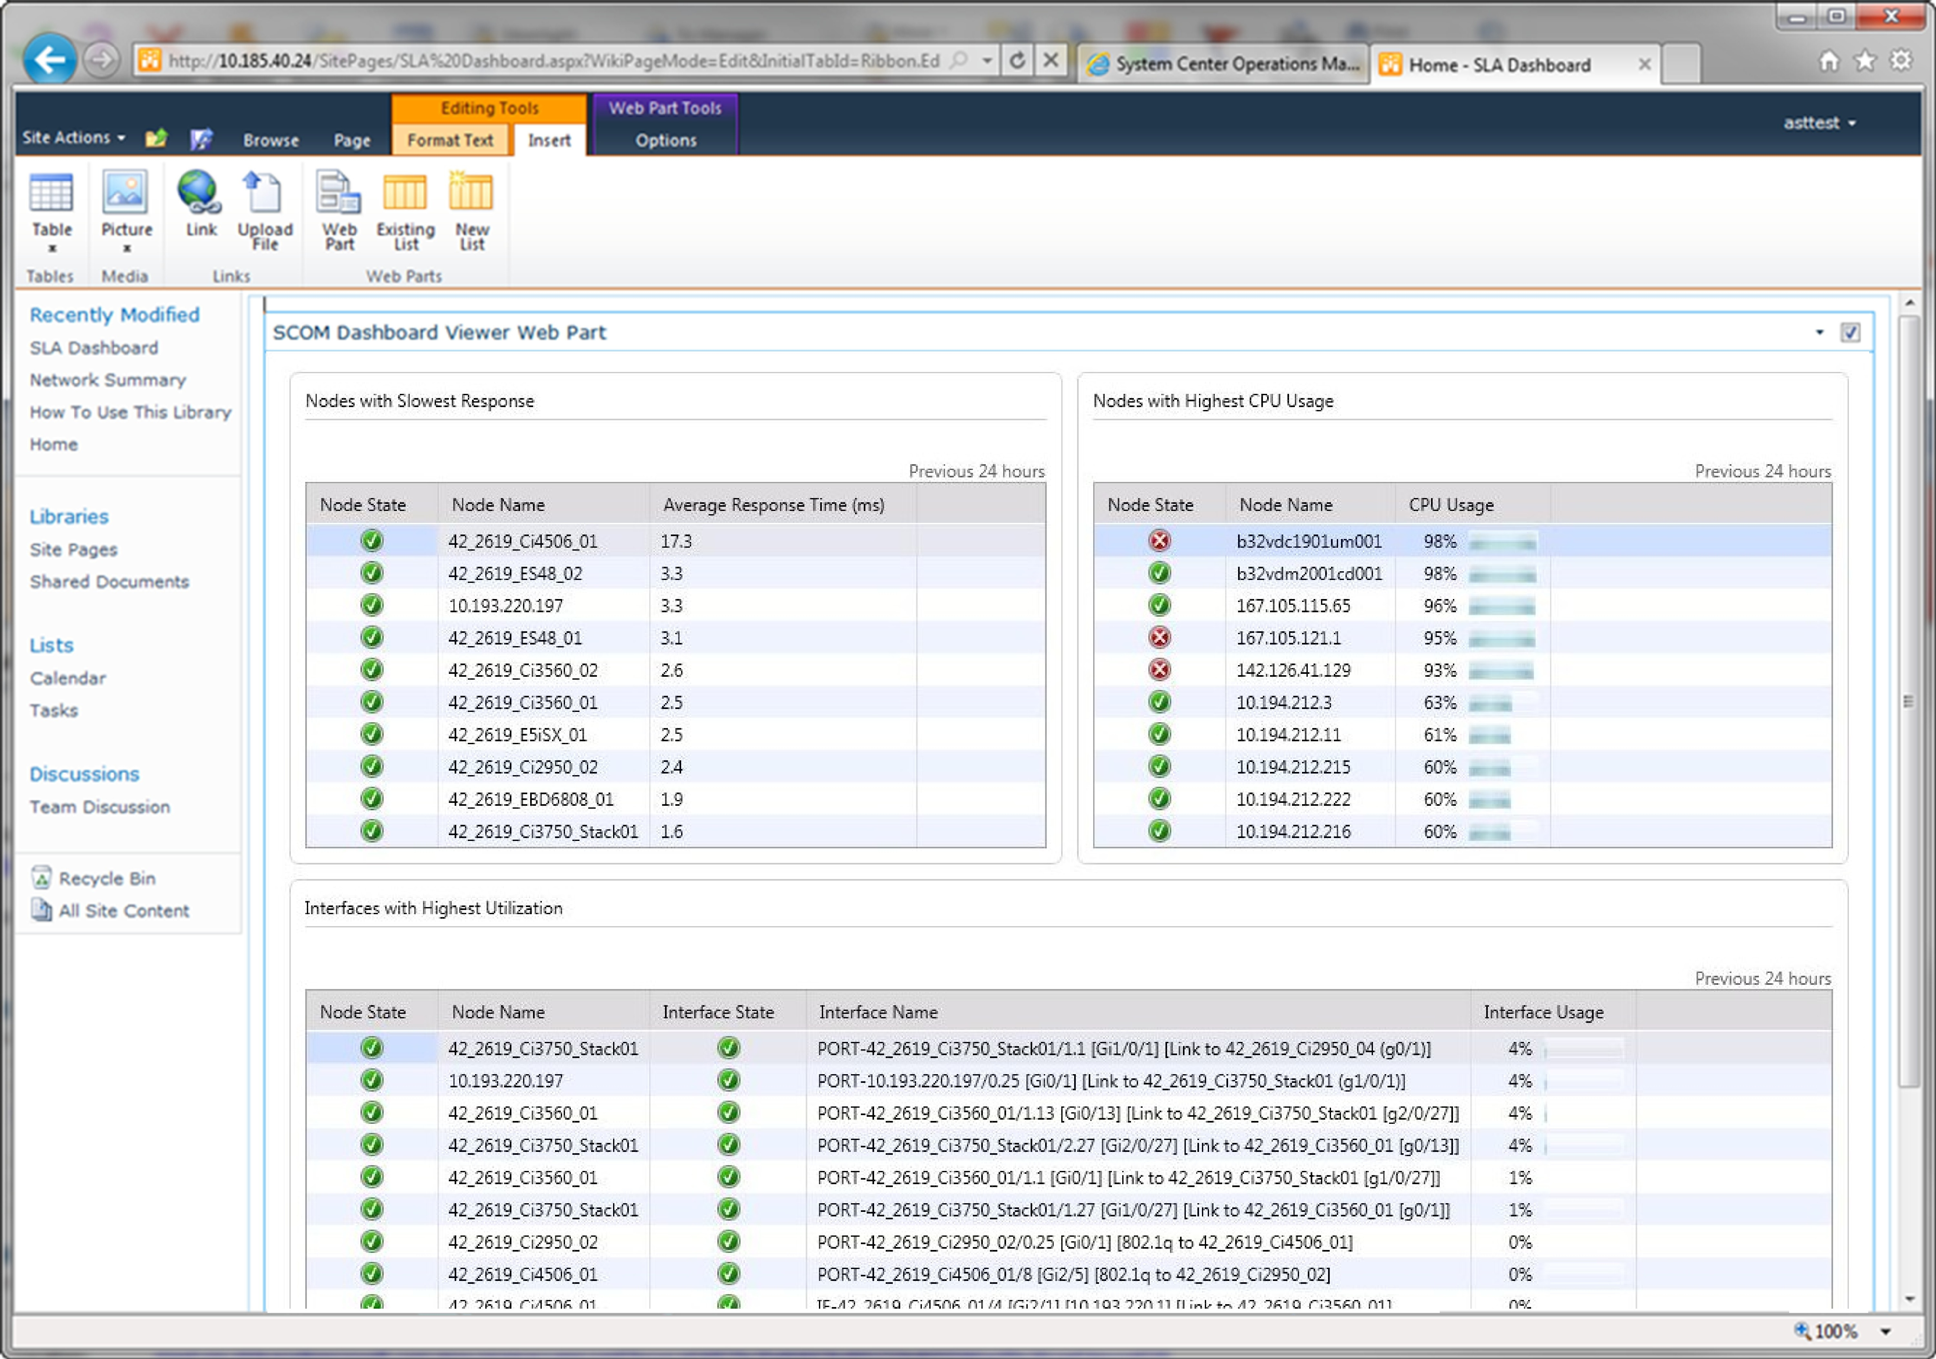
Consistent Experience – SharePoint
Desktop Console
Web Console
Pre-release Screens – subject to change

Slide 32
Dashboards
Pre-release Screens – subject to change
Demo

Slide 33
Simple and Powerful Visualizations via Dashboards
Easy to create Dashboards from Windows and Web Console
Easy to customize data visualizations via Widgets
Dashboard and Widgets delivered through MPs
Show Dashboards in SharePoint

Slide 34
IT Pro Visibility
Reduced TCO of Management Infra
MTTR
Holistic view of Application Health
Simple and Powerful Visualizations decreasing time to value

Slide 35
Session Objectives and Takeaways
Session Objectives:
  Introduce you to what is new in Operations Manager 2012
Understand how Operations Manager 2012:
  Helps reduce the customer’s Mean Time to Resolution
  Expands the IT Pro’s visibility of their environment

Slide 36
Learn More about Monitoring at TechEd
Monday 4:45p | SIM355 | OM12 : What is new 2012 overview (1 of 4)
Wednesday 8:30a | SIM355-R | OM12 : What is new 2012 overview (1 of 4)
Wednesday 3:15p | SIM356 | OM12 : Setup & Config (2 of 4)
Thursday 8:30a | SIM354 | OM12 : Networking (3 of 4)
Thursday 10:15a | SIM353 | OM12 : MPs & Dashboards (4 of 4)
Tuesday 5:00p | SIM343 | AVIcode : Overview
Wednesday 5:00p | SIM344 | AVIcode : Intercept Setup & Deployment
Thursday 1:00p | SIM342 | AVIcode : Diagnosing Applications

Slide 37
Learn More about Monitoring at TechEd
Hands-On Labs | SIM369-HOL | OM12 : Introduction
Hands-On Labs | SIM368-HOL | OM12 : Installing
Hands-On Labs | SIM366-HOL | OM12 : Monitoring E/S/WS
Hands-On Labs | SIM367-HOL | OM12 : Authoring MPs
Hands-On Labs | SIM365-HOL | AVIcode : Getting Started
Hands-On Labs | SIM364-HOL | AVIcode : Diagnosing Application Errors
Expert Station | TLC Expo | Ops Mgr 2012
Expert Station | TLC Expo | AVIcode 5.7 with OpsMgr 2007 R2
Interactive | SIM383 | Managing the Datacenter (panel)
Interactive | SIM382 | OM & AVI : Ask the Experts (panel)

Slide 38
Q&A

Slide 39
Now Taking Applications for OM 12 CEP
Community Evaluation Program
Guided evaluation of Management & Security Products
  Access to evaluation bits and VHDs
  Access to product group at Virtual Chalk Talks
Community of Participants
  Share feedback on product and documentation
  Share best practices and experiences
Learn more about programs at
  http://msft.it/cep
  Or email mscep@microsoft.com with your interest
  NOW ACCEPTING APPLICATIONS … email OMCEP@microsoft.com

Slide 40
Resources on Operations Manager
Website www.microsoft.com/OpsMgr
TechCenter technet.microsoft.com/OpsMgr
Forums social.technet.microsoft.com/Forums/en-US/category/OM
Team Blog blogs.technet.com/MOMteam
Ops Mgr CEP OMCEP@microsoft.com (now taking applications)
Jason Buffington JBUFF@microsoft.com
Jason’s blog jasonbuffington.com
Jason’s tweets twitter.com/JBuff
Jason’s book DataProtectionBible.com
Gordon McKenna Gordon@inframon.com
Inframon website www.inframon.com
War On Cost www.WARonCOST.com

Slide 41

Track Resources
Don’t forget to visit the Cloud Power area within the TLC (Blue Section) to see product demos and speak with experts about the Server & Cloud Platform solutions that help drive your business forward.
You can also find the latest information about our products at the following links:
Cloud Power - http://www.microsoft.com/cloud/
Private Cloud - http://www.microsoft.com/privatecloud/
Windows Server - http://www.microsoft.com/windowsserver/
Windows Azure - http://www.microsoft.com/windowsazure/
Microsoft System Center - http://www.microsoft.com/systemcenter/
Microsoft Forefront - http://www.microsoft.com/forefront/

Slide 42





Resources
  Connect. Share. Discuss.
http://northamerica.msteched.com
Learning
  Sessions On-Demand & Community
  Microsoft Certification & Training Resources
www.microsoft.com/teched
www.microsoft.com/learning
  Resources for IT Professionals
  Resources for Developers
http://microsoft.com/technet
http://microsoft.com/msdn

Slide 43












Complete an evaluation on CommNet and
enter to win!

Slide 44


Slide 45

© 2011 Microsoft Corporation. All rights reserved. Microsoft, Windows, Windows Vista and other product names are or may be registered trademarks and/or trademarks in the U.S. and/or other countries.
The information herein is for informational purposes only and represents the current view of Microsoft Corporation as of the date of this presentation. Because Microsoft must respond to changing market conditions, it should not be interpreted to be a commitment
on the part of Microsoft, and Microsoft cannot guarantee the accuracy of any information provided after the date of this presentation. MICROSOFT MAKES NO WARRANTIES, EXPRESS, IMPLIED OR STATUTORY, AS TO THE INFORMATION IN THIS PRESENTATION.

