Slide 1

Microsoft System Center Operations Manager 2012: Advanced Topics
SIM353
David Allen
Principal Consultant
Infront Consulting Group
David.Allen@infrontconsulting.com
BLOG : http://SystemCenterCentral.com
TWITTER : @AquillaWeb
Jason Buffington
Sr. Tech. Prod. Mgr.
Microsoft Corporation
JBUFF@microsoft.com
BLOG : http://JasonBuffington.com
TWITTER : @JBUFF

Slide 2

In this session, we will talk about…
Management Packs in OpsMgr 2012
    MP Stability
    MPs in OM12
    MP version strategy
    Feature Packs
    PinPoint
Dashboards & Authoring

Slide 3
Management Packs in OM12
Jason Buffington
Microsoft

Slide 4
System Center Operations Manager
2007 → 2012
Looking back
  When Ops Mgr 2007 RTM released,
  we had a happy customer base running on MOM 2005
    There was a catalog of management packs that were the product crown jewels
    There were some gaps that we learned about and addressed over time
Looking ahead
  We have a happy customer base running Operations Manager R2
    We have a management pack catalog full of management packs
    New types of management packs that light up Operations Manager 2012 features will be in the catalog at launch

Slide 5
Looking ahead to Operations Manager 2012
Questions we have received from you about management packs
  Will new MP’s in the catalog be available for the next version?
  Will they be native operations manager 2012 packs?
  Will Microsoft be converting all of the MP’s in the catalog for 2012?
  Will I have to re-author all of the management packs I have created for my company?

Slide 6
Our Management Pack Promises
Will the management pack that I have need to be changed in the next version of Operations Manager?
  Promise: Any management pack that you have will work in the next version, unchanged. Your existing management packs are already native Operations Manager 2012 monitoring packs – they will continue to be native packs
How can my company take advantage of new features in the next version of Operations Manager if the management packs aren’t going to need updates?
  Promise: Operations Manager 2012 will ship with many new features that you can take advantage of in your own management packs
    You will be able to create your own dashboards directly in the console, without having to use a separate tool
    New templates and tools are being added to the console for you to author your own new content

Slide 7
Our Management Pack Promises
Management packs will not break
  Any management pack in the catalog today will work as-is in Operations Manager 2012
Your own management packs will not break
  The tools, override, packs and investments you have made are still relevant
OM 2012 management pack back-compat testing investments
  No conversion tools required: MP’s aren’t changing
  We won’t ship if the management packs in the catalog today are broken
    Rigorous testing and partner validation in progress

Slide 8
Management Pack Versioning
Goal: Support as many customers as possible with a single MP version no matter which version of Operations Manager that they have
  Determines: Management Pack Library version dependency
Goal: Give customers management packs using the newest features
  Introducing: Feature Packs
    Feature pack is a smaller investment, showcasing newest management capabilities
 | 2010 | 2011 | 2012 | 2013 | 2014 | 2015
Native Monitoring packs | Ops Mgr SP1 |  | Ops Mgr R2 |  | Ops Mgr 2012
Ops Mgr 2012 Feature Packs | N/A |  | Ops Mgr 2012
Product Ship Year
OM Version

Slide 9
Sustaining Customer and Partner Value
Preserving existing management pack investments
  All of the packs in the catalog today will work with Operations Manager 2012
  No changes required in the current catalog MPs
    No concept of “new schema” to consider
    No need to ship newer MP’s to support different OM versions
MP name format changes to reflect this reality
  Old name
    Xyz product management pack for Operations Manger 2007 SP1
  New name reflects new approach
    XYZ product monitoring management pack
    Xyz product dashboard feature pack

Slide 10
Our journey together
Pinpoint…

Slide 11
On Pinpoint…
From you we heard
  “I hate Pinpoint. I call it painpoint. Why can’t Microsoft go back to the old MP catalog?”
  “I can’t find when a new MP ships”
  “Search on pinpoint doesn’t work, I can’t find the IIS 6 management pack for Server 2003”
Learned
  We didn’t prepare you when we launched pinpoint. It was a big surprise and it left you without the catalog you need.
  Key scenarios are search, latest MP updates and making the catalog a dedicated system center experience
Looking ahead
  Continue to engage deeply and make changes as needed to address the key scenarios that you use the catalog for

Slide 12
Pinpoint Investment History
We have heard your feedback
  Too hard to find MPs in the overall pinpoint marketplace
  Too hard to find newest MPs and version numbers
  Search is not limited to system center results
Delivering on your asks – a history of investment
  Pinpoint.microsoft.com/systemcenter
    Introduced filtering (Summer 2010)
    Introduced reverse date sorting (Fall 2010)
  The next release…

Slide 13
System Center Marketplace
Introducing

Slide 14
David Allen
Infront Consulting
Dashboards

Slide 15
Feature Pack Highlight: Dashboards
Adding rich visualization capabilities to management packs
  Improved visualization of complex information
  Relationships and drill-down become evident
  Graphical format – improvement over the old style of dashboard
  Featured in Console, Web Console and publish to SharePoint 2012

Slide 16
Dashboard Goals
Build an extensible visualization solution
  Dashboards defined in MPs
  Maximize re-use
  Consistency
  Write once / visualize everywhere (Windows Console | Web Console | SharePoint)
Enable customers to create new dashboards
  Enabled from both Windows and Web consoles
Enable out of band UX solutions and rich customer personalization scenarios
Integrate with current and previous investments

Slide 17
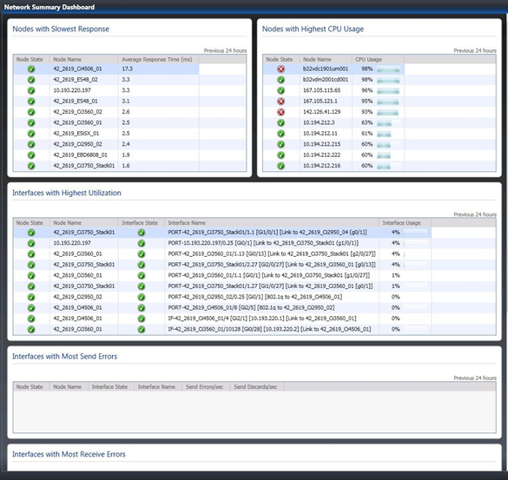
Dashboard Concepts
Dashboard View
Dashboard Container
Dashboard Widget
  UI Control
  Data Provider
  Configuration
  Personalization
Dashboard Layout
Dashboard Template
Widget Connection

Slide 18
Operations Manager 2012 Dashboards
demo

Slide 19
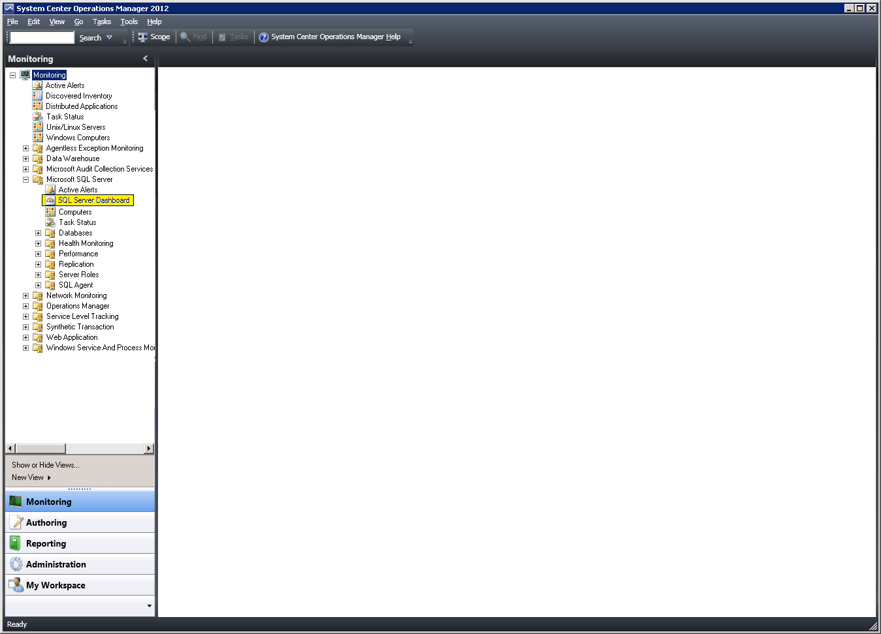
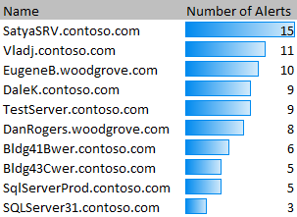
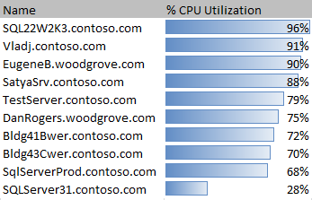
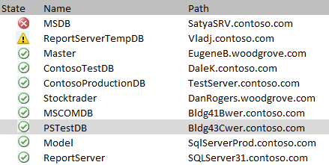
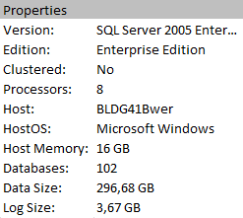
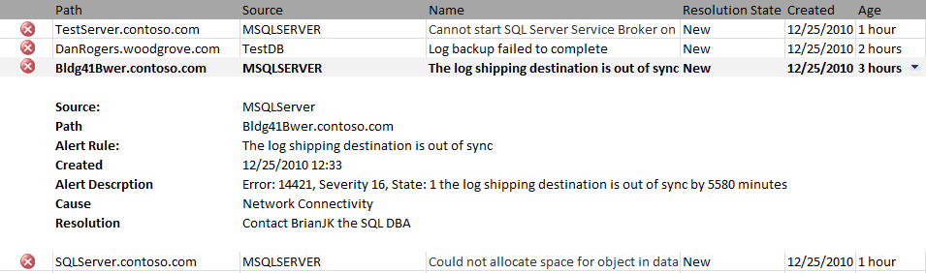
Summary
Dashboard
Top 10 SQL Servers with most Alerts
Active Alerts
Top 10 SQL Servers with highest CPU Utilization
Intended for the workload manager
SQL Server Database State
SQL Alerts Generated in the last 24 hours

Slide 20
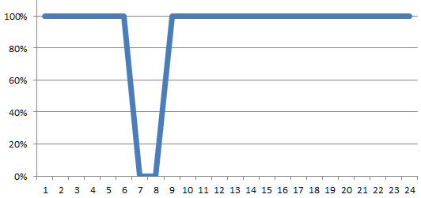
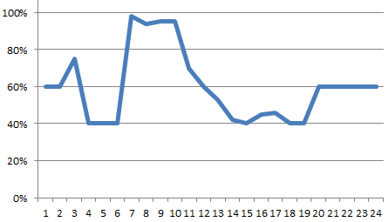
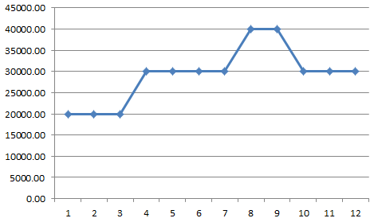
Performance
Dashboard
SatyaSrv.contoso.com\Instance 1
SQL Server Availability over last 24 hours
SQL CPU Utilization over last 24 hours
Intended for the workload specialist
SQL Memory Usage in KB
Disk Storage
Total Memory: 50,000 KB
Data Files: 17.6 GB
66%
Log Files: 6.93 GB
2%
SQL Server Properties
Total Memory Used on Server
80%
Total Memory Used by SQL
90 %

Slide 21
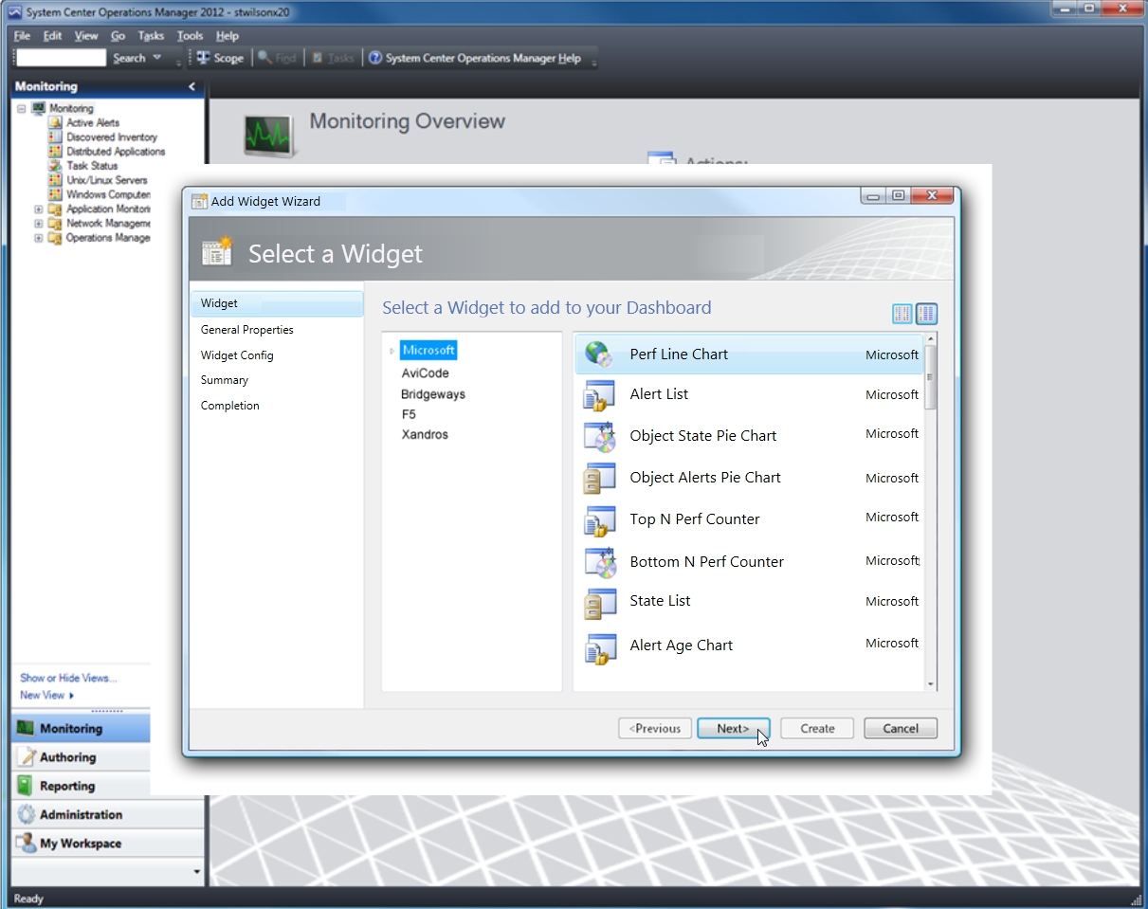
Pre-release Conceptual Screens – subject to change

Slide 22
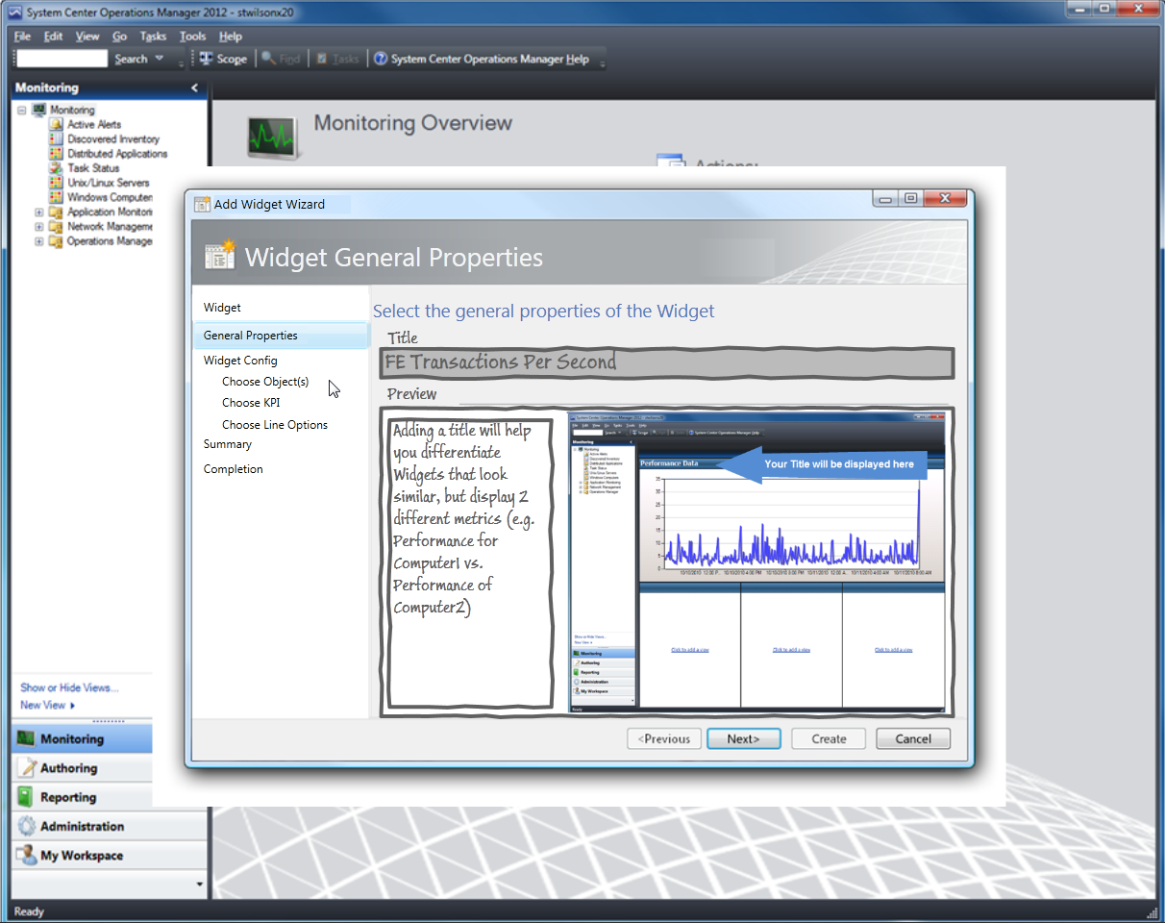
Pre-release Conceptual Screens – subject to change

Slide 23
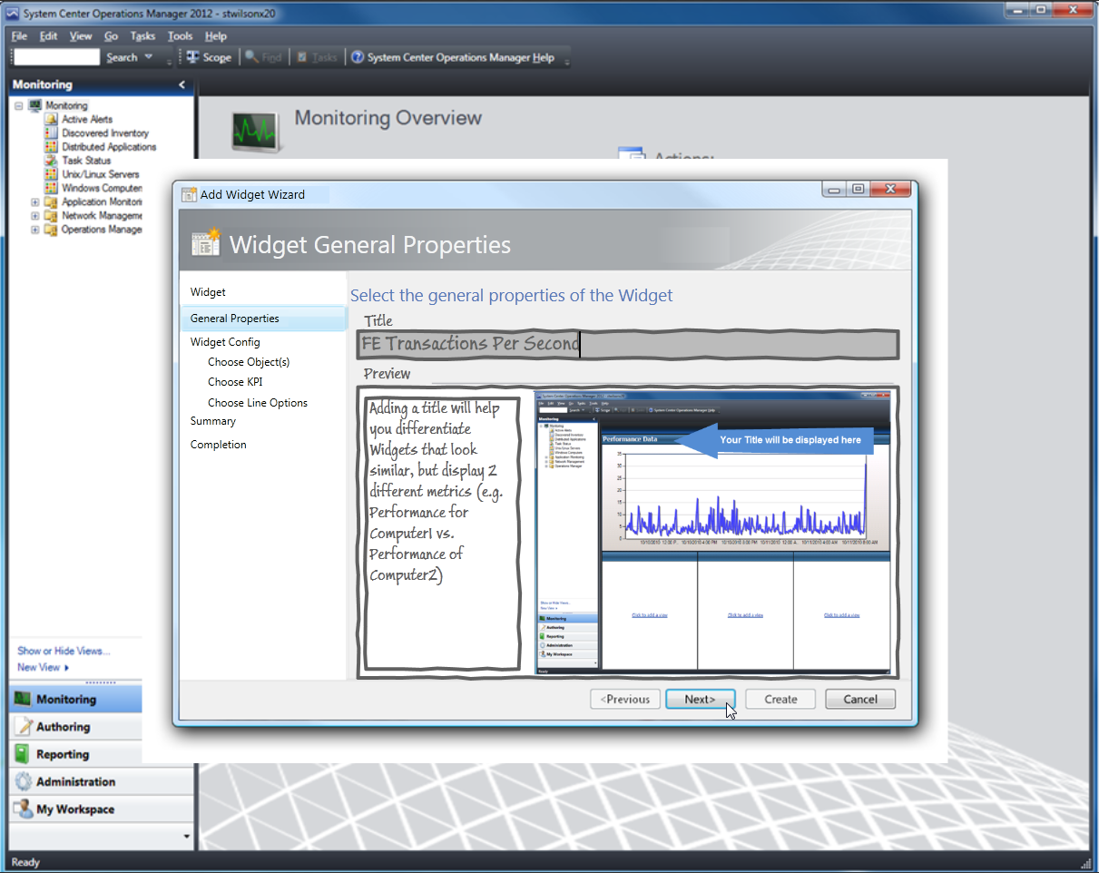
Pre-release Conceptual Screens – subject to change

Slide 24
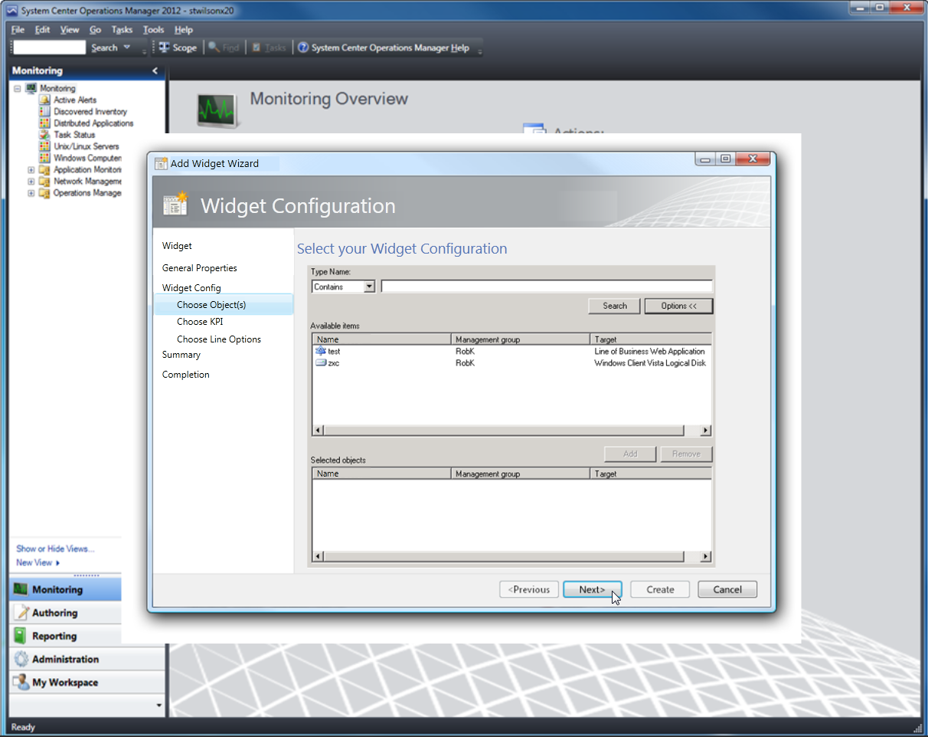
Pre-release Conceptual Screens – subject to change

Slide 25
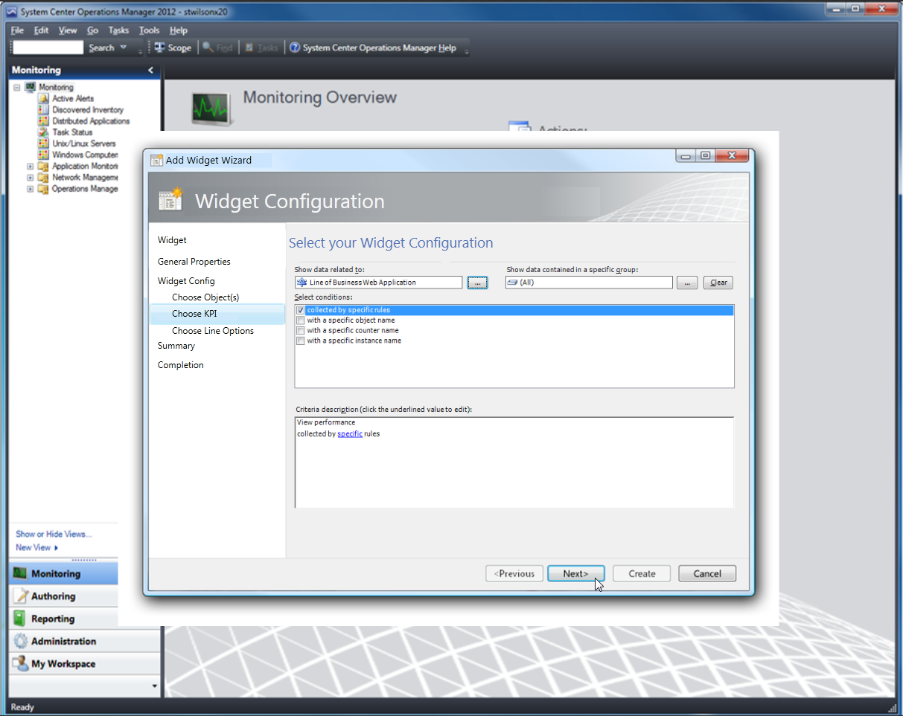
Pre-release Conceptual Screens – subject to change

Slide 26
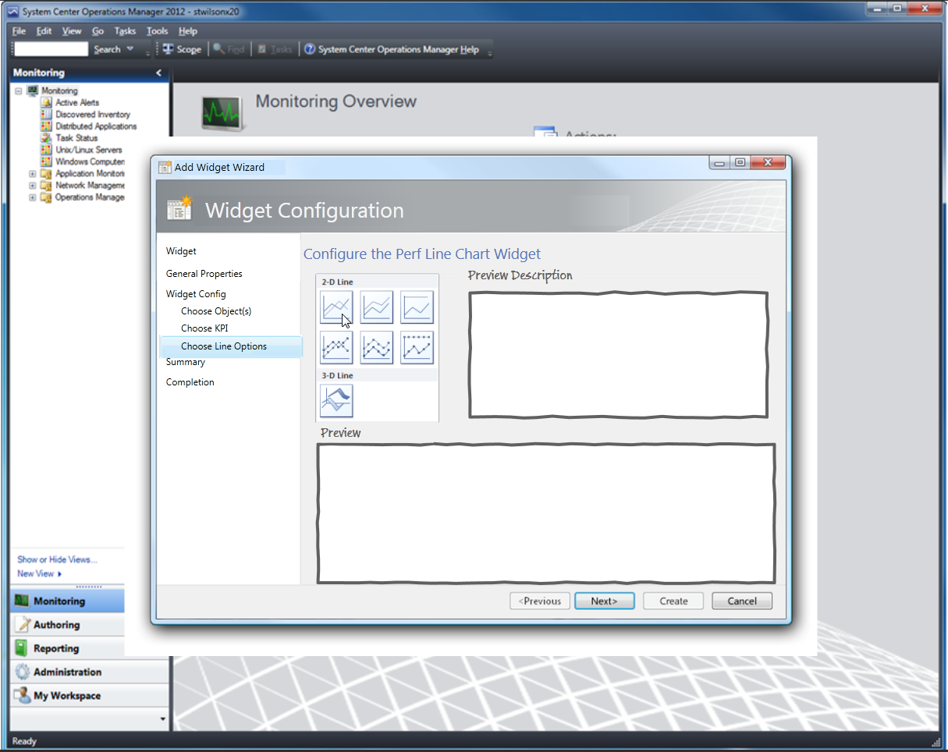
Pre-release Conceptual Screens – subject to change

Slide 27
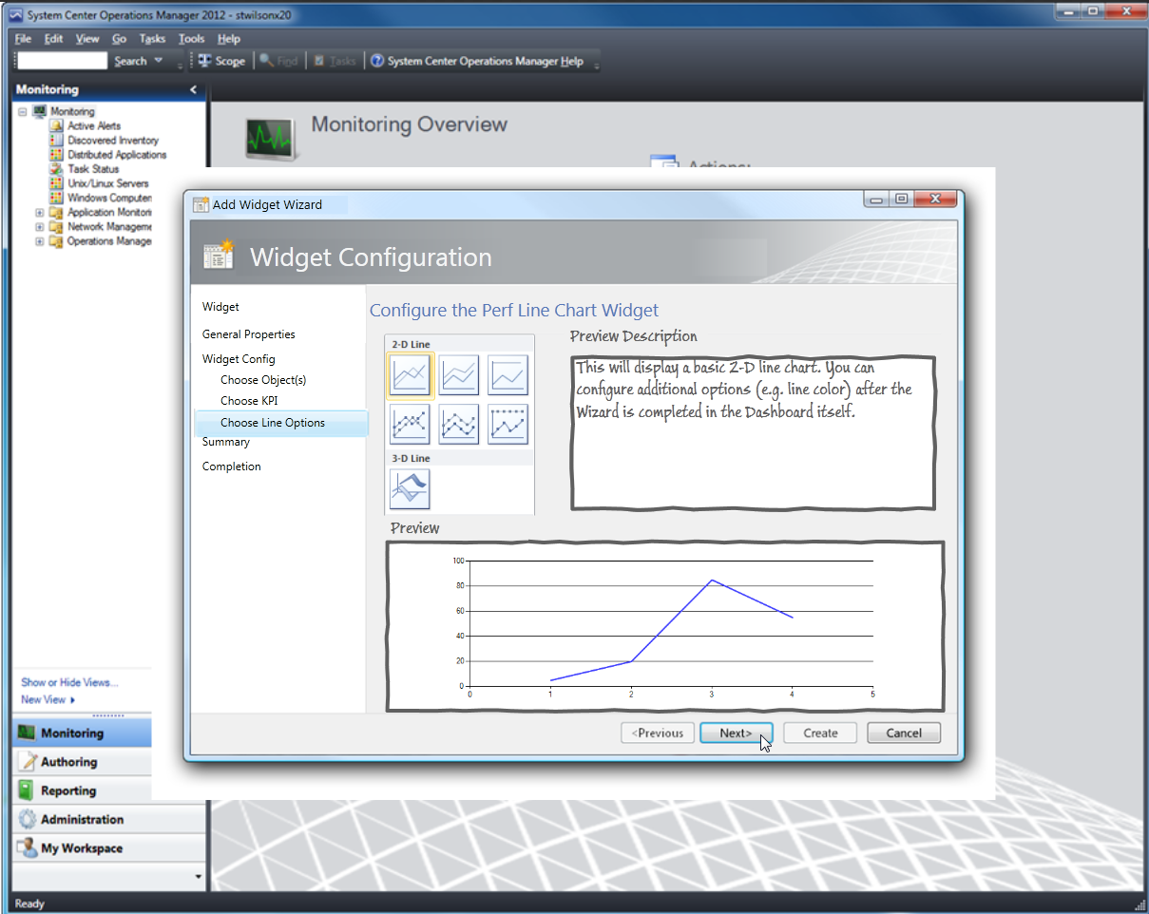
Pre-release Conceptual Screens – subject to change

Slide 28
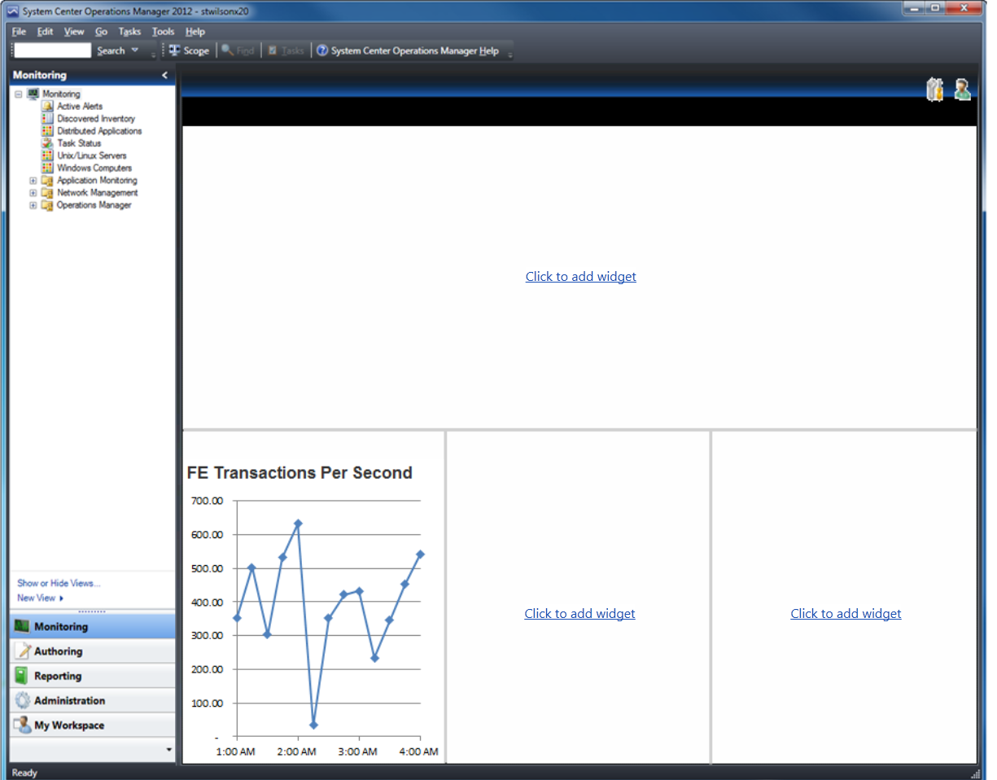
Pre-release Conceptual Screens – subject to change

Slide 29
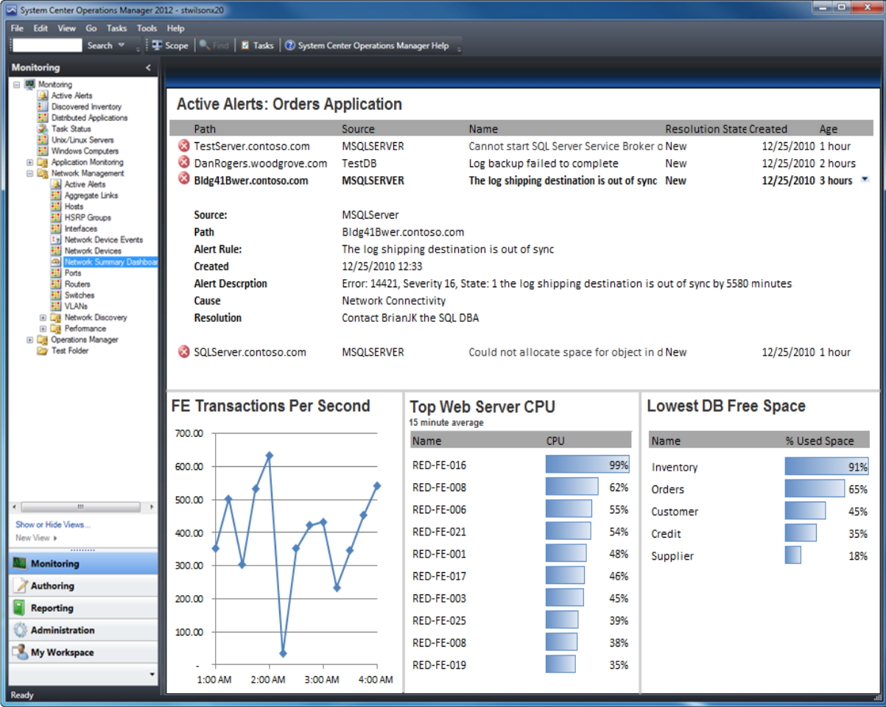
Pre-release Conceptual Screens – subject to change

Slide 30
Defining a Dashboard
Select a folder to show the dashboard
  Determines MP to store it in
Choose a template
  Choose layout
Add widgets and/or configure (depending on template)
Each user can personalize
  Follows user across windows console, web and sharepoint

Slide 31
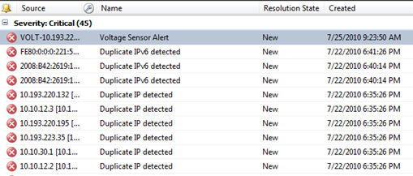
Alert Widget
Scenario: view alerts
UI control: Grid
Data provider: Alert data (OpsMgr DB)
Configuration: group/instance, alert severity, priority and resolution
Personalization: alert columns, sort order, grouping

Slide 32
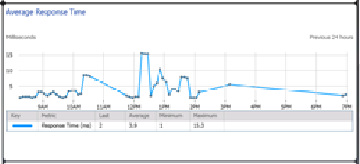
Performance Widget
Scenario: view performance data
UI control: Performance control
Data provider: Performance data (OpsMgr DW)
Configuration: group/instance, perf counters/objects/instances, time range
Personalization: alert columns, sort order, grouping

Slide 33
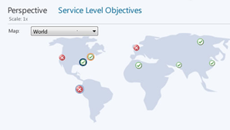
Map with State
Scenario: View state on a map
UI control: topology control
Data provider: state data (OpsMgr DB)
Configuration: image, group/instances, location
Personalization: TBD

Slide 34
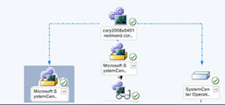
Topology
Scenario: View state on a map
UI control: topology control
Data provider: state data (OpsMgr DB)
Configuration: Show contained objects, Levels of containment, Virtual grouping (yes/no), Virtual group parameters, Background image, Object location (pining)
Personalization: TBD

Slide 35
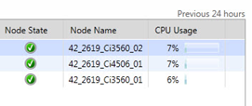
State
Scenario: View state of objects
UI control: grid control
Data provider: state data (OpsMgr DB) + managed entity properties + performance provider
Configuration: group/instances, columns
Personalization: columns, sorting

Slide 36
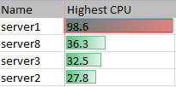
Top/bottom N for Perf (and SLO)
Scenario: view TOP instances in relation to some performance metric
UI control: grid control
Data provider: Top/bottom N for performance provider (DW)
Configuration: group/instances, Top or bottom, Bar color, Latest value or average, Time window for average, Threshold
Personalization: columns

Slide 37
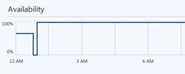
Availability History Over Time
Scenario: view availability history for an object
UI control: performance control
Data provider: Availability history (DW)
Configuration: collection of instance/monitor, Availability algorithm (0/100 per sample or aggregate over sub-periods), Sub-period aggregation periods, Min/max of vertical axis, Line color, Line width
Personalization: TBD

Slide 38
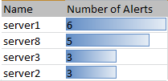
Top N for Alerts
Scenario: view instances with the most alerts
UI control: Grid control
Data provider: Top N for Alerts
Configuration: group/type, bar color
Personalization: TBD

Slide 39


Perf Gauge and SLA Gauge
Scenario: View perf value, View SLA value
UI control: gauge control
Data provider: perf DP (DW), SLA DP (DW)
Configuration Perf: Object-counter-instance, Collection rule, Last sampled value or average, Latest value or time range of average (hourly/daily), Min/max of gauge, Pointer color, Threshold
Configuration SLA: Instance or Monitor, Time range for availability calculation, Min/max of gauge, Pointer color, Threshold
Personalization: TBD

Slide 40
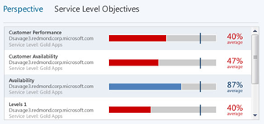
Perf Gauge and SLA Gauge
Scenario: View perf value, View SLA value
UI control: gauge control
Data provider: perf DP (DW), SLA DP (DW)
Configuration Perf: Object-counter-instance, Collection rule, Last sampled value or average, Latest value or time range of average (hourly/daily), Min/max of gauge, Pointer color, Threshold
Configuration SLA: Instance or Monitor, Time range for availability calculation, Min/max of gauge, Pointer color, Threshold
Personalization: TBD

Slide 41
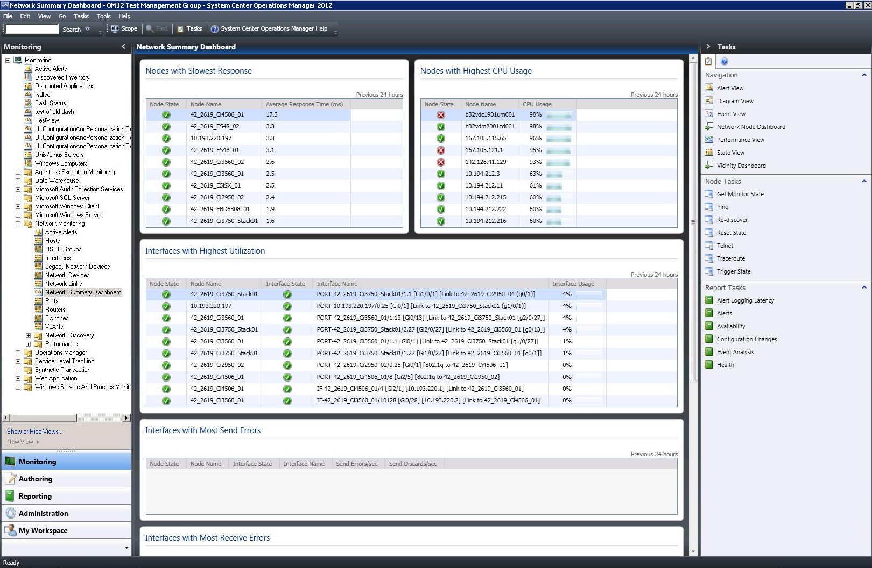
Consistent Experience – Desktop Console

Slide 42
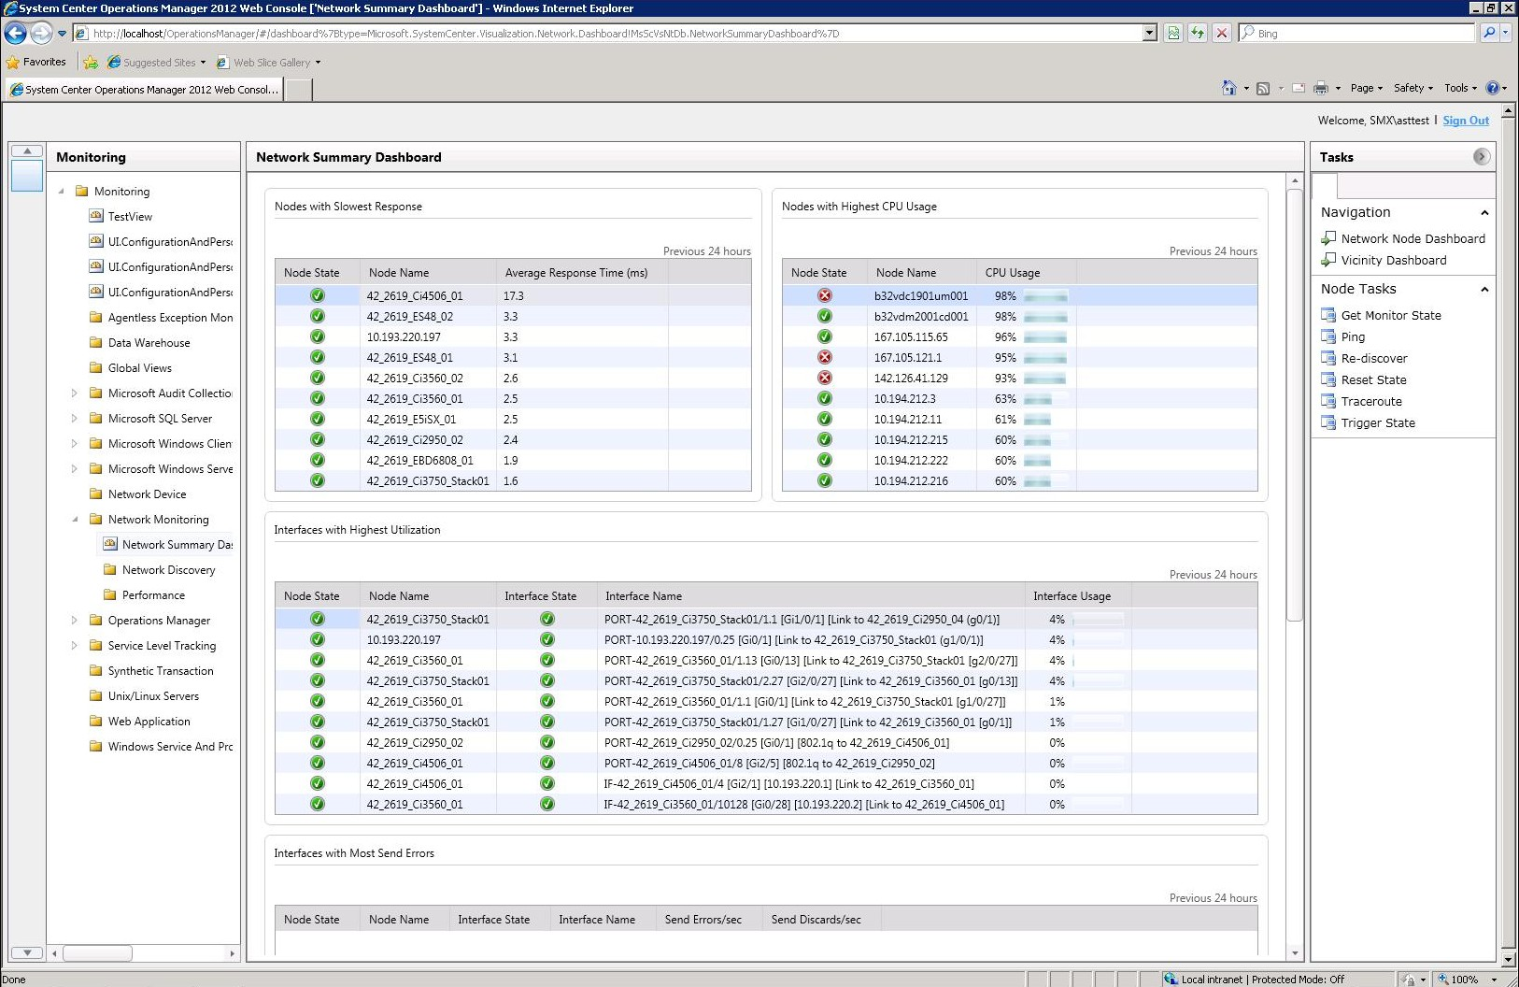
Consistent Experience – Web Console
Desktop Console

Slide 43
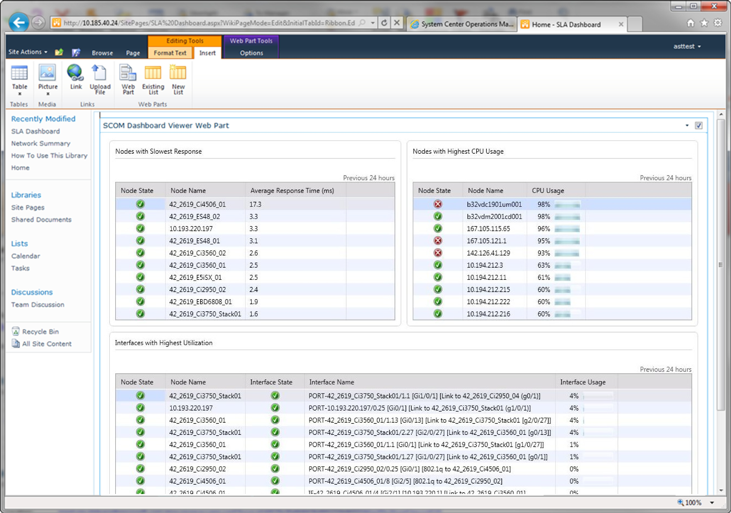
Consistent Experience – SharePoint
Desktop Console
Web Console

Slide 44
UI Architecture
Windows Console
Web Client
Sharepoint
Mgmt Server
SDK
Mgmt Server
SDK/Web server
Mgmt Server
SDK web Server
OpsMgr
DB
OpsMgr
DW

Slide 45
Partner Dashboards
These are the dashboards that ship at the same time as OM12
Working with internal Microsoft groups and external partners
  e.g. Exchange, SQL, SharePoint, etc.
Consistency
  Templates for Summary, Performance
  UI Design and styling best practices

Slide 46
Top 10 SQL Servers with most Alerts
Active Alerts
Top 10 SQL Servers with highest CPU Utilization
SQL Server Database State
SQL Alerts Generated in the last 24 hours

Slide 47
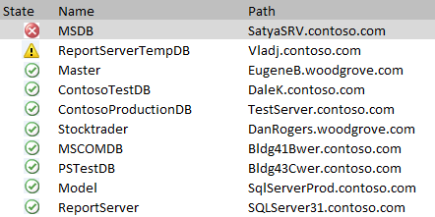
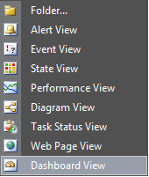
Top 10 SQL Servers with most Alerts
Active Alerts
Top 10 SQL Servers with highest CPU Utilization
SQL Server Database State
SQL Alerts Generated in the last 24 hours

Slide 48
SatyaSrv.contoso.com\Instance 1
SQL Server Availability over last 24 hours
SQL CPU Utilization over last 24 hours
SQL Memory Usage in KB
Disk Storage
Total Memory: 50,000 KB
Data Files: 17.6 GB
66%
Log Files: 6.93 GB
2%
SQL Server Properties
Total Memory Used on Server
80%
Total Memory Used by SQL
90 %

Slide 49
Now Taking Applications for OM 12 CEP
Community Evaluation Program
Guided evaluation of Management & Security Products
  Access to evaluation bits and VHDs
  Access to product group at Virtual Chalk Talks
Community of Participants
  Share feedback on product and documentation
  Share best practices and experiences
Learn more about programs at
  http://msft.it/cep
  Or email mscep@microsoft.com with your interest
  NOW ACCEPTING APPLICATIONS … email OMCEP@microsoft.com

Slide 50
Summary and Call to Action
Your MPs will work in OM 2012
Get ready for OM12 beta (summer)
  Share feedback on widgets
  Share feedback on dashboards
Encourage partners you work with to build and invest in dashboards
Prepare your customers for OM12
  Think about monitoring the application
  Think about monitoring the fabric

Slide 51
Resources on Operations Manager
Website www.microsoft.com/OpsMgr
TechCenter technet.microsoft.com/OpsMgr
Forums social.technet.microsoft.com/Forums/en-US/category/OM
Team Blog blogs.technet.com/MOMteam
Tweets @MPreleases @System_Center
Ops Mgr CEP OMCEP@microsoft.com (now taking applications)
MP feedback for OM12 DANRO@microsoft.com
Jason Buffington JBUFF@microsoft.com
Jason’s blog jasonbuffington.com
Jason’s tweets twitter.com/JBuff
Jason’s book DataProtectionBible.com
David Allen David.Allen@infrontconsulting.com
Infront InfrontConsulting.com
SC Blog SystemCenterCentral.com

Slide 52
Learn More about Monitoring at TechEd
Monday 4:45p | SIM355 | OM12 : What is new 2012 overview (1 of 4)
Wednesday 8:30a | SIM355-R | OM12 : What is new 2012 overview (1 of 4)
Wednesday 3:15p | SIM356 | OM12 : Setup & Config (2 of 4)
Thursday 8:30a | SIM354 | OM12 : Networking (3 of 4)
Thursday 10:15a | SIM353 | OM12 : MPs & Dashboards (4 of 4)
Tuesday 5:00p | SIM343 | AVIcode : Overview
Wednesday 5:00p | SIM344 | AVIcode : Intercept Setup & Deployment
Thursday 1:00p | SIM342 | AVIcode : Diagnosing Applications

Slide 53
Learn More about Monitoring at TechEd
Hands-On Labs | SIM369-HOL | OM12 : Introduction
Hands-On Labs | SIM368-HOL | OM12 : Installing
Hands-On Labs | SIM366-HOL | OM12 : Monitoring E/S/WS
Hands-On Labs | SIM367-HOL | OM12 : Authoring MPs
Hands-On Labs | SIM365-HOL | AVIcode : Getting Started
Hands-On Labs | SIM364-HOL | AVIcode : Diagnosing Application Errors
Expert Station | TLC Expo | Ops Mgr 2012
Expert Station | TLC Expo | AVIcode 5.7 with OpsMgr 2007 R2
Interactive | SIM383 | Managing the Datacenter (panel)
Interactive | SIM382 | OM & AVI : Ask the Experts (panel)

Slide 54
Track Resources
Don’t forget to visit the Cloud Power area within the TLC (Blue Section) to see product demos and speak with experts about the Server & Cloud Platform solutions that help drive your business forward.
You can also find the latest information about our products at the following links:
Cloud Power - http://www.microsoft.com/cloud/
Private Cloud - http://www.microsoft.com/privatecloud/
Windows Server - http://www.microsoft.com/windowsserver/
Windows Azure - http://www.microsoft.com/windowsazure/
Microsoft System Center - http://www.microsoft.com/systemcenter/
Microsoft Forefront - http://www.microsoft.com/forefront/

Slide 55





Resources
  Connect. Share. Discuss.
http://northamerica.msteched.com
Learning
  Sessions On-Demand & Community
  Microsoft Certification & Training Resources
www.microsoft.com/teched
www.microsoft.com/learning
  Resources for IT Professionals
  Resources for Developers
http://microsoft.com/technet
http://microsoft.com/msdn

Slide 56












Required Slide
Complete an evaluation on CommNet and
enter to win!

Slide 57
MS Tag Placeholder Slide
Required Slide
Your MS Tag will be inserted here during the final scrub.

Slide 58

© 2011 Microsoft Corporation. All rights reserved. Microsoft, Windows, Windows Vista and other product names are or may be registered trademarks and/or trademarks in the U.S. and/or other countries.
The information herein is for informational purposes only and represents the current view of Microsoft Corporation as of the date of this presentation. Because Microsoft must respond to changing market conditions, it should not be interpreted to be a commitment
on the part of Microsoft, and Microsoft cannot guarantee the accuracy of any information provided after the date of this presentation. MICROSOFT MAKES NO WARRANTIES, EXPRESS, IMPLIED OR STATUTORY, AS TO THE INFORMATION IN THIS PRESENTATION.

