Slide 1
Microsoft System Center Configuration Manager 2012: Technical Overview
SIM352
Wally Mead
Senior Program Manager
Microsoft Corporation

Slide 2
Business Trends and Challenges
Industry Trends
Employee Demands
IT Requirements
“More things to manage”
“Blurring of work and life”
Work on any device I
want, wherever I want
Proliferation of devices
Enable worker
productivity
Virtualization moving
to the desktop
Use the applications
I want, now
Growing threats to
corporate information
Access to my workplace
whenever I need it
Protect corporate
assets and data
Manage operational costs

Slide 3

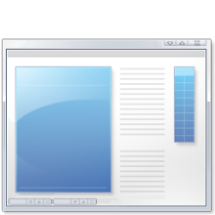




System Center Configuration Manager
Empower Users
Unify Infrastructure
Simplify Administration
Empower people to be productive from anywhere on whatever device they choose
Reduce costs by unifying IT management infrastructure
Improve IT effectiveness and efficiency
Device freedom
Optimized, personalized
application experience
Application self-service
Mobile, physical, and virtual management
Security & compliance
Service management integration
Comprehensive client
management capabilities
Improved administrator
effectiveness
Reduced infrastructure complexity

Slide 4
Empower User Productivity

Slide 5
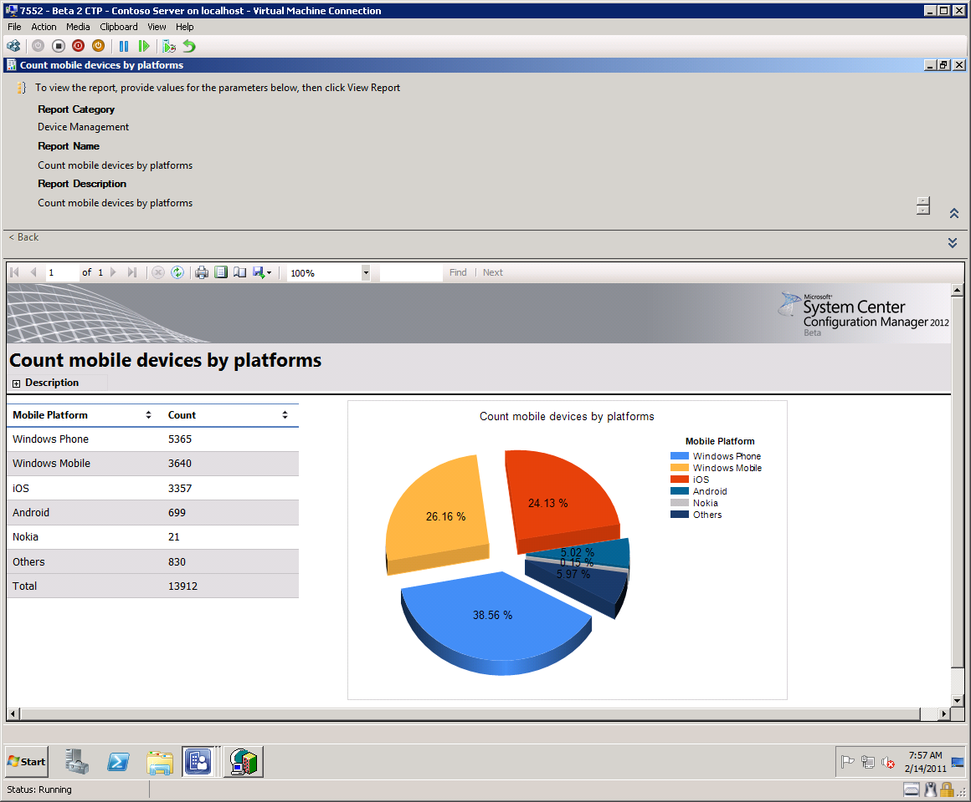




Mobile Device Management
Light Management
EAS-based policy delivery
Discovery and inventory
Settings policy
Remote Wipe
7
NOKIA
Depth Management
Secure over-the-air enrollment
Monitor and remediate out-of-compliance devices
Deploy and remove applications
Inventory
Remote wipe
  (WinCE 5.0, 6.0; Windows Mobile 6.0, 6.1, 6.5.x)

Slide 6
“Depth” Mobile Device Management
Establishes mutual trust between the device and the management server
Devices enrolled and provisioned securely over-the-air
  Admin (or end user) registers new mobile device and receives one-time PIN from Site Server
  Admin sends PIN and enrollment instructions to user
  Simplified end user experience and deployment User enrolls via Enroll utility on mobile device

Slide 7
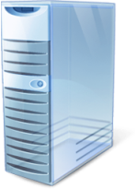

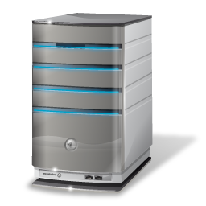


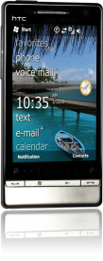

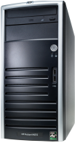








Enrollment Architecture
Microsoft CA
Active
Directory
Public DNS
DMZ
Enrollment Web Proxy
FQDN Discovery
User Discovery
User Cert
request
Email and pwd
Enrollment Service Point
User Cert request
Download enrollment client
Email and pwd
Primary Site
User Cert request
Management Point
Email & pwd
Get Policy
Grant enrollment rights to user collection
Distribution Point

Slide 8
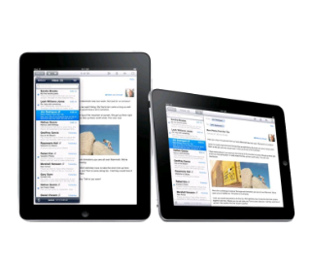

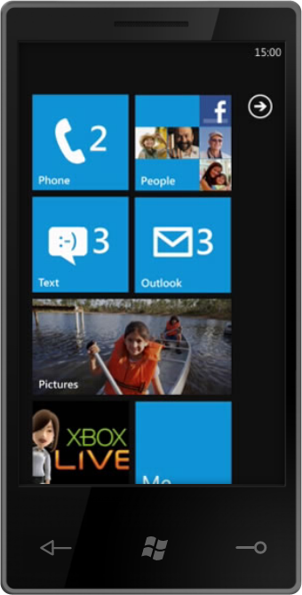

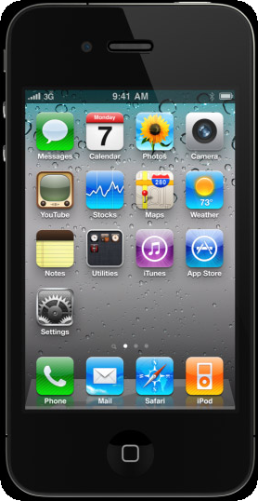
“Light” management via Exchange
Provide basic management for all Exchange ActiveSync (EAS) connected devices
Features Supported:
  Discovery/Inventory
  Settings policy
  Remote Wipe
Supports on-premise Exchange 2010 and hosted Exchange

Slide 9



Light Management Architecture
Active
Directory
Exchange
Client Access Server
Apply Settings
Device Settings
Get Device
Settings Policy
Settings Policy
Primary Site
Discover Mobile Devices
Device info
Check access to
Exchange
Mail Request
Apply Settings
Device Info
Discover Mobile
Devices
Settings Policy
Mail Request
Configure Exchange Connector
Exchange Mailbox Server

Slide 10
Managing Mobile Devices
demo

Slide 11





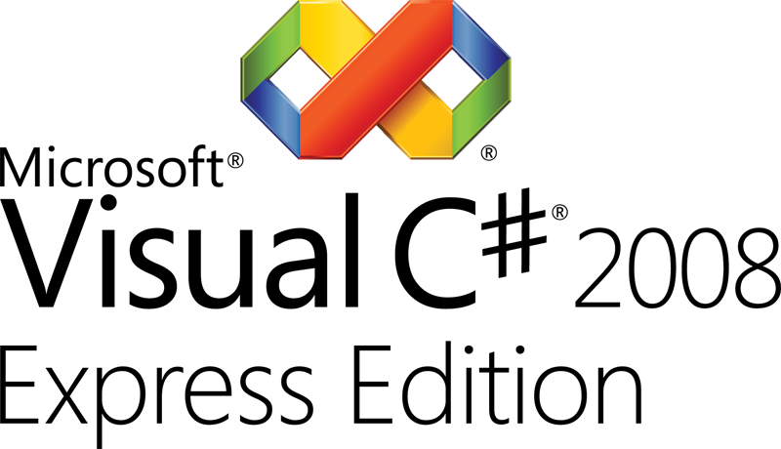

Application Model in-depth
Administrator Properties
General information about the application
Keep your apps organized and managed
End User Metadata
The “friendly” information for your users
App-V
Windows
Script
Windows
Installer (MSI)
Mobile (CAB)
Deployment Type
Workhorse for application
Detection Method
Is app installed?
Install Command
Command line and options
Requirement Rules
Can/cannot install app
Dependencies
Apps that must be present
Supersedence
Remove previous versions

Slide 12


Software Distribution
DMZ
Install App
Management Point
Get policy
Report install status
Primary Site
Get policy
Windows
Phone
Report install status
Nokia Phone
MSI
Get policy
Get content
Report install status
New Application
Install App
Deploy Application
Distribute content to DPs
Distribution Point
Nokia
Get content

Slide 13





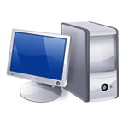
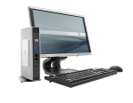

Personalized Application Experience
System Center Configuration Manager 2012 examines:
User identity
Application dependencies
Device type
Network bandwidth
Administrative Intent
Local Install
Presentation Server
Windows desktop
Windows thin client
Windows Slate
iPhone

Slide 14
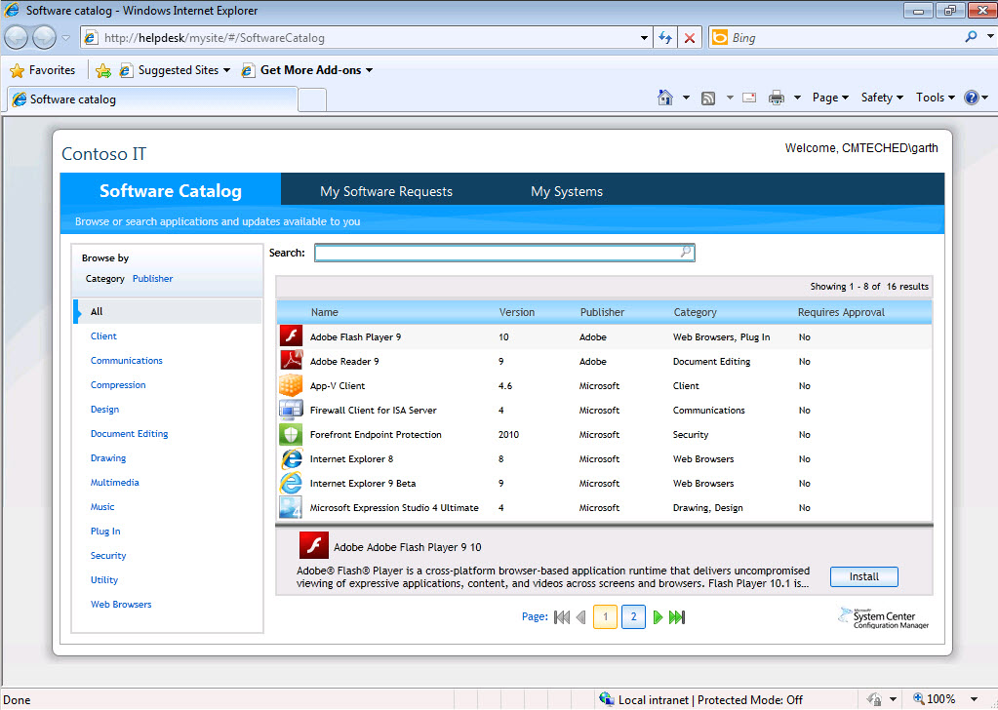
Application Self-Service
Employees can see only
applications that they have
permission to install.

Slide 15

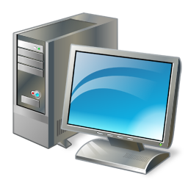
On Demand Installation
Combine with earlier slide – need a cleaner diagram
Process Flow
Web Site
Site Server
1
User clicks “install” on Catalog item
2
Web site checks user’s permissions to install
3
Server creates policy for the specified client and app and passes it to client
5
4
6
Web site requests Client ID from ConfigMgr client agent and passes it to Site server
Client agent evaluates requirements from the policy and initiates installation
Client agent completes installation process and reports status
Melissa
Agent

Slide 16
User Centric Software Delivery
demo

Slide 17
Unify Your Management Infrastructure

Slide 18




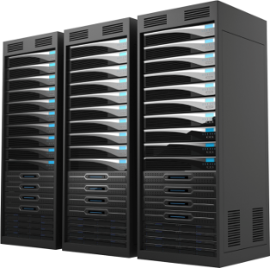





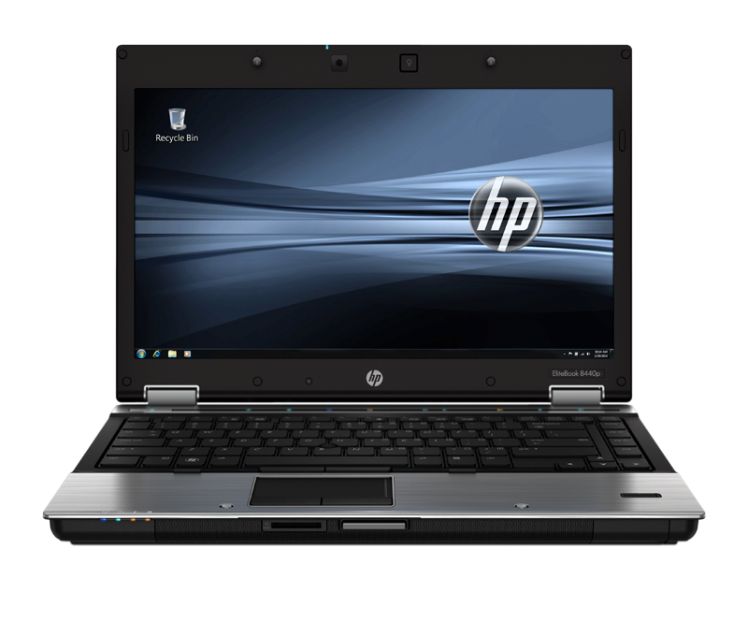
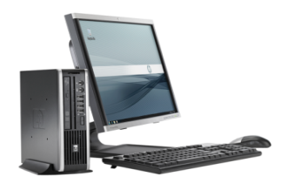

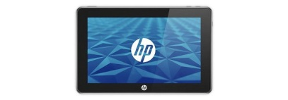
Managing Virtual Desktop Environments
  Centralized management of virtual and physical desktops
  Simplified compliance
  management
Management of all virtual desktop deployment scenarios
Orchestration of application delivery across multiple desktop virtualization platforms
  Automatic compliance remediation and continuous enforcement for personal desktops
  Visibility into noncompliant machines in pooled
  virtual scenarios

Slide 19
Managing Application Virtualization
Integration requires App-V 4.6 client
New Application Model, User-centric features
    Enable support for application dependencies
    Improved update behaviors
    Selective publishing of components
    Dynamic Suite Support
  Instant icon gratification for unlock events
  Integration with Remote Desktop Services (TS)
Content Improvements
  Streaming improvements
  Reduce virtual app footprint when using Download and Execute

Slide 20
Managing VDI User Environments
Citrix XenDesktop and Microsoft RDS integration
  Gather inventory from Guest VM for Broker Site Name, Desktop Type and Pool Name and exposed for compliance monitoring and inventory reports
  ConfigMgr uniqueness is persisted through Pooled VM shutdown and startup
Randomization of schedules automatically for any client:
  Hardware Inventory scan
  Software Inventory scan
  Software Update scan, download and install

Slide 21
Settings Management
Unified settings management across servers, desktops and mobile devices
ConfigMgr 2007 reports configuration drift – ConfigMgr 2012 can now enforce (Registry, WMI and Script-Based settings)
Improved functionality:
    Copy settings
    Define compliance SLAs for Baselines to trigger console alerts
    Richer reporting to include troubleshooting, conflict, remediation information
Enhanced versioning and audit tracking
    Ability to specify specific versions to be used in baselines
    Audit tracking includes who changed what

Slide 22


Architecture – Settings Management
Public DNS
DMZ
Microsoft CA
Enrollment Web Proxy
Get policy
Get current configuration
Apply settings
Report compliance
Get policy
Report compliance
Generate remediation commands
Enrollment Service Point
Generate remediation commands
Report compliance
Assess Compliance
Get policy
Assess Compliance
Primary Site
Baseline
Baseline
Management Point
Get policy
Get current configuration
Apply settings
Report compliance
Assign
Baseline
Distribution Point
Nokia

Slide 23
Settings Management
demo

Slide 24
Simplify IT Administration

Slide 25
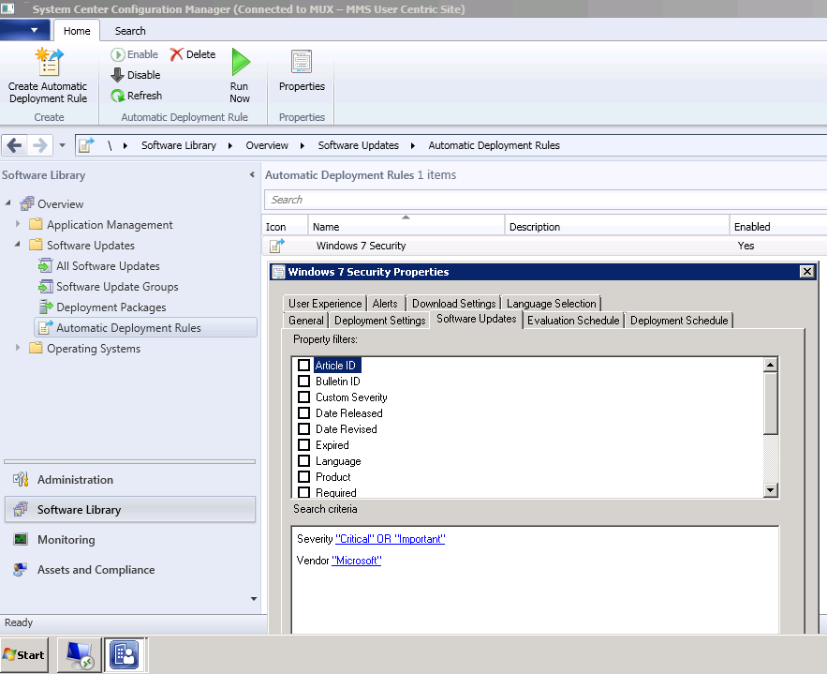
Simplify: Administrative Efficiency
New Administrative experience
  Intuitive ribbon interface
  Role-Based Administration
  In-console alerts
  Global search capability
  New Collection membership rules allow better filtering of members

Slide 26
Role Based Administration
Enables central management
Administrators see only the tasks relevant to their job role
Security roles and scope simplify administration
Reduce primary sites to separate roles
Functionality | ConfigMgr 2007 | ConfigMgr 2012
What types of objects can I see and what can I do to them? | Class rights | Security roles
Which instances can I see and interact with? | Object instance permissions | Security scopes
Which resources can I interact with? | Site specific resource permissions | Collection limiting

Slide 27
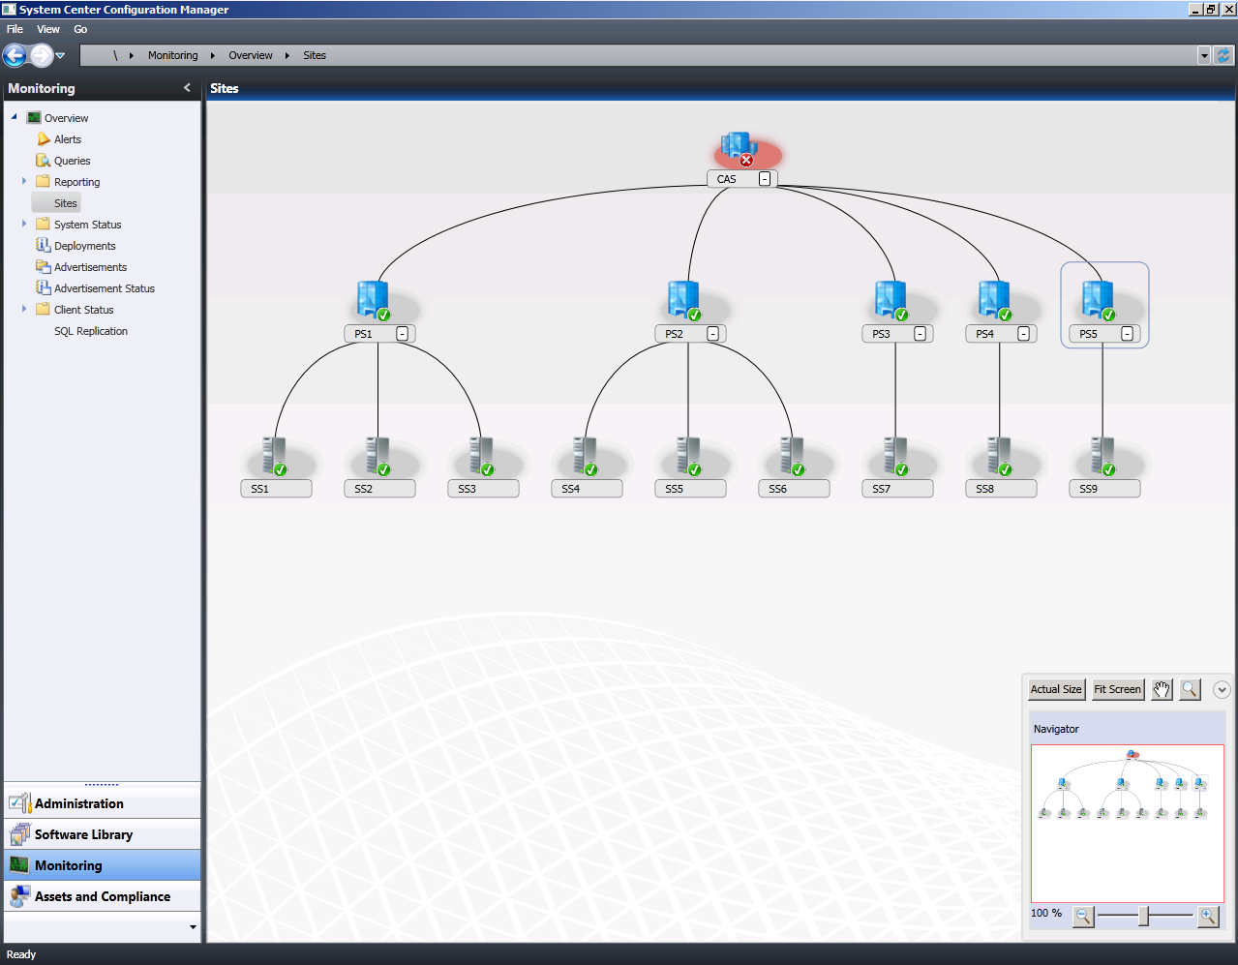
Simplified Hierarchical Infrastructure
Central Administration Site | Primary Sites | Secondary Sites
Central primary site administration | Client management & settings | Content routing
Reporting | 100K clients per site | Distributions points
 | Delegated Administration | Requires SQL server
 | Language Packs | Lack of local administrator
 | Support distributed organizational boundaries

Slide 28
Infrastructure Changes
Collections
Distribution Points
Consolidated Distribution Point
  PXE Service Point
  Multicast option
  Throttling and scheduling of content to that location
Improved Distribution Point Groups
  Manage content distribution to individual Distribution Points or Groups
  Dynamic content management from Distribution Points based on Group membership
  Distribution group to collection mapping
No Branch DPs - DPs can be installed on clients and servers now
Device and user type collections
Roles scopes to collections
Reduce complex query logic via new membership rules
Easier to organize collections around organizations folders

Slide 29
Role Based Security and
Hierarchy Views
demo

Slide 30



Boundaries
Boundaries represent network topology –
used to optimized network utilization
Clients use boundaries to:
  Automatically determine site assignment
  Locate the best management point (MP)
  Locate the best distribution point (DP) or
  state migration point (SMP)
Define separate boundaries for client activities
versus content
Automatically created with the Forest Discovery method
  Discovers AD Sites, IP Subnets, IPv6 Prefix type boundaries
  Can automatically add as boundaries immediately or add later
Boundaries are members of one or more groups:
  Groups support: site assignment, site system look-ups or both
  Create group with boundaries in one step
  Add boundaries to an existing group
  Multi-select and reflective views supported

Slide 31
Client Activity and Health
Product integrated health and remediation solution
Server side metrics for evaluating client activity:
  Policy Requests
  Hardwate and software Inventory
  Heartbeat DDRs
  Status Messages
Client side monitoring/remediation for:
  Dependent Windows components and services
  ConfigMgr client prerequisites
  WMI Repository and namespace evaluation
  In console and Web reporting
‘In-console’ alerts when healthy/unhealthy ratio drops below configurable threshold

Slide 32
Client Health
demo

Slide 33

Remote Control
IS BACK!
Send Ctrl+Alt+Del to host device to regain previous
feature parity

Slide 34
Migration from ConfigMgr 2007 to 2012
Assist with Flattening of Hierarchy
Assist with Migration of Objects
Assist with Migration of Clients
Maximize Re-usability of x64 Server Hardware
Minimize WAN impact

Slide 35
Minimum System Requirements
Component | Minimum Requirement
Site Server and Site Roles | Windows Server 2008 (64-bit ) Windows Server 2008 R2 (64-bit)
Database | SQL Server 2008 SP1 & Cumulative Update 10+ (64-bit)
Distribution Point | Windows Server 2003 (including 32-bit) with limited functionality Windows Vista SP2 and later (including 32-bit)
Client | Windows XP SP2 & SP3 (32-bit & 64-bit) Windows 2003 Server SP2 (32-bit & 64-bit) Vista SP2 (32-bit & 64-bit) Windows 7 RTM (32-bit & 64-bit) Windows 7 SP1 (32-bit & 64-bit) Windows 2008 SP2 (32-bit & 64-bit) Windows 2008 R2 RTM (64-bit) Windows 2008 R2 SP1(64-bit)
Admin Console | Vista SP2 (32-bit & 64-bit) Windows 7 RTM (32-bit & 64-bit) Windows 7 SP1 (32-bit & 64-bit) Windows 2008 SP2 (32-bit & 64-bit) Windows 2008 R2 RTM (64-bit) Windows 2008 R2 SP1(64-bit)

Slide 36
Prepare for Configuration Manager 2012
Flatten hierarchy where possible
Plan for Windows Server 2008, SQL 2008, and 64-bit
Start implementing BranchCache™ with Configuration Manager 2007 SP2
Move from web reporting to SQL Reporting Services
Avoid mixing user and devices in collection definitions
Use UNC (\\server\myapp\myapp.msi) in package source path instead of local path (d:\myapp)

Slide 37
System Center Configuration Manager
Empower Users
Unify Infrastructure
Simplify Administration
Empower people to be productive from anywhere on whatever device they choose
Reduce costs by unifying IT management infrastructure
Improve IT effectiveness and efficiency
Device freedom
Optimized, personalized
application experience
Application self-service
Mobile, physical, and virtual management
Security & compliance
Service management integration
Comprehensive client
management capabilities
Improved administrator
effectiveness
Reduced infrastructure complexity

Slide 38
Next Steps
Download the beta - here
Download the VHD - here
Work through the TechNet Virtual Labs - here
Participate in the Community Evaluation Program
Join the Conversation on Twitter (#sysctr)
Follow our blog and website
Program overview is here

Slide 39

Track Resources
Don’t forget to visit the Cloud Power area within the TLC (Blue Section) to see product demos and speak with experts about the Server & Cloud Platform solutions that help drive your business forward.
You can also find the latest information about our products at the following links:
Cloud Power - http://www.microsoft.com/cloud/
Private Cloud - http://www.microsoft.com/privatecloud/
Windows Server - http://www.microsoft.com/windowsserver/
Windows Azure - http://www.microsoft.com/windowsazure/
Microsoft System Center - http://www.microsoft.com/systemcenter/
Microsoft Forefront - http://www.microsoft.com/forefront/

Slide 40





Resources
  Connect. Share. Discuss.
http://northamerica.msteched.com
Learning
  Sessions On-Demand & Community
  Microsoft Certification & Training Resources
www.microsoft.com/teched
www.microsoft.com/learning
  Resources for IT Professionals
  Resources for Developers
http://microsoft.com/technet
http://microsoft.com/msdn

Slide 41












Complete an evaluation on CommNet and
enter to win!

Slide 42


Slide 43

© 2011 Microsoft Corporation. All rights reserved. Microsoft, Windows, Windows Vista and other product names are or may be registered trademarks and/or trademarks in the U.S. and/or other countries.
The information herein is for informational purposes only and represents the current view of Microsoft Corporation as of the date of this presentation. Because Microsoft must respond to changing market conditions, it should not be interpreted to be a commitment
on the part of Microsoft, and Microsoft cannot guarantee the accuracy of any information provided after the date of this presentation. MICROSOFT MAKES NO WARRANTIES, EXPRESS, IMPLIED OR STATUTORY, AS TO THE INFORMATION IN THIS PRESENTATION.

