Slide 1

Microsoft System Center
Configuration Manager 2012:
Migrating from 2007 to 2012
SIM351
Wally Mead
Senior Program Manager
Microsoft Corporation

Slide 2
Session Objectives And Takeaways
Migration from ConfigMgr 2007 to ConfigMgr 2012
  Built-in migration functionality
  What can I do today to prepare

Slide 3
Terminology
Content:
Package binaries / files
Objects:
Packages, Configuration Items (DCM), Software Update Deployments, OS Images, etc.
Server Settings:
Site Role Settings and Site Properties, etc.
Client GUID, Inventory, State, etc.
Client Information:

Slide 4
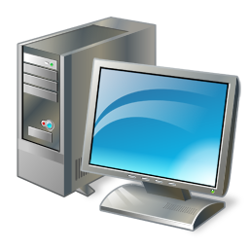
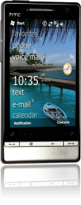


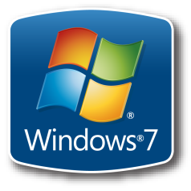


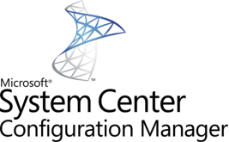
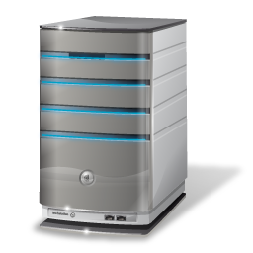



Migration Planning
Clients
Deployment Objects
Inventory & Compliance Data
Server Infrastructure

Slide 5
Comparing Migration
Server Infrastructure
SMS 2003 to ConfigMgr 2007:
Migration occurred top-down when using in-place upgrade
  Central Sites were upgraded first followed by Primary and
  Child Primary Sites
More than half of the TAP survey respondents used
side-by-side Migration
  Hardware refresh
  Start with clean environment

Slide 6
Comparing Migration
Deployment Objects
SMS 2003 to ConfigMgr 2007:
Side-by-side:
  To migrate objects customers had to either manually migrate or use scripts
Which objects do I have left to migrate?
How do I prevent content from crossing the WAN?

Slide 7
Comparing Migration
Inventory & Compliance Data
SMS 2003 to ConfigMgr 2007:
Inventory data retained only when performing in-place
With Side-by-Side this needs to be regenerated

Slide 8
Comparing Migration
Clients
SMS 2003 to ConfigMgr 2007:
Customers used their preferred client deployment mechanisms to perform client upgrades to get to ConfigMgr 2007:
  Software Distribution, Client Push, Group Policy,
  Software Update, etc.
Which clients do I have to migrate?

Slide 9
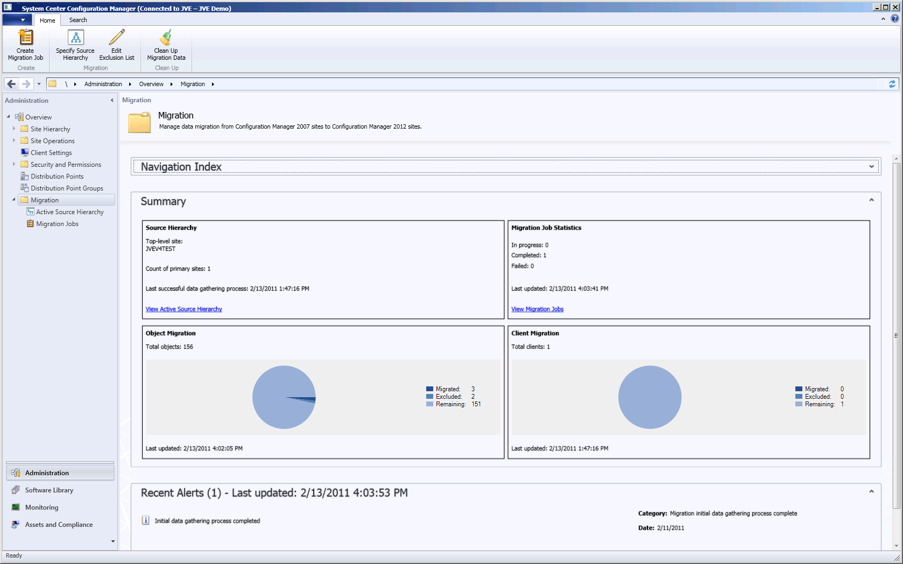
Monitoring Migration in ConfigMgr 2012

Slide 10
ConfigMgr 2012 Migration Goals
Maximize Re-usability of x64 Server Hardware
Minimize WAN impact
Assist with Migration of Clients
Assist with Migration of Objects
Assist with Flattening of Hierarchy

Slide 11
Migration Process to ConfigMgr 2012
Plan
Migrate
Configure Migration Feature
Configure Software Update Point & Synchronize Updates
Requires ConfigMgr 2007 SP2
Migrate Objects
Migrate Clients
Setup server roles
Uninstall Configuration Manager 2007 sites
Rinse & Repeat
Test/Proof of Concept
Setup Initial 2012 Primary Site(s)
Design
ConfigMgr 2012 HW Reqs: Windows Server 2008 x64*, SQL Server 2008 x64 (sp1 & Cumulative Update 10)
Deploy
Make sure the hierarchy is operating and software deployment works
Upgrade Distribution points
Assess current environment
Enable Distribution Point Sharing

Slide 12

Enable Built-in Migration Feature
Specify the top-level site of the ConfigMgr 2007 SP2 hierarchy:
  Gathers Hierarchy and Client information from ConfigMgr 2007 to set the baseline
  Information is retained in ConfigMgr 2012 for reporting and displaying progress
2007
HQ CS
HQ
CAS
2012
EMEA PS
USA PS
EMEA
PS
USA
PS
USA-SEA
PS
France
Sec. Site
USA-SFO
Sec. Site
USA-SEA
Sec. Site
France
Sec. Site
USA-SFO
PS

Slide 13
Managing the Source Hierarchy
Configure additional Source Sites top-down to enable migration of objects for those sites
  ConfigMgr 2012 checks the ConfigMgr 2007 site(s) every 4 hours:
    To keep data accurate for migration job creation
    Retrieve package status of Distribution Points at the source
2007
HQ CS
HQ
CAS
2012
EMEA PS
USA PS
EMEA
PS
USA
PS
USA-SEA
PS
France
Sec. Site
USA-SFO
Sec. Site
USA-SEA
Sec. Site
France
Sec. Site
USA-SFO
PS

Slide 14

Migration Jobs
Object Migration by type/instance
  Enables admin to cherry pick objects to migrate
  Additional variant added to Beta 2; migration job “Objects modified after migration”
Collection Migration
  Enables admin to include all related objects for a collection and all objects targeted to the members of the selected collection
  Objects can be excluded so they are not automatically selected for subsequent jobs

Slide 15

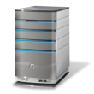






Migration Jobs and Content
ConfigMgr 2007
ConfigMgr 2012
Migrate Office 2010
  Metadata only
Distribution Manager picks up source files
Content distributed to distribution point
Client gets policy with Office 2010 app
Client retrieves content for Office 2010 app
2
Primary Site
Primary Site
1
3
4
5
2007 | 2012 | Site
 |  | Primary Site
 |  | Distribution Point
 |  | File Server containing source files

Slide 16
Objects supported for Migration
Collections
Advertisements
Boundaries
Software Distribution Packages and Virtual Application Packages
Software Update:
  Deployments, Deployment Packages, Templates and Software Update Lists
Operating System Deployment:
  Boot Images, Driver Packages, Drivers, Images, Packages and Task Sequences
Settings Management:
  Configuration Baselines and Configuration Items
Asset Intelligence Customizations
Software Metering Rules

Slide 17
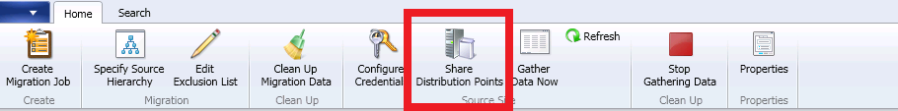
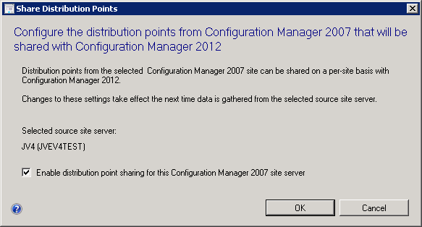
Distribution Points
ConfigMgr 2007 Distribution Points sharing
  Clients can retrieve content for migrated Packages which are hosted on ConfigMgr 2007 Distribution Points
  Excludes Bootimages and App-V content

Slide 18

Shared Distribution Point Example
ConfigMgr 2007
ConfigMgr 2012
1
Primary Site
Chicago
Primary Site
Migrate Office 2010
  Metadata
Deploy Office 2010 to ConfigMgr 2012 clients
Client retrieves content from ConfigMgr 2007 DP
2
3
Distribution Point
2007 | 2012 | Site
 |  | Primary Site
 |  | Distribution Point
Branch Office

Slide 19
Configuring Migration
demo

Slide 20
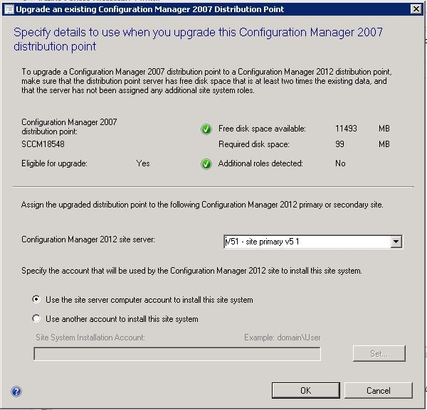
Upgrade Distribution Points
Automated Distribution Point Upgrade:
  Content of migrated packages converted to ConfigMgr 2012
  Ensure no additional site system roles exist
  Ensure enough disk-space is available
  Branch Distribution Points cannot be upgraded
Manual upgrade:
  Uninstall from ConfigMgr 2007 environment
  Deploy the Distribution Point from 2012 and use the prestage content feature

Slide 21
Secondary Sites and Other Site System Roles
Secondary sites need to be manually uninstalled from ConfigMgr 2007 environment
  Consider replacing this with for example a Distribution Point
  with PXE
Other site system roles have to be manually uninstalled

Slide 22
Client Migration
Clients retain execution history on upgrade
  Avoids re-running advertisements
Use your preferred deployment method to upgrade client
  Client Push Installation, Software Distribution, Group Policy, Windows Software Update Services (WSUS), Manual Installation, or Operating System Deployment (OSD) integrated
Minimum Supported Client Versions
  Windows XP SP2 (64-bit) & SP3 (32-bit), Server 2003 SP2, Vista SP2, Windows 7 RTM and SP1, Server 2008 SP2, Server 2008 R2 RTM and SP1 (64-bit)

Slide 23
Inventory & Compliance Data
Full inventory data sent after client upgrade
  Reduce network/server load by using phased approach of upgrading clients
Retain ConfigMgr 2007 data
  Use SQL Reporting Services

Slide 24
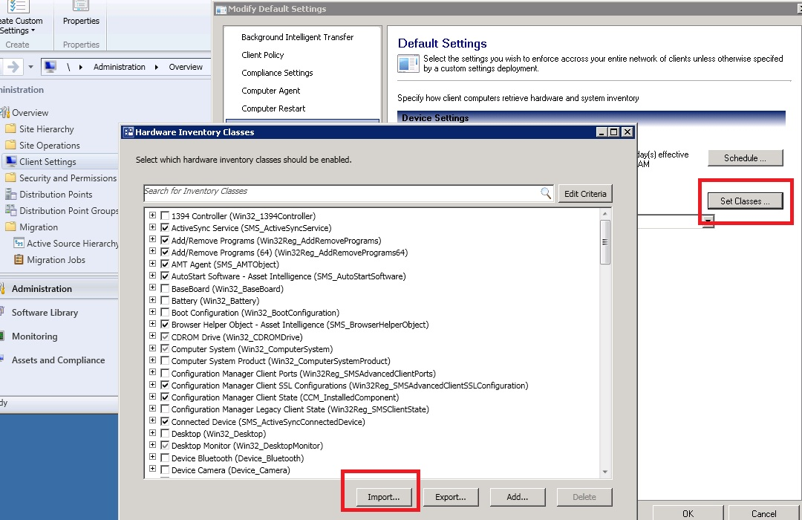
Hardware Inventory
ConfigMgr 2007 .MOF files can be imported through
Client Settings

Slide 25
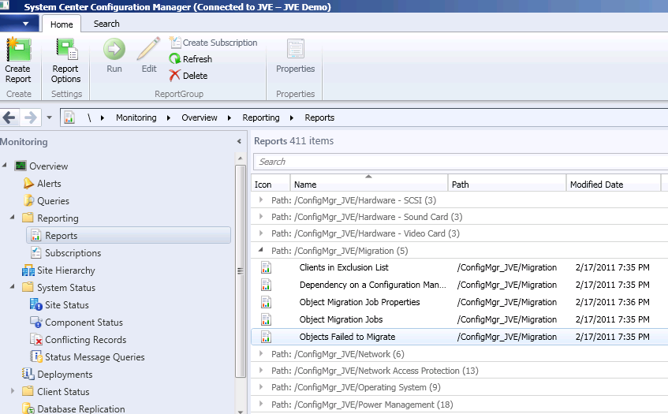
Reports
5 new reports added specifically for migration:
  Object Migration Jobs
  Objects included in Migration Job
  Objects Failed to Migrate
  Dependency on a Configuration Manager 2007 Collection
  Client which are excluded from upgrading to ConfigMgr 2012

Slide 26
Migration Object and
Content Specifics

Slide 27
Boundaries
Grouped by ConfigMgr 2007 site when migrated:
  Boundary groups created by migration are only enabled for content lookup
    Avoids boundary overlap in Active Directory
    Prevents new ConfigMgr 2007 clients from accidently getting assigned to the ConfigMgr 2012 environment
When the Shared Distribution Point option is enabled:
  Boundaries associated with the Distribution Point in ConfigMgr 2007 are automatically migrated
  Boundary group created for each shared Distribution Point

Slide 28
Software Updates Management
Ensure Software Update Point is configured and Update Repository contains the same updates as Configuration Manager 2007 environment.
  Wsusutil.exe export/import
Supported by migration:
  Conversion of Update Lists to Update Groups
  Software Update Deployments are migrated to Deployments and Update Groups
  Software Update Packages
  Software Update Templates

Slide 29
Software Distribution
Classic Package and Programs are migrated as-is:
  Use UNC in ConfigMgr 2007 for package source file location!
App-V:
  App-V packages are converted to applications, after migration a deployment needs to be created.
  Ensure clients have the App-V 4.6 SP1 client installed before upgrading the ConfigMgr client
    For App-V Distribution Point Sharing not available

Slide 30
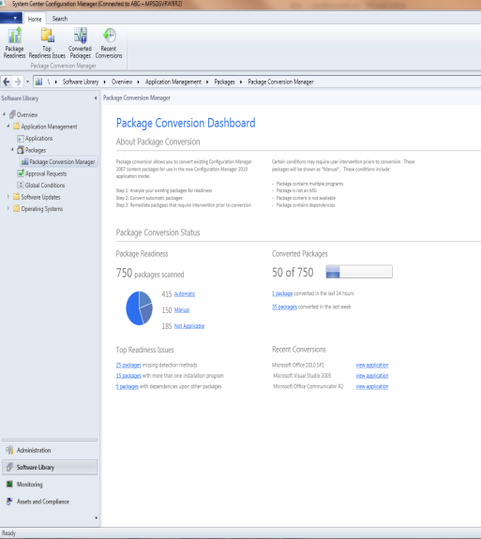
Software Distribution – Conversion to AppModel
Learn how to analyze & detect packages/programs cap[able of being converted
Convert your packages/programs to ConfigMgr 2012 App Model
Move collection queries to Global Conditions and Requirement Rules
Track progress throughout your conversion

Slide 31
Operating System Deployment
Supported by migration:
  OS Image/Package
  Task Sequences
  Drivers & Driver Packages
Special cases:
  Boot Image source path for beta replaced by default image on ConfigMgr 2012 site due to new WAIK
  ConfigMgr 2012 will not convert client installation package

Slide 32
Settings Management (DCM)
Supported by migration:
  Configuration Items and Baselines created by customers & ISV’s
    Un-interpreted Configuration Items are not supported
  Upon re-migration of the object the changes are added as a new revision
Existing 2007 Config Packs can also be added to ConfigMgr 2012 through Import feature
  Import will automatically convert ConfigMgr 2007 schema to ConfigMgr 2012 schema

Slide 33
Content Migration
Package source file path is migrated as-is
  Standardize on UNC paths for package source files
For objects such as driver packages the CAS must have at least read access to the ConfigMgr 2007 source path.
ConfigMgr 2012 clients can obtain content from ConfigMgr 2007 DP’s if requested content is available

Slide 34
Other Objects
Additional objects:
  Asset Intelligence customizations
  Software Metering Rules
  Search and Administrative Folders

Slide 35
Reports
Report migration from ConfigMgr 2007
  Export/Import custom reports (RDL file)
  Review the report/queries of the reports
On ConfigMgr 2007 start using SQL Reporting Services

Slide 36
Collection Migration
demo

Slide 37
Preserve Collection Investment
(Sub-Collections)
Sub/Linked Collections no longer exist
Adds inclusion rules for the new collections
  Redmond includes B41 and B44
Redmond
B41
B44
“Collection Node”
B41
B44
Redmond
ConfigMgr 2012
ConfigMgr 2007

Slide 38
Preserve Collection Investment (Folders)
All related collections are automatically migrated
Redmond
B41
B44
Sites
Desktops
Desktop North America
Redmond (Folder)
B41
Sites (Folder)
Desktops (Folder)
Desktop North America
Limit to
ConfigMgr 2007
ConfigMgr 2012

Slide 39
Prevent Increase in Collection Scope
In ConfigMgr 2007:
Collection definitions evaluated at a site and it’s child sites
Advertisements created at child site automatically limited to collection members of just that site
Central Site
Collection Win7 Clients
North-America Site
Advertisement of software specific to North-America
Shanghai Site
Advertisement of software specific to Shanghai
ConfigMgr 2007

Slide 40
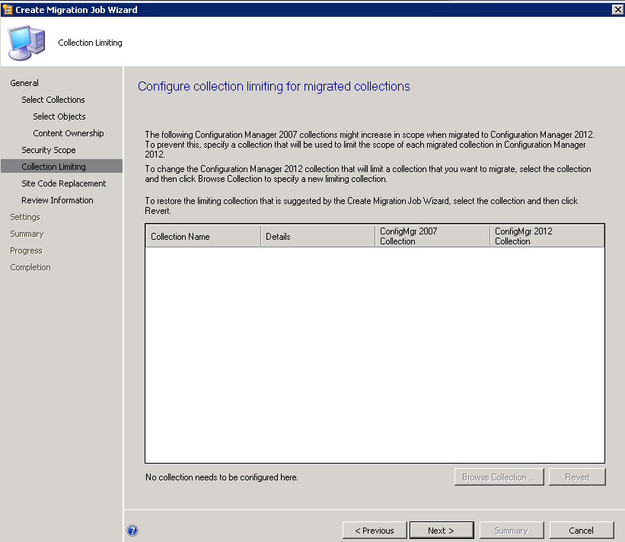
Prevent Increase in Collection Scope
In ConfigMgr 2012:
Collection definitions are globally replicated and evaluated
at each site
  Migration feature allows redefinition of limited collection

Slide 41
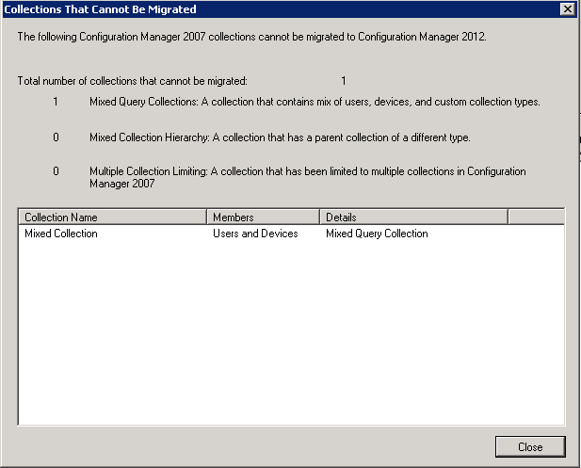
Mixed Collections
Collections not supported:
User and device resource types, or other custom resource types in one collection
Sub/linked collection structure containing mixed types
Collections with “limit to” queries to multiple collections

Slide 42
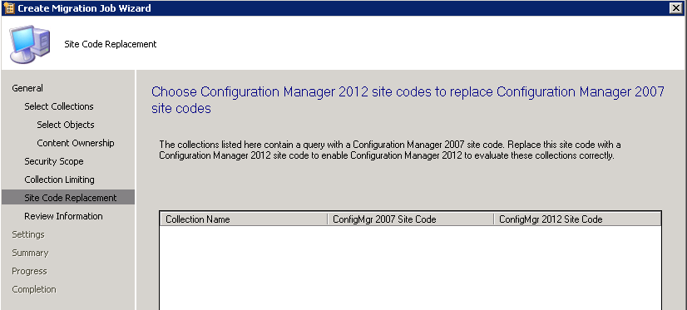
Other Collection Scenarios
Direct Membership Collections will be migrated as is
Collections which are limited to multiple collections
Collections which contain site-codes in the query

Slide 43
Migration Examples

Slide 44
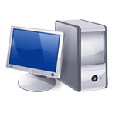

Customer Profile #1
Headquarters
Chicago
  Ensure ConfigMgr 2007 SP2 is installed
  Install 2012 Primary
  Enable Software Update Point
  Specify source hierarchy
  Migrate objects
  Migrate clients
  Uninstall secondary and deploy 2012 Distribution Point
  Migrate warehouse clients to 2012
  Uninstall secondary and deploy 2012 secondary site
  Migrate district clients to 2012 environment
  Migrate Sales office
  Uninstall ConfigMgr 2007 Primary
Sales Office
District
Warehouse
2012 | 2007 | Site
 |  | Primary Site
 |  | Secondary Site

Slide 45
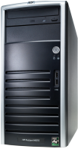

Customer Profile #2
  Ensure ConfigMgr 2007 SP2 is installed
  Install 2012 Central Administration Site
  Enable Software Update Point
  Install 2012 Primary Site
  Specify source hierarchy
  Configure Source Site
  Migrate objects
  Migrate clients
  Steps 6-8 for HQ Primary Site
  Stop data gathering process for source sites
  Uninstall ConfigMgr 2007 Primary’s
Headquarters
Chicago
15,000 clients
London
10,000 clients
2012 | 2007 | Site
 |  | Central Admin Site
 |  | Primary Site

Slide 46
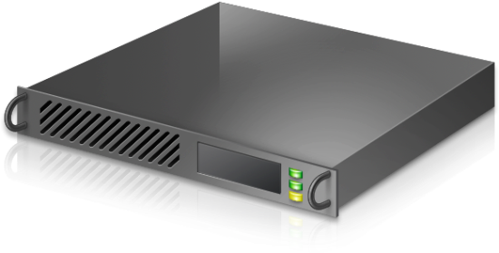
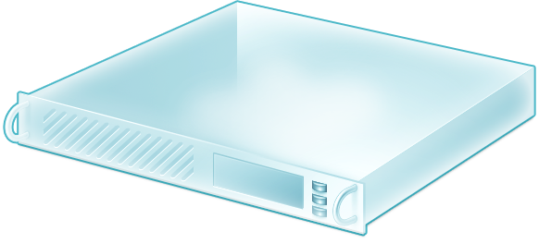
ConfigMgr P2V Migration Toolkit
Why another P2V tool?
  Need an offline P2V solution that works at ConfigMgr site server
  branch locations
ConfigMgr 2012 Migration Scenario:
  P2V existing Configuration Manager 2007 site server
  Re-utilize same hardware where parallel servers are not possible
  Leverage ConfigMgr technology where possible (OSD)
ConfigMgr P2V Migration Toolkit:
  Captures a VHD clone of the physical server
  Installs Hyper-V ready OS & configures it
  Utilizes VHD to re-enable ConfigMgr 2007 Site Server services
CTP available now through Connect website
  Available through the ConfigMgr 2012 beta program

Slide 47
Prepare for ConfigMgr 2012
Get to ConfigMgr 2007 SP2 at a minimum
Flatten hierarchy where possible
Plan for Windows Server 2008, SQL 2008, and 64-bit
Start implementing BranchCache™ with Configuration Manager 2007 SP2
Consider virtualizing your ConfigMgr infrastructure

Slide 48
Prepare for ConfigMgr 2012
Collections:
  Avoid mixing user & devices in collection definitions, these are
  no longer supported
  Don’t use collections with multiple query rules which limit to different collections.
Use UNC (\\server\myapp\myapp.msi) in package source
Site codes between ConfigMgr 2012 and ConfigMgr 2007 have to be unique
Move from web reporting to SQL Reporting Services

Slide 49
ConfigMgr 2012 Migration
Assists with Migration of Objects
Assists with Migration of Clients
Minimizes WAN impact
Assists with Flattening of Hierarchy
Maximize Re-usability of x64 Server Hardware

Slide 50

Track Resources
Don’t forget to visit the Cloud Power area within the TLC (Blue Section) to see product demos and speak with experts about the Server & Cloud Platform solutions that help drive your business forward.
You can also find the latest information about our products at the following links:
Cloud Power - http://www.microsoft.com/cloud/
Private Cloud - http://www.microsoft.com/privatecloud/
Windows Server - http://www.microsoft.com/windowsserver/
Windows Azure - http://www.microsoft.com/windowsazure/
Microsoft System Center - http://www.microsoft.com/systemcenter/
Microsoft Forefront - http://www.microsoft.com/forefront/

Slide 51





Resources
  Connect. Share. Discuss.
http://northamerica.msteched.com
Learning
  Sessions On-Demand & Community
  Microsoft Certification & Training Resources
www.microsoft.com/teched
www.microsoft.com/learning
  Resources for IT Professionals
  Resources for Developers
http://microsoft.com/technet
http://microsoft.com/msdn

Slide 52












Complete an evaluation on CommNet and
enter to win!

Slide 53


Slide 54

© 2011 Microsoft Corporation. All rights reserved. Microsoft, Windows, Windows Vista and other product names are or may be registered trademarks and/or trademarks in the U.S. and/or other countries.
The information herein is for informational purposes only and represents the current view of Microsoft Corporation as of the date of this presentation. Because Microsoft must respond to changing market conditions, it should not be interpreted to be a commitment
on the part of Microsoft, and Microsoft cannot guarantee the accuracy of any information provided after the date of this presentation. MICROSOFT MAKES NO WARRANTIES, EXPRESS, IMPLIED OR STATUTORY, AS TO THE INFORMATION IN THIS PRESENTATION.

