Slide 1

Microsoft System Center Configuration Manager 2007 R3: Technical Overview
SIM348
Eric Alvarez
Optimized Desktop Specialist
Microsoft

Slide 2

The ‘List’ of Core Features
Admin UI Improvements (still MMC)
  Updated through SP2 and R3
Asset Intelligence
  Altered Certs requirement (at SP2)
HW/SW Inventory
OS Deployment
  Added platform support at SP1/2 and features at R3
Software Update Management
Network Access Protection
Software Distribution
  Added AppV at R2 and Policy improvements at SP2 and R3
Desired Configuration Management
Device Management
SDK

Slide 3
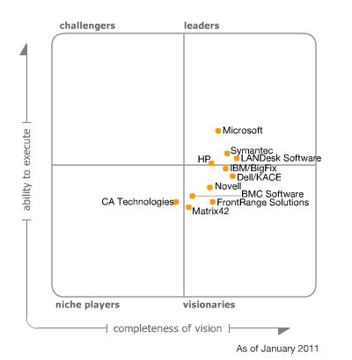
Gartner: Magic Quadrant for PC Lifecycle Management
ConfigMgr's integration with App-V is tight, which Microsoft tightened further with the R3 release of ConfigMgr.
Microsoft is developing tight integration with products in important companion areas — for example, System Center Service Manager and Forefront Endpoint Protection
ConfigMgr is a stable product. Since its introduction in August 2007, there have been few product bugs
“ConfigMgr appeared in Gartner client buying decisions more frequently than any other product in the market in 2010.”

Slide 5
Configuration Manager 2007 R3
Scale Increase
Performance enhancements
Admin Console improvements
Resource management improvements
OS Deployment OEM Pre Stage media
Power Management

Slide 6
Scale Improvements in R3
Supports 300,000 clients when using the default settings for all Configuration Manager 2007 features
NOTE: No change to other site and site role supported numbers (at the site role level)

Slide 7
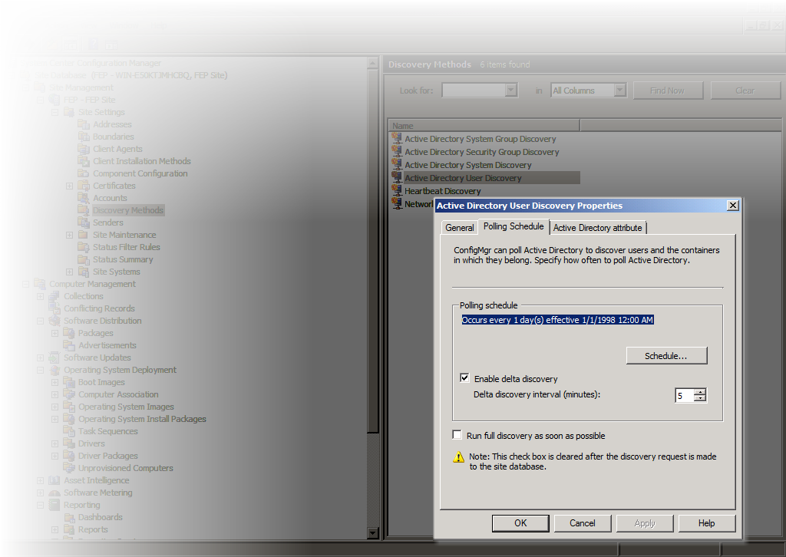
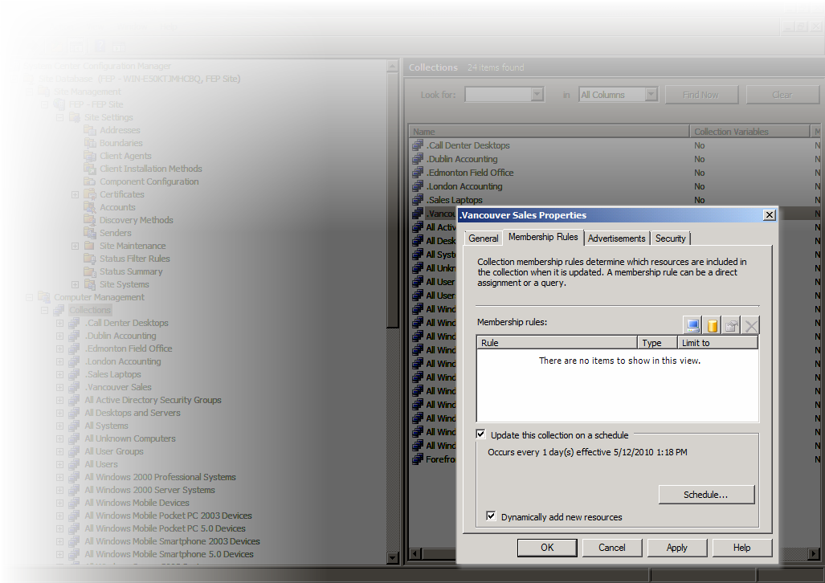
Scale and Performance Improvements
Collection Management in R3
Focus for R3 is evaluating new systems
New Collection setting ‘Dynamically add new resources’
Newly discovered machines will populate collections faster
Full evaluations are still processed in the same way
A new collection needs a full evaluation to show existing clients

Slide 8

Software Distribution Process for New Machines
 | Time – ConfigMgr07 | Time – ConfigMgr07 R3
 | Depends on AD | Depends on AD
 | Min = 24 hours | Min = 5 mins (Delta Discovery)
 | Default = 24 hours, Min ~ 1 hour | Min= 5 Min (Fast collections)
 | ~5-30 mins depending on queue | ~5-30 mins depending on queue
 | Once an hour | Once an hour or when user logs on SP2 contained change to evaluate policy at logon
 | Within 1-2 min of receiving policy | Within 1-2 min of receiving policy
 | Depends on content | Depends on content
User/Device created in AD or AD Replication
User/Device discovered in AD – Inserted into ConfigMgr DB
User/Device added to Collection
Client evaluates policy
Device requests policy for User/Device
Policy created for User/Device
Client downloads and installs content
CM agent install

Slide 9
Getting Managed Faster with R3
Active Directory Discovery improvements and Collection Update enhancements
demo

Slide 10
Admin Console Improvements
Add to Collection
New Collection
Remove from Collection
Add Resources
Adds the currently selected resource(s) to an existing collection (as specified by the Administrator)
Adds the currently selected resource(s) to a new collection (as specified by the Administrator)
Removes the currently selected resource(s) from the current collection
Launches a dialog that allows administrators to search for resources and add create direct membership rules

Slide 11
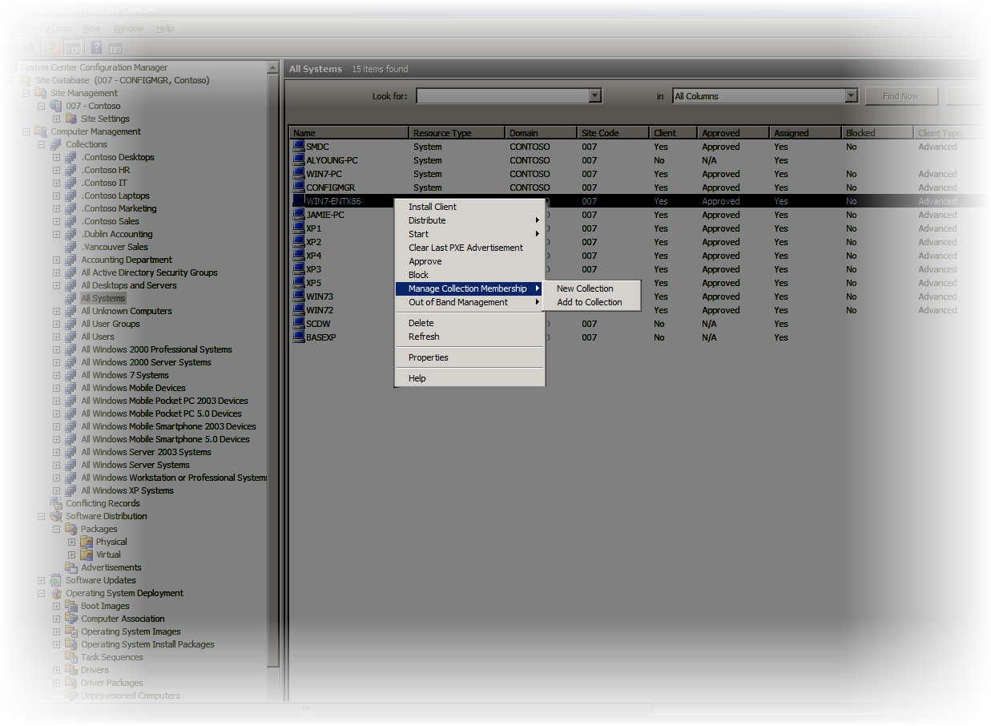
Resource Management Improvements
Add to Collection – Adds the currently selected resource(s) to an existing collection (as specified by the Administrator)
New Collection – Adds the currently selected resource(s) to a new collection (as specified by the Administrator)

Slide 12
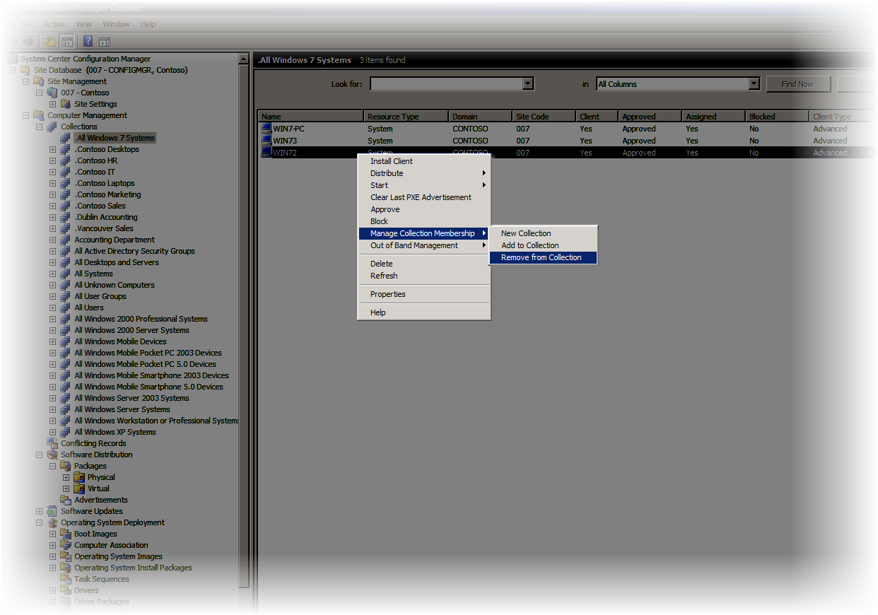
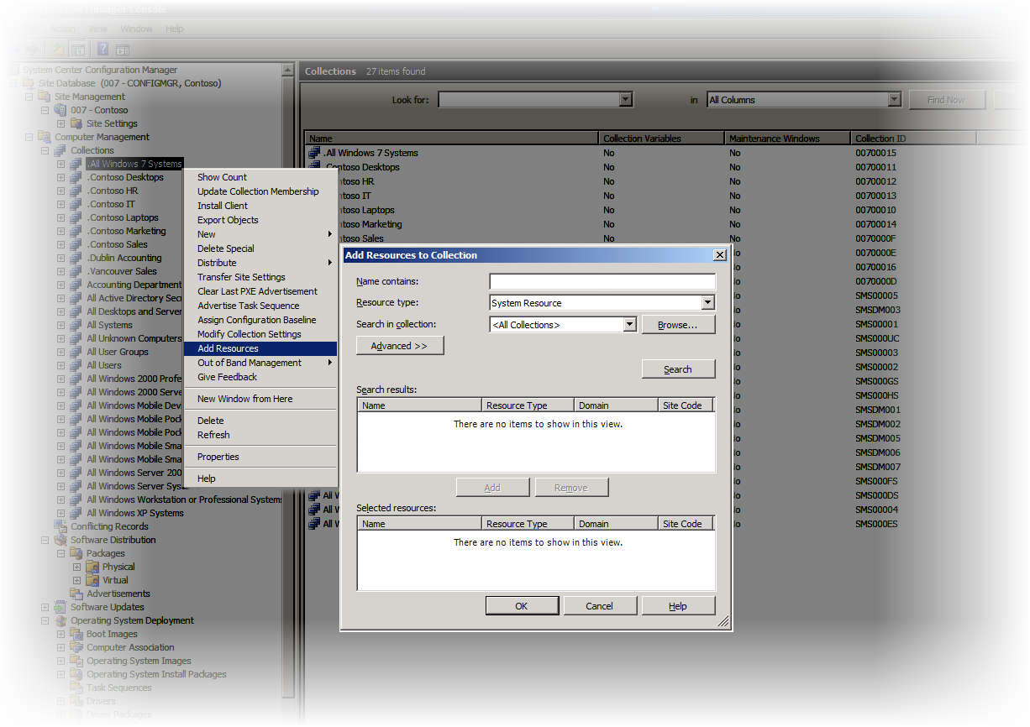
Resource Management Improvements
Remove from Collection
Removes the currently selected resource(s) from the current collection
Add Resources
Launches a dialog that allows administrators to search for resources and add create direct membership rules.

Slide 13
Resource Management Improvements with R3
Collection Actions, and Resource changes in console
demo

Slide 14
OS Deployment – Prestaged Media
Provides a way to use existing packages in ConfigMgr
Integrates with existing task sequences
Easy and repeatable process to create media
Can integrate with OEM factory services
  Can speed up their new hardware deployments
Keep inline with their current processes for OSD

Slide 15
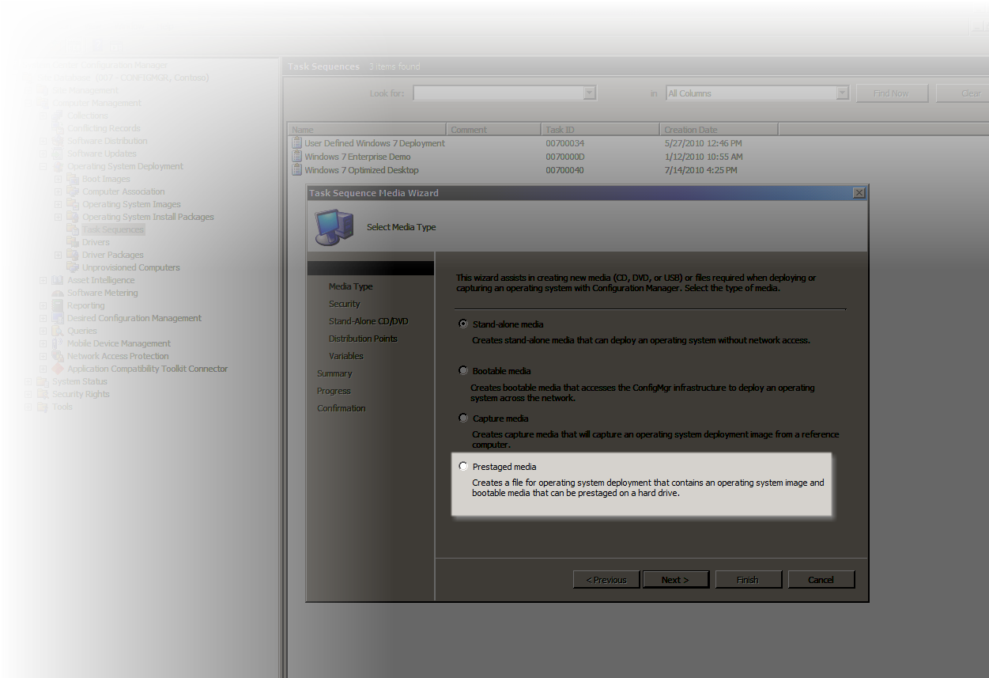
Prestaged Media – How it works
Integrated into the Task Sequence Media Wizard
Hybrid .wim file containing boot media and operating system .wim file
New MediaType (“OEMmedia”) added for condition statements to leverage one task sequence
Apply OS action updated to interact with new MediaType, will not wipe drive when set

Slide 16
Using R3 for OS Deployment Pre Stage Media creation
demo

Slide 17
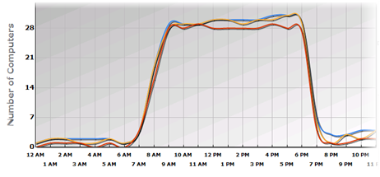
System Center Power Management
Power Planning
Power Policy Configuration and Application
Power Configuration Monitoring and Remediation
Power Savings Reporting
Monitor current power state
and consumptions
Plan and create a power
management policy, check
for exceptions
Apply power management
policy
Check compliance and
remediate non-compliance
Report saving in power
consumption and costs
and environmental impact

Slide 18
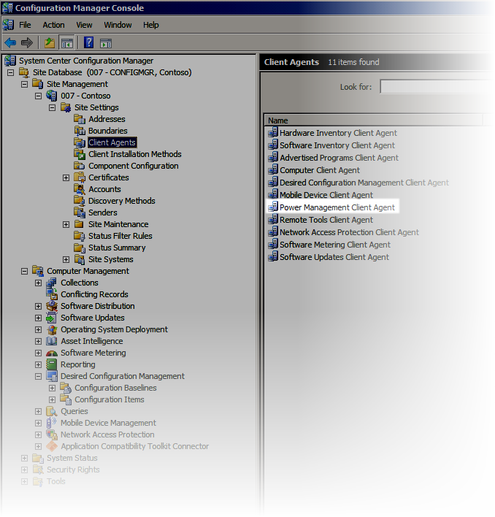
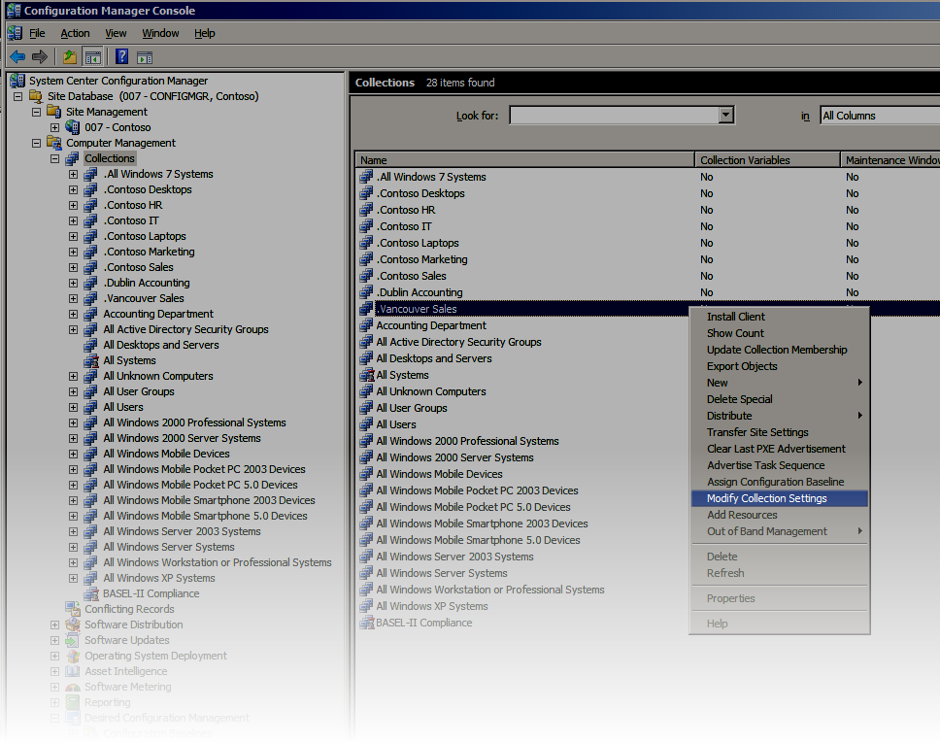
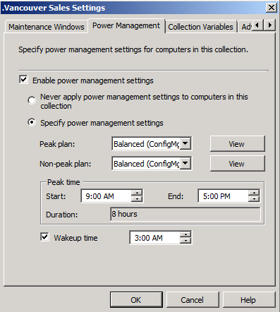
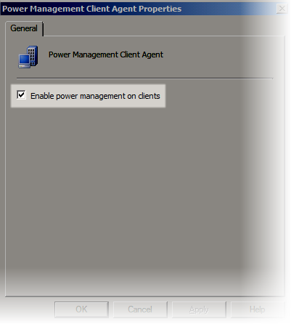
Setting Up Power Management Monitoring
Enabled at:
  Client Agent
  Collections

Slide 19
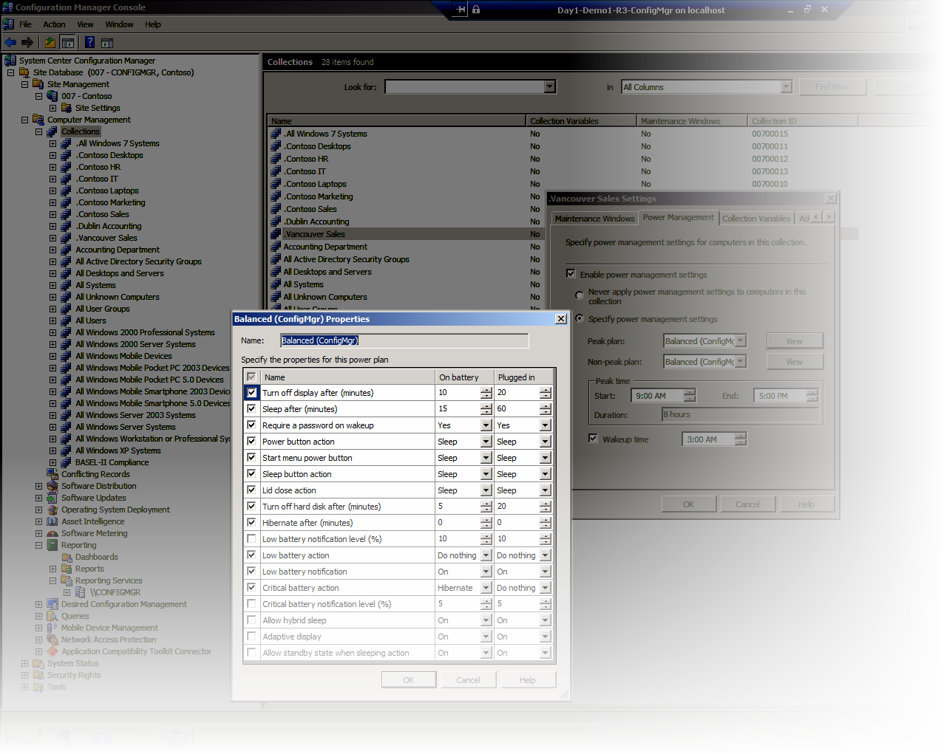
Configuring Power Management Policy
Enabled only monitoring to start
Need to specify at Collection level
Choices to make for Peak/ Non Peak
Specify Windows Wake Timer

Slide 20
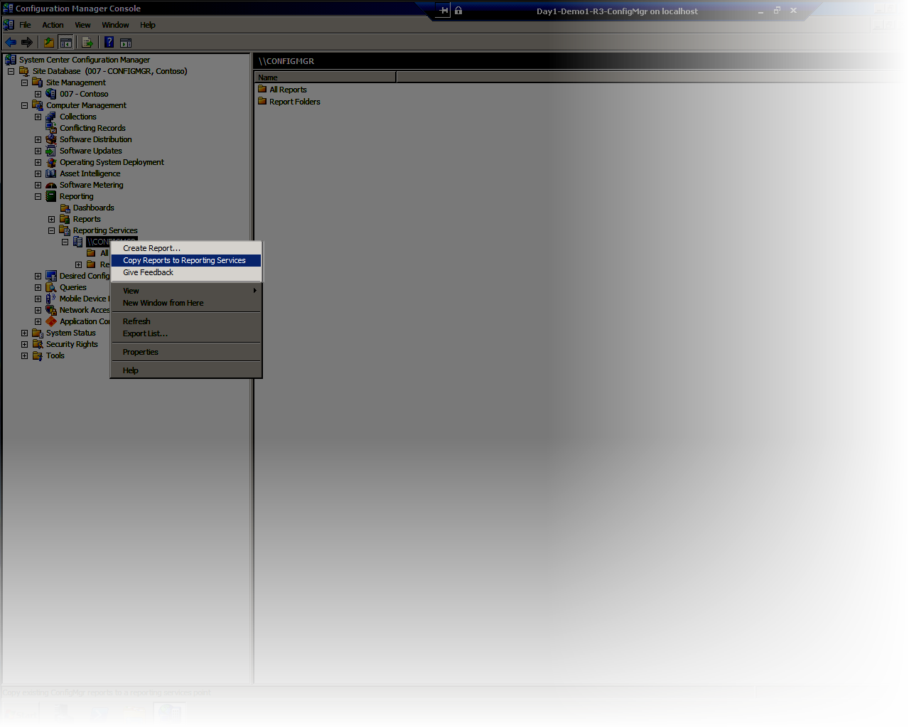
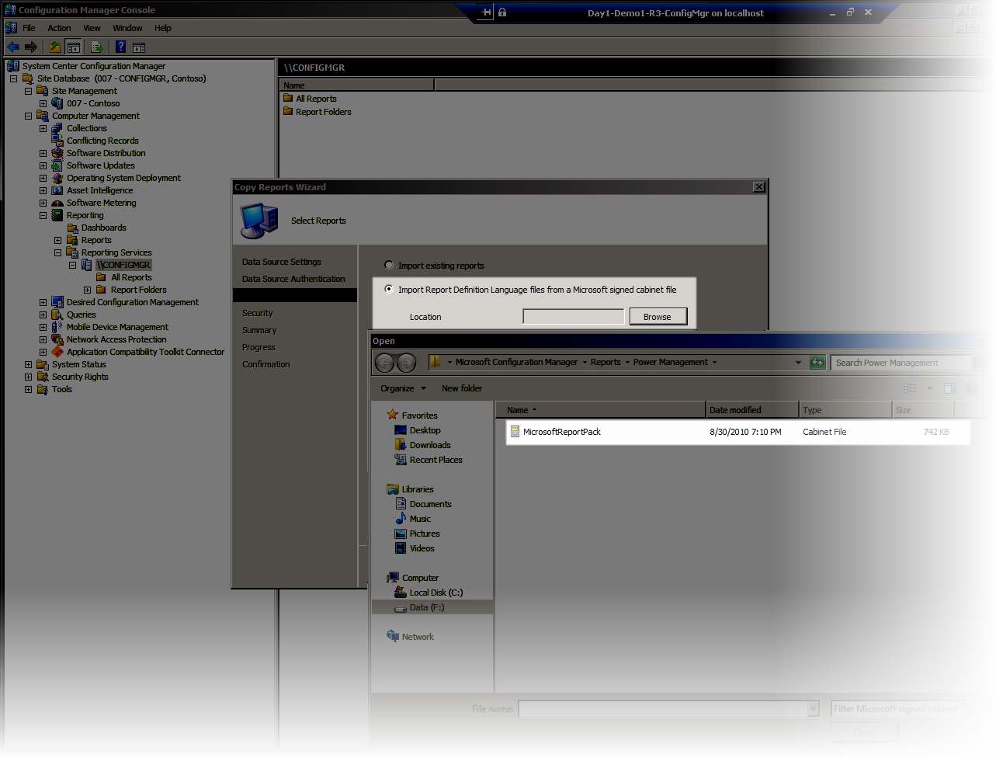
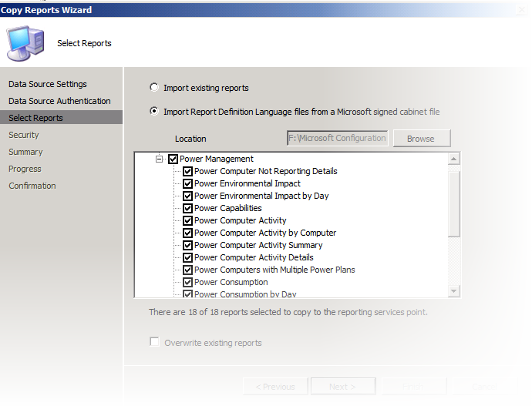
Reporting on Power Management
SRSS Required
Reports must be copied to SRSS Server
Only then will they show up in Report Server
R3 Install provides a cab file

Slide 21
Taking Advantage of Centralized Power Management with R3 Enable, Monitor, Configure and Report
demo

Slide 22
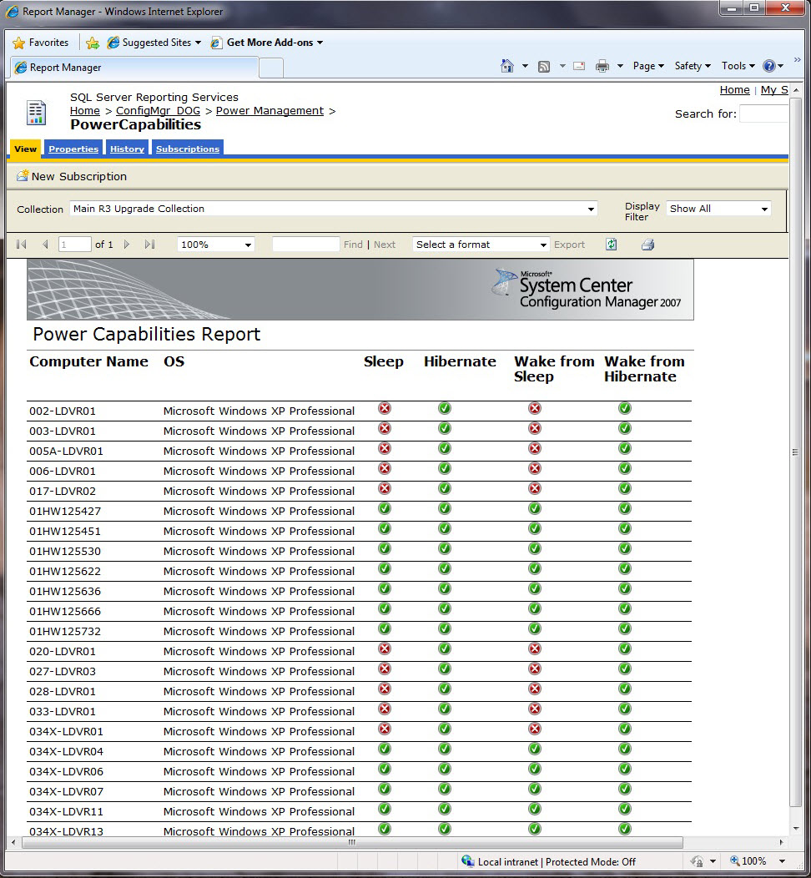

Slide 23
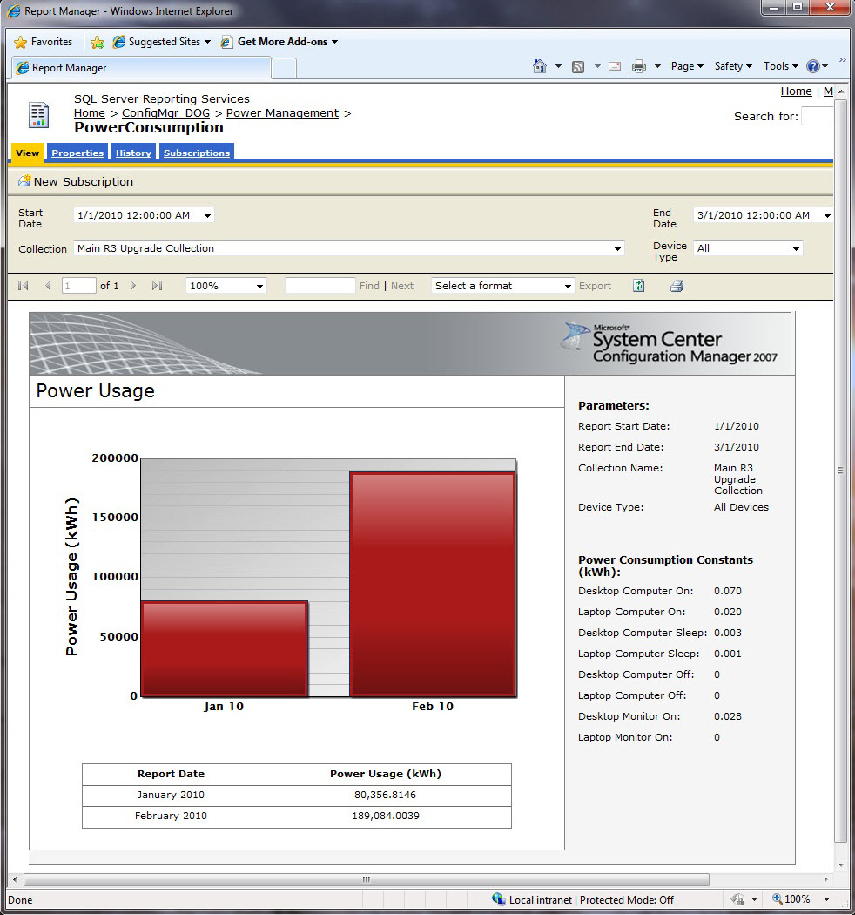

Slide 24
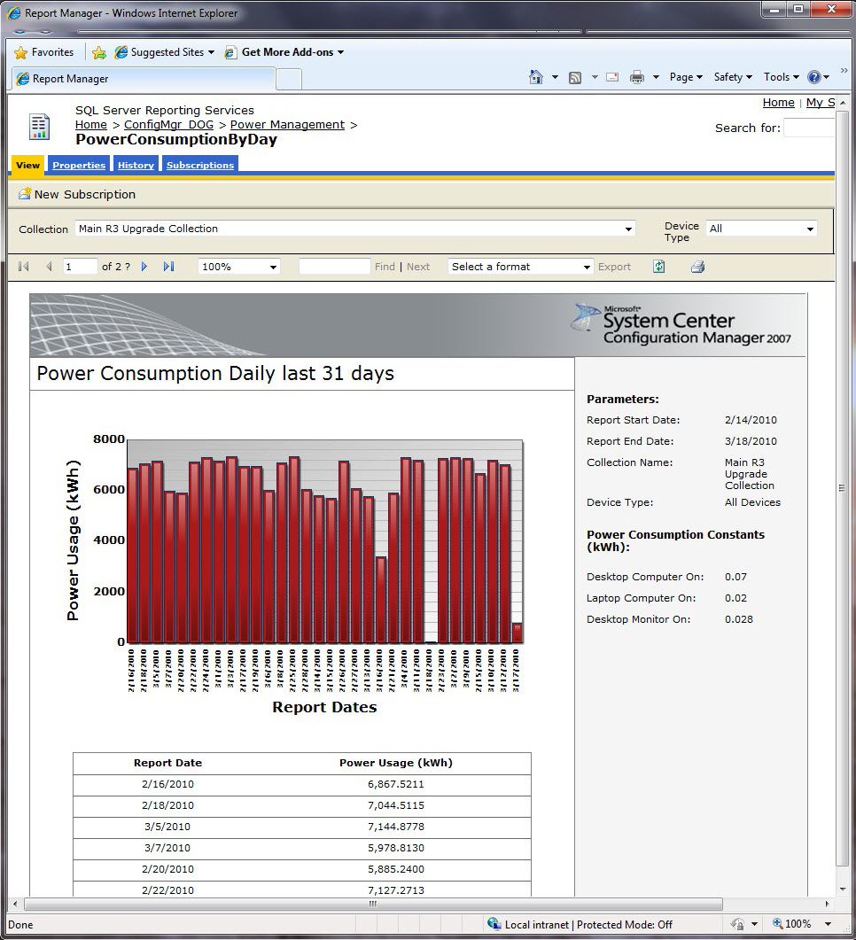

Slide 25
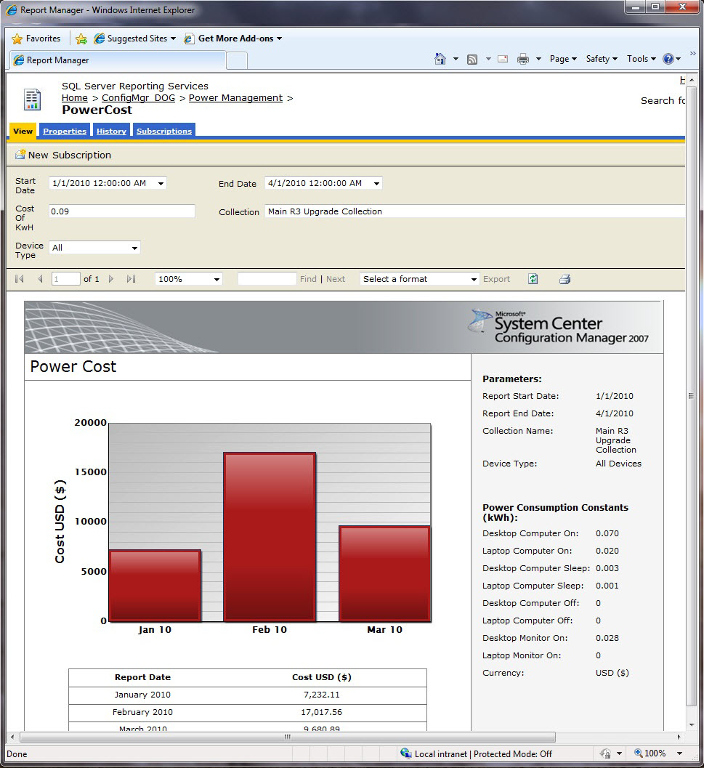

Slide 26
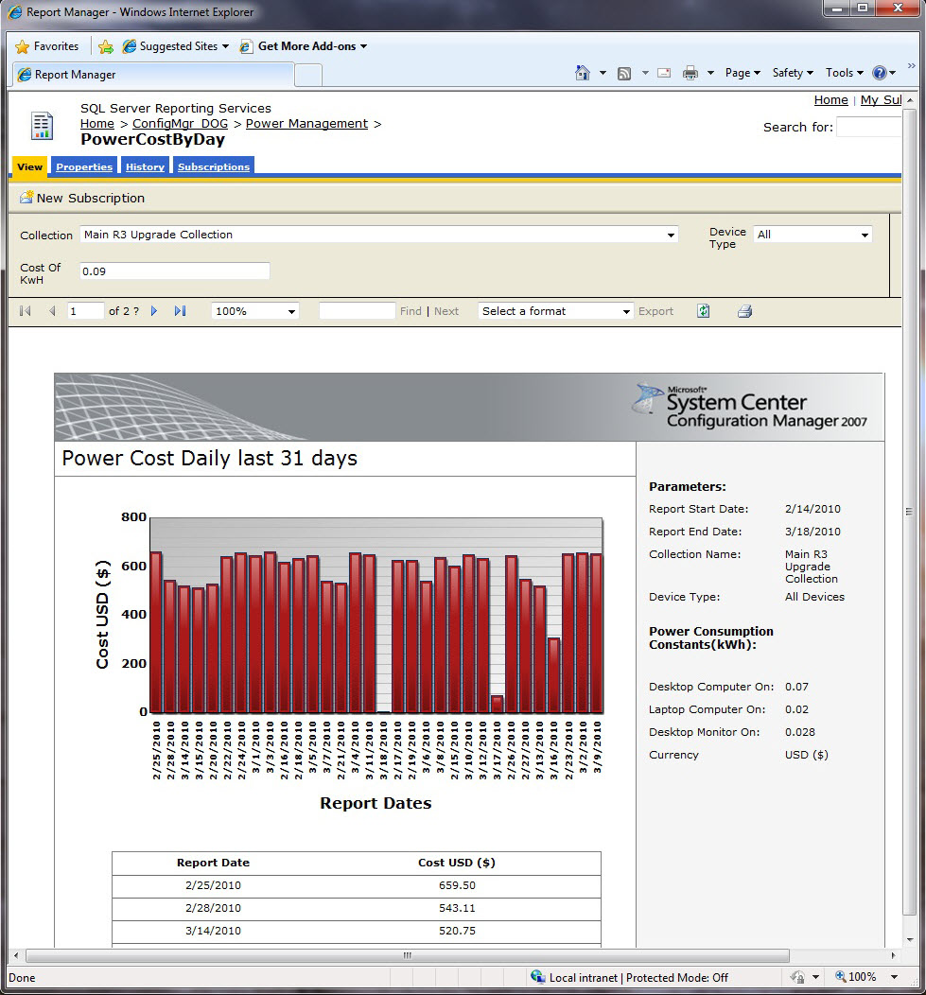

Slide 27
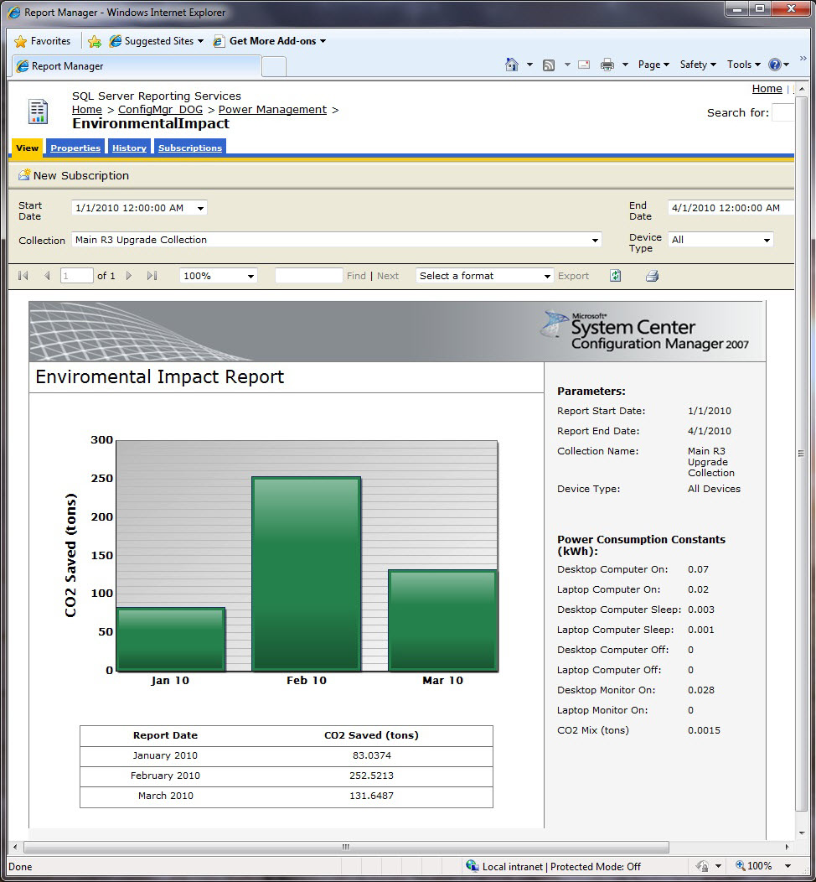

Slide 28
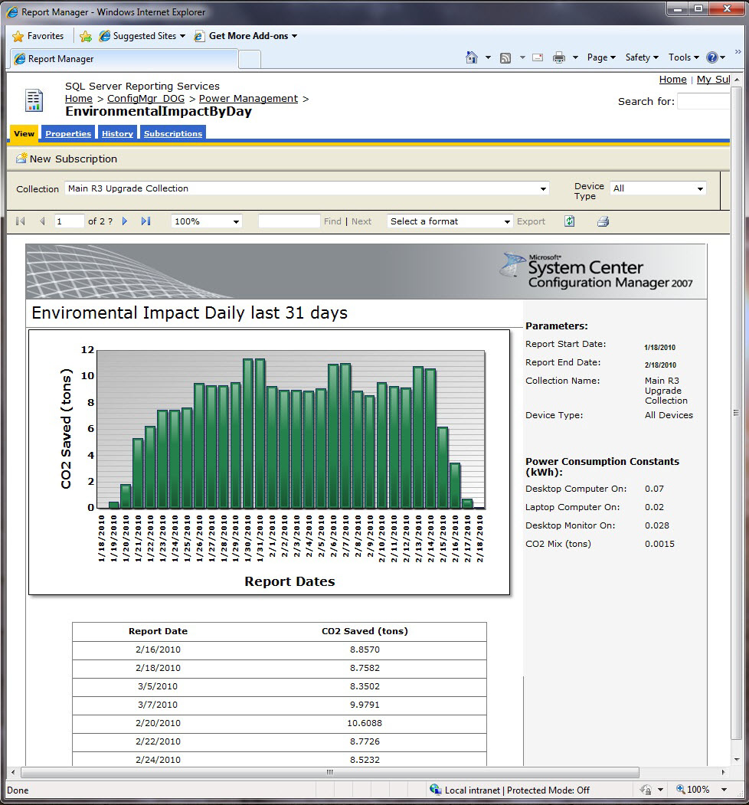

Slide 29
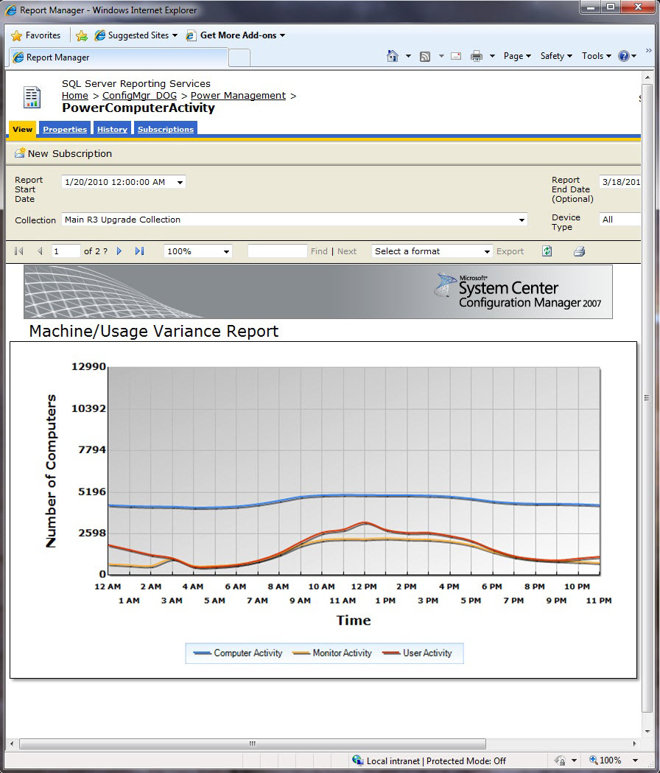

Slide 30





Forefront Endpoint Protection 2010
Next Generation Of Forefront Client Security
        Ease of Deployment
        Enhanced Protection
        Simplified Desktop Management
Built on distribution infrastructure of Microsoft® System Center Configuration Manager software
Supports all System Center Configuration Manager topologies and enables enterprise-wide scalability
Facilitates easy migration
Able to deploy across various operating systems (including Microsoft Windows® client and Microsoft Windows Server ®)
        Protection against viruses, spyware, rootkits, and network vulnerabilities
        Productivity-oriented default configuration
        Integrated management of host firewall
        Backed by Microsoft Malware Protection Center
        Unified management interface for desktop administrators
        Timely and effective alerts
        Simple, operation-oriented policy administration
        Historical reporting for security administrators

Slide 31
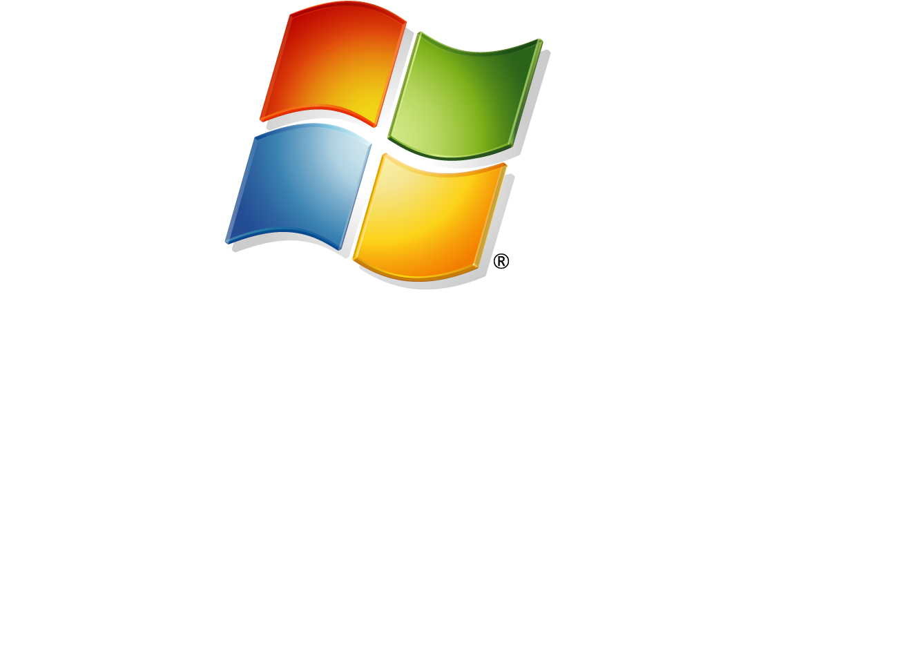
Manage Embedded Device Collections & Reports
Deploy Updates to Write Filter-Protected Devices
Deploy Embedded OS Using OEM Device Imaging Solutions
Extending Configuration Manager 2007 to Manage Embedded Devices

Slide 32
Prepare for Configuration Manager 2012
Flatten hierarchy where possible
Plan for Windows Server 2008, SQL 2008, and 64-bit
Start implementing BranchCache™ with Configuration Manager 2007 SP2
Move from web reporting to SQL Reporting Services
Avoid mixing user & devices in collection definitions
Use UNC (\\server\myapp\myapp.msi) in package source path instead of local path (d:\myapp)

Slide 33
Things you can do next
Download the beta of ConfigMgr 2012 – http://go.microsoft.com/fwlink/?LinkId=193914
Download the VHDs – http://blogs.technet.com/b/systemcenter/archive/2010/10/21/looking-for-vhds.aspx
Work through the TechNet Virtual Labs – http://blogs.technet.com/b/systemcenter/archive/2010/10/05/configuration-manager-v-next-virtual-labs-announcement.aspx
Participate in the Community Evaluation Program -http://blogs.technet.com/b/systemcenter/archive/2010/09/17/announcing-the-configuration-manager-v-next-community-evaluation-program.aspx
Join the Conversation on Twitter (#sysctr)
Follow our blog - http://blogs.technet.com/b/systemcenter/ and website - http://www.microsoft.com/systemcenter/en/us/configuration-manager.aspx
Program overview is here - http://blogs.technet.com/b/systemcenter/archive/2010/09/21/what-program-is-right-for-my-organization.aspx

Slide 34
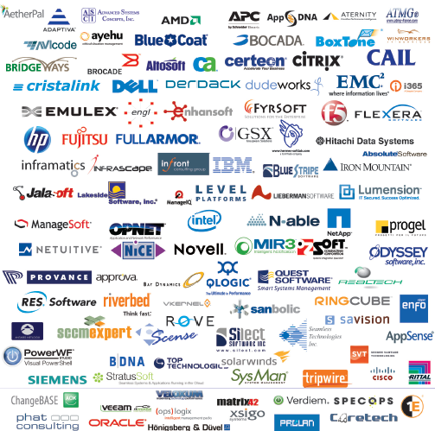
The System Center Alliance
165 ISV partners
selling solutions
built on the System
Center portfolio
Ecosystem grew by
95% over last year

Slide 35
Related Sessions – Breakout
PRC08 | Unleash the Power of Microsoft System Center Configuration Manager 2007 OS Deployment
SIM311 | Microsoft Forefront Endpoint Protection 2010 and Microsoft System Center Deep Dive into Management and Reporting
SIM317 | Planning and Deploying Microsoft Forefront Endpoint Protection 2010 with Microsoft System Center Configuration Manager
SIM330 | Client Management and Protection at Microsoft: Real-World Deployment Case Study of Microsoft Forefront Endpoint Protection
SIM337 | Integrating the Microsoft System Center Stack for Process Compliance and Automation
SIM346 | Microsoft System Center Configuration Manager 2012: Application Management
SIM347 | Microsoft System Center Configuration Manager 2012: Deployment and Infrastructure Technical Overview
SIM348 | Microsoft System Center Configuration Manager 2007 R3: Technical Overview
SIM351 | Microsoft System Center Configuration Manager 2012: Migrating from 2007 to 2012
SIM352 | Microsoft System Center Configuration Manager 2012: Technical Overview
SIM359 | Extending Microsoft System Center Configuration Manager to Specialized Devices with Windows Embedded Device Manager 2011
SIM407 | Microsoft System Center Configuration Manager: Hints, Allegations and Other Things Left Unsaid
VIR319 | Using Microsoft Enterprise Desktop Virtualization (MED-V) to Solve Windows 7 Application Compatibility
VIR375-INT | Deploying MED-V 2.0 with Microsoft System Center Configuration Manager 2007
WCL305 | Deploying the Core Optimized Desktop with Microsoft Deployment Toolkit 2010 and Microsoft System Center Configuration Manager
WSV303 | Deployment Internals: Mastering Windows Deployment Services

Slide 36
Related Sessions – Labs
OSP382-HOL | Deploying a Virtual Office with Microsoft System Center Configuration Manager
SIM271-HOL | Extend Microsoft System Center Configuration Manager 2007 to Manage Your Embedded Devices with Windows Embedded Device Manager 2011
SIM272-HOL | Deploy an Operating System Image to Your Embedded Device Using Windows Embedded Device Manager 2011
SIM379-HOL | Deploying Microsoft System Center Configuration Manager 2012
SIM380-HOL | Basic Software Distribution in Microsoft System Center Configuration Manager 2012
SIM381-HOL | Advanced Software Distribution in Microsoft System Center Configuration Manager 2012
SIM382-HOL | Migrating from Microsoft System Center Configuration Manager 2007 to Configuration Manager 2012
SIM378-HOL | Introduction to Microsoft System Center Configuration Manager 2012
SIM383-HOL | Implementing Role Based Administration in Microsoft System Center Configuration Manager 2012
SIM384-HOL | Deploying a Microsoft System Center Configuration Manager 2012 Hierarchy
SIM385-HOL | Implementing Settings Management in Microsoft System Center Configuration Manager 2012
SIM386-HOL | Implementing Software Updates in Microsoft System Center Configuration Manager 2012
SIM387-HOL | Maintaining Healthy Clients in Microsoft System Center Configuration Manager 2012
SIM388-HOL | Deploying Microsoft System Center Configuration Manager 2012 Device Management
SIM389-HOL | Deploying Windows 7 with Microsoft System Center Configuration Manager 2007
SIM390-HOL | Microsoft Forefront Endpoint Protection (FEP) 2012 Beta Overview
SIM394-HOL | Microsoft Forefront Endpoint Protection 2010 Overview
WCL372-HOL | Deploying the Core Optimized Desktop with Microsoft Deployment Toolkit 2010 and System Center Configuration Manager
WCL374-HOL | Getting Started with Microsoft Deployment Toolkit 2010

Slide 37

Track Resources
Don’t forget to visit the Cloud Power area within the TLC (Blue Section) to see product demos and speak with experts about the Server & Cloud Platform solutions that help drive your business forward.
You can also find the latest information about our products at the following links:
Cloud Power - http://www.microsoft.com/cloud/
Private Cloud - http://www.microsoft.com/privatecloud/
Windows Server - http://www.microsoft.com/windowsserver/
Windows Azure - http://www.microsoft.com/windowsazure/
Microsoft System Center - http://www.microsoft.com/systemcenter/
Microsoft Forefront - http://www.microsoft.com/forefront/

Slide 38





Resources
  Connect. Share. Discuss.
http://northamerica.msteched.com
Learning
  Sessions On-Demand & Community
  Microsoft Certification & Training Resources
www.microsoft.com/teched
www.microsoft.com/learning
  Resources for IT Professionals
  Resources for Developers
http://microsoft.com/technet
http://microsoft.com/msdn

Slide 39












Complete an evaluation on CommNet and
enter to win!

Slide 40


Slide 41

© 2011 Microsoft Corporation. All rights reserved. Microsoft, Windows, Windows Vista and other product names are or may be registered trademarks and/or trademarks in the U.S. and/or other countries.
The information herein is for informational purposes only and represents the current view of Microsoft Corporation as of the date of this presentation. Because Microsoft must respond to changing market conditions, it should not be interpreted to be a commitment on the part of Microsoft, and Microsoft cannot guarantee the accuracy of any information provided after the date of this presentation.
MICROSOFT MAKES NO WARRANTIES, EXPRESS, IMPLIED OR STATUTORY, AS TO THE INFORMATION IN THIS PRESENTATION.

