Slide 2

Microsoft System Center Configuration Manager 2012: Deployment and Infrastructure Technical Overview
SIM347
Wally Mead
Senior Program Manager
Microsoft Corporation

Slide 3
Session Objectives and Takeaways
Simplification
Infrastructure
Administration

Slide 4
Infrastructure Promises
Simplification
Infrastructure
Administration
Modernizing Architecture
  Minimizing infrastructure for remote offices
  Consolidating infrastructure for primary sites
  Scalability and Data Latency Improvements
    Central Administration Site is just for administration and reporting – Other work distributed to
    the primaries as much as possible
    File processing occurs once at the Primary Site and uses replication to reach other sites
    (no more reprocessing at each site in the hierarchy)
    System-generated data (HW Inventory and Status) can be configured to flow to the Central Administration Site directly
Be Trustworthy
  Interactions with SQL DBA are consistent with Configuration Manager 2007
  Configuration Manager admin can monitoring and troubleshoot new replication approach independently

Slide 5
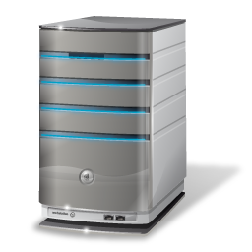



Simplify Your Hierarchy
Simplification
Infrastructure
Administration
Central Site
Primary
Primary
Primary Site
Secondary Site
Distribution Point
Secondary Site
Primary Site
Distribution Point
Primary Site
Secondary Site
Primary Site
Distribution Point
Distribution Point

Slide 6
Simplify Your Hierarchy
Simplification
Infrastructure
Administration
Central Administration Site
Primary
Primary
Distribution Point
Secondary Site
Secondary Site
Distribution Point
Secondary Site
Distribution Point

Slide 7



When do I Need a Primary Site?
Simplification
Infrastructure
Administration
To manage any clients
Add more primary sites for:
  Scale (more than 100,000 clients)
  Reduce impact of primary site failure
  Local point of connectivity for administration
  Political reasons
  Content regulation
  Decentralized administration
  Logical data segmentation
  Client settings
  Language
  Content routing for deep hierarchies

Slide 8
When do I Need a Secondary Site?
Simplification
Infrastructure
Administration
Manage upward-flowing WAN traffic
Tiered content routing for deep network topologies
No local administrator

Slide 9
When do I Need a Local Distribution Point?
Simplification
Infrastructure
Administration
BITS not enough control for WAN traffic
Multicast for Operating System Deployment
App-V streaming

Slide 10
When don’t I need a Local
Distribution Point?
Simplification
Infrastructure
Administration
BITS provides enough control for WAN traffic
BranchCache™ deployed
  Distribution point on Windows Server 2008 R2
  Clients running compatible operating system
    Vista SP2 with KB960568 installed
    Windows 7

Slide 11
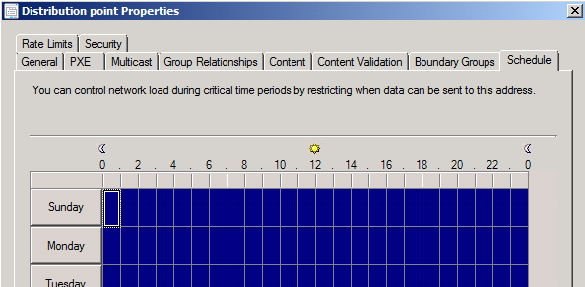
Distribution Points
Simplification
Infrastructure
Administration
One distribution point type
  Role can be installed on clients and servers
    Clients - Windows Vista SP2 and later
    Servers - Windows Server 2003 SP2 and later
  Ability to configure throttling and scheduling
  PXE service and multicast properties
  Specify drives for content storage
  IIS feature is required on all
  distribution points
  Co-exist on secondary site server or remotely connected

Slide 12
Content Prestaging
Configuration Manager 2007
Simplification
Infrastructure
Administration
Courier Sender
  Allows for prestaging at a site server of all content types (Configuration Manager 2007)
PkgPreLoadOnSite
  Allows for prestaging at a site server for classic packages (ConfigMgr Toolkit)
Manual Prestaging
  Manually copy package to a Branch distribution point only (Configuration Manager 2007)

Slide 13
Content Prestaging
New for Configuration Manager 2012
Simplification
Infrastructure
Administration
A single process that can preload on a site server or a distribution point
  All package types supported
  Content Library and Package Share
  Registers package availability with site server
  Prestaged content file is compressed
  Single action to load Multiple prestaged content files
    < ExtractContent.exe> used for prestaging the prestaged content file
  Conflict detection to ensure latest package version

Slide 14
Delivering on the Promise
Simplification
Infrastructure
Administration
Minimize infrastructure
supporting remote
office locations

Slide 15




Woodgrove Company Profile
“Remote office optimization”
Simplification
Infrastructure
Administration
Chicago metro office
50,000 clients
1 administrator with other IT responsibilities, limited day-to-day use
Weekly inventory, deploys software and software updates
2012

Slide 16
Woodgrove – 50,000 clients
“Remote office optimization”
Simplification
Infrastructure
Administration
Corporate Campus
Primary site (48,000 clients)
Local SQL Server
MP, DP (x5), FSP*, SLP*, SUP, RP/RSP
Sales Office
Only 15 clients
Good connectivity
BranchCache™
Processing Center
Distribution point with throttling and scheduling (485 clients)
Manage downward flow of Content over WAN
District Office
Secondary site (1500 clients)
Manage upward/downward WAN traffic
SQL Express
MP, DP, SUP, PMP
2012

Slide 17
Forest & Boundary Process Flow
Simplification
Infrastructure
Administration
Domains | Subnets | Sites
Contoso | 10.10.10.x | NorthAmerica
engineering | 10.10.11.x | Hawaii
 | 10.10.12.x
Contoso.com
Engineering.contoso.com
Discovery
Runs
Boundaries | Boundary Group | Boundary Group Purpose
NorthAmerica | NA_Site_QQQ | Site Assignment
Hawaii | HI_Site_HAW | Site Assignment, Content
10.10.10.x | Chicago_DP | Content
10.10.11.x | Chicago_DP | Content
10.10.12.x | St_Louis_DP1 | Content

Slide 18
Forest Discovery - New
Simplification
Infrastructure
Administration
Discovers site server’s forest + any trusted forests
Manually add forests that are not trusted
  Example: Forests for a perimeter network
  Supports both publishing and discovery
Discovery returns the following information:
  Domains, IP Subnets, AD Sites
Supports boundary creation
  Can even be automatic!
  On-Demand selection of specific boundaries
Contoso.com

Slide 19
Boundaries
Simplification
Infrastructure
Administration
Retained same boundary types as Configuration Manager 2007
Boundary management has been simplified
  Automatically create boundaries as part of forest discovery
    Enable Active Directory forest discovery
  Separated client assignment and content lookup
  Added boundary groups to keep boundaries organized in logical containers
  Boundary groups are the primary object for client assignment and content lookup (not the boundary)
Automatically create a boundary group and associated boundaries from Configuration Manager 2007 site during migration.
Active Directory Site | IPv4 subnet
IP address range | IPv6 prefix

Slide 20
Boundary Groups &
Distribution Points
demo

Slide 21
When do I Need a
Central Administration Site?
Simplification
Infrastructure
Administration
More than one Primary Site in a single hierarchy
Off-load reporting and administration from your Primary Site
  Migration Consideration: The Central Administration Site must always be installed on new hardware

Slide 22
Delivering on the Promise
Simplification
Infrastructure
Administration
Minimize infrastructure
to support unique settings
and policies

Slide 23




Woodgrove Grows – Company Profile
“Minimize Infrastructure”
Simplification
Infrastructure
Administration
Headquarters in Chicago
2-4 administrators with other IT responsibilities, limited day to day use
Subsidiary in London
125,000 clients
Weekly inventory, deploys software and software updates
2012

Slide 24



Woodgrove – 125,000 clients
“Minimize Infrastructure”
Simplification
Infrastructure
Administration
Chicago Primary Site 1
Primary site (25,000 clients)
Local SQL Server
HR Collection-based settings for Remote Control
Central Admin Site
No Clients
Administration & Reporting for Hierarchy
Admin segment for HR clients
Chicago Campus
75,000 clients
Chicago Primary Site 2
Primary site (50,000 clients)
Local SQL Server
Engineering Collection-based settings for Power Control
London Primary
Primary site (50,000 clients)
Inventory Class reporting at Collection level
Admin Segment for Servers
London Offices
49,500 desktops
500 Servers
2012

Slide 25
SQL Server in Configuration Manager 2012
Simplification
Infrastructure
Administration
Be Trustworthy
  Interactions with SQL DBA are consistent with Configuration Manager 2007
  Configuration Manager admin can monitoring and troubleshoot new replication approach independently
One Configuration Manager site per SQL Server instance
All database communication encrypted
TCP/IP port for service broker

Slide 26
Replication
Simplification
Infrastructure
Administration
Data type | Examples | Replication type | Where is data found?
Global data Created by admin | Collection rules, package metadata, software update metadata, Deployments | SQL | Central administration site, all primary sites, secondary sites*
Site data Created by system | Collection members, HINV, alert messages | SQL | Central administration site, originating primary site
Content | Software package installation bits, software updates, boot images | File-based | Primary sites, secondary sites, distribution points
*Subset of global data only

Slide 27
SQL Replicated Data Types
Simplification
Infrastructure
Administration
Global Data Examples
Site Data Examples
Collection Rules & Count
Package Metadata
Program Metadata
Deployments
Configuration Item Metadata
Software Update Metadata
Task Sequence Metadata
Site Control File
System Resource List (site servers)
Site Security Objects (Roles, Scopes, etc.)
Alert Rules
Collection Membership Results
Alert Messages
Hardware Inventory
Software Inventory & Metering
Asset Intelligence CAL Track Data
Status Messages
Software Distribution Status Details
Status Summary Data
Component and Site Status Summarizers
Client Health Data
Client Health History
Wake On LAN
Quarantine Client Restriction History

Slide 28




Conceptual Replication Model
Simplification
Infrastructure
Administration
Global Data
Available at: Central Administration Site and all Primary Sites
Examples
Collection rules
Package metadata
Deployments
Security Scopes
Site Data
Available at: Central Administration Site, Replicating Primary
Examples:
HINV
Status
Collection Membership Results
Content
Available where content has been distributed to a Distribution Point
Central Administration Site
Texas (Keller)
Germany
(Baumholder)
Amarillo
Canyon
 | Central Administration Site
 | Primary Site
 | Secondary Site
Global Data subset
Examples
Packages metadata and status
Program metadata
Hereford
Content routing between Secondaries

Slide 29
Site Replication Monitoring
demo

Slide 30
Client Settings
Easiest Step to Infrastructure Reduction:
Stop using primary sites for different Client Settings
Simplification
Infrastructure
Administration
Default Client Settings for the entire hierarchy
Custom Client Settings assigned to collections
Resultant settings can be an aggregation of both default & one or more custom settings
Priority-based conflict resolution
  Custom settings override default settings

Slide 31
Client Settings & Collection Assignment
Collections are Global Data
Simplification
Infrastructure
Administration
Configuration Manger 2007: a collection created at a primary site can only affect resources at or below this site
Configuration Manger 2012: collections are now globally evaluated at all sites
  Clients from any site can be members and receive targeted deployments
  Change focus from site-centric administration to client-centric
Remember
  Global data: collection rules & count
  Site data: collection members

Slide 32
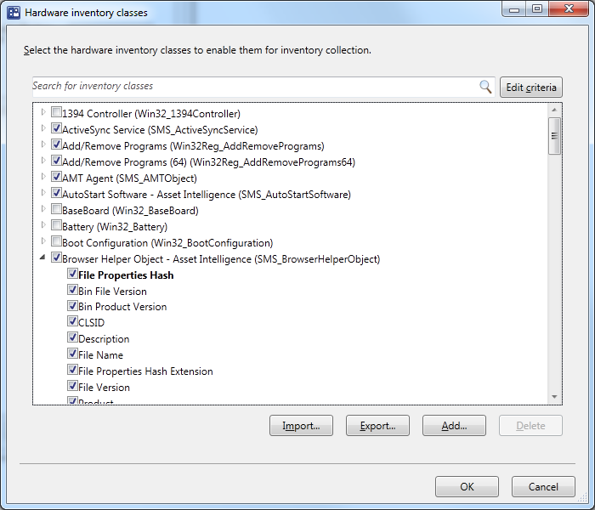
Hardware Inventory
Simplification
Infrastructure
Administration
Simplified experience
  Forget about SMS_DEF.MOF!
  Browse WMI namespace to select the classes you need
Backward compatible
  Import existing .mof files

Slide 33



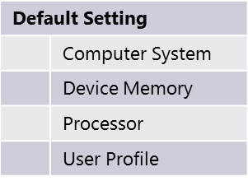

Hardware Inventory
Simplification
Infrastructure
Administration
Use Client Setting to configure inventory classes

Slide 34
Collection Based
Client Settings
Enabling Hardware
Inventory Classes
demo

Slide 35
Role-Based Administration
“Display what’s relevant to me”
Simplification
Infrastructure
Administration
Simplified security management
Role-Based Administration allows:
Mapping organizational roles of
administrators to security roles
Hierarchy-wide security management from a single console
  RBA is global data
  Don’t think about sites!
Removing clutter from the console
  “Show me what’s relevant to me”!

Slide 36
Administrative Segmentation
Simplification
Infrastructure
Administration
Security Roles
  What types of objects can I see and what can I do to them?
  Example: the “Software Update Manager” role gives rights to read and deploy collections and Software Updates.
  Security Scopes
  Which instances can I see and interact with?
  Collections
  Which resources can I interact with?

Slide 37


Data Segmentation
Configuration Manager 2007
Simplification
Infrastructure
Administration
Meg wishes to distribute a package to all of her EMEA users in the West region
France Primary Site
Louis
“French Admin”
French collections
Create advertisement for French collections
England Primary Site
Meg Collins
“Central Admin”
Create and distribute package
Anthony
“English Admin”
English collections
Create advertisement for English collections

Slide 38
Segmentation using Role Based Administration Configuration Manager 2012
Simplification
Infrastructure
Administration
Meg wishes to distribute an application to all of her EMEA users in the West region
Central
Admin Site
Louis
“French Admin”
Anthony
“English Admin”
Meg Collins
“Central Admin”
Create and distribute application
English collection(s)
Create deployment for English collection(s)
French collection(s)
Create deployment for French collection(s)

Slide 39
Collection Limiting
Simplification
Infrastructure
Administration
Meg gives Louis permissions to “French Systems”
All Systems
Louis
can read French Systems and all collections limited to French Systems
cannot see All Systems and English Systems
can modify and delete French Desktops
can create new collections limited to French Systems or French Desktops
French Systems
English Systems
French Desktops
French Servers

Slide 40
Collection Limiting
Simplification
Infrastructure
Administration
Every collection is limited by another
Assigning a collection to an administrator automatically assigns all limited collections
Ship with two read-only root collections
  All Systems
  All Users and User Groups

Slide 41
Role Based
Administration
demo

Slide 42
Configuration Manager 2007 vs. 2012
Delivering on the Promise
Simplification
Infrastructure
Administration
Promise | Configuration Manager 2007 | Configuration Manager 2012
Scalability and data latency improvements | Central primary reprocesses all data from child sites | Central administration site – no data processing
Consolidating infrastructure for primary sites | Separate primary | Collection-based settings Role-based administration/ Admin Segmentation
Minimizing infrastructure for remote offices | Secondary Site Standard Distribution Points and Branch Distribution Points | Secondary Site Distribution Points with throttling and scheduling Distribution Points BranchCache™

Slide 43
Migration from ConfigMgr 2007 to 2012
Assist with Flattening of Hierarchy
Assist with Migration of Objects
Assist with Migration of Clients
Maximize Re-usability of x64 Server Hardware
Minimize WAN impact

Slide 44
Built-in Migration Feature
Migration Job Types:
  Object Migration (Collections, software distribution packages, boundaries, metering rules etc.)
  Collection based Migration (Select a collection and migrate associated objects)
Content functionality:
  Re-use of existing Configuration Manager 2007 content (Distribution point sharing)
  Distribution point upgrade
Import of Configuration Manager 2007 inventory MOF files

Slide 45
Minimum System Requirements
Simplification
Infrastructure
Administration
Component | Minimum Requirement
Site Server and Site Roles | Windows Server 2008 (64-bit ) Windows Server 2008 R2 (64-bit)
Database | SQL Server 2008 SP1 & Cumulative Update 10+ (64-bit)
Distribution Point | Windows Server 2003 (including 32-bit) with limited functionality Windows Vista SP2 and later (including 32-bit)
Client | Windows XP SP2 (64-bit) & SP3 (32-bit) Windows 2003 Server SP2 (32-bit & 64-bit) Vista SP2 (32-bit & 64-bit) Windows 7 RTM (32-bit & 64-bit) Windows 2008 SP2 (32-bit & 64-bit) Windows 2008 R2 RTM (64-bit)

Slide 46
Prepare for
Configuration Manager 2012
Simplification
Infrastructure
Administration
Flatten hierarchy where possible
Plan for Windows Server 2008, SQL 2008, and 64-bit
Start implementing BranchCache™ with Configuration Manager 2007 SP2
Move from web reporting to SQL Reporting Services
Avoid mixing user & devices in collection definitions
Use UNC (\\server\myapp\myapp.msi) in package source path instead of local path (d:\myapp)

Slide 47

Track Resources
Don’t forget to visit the Cloud Power area within the TLC (Blue Section) to see product demos and speak with experts about the Server & Cloud Platform solutions that help drive your business forward.
You can also find the latest information about our products at the following links:
Cloud Power - http://www.microsoft.com/cloud/
Private Cloud - http://www.microsoft.com/privatecloud/
Windows Server - http://www.microsoft.com/windowsserver/
Windows Azure - http://www.microsoft.com/windowsazure/
Microsoft System Center - http://www.microsoft.com/systemcenter/
Microsoft Forefront - http://www.microsoft.com/forefront/

Slide 48





Resources
  Connect. Share. Discuss.
http://northamerica.msteched.com
Learning
  Sessions On-Demand & Community
  Microsoft Certification & Training Resources
www.microsoft.com/teched
www.microsoft.com/learning
  Resources for IT Professionals
  Resources for Developers
http://microsoft.com/technet
http://microsoft.com/msdn

Slide 49












Complete an evaluation on CommNet and
enter to win!

Slide 50

Notes:
New for TechEd 2011, we will be working with Microsoft Tag (http://tag.microsoft.com/overview.aspx) to create unique Tags for every session at the event. Your session Tag will appear on both the room signage and at the end of your presentation. With your session Tag, attendees will be able to scan as they enter the room to retrieve session details, view speaker bios, and engage in discussions; or scan at the end of the presentation to evaluate your session and download materials. We’re excited to integrate Microsoft Tag across the My TechEd mobile experience this year.

Slide 51

© 2011 Microsoft Corporation. All rights reserved. Microsoft, Windows, Windows Vista and other product names are or may be registered trademarks and/or trademarks in the U.S. and/or other countries.
The information herein is for informational purposes only and represents the current view of Microsoft Corporation as of the date of this presentation. Because Microsoft must respond to changing market conditions, it should not be interpreted to be a commitment
on the part of Microsoft, and Microsoft cannot guarantee the accuracy of any information provided after the date of this presentation. MICROSOFT MAKES NO WARRANTIES, EXPRESS, IMPLIED OR STATUTORY, AS TO THE INFORMATION IN THIS PRESENTATION.

