Slide 1

Microsoft System Center Configuration
Manager 2012: Application Management
SIM346
Wally Mead
Senior Program Manager
Microsoft Corporation

Slide 2
Session Agenda
Overview of Software Distribution (SWD) in
Configuration Manager 2012
  Create, Deploy and Monitor Applications
  User Device Affinity
  Global Conditions and Expressions
  Application Uninstall
  Application Supersedence

Slide 3

New Features for Software Distribution in Configuration Manger 2012
Application Model
  Incorporates all supported software types
  (MSI, Script, App-V, Mobile CAB)
  Greatly improved dependency handling
  Installation requirement rules
  Installation detection methods
  Application supersedence
  Application uninstall
User Device Affinity
Unified monitoring experience
End user experience
  Application Catalog
  Software Center
Content management
  Distribution Point groups
  Content library
  Improved content monitoring experience
  Content validation

Slide 4
Configuration Manager 2007 to Configuration Manager 2012 Comparison Model
Feature | Configuration Manager 2007 | Configuration Manager 2012
Create/Model Software | Package Program | Application and Deployment Types
Deploy Software | Advertisement (Install Status) | Deployment (state based) via detection method
Targeting | Collection rules (Server) | Requirement rules (Client)
User-targeting | None or limited | User Device Affinity
Client User Experience | Run Advertised Programs | Software Center
Software Install from Web site | None | Application Catalog
Content Management | None or limited | Content library

Slide 5
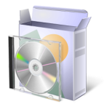




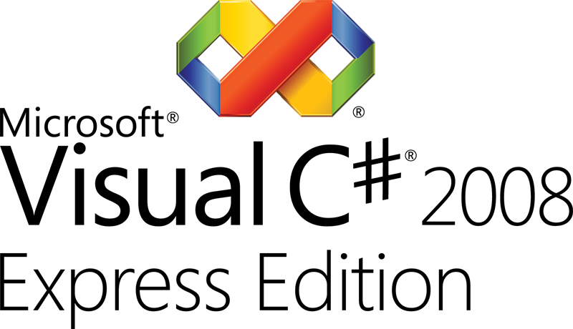

Application Model Diagram
Administrator Properties
General information about the software application
Keep your apps organized and managed
End User Metadata
The “friendly” information for your users
App-V
Windows
Script
Windows
Installer (MSI)
Mobile (CAB)
Deployment Type
Workhorse for application
Requirement Rules
Can/cannot install app
Dependencies
Apps that must be present
Detection Method
Is app installed?
Install Command
Command line and options
Content
Source files for the app

Slide 6
Detection Methods
State-based Application Management
Detection methods enable systems to determine
whether or not an application is already present on a system (Discovery)
Many system attributes play into presence of an application on a system (registry, file versions, MSI database, etc)
Detection is the key to any state based software distribution system

Slide 7
Enhanced Detection Methods
Provides more granular control over detecting the presence of an application
Includes File, Windows Installer, and Registry providers
  File – File and folder properties including exists, version, date/time, size and more
  Windows Installer – Product code and version
  Registry – Key exists, value exists, comparisons of registry values
Complex expressions containing multiple rules can be built and grouping logic applied

Slide 8
Requirement Rules
State-based Application Management
Properties of users and/or devices that makes delivering software appropriate
Rules are per deployment type
Evaluated in real-time on the client
Evaluated before content is downloaded to the client

Slide 9
Dependencies
Other deployment types that must be present in order for the current application deployment type to be installed
1 to n Dependencies
This AND this AND this OR this
  .NET Framework either 3.5 or 4.0 and
  Browser either IE7 or IE8, install IE8 if none present
Dependencies are modeled as applications and can also be deployed independently

Slide 10
Create an Application
demo

Slide 11
Content Distribution
Distribution Point Groups
  Can be linked to Collections for workflow optimization
  Automatic distribution of content for distribution points added to the group
Distribute Content Wizard
  Send multiple packages to multiple distribution points or groups at once
  Detect Application dependencies and add them to the distribution
  Select a task sequence and distribute all related content
Content Library
  Files will be stored once, even if they are used across multiple applications, packages, update packages, etc…
  Only files required by the distribution point are distributed over the network
Bandwidth Control
  Customize time and bandwidth utilization on distribution points

Slide 12
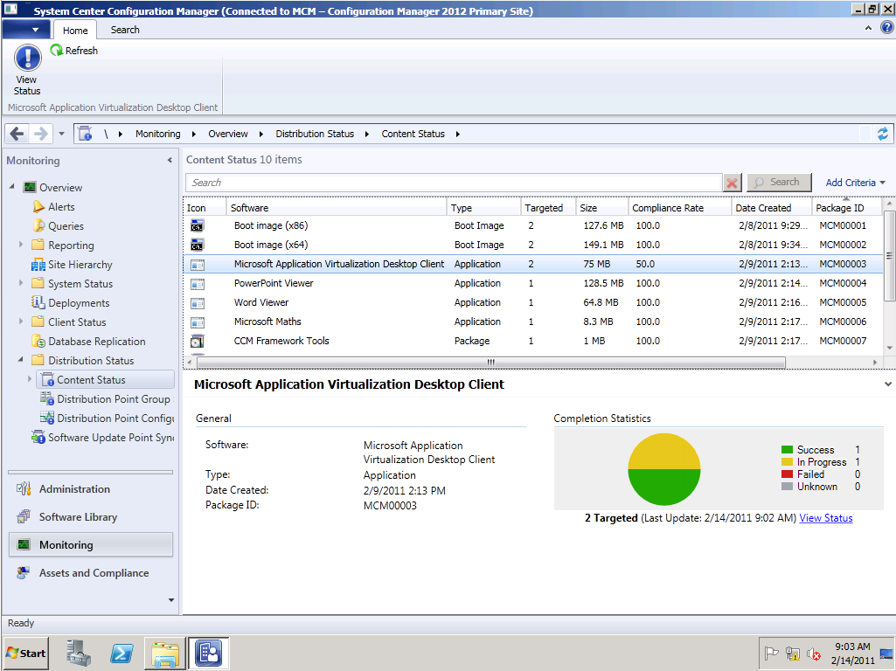
Content Monitoring
Compliance of content distributed in multiple views
  Application, package, etc.. level
  Distribution point group level
  Distribution point level
Ability to validate content on a distribution point
  Available as a set schedule or on demand
  Updates package compliance in the monitoring node

Slide 13
Deployment
Replaces “Advertisement” from Configuration Manager 2007
Created when an Application is deployed to a Collection
  Due to applications being state based, only deploy to a collection once
2 types of deployment purposes
  Required (like mandatory in Configuration Manager 2007)
  Available (like optional in Configuration Manager 2007)
    Available for User targeted displayed in the Application Catalog
    Available for Device targeted displayed in Software Center on client
2 types of actions
  Install
  Uninstall
Provides setting for “Pre-deployment” feature when targeting user or user security group collections

Slide 14
Deployment Monitoring
State Based (and state message based)
  If state changes (for example during Global Evaluation) monitoring will be updated
5 Categories of state (success, in progress, requirements not met, error, unknown)
Compliance Monitoring:
  For system targeted deployments, compliance = 1 state per system
  For user targeted deployments, compliance = worst state of app for user on any system
    If app successful on one device and fails on another, overall compliance for user = error
  For available deployments, compliance percentage calculated on users that have requested app, not total members of collection

Slide 15


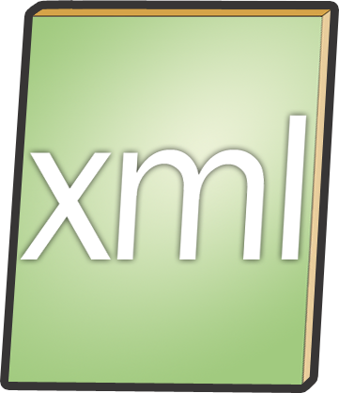


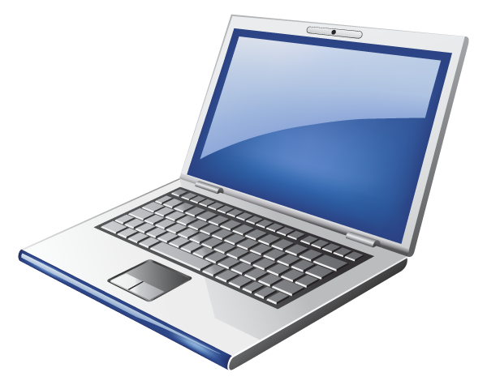
Application Evaluation Flow
New Policy App Install Schedule
Requirements met?
No
Yes
Is installed?
Yes
No
Dependencies installed?
No
Install dependencies
Yes
Install Application
Dependencies installed

Slide 16
Distribute Content, Deploy Software and Monitoring
demo

Slide 17
Application Catalog
User Targeted Available Software
Browse and search for software
  Fully localized for site and applications
  Search via category or name
Install Software
  Direct self-installation from Application Catalog
  Leverages full infrastructure for content and status
  Automatic installation upon approval
Request Applications
  Request approval for software
  View request history

Slide 18
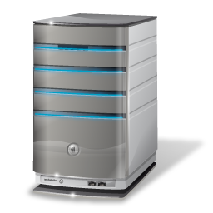


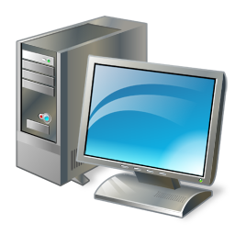


On Demand Installation
Process Flow
Web Site
Site Server
1
User clicks “install” on Catalog item
2
Web site checks user’s permissions to install
3
Server creates policy for the specified client and app and passes it to client
5
4
6
Web site requests Client ID from ConfigMgr client agent and passes it to Site server
Client agent evaluates requirements from the policy and initiates installation
Client agent completes installation process and reports status
Melissa
Agent

Slide 19
Installing Software through the Application Catalog
demo

Slide 20
Benefits of Multiple Deployment Types
Flexible way to deliver different installation formats based on conditions
No restrictions on the number and types of deployment types
  Many of the same type of deployment types could be added to an application each representing a different flavor or transform
  App-V or Remote Desktop Services app might go to a guest logged into a kiosk, full MSI to a users primary desktop machine

Slide 21
Applications with Multiple Deployment Types and Requirement Rules
demo

Slide 22
Applications, UDA and Task Sequences
Use Applications for complex software installation in place of the task sequence
  Applications are optimized for user targeting, task sequences are still machine based
  Applications are optimized for conditional delivery, dependencies and version management
  Not preventing the use of task sequence, however Application will cover almost all scenarios! ☺
Use task sequences for managing a deployment of an operating system
  Only install Applications that require state restore (USMT settings) as part of a task sequence
  User device affinity and pre-deploy will complete the installation of user targeted applications immediately after the task sequence completes

Slide 23
What is User Device Affinity?
Is the key to helping our customers move to
User Centric Software Distribution
  Provides the ability to define a relationship between a user and a device
  Allows the admin to think “user first”, while also ensuring the application
  not installed everywhere the user logs on
Configuration Manager 2012 supports:
  Single primary user to primary device
  Multiple primary devices per user
  Multiple primary users per device
The system allows both the administrator and user to define this relationship

Slide 24
Benefits of User Device Affinity
Allows the deployment of software based on the nature of the relationship between the user and device
  For example:
    Install the MSI or App-V version of Microsoft Office when the device is a primary device of the user targeted; install the Terminal Server version if the device is not a primary device
    Only install the App-V version of Microsoft Visio if the device is a primary device of the targeted user, otherwise don’t install
    Eliminates the problem of users leaving software everywhere they log in
Enables Pre-Deployment of Software: Allows software to be pre-deployed on a user’s primary devices whether or not the user is logged in

Slide 25
How Can User Device Affinity be set?
User device affinity relationships are defined:
  Based on a usage threshold on client
  Using import file from external system
  As part of Operating System Deployment
    Can be set from PXE, Bootable and Prestaged Media
    UDA relationship can be configured to:
      Auto Approve, Pending Approval and Do Not Allow
  During Mobile Device enrollment
  By end-user through Application Catalog
  Manually by administrator
Client Agent Settings
  Define user device affinity configuration at collection level
  Usage and User based user device affinity can be enabled and configured using client agent settings

Slide 26
Global Conditions in ConfigMgr 2012
Foundation of Requirement Rules
Properties of users and/or devices that make delivering software appropriate
Global conditions are system artifacts
  Default Global condition = Memory is greater than 512MB
  Custom Global condition = Machine is Corporate Device
    “Machine is Corporate Device” maps to a registry key attribute

Slide 27
Global Expressions
Enables the application author or administrator to create logical groupings of global conditions and assign values. These expressions can be reused for applications
Example:
  An expression such as “Corporate Primary Device” consists of the following rules:
    Memory = 1 GB
    and Free Disk Space = 500 MB
    and Operating System = Windows 7
    Primary Device = True
    CorporateDevice = True

Slide 28
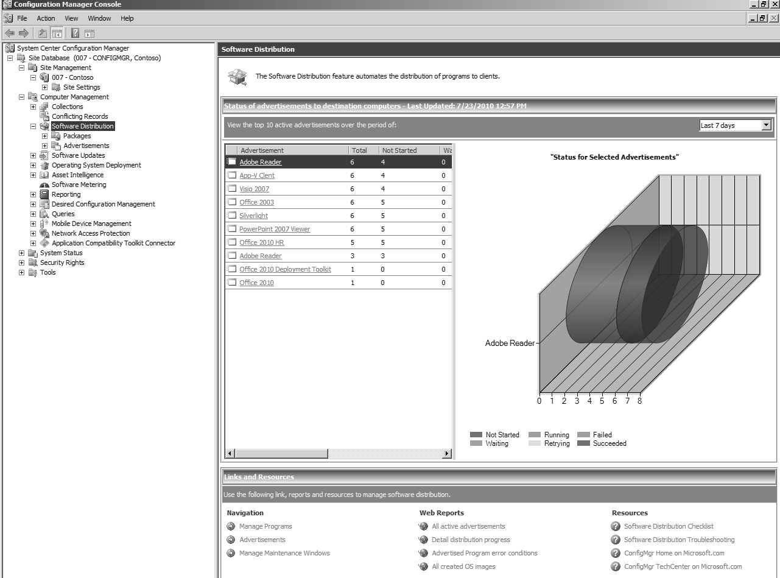
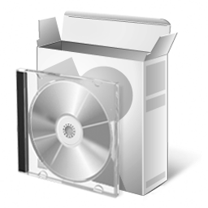
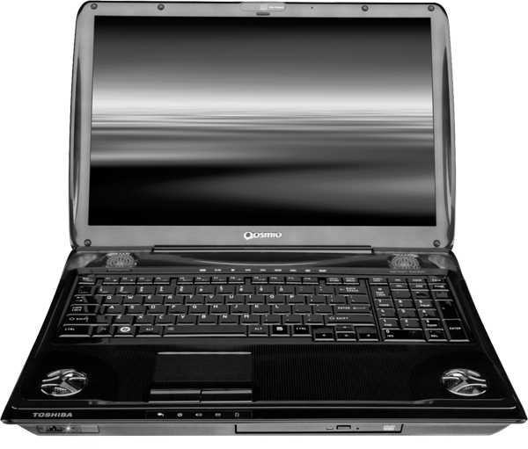
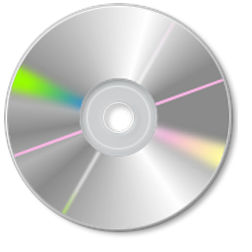






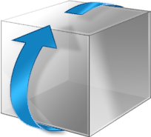
Application Lifecycle
New Application
  Application Installation
  (beta1)
Remove Application
Update Application
  Application Uninstall
  (beta2)
  Application Revision
  (beta1)
Retire Application
Replace Application
  Application Retirement
  (beta1)
  Application Supersedence
  (beta2)

Slide 29
Uninstall in ConfigMgr 2012
Admin creates an Uninstall Deployment
  Uninstall is a deployment action
  The App Model defines an uninstall method for each Deployment Type of an Application. For MSI Deployment Types, for example, a supported uninstall command for the Deployment Type might look like msiexec /x “setup.msi”.
An admin defines a specific collection to target the Uninstall Deployment to (either users or machines)
If a user or device is the recipient of both an install and uninstall deployment, then install wins and the app will not be removed

Slide 30
What is Application Supersedence
Definition: The ability for the admin to create a relationship and declare one application newer than another previous application. Ultimately resulting in the newer application replacing the older application for a user on a device
Why is this feature important to our customers?
  Provides the ability to ensure users have the latest version of software
  Provides the ability in one process to migrate users from one application version to another version/application
Overall goals
  Utilize supersedence conceptual models from Software Updates and WU
  Allow admins to test\pilot newer application, prior to production release. While permitting the older application to continue to exist for the majority of users
  Allow the admin to eventually halt installations of the older application and move users to the newer application
  Provide the ability to uninstall OR upgrade previous version
  Ability to offer users only the latest release of an app in the Application Catalog or software center.
  Ability to create new application or version and make sure we do not get in a “race condition” between conflicting detection methods

Slide 31
Application Supersedence with uninstall
demo

Slide 32
Design Details
Supersedence relationship is defined at both application level and deployment type.
  Admin first defines the relationship at an application level
  Secondly admin maps each deployment type of both applications
Non-mapped deployment types for both the superseded and superseding application
Both upgrade and install of superseded application
Relationship Manager shows supersedence relationships

Slide 33
In Review
Session Objectives and Takeaways
Outlined the new feature set for software
distribution in Configuration Manager 2012
Illustrated how the tasks you do today will be executed with this feature set
Completed the application lifecycle for software distribution
Key Takeaways:
  Application model is extremely powerful way to manage full application lifecycle
  Package\programs as you know them today still exist, but no investment for this release
  Admin can still target devices, but provided enhanced functionality to deploy software to users

Slide 34

Track Resources
Don’t forget to visit the Cloud Power area within the TLC (Blue Section) to see product demos and speak with experts about the Server & Cloud Platform solutions that help drive your business forward.
You can also find the latest information about our products at the following links:
Cloud Power - http://www.microsoft.com/cloud/
Private Cloud - http://www.microsoft.com/privatecloud/
Windows Server - http://www.microsoft.com/windowsserver/
Windows Azure - http://www.microsoft.com/windowsazure/
Microsoft System Center - http://www.microsoft.com/systemcenter/
Microsoft Forefront - http://www.microsoft.com/forefront/

Slide 35





Resources
  Connect. Share. Discuss.
http://northamerica.msteched.com
Learning
  Sessions On-Demand & Community
  Microsoft Certification & Training Resources
www.microsoft.com/teched
www.microsoft.com/learning
  Resources for IT Professionals
  Resources for Developers
http://microsoft.com/technet
http://microsoft.com/msdn

Slide 36












Complete an evaluation on CommNet and
enter to win!

Slide 37


Slide 38

© 2011 Microsoft Corporation. All rights reserved. Microsoft, Windows, Windows Vista and other product names are or may be registered trademarks and/or trademarks in the U.S. and/or other countries.
The information herein is for informational purposes only and represents the current view of Microsoft Corporation as of the date of this presentation. Because Microsoft must respond to changing market conditions, it should not be interpreted to be a commitment
on the part of Microsoft, and Microsoft cannot guarantee the accuracy of any information provided after the date of this presentation. MICROSOFT MAKES NO WARRANTIES, EXPRESS, IMPLIED OR STATUTORY, AS TO THE INFORMATION IN THIS PRESENTATION.

