Slide 1

AVIcode: Setup and
Deploy Intercept Studio
SIM344
Shawn Gibbs, Chris Childers
Microsoft
Simon Skinner
SCOM MVP

Slide 2
Agenda
The AVIcode solution
AVIcode architecture
Installing AVIcode
Configuring application monitoring
Advanced configuration options

Slide 3
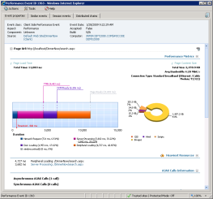
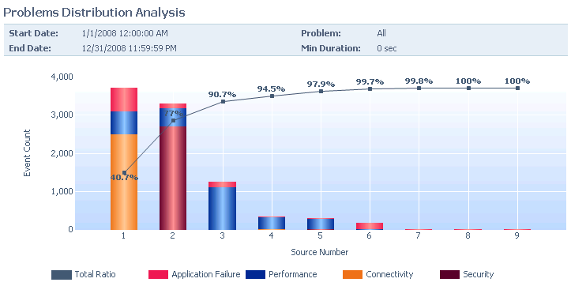
The AVIcode Solution
24x7 LOB applications monitoring
No source code modifications
Low overhead
End-to-end transaction tracking
360º application holistic view
Application availability monitoring
Problem management workflows
End-user health monitoring
Intelligent analytics and reports

Slide 4
AVIcode Architecture
Web Applications
1. SEViewer
2. Advisor
Web Services
1. SELog
2. uX Collector
Databases
1. Event database
2. Report database
Management Packs
1. NET Enterprise
2. uX User health

Slide 5
Deployment Scenarios
Scenarios Include:
1. Load Balanced
2. Fail Over
Multiple installs can utilize same
database instances.

Slide 6
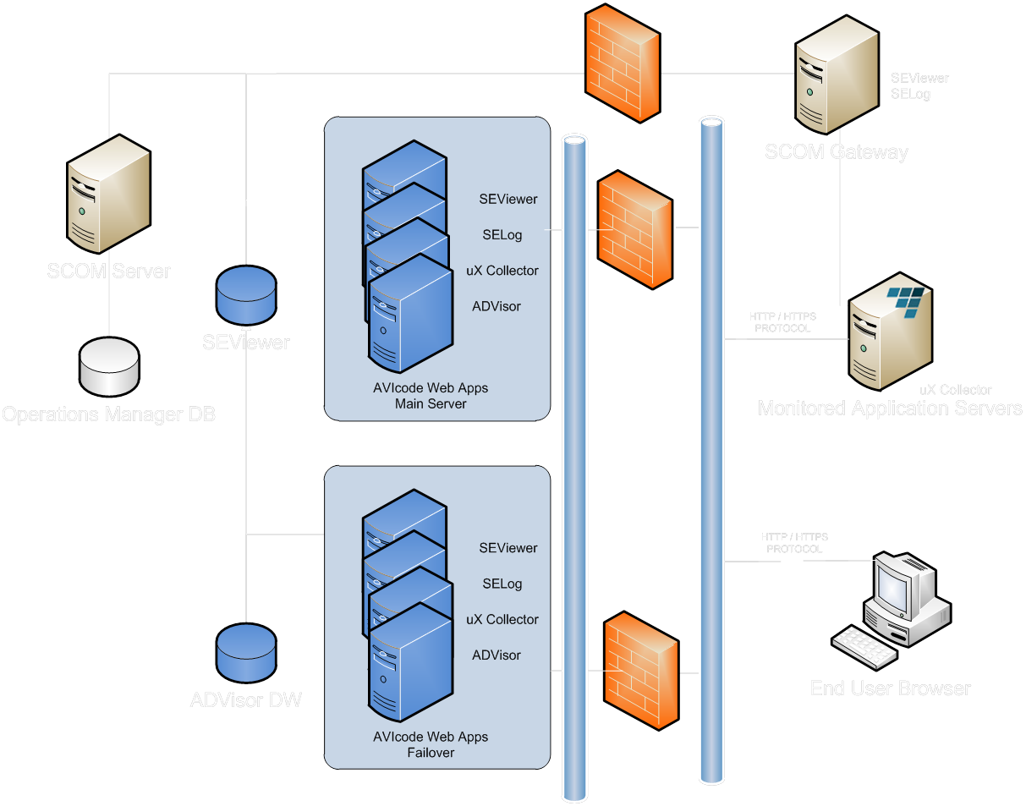
Deployment Scenarios DMZ
Web DMZ
1.AVIcode installed
on OpsMgr Gateway
2. uX collector installed
on Web App server

Slide 7
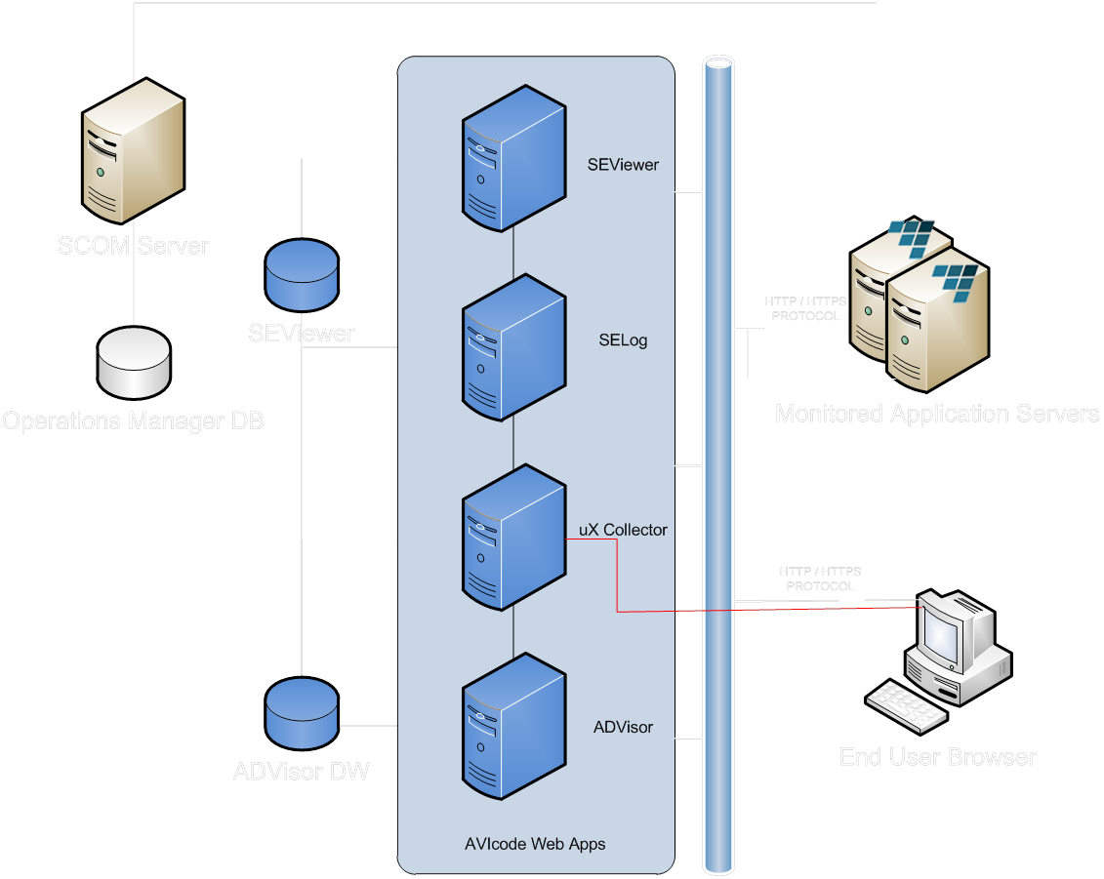
Architecture Confirmation
Required
2 Separate solution install paths can be taken, stand alone and SCOM integrated. Both require core AVIcode web apps and DB’s.

Slide 8
AVIcode Installation Steps
AVIcode.NET Enterprise MP
  Install SEViewer and Enterprise .NET MP
  Configure groups
  Configure .NET server monitoring
  Import uX MP
  Install uX collector web service on monitored servers
  Configure uX monitoring on monitored servers
  Configure uX MP
  Install Advisor reporting
Standalone AVIcode
  Install SEViewer
  Configure SEViewer DB
  Install Agent
  Install uX collector web service
  Install Advisor reporting
  Configure Advisor DB
  Configure server side application monitoring
  Configure uX monitoring
  Install Advisor reporting

Slide 9
Ensuring Successful Deployment
SEViewer and Advisor minimum requirements
  Windows XP and greater
  IIS 5.2 and greater
  SQL Server Express and SQL 2005 and greater
  Advisor requires SSRS 2005 or greater
  ASP.NET 2.0
Recommended security settings
  Run installs as local system admin
  SQL server admin rights
  Configure SQL for mixed mode security
  OperationsMgr DB admin rights (for SCOM deployments)

Slide 10
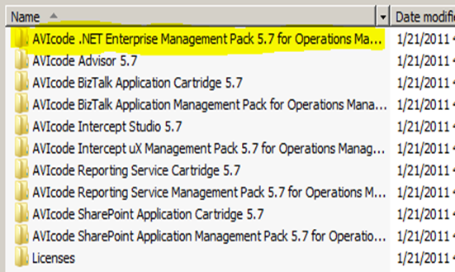
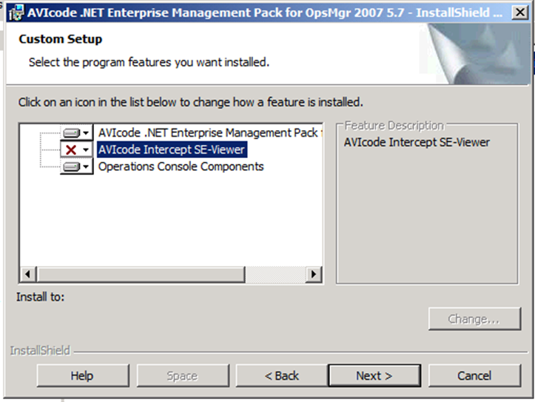
Installing The .NET MP
The installer for .NET Enterprise MP includes Intercept Studio and MP with components.
  AVIcode .NET MP: imports the AVICode MP into SCOM 2007
  AVICode Intercept SEViewer: installs the AVIcode standalone web console
  All SCOM consoles: installs on each SCOM console

Slide 11
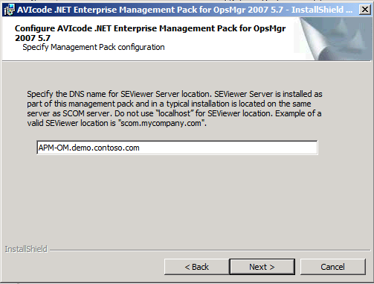
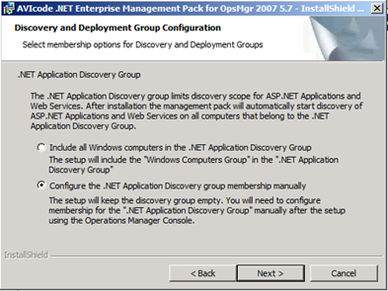
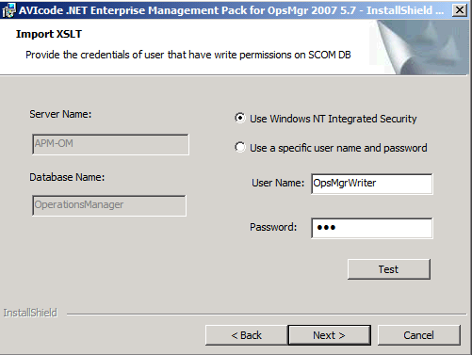
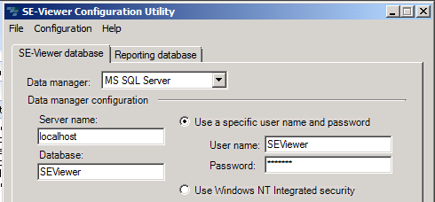
.NET MP Installation
Specify SEViewer DNS name
Discovery and Deployment group configuration
  Automatically add ‘Windows Computer Group” to the groups
  Or manually add individual servers as needed to each group
Configure XSLT import to database
Configure SEViewer DB
  Create database and user
  Create connection string

Slide 12
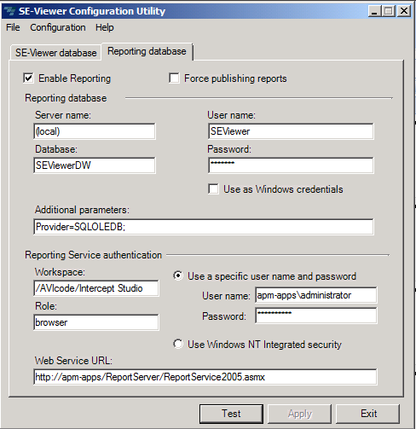
AVIcode Advisor Installation
Install Advisor reporting
  Run advisor.msi on web application server which will host Advisor
Reporting database ( Advisor )
  Creates Advisor database and user
  Creates Advisor connection string
  Configures SSRS url
  Publishes reports to SSRS

Slide 13
Installing AVIcode
Simon Skinner - System Center MVP
demo

Slide 14
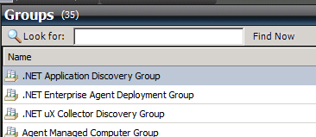
Configuring MP Discovery and Deployment
Configuring .NET Enterprise management pack groups
  Discovery group
  Deployment group
  UX Collector Group

Slide 15
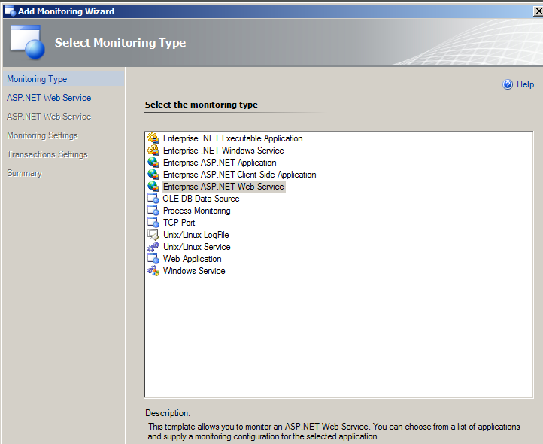
Configure Monitoring In SCOM
Add monitor wizard
  Discover applications
  Store completed template in unsealed MP
  Set ‘Alerting’
  Set ‘Sensitivity’
  Choose events type to collect

Slide 16
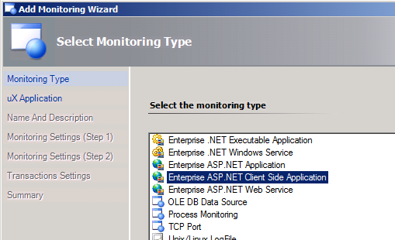
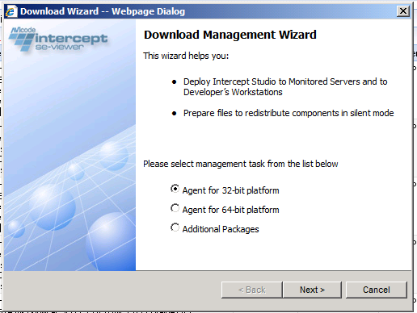
Agent Installation Options
Methods for installing
  SCOM - Add Monitor Wizard will use SCOM agent to pull from SEViewer and perform basic configuration on all server required
  Manual Install of agent requires downloading and running agent installer then performing basic configuration manually
uX user health monitoring is installed by default but requires manual set-up for SCOM or stand alone.

Slide 17
Standalone Agent Install
Manual agent install
  Run agent.msi as local admin
  Browse SEVIewer url Tools>Download Wizard to obtain latest agent
Confirm SEViewer communication
  Run MMC Snap-In to and verify communication to SEViewer service

Slide 18
Standalone Agent Configuration
Enable and disable monitoring
Set and test SEViewer location
Configure application monitoring
Set performance thresholds
Set exception level
Set throttling
Modify performance counters
Enable event log collection

Slide 19
Configuring Application Monitoring
Chris Childers
demo

Slide 20
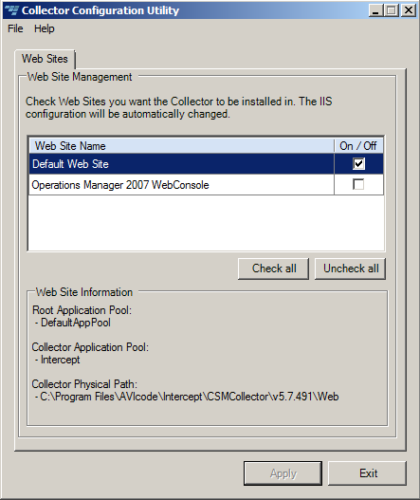
Installing Intercept uX
Importing the Intercept uX MP
  uX MP allows configuration and visualization of web based end user application health
Installing and Configuring the uX Collector
  Run the collector configuration utility to install in each target web application

Slide 21
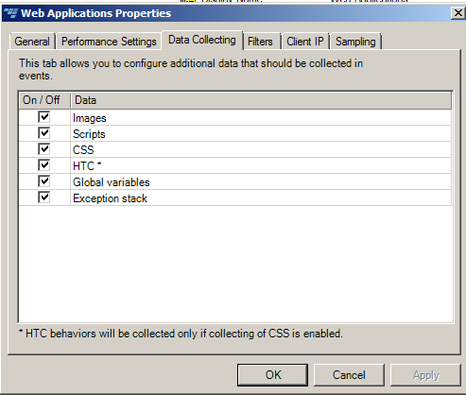
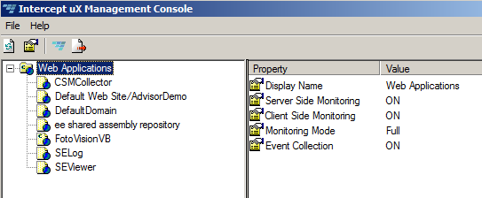
Configuring uX Monitoring
Configuring user health monitoring with uX Console
  Alerting thresholds
  Data collection detail
  Filtering rules

Slide 22
uX Configuration
Shawn Gibbs
demo

Slide 23
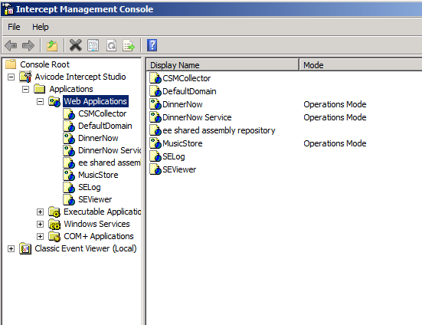
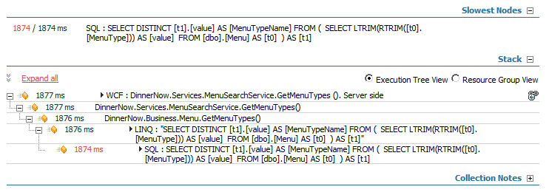
Advanced Configuration
Using configuration MMC snap-in to control more advanced collection
  Throttling events
  Light request
  Resources
  Entry Points
Developer terms used in configuration
  Namespaces
  Classes
  Methods / Functions

Slide 24
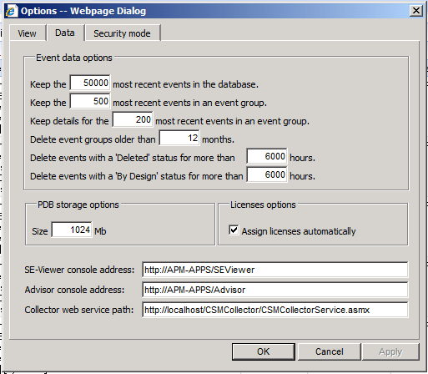
Event Management Options
Event data options
  When is grooming fired
  What are retention options
Console locations
Security modes

Slide 25
Advanced Configuration
demo

Slide 26

Track Resources
Don’t forget to visit the Cloud Power area within the TLC (Blue Section) to see product demos and speak with experts about the Server & Cloud Platform solutions that help drive your business forward.
You can also find the latest information about our products at the following links:
Cloud Power - http://www.microsoft.com/cloud/
Private Cloud - http://www.microsoft.com/privatecloud/
Windows Server - http://www.microsoft.com/windowsserver/
Windows Azure - http://www.microsoft.com/windowsazure/
Microsoft System Center - http://www.microsoft.com/systemcenter/
Microsoft Forefront - http://www.microsoft.com/forefront/

Slide 27





Resources
  Connect. Share. Discuss.
http://northamerica.msteched.com
Learning
  Sessions On-Demand & Community
  Microsoft Certification & Training Resources
www.microsoft.com/teched
www.microsoft.com/learning
  Resources for IT Professionals
  Resources for Developers
http://microsoft.com/technet
http://microsoft.com/msdn

Slide 28












Complete an evaluation on CommNet and
enter to win!

Slide 29


Slide 30

© 2011 Microsoft Corporation. All rights reserved. Microsoft, Windows, Windows Vista and other product names are or may be registered trademarks and/or trademarks in the U.S. and/or other countries.
The information herein is for informational purposes only and represents the current view of Microsoft Corporation as of the date of this presentation. Because Microsoft must respond to changing market conditions, it should not be interpreted to be a commitment
on the part of Microsoft, and Microsoft cannot guarantee the accuracy of any information provided after the date of this presentation. MICROSOFT MAKES NO WARRANTIES, EXPRESS, IMPLIED OR STATUTORY, AS TO THE INFORMATION IN THIS PRESENTATION.

