Slide 1

AVIcode: Overview of Application
Monitoring That You Can Do Today
SIM343
Victor Mushkatin
Principal Program Manager
Microsoft Corporation

Slide 2
Agenda
Customer Challenges
APM Market
The AVIcode solution
Demo
Q&A

Slide 3
Uncertainty Principle
It is impossible to determine simultaneously both the position and momentum of an electron or any other particle with any great degree of accuracy or certainty.
Werner Heisenberg, 1927

Slide 4
Running a service
Live site first
  Resolving critical issues have higher priority then shipping new features
  % of service teams time are allocated to support
Service continuity
  Shared responsibility between ops and dev
  Transparent incident resolution process for entire service delivery team

Slide 5

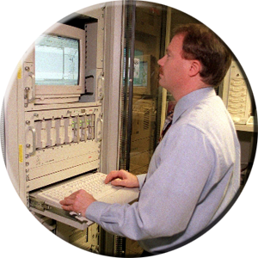
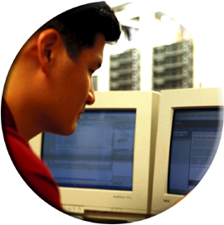
Support Challenges…
Unreliable incident detection
Limited communication of knowledge between Operations and Development
Incorrect problem attribution
Time consuming problem resolution
Operations
“It is your server, not my code !”
“Why? It works fine in staging”
“So how is it failing?”
“But I only know it’s unavailable when my customers call”
“How do I monitor your .NET application for availability in production?”
“How should I know, I didn’t write the code”
“!@$#% $^%& *^!!!”
Development
Notes:
5/17/2011 7:39 PM
© 2005 Microsoft Corporation. All rights reserved.
This presentation is for informational purposes only. Microsoft makes no warranties, express or implied, in this summary.
5

Slide 6

The Solution to the Challenges: APM
“the management of existing business-facing applications to optimize value delivered for acceptable cost and risk.”
- Gartner - 2010
Or in simpler terms “Application Performance Management”

Slide 7

The Solution to the Challenges: APM
Application Real-Time Architecture Discovery and Modeling
  Discover and gain insight into the relationships between the software and hardware components within your application environment
End User Experience
Monitoring
  Understand how your end users experience your application’s performance and quality
Application Performance Analytics
  Optimize Resources
  Improve Business Processes
User-Defined Transaction Profiling
  Trace the performance of specific critical business transactions across the application stack and infrastructure
Application Component Deep Dive Monitoring
  Monitor the health of an application, and rapidly diagnose problems

Slide 8
The AVIcode Solution
Low overhead
24x7 LOB applications monitoring
No source code modifications
End-to-end transaction tracking
Application reliability and performance monitoring
Problem management workflows
End-user health monitoring
Intelligent analytics and reports

Slide 9

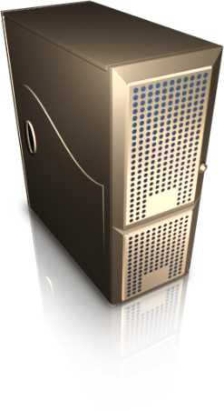
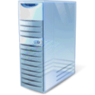
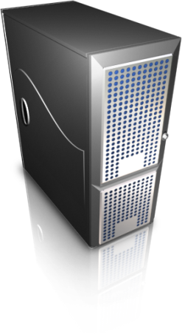

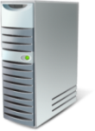

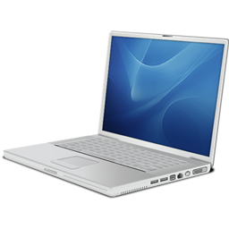
AVIcode Management Platform Architecture
Web Browser
WWW
CSM Collector
Event information is displayed or the URL of the event is sent via e-mail notification
SCOM 2007
Server
SE-Viewer Server
Structured Events are sent through WMI to SCOM
Operations PC
SQL Event Storage
SQL Event Storage
Development PC
Portable Device

Slide 10




Process Integration
Service
Service Telemetry Layer
Management Platform
  Volume based alerts for unknown problems
  Reliability and Performance monitoring
  Security/Connectivity problem remediation
  DB performance troubleshooting
  KPI baselining/monitoring
SCOM + .NET MP
NOC Operator
SE-Viewer
  Problem management
  Troubleshooting/debugging
Requests
End User
Support/Dev
Advisor
  QoS analysis
    Before/After
    Quick wins
    Application scoring
  SLA management
Biz/App Owner

Slide 11

Telemetry Platform
Service
Distributed application
External Resources
Requests
End User
Platform
Service Telemetry Layer
Application Component
Request
Dependency
Platform
  Discovery
    ASP.NET, WCF, COM+, NT Service, Winforms
  QoS metrics:
    Availability = available time / total time
    Reliability = successful requests / total request
    Performance = satisfied count / total request
  Performance SLA
  Critical/Non-critical internal failures
  Run-time root cause info
  Distributed chaining
  Request metrics: call/sec, avg time, % failures, % perf degradation
  Resource calls (SQL, WCF, .NET Remoting)
  Connectivity & Security failures
  Worker process load:
    CPU
    Memaory
    I/O

Slide 12
Monitoring goal
Detection, prevention and remediation of workload availability, reliability and performance problems
Known problems
  Problem signatures that are defined in advance are called known problems
  Proactive monitoring (capacity warnings)
  Reactive monitoring (connectivity failures)
Unknown problems
  Problems that can be detected from user experience stand point, but no KB about signature
  Reactive monitoring (application exception due to data inconsistency)

Slide 13
Fighting the Uncertainty
# Problems
Agile Release
1-4 weeks
Traditional Release 12-24 months
Known
Unknown
Time
Changes in the environment (elasticity, 3rd party dependency) and release frequency invalidate knowledge about application behavior therefore exacerbating the need for highly adaptable LOB application monitoring

Slide 14
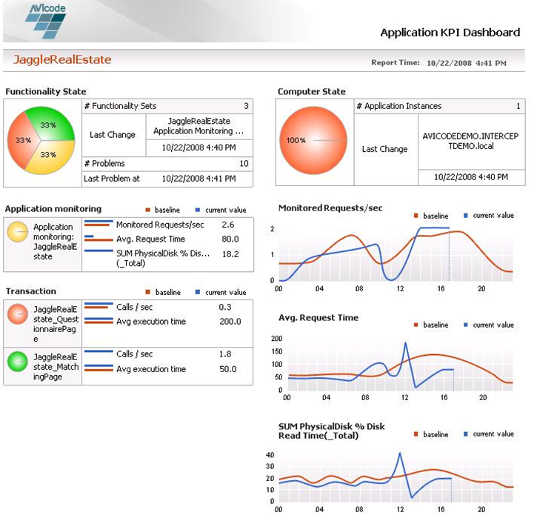
Application Monitoring
Volume-based health definition
Easily define custom KPIs/
critical transactions
Monitor the health state of individual transactions
Automatically calculate baseline performance levels
Real-time dashboard and performance insight
Alerts with root-cause information

Slide 15
Application Monitoring
Victor Mushkatin
Principal Program Manager
SC Operations Manager
Demo

Slide 16


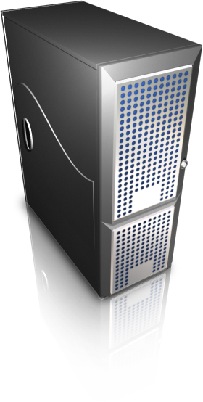






Value Across the Lifecycle
Executive – Improving Business Performance
Management – Optimizing Resources and Processes
Architecture
Development
QA/Test
Production
Support
Web 2.0
!
Speed time to market
Improve MTTR
Improve availability and reliability
Enhance productivity and optimize resource utilization

Slide 17

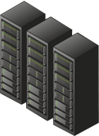


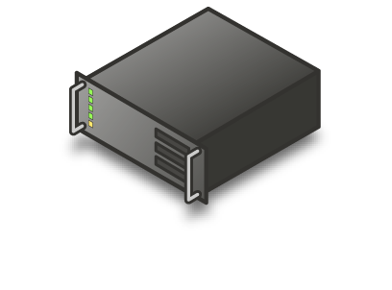


Adding AVIcode Delivers Competitive Value Today, Differentiation Tomorrow
.NET Transaction Monitoring
Lower costs and simplify management of datacenter applications
Optimize availability and performance of critical LOB applications
Build unified management of applications from the datacenter to the cloud

Slide 18
Track Resources
Don’t forget to visit the Cloud Power area within the TLC (Blue Section) to see product demos and speak with experts about the Server & Cloud Platform solutions that help drive your business forward.
You can also find the latest information about our products at the following links:
Cloud Power - http://www.microsoft.com/cloud/
Private Cloud - http://www.microsoft.com/privatecloud/
Windows Server - http://www.microsoft.com/windowsserver/
Windows Azure - http://www.microsoft.com/windowsazure/
Microsoft System Center - http://www.microsoft.com/systemcenter/
Microsoft Forefront - http://www.microsoft.com/forefront/

Slide 19





Resources
  Connect. Share. Discuss.
http://northamerica.msteched.com
Learning
  Sessions On-Demand & Community
  Microsoft Certification & Training Resources
www.microsoft.com/teched
www.microsoft.com/learning
  Resources for IT Professionals
  Resources for Developers
http://microsoft.com/technet
http://microsoft.com/msdn

Slide 20












Complete an evaluation on CommNet and
enter to win!

Slide 21


Slide 22

© 2011 Microsoft Corporation. All rights reserved. Microsoft, Windows, Windows Vista and other product names are or may be registered trademarks and/or trademarks in the U.S. and/or other countries.
The information herein is for informational purposes only and represents the current view of Microsoft Corporation as of the date of this presentation. Because Microsoft must respond to changing market conditions, it should not be interpreted to be a commitment
on the part of Microsoft, and Microsoft cannot guarantee the accuracy of any information provided after the date of this presentation. MICROSOFT MAKES NO WARRANTIES, EXPRESS, IMPLIED OR STATUTORY, AS TO THE INFORMATION IN THIS PRESENTATION.

