Slide 1

AVIcode:
Diagnosing Application Problems
SIM342
Chris Childers
Shawn Gibbs

Slide 2
Session Objectives and Takeaways
Understand strategies for analyzing applications
Learn how to interpret AVIcode diagnostic information and identify root-cause
Walk through AVIcode Advisor reports and learn how to generate trend and problem reports
Notes:
This slide is required. Do NOT delete. This should be the first slide after your Title Slide. This is an important year and we need to arm our attendees with the information they can use to Grow Share! Please ensure that your objectives are SMART (defined below) and that they will enable them to go in and win against the competition to grow share. If you have questions, please contact your Track PM for guidance. We have also posted guidance on writing good objectives, out on the Speaker Portal (https://www.mytechready.com).
This slide should introduce the session by identifying how this information helps the attendee, partners and customers be more successful. Why is this content important?
This slide should call out what’s important about the session (sort of the why should we care, why is this important and how will it help our customers/partners be successful) as well as the key takeaways/objectives associated with the session. Call out what attendees will be able to execute on using the information gained in this session. What will they be able to walk away from this session and execute on with their customers.
Good Objectives should be SMART (specific, measurable, achievable, realistic, time-bound). Focus on the key takeaways and why this information is important to the attendee, our partners and our customers.
Each session has objectives defined and published on www.mytechready.com, please work with your Track PM to call these out here in the slide deck.
If you have questions, please contact your Track PM listed below:
Track Name, Acronym and Track PM
Application Server (APS) – Tony Meleg, Joe Klug, Ena Reynen
Architecture (ARC) – Miha Kralj, Terra Suddarth
Business Intelligence (BIN) - Pej Javaheri
Business Solutions (MSDY) - Pattie Grimm, Scarlet Leung
Database (DB) – Kevin Ashby, Dandy Weyn, Maxine Coo
Development Tools & Technologies (DEV) – Bijan Javidi
IT Service Management (ITSM) - Bebe Acciavatti
Management, Operations & Deployment (MOD) – Aurora Santiago, Jennifer Culp, Lindsey Harper
Office 365 (OFC) (Formerly Microsoft Online Services (MOS))- Mike Naughton, Lori Skinner-Studley
Office and SharePoint (OSP) – Matt Berg, Lita Spratt, Hila Grinberger, Monica Woolley Watson
Optimization (OPT) – Michael McGuire, Yoav Land, Chris Jackson
ReadyTech (RT) - Joe Culp, KariLynne Gratzer
Security, Identity & Privacy (SIP) – Michelle Moore, Diana Tynes, Jennifer Culp
Unified Communications (UC)– Lauren Horgan, Navin Chand, Jackie Steinke
Virtualization (VIR) – Aurora Santiago, Jennifer Culp, Lindsey Harper
Windows Azure platform (AZR) - Vikram Rana, Sabrina Johnson
Windows Client (CLI) – Susie Kandzor, Angie Nelson
Windows Phone (WP) – Larry Lieberman, Sanjay Rajashekar, Tim McAfee
Windows Server (SVR) – Aurora Santiago, Jennifer Culp, Lindsey Harper
Cross Track Coverage
Application Platform – APS/DB/AZR/ARC Private Cloud – Aurora Santiago
Competition – Jules Dickerson User Experience – Jeff Jurvis, Alison Clark
Midsize IT – Jason Buffington Windows Client Development – Angie Nelson
Next Web – Olga Londer Windows Embedded – Olivier Bloch

Slide 3
Agenda
Application Management Challenges
The AVIcode Solution
Data Analysis Strategies
  Analyzing Transactional Information
  AVIcode Advisor Reporting
Q&A

Slide 4










Managing Complex Applications
End users
How do I know I have a problem?
How do I isolate the problem?
How do I diagnose the problem?
?
Web servers
Data servers
Application servers

Slide 5



Application Stakeholders
Ensure application quality, reliability and performance
Reduce MTTR and ensure customer satisfaction
App Owner
Build applications and verify quality
Improve application functionality
Troubleshoot critical issues and resolve
Dev/QA
Manage infrastructure and application delivery
Identify deviations from acceptable behavior
Isolate and coordinate problem resolution
IT/Ops

Slide 6
Today’s World
Inconsistent application instrumentation and management strategies
Lack of real-time application level visibility
Inefficient incident and problem management
Poor communication between stakeholders
Wall of Confusion
Development
IT/Ops

Slide 7


How do we normally work on problems?
Something went wrong!
What did you do?
End User
Help Desk
Its your Code
?
IT/Ops
Its your Infrastructure
App Dev

Slide 8
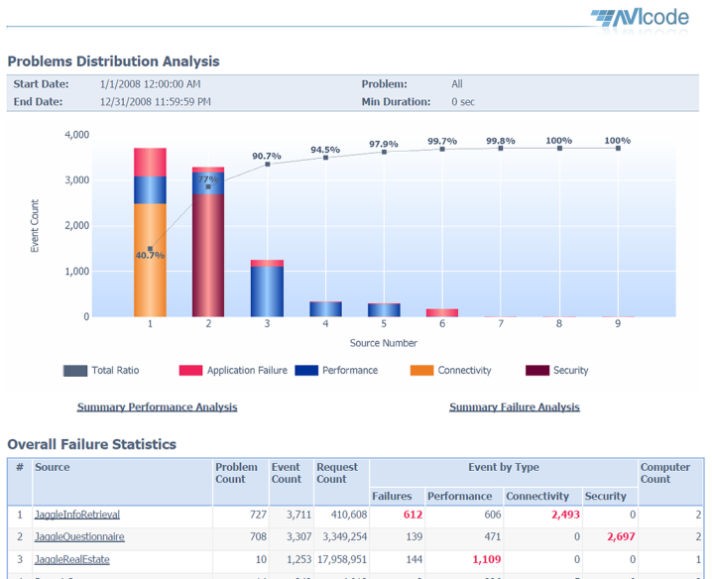
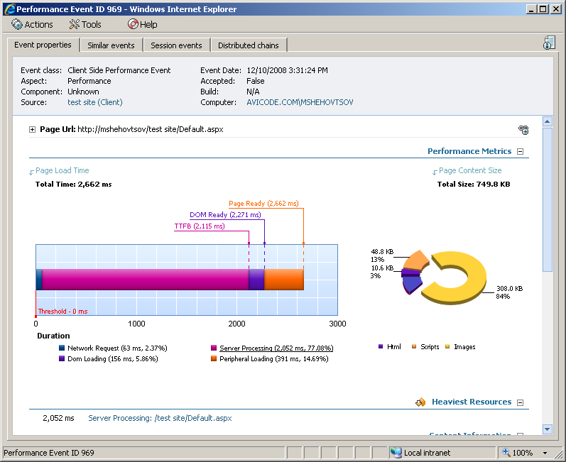


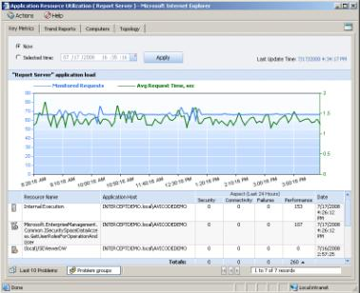
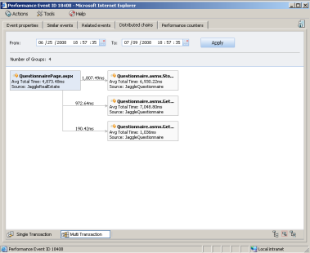
Managing Complex Applications With AVIcode
End users
Web servers
Data servers
Application servers

Slide 9
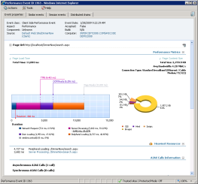
AVIcode: Key Features
24x7 .NET application monitoring
No code modification required
Low overhead
End-to-end application health monitoring
Real-time detection of performance bottlenecks and failures
Root-cause data collection
Intelligent analytics and reports
Integration with OM 2007

Slide 10
AVIcode simplifies the process
Application
Real-time Alerting
Diagnostic Information
IT/Ops
Problem Resolution
App Dev

Slide 11
Options for Data Analysis
Analyzing real-time application events and statistics
  Incident and Problem management
Trend Analysis and Reporting
  Application load, quality and resource consumption over time
Development
IT/Ops

Slide 12
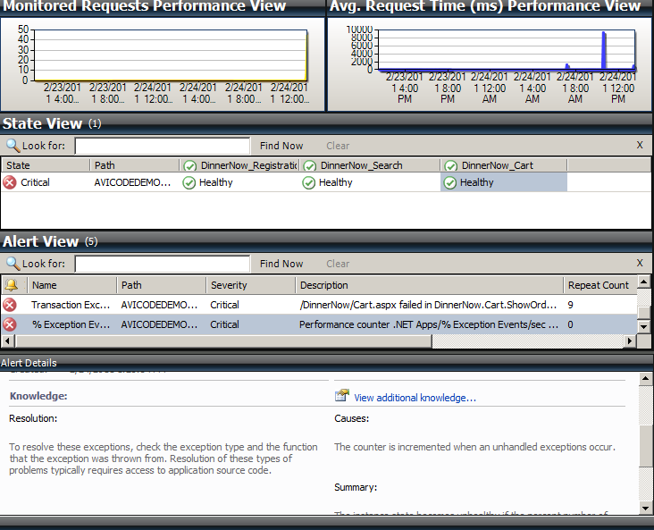
How do I know I have a problem?
Using Operations Manager
  State view indicates application health
  Alerts indicate application problems
  Notifications and actions can be configured based on alerts
Using AVIcode web console
  View events by time
  Create notifications for alerting
  directly from web console

Slide 13
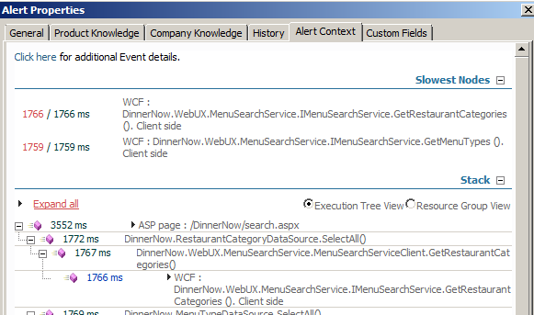
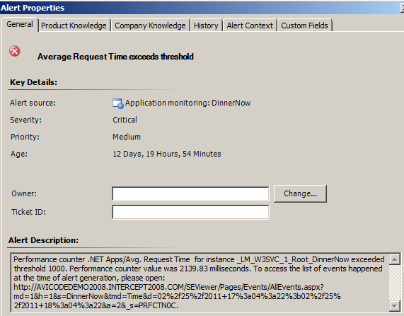
Using SCOM for Alerting
2 Alert Types
  AVIcode events with diagnostic detail
  Alerts based on app performance counter deviations
Monitors
  Based on application performance counters

Slide 14
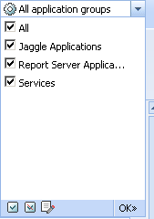
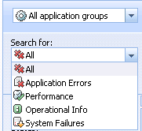
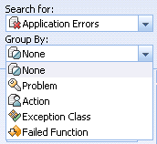
Using SE Viewer for Event Analysis
Use Event Filtering
  Application Groups
  Event Types
  Event Source
  Time and Date
Isolate Problems by
  Problem
  Heaviest resource
  Failed Function
  Occurrence
Application Grouping
Search for:
Group By

Slide 15
How do we isolate the problem?
AVIcode
  Events are correlated and categorized across monitored application tiers to isolate the problem area
  Host metrics are correlated application events to expose relationships between app and resources
Operations Manager
  Synthetic monitoring to understand application availability
  Monitor host platform/services health to understand when dependent services are experiencing problems

Slide 16
How do we diagnose an app problem?
Leverage AVIcode to diagnostic information to understand what the app/user was executing
Determine if its an operational or application support issue
Initiate incident / problem management processes to route information to appropriate teams

Slide 17
Analyzing real-time application events

Slide 18
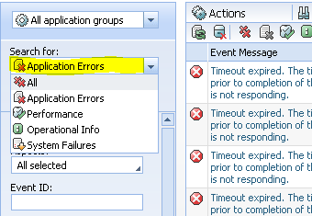

Event Types
Events are divided into 4 major categories
  Application Errors
  Performance
  Operational Info
  System Failures
Application failures are further divided
into one of three Aspects
  Application Failure
  Connectivity
  Security

Slide 19
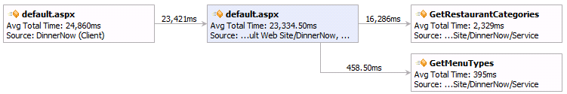
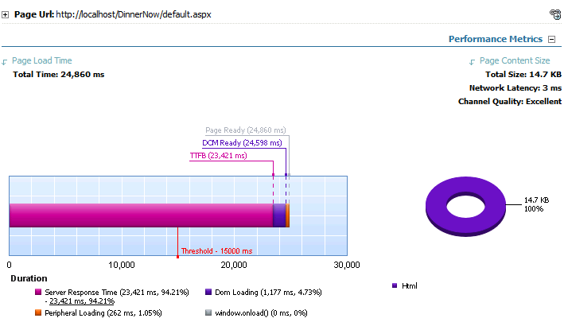
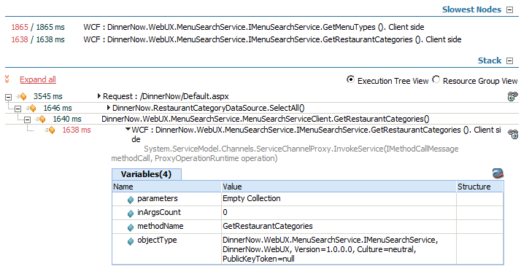
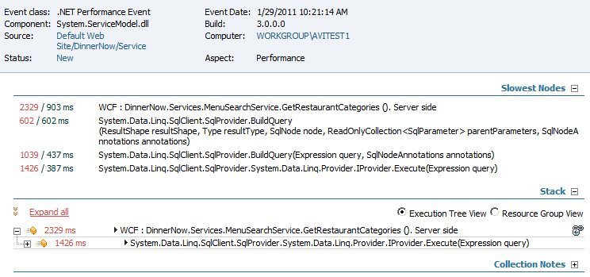
Performance Events
Correlated Performance Events
Client
Server
Service

Slide 20
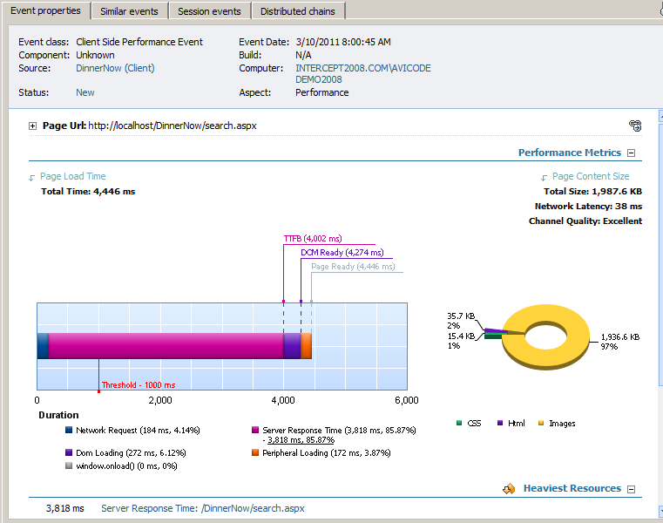
Client-side Performance Event Breakdown
Server
User page Request
Latency Test
Total Time
Payload Breakdown
Time Breakdown

Slide 21
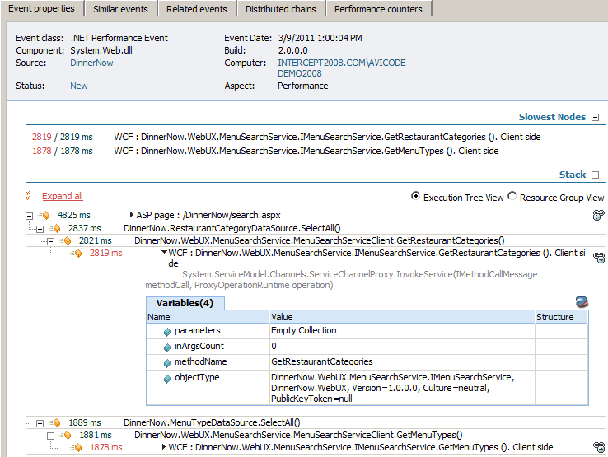
Server-side Performance Event Breakdown
Server
Server
Slowest resource calls
Viewing Options
Execution Time
Resource Call
Execution Detail

Slide 22
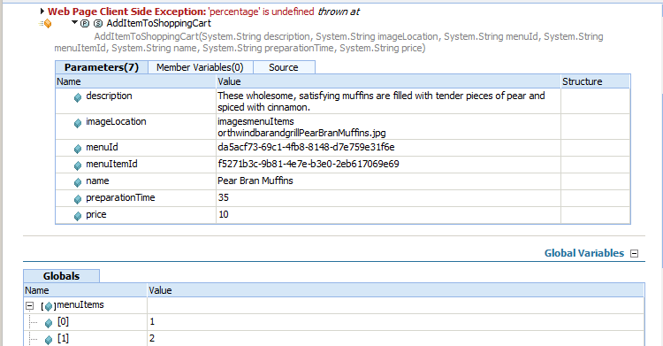
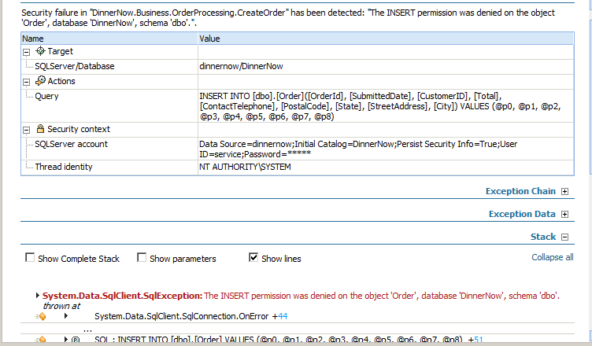
Application Failure Events
Client-side
  JavaScript exception and parameters
  Ajax request failures
Server-side
  Server-side application exceptions
  Categorized by app failure, security and connectivity

Slide 23
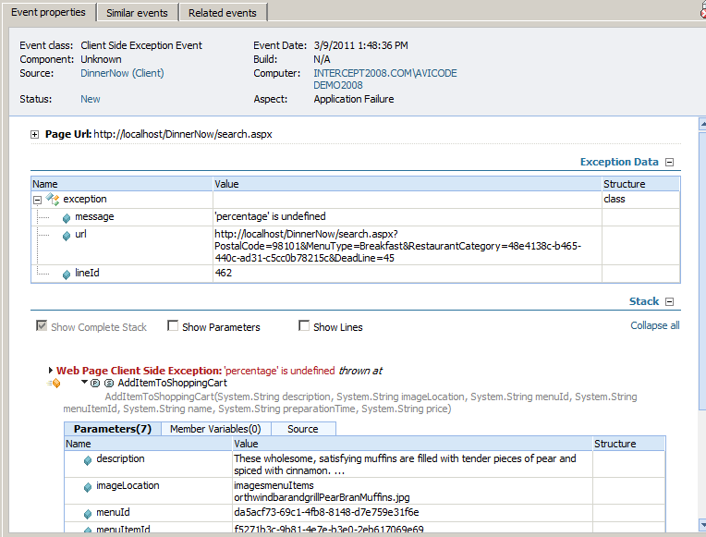
Client-side JavaScript Failure Breakdown
Server
User page Request
Exception Detail
Diagnostic Info

Slide 24
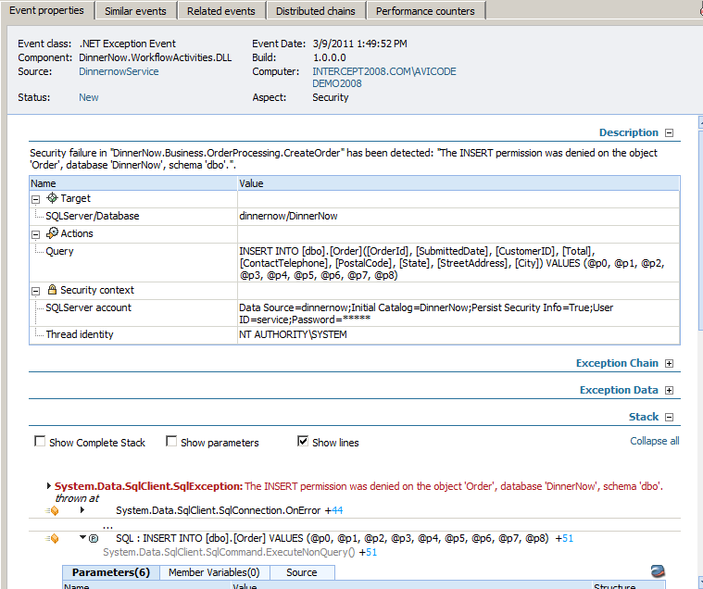
Server-side Failure Event Breakdown
Failure Category
Failure Description
Exception Detail
Diagnostic Info

Slide 25
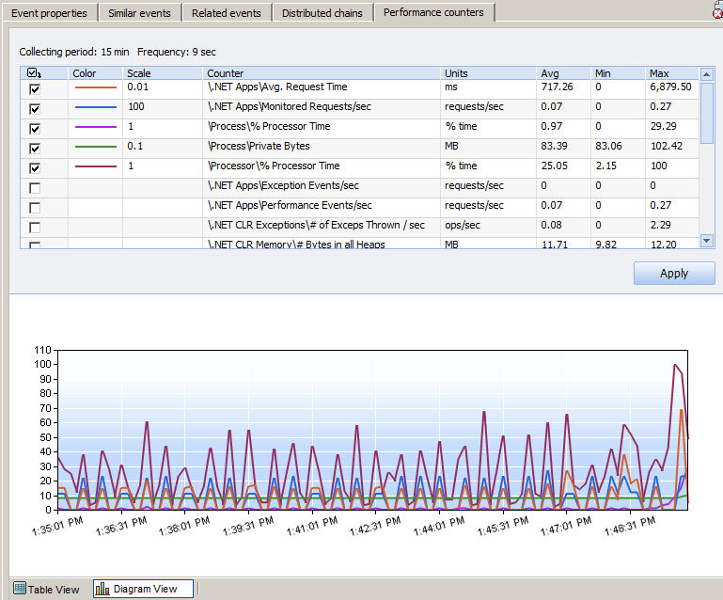
Troubleshooting Performance Counters
High Sampling Frequency
User Defined Perf Counters
Correlated to Time of Failure

Slide 26
Analyzing AVIcode Application Events
Demo

Slide 27
Trend Analysis and Reporting

Slide 28

AVIcode Advisor Overview
Leverages AVIcode transactional information
Built on SQL Reporting Services
Multiple levels of data analysis and reporting for:
  Identifying application problem areas
  Measuring before/after performance
  Capacity planning and analysis
  End-user impact
Flexible report scheduling options

Slide 29
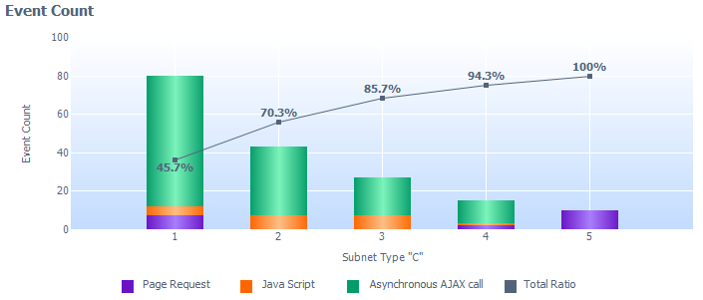
Types of Reports
Application quality
Problem prioritization
Application load
Resource utilization
Application status reporting
Application baselining

Slide 30
Advisor Application Reporting
Demo

Slide 31
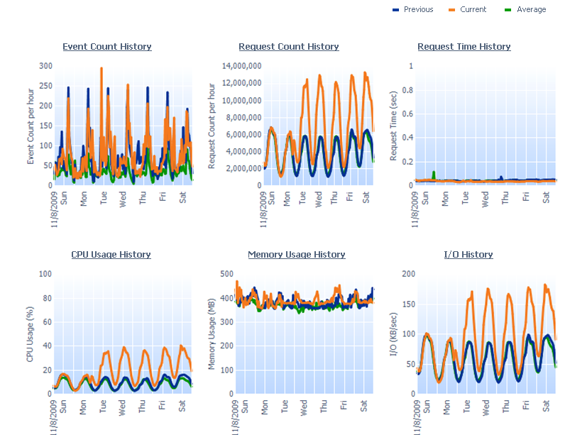
Case Study: Xbox LIVE
Xbox
Advisor – Application Status

Slide 32

Track Resources
Don’t forget to visit the Cloud Power area within the TLC (Blue Section) to see product demos and speak with experts about the Server & Cloud Platform solutions that help drive your business forward.
You can also find the latest information about our products at the following links:
Cloud Power - http://www.microsoft.com/cloud/
Private Cloud - http://www.microsoft.com/privatecloud/
Windows Server - http://www.microsoft.com/windowsserver/
Windows Azure - http://www.microsoft.com/windowsazure/
Microsoft System Center - http://www.microsoft.com/systemcenter/
Microsoft Forefront - http://www.microsoft.com/forefront/

Slide 33





Resources
  Connect. Share. Discuss.
http://northamerica.msteched.com
Learning
  Sessions On-Demand & Community
  Microsoft Certification & Training Resources
www.microsoft.com/teched
www.microsoft.com/learning
  Resources for IT Professionals
  Resources for Developers
http://microsoft.com/technet
http://microsoft.com/msdn

Slide 34












Complete an evaluation on CommNet and
enter to win!

Slide 35

Notes:
New for TechEd 2011, we will be working with Microsoft Tag (http://tag.microsoft.com/overview.aspx) to create unique Tags for every session at the event. Your session Tag will appear on both the room signage and at the end of your presentation. With your session Tag, attendees will be able to scan as they enter the room to retrieve session details, view speaker bios, and engage in discussions; or scan at the end of the presentation to evaluate your session and download materials. We’re excited to integrate Microsoft Tag across the My TechEd mobile experience this year.

Slide 36

© 2011 Microsoft Corporation. All rights reserved. Microsoft, Windows, Windows Vista and other product names are or may be registered trademarks and/or trademarks in the U.S. and/or other countries.
The information herein is for informational purposes only and represents the current view of Microsoft Corporation as of the date of this presentation. Because Microsoft must respond to changing market conditions, it should not be interpreted to be a commitment
on the part of Microsoft, and Microsoft cannot guarantee the accuracy of any information provided after the date of this presentation. MICROSOFT MAKES NO WARRANTIES, EXPRESS, IMPLIED OR STATUTORY, AS TO THE INFORMATION IN THIS PRESENTATION.

