Slide 1

A First Look at Microsoft System Center Data Protection Manager 2012
SIM341
Jason Buffington
Sr. Tech. Product Manager
Microsoft Corporation
@JBuff
Prabu Ambravaneswaran
Program Manager
Microsoft Corporation

Slide 2



Our Journey “Best for Windows, from Microsoft” so far
DPM v3
Unified disk, tape and cloud/DR
Advanced MS workloads
Windows Client protection
Enterprise Scalability
DPM v2
Seamless Disk- and Tape-protection
Windows Application and File Servers
System State, BMR and Cluster-support
DPM v1
Disk-based replication of files
End-user Restore without Help Desk
Centralized Backup of Branch Office
Notes:
2

Slide 3

Our Journey “Best for Windows, from Microsoft” so far
DPM v3
Unified disk, tape and cloud/DR
Advanced MS workloads
Windows Client protection
Enterprise Scalability
DPM v2
Seamless Disk- and Tape-protection
Windows Application and File Servers
System State, BMR and Cluster-support
DPM v1
Disk-based replication of files
End-user Restore without Help Desk
Centralized Backup of Branch Office
Notes:
3

Slide 4
Our Journey “Best for Windows, from Microsoft” so far
Enterprise Scenarios
& Advanced workloads
DPM v3
Unified disk, tape and cloud/DR
Advanced MS workloads
Windows Client protection
Enterprise Scalability
Application Servers and Virt.Hosts
to
Disk & Tape
?
DPM v2
Seamless Disk- and Tape-protection
Windows Application and File Servers
System State, BMR and Cluster-support
Branch Files to disk
Windows Clients
DPM v1
Disk-based replication of files
End-user Restore without Help Desk
Centralized Backup of Branch Office
Notes:
4

Slide 5

Our Journey “Best for Windows, from Microsoft” so far
2012
We asked ”What should we focus on next?”
?
You Answered:
Centralized Console
Continue Advancing Workload Protection
Enterprise Deployment Scenarios
Integration within System Center
Notes:
5

Slide 6
Prabu Ambravaneswaran
Program Manager
DPM 2012

Slide 7
DPM 2012
Centralized Management
Infrastructure Enhancements
  Certificate Based Authentication
  Smarter Media Co-location
Workload Enhancements
  SharePoint Optimized Item-Level Restore
  Hyper-V ILR with DPM running in a VM
  Generic Data Source Protection

Slide 8
We Heard You
You Even Had To Ask ?*!!$%@#
Of Course!!
96%
52%
Badly Needed!!
Centralized Monitoring
Remote Troubleshooting
Role Based Administration
83%
Remote Console
I Will Use It...
Very Helpful
34%
23%
Centralized Reporting
Centralized Deployment

Slide 9
Centralized Management Road Map
Centralized Monitoring and Troubleshooting
Role Based Access Control
Centralized Change and Backup Policy Management
Remote Administration
Centralized Reporting
Scope for V4 Release

Slide 10







DPM Centralized Management
A single console for the datacenter that reduces management costs and can fit into the existing environment
Single Console for the Datacenter Up to 100 DPM Servers or 50,000 protected data sources Manage DPM 2010 and DPM 2012 using single console
Reduce Management Costs
Centrally Monitor and manage Centralized monitoring Remote administration Remote recovery Role Based management
Reduce time for resolving issues Remote corrective actions Scoped Troubleshooting Push to Resume Backups
Work on important issues SLA based Alerting : Alert only when SLA violated Consolidated Alerts ensure one ticket per root cause issue Alert categorization (Ex: infra alerts versus backup failure alerts)
Extensibility Allow admins to automate/extend the base functionality using PowerShell
Fits into my Environment Integration into existing ticketing systems, workflows and team structures. Enterprise scale, Fault tolerance & Reliability. All common OpsMgr 2007 R2 deployment configurations supported
DPM 2012
DPM 2012
Ticketing System

Slide 11
DPM 2012 Central Console
Prabu Ambravaneswaran
Program Manager
DPM 2012
demo

Slide 12
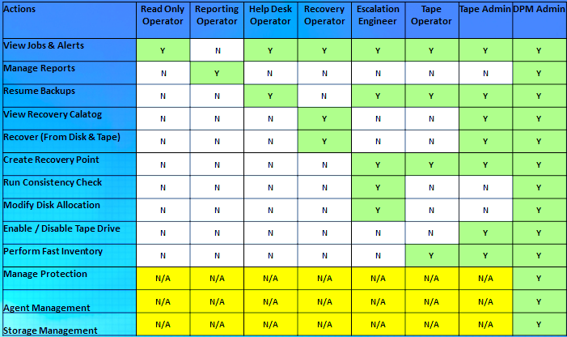
Role Based Management
What you asked for
“DPM must allow a broad team to access the DPM console in a secure way – each with their own responsibilities and privileges”
With DPM 2012 Central Console, you can
Control operations available to each user
Can create User Roles (using OpsMgr) & associate & validate operation privileges of each role using Claim Based Token Service
Designed for the Backup Service Team & not for the consumers of the backup service

Slide 13
DPM 2012 – Certificate Based Protection
DPM 2010
  DPM 2010 supports protection of Production Servers, not in a 2-way trust relationship with domain of DPM Server using local accounts and NTLM.
DPM 2012
  DPM 2012 now supports Certificate
  Based Protection.
  DPM 2012 supports protection of Clustered Workloads, not in a 2-way trust relationship with DPM domain

Slide 14
DPM 2012 – Tape Media Co-location
DPM 2010
  DPM 2010 Supports Media Co-location at a DPM Server Level
DPM 2012
  DPM 2012 has a much simplified Media Co-location feature at a more granular (Protection Group) Level

Slide 15
DPM 2012 – SharePoint Item-Level Recovery
DPM 2007
  DPM 2007 used SharePoint Recovery Farm before restoring to production farm
DPM 2010
  DPM 2010 supports recovery without setting up a SharePoint Recovery Farm.
  DPM 2010 provides support for Item Level Recovery (ILR) of SharePoint backup data
DPM 2012
  DPM 2012, restore of a 1 MB document takes less than 20 seconds

Slide 16
DPM 2012 – Virtual DPM Enhancements
Enable Hyper-V Item Level Recovery even when DPM is running inside a VM!

Slide 17
DPM 2012 – Generic Data Source Protection
Allows basic protection/recovery support of any referential
data source
Supports Full Application Backup (Express Full, Delta Replication and Consistency Check) for any application
Supports Original location recovery & Restore as Files to a network location
Capability to use Xml to support applications which do not have a VSS writer

Slide 18
DPM 2012 Workload Enhancements
Prabu Ambravaneswaran
Program Manager
DPM 2012
demo

Slide 19
Ready to try DPM 2012 ? Join our CEP this Summer
Community Evaluation Program
Guided evaluation of Management & Security Products
  Access to evaluation bits and VHDs
  Access to product group at Virtual Chalk Talks
Community of Participants
  Share feedback on product and documentation
  Share best practices and experiences
Learn more about programs at
  http://msft.it/cep
  Or email mscep@microsoft.com with your interest
  Watch our blogs for your chance to apply !

Slide 20







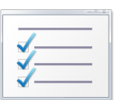

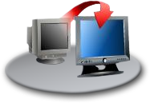


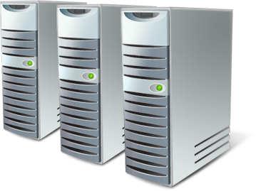











System Center 2012
Integration Pack
Service Management
Configuration
Monitoring
Provisioning
Protection
Automation
Ticketing
Disaster Recovery site staging
Central Console .
Mgmt Packs
Agent Deployment

Slide 21
DPM at TechEd 2011
SIM213 Monday 3PM Protecting the Datacenter with DPM 2010 !
SIM341 Tuesday 10:15a First Look at DPM 2012
SIM339 Tuesday 1:30p Protecting Client Data with DPM 2010
Come see us in the DPM booth in the Expo TLC area
Try out the Hands-on Labs
  How to protect Exchange with DPM 2010
  How to protect SQL Server with DPM 2010
  How to protect SharePoint with DPM 2010
  Technical Introduction to DPM 2012

Slide 22
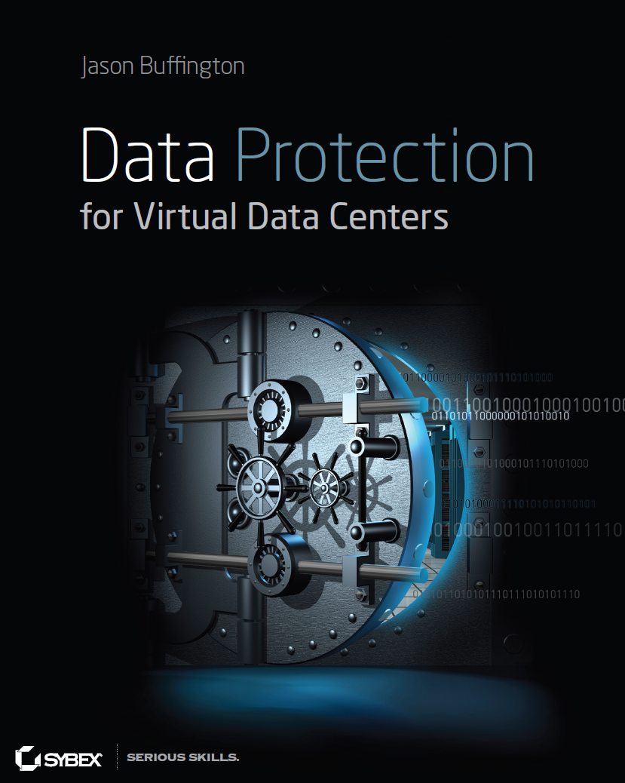
DPM Resources
Website www.microsoft.com/DPM
TechCenter technet.microsoft.com/DPM
Forums social.technet.microsoft.com/Forums/en-US/category/DPM
Team Blog blogs.technet.com/DPM
Prabu Ambravaneswaran PRAMBRAV@microsoft.com
Jason Buffington JBUFF@microsoft.com
Jason’s blog jasonbuffington.com
Jason’s tweets twitter.com/JBuff
Jason’s book DataProtectionBible.com

Slide 23
Track Resources
Don’t forget to visit the Cloud Power area within the TLC (Blue Section) to see product demos and speak with experts about the Server & Cloud Platform solutions that help drive your business forward.
You can also find the latest information about our products at the following links:
Cloud Power - http://www.microsoft.com/cloud/
Private Cloud - http://www.microsoft.com/privatecloud/
Windows Server - http://www.microsoft.com/windowsserver/
Windows Azure - http://www.microsoft.com/windowsazure/
Microsoft System Center - http://www.microsoft.com/systemcenter/
Microsoft Forefront - http://www.microsoft.com/forefront/

Slide 24





Resources
  Connect. Share. Discuss.
http://northamerica.msteched.com
Learning
  Sessions On-Demand & Community
  Microsoft Certification & Training Resources
www.microsoft.com/teched
www.microsoft.com/learning
  Resources for IT Professionals
  Resources for Developers
http://microsoft.com/technet
http://microsoft.com/msdn

Slide 25












Complete an evaluation on CommNet and
enter to win!

Slide 26


Slide 27

© 2011 Microsoft Corporation. All rights reserved. Microsoft, Windows, Windows Vista and other product names are or may be registered trademarks and/or trademarks in the U.S. and/or other countries.
The information herein is for informational purposes only and represents the current view of Microsoft Corporation as of the date of this presentation. Because Microsoft must respond to changing market conditions, it should not be interpreted to be a commitment
on the part of Microsoft, and Microsoft cannot guarantee the accuracy of any information provided after the date of this presentation. MICROSOFT MAKES NO WARRANTIES, EXPRESS, IMPLIED OR STATUTORY, AS TO THE INFORMATION IN THIS PRESENTATION.

