Slide 1

Service Manager 2010:
Modeling your Business Process
SIM340
Sean Christensen
Senior Technical Product Mgr
Microsoft Corporation
Alexandre Verkinderen
Principal Consultant
Infront Consulting Group

Slide 2
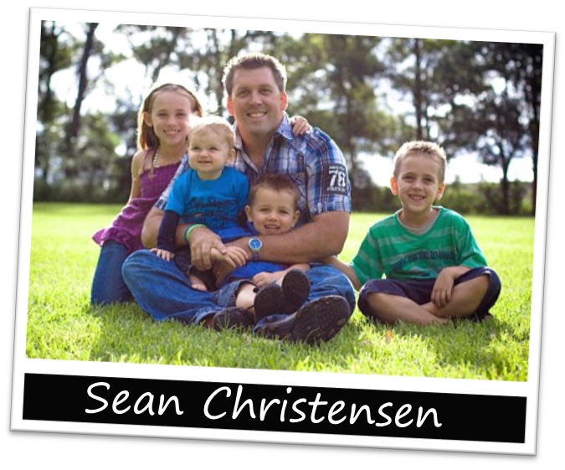




Sean Christensen
Contact Details
Email: sean.christensen@microsoft.com
Blog: http://blogs.technet.com/b/systemcenter
LinkedIn: http://www.linkedin.com/in/chr1st3ns3n
Twitter: @SeanC_MSFT

Slide 3

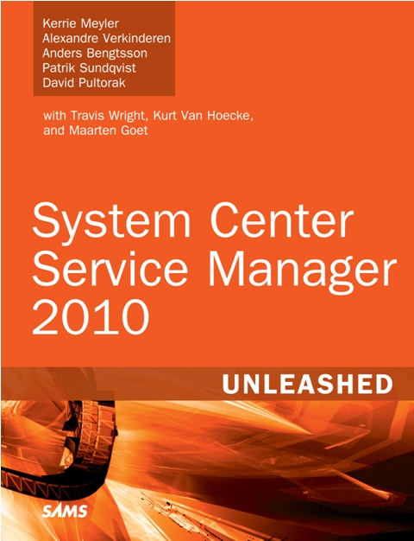
Alexandre Verkinderen
Contact Details
http://scug.be/blogs/scom
    alexandre@infrontconsulting.com
LinkedIn: http://linkedin.com/in/alexandreverkinderen
Twitter: @AlexVerkinderen
Service Manager 2010
Unleashed RTM soon!

Slide 4
Agenda
  Scenario
  Defining the Process
  Create the Coffee CI
  Create the Support Team
  Create the Incident Workflow
  Automation
  Create the Change Workflow
  Q & A

Slide 5


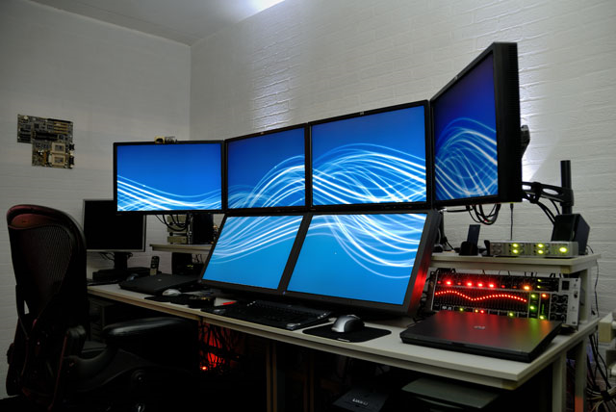


Scenario
Business Critical

Slide 6




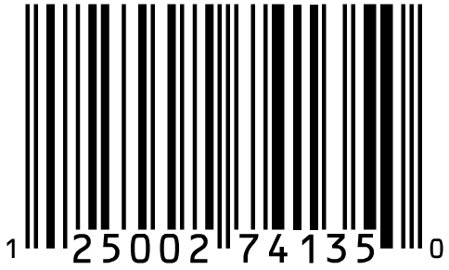
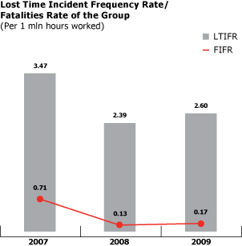
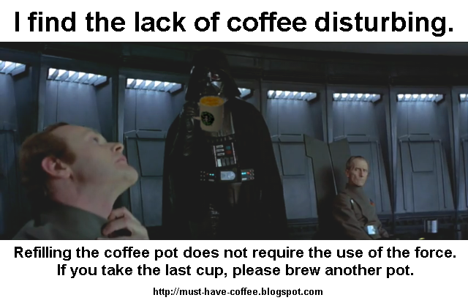
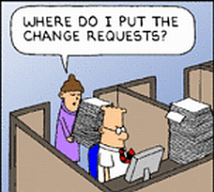
Scenario

Slide 7
Defining the Process
Configuration Management
A coffee team
Incident Management
Change Management

Slide 8
<ManagementPack ContentReadable="true" SchemaVersion="1.1" OriginalSchemaVersion="1.1" xmlns:xsd="http://www.w3.org/2001/XMLSchema" xmlns:xsl="http://www.w3.org/1999/XSL/Transform">
<Manifest>
<Identity>
<ID>UtilityManagementPack</ID>
<Version>1.0.0.0</Version>
</Identity>
<Name>UtilityManagementPack</Name>
<References>
<Reference Alias="Console">
<ID>Microsoft.EnterpriseManagement.ServiceManager.UI.Console</ID>
<Version>7.0.6555.0</Version>
<PublicKeyToken>31bf3856ad364e35</PublicKeyToken>
</Reference>
<Reference Alias="Alias_64723459_bb9f_4b66_bb03_9c2901039df7">
<ID>Microsoft.EnterpriseManagement.ServiceManager.UI.Authoring</ID>
<Version>7.0.6555.0</Version>
<PublicKeyToken>31bf3856ad364e35</PublicKeyToken>
</Reference>
<Reference Alias="ConfigurationManagement">
<ID>ServiceManager.ConfigurationManagement.Library</ID>
<Version>7.0.6555.0</Version>
<PublicKeyToken>31bf3856ad364e35</PublicKeyToken>
</Reference>
<Reference Alias="System">
<ID>System.Library</ID>
<Version>7.0.6555.0</Version>
<PublicKeyToken>31bf3856ad364e35</PublicKeyToken>
</Reference>
</References>
</Manifest>
<TypeDefinitions>
<EntityTypes>
<ClassTypes>
<ClassType ID="Utility" Accessibility="Public" Abstract="true" Base="System!System.ConfigItem" Hosted="false" Singleton="false" Extension="false">
<Property ID="UtilityID" Type="string" AutoIncrement="true" Key="true" CaseSensitive="false" MaxLength="256" MinLength="0" Required="true" DefaultValue="{0}" />
<Property ID="PuchaseDate" Type="datetime" AutoIncrement="false" Key="false" CaseSensitive="false" MaxLength="256" MinLength="0" Required="false" />
</ClassType>
<ClassType ID="CoffeeMachine" Accessibility="Public" Abstract="false" Base="Utility" Hosted="false" Singleton="false" Extension="false">
<Property ID="Model" Type="enum" AutoIncrement="false" Key="false" CaseSensitive="false" MaxLength="256" MinLength="0" Required="false" EnumType="CoffeeModels" />
</ClassType>
<ClassType ID="TeaMachine" Accessibility="Public" Abstract="false" Base="Utility" Hosted="false" Singleton="false" Extension="false">
<Property ID="Property_6" Type="string" AutoIncrement="false" Key="true" CaseSensitive="false" MaxLength="256" MinLength="0" Required="false" />
</ClassType>
</ClassTypes>
<EnumerationTypes>
<EnumerationValue ID="CoffeeModels" Accessibility="Public" />
<EnumerationValue ID="Enum.837b675705d740bda82090637eab5b32" Accessibility="Public" Parent="CoffeeModels" Ordinal="0" />
</EnumerationTypes>
</EntityTypes>
</TypeDefinitions>
<Categories>
<Category ID="UtilityManagementPack.Category" Value="Console!Microsoft.EnterpriseManagement.ServiceManager.ManagementPack">
<ManagementPackName>UtilityManagementPack</ManagementPackName>
<ManagementPackVersion>1.0.0.0</ManagementPackVersion>
</Category>
<Category ID="CategoryId_384e293e_d8f8_4746_b61a_c1a12a250915" Target="CoffeeModels" Value="Alias_64723459_bb9f_4b66_bb03_9c2901039df7!Microsoft.EnterpriseManagement.ServiceManager.UI.Authoring.EnumerationViewTasks" />
<Category ID="CategoryId_a47a4425_aaeb_498e_b7f9_3eea172ca598" Target="CoffeeModels" Value="System!VisibleToUser" />
<Category ID="Category.1d8aba7cc7884f86ab48ee1d2d48e046" Target="Folder.7d7fc8366d2d464eadb5cd0b93663fb8" Value="Console!Microsoft.EnterpriseManagement.ServiceManager.UI.Console.FolderTasks" />
<Category ID="Category.eb3817d7b33a4c5b9e35e71f9af03178" Target="View.6af69141f11d420ca31fb70be8627c3d" Value="Console!Microsoft.EnterpriseManagement.ServiceManager.UI.Console.ViewTasks" />
<Category ID="Category.14cc992f4a5947b78065257c03bc0535" Target="View.6af69141f11d420ca31fb70be8627c3d" Value="Alias_64723459_bb9f_4b66_bb03_9c2901039df7!Microsoft.EnterpriseManagement.ServiceManager.UI.Authoring.CreateTypeCategory" />
</Categories>
<Presentation>
<Views>
<View ID="View.6af69141f11d420ca31fb70be8627c3d" Accessibility="Public" Enabled="true" Target="CoffeeMachine" TypeID="Console!GridViewType" Visible="true">
<Category>NotUsed</Category>
<Data>
<Adapters>
<Adapter AdapterName="dataportal:EnterpriseManagementObjectAdapter">
<AdapterAssembly>Microsoft.EnterpriseManagement.UI.SdkDataAccess</AdapterAssembly>
<AdapterType>Microsoft.EnterpriseManagement.UI.SdkDataAccess.DataAdapters.EnterpriseManagementObjectAdapter</AdapterType>
</Adapter>
<Adapter AdapterName="viewframework://Adapters/AdvancedList">
<AdapterAssembly>Microsoft.EnterpriseManagement.UI.ViewFramework</AdapterAssembly>
<AdapterType>Microsoft.EnterpriseManagement.UI.ViewFramework.AdvancedListSupportAdapter</AdapterType>
</Adapter>
</Adapters>
<ItemsSource>
<AdvancedListSupportClass DataTypeName="" AdapterName="viewframework://Adapters/AdvancedList" FullUpdateAdapter="dataportal:EnterpriseManagementObjectAdapter" DataSource="mom:ManagementGroup" FullUpdateFrequency="1" Streaming="true" IsRecurring="true" RecurrenceFrequency="{x:Static s:Int32.MaxValue}" xmlns="clr-namespace:Microsoft.EnterpriseManagement.UI.ViewFramework;assembly=Microsoft.EnterpriseManagement.UI.ViewFramework" xmlns:av="http://schemas.microsoft.com/winfx/2006/xaml/presentation" xmlns:x="http://schemas.microsoft.com/winfx/2006/xaml" xmlns:s="clr-namespace:System;assembly=mscorlib">
<AdvancedListSupportClass.Parameters>
<QueryParameter Parameter="ManagementPackClassId" Value="$MPElement[Name='CoffeeMachine']$" />
</AdvancedListSupportClass.Parameters>
</AdvancedListSupportClass>
</ItemsSource>
<Criteria>
<QueryCriteria Adapter="omsdk://Adapters/Criteria" xmlns="http://tempuri.org/Criteria.xsd">
<Criteria>
<FreeformCriteria>
<Freeform>
<Criteria xmlns="http://Microsoft.EnterpriseManagement.Core.Criteria/">
<Expression>
<SimpleExpression>
<ValueExpressionLeft>
<Property>$Context/Property[Type='System!System.ConfigItem']/ObjectStatus$</Property>
</ValueExpressionLeft>
<Operator>NotEqual</Operator>
<ValueExpressionRight>
<Value>{47101e64-237f-12c8-e3f5-ec5a665412fb}</Value>
</ValueExpressionRight>
</SimpleExpression>
</Expression>
</Criteria>
</Freeform>
</FreeformCriteria>
</Criteria>
</QueryCriteria>
</Criteria>
</Data>
<Presentation>
<Columns>
<mux:ColumnCollection xmlns="http://schemas.microsoft.com/winfx/2006/xaml/presentation" xmlns:mux="http://schemas.microsoft.com/SystemCenter/Common/UI/Views/GridView" xmlns:s="clr-namespace:System;assembly=mscorlib" xmlns:x="http://schemas.microsoft.com/winfx/2006/xaml" xmlns:data="clr-namespace:Microsoft.EnterpriseManagement.UI.SdkDataAccess.Common;assembly=Microsoft.EnterpriseManagement.UI.SdkDataAccess">
<mux:Column Name="DisplayName" DisplayMemberBinding="{Binding Path=DisplayName}" Width="100" DisplayName="DisplayName.5b83c10b8bf149eea6ee7583079294a6" Property="DisplayName" DataType="s:String" />
<mux:Column Name="$DisplayName$" DisplayMemberBinding="{Binding Path=$DisplayName$}" Width="100" DisplayName="DisplayName.dd4c5809cb3248fa8a3c0cec3c30272c" Property="$DisplayName$" DataType="s:String" />
<mux:Column Name="$Id$" DisplayMemberBinding="{Binding Path=$Id$}" Width="100" DisplayName="Id.53ee20a1406a43409696843e2d10c4fc" Property="$Id$" DataType="s:Guid" />
<mux:Column Name="Model.DisplayName" DisplayMemberBinding="{Binding Path=Model.DisplayName}" Width="100" DisplayName="Model.a286e99f6a4c4dfa9a9fba59727376c2" Property="Model.DisplayName" DataType="s:String" />
<mux:Column Name="PuchaseDate" DisplayMemberBinding="{Binding Path=PuchaseDate}" Width="100" DisplayName="PuchaseDate.7f83dfacdd9c4562a35214527d0ffb5d" Property="PuchaseDate" DataType="s:DateTime" />
</mux:ColumnCollection>
</Columns>
<ViewStrings>
<ViewString ID="DisplayName.5b83c10b8bf149eea6ee7583079294a6">$MPElement[Name="DisplayName.5b83c10b8bf149eea6ee7583079294a6"]$</ViewString>
<ViewString ID="DisplayName.dd4c5809cb3248fa8a3c0cec3c30272c">$MPElement[Name="DisplayName.dd4c5809cb3248fa8a3c0cec3c30272c"]$</ViewString>
<ViewString ID="Id.53ee20a1406a43409696843e2d10c4fc">$MPElement[Name="Id.53ee20a1406a43409696843e2d10c4fc"]$</ViewString>
<ViewString ID="Model.a286e99f6a4c4dfa9a9fba59727376c2">$MPElement[Name="Model.a286e99f6a4c4dfa9a9fba59727376c2"]$</ViewString>
<ViewString ID="PuchaseDate.7f83dfacdd9c4562a35214527d0ffb5d">$MPElement[Name="PuchaseDate.7f83dfacdd9c4562a35214527d0ffb5d"]$</ViewString>
</ViewStrings>
</Presentation>
</View>
</Views>
<Folders>
<Folder ID="Folder.7d7fc8366d2d464eadb5cd0b93663fb8" Accessibility="Public" ParentFolder="ConfigurationManagement!ServiceManager.Console.ConfigurationManagement.ConfigItem.Root" />
</Folders>
<FolderItems>
<FolderItem ElementID="Console!Microsoft.EnterpriseManagement.ServiceManager.UI.Console.Task.CreateGridView" ID="FolderItem.ca41baca601f4ba2ab1f3370f53f8ffc" Folder="Folder.7d7fc8366d2d464eadb5cd0b93663fb8" />
<FolderItem ElementID="View.6af69141f11d420ca31fb70be8627c3d" ID="FolderItem.9a2562c21d2f42e08e48cebc4ae8d8c0" Folder="Folder.7d7fc8366d2d464eadb5cd0b93663fb8" />
</FolderItems>
<ImageReferences>
<ImageReference ElementID="Folder.7d7fc8366d2d464eadb5cd0b93663fb8" ImageID="Console!Microsoft.EnterpriseManagement.ServiceManager.UI.Console.Image.Folder" />
<ImageReference ElementID="View.6af69141f11d420ca31fb70be8627c3d" ImageID="ConfigurationManagement!ConfigItemImage16x16" />
</ImageReferences>
<StringResources>
<StringResource ID="DisplayName.5b83c10b8bf149eea6ee7583079294a6" />
<StringResource ID="DisplayName.dd4c5809cb3248fa8a3c0cec3c30272c" />
<StringResource ID="Id.53ee20a1406a43409696843e2d10c4fc" />
<StringResource ID="Model.a286e99f6a4c4dfa9a9fba59727376c2" />
<StringResource ID="PuchaseDate.7f83dfacdd9c4562a35214527d0ffb5d" />
</StringResources>
</Presentation>
<LanguagePacks>
<LanguagePack ID="NLB" IsDefault="true">
<DisplayStrings>
<DisplayString ElementID="UtilityManagementPack">
<Name>UtilityManagementPack</Name>
</DisplayString>
<DisplayString ElementID="Folder.7d7fc8366d2d464eadb5cd0b93663fb8">
<Name>Utility</Name>
</DisplayString>
<DisplayString ElementID="View.6af69141f11d420ca31fb70be8627c3d">
<Name>CoffeeMachines</Name>
</DisplayString>
</DisplayStrings>
</LanguagePack>
<LanguagePack ID="ENU" IsDefault="false">
<DisplayStrings>
<DisplayString ElementID="UtilityManagementPack">
<Name>UtilityManagementPack</Name>
</DisplayString>
<DisplayString ElementID="Utility">
<Name>Utility</Name>
<Description>Utility base absctract class</Description>
</DisplayString>
<DisplayString ElementID="Utility" SubElementID="UtilityID">
<Name>Utility ID</Name>
<Description>Utility ID</Description>
</DisplayString>
<DisplayString ElementID="CoffeeMachine">
<Name>CoffeeMachine</Name>
<Description>CoffeeMachine inherits from Utility.</Description>
</DisplayString>
<DisplayString ElementID="Utility" SubElementID="PuchaseDate">
<Name>Purchase Date</Name>
<Description>Purchase Date</Description>
</DisplayString>
<DisplayString ElementID="CoffeeMachine" SubElementID="Model">
<Name>Model</Name>
</DisplayString>
<DisplayString ElementID="TeaMachine">
<Name>Tea Machine</Name>
<Description>This class inherits from Utility.</Description>
</DisplayString>
<DisplayString ElementID="TeaMachine" SubElementID="Property_6">
<Name>Property_6</Name>
</DisplayString>
<DisplayString ElementID="CoffeeModels">
<Name>Coffee Models</Name>
<Description>Coffee Models</Description>
</DisplayString>
<DisplayString ElementID="Folder.7d7fc8366d2d464eadb5cd0b93663fb8">
<Name>Utility</Name>
</DisplayString>
<DisplayString ElementID="DisplayName.5b83c10b8bf149eea6ee7583079294a6">
<Name>Display Name</Name>
<Description>Display name of the object.</Description>
</DisplayString>
<DisplayString ElementID="DisplayName.dd4c5809cb3248fa8a3c0cec3c30272c">
<Name>Display Name</Name>
<Description>Display name</Description>
</DisplayString>
<DisplayString ElementID="Id.53ee20a1406a43409696843e2d10c4fc">
<Name>ID</Name>
<Description>ID</Description>
</DisplayString>
<DisplayString ElementID="Model.a286e99f6a4c4dfa9a9fba59727376c2">
<Name>Model</Name>
</DisplayString>
<DisplayString ElementID="PuchaseDate.7f83dfacdd9c4562a35214527d0ffb5d">
<Name>Purchase Date</Name>
<Description>Purchase Date</Description>
</DisplayString>
<DisplayString ElementID="View.6af69141f11d420ca31fb70be8627c3d">
<Name>CoffeeMachines</Name>
</DisplayString>
<DisplayString ElementID="Enum.837b675705d740bda82090637eab5b32">
<Name>Senseo</Name>
<Description>Senseo</Description>
</DisplayString>
</DisplayStrings>
</LanguagePack>
</LanguagePacks>
</ManagementPack>

Slide 9

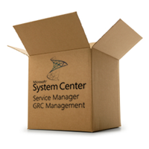


Coffee Machine Configuration Item
Create a management pack to store the model in
Create classes for the model
Add properties to the classes
Sealing the management pack containing the data model
Import the management pack into Service Manager

Slide 10
New Management Pack Improvements
  SCSM new MP XML schema 1.1
    New Data Types
  New Schema Elements
    Regular Expressions
    Auto-Increment
    Type Projections
  Management Pack Bundles

Slide 11
Management Pack Deployment
Views
Object Template
Column1
Column2
Column3
Column4
Management Pack
Views
Information
Template
Information
New
Non-Abstract
Class
...
Information
New Column01
New Column02
New Column03
New Table
...

Slide 12
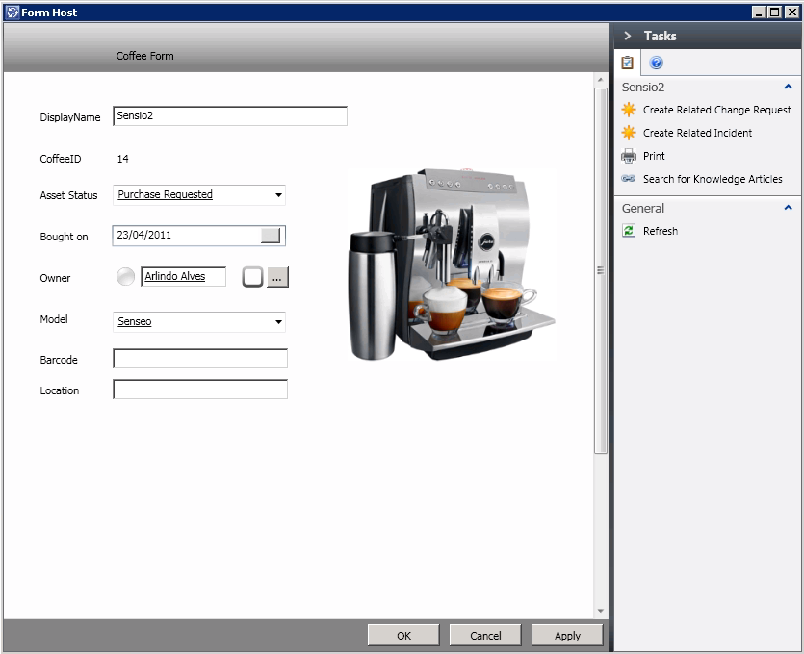
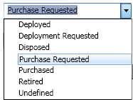
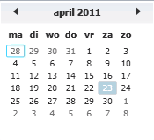

Creating an Input Form

Slide 13
Coffee Machine => Configuration Item
Demo

Slide 14
Coffee Service Desk

Slide 15
Queues and groups
Queues
  Collection of Workitems
  Dynamic Inclusion Criteria
Groups
  Collection of CI’s only
  Dynamic Inclusion criteria
  Static Membership
  Exclude Objects and Include other Groups
Role Based Security scoping
Notification subscription criteria
Report filtering

Slide 16
Creating the Coffee Service Desk

Slide 17

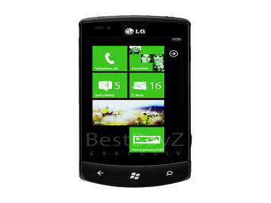









Incident Workflow
Coffee Team

Slide 18
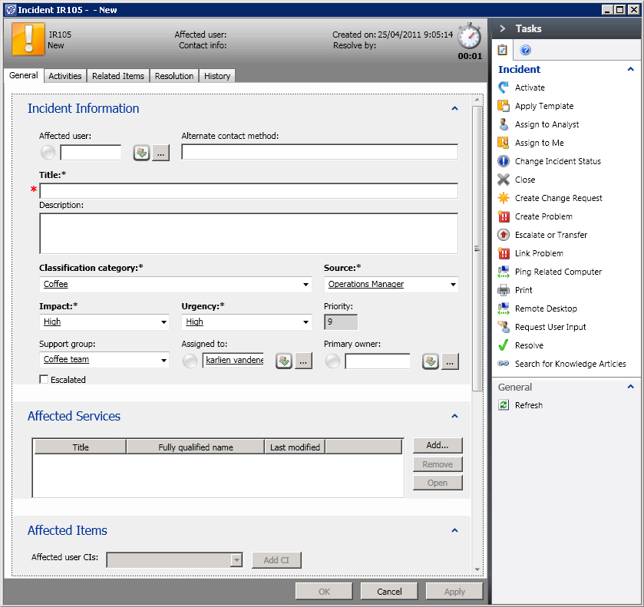
Customized Incident Template

Slide 19
Creating the Incident Workflow
Demo

Slide 20



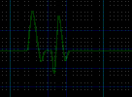
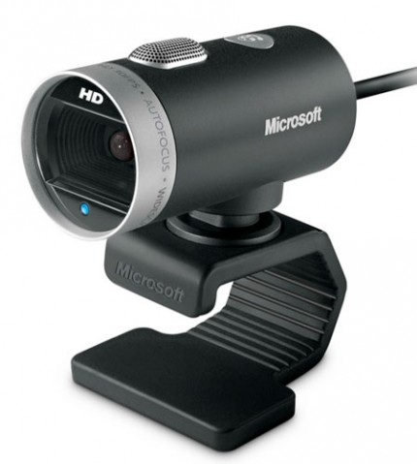




Monitoring the Coffee Machines
24/7
http://blog.coretech.dk

Slide 21
Automating the coffee machine
Demo

Slide 22


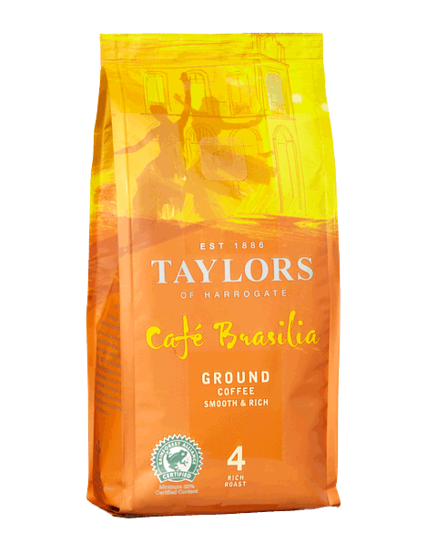
Change Request
CR 123 – Apply Coffee Policy
Manager
Approval
Automated Activity – Sends mail to Facility Department to change the blend
Closed

Slide 23
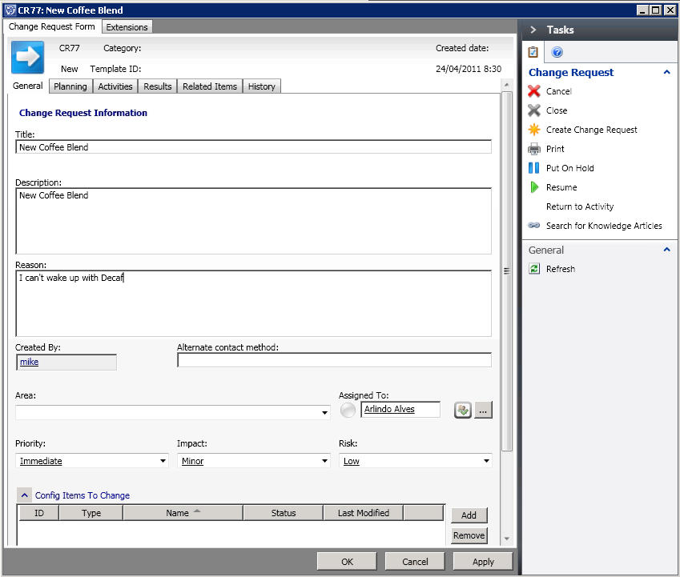
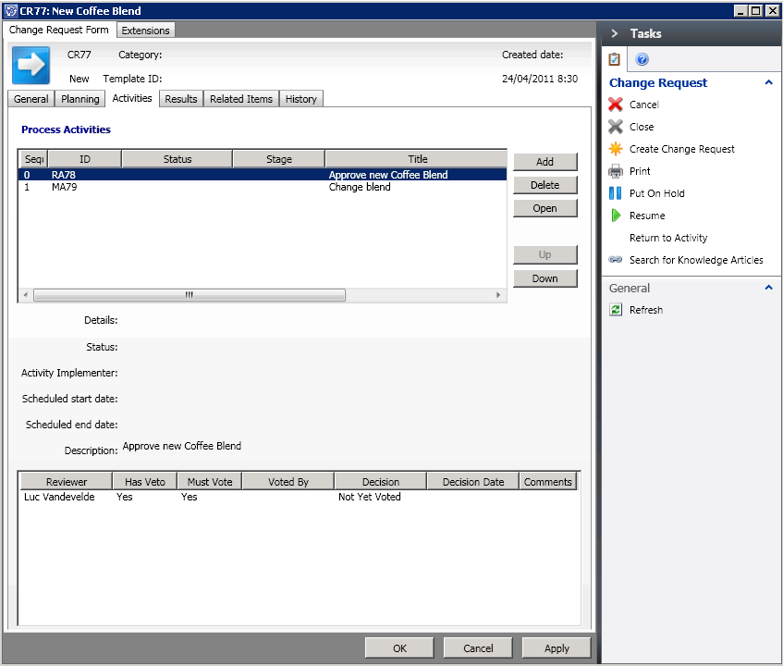
Specific Change Request Template

Slide 24
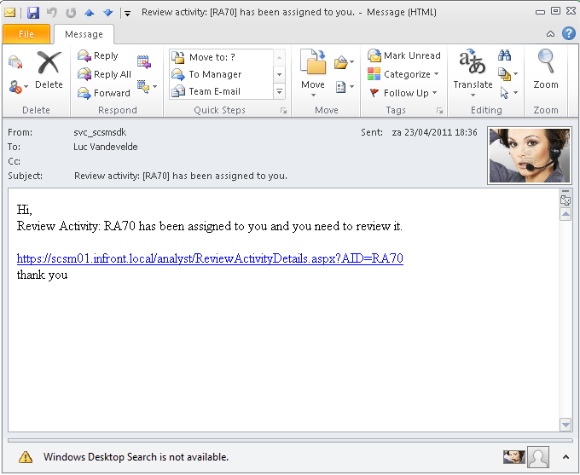
Notifications

Slide 25
Creating the Change
Request Workflow
Demo

Slide 26
Wrap-up
Begin with the end in mind . . .
Easy to create customized CI’s
No coding required (unless you really want to ☺)
Build specific workflows
Planning is the key

Slide 27
Related Content
Required Slide
Speakers, please list the Breakout Sessions, Interactive Discussions, Labs, Demo Stations and Certification Exam that relate to your session. Also indicate when they can find you staffing in the TLC.
Breakout Sessions
  SIM 208 - Management in the Datacenter
  SIM 209 - Microsoft System Center Service Manager - A Deep Dive on How to Automate ITIL or MOF
  SIM 210 - Sneak Peak at Microsoft System Center Service Manager 2012
  SIM 335 - Automation - Service Manager & Orchestrator - Better Together
  SIM 340 - Extending Microsoft System Center Service Manager - Modeling your Business Process
  SIM 362 - Monitoring IT as a Service with Microsoft System Center
  SIM??? - Taking the Next Step in IT GRC
Interactive Sessions
  SIM 372INT - How to Deploy and Configure Microsoft System Center Service Manager
  SIM 373INT - Stump The Microsoft System Center Service Manager team
  SIM383INT - Managing the Datacenter: Ask a Panel of Experts
Hands-on Labs
  SIM371-HOL Building a Microsoft System Center Service Manager Test Lab - Hall B1
  SIM372-HOL Incident and Change Management in Microsoft System Center Service Manager 2010 - Hall B1
  SIM373-HOL Microsoft System Center Service Manager 2010 Data Warehouse and Reporting - Hall B1
  SIM374-HOL IT Governance, Risk and Compliance Configuration in Microsoft System Center Service Manager 2010 - Hall B1
Product Demo Stations TLC – SIM – station 21
Find Me Later At…TLC station 21 or @SeanC_MSFT

Slide 28
Track Resources
Don’t forget to visit the Cloud Power area within the TLC (Blue Section) to see product demos and speak with experts about the Server & Cloud Platform solutions that help drive your business forward.
You can also find the latest information about our products at the following links:
Cloud Power - http://www.microsoft.com/cloud/
Private Cloud - http://www.microsoft.com/privatecloud/
Windows Server - http://www.microsoft.com/windowsserver/
Windows Azure - http://www.microsoft.com/windowsazure/
Microsoft System Center - http://www.microsoft.com/systemcenter/
Microsoft Forefront - http://www.microsoft.com/forefront/

Slide 29





Resources
  Connect. Share. Discuss.
http://northamerica.msteched.com
Learning
  Sessions On-Demand & Community
  Microsoft Certification & Training Resources
www.microsoft.com/teched
www.microsoft.com/learning
  Resources for IT Professionals
  Resources for Developers
http://microsoft.com/technet
http://microsoft.com/msdn

Slide 30












Required Slide
Complete an evaluation on CommNet and
enter to win!

Slide 31


Slide 32

© 2011 Microsoft Corporation. All rights reserved. Microsoft, Windows, Windows Vista and other product names are or may be registered trademarks and/or trademarks in the U.S. and/or other countries.
The information herein is for informational purposes only and represents the current view of Microsoft Corporation as of the date of this presentation. Because Microsoft must respond to changing market conditions, it should not be interpreted to be a commitment
on the part of Microsoft, and Microsoft cannot guarantee the accuracy of any information provided after the date of this presentation. MICROSOFT MAKES NO WARRANTIES, EXPRESS, IMPLIED OR STATUTORY, AS TO THE INFORMATION IN THIS PRESENTATION.

