Slide 1
Integrating the Microsoft System Center Stack for Process
Compliance and Automation
SIM337
Shitanshu Verma
Lead Operations Manager
Microsoft Corporation
Karthik Jayavel
Sr. Service Engineer
Microsoft Corporation

Slide 2
Session Objectives and Takeaways
Understand how System Center Desired Configuration Management (DCM) is used to evaluate compliance
Integrate DCM data with OpsMgr and Service Manager
Demonstrate Real World Scenarios Integrating All Three Products for Compliance and Automation
Conclude with Best Practices

Slide 3



Who is Management Platforms & Service Delivery (MPSD)?
280,000 Clients Managed at Microsoft
7,800 Clients Managed at Energizer
5,300 Clients Managed at XL
600+ Clients in the Microsoft Store
293,700 Clients Managed

Slide 4










Solution Overview @ Microsoft IT
Business Goals
Solution
Results/Benefits
Improve overall infrastructure reliability, availability and health proactively
Strengthen Compliance
Leverage alerting and automation
Integrate with Service Manager for actionable change drifts
Ensures the organization meets industry standards, compliances, and Configurations
Verify accuracy and efficacy of planned changes
Improve troubleshooting and “time-to-resolve”

Slide 5
Microsoft IT Key Compliance Scenarios
SAS 70, SOX & PCI Compliance
  Machine Local Admins group compliance
  SQL Service Authentication
  Port 80 check
Application Compliance
  Windows Server Update Services (WSUS) Pool Settings
  Advance IIS Settings
  Windows update Agent Settings

Slide 6

Configuration Manager Architecture
Microsoft IT ConfigMgr 07 Central Site
~280k Clients
Redmond Campus
~130k Clients
6 SUP | 6 MP | 16 DP
North & South America
~35k Clients
10 SS | 2 SUP | 2 MP | 89 DP
Limited Services
~4k Clients
1 SUP | 1 MP | 2 DP
Europe, Middle east & Africa
~35k Clients
14 SS | 2 SUP | 2 MP | 62 DP
Fareast & South Pacific
~65k Clients
7 SS | 2 SUP | 3 MP | 25 DP

Slide 7
Desired Configuration Management Overview
Karthik Jayavel

Slide 8
Desired Configuration Management Overview
DCM ensures that systems comply with configuration states:
Audit compliance on defined standards and policies
Proactive monitoring of drifts in configurations
Act on non-compliant machines and remediate
Improve systems availability, security, and performance of systems

Slide 9
Overview: Terms & Concepts
Configuration Item (CI)
  CIs represent units of configuration policy that can be detected for compliance
Configuration Baseline
  A configuration baseline composed of other CIs classified as required, optional or prohibited
  Primary unit of administrative work and can be assigned to collections for compliance monitoring
Type of CIs – Registry, File, SQL query, WMI, LDAP etc.,

Slide 10
Overview: Data flow
Configuration
Packs
1
Configuration
Items created by
import
ConfigMgr Database
Windows
Server
2008
CI
Line-of-business
Application
CI
New
Configuration
Items authored
Antivirus
Software
CI
2
Compliance
State
Tables
ConfigMgr
Admin
Console
Configuration
Baseline defined
using
CIs
Line-of-business
Application Server
Baseline
3
ConfigMgr Server
Managed
Client
4
Configuration baseline assigned
to collection
WMI
6
5
Compliance
state sent to
ConfigMgr Database
for reporting
XML
DCM discovers
CIs and
validates data
against rules
Script
Configuration Manager Client
Active
Directory
SQL
Registry
File
Software
Updates
IIS
MSI

Slide 11
Compliance Life Cycle – Four “A”s
Assess
Phase 1
Analyze standards and settings
Phase 2
Create and
assign DCM baselines
Assign
Alert
Act
Phase 4
Remediate and report
Phase 3
Monitor compliance status

Slide 12
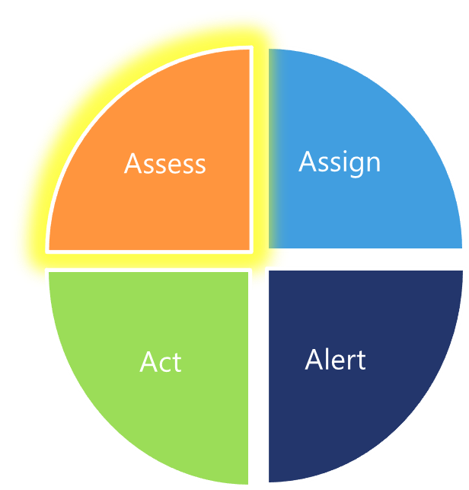
Compliance Life Cycle – Assess
Evaluate compliance standards
Choose critical standards for checking
Understand the setting behavior
Plan the type of setting in CI

Slide 13
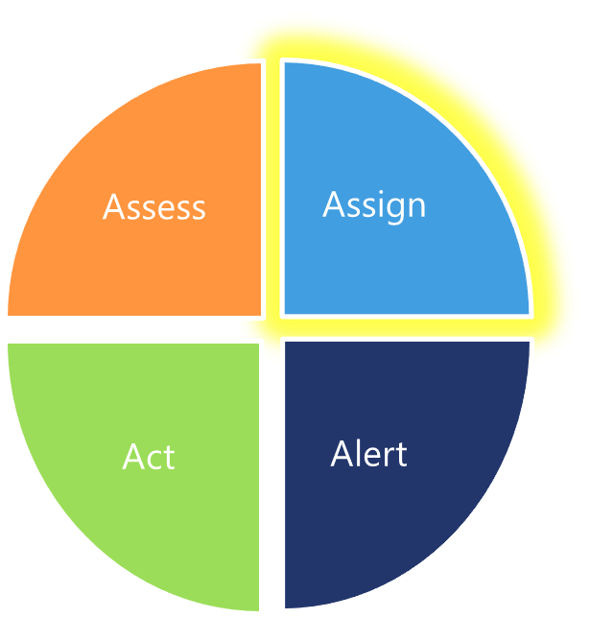
Compliance Life Cycle – Assign
Create the CI with the planned setting
Combine multiple CIs in a baseline
Define the collection structure – Eg : SQL , IIS
Assign the baseline to collections
Pilot the baseline deployment

Slide 14
Create and Configure Baseline
Karthik Jayavel
demo

Slide 15
Alert and Act Phases
Shitanshu Verma

Slide 16
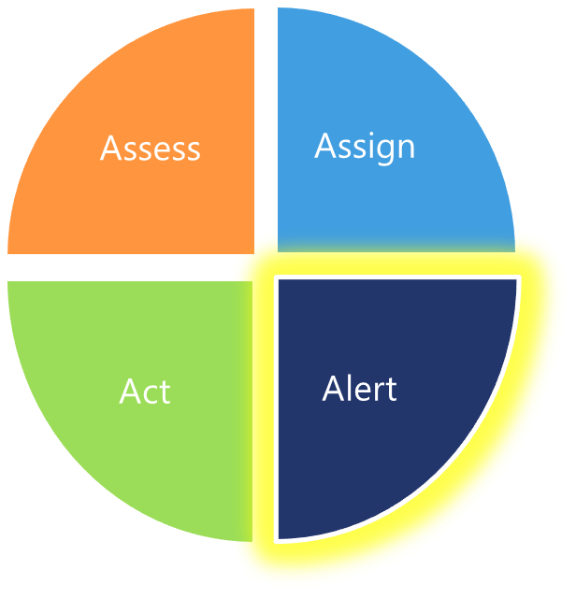
Compliance Life Cycle – Alert
Decide baseline compliance target
Configure CI to create an event for non-compliance
Deploy custom OpsMgr rule for non-compliance
Validate the OpsMgr rule for alerting in pre-production

Slide 17
Configuring DCM Event Rule in OpsMgr
Shitanshu Verma
demo

Slide 18
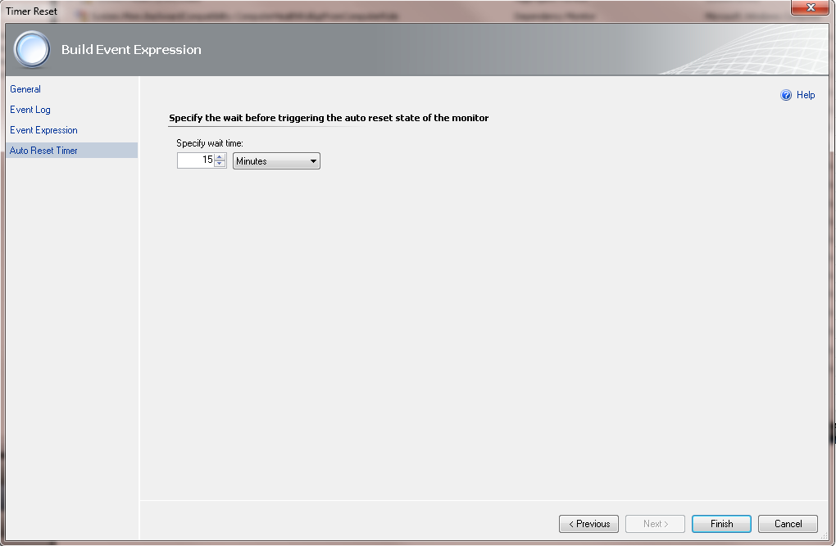
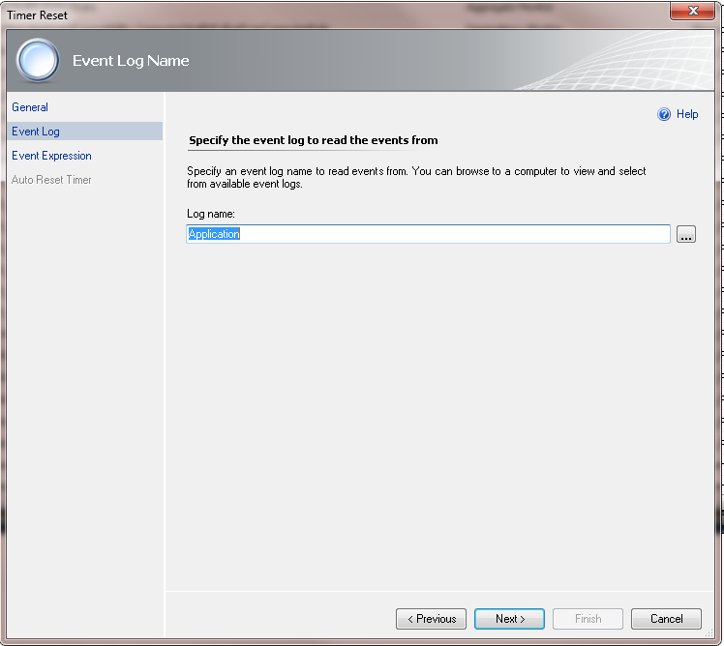
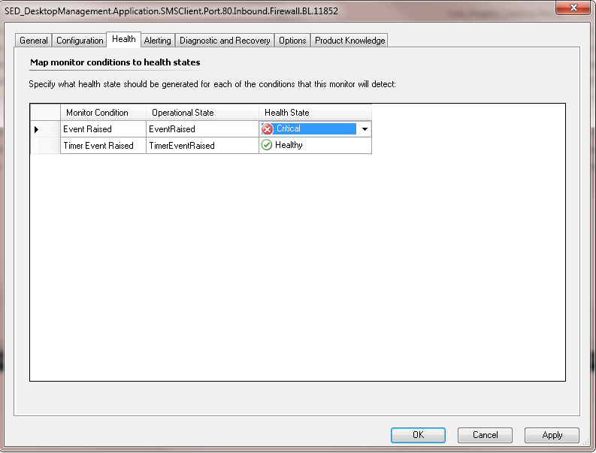
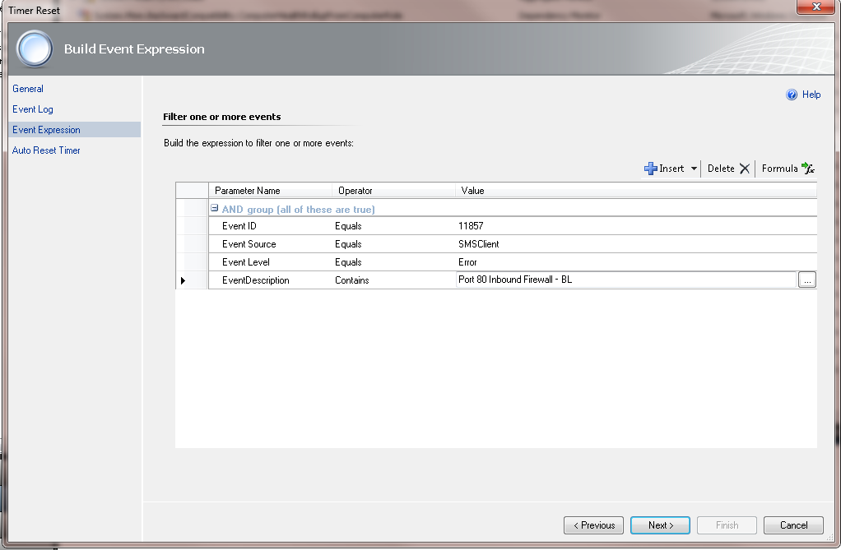
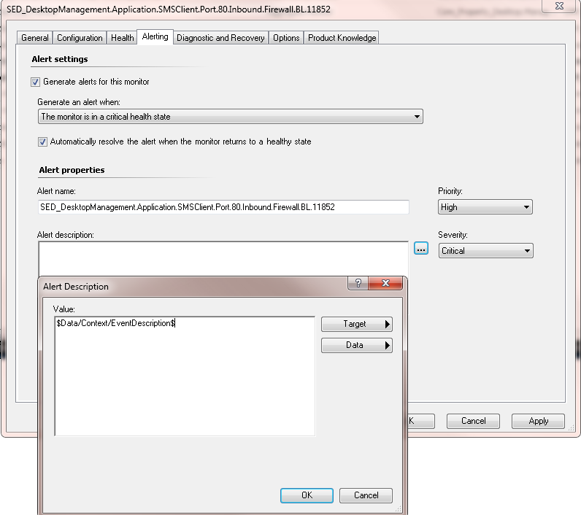
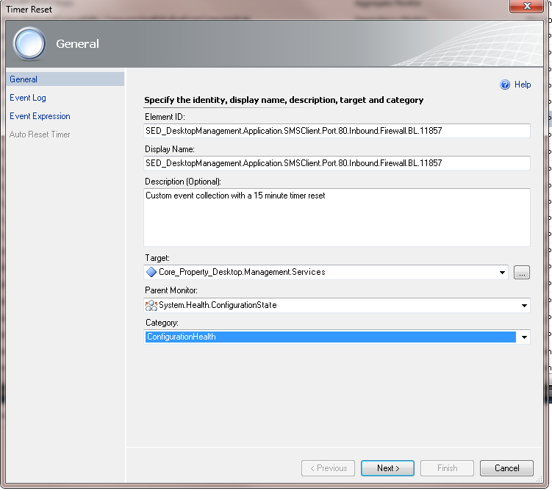
Configuring DCM Event Rule in OpsMgr
Open OpsMgr Authoring Console to create new monitor
Configure the general tab
Fill in the Event Log source
Specify Event expression details
Auto Reset
Right click the event collection, and click properties.
  Click on health.
  Change Event raised to Critical from
  Warning.
Click the Alerting Tab
  Click the Generates Alert checkbox.
  Modify the Priority from Medium to high.
  Modify the Alert description.
  Click Ok
Import Management Pack into production for alert

Slide 19
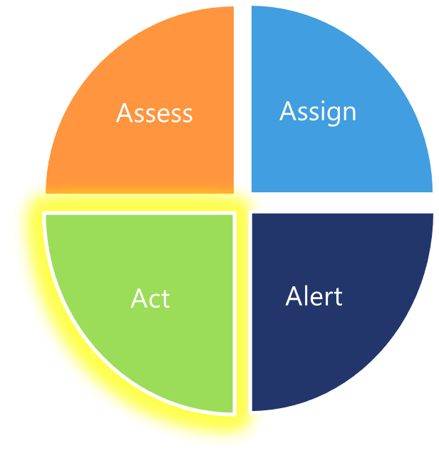
Compliance Life Cycle – Act
Create a Service Manager incident
<<Or>> Automate remediation steps
Create dynamic collections for remediation
Deploy remediation using software distribution
Report status of remediation and monitor
the improvement

Slide 20
Walkthrough for all 4 “A’s”
Karthik Jayavel
demo

Slide 21
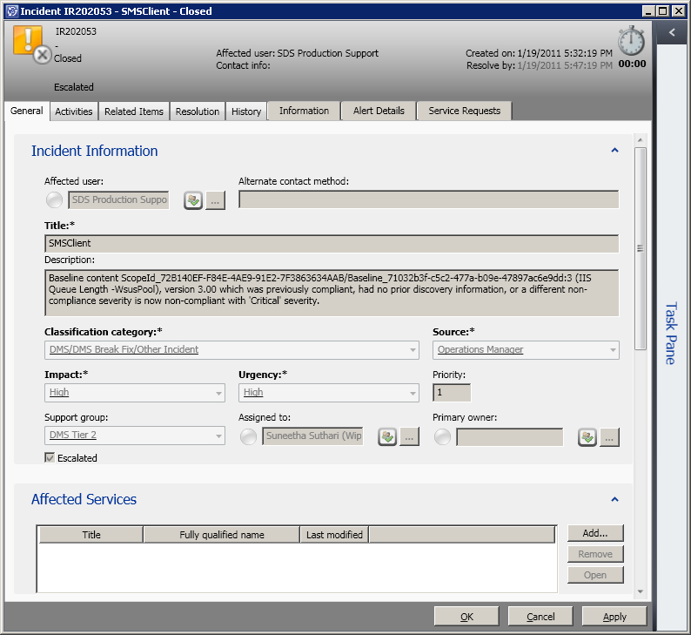
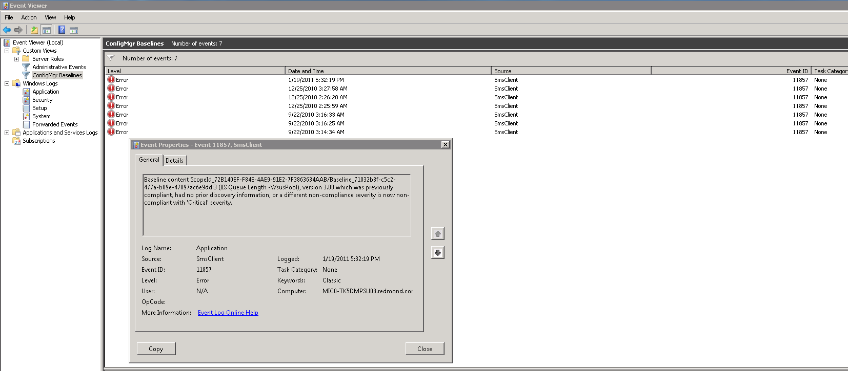
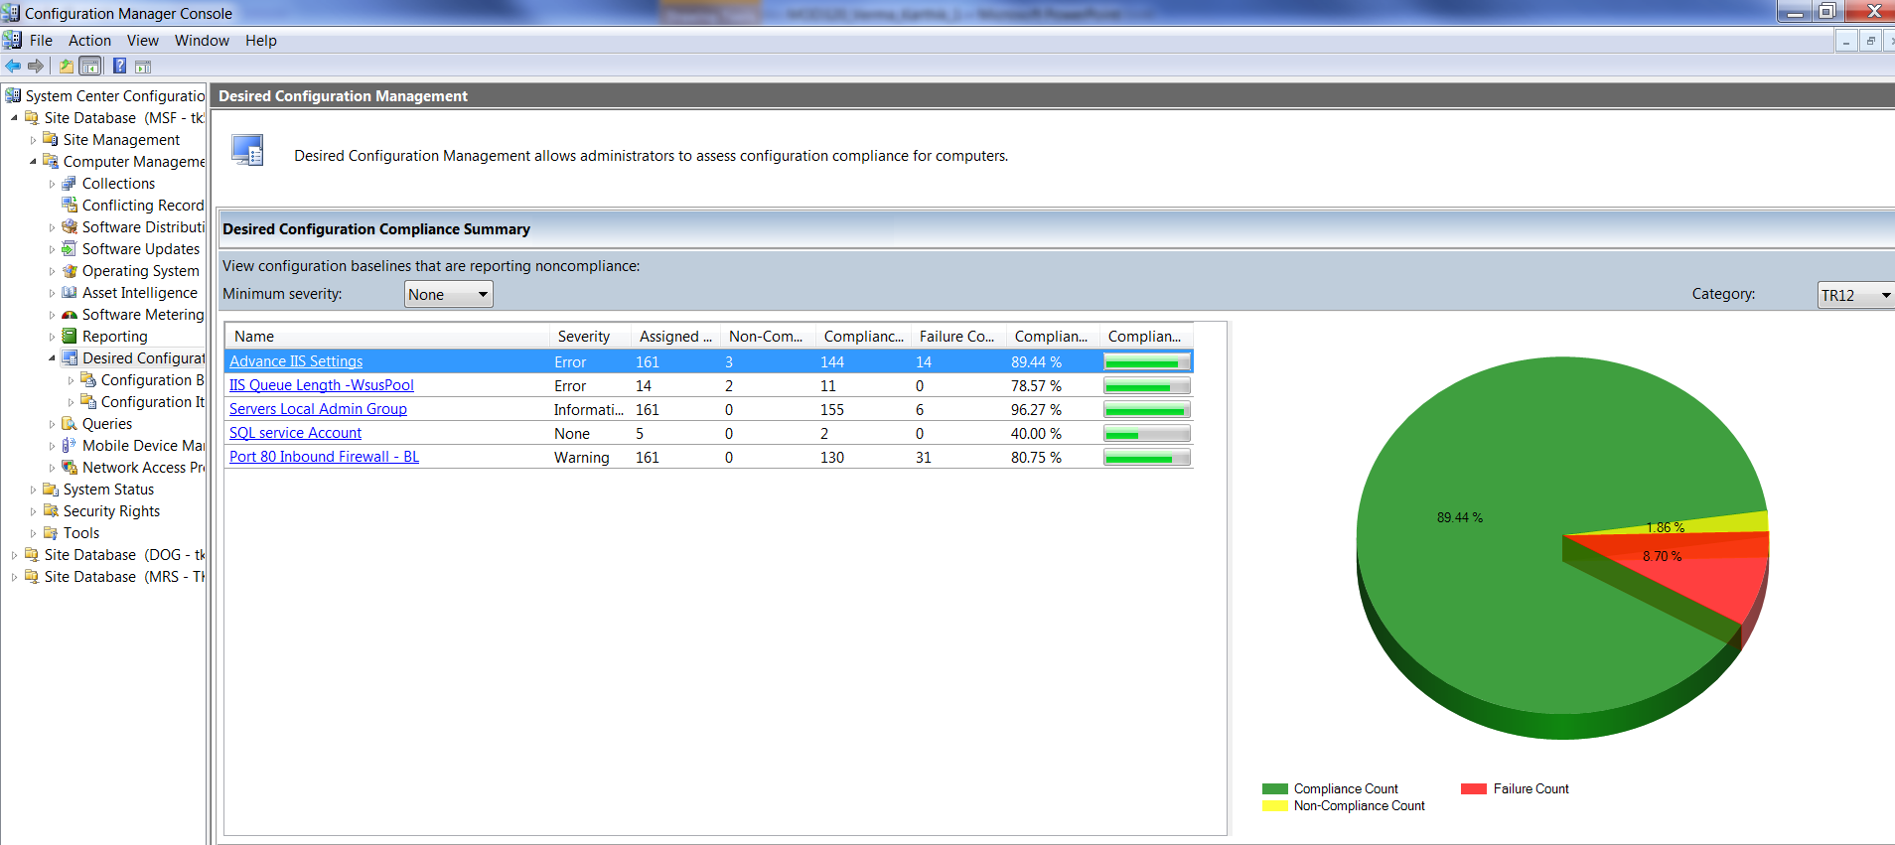
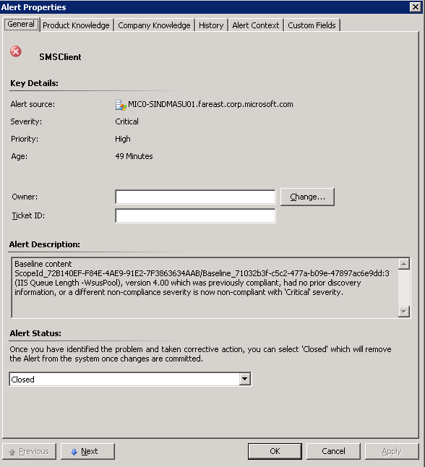
Walkthrough for 4 “A’s”

Slide 22
Other Real World Scenarios
Antivirus signature version deviance using custom script
Software update compliance for monthly updates
Fall Back Status point settings on ConfigMgr clients
File version checks without additional software inventory rules
Check Cache size and Drive space issues for client health maintenance

Slide 23
What is new in Configuration Manager 2012?

Slide 24
Setting Mgmt. in ConfigMgr 2012
Enforce Remediation of non-compliant machines
Monitoring Baseline Deployment Status
  InConsole Monitoring
Simplify administrator experience
  To browse gold system when creating settings
  Define SLA’s for deployments and generate alerts
Role-based administration “Compliance Settings Management Role”

Slide 25
Best Practices
Import DCM packs that are readily available for different types of servers
Plan type of checks in Configuration Item consciously
Software update compliance – monitor emergency patching
Use OpsMgr Authoring Console for creating custom alert
Perform pilot for DCM baseline and OpsMgr rule
Communicate to support team for alerts and actions

Slide 26
Summary and Key Takeaways
Use ConfigMgr DCM to Improve overall infrastructure reliability, availability and health through proactive Settings Compliance Management
Leverage OpsMgr for alerting and automation
Integrate with Service Manager for actionable change drifts

Slide 27
More Information
Download Configuration packs : http://pinpoint.microsoft.com/en-US/systemcenter/managementpackcatalog
Introduction to DCM using videos : http://technet.microsoft.com/en-us/edge/dcm-introduction.aspx
Blog on how to deploy DCM configuration packs and other information : http://blogs.technet.com/b/jasonlewis/
System Center Configuration Manager product technical details: http://technet.microsoft.com/en-us/configmgr/default.aspx
The Configuration Manager Support Team Blog: http://blogs.technet.com/configurationmgr/default.aspx
Configuration Manager News from Microsoft IT
  http://blogs.msdn.com/shitanshu/default.aspx
      http://twitter.com/ConfigMgr_MSIT
System Center in Action - Best Practices : http://technet.microsoft.com/en-us/systemcenter/ee942121.aspx

Slide 28
Questions?
Shitanshu Verma - shverma@microsoft.com
Karthik Jayavel - kjayavel@microsoft.com

Slide 29
Track Resources
Don’t forget to visit the Cloud Power area within the TLC (Blue Section) to see product demos and speak with experts about the Server & Cloud Platform solutions that help drive your business forward.
You can also find the latest information about our products at the following links:
Cloud Power - http://www.microsoft.com/cloud/
Private Cloud - http://www.microsoft.com/privatecloud/
Windows Server - http://www.microsoft.com/windowsserver/
Windows Azure - http://www.microsoft.com/windowsazure/
Microsoft System Center - http://www.microsoft.com/systemcenter/
Microsoft Forefront - http://www.microsoft.com/forefront/

Slide 30





Resources
  Connect. Share. Discuss.
http://northamerica.msteched.com
Learning
  Sessions On-Demand & Community
  Microsoft Certification & Training Resources
www.microsoft.com/teched
www.microsoft.com/learning
  Resources for IT Professionals
  Resources for Developers
http://microsoft.com/technet
http://microsoft.com/msdn

Slide 31












Complete an evaluation on CommNet and
enter to win!

Slide 32


Slide 33

© 2011 Microsoft Corporation. All rights reserved. Microsoft, Windows, Windows Vista and other product names are or may be registered trademarks and/or trademarks in the U.S. and/or other countries.
The information herein is for informational purposes only and represents the current view of Microsoft Corporation as of the date of this presentation. Because Microsoft must respond to changing market conditions, it should not be interpreted to be a commitment
on the part of Microsoft, and Microsoft cannot guarantee the accuracy of any information provided after the date of this presentation. MICROSOFT MAKES NO WARRANTIES, EXPRESS, IMPLIED OR STATUTORY, AS TO THE INFORMATION IN THIS PRESENTATION.

