Slide 2

Microsoft Forefront Online Protection for Exchange and Microsoft Office 365:
Better Together!
SIM331
Harpreet Singh Juneja
Sridhar Chandrashekar
Notes:
Greet: Good Afternoon and welcome to this session on “FOPE and Office 365 - Better Together”.
Thank: I would like to thank you for coming;
Introduce: I am Harpreet Singh Juneja, a program manager in the FOPE team. I am joined today with Sridhar Chandrashekar, group program manager within the FOPE team.

Slide 3
Agenda
FOPE in Office 365 Beta, An Overview
FOPE Admin Center integration in Exchange Control Panel
Junk Mail Management Options
FOPE Connectors to control mail flow E2E
Session Objective:
  Understand FOPE effectiveness, reliability and robustness
  FOPE Admin Center is a powerful tool for Office 365 customers
  FOPE Connectors provide remarkable flexibility in email routing
Notes:
Expand FOPE: Before we begin, FOPE is an acronym for Forefront Online Protection for Exchange
This session is divided into 4 main sections and should help answer questions like,
1. What is FOPE?
2. What does FOPE do? What does FOPE bring to Office 365?
3. How is the FOPE Admin Center integrated with Exchange Control Panel (ECP)?
4. What are the Junk Mail Management Options with FOPE and Office 365
5. How do you achieve advanced mail flow control by using FOPE connectors?

Slide 4
FOPE in Office 365 Beta, An Overview
FOPE Admin Center
Junk Mail Management Options
FOPE Connectors
Notes:
This is the First Section where we shall cover ...
1. The benefits of using FOPE ...
2. How does FOPE work … From a service overview to inbound and outbound mail flow … and
3. How can you onboard to FOPE …

Slide 5








Forefront Online Protection for Exchange
    Built-in protection for Exchange Online customers
z
External Email
Hub Transport
Mailbox
About 90% of
email is junk
    High-accuracy spam filtering
    Multiple virus-scanning engines
    Tuned for enterprise email
    Included with Exchange Online subscription
Notes:
5
Benefits:
This is the network topology of FOPE, it is a enterprise grade email filtering service hosted in the cloud that shall
1. help Reduces mail processing by around ~90%, hence significantly less hardware required
2. It provides Protection from common threats such as dangerous worms
3. It provides Protection from denial-of-service assaults
4. It provides Protection from directory harvesting and dictionary attacks
5. It provides Options to Mail Admin for policy rules definition and control
6. It ensures Zero interruption to email service, even if a largest DC is down and even if customer servers are down – FOPE shall hold the message for a limited time and attempt redelivery
Robustness and Reliability of FOPE:
1. FOPE is powered by a global network of data centers located at key positions on the internet backbone
2. FOPE designed on a fault-tolerant and redundant architecture with failover within a DC or across DC’s
3. Mail flow is load-balanced (globally and internally within each data center), and adhering to all data privacy compliances
Onboarding is Simple, Easy and Quick:
1. No hardware to provision
2. No software to buy, install and configure
3. No extensive training for the IT staff
4. It is a matter of changing the MX record and pointing all email to global FOPE data centers
5. And for those of you who don’t know it is part of the Part of ECAL and EECAL licences

Slide 6

















FOPE Inbound Filtering
If server down,
E-mail queued for up to 5 days
Queue
E-mail enters the global
data center network – MX (mail.messaging.microsoft.com)
Look up e-mail filtering settings for domain
Delivered in a flow-controlled fashion when server is available
Sync
Spam
Prevention
Virus
Scanning
Policy Enforcement
SPAM Protection
Directory
Services
SPAM prevention
SPAM
E-mail server available?
SPAM
Kaspersky
Custom Policy Rules
Safe senders
Mail addressed to non existent users if rejected
Mail form IP Spammers are blocked
Symantec
Custom Spam Filter management
IP Reputation based Filtering
Attachment and message attribute management
Authentium
Fingerprint Engines
Mailbox
Store
Reputation database
Rules Based Scoring
SMTP Reject: 5xx
Customer Feedback
False
+ve / -ve
Content and Policy Quarantine
SPAM Quarantine
SPAM
Spam Analysts
SPAM
SPAM
Notes:
This is an animated slide that shall drive through the inbound mail processing pipe to show each step of filtering. You shall see how FOPE provides defense in depth through multiple filters and layers. We shall work left to right and I’ll describe what happens to messages as they enter our system. You'll see just how hard it is for spam and virus to get through!
First up is the Edge Protection: This is our first line of defense and a significant one. We receive, on average, anywhere between 4 and 5 billion messages every day at the edge and we block around 90-95% of traffic at the edge, this is made possible by 2 main filtering layers at the edge … The IP reputation based scanning and RF
IP Reputation based scanning: With the help of our data mining traffic and spam patterns and implement our own IP block list and with multiple third party IP block lists we determine if we should allow the mail to come in based on the sender IP. This is called IP Reputation based scanning. We currently have over 300 million IPs (over 10%!) on these lists.
DBEB: For customers that choose to upload their user lists to our service, we perform directory services lookup based on the recipient. If the recipient is not a valid user we can reject it right there. We strongly recommend customers to upload user lists. FOPE provides several automated ways to upload this user lists.
The mail that passes edge is not from a known spammer IP and it is addressed to a valid user in the customer domain.
The Second layer of defense is our virus scanning. We run multiple virus engines on the email (and attachment). We guarantee that every email passes through at-least 3 virus engines. These virus engines are kept up to date every fifteen minutes with the latest signatures and we constantly monitor virus scanner effectiveness both for the scanners we use and any new scanners on the market. We switch multiple virus engines in and out accordingly to maintain our guarantee of 100% detection of all known viruses. If we detect a known virus in the mail we trash the mail so you’re safe knowing it didn’t enter your network.
So, we know the mail is not from a known spammer IP and it is addressed to a valid user and does not have virus, it then moved to our Third layer of defense that is policy based filtering.
These are customer configured policy rules and FOPE provides a wealth of options so that the customer can Accept, Reject, Copy, Redirect, Encrypt , Decrypt or Quarantine mail based on policy rules on message attributes, content or attachments. Administrators manage these rules and manage the quarantined messages and chose to release it as well as get an idea of how the policy rules are being applied in the service.
So, we have a mail we know isn't from a bad IP, is to a known user, does not have virus and passes corporate policy
Finally, the Forth layer of defense where we do our deepest anti spam checks and build up a score for the email as it relates to spam.
We first check the safe senders list if we have them. If the customer has designated a sender as safe we allow it through.
Next the custom spam filter checks the rules defined by the administrator for example, no vbscript, no URL with Ips in it etc. and sensitive word checks. Basically content scan
We also have fingerprinting techniques both in house and third party that constantly monitor mail and look for recurring patterns that would suggest that the mail is spam. The mail is scored based on how closely this matches other spam mail.
Finally we score based on a set of around 10,000 rules that validate the headers and content of the mail for potential issues. We can check header information, content through regular expression matches and other checks.
If the score is high (default threshold is 30) then we will mark as spam and send to spam quarantine. The users can access their spam quarantine and salvage a mail or mark as a false positive.
So, finally , we are as sure as anyone can be that the message is good! This whole process only took a matter of seconds and by our SLA less than 60 of those!
Lastly we then send it on to the customer mail server. If that server is down we'll queue the mail for the customer and send in a controlled fashion when the server comes back up – a little bit of bonus business continuity right there.
But we’re not done yet.
We have a continuous feedback loop in the system:
The customers can submit false positive and false negative verdicts on mail we sent or quarantined and this information is fed back into the system to improve the accuracy.
So, we have a great automated system in place to ensure we process mail in a timely manner and deliver only good mail.

Slide 7

FOPE Outbound Filtering
Look up e-mail filtering settings for domain
Outbound Pool
Virus
Scanning
Policy Enforcement
SPAM Protection
Score < 300
Kaspersky
Custom Policy Rules
Safe senders
Symantec
Custom Spam Filter management
High Risk
Delivery Pool
Attachment and message attribute management
Score > 300
Authentium
Rules Based Scoring
Mail Server
Fingerprint Engine
SEWR
Content and Policy Quarantine
Spam Analysts
Notes:
This slide is also animated and would walk us through the outbound scenario, but before that … why do you need outbound filtering?
A system in your domain can easily become infected with agents that silently run and send mails using the network. Unknowingly your IP becomes source of spam and loose reputation. Worse, if the IP’s ends up on block lists and is unable to send any mail.
FOPE has support for outbound filtering and we can help there too.
The mail comes from the customer and goes through the familiar pipe. We also have outbound policy rules so you can also control what your employees are sending out. We finally check the mail with our spam checks and score it.
At that point if it is <300 we send it via outbound and otherwise we route it via our NDR pool.
NDR Pool: This pool runs at a lower priority and while we still deliver the mail we monitor this very closely with our Spam Early Warning Report.
Value Add: If our machines are getting flagged in the NDR pool we work with our customers to ensure that they know they are being flagged as spammers.

Slide 8
FOPE Service Level Agreement (SLAs)
Spam and Virus
Filtering Effectiveness
100%
Known Virus
Protection
> 98%
Spam
Detection
< 1:250,000
False Positive Ratio
Filtering Network
Performance
Network Uptime
> 99.999%
Rapid Email Delivery
(Average delivery commitment
of less than 1 minute)
FOPE SLA related to mail hygiene added to the current Exchange Online SLA
Notes:
We talked about how the service works and the benefits it provides. For FOPE to be Enterprise Grade with fault-tolerant and redundant architecture and offer Zero Interruption to email, it has to be backed with Service Level Agreement (SLA) numbers.
We can divide the FOPE SLA’s into 2 buckets
Network Infrastructure
Network uptime: 99.999% : Global DC locations and key sites on internet backbone, HA at machine level and across DC
Email delivery: Average delivery commitment of less than one minute: Achieved with the help of a farm of machines equally load balanced across DC’s, global routing for load distribution, different roles doing different level of filtering
Filtering Accuracy
Virus Blocking: 100% protection against all known email viruses: multiple engines, virus signatures updated every 15 mins - every mail passes at-least 3 engines
Spam Capture: Capture of at least 98% of all inbound spam emails (99.8% in reality) - achieved by 10000+ spam rules, weighted rules being updated by manual spam analyst around the clock
False Positive Ratio: False positive commitment of less than 1 in 250,000 emails (1 in 800,000 in reality) – 1 legitimate email in 250000 actual spam emails.
I have more good news, as part of integration with Office 365, all the Filtering Accuracy related SLA’s are now part of Exchange Online.

Slide 9
FOPE in Office 365 Beta, An Overview
FOPE Admin Center
Junk Mail Management Options
FOPE Connectors
Notes:
This is the second section, in the previous section we talked about the benefits FOPE adds, how does filtering work and the SLA’s FOPE commits to.
Assuming now we know that how the service works, let’s discuss the areas which involve configuration of the service.
In this section we should have answer to
what is FOPE AC,
who uses FOPE AC and
why use FOPE AC

Slide 10
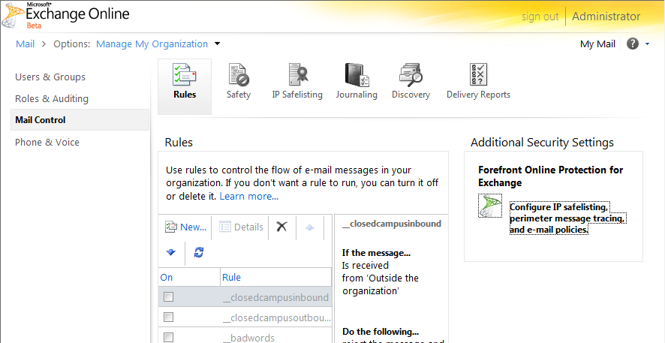
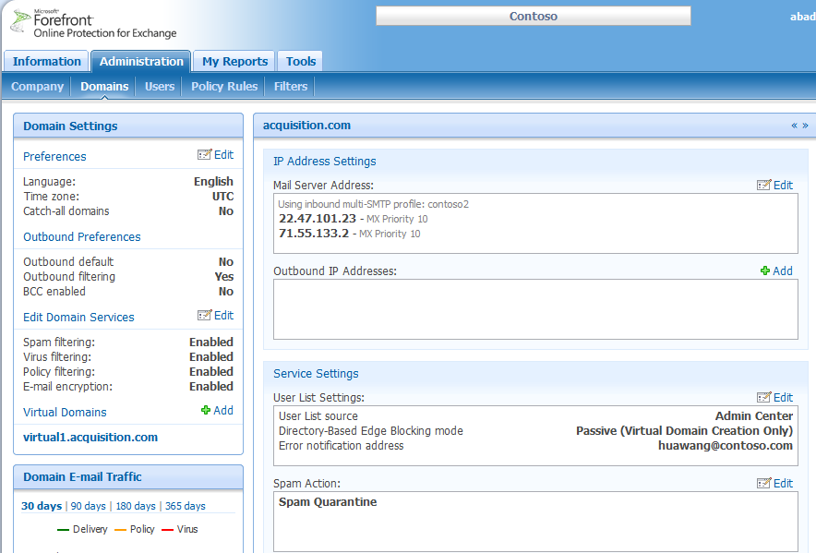
FOPE Admin Center
Provides Office 365 customers with a new level of control
Run real-time reports Configure policy filtering
Perform message tracking Customize spam settings
Office 365 customers can access FOPE Admin Center
Notes:
What is FOPE Admin Center?
FOPE Admin Center is the online web console that a IT admin can use to implement an advanced configuration or customization of settings related to Mail hygiene – it is a Single interface for all mail protection and hygiene control
Corporate policy
Spam settings
Virus Settings
Mail Routing and configuration
It is also the single interface to generate security detection statistics, including
Message tracking
Health data
Exchange Online have enterprise-class anti-spam and antivirus protection built-in today, via FOPE
The service doesn’t require customers to set up or manage anti-spam or antivirus settings
Office 365 customers who have Exchange Control Panel
Single Sign On from ECP to AC, No separate credentials
SSO: Till few months back Exchange online customers used to log in with administrator credentials that are separate from their O365 credentials
At public beta, we enabled SSO – so that right from the Exchange Control Panel, you can enter the Admin Center (no need to log in again)
The admin who is logged into the Exchange Control panel can seamlessly transition to the FOPE Admin Center landing page (no need to enter a password).

Slide 11
DEMO
FOPE Admin Center

Slide 12

When to use Admin Center vs. the Exchange Control Panel
Use Exchange Control Panel for these tasks
Use FOPE Admin Center for these tasks
Domain Management
  Office 365 customers (Hosted Email)
Message Trace
  Within your organization
Transport rules to control email delivery
Configure journaling of emails to external archive
Domain Management
  Filtering Only customers
Message Trace
  Outside your organization
Transport rules to control mail hygiene and corresponding mail delivery
  Configure org-wide safe/blocked senders
  Configure granular anti-spam settings
View reports on email hygiene
Configure and Control End to End Email Flow
  Configure Connectors
Notes:
For hosted customers that have ECP and AC, a common question is “when to use ECP and when to use AC”
ECP to be used for mail control and AC to be used for mail hygiene related settings, for Exchange online customers
Domain Management in ECP for Office 365 (hosted customers):
Users cannot add, validate, enable, or delete domains (Use Exchange Control Panel)
Users cannot change Mail Server Addresses and Outbound Mail Server IP Addresses (Use Exchange Control Panel)
Virus filtering settings are not configurable since virus filtering is provided by FPE running on Exchange Servers in cloud
Users cannot transfer IP addresses or Virus filtering notifications while using the Transfer Domains from on-prem settings to hosted
Company Management in ECP for Office 365 (hosted customers):
Users cannot change Outbound Mail Server IP Addresses
Reporting and Message Trace
- Within your organization, is ECP
- beyond the organization you would use AC
Transport Rules used in ECP for
Add disclaimers to emails
Look for keywords and regular expressions
Block email sent to the outside world (by sender, domain, etc)
Moderate email delivery
Transport Rules used in FOPE AC for
Specific header attributes (X-Header)
Custom dictionaries, character sets
Actions such as quarantine or encrypt
FOPE Connectors – Available only via the FOPE Admin Center, connectors help provide end to end control on the mail pipeline.

Slide 13
Permissions Mapping
Permissions mapping between Exchange Online and FOPE
Exchange Online Console | FOPE Admin Center
Billing Administrator | No access
Global Administrator | Full Admin privileges
Password Administrator | Admin Read-only privileges
Service Administrator | No access
User Management Administrator | No access
Notes:
As we know that FOPE AC is the interface to manage all mail hygiene settings, only a subset of admins who deal in this area would need access to FOPE AC. This mapping is maintained by allowing access Full Access to Global Admins and RO access to Password Admins of ECP. This is something that should be kept in mind while provisioning an EXO admin.

Slide 14
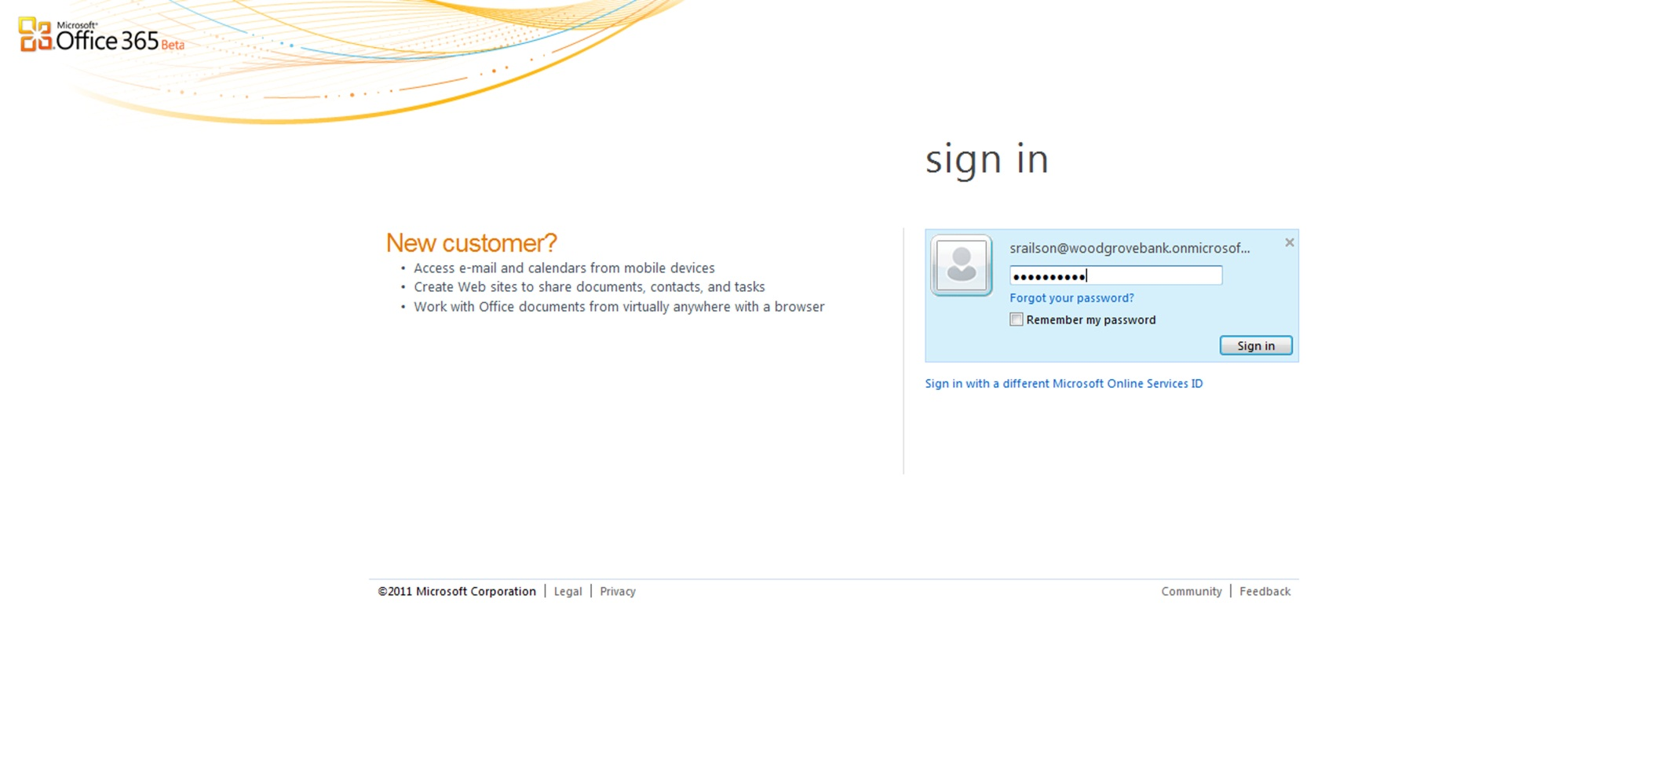
FOPE Single Sign-On

Slide 15
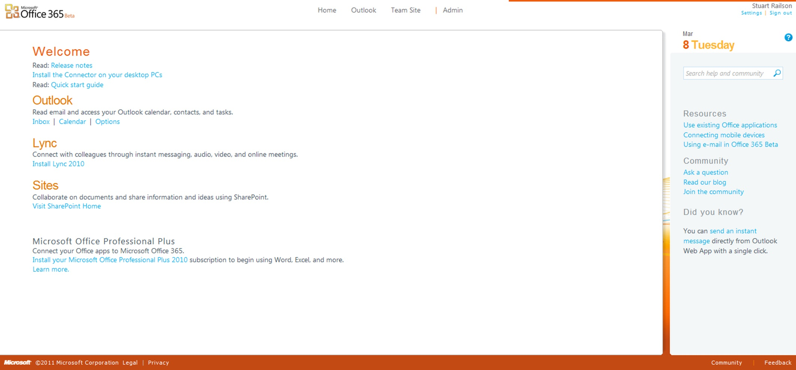
FOPE Single Sign-On (cont.)

Slide 16
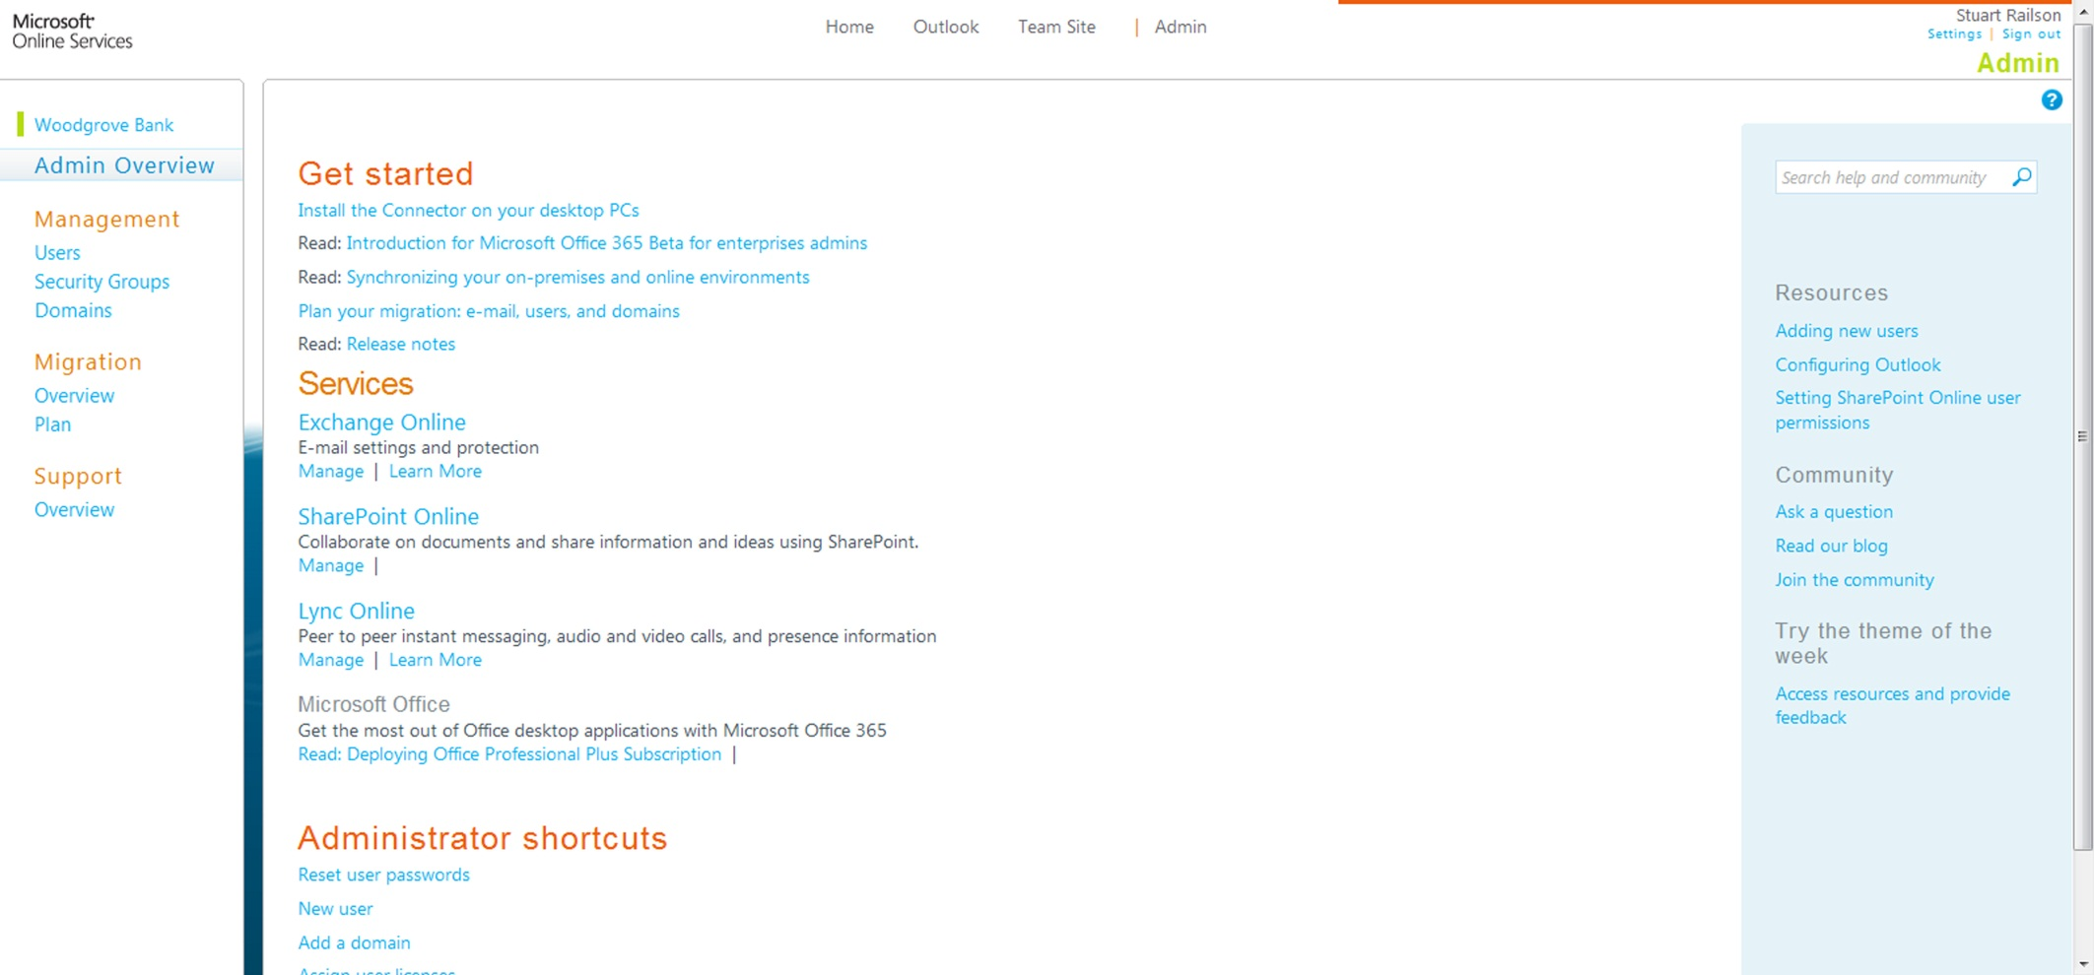
FOPE Single Sign-On (cont.)

Slide 17
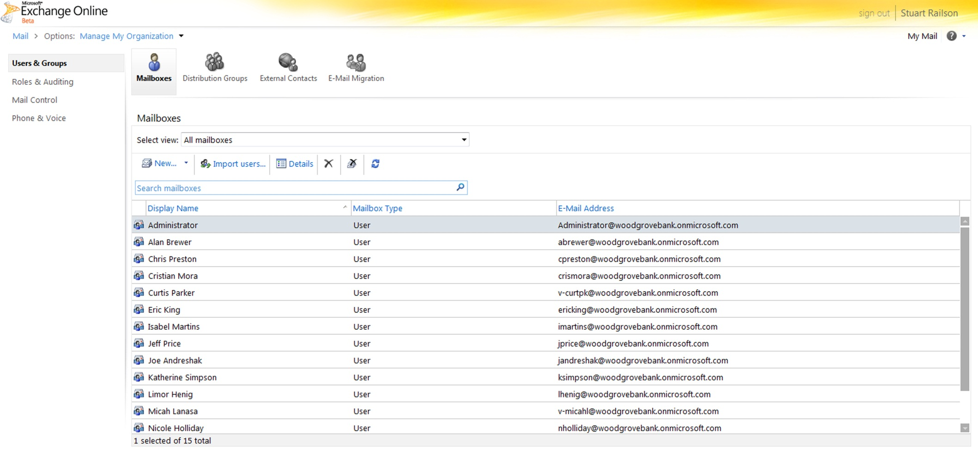
FOPE Single Sign-On (cont.)

Slide 18
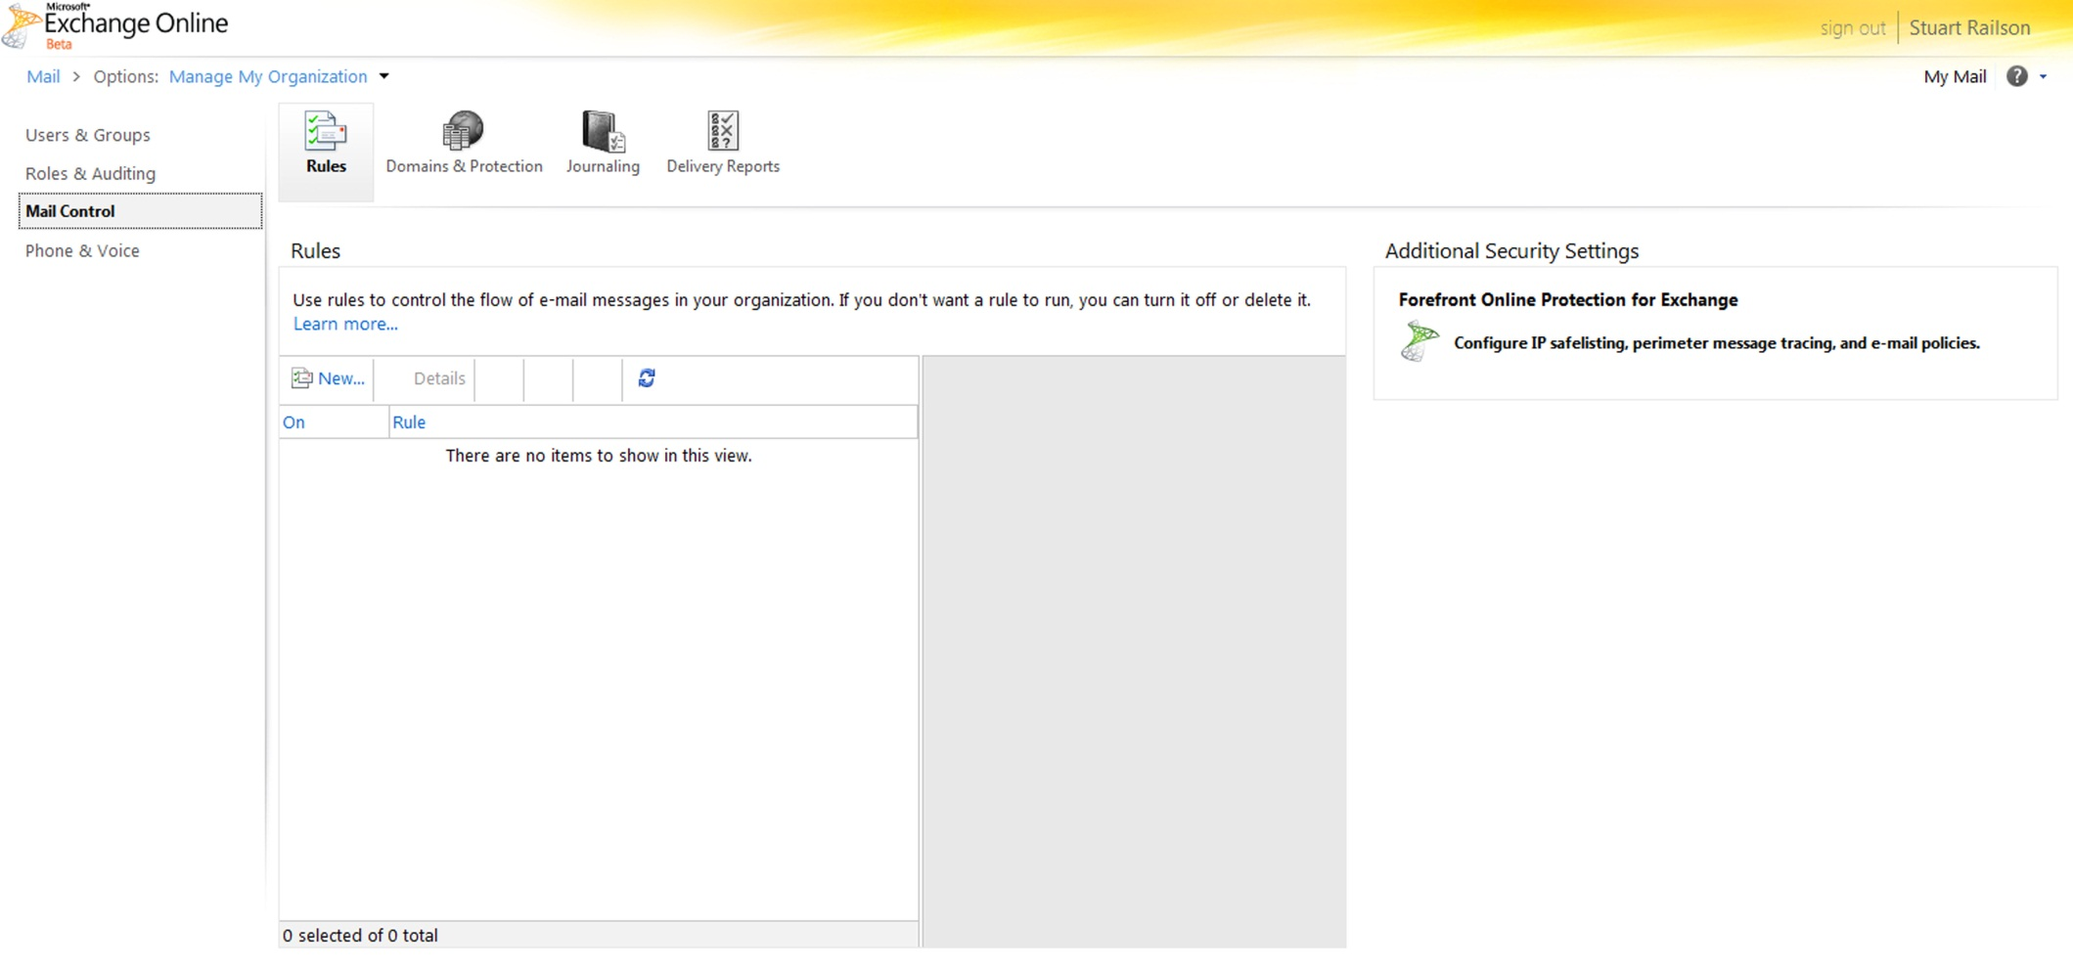
FOPE Single Sign-On (cont.)
Notes:
Talk about link – only shows for Global or Password Administrator

Slide 19
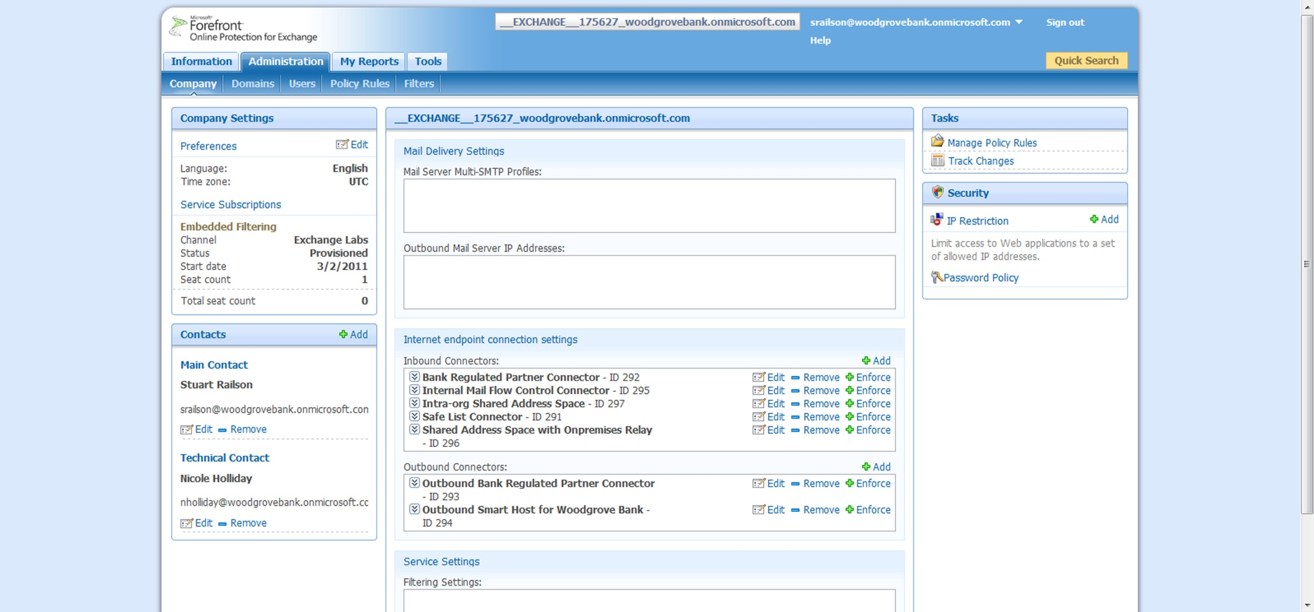
FOPE Single Sign-On (cont.)

Slide 20
FOPE in Office 365 Beta, An Overview
FOPE Admin Center
Junk Mail Management Options
FOPE Connectors
Notes:
This is the third section of the presentation, till now we talked about FOPE as a Service, how does filtering work and the SLA’s FOPE commits to. Then we spent time discussing how FOPE Admin Center adds the benefits of managing mail hygiene related setting.
If you remember in the first section we talked about Policy enforcement and Spam analysis, for policy enforced message you would recall that we provide an option to the Administrator to Quarantine the messages, the messages detected as spam may also be Quarantined – both of these fall under Junk Mail for the user. And in this section we shall talk about the options provided to the user to manage Junk Mail.

Slide 21
Junk Mail Management
Default
 | Outlook/OWA junk mail | FOPE Spam Quarantine
Where does suspect spam go? | Outlook junk mail folder (default) | FOPE Quarantine
Spam quarantine notifications | None | Every 3 days (daily when Recipient filtering ON)
Personal block sender list | Configured in Outlook | Not available
Personal safe sender list | Configured in Outlook | Not available
Two additional configurations can be done in FOPE:
  Spam Redirection
  Subject Modification
Notes:
Users get 4 Spam Action options:
JMF in outlook: achieved by adding a X-Header (default for O365 = X-FOSE-Spam)
Adds customized X-Header comments to messages that have been identified as spam by the service. The X-Header is then added to the Internet header of all subsequent spam messages.
Spam Quarantine
Used by 95% of enabled FOPE domains (excluding BPOS V1)
Spam Notifications can be set with an interval anywhere between 3 and 14 days, and can be set to 1 day if the domain uses Directory Based Edge Blocking
Spam Notifications can be sent in either Text or HTML
HTML comes in two types – one for domains where the Admin allows end user access to the Spam Quarantine, and one for domains where the Admin prohibits end user access to the Spam Quarantine
Spam Redirection
Delivers all spam to an alternate email address within the domain
Modify Subject
Adds an identifying word or phrase to the subject line of messages that have been identified as spam

Slide 22
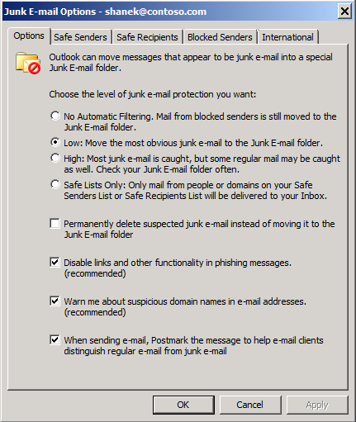
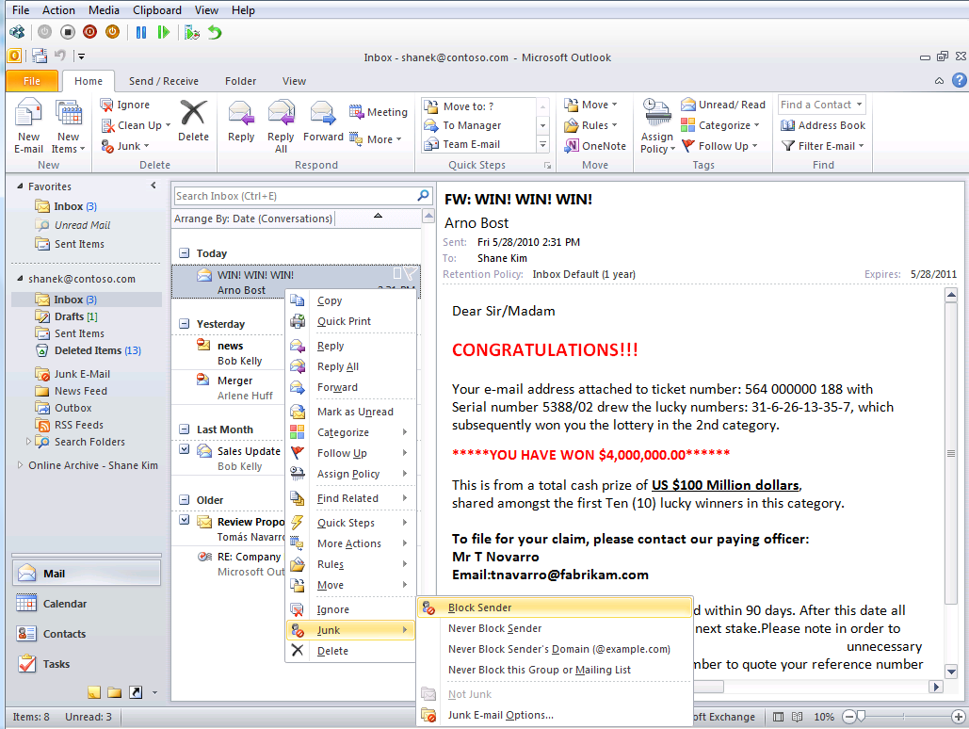
Junk Mail Management in Office 365 Exchange Online
Default approach: users manage junk mail in Outlook/OWA
Manage safe/block sender lists directly in Outlook or Outlook Web App
Direct access
to Junk Mail folder
Block/allow senders directly within message
Notes:
Junk Mail Management in Office 365, this is the default option for Office 365. Provides added power because Administrators can choose to apply policy rules and Quarantine emails and FOPE can detect emails as SPAM and Quarantine them. In addition the user can Right click on the message and add the user to Block List, all these emails land up in the JMF.
Users do not need to log into a separate mailbox to review and manage junk mail. They have direct access to Safe/blocked sender list management tools in Outlook and Outlook Web App.
Note that the users can create Safe Senders, Safe Recipients, and Blocked Senders lists (this applies only if they are using the Junk Email Folder. These safe sender lists are not replicated to FOPE so they cannot be applied if the customer chooses to use Spam Quarantine as their Spam Action in FOPE.)

Slide 23
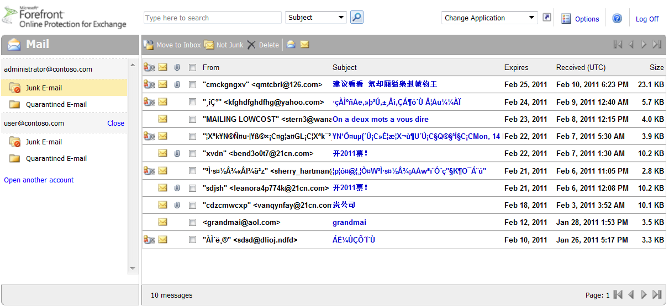
Junk Mail Management (cont.)
Flexibility to use FOPE Spam Quarantine
FOPE quarantine can be used instead of the integrated Outlook experience
Admins will have SSO access to Quarantine
Notes:
Enterprises can opt to use the FOPE spam quarantine. This is enabled in the FOPE Admin Center on the Domains page under “Spam Action”.
Administrators can configure email notifications on the Domains page under “Notifications”.
The quarantine is accessed by end users at quarantine.messaging.microsoft.com where users log on with their email address and a password of their choice. Messages are store in the quarantine for 14 days and, if no action is taken on them, they are deleted.
Office 365 Administrators Experience: SSO from ECP to AC and then AC to SQ is also SSO

Slide 24
FOPE in Office 365 Beta, An Overview
FOPE Admin Center
Junk Mail Management Options
FOPE Connectors
Notes:
This brings us to the forth section of this presentation: FOPE connectors
Let’s spend a minute to recall what all we covered till now, we talked about FOPE service in general, the benefits it brings to an organization by adding layers of security in inbound and outbound mail flow. In the second section, we talked about the management console, that is FOPE admin center and its integration with Exchange Control Panel. Third section was on Junk mail management and options available to organization for managing Junk mail with FOPE.
All the areas we talked about till now were related to providing security on a message based on its content. What is missing is end to end security, basically thinking beyond the message content.
Till now whatever we discussed was "if the content is not safe - what does FOPE do and how to manage and report that" ... now let’s talk about how does FOPE help in enforcing security on the channels an organization received a message, or on specific domains or for specific partners.
This is provided by use of connectors …

Slide 25




FOPE Connector Architecture
Inbound Connector (controls email sent to your domain)
Connection
Security
Filtering
Source IP
Source Domain
Reject non Source IP
Opportunistic TLS
Forced TLS
Connection
Spam
Policy
Outbound Connector (controls email sent from your domain)
Connection
Security
Delivery
Destination domain
Opportunistic TLS
Forced TLS
Smart host
MX
Notes:
The FOPE Connector controls message behavior at the network perimeter. They are building blocks that give granular control over all stages of mail flow.
For example, if you would like to force an inbound connection to TLS, FOPE connectors can help you achieve that.
2 types of connectors
Inbound and Outbound
Level of control available via the Inbound connectors is
1. Connection, which helps you specify source IP, source Domain
2. Type of security you want to enforce on that connection – like TLS
3. And the Kind of filtering to be applied for this connection
Level of control available via the Outbound connectors is
1. Connection, which helps you specify destination domain
2. Type of security you want to enforce on that connection – like TLS
3. And the Kind of delivery to be applied, SmartHost or MX
Some of you might be thinking when to use Connectors and when to you policies – they are independent and that makes them even more strong
FOPE Connector: If a customer want to attribute and enforce action at connection level use FOPE connector.
• Forced Inbound or Forced Outbound TLS
• SafeList an IP or Bypass Filtering on a connection
• Outbound Smarthosting
FOPE Policy: : If a customer want to enforce an action based on the Message content
• Encryption
• Message Size
• Custom Keyword based policy

Slide 26




FOPE Connectors: Flexibility and control in mail routing
nwtraders.com
Route outbound email through on-premises servers or DLP appliances
Force TLS for secure B2B communication
Bypass spam filters for trusted partners
And much, much more…
Forced TLS
Contoso.com
litware.com
Inbound safe listing
Outbound smart host
DLP appliance
All external recipients
Notes:
We talked about the connector architecture, now let’s talk about the usability of connectors …
Before I forget, there is a session on Connectors, it’s called “” and it’s at “”. Please plan to attend to gain in-depth knowledge on connectors.
In this slide I shall cover some basic requirements for adopting connectors, keep in mind all these are add-on’s, all these settings are optional configurations that you can implement …
And I will go bottom up when talking about customer asks …
First example is, if customers need to do extra processing on outbound mail (through a 3rd party Data Leakage Prevention (DLP) appliance, for example), or want to route outbound mail through private networks.
Why is this important?
Allows customers to use 3rd party DLP appliances or DLP services to meet their industry specific needs.
Allows customers to route outbound mail through their on-premises mail server.
In addition, post-processing of mail can be performed in the customer’s on-premises infrastructure. Features like custom address rewrite and the use of custom transport agents, which are not available in the core Exchange Online service, can be performed on the outbound mail.
Customers who have a private network of IPSec, Leased Lines, and TLS connections to business partners can continue to use those connections
Second example is, if a customer wants to have email from trusted partner domains bypass spam filters
Third example is, if a customer wants to configure forced TLS (outbound and inbound).
If you expand the scenario’s then there a lot you can add to it, like
Secure Partner Routing: All inbound and outbound from partner’s gateway server
Secure Cross Premise Mailflow for hybrid customers who filter mail for cloud users: FOPE does not do any filtering for Internet and intra-org mail relayed by the gateway server
Secure Cross Premise Mailflow for hybrid customers who do not filter mail for cloud users: FOPE performs filtering for Internet traffic relayed by gateway servers and no filtering is done for intra-Org mail
All the above could not have been possible without FOPE connectors, now let’s discuss the benefits of these 3 scenarios in more detail …

Slide 27
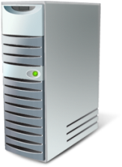



Outbound Smart Host Scenario
Internet
Contoso.com
DLP appliance or service
FOPE
From: Joe@contoso.com
To: sales@fabrikam.com
Edge
Virus*
Outbound Connector
Policy
Spam
FOPE routes outbound email to smart host for custom mail process or delivery
Virus scanning is performed by FPE for Exchange Online mailboxes
Value Proposition
Use DLP or encryption appliances from third parties
Perform custom processing or address rewrite
Maintain “total mail control” during coexistence (inbound and outbound mail is all routed through on-prem server
Service.contoso.com
Exchange Online
Mailboxes
Notes:
This is the scenario where the organization would want all outgoing mail to pass through a 3rd part DLP device to meet industry standards.
FOPE can be configured to direct all or part of their outbound mail to flow through an on-premises server that applies additional processing before delivering mail to its final destination.
In this scenario, FOPE is acting as the smart host.
FOPE brings the benefits of FOPE edge, virus, policy, and spam filtering.
Other examples include features like custom address rewrite and the use of custom transport agents, which are not available in the core Exchange Online service, and
Customers who have a private network of IPSec, Leased Lines, and TLS connections to business partners can continue to use those connections

Slide 28
Inbound Safe Listing Scenario
Fabrikam.com
Safe-listed Partner
Mailboxes
Inbound Connector
From: jane@fabrikam.com
To: salesman@contoso.com
FOPE
Edge
Virus*
Policy
Inbound mail is filtered by FOPE
IP filtering is skipped for trusted domains
Optionally, also skip spam and policy filtering
Virus scanning is performed by FPE for Exchange Online mailboxes
Spam
Value Proposition
Reduce the chance of false positives (legitimate email from trusted partner being flagged as spam)
Contoso.com
Mailboxes
Notes:
Contoso trusts Fabricam, hence Contoso can go into the FOPE admin center and add Fabricam’s IP addresses to a “safe list”
By adding a partner to a safe list, you bypass FOPE’s IP filtering service even if a partner’s IP address appears on the FOPE block list.
Mail that has a high spam rating that originates from the partner will still be blocked unless you configure the connector to skip spam filtering as well.
Mail that conforms to a policy rule will be blocked as well, unless you configure the connector to skip policy filtering.
Question: Doesn’t adding people to org-level safe senders list take care of this automatically?
Answer: The Inbound IP Policy rule will bypass IP reputation blocks and Spam Filtering. The Inbound Connector will allow more control than the Policy Rule. With an Inbound Connector you can bypass IP Reputation Blocks while still allowing the Policy Filtering and Spam Filtering to scan the messages. You can customize filtering options for the messages based on tying the logic to the sending IP, sending domain and TLS settings.
Benefit: Reduce the chance of false positives …

Slide 29

Forced TLS Scenario
woodgrovebank.com
Inbound Connector
Business Partner
Opportunistic TLS is on by default for Office 365 customers
(no action is required to enable it)
Mailboxes
Outbound Connector
FOPE
Edge
Virus*
Forced TLS can be configured using the methods shown here
Policy
Spam
TLS can be forced for inbound connections, outbound connections, or both
FOPE attempts to set up a TLS connection
If TLS cannot be established, email is not sent/received
Virus scanning is performed by FPE for Exchange Online mailboxes
Value Proposition
Maintain secure and trusted communication channel with partners
Avoid email interception/ eavesdropping
Contoso.com
Exchange Online
Mailboxes
Notes:
Contoso has a HBI business partner WoodGroveBank, hence Contoso wants to ensure that all email communication with this HBI partner is secured.
Contoso’s IT admin can go into FOPE admin center to create 2 connectors to set up a secure mail flow channel with trusted partners.
Communicate over TLS or sign in using a third-party validated certificate.
Using FOPE connectors, you can configure both forced inbound and outbound Transport Layer Security (TLS) using self-signed or CA-validated certificates.
TLS is a cryptographic protocol that provides security for communications over the Internet.
If TLS cannot be established, email is not sent/received on that channel.

Slide 30
DEMO
FOPE Connectors

Slide 31
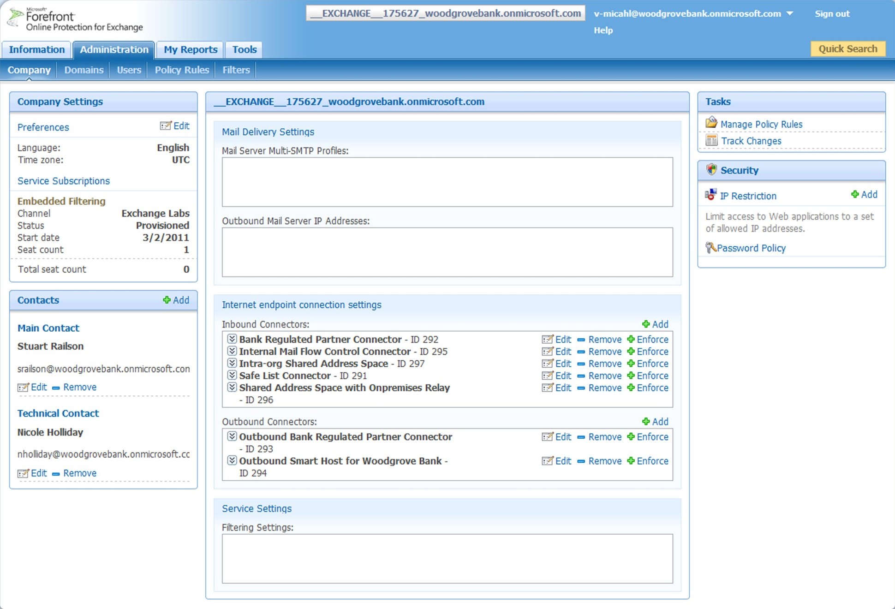
Creating FOPE Connectors
Notes:
FOPE Connectors are created in the Company subtab of the Administration page. Multiple connectors can be created for each company.
Currently there is no limit on the number of connectors you want to create for a company.

Slide 32
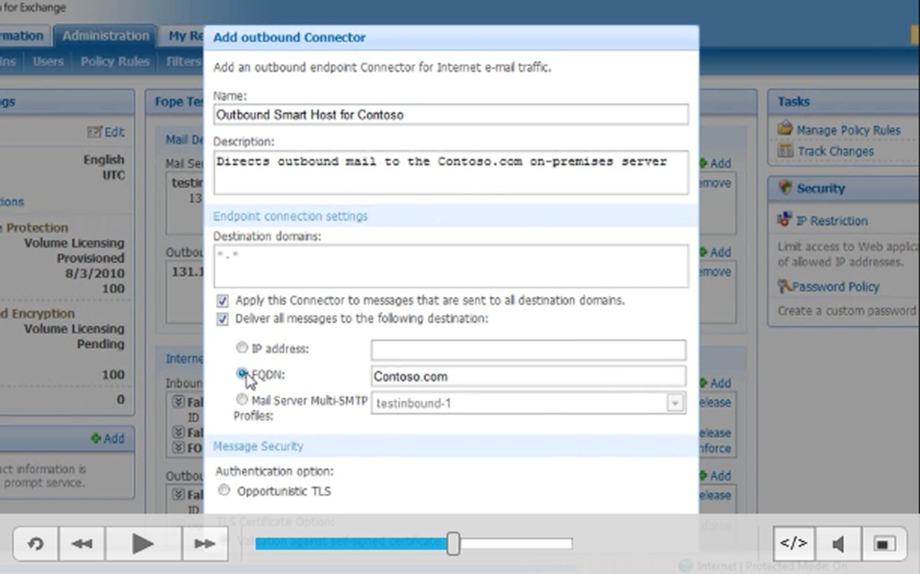
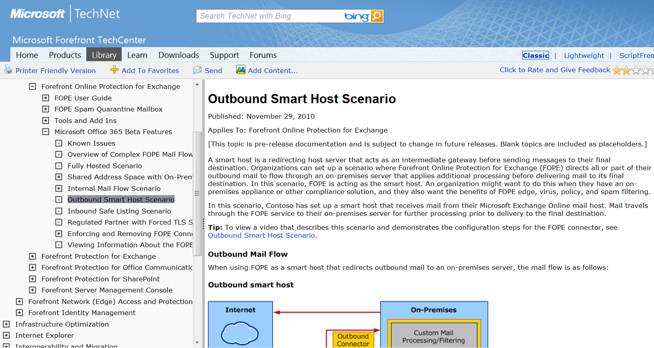
How to configure FOPE Connectors
    Docs and video tutorials available on TechNet
http://technet.microsoft.com/en-us/library/gg430178.aspx
Notes:
Docs and video tutorials available on TechNet

Slide 33
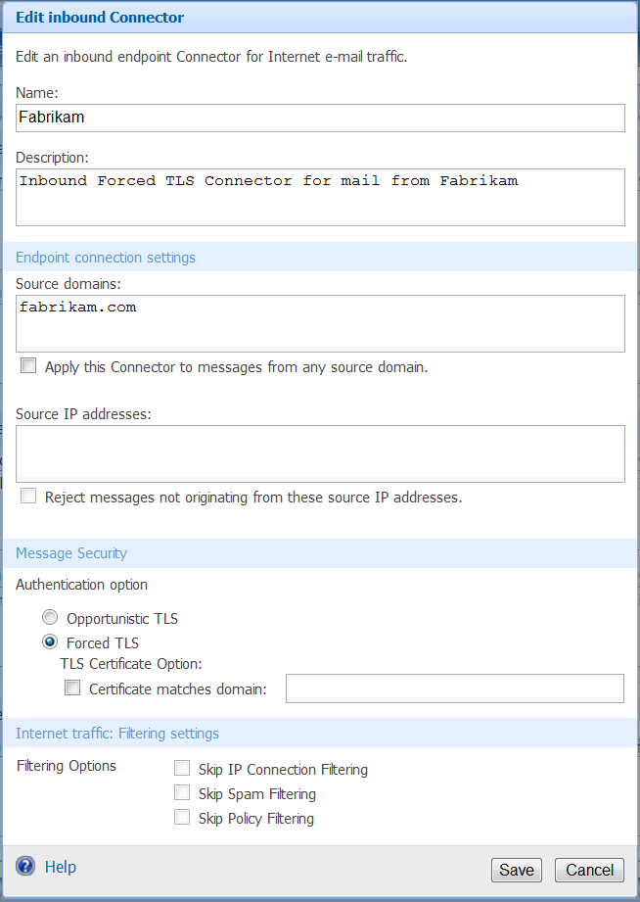
Inbound FOPE Connector
Inbound connectors apply to inbound mail
This connector shows the “Forced TLS Scenario”: incoming messages from fabrikam.com will be secured with TLS
Notes:
Screen Shot - This connector shows the “Forced TLS Scenario”: incoming messages from fabrikam.com will be secured with TLS

Slide 34
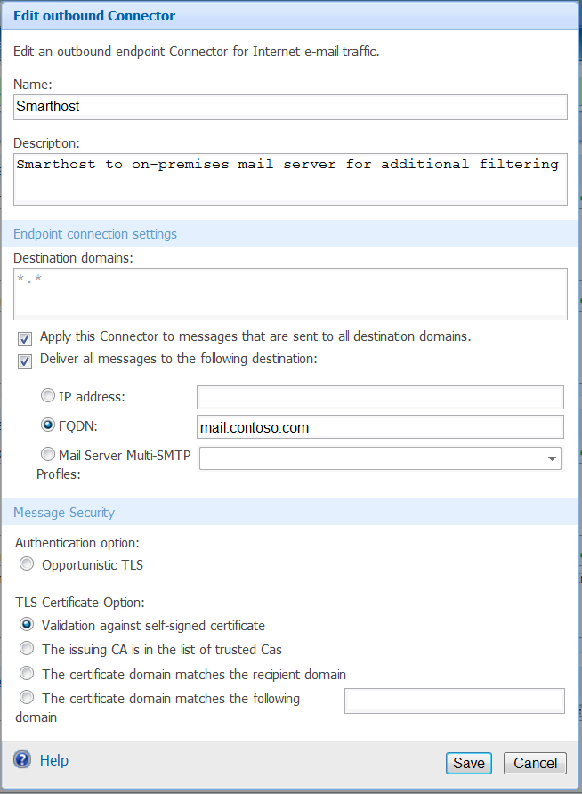
Outbound FOPE Connector
Outbound connectors apply to outbound mail
This connector shows the “Outbound Smart Host Scenario”: all outgoing mail will be routed to Contoso’s on-premises mail servers for additional processing
Notes:
Screen Shot - This connector shows the “Outbound Smart Host Scenario”: outbound messages from Contoso’s hosted mailboxes will be routed to the on-premises mail server(s) at mail.contoso.com.

Slide 35
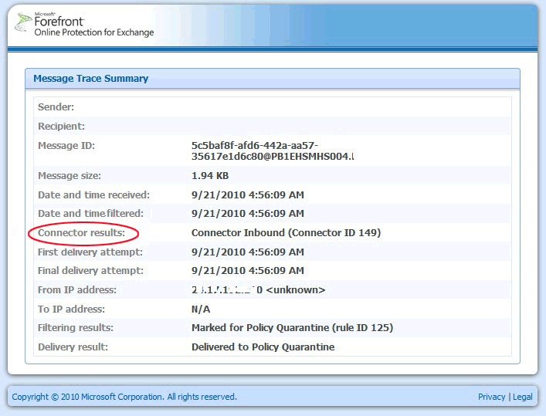
FOPE Connector Reporting
Viewing Information About FOPE Connectors
      View connector information in reports, using the My Reports tab
      Trace connector activity by viewing the Message Trace Summary page
Notes:
Message Trace Summary page shall show the connector ID applied to that message

Slide 36
Mail Routing Options
Notes:
Let’s quickly talk about the 2 routing mechanisms we support for Hybrid customers (customers with on prem and hosted emails)

Slide 37
Two options for mail routing
Why? Least disruptive option for most customers
Recommended in our documentation
for Exchange Online coexistence (Simple and Rich)
Mail forwarders are auto-configured when a mailbox is moved to the cloud using our tools
“Shared Address Space with On-Premises Relay”
MX record pointed on-premises
Why? Customers can stop doing AV/AS themselves
and reduce dependence on local mail server
How?
      FOPE passes all email to Exchange Online
  Mail-enabled users route email to on-prem users
FOPE subscriptions are required for on-premises users
“Shared Address Space with FOPE Relay”
MX record pointed to the cloud
Notes:
You can accomplish MX record pointed to the cloud scenario by either:
Let Exchange sort out who’s on-prem and who’s online (preferred method)
Let FOPE sort out who’s on-prem and who’s online
Question: For MX record pointed to on-prem, what does the customer have to do in FOPE?
Answer: If the domain is not currently routing through FOPE then there should be nothing required outside of what is necessary for any other O365 customer.
Mail forwarders are auto-configured when a mailbox is moved to the cloud using our tools
Example universities – move student mailbox to cloud, nothing to do.
“Shared Address Space with On-Premises Relay”

Slide 38
Message and Recipient Limits
Notes:
Let’s quickly talk about the Message and Recipient Limits and why we need them …
Prevent spammers from using the platform as a spam factory
Ensure rapid mail delivery times and service health

Slide 39
Message and Recipient Limits
    FOPE and Exchange Online enforce limits in order to:
        Prevent spammers from using the platform as a spam factory
        Ensure rapid mail delivery times and service health
    Exchange Online has limits that are more restrictive than FOPE
Key limits to know
 | Details | Notes
Maximum message size | 25 MB 2 MB for large distribution groups (5000+ recipients) | These limits cannot be raised Customer can reduce maximum attachment size, using transport rules
Recipient limits | 500 recipients per message 1500 recipients per day | A shared distribution group counts as 1 recipient Enforced based on a hidden counter in the mailbox
Message rate | 30 messages per minute | Okay to submit messages at faster rate, but system will change rate of delivery
Notes:
Maximum message size - 25 MB and 2 MB for large distribution groups (5000+ recipients)
Recipient limits - 500 recipients per message and 1500 recipients per day
Message rate - 30 messages per minute

Slide 40
Additional Resources

Slide 41
Business Ready Security Demo 4.0i
BRS 4.0i
      New! FPSMC RTW Included
      New! FPSMC HOL
      New! FPE/FPSP Rollup Updates
End to end demo environment
      All Identity and Security Solutions/Technologies
      7 GB size zipped/installer package
Demo scripts/architecture overview documentation provided
Available as download
      http://go.microsoft.com/fwlink/?LinkId=190269
Distribution List: msvmtalk@microsoft.com

Slide 42
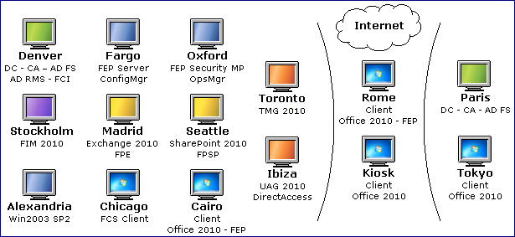
Business Ready Security Demo 4.0i cont.

Slide 43
Related Content
Breakout Sessions
  SIM 309 - Microsoft Forefront Online Protection for Exchange Advanced Routing Scenarios Deep Dive
  SIM 326 - Microsoft Forefront End-to-End Protection for Information Worker Business
  SIM 333 - Centralized Management of Anti-Malware/Anti-Spam Using Microsoft Forefront Protection Server Management Console
  SIM 334 - Microsoft Forefront Online Protection for Exchange Deep Dive
Interactive Sessions (SIM378-INT, Microsoft Forefront Online Protection for Exchange and Microsoft Office 365 Demos)
Find Me Later At… hsj@microsoft.com

Slide 44
Track Resources
Don’t forget to visit the Cloud Power area within the TLC (Blue Section) to see product demos and speak with experts about the Server & Cloud Platform solutions that help drive your business forward.
You can also find the latest information about our products at the following links:
Cloud Power - http://www.microsoft.com/cloud/
Private Cloud - http://www.microsoft.com/privatecloud/
Windows Server - http://www.microsoft.com/windowsserver/
Windows Azure - http://www.microsoft.com/windowsazure/
Microsoft System Center - http://www.microsoft.com/systemcenter/
Microsoft Forefront - http://www.microsoft.com/forefront/

Slide 45





Resources
  Connect. Share. Discuss.
http://northamerica.msteched.com
Learning
  Sessions On-Demand & Community
  Microsoft Certification & Training Resources
www.microsoft.com/teched
www.microsoft.com/learning
  Resources for IT Professionals
  Resources for Developers
http://microsoft.com/technet
http://microsoft.com/msdn

Slide 46












Complete an evaluation on CommNet and
enter to win!

Slide 47

Notes:
New for TechEd 2011, we will be working with Microsoft Tag (http://tag.microsoft.com/overview.aspx) to create unique Tags for every session at the event. Your session Tag will appear on both the room signage and at the end of your presentation. With your session Tag, attendees will be able to scan as they enter the room to retrieve session details, view speaker bios, and engage in discussions; or scan at the end of the presentation to evaluate your session and download materials. We’re excited to integrate Microsoft Tag across the My TechEd mobile experience this year.

Slide 48

© 2011 Microsoft Corporation. All rights reserved. Microsoft, Windows, Windows Vista and other product names are or may be registered trademarks and/or trademarks in the U.S. and/or other countries.
The information herein is for informational purposes only and represents the current view of Microsoft Corporation as of the date of this presentation. Because Microsoft must respond to changing market conditions, it should not be interpreted to be a commitment
on the part of Microsoft, and Microsoft cannot guarantee the accuracy of any information provided after the date of this presentation. MICROSOFT MAKES NO WARRANTIES, EXPRESS, IMPLIED OR STATUTORY, AS TO THE INFORMATION IN THIS PRESENTATION.

Slide 49
Appendix

Slide 50
SMTP relay
There is no unauthenticated SMTP relay in Office 365
Each device or application that sends mail using SMTP must use a licensed Exchange Online mailbox
  This can be a Kiosk subscription
  Multiple apps can send from the same account (sharing username/password)
  Recipient limits will be enforced, just as with regular mailboxes
Customers need to keep a server on-premises for mail relay, or use a 3rd party service, if:
  They have devices/applications that can’t use the “authenticated SMTP with a username/password” approach
  They have apps that send huge quantities of email (customer newsletters, other bulk mail)
Notes:
SMTP Relay
Exchange Online can be used as an SMTP delivery service to relay email messages sent from fax gateways, network appliances, and custom applications. For example, if a line-of-business application sends email alerts to users, it can be configured to use Exchange Online as the mail delivery system. The application or service must authenticate to a valid, licensed Exchange Online mailbox and connect using TLS. Applications that use SMTP relay are subject to the same message size and rate limits as regular users. The details for are described in the Mailbox Size Limits section earlier in this document.

Slide 51
FOPE Feature Differences by SKU

Slide 52
FOPE UI/Feature Differences by SKU
Product | FOPE Admin Center Access | FOPE Admin Center Login Method | Use FOPE Admin Center to configure domains and change IP addresses | Virus Scanning, Edge Blocking, Anti-Spam, Message Hygiene | Use FOPE Connectors for complex scenarios | Directory Synchronization Method
FOPE Standalone | Yes | FOPE credentials | Yes | Yes | Yes, for certain scenarios | FOPE Directory Synchronization Tool
Office 365 Beta or Professionals and Small Businesses | No | N/A | No | Yes | No | None
Office 365 Beta for enterprises or education | Yes | Single sign on via FOPE link in Exchange Control Panel | No | Yes | Yes | Office 365 Directory Synchronization Tool
Live@edu | Yes | Single sign on via FOPE link in Exchange Control Panel | No | Yes | Yes | Outlook Live Directory Synchronization Tool
Business Productivity Online Suite – Standard | Yes, limited access by request to Technical Support | FOPE credentials | No | Yes | No | Exchange Online Directory Synchronization Tool
Business Productivity Online Suite – Dedicated | Yes | FOPE credentials | Yes | Yes | Yes | Exchange Online Directory Synchronization Tool
Note: For Microsoft Office 365 Beta customers, antivirus scanning is performed by Forefront Protection 2010 for Exchange Server (FPE) on the Exchange Online servers rather than by FOPE

Slide 53
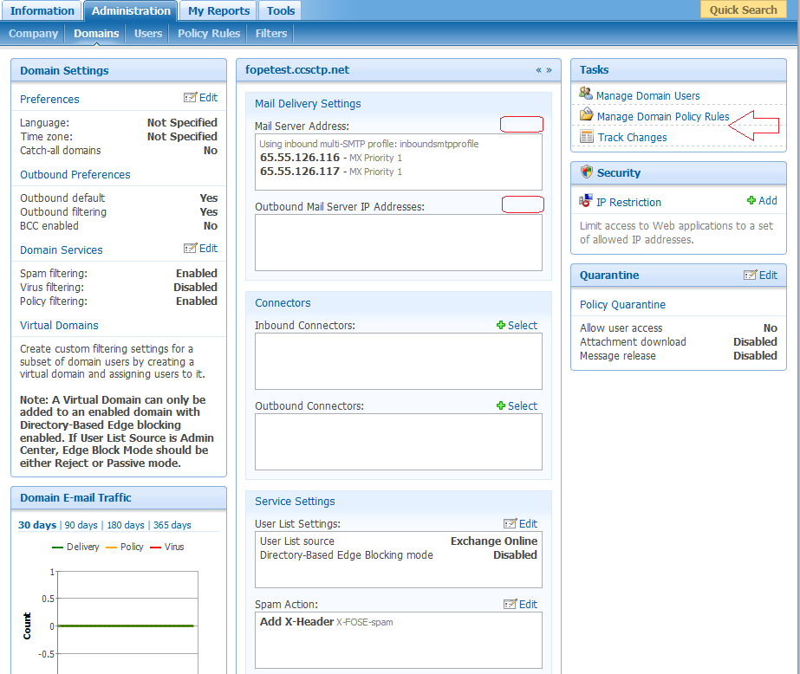
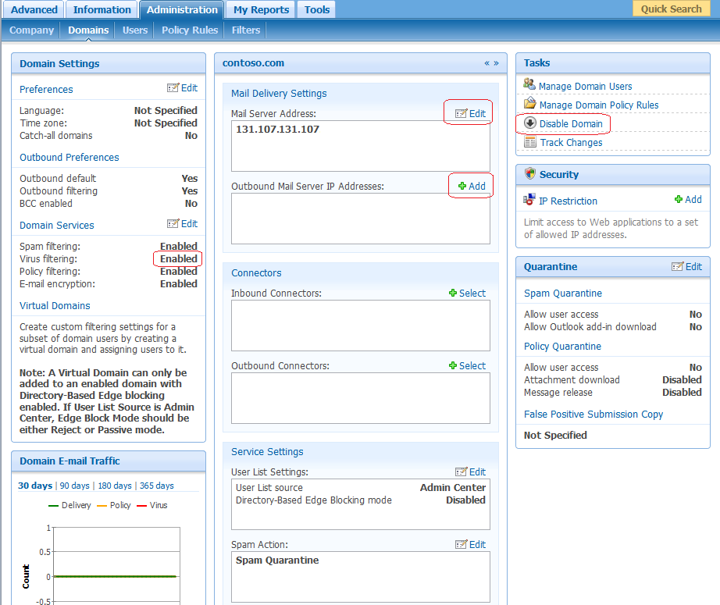
What’s different in the FOPE Admin Center for Office 365 customers?
Some of the Admin Center options are unavailable to Office 365 customers
Office 365
Stand-alone
Notes:
When accessing the Forefront Online Protection for Exchange (FOPE) Administration Center, certain features and settings are different between a FOPE standalone domain and a hosted domain. For example, if you have created companies or domains within the Microsoft Office 365 Beta or Live@EDU cloud hosting services, these settings must be managed in the Exchange Control Panel rather than in the FOPE Administration Center.

Slide 54
What’s different in the FOPE Admin Center for Office 365 customers? (cont.)
Domain Management:
  Users cannot add, validate, enable, or delete domains (Use Exchange Control Panel)
  Users cannot change Mail Server Addresses and Outbound Mail Server IP Addresses (Use Exchange Control Panel)
  Catch-all domains, Outbound filtering, Spam filtering, and Virus filtering settings are not configurable
  Users cannot transfer IP addresses or Virus filtering notifications while using the Transfer Domains dialog box
Notes:
In the FOPE Administration Center, in the Domains tab if you have a hosted domain rather than a standalone domain:
·You cannot add, validate, enable, or delete domains. As a result, the Add Domains option is not viewable in the Tasks pane, and the Disable button is not viewable from Disabled Domains in the Views pane. This should be done in the Mail Control tab of the Exchange Control Panel.
·You can view but you cannot change the value of the Mail Delivery Settings (Mail Server Addresses and Outbound Mail Server IP Addresses settings). This should be done in the Exchange Control Panel.
·The Catch-all domains, Outbound filtering, Spam filtering, and Virus filtering settings are not configurable in the Domain Settings pane.
The Virus Filtering setting will appear disabled; this is because virus filtering is performed by FPE on the Exchange Online servers, not by FOPE
·When transferring domain settings via the Transfer Domains dialog box, the IP addresses and Virus filtering notifications options cannot be transferred because the IP addresses point to Exchange Online and virus filtering notifications are sent by FPE rather than by FOPE.

Slide 55
What’s different in the FOPE Admin Center for Office 365 customers? (cont.)
Company Management:
  Users cannot change Outbound Mail Server IP Addresses
Antivirus Reporting Statistics:
  Unavailable via FOPE Admin Center (antivirus scanning performed by FPE on Exchange Online servers)
Notes:
Company Management
In the FOPE Administration Center, in the Company tab, if you have a hosted domain rather than an on-premises domain, you can view but you cannot change the value of the Outbound Mail Server IP Addresses setting.
Antivirus Reporting
Because antivirus filtering in Office 365 Beta is performed by FPE on the Exchange Online servers rather than by FOPE, antivirus reporting statistics are not available in the FOPE Administration Center.

Slide 56
Business Ready Security Demo 4.0i (cont.)
Solution | Scenarios
Secure Messaging | Seamless, secure access through Unified Access Gateway (UAG) Automatically control confidential email with built-in information protection Protect Exchange with multiple best-in-class anti-malware engines using FPE Centralized management experience with FPSMC Outlook Web Access 2010 integration with AD RMS Outlook 2010 automatic protection
Secure Collaboration Solution | Secure collaboration by using AD FS and AD RMS (for Partner employees) Protection your collaboration portal from malware infection using FPSP Centralized management experience with FPSMC Secure collaboration by using UAG (for Internal employees)
Secure Desktop Solution | Advanced threat protection with Forefront TMG 2010 Malware protection when not connecting to the company network Malware protection using FEP FEP Deployment and Management using SSCM Direct Access with Unified Access Gateway (UAG)
Information Protection Solution | Protecting data-in-motion with Exchange 2010 and AD RMS Protecting data-at-rest with SharePoint 2007, AD FS and AD RMS Protection data-at-rest with File Classification Infrastructure (FCI) and AD RMS
Identity and Access Management Solution | Group management with FIM 2010 and Outlook Self-service password reset with FIM 2010

Slide 57
Links & Resources
Forefront Site | http://www.microsoft.com/forefront/
Forefront on TechNet Library | http://technet.microsoft.com/en-us/library/ff684056.aspx
Forefront Videos on TechNet Edge | http://technet.microsoft.com/en-us/edge/ff832960.aspx?category=Forefront
Notes:
Try to limit to TOP 5 links and Resources

Slide 58
Understanding Terminology
 | FOPE/Exchange documentation says | What this means in layman’s terms
 | “Outbound Smart Host” | Route outbound mail through a DLP device
 | “Regulated partner with forced TLS” | Forced TLS
 | “Inbound safe listing“ | Bypass spam filtering for domains I trust
 | “Shared address space with on-premises relay” | Coexistence: Customer’s MX record is pointed on-premises
 | “Shared Address Space with Cloud Relay” | Coexistence: Customers’ MX record is pointed to the cloud (virtual domains method)
http://technet.microsoft.com/en-us/library/gg430178.aspx
http://help.outlook.com/en-us/beta/Dd775210.aspx

Slide 59
Fully hosted: Inbound and Outbound
Internet
Outbound
From: Bill@contoso.com
To: sales@fabrikam.com
FOPE
Mail is sent outbound
Virus scanning is performed by FPE on Exchange Online servers
FOPE filters as outbound
FOPE delivers to Internet
Edge
Inbound
From: sales@fabrikam.com
To: Bill@contoso.com
Virus
Policy
Spam
Contoso signs up for Exchange Online
Exchange Online has provisioned tenant in FOPE
Mail sent to FOPE
FOPE filters inbound mail
Virus scanning is performed by FPE on Exchange Online servers
Mail is delivered to the recipient’s mailbox
Exchange Online
Mailboxes
contoso.com
Notes:
Using a fully hosted scenario with FOPE refers to when all of your organization’s mailboxes are hosted exclusively through Microsoft Exchange Online cloud services. The fully hosted scenario consists of Exchange Online being provisioned with FOPE, which provides edge, virus, policy, and spam filtering protection for your mailboxes.
When email is sent inbound to Contoso from an external Internet source, it is passed to FOPE, which performs various inbound filtering operations on the message: edge filtering (Forefront DNS block list, envelope filtering, and directory based edge blocking), virus scanning, policy enforcement, and spam filtering. If the email passes inspection, it is delivered to the specified recipients hosted in Exchange Online. If the email fails inspection, FOPE performs actions on the message depending upon the inbound configuration settings.
When email is sent outbound from Contoso to an external Internet source, it is passed to FOPE, which performs various outbound filtering operations on the message: edge filtering, virus scanning, policy enforcement, and spam filtering. If the email passes inspection, it is delivered to the Internet (as per directive by the mail exchanger record (MX record) where it will reach the specified recipients. If the email fails inspection, FOPE performs actions on the message depending upon the outbound configuration settings.

Slide 60
Shared Address Space with On-Premises Relay Scenario (MX Points to FOPE) - Inbound
Internet
On-Premises Exchange
Customer Mail Processing/Filtering
Outbound Exchange Send Connector
FOPE
Mailboxes
Inbound
From: sales@fabrikam.com
To: Joe@contoso.com
Edge
Virus*
Inbound FOPE Connector
Policy
contoso.com
Spam
MX points to FOPE for spam processing, filtering, and scanning
Mail is routed to on-premises server, and if mailbox does not exist on-premises, mail is routed back to FOPE
FOPE forwards mail to hosted mailbox
Virus scanning is performed by FPE for Exchange Online mailboxes
Inbound Exchange Receive Connector
Exchange Online
Mailboxes
service.contoso.com
Notes:
Using a shared address space with FOPE relay scenario with FOPE refers to when you host a portion of your mailboxes in the cloud and a portion of your mailboxes on-premises, and your MX record points to FOPE. This scenario is appropriate for when you are using the Microsoft Office 365 service to host some of your organization’s mailboxes and you are using FOPE to protect both your on-premises and cloud mailboxes.
In this example, Contoso has an on-premises solution for email, and they use FOPE to inspect all inbound mail. After purchasing Exchange Online with FOPE as part of the Office 365 service, Contoso migrates some mailboxes to the cloud (Exchange Online). However, given the compliance rules for some of their email, such as the legal department’s, Contoso keeps some of their mailboxes on-premises. This enables them to maintain greater control over their mail flow and to continue to take advantage of their existing on-premises infrastructure. FOPE is configured by use of an inbound connector and on-premises mail servers are configured using a send connector.
Each inbound message is initially processed by FOPE, as per directive by the MX record. FOPE performs spam removal, virus scanning, and custom filtering. If a message fails inspection, FOPE performs actions on the message, depending on configuration settings set by the organization. After inspection, FOPE directs email to the on-premises server, where additional filtering may occur. Subsequently, the message is delivered to the intended recipient. If that recipient is a user whose mail is hosted by Exchange Online, the message is redirected back to FOPE, where it is forwarded on to the recipient’s mailbox at the Office 365 cloud hosting service.

Slide 61
Shared Address Space with On-Premises Relay Scenario (MX Points to FOPE) - Outbound
Internet
On-Premises Exchange
Customer Mail Processing/Filtering
FOPE
Outbound FOPE Connector
Mailboxes
Outbound
From: Joe@contoso.com
To: sales@fabrikam.com
Edge
Virus*
Inbound Exchange Receive Connector
Policy
contoso.com
Spam
Scanning by Forefront Protection for Exchange on Microsoft Exchange Online mail hubs
Delivery to FOPE for scanning
Delivered to on-premises Exchange server
Custom processing on premises
Outbound delivery to FOPE
Delivery to Internet
Outbound Exchange Send Connector
Exchange Online
Mailboxes
service.contoso.com
Notes:
In this example, an email message is sent outbound from a Contoso cloud user to an external Internet address. Exchange Online sends the message to FOPE, which performs outbound filtering operations on the message. FOPE then sends the email to the on-premises server, which performs its own custom processing on the message before returning the stamped message back to FOPE. Subsequently, the message is delivered to the Internet and on to its destination.
If an outbound mail message is sent from an on-premises mailbox, the message is processed on the on-premises server, sent to FOPE, where additional outbound scanning and processing occurs, and finally sent to the Internet.

Slide 62
Shared Address Space with On-Premises Relay Scenario (MX Points to FOPE) – Intra-Org
On-Premises Exchange
Inbound Exchange Receive Connector
Customer Mail Processing/Filtering
FOPE
Mailboxes
Edge
Outbound FOPE Connector
Outbound
From: Joe@contoso.com
To: Bob@contoso.com
Virus
Policy
Inbound FOPE Connector
contoso.com
Spam
Hosted mailbox sends mail outbound
Delivery to FOPE (virus scanning disabled by default; policy rules dependent on customer configuration)
Delivery to on-premises mailbox
Outbound Exchange Send Connector
Exchange Online
Mailboxes
service.contoso.com
Notes:
In this example, an email message is sent from a Contoso user whose mail is hosted in the Office 365 cloud hosting service to an on-premises Contoso user. The Office 365 mailbox sends the email outbound, where it passes through FOPE. Scanning and filtering operations are skipped and the message is delivered to the recipient’s on-premises mailbox.
If the message is traveling from an on-premises sender to a recipient whose mailbox is hosted by the Office 365 cloud hosting service, the message passes through FOPE without being scanned, in the same manner as a message sent from a hosted mailbox to an on-premises mailbox.

Slide 63
Shared Address Space with On-Premises Relay Scenario (MX Points to On-Premises) - Inbound
On-Premises
Internet
Inbound FOPE Connector
Outbound Exchange Connector
Customer Mail Processing/Filtering
FOPE
Mailboxes
Edge
Inbound
From: sales@fabrikam.com
To: Joe@contoso.com
Virus*
Policy
contoso.com
Spam
MX points to on premises for initial filtering
Custom filtering, archival etc. done on-premises
Cloud mail is re-directed to FOPE where it is filtered
Delivered to Exchange Online
Virus scanning is performed by FPE for Exchange Online mailboxes
Exchange Online
Mailboxes
service.contoso.com
Notes:
Using a shared address space with on-premises relay scenario with FOPE refers to when email is hosted partially in the cloud (Internet) and partially on-premises, and mail flow is controlled on-premises. You can use this scenario when you are using the Microsoft Office 365 Beta service to host at least some of your organization’s mailboxes in the cloud.
The shared address space with on-premises relay scenario consists of Microsoft Exchange Online being provisioned with FOPE. You must configure FOPE connectors to control how mail is routed within the various available mail flow scenarios (inbound, outbound, and intra-organizational). You must also configure on-premises Exchange server settings and Exchange Online data center server settings in order to successfully implement this scenario. This topic provides diagrams that show how the mail flow scenarios work, followed by the configuration procedures.
In this example, Contoso has an on-premises solution for email. After purchasing Exchange Online with FOPE as part of the Office 365 service, Contoso migrates some email to the cloud (Exchange Online). However, given the highly confidential nature of some of their email (like the legal department), Contoso decides to leave this email on-premises, thereby enabling them to maintain greater control over their mail flow, while continuing to take advantage of their existing on-premises infrastructure. The relationship between the on-premises solution and FOPE is configured through MX records on the on-premises side, and connectors on the FOPE side.
In such a scenario, when email is sent inbound from an external Internet source to a Contoso user whose mail is hosted in the Office 365 cloud hosting service, it is delivered on-premises as per directive by the MX record. The on-premises protection solution, such as Forefront Protection 2010 for Exchange Server (FPE), performs its functions, like virus scanning, custom filtering, or archiving. Through an address rewrite, the on-premises protection solution then redirects the email to FOPE where inbound policy and spam filtering operations are performed on the message. If the email passes inspection, it is delivered to the specified recipients hosted in Exchange Online. If the email fails inspection, FOPE performs actions on the message depending upon the inbound configuration settings.

Slide 64
Shared Address Space with On-Premises Relay Scenario (MX Points to On-Premises) - Outbound
On-Premises
Internet
Customer Mail Processing/Filtering
Outbound FOPE Connector
Inbound Exchange Connector
FOPE
Mailboxes
Edge
Outbound
From: joe@contoso.com
To: sales@fabrikam.com
Virus*
Policy
contoso.com
Spam
Hosted mailbox sends mail outbound
Virus scanning is performed by FPE for Exchange Online mailboxes
Filtered by FOPE
Delivered to on-premises
Custom processing on-premises
Delivery by on-premises
Exchange Online
Mailboxes
service.contoso.com
Notes:
In this example, an email is sent outbound from a Contoso cloud user to an external Internet address. Exchange Online sends the mail to FOPE, which performs outbound filtering operations on the message. FOPE then sends the email to the on-premises server, which performs its own custom processing on the message before delivering it.

Slide 65
Shared Address Space with On-Premises Relay Scenario (MX Points to On-Premises) – Intra Org
Outbound Exchange Connector
On-Premises
Customer Mail Processing/Filtering
Inbound FOPE Connector
FOPE
Mailboxes
Edge
Intra Org
From: salesman@contoso.com
To: Joe@contoso.com
Virus
Policy
contoso.com
Spam
MX points to on-premises for initial filtering
Custom processing on-premises
Delivery to FOPE
Filtering skipped
Delivery to Exchange Online by FOPE
Exchange Online
Mailboxes
service.contoso.com
Notes:
In this example, an email is sent from an on-premises Contoso user to a Contoso user whose mail is hosted in the Office 365 cloud hosting service. The on-premises mailbox sends the email outbound where custom processing is performed by the on-premises protection solution. The email is then sent to FOPE, which skips filtering operations, because it is intra-organizational mail and therefore the custom processing performed by the on-premises protection solution is considered sufficient. FOPE then delivers the mail to Exchange Online where it can be accessed by the Contoso cloud user.

Slide 66
© 2011 Microsoft Corporation. All rights reserved. Microsoft, Windows, Windows Vista and other product names are or may be registered trademarks and/or trademarks in the U.S. and/or other countries.
The information herein is for informational purposes only and represents the current view of Microsoft Corporation as of the date of this presentation. Because Microsoft must respond to changing market conditions, it should not be interpreted to be a commitment
on the part of Microsoft, and Microsoft cannot guarantee the accuracy of any information provided after the date of this presentation. MICROSOFT MAKES NO WARRANTIES, EXPRESS, IMPLIED OR STATUTORY, AS TO THE INFORMATION IN THIS PRESENTATION.

