Slide 1
Client Management and Protection at Microsoft: Real-World Deployment Case Study of Microsoft Forefront Endpoint Protection
SIM330
Satish Petwe
Senior Service Engineer
Microsoft Corporation
Shitanshu Verma
Lead–Operations Engineering
Microsoft Corporation

Slide 2
Session Objectives and Takeaways
Detail Forefront Endpoint Protection (FEP) Solution at
Microsoft IT
  Components
  Architecture
  Deployment strategy
Analyze Configuration Manager After FEP
Understand Benefits of FEP and System Center Configuration Manager 2007 Integration
Conclude with Best Practices

Slide 3



Who is Management Platforms & Service Delivery (MPSD)?
280,000 Clients Managed at Microsoft
7,800 Clients Managed at Energizer
5,300 Clients Managed at XL
600+ Clients in the Microsoft Store
293,700 Clients Managed

Slide 4







Solution Overview @ Microsoft IT
Business Challenge
Solution
Results/Benefits
Limited monitoring
No consolidated reporting
Laborious manual process
Chose FEP 2010 as new antimalware management solution
Deployed to existing ConfigMgr 2007 R2 and R3 servers & Clients
Faster response to infections
Better type of malware knowledge
Improved SLA for policy deployment
Only added 1 server for FEP SQL data warehouse
Minimal impact to network performance

Slide 5
FEP 2010 Deployment & Management Lifecycle
  Phase 1
  Implementation Planning: Infrastructure & FEP Policies
  Phase 2
  FEP Server and Client Deployment
Planning
Deployment
Reporting
Management
  Phase 4
  Monitoring Alerting and Reporting
  Phase 3
  Ongoing Policy and Update Management

Slide 6
FEP 2010 Overview

Slide 7
ConfigMgr 2007 & FEP 2010 Integration
4
  1. FEP Service Extensions
1
Management Point
ConfigMgr Console
  2. Databases
    FEP DB
    FEP Reporting Data warehouse DB
ConfigMgr 2007 Site Server
2
  3. FEP Reporting
Distribution Points
SQL Server
5
  4. FEP Console Extensions
3
Software Update
Point
  5. FEP 2010 Clients
SQL Reporting Server
ConfigMgr Clients

Slide 8

FEP 2010 Overview
FEP Objects in Console
demo

Slide 9
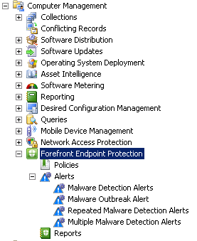
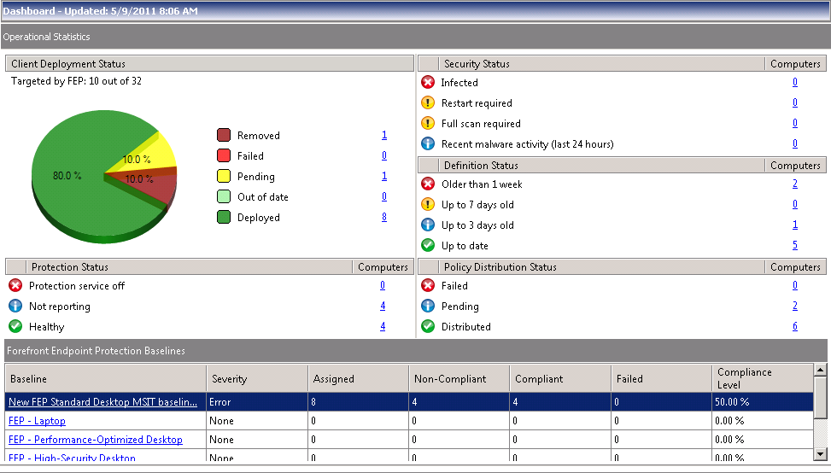
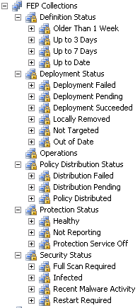
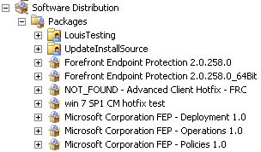
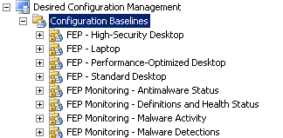
Demo - FEP Objects in Console

Slide 10
FEP Management Models
  Planning
Centralized
  Management done at Central Site
  Central Reporting for all clients
Decentralized
  Managed autonomously at each Child Site
  Reporting scope limited to Child Sites only
Decentralized with Central Reporting
  Managed autonomously at each Child Site
  Central Reporting for all clients

Slide 11
FEP Deployment Options
  Planning
Basic
  All Components installed on same server
  Typical for small environments (< 5000 clients)
Basic with Remote Reporting Database
  Current Site DB Server not enough for scale
  Current Site DB Server doesn’t meet software requirements
Advanced
  Granular control of FEP role placement

Slide 12

FEP Deployment Solution @ Microsoft IT
  Planning
ConfigMgr 07 Central Site
220,000 Clients Managed
FEP Server + Console Extensions
FEP SQL DB
FEP SQL Data Warehouse & Reporting
Redmond Campus
~80k Clients
North & South America
~35k Clients
Limited Services
~4k Clients
Europe, Middle east & Africa
~35k Clients
Fareast & South Pacific
~65k Clients
FEP Management Model: Centralized
FEP Deployment Option: Basic with Remote Reporting

Slide 13
FEP 2010 Policy Deployment

Slide 14
FEP 2010 Policy Deployment
Policy Creation
Policy Assignment
demo

Slide 15
FEP 2010 Policy Management
  Deployment
What is FEP Policy?
  Antimalware, Windows Firewall Settings
  Definition Update Source Configuration
What can you do?
  Copy, Edit, Assign, Import & Export Policy
  Use Templates, Set Precedence
Where are they?
  FEP Node - Policies
  All Policies -> Programs in one FEP Policy Package
  All Assignments -> Advertisement of FEP Policy programs

Slide 16
FEP Policy @ Microsoft
  Deployment
Antimalware Settings
  Real time Protection – Both ways
  Weekly Quick scan
  Allow Users to:
    Change Schedule
    Add Exclusions
    Processor % Usage
No Firewall Setting
Definition Update Source Order
  ConfigMgr/Windows Server Update Services (WSUS)
  Microsoft Update (MU)

Slide 17
Definition Update Source
  Deployment
Update Source Order Configuration
  WSUS – Set Auto Approval Rules for FEP Definitions
  Universal Naming Convention (UNC)
    File Shares - < 500 clients
    Distributed File System Replication (DFSR) – Large Orgs
Default order without FEP Policy – WSUS, MU
Definition Size
Source | First time | Daily (approx. 3 times a day) | Engine Update (approx. once a month)
WSUS/MU | ~65 MB | 100 KB-1 MB (Binary Delta) | 11MB-15MB
UNC/MMPC* | ~65 MB | 1MB-6MB (Delta) | ~61MB
* MMPC – Microsoft Malware Protection Center

Slide 18
FEP 2010 Client Deployment

Slide 19
FEP 2010 Client Deployment
  Deployment
  http://technet.microsoft.com/en-us/library/ff823842.aspx
Configure & Target FEP Policy
ConfigMgr based Deployment
  Client Installation Package Available in ConfigMgr
  Add Distribution Points
  Target Package to Collections
Use Dashboard & ConfigMgr Reports for Tracking Deployment
Uninstalls Existing Antimalware Products before installation

Slide 20
Client Deployment @ Microsoft ..contd
  Deployment
Phases of Deployment
  LAB : Server & < 10 Clients
  Pre-Production : Server & Clients in Phases : 100, 500, 1000..8500
  Production : Server & Clients in Phases 1000, 4000 & higher
Description | Size on Disk | Service Name | Process
FEP 2010 Client | ~22MB | Microsoft Antimalware Service (MsMpSvc) | MsMpEngine.exe
FEP Client Deployment package | ~19MB

Slide 21
Client Deployment @ Microsoft ...con’t
  Deployment
Targeted ~ 26K clients, Actual Failures after analysis ~850
Failed
Failed

Slide 22
Client Deployment @ Microsoft ..con’t
  Deployment
Deployment Experience
  ~1-3% Deployment Failures – Remediate & Re-Target Install
    Mostly Environmental – Disk space, Other MSI Installs
    Conflicting Products – Microsoft Security Essentials, Intune, OneCare
    FEP Install Program Run Time exceeded – Change default 15 minutes to 60 minutes
  WU/MU Access blocked to clients – Deploy KB981889 in advance prior to FEP installation using Software Distribution
  Windows 7 and Server 2008 (R1 and R2) SP1 – KB981889 Hotfix is included in SP1
  Do not want first signature to install from WSUS/MU? – Setup the Group policy to obtain first signature from local UNC share

Slide 23
FEP 2010 Dashboard & Reporting

Slide 24

FEP 2010 Reporting
FEP Dashboard
FEP Reports
demo

Slide 25
ConfigMgr After FEP

Slide 26
Security Events – Data Flow
  1. Malware Infects Client
Management Point
ConfigMgr Console
  2. FEP Client Cleans malware
      Security Event Raised
      DCM Evaluation Triggered
ConfigMgr 2007 Site Server
4
  3. DCM State Message Sent
Distribution Points
SQL Server
3
2
1
1
  4. Infection Data replicated to Data Warehouse Server
Software Update
Point
5
SQL Reporting Server
ConfigMgr Clients
  5. Infection Data available in Reports

Slide 27

ConfigMgr After FEP Deployment
  Manage
Client to Server Traffic
  New Client Installation
  Malware Infection on client
Site Server Performance After FEP
  During FEP Client Deployments
  During Patch deployments

Slide 28
Traffic Analysis After FEP Deployment
  Manage
FEP/ConfigMgr Event | Type | No. | Size (KB) | Total Size (KB)
FEP 2010 Client Installation | Status Message | ~6 | 1 | 6
Delta Hardware Inventory | Inventory File | 1 | 11 | 11
FEP Default Policy Applied | Status Message | ~6 | 1 | 6
4 DCM Baseline Policies & Results | State Message | 1 | 78 | 78
Total |  |  |  | 101 KB
Malware Detected Event | Type | No. | Size (KB) | Total Size (KB)
2 DCM Baseline Evaluation & Results | State Message | 1 | 49 | 49
Total |  |  |  | 49 KB

Slide 29
Traffic Analysis After FEP Deployment
  Manage
FEP/ConfigMgr Event | Type | No. | Size (KB) | Total Size (KB)
FEP 2010 Client Installation | Status Message | ~6 | 1 | 6
Delta Hardware Inventory | Inventory File | 1 | 11 | 11
FEP Default Policy Applied | Status Message | ~6 | 1 | 6
4 DCM Baseline Policies & Results | State Message | 1 | 78 | 78
Total |  |  |  | 101 KB
Malware Detected Event | Type | No. | Size (KB) | Total Size (KB)
2 DCM Baseline Evaluation & Results | State Message | 1 | 49 | 49
Total |  |  |  | 49 KB

Slide 30
ConfigMgr SQL Database Growth
After FEP Deployment
  Manage
Key Tables Changed | Rows Added | Size Growth
FEP related Status Messages | 121 | 35.05 KB
Compliance Detail | 4 | 16 KB
Total | 121 | 51.05 KB
Projected Growth for 220k clients |  | 10.71 GB
Malware Incident Key Tables Changed | Rows Added | Size Growth
Compliance Status, Compliance Details, Compliance History | 4 | 17 KB
Total | 4 | 17 KB
Projected Growth for 220k clients |  | 3.56 GB

Slide 31
FEP SQL Data Warehouse Details @ Microsoft
  Manage
FEP SQL Data Warehouse Server Specs
  CPU: Intel Xeon E5410 2.33 Ghz (2 Processor)
  Memory: 32 GB
  Disk Space: 1 TB
    shared between drives for OS, Applications, DB file, backup, logs, etc.
    SAN drives
FEP SQL Data Warehouse Database Size
  Database Size is ~180 GB
  Database size per client is ~1 MB

Slide 32

Server Performance After FEP Deployment
  Manage
Performance Analysis includes
  Before: 14 August Patch Release with 1 Out of Band Release
  After: 9 September Patch Release
Performance Data Collected every 15 minutes
Legend: Green = Less than 25% spike; Yellow = Between 25% and 50%; Red = Greater than 50% spike
Server performance is directly proportional to number of deployments
Primary Site 1: 94,000 ConfigMgr Clients and 53,000 FEP Clients
Site Role | Total Processor % Utilization |  |  | Memory Available |  |  | Total KiloBytes per second |  |  | Web Service Current Connection Count
 | Before | After | Status | Before | After | Status | Before | After | Status | Before | After | Status
Site Server | 37% | 13% |  | 8 GB | 8 GB |  | 912 | 1270 |  | NA | NA | NA
MP’s | 7% | 27% |  | 4.5 GB | 4.5 GB |  | 632 | 448 |  | 840 | 1007
SUP | 7% | 5% |  | 5.5 GB | 5.8 GB |  | 2491 | 722 |  | 142 | 99

Slide 33
Server Performance After FEP Deployment
  Manage
ConfigMgr Performance Counter (Processed/Min)
Role | State Sys Files |  |  | State Sys Records |  |  | Hardware Inventory (MIFs) |  |  | Data Discovery Records (DDRs) |  |  | Status Message Records/second
 | Before | After | Status | Before | After | Status | Before | After | Status | Before | After | Status | Before | After | Status
Central Site | 730 | 750 |  | 8200 | 7800 |  | 45 | 47 |  | 160 | 175 |  | 337 | 462
Primary Site | 200 | 180 |  | 3100 | 3200 |  | 22 | 19 |  | 56 | 83 |  | 28 | 22

Slide 34
Benefits & Best Practices from Microsoft IT

Slide 35
Best Practices
Implementation
  Deploy in phases to reduce potential for negative impact to the environment
  Allow an opt-out option
  Re-deploy the client to failed machines
Security
  Use multiple sources for definitions updates
  Determine the best times for scanning
Monitoring and Reporting
  Consider installing the reporting database on a dedicated server for large enterprises

Slide 36
Benefits
Simplified implementation of large-scale endpoint protection with centralized administration.
Faster response to infections and better knowledge of the type of malware.
Improved SLA for antimalware policy deployment from more than a day to four hours.
Use of existing infrastructure with only 1 additional server and minimal impact to network performance

Slide 37
What is new in Configuration Manager 2012?

Slide 38
Forefront Endpoint Protection 2012 Beta
Convergence of Management and Security
  Built on System Center Configuration Manager 2012
  Advanced protection with lower impact on productivity
New Enhancements
  Simplified hierarchy model
  Role Based Access Control
  Definition Updates and automatic approval rules through ConfigMgr
  Improved alert timings
Evaluation Options
  FEP 2012 Beta available now: http://www.microsoft.com/fep
  Join Community Evaluation Program (included in ConfigMgr CEP) https://connect.microsoft.com/site1211

Slide 39
Summary and Key Takeaways
Use Microsoft IT FEP 2010 Deployment & Management Lifecycle
  Planning, Deployment, Management & Reporting
Evaluate potential ConfigMgr changes After FEP Deployment
Leverage Best Practices from Microsoft IT
Maximize the benefit by integrating management and security

Slide 40
More Information
Forefront Endpoint Protection (FEP)
  Microsoft Forefront Endpoint Protection 2010 - http://www.microsoft.com/fep/
  FEP 2010 deployment case study at Microsoft - http://technet.microsoft.com/en-us/library/gg543127.aspx
  FEP TechNet Library - http://technet.microsoft.com/en-us/library/ff684073.aspx
  FEP Server Policy Templates - http://go.microsoft.com/fwlink/?LinkId=207730
  FEP DW Capacity Planning - http://blogs.technet.com/b/clientsecurity/archive/2011/01/19/fep-capacity-planning-worksheet.aspx
System Center Configuration Manager (ConfigMgr)
  ConfigMgr TechNet Library - http://technet.microsoft.com/en-us/configmgr/default.aspx
  ConfigMgr Team Blog - http://blogs.technet.com/b/systemcenter/
  ConfigMgr Support Team Blog - http://blogs.technet.com/configurationmgr/default.aspx
System Center Best Practices - http://technet.microsoft.com/en-us/systemcenter/ee942121.aspx
Configuration Manager News from Microsoft IT -
  http://blogs.msdn.com/shitanshu/default.aspx
  http://twitter.com/ConfigMgr_MSIT

Slide 41
Questions?
Shitanshu Verma – shverma@microsoft.com
Satish Petwe – sapetwe@microsoft.com

Slide 42
Track Resources
Don’t forget to visit the Cloud Power area within the TLC (Blue Section) to see product demos and speak with experts about the Server & Cloud Platform solutions that help drive your business forward.
You can also find the latest information about our products at the following links:
Cloud Power - http://www.microsoft.com/cloud/
Private Cloud - http://www.microsoft.com/privatecloud/
Windows Server - http://www.microsoft.com/windowsserver/
Windows Azure - http://www.microsoft.com/windowsazure/
Microsoft System Center - http://www.microsoft.com/systemcenter/
Microsoft Forefront - http://www.microsoft.com/forefront/

Slide 43





Resources
  Connect. Share. Discuss.
http://northamerica.msteched.com
Learning
  Sessions On-Demand & Community
  Microsoft Certification & Training Resources
www.microsoft.com/teched
www.microsoft.com/learning
  Resources for IT Professionals
  Resources for Developers
http://microsoft.com/technet
http://microsoft.com/msdn

Slide 44












Complete an evaluation on CommNet and
enter to win!

Slide 45


Slide 46

© 2011 Microsoft Corporation. All rights reserved. Microsoft, Windows, Windows Vista and other product names are or may be registered trademarks and/or trademarks in the U.S. and/or other countries.
The information herein is for informational purposes only and represents the current view of Microsoft Corporation as of the date of this presentation. Because Microsoft must respond to changing market conditions, it should not be interpreted to be a commitment
on the part of Microsoft, and Microsoft cannot guarantee the accuracy of any information provided after the date of this presentation. MICROSOFT MAKES NO WARRANTIES, EXPRESS, IMPLIED OR STATUTORY, AS TO THE INFORMATION IN THIS PRESENTATION.

